Slide 1
CEPC Booster Design
Dou Wang, Chenghui Yu, Tianjian Bian, Xiaohao Cui, Chuang Zhang, Yudong Liu, Na Wang, Daheng Ji, Jiyuan Zhai, Wen Kang, Cai Meng, Jie Gao
CEPC CDR internal review, Feb 10, 2018 . A415, IHEP.

Slide 2
CEPC CDR Parameters
 | Higgs | W | Z
Number of IPs | 2
Energy (GeV) | 120 | 80 | 45.5
Circumference (km) | 100
SR loss/turn (GeV) | 1.73 | 0.34 | 0.036
Half crossing angle (mrad) | 16.5
Piwinski angle | 2.58 | 7.74 | 23.8
N_{e}/bunch (10¹⁰) | 15 | 15 | 8.0
Bunch number (bunch spacing) | 242 (0.68us) | 1220 (0.27us) | 12000 (25ns+10%gap)
Beam current (mA) | 17.4 | 87.9 | 461
SR power /beam (MW) | 30 | 30 | 16.5
Bending radius (km) | 10.6
Momentum compaction (10⁻⁵) | 1.11
β_{IP} x/y (m) | 0.36/0.0015 | 0.36/0.0015 | 0.2/0.0015
Emittance x/y (nm) | 1.21/0.0031 | 0.54/0.0016 | 0.17/0.004
Transverse σ_{IP} (um) | 20.9/0.068 | 13.9/0.049 | 5.9/0.078
ξ_{x}/ξ_{y}/IP | 0.031/0.109 | 0.013/0.12 | 0.0041/0.056
V_{RF} (GV) | 2.17 | 0.47 | 0.1
f _{RF} (MHz) (harmonic) | 650 (216816)
Nature bunch length σ_{z} (mm) | 2.72 | 2.98 | 2.42
Bunch length σ_{z} (mm) | 3.26 | 6.53 | 8.5
HOM power/cavity (kw) | 0.54 (2cell) | 0.87(2cell) | 1.94(2cell)
Energy spread (%) | 0.1 | 0.066 | 0.038
Energy acceptance requirement (%) | 1.35 | 0.4 | 0.23
Energy acceptance by RF (%) | 2.06 | 1.47 | 1.7
Photon number due to beamstrahlung | 0.29 | 0.44 | 0.55
Lifetime _simulation (min) | 100
Lifetime (hour) | 0.33 (20 min) | 3.5 | 7.5
F (hour glass) | 0.89 | 0.94 | 0.99
L_{max}/IP (10³⁴cm⁻²s⁻¹) | 2.93 | 11.5 | 16.6

Slide 3
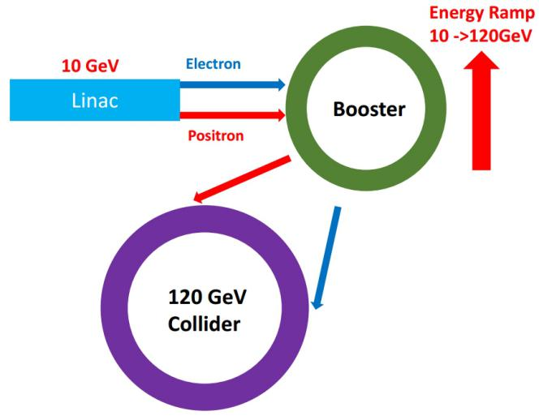
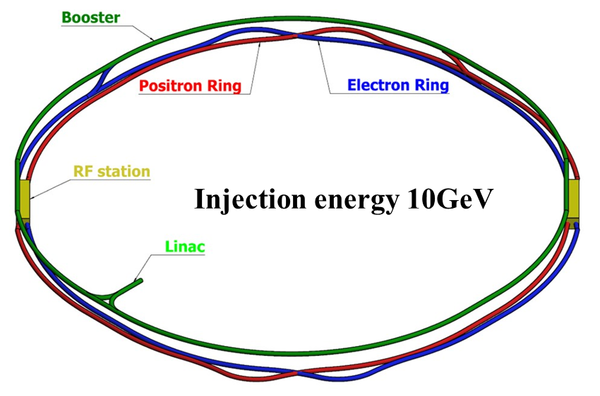
CEPC injector chain
10 GeV linac provides electron and positron beams for booster.
Top up injection for collider ring ~ 3% current decay
Booster is in the same tunnel as collider ring, above the collider ring.
Booster has the same geometry as collider ring except for the two IRs.
Booster bypasses the collider ring from the outer side at two IPs.

Slide 4
Design requirements for CEPC booster
Parameters | Design goals
Beam current (mA) | <0.8
Emittance in x (nm rad) | <3.6
Dynamic aperture (σ, normalized by linac beam size) | >3
Energy acceptance | >1%
Booster transfer efficiency | >92%
total transfer efficiency (inc. inj. & ext.) | >90% (99%*92%*99%)
Timing | Meet the top-up injection requirements
Beam current threshold in booster is limited by TMCI ~0.8mA.
The diameter of the inner aperture is selected as 55mm due to impedance issue.
Booster transfer efficiency 92%: 3% beam loss due to quantum lifetime + 5% beam loss during ramping process.

Slide 5
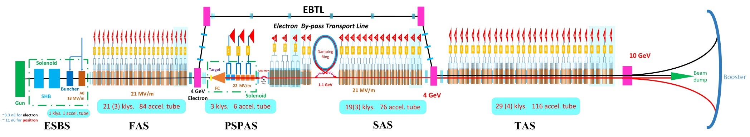
CEPC Linac
Parameter | Symbol | Unit | Baseline | Designed
e⁻ /e⁺ beam energy | E_{e-}/E_{e+} | GeV | 10 | 10
Repetition rate | f_{rep} | Hz | 100 | 100
e⁻ /e⁺ bunch population | N_{e-}/N_{e+} |  | > 9.4×10⁹ | 1.9×10¹⁰ / 1.9×10¹⁰
 |  | nC | > 1.5 | 3.0
Energy spread (e⁻ /e⁺ ) | σ_{e} |  | < 2×10⁻³ | 1.5×10⁻³ / 1.6×10⁻³
Emittance (e⁻ /e⁺ ) | ε_{r} | nm⋅ rad | < 120 | 5 / 40 ~120
Bunch length (e⁻ /e⁺ ) | σ_{l} | mm |  | 1 / 1
e⁻ beam energy on Target |  | GeV | 4 | 4
e⁻ bunch charge on Target |  | nC | 10 | 10

Slide 6
Booster parameters @ injection (10GeV)
 |  | H | W | Z
Bunch number |  | 242 | 305 | 600
Transmission efficiency | % | 0.92 | 0.92 | 0.92
Bunch charge | nC | 0.78 | 0.78 | 0.417
Beam current | mA | 0.568 | 0.7161 | 0.7513
Natural Energy spread | % | 0.0078
SR loss/turn | keV | 73.5
Momentum compaction factor | 10⁻⁵ | 2.44
Natural Emittance | nm | 0.025
RF voltage | GV | 0.0627
Longitudinal fractional tune |  | 0.1
RF energy acceptance | % | 1.9
Damping time | s | 90.7
Bunch length from linac | mm | 1
Energy spread from linac | % | 0.16
Emittance from linac | nm | 40~120

Slide 7
Booster parameters @ extraction
 |  | H | W | Z
Bunch number |  | 242 | 305 | 600
Transmission efficiency | % | 0.92 | 0.92 | 0.92
Bunch charge | nC | 0.72 | 0.72 | 0.384
Beam current | mA | 0.5227 | 0.6588 | 0.6912
Ramping time (up+down) | s | 10 | 6.6 | 3.8
Injection time (e+，e-) | s | 25.84 | 85.76 | 592
Injection period | s | 37 | 383 | 811
Number of Cycles |  | 1 | 4 | 20
Natural (extr.) Energy spread | % | 0.094 | 0.062 | 0.0355
SR loss/turn | GeV | 1.5 | 0.3 | 0.032
Momentum compaction factor | 10⁻⁵ | 2.44 | 2.44 | 2.44
Natural (extr.) Emittance | nm | 3.58 | 1.59 | 0.51
RF voltage | GV | 1.7 | 0.585 | 0.287
Longitudinal fractional tune |  | 0.1 | 0.1 | 0.1
RF energy acceptance | % | 0.52 | 1.2 | 1.8
Damping time | s | 0.052 | 0.177 | 0.963
Natural (extr.) Bunch length | mm | 3.5 | 2.4 | 1.3

Slide 8
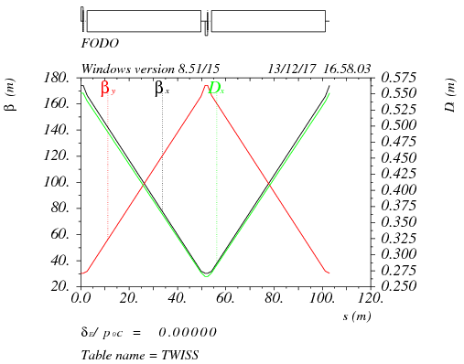
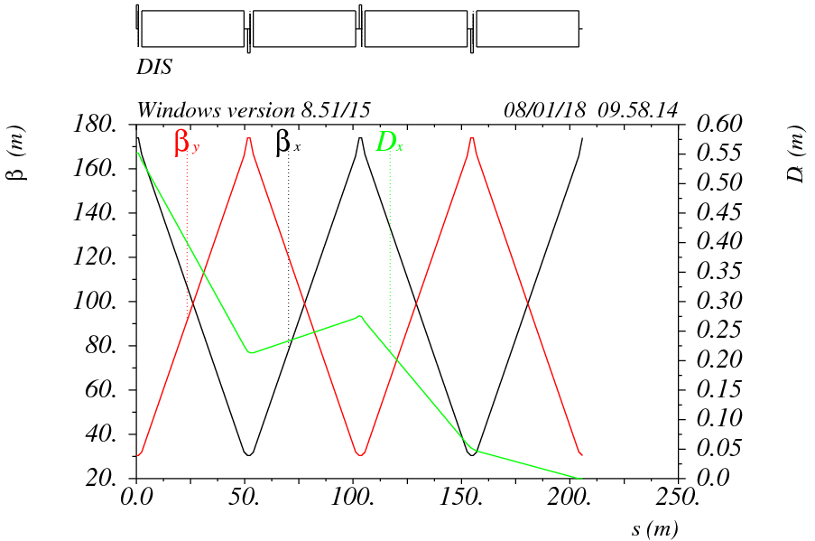
Booster optics - ARC
90°/ 90° FODO cell
FODO length: 102.9m
Noninterleave sextupole scheme
Dispersion suppressor
- two standard FODO cell
- ½ bend strength
FODO cell
Dispersion suppressor

Slide 9
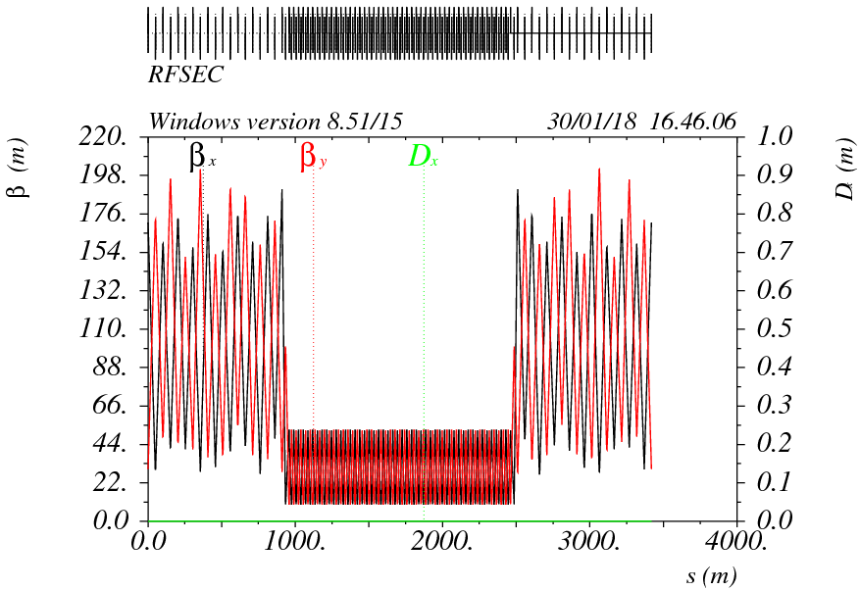
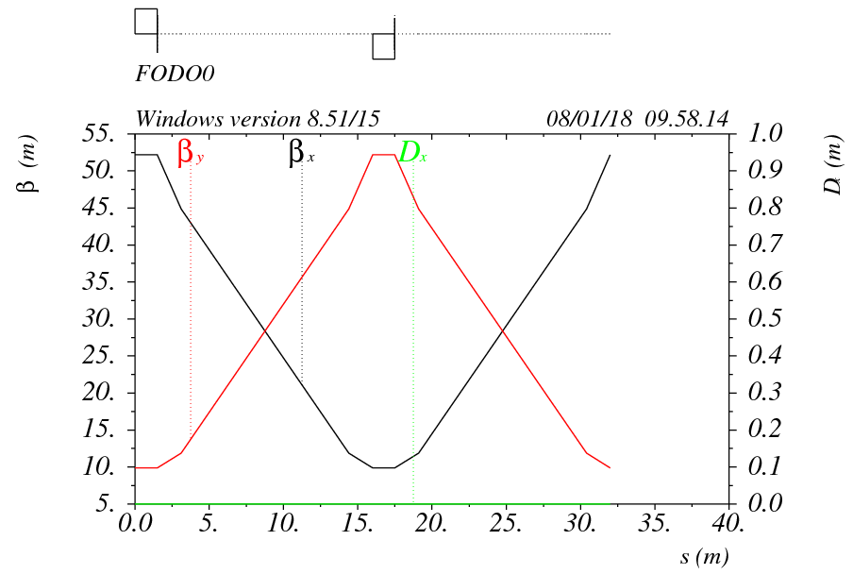
Booster optics - RF
Booster RF straight section at the same location as collider ring
Low average beta to reduce the multi-bunch instability by RF cavities
- 90°/ 90° FODO cell
- Average beta: 30 m
- Space between quadrupoles :12m
RF section

Slide 10
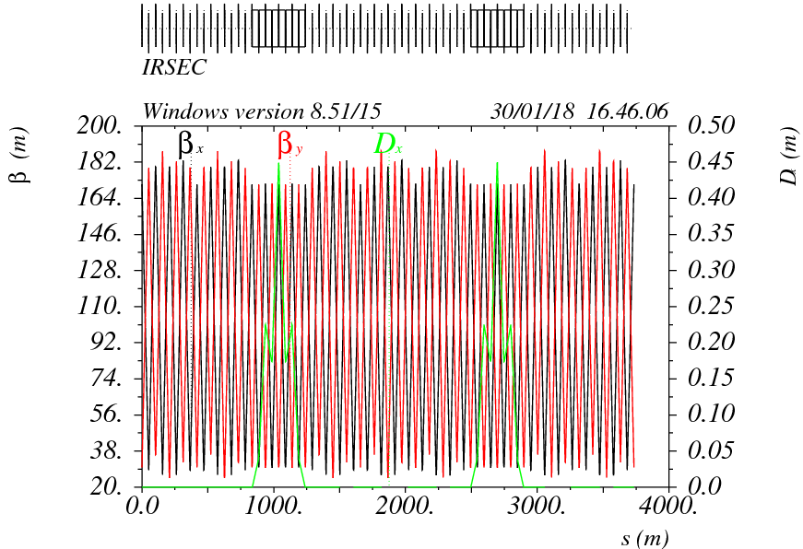
Booster optics – IR bypass
In CEPC detector region, booster bypasses the collider ring from the outer side.

Slide 11
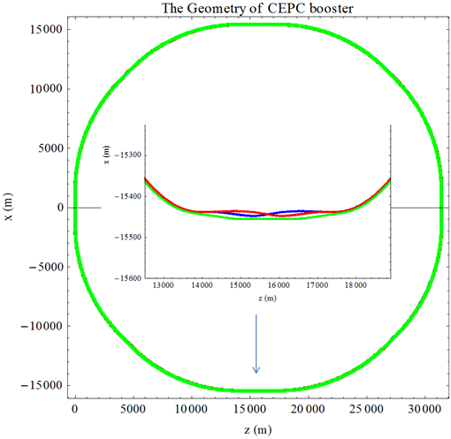
Booster geometry
Booster has nearly same geometry as collider ring except for the two IRs.
Separation between detector center and booster: ~20 m
Minimum separation between booster and collider @ IR: ~10 m

Slide 12
Booster error studies
Gaussian distribution and cut-off at 3σ
Errors Setting
 | Dipole | Quadrupole | Sextupole | Corrector
Transverse shift X/Y (μm) | 100 | 100 | 100 | 100
Longitudinal shift Z (μm) | 150 | 150 | 150 | 150
Tilt about X/Y (mrad) | 0.1 | 0.2 | 0.2 | 0.2
Tilt about Z (mrad) | 0.05 | 0.2 | 0.2 | 0.2
Nominal field | 1e-3 | 1e-3 | 1e-3 | 1e-2
 | Accuracy (m) | Tilt (mrad) | Gain | Offset after BBA(mm)
BPM | 1e-5 | 10 | 5% | 1e-3

Slide 13
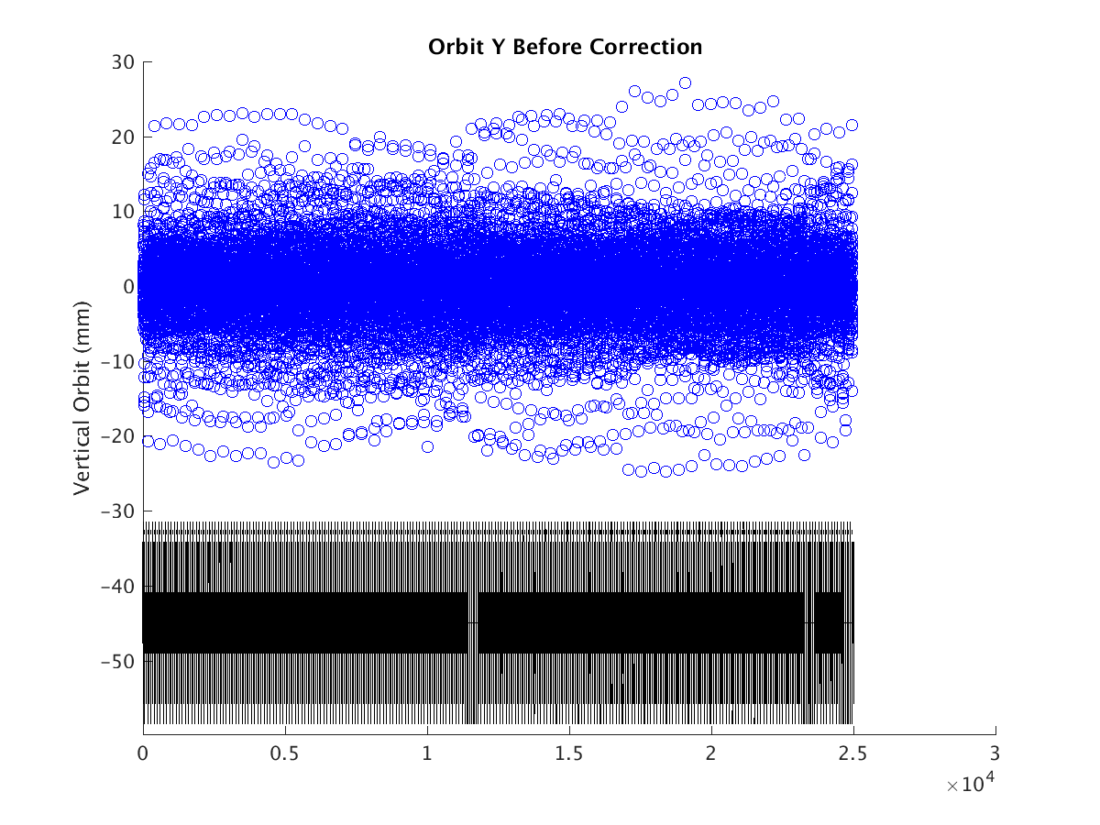
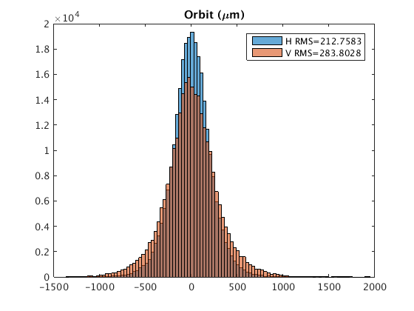
Booster orbit with errors
Orbit within the beam stay clear
“First turn trajectory” is not necessary
Horizontal Corrector: 48 correctors +856 BTs
Vertical Corrector : 904 correctors
BPM : 904*2
Hor. 0.2mm Ver. 0.3mm

Slide 14
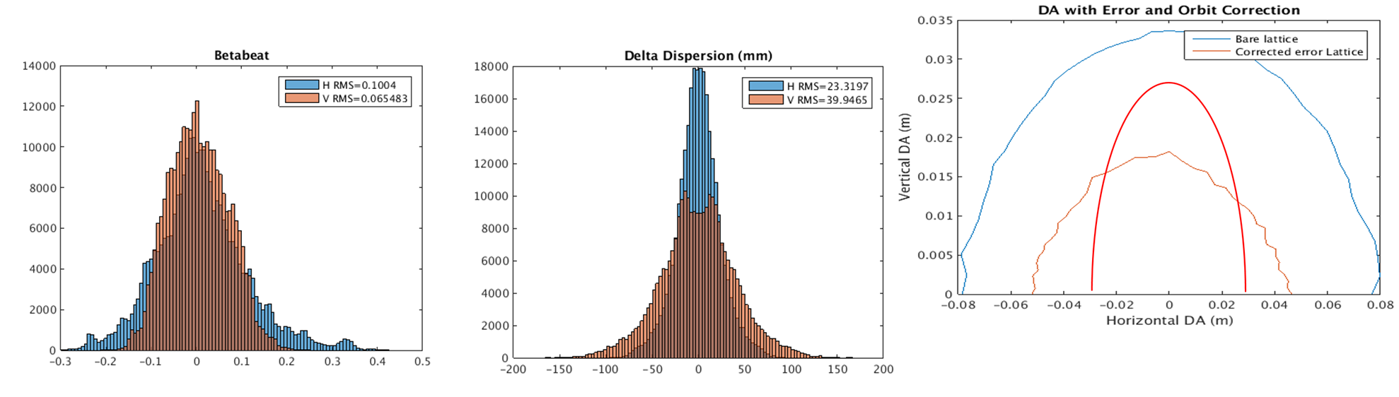
Booster optics & DA with corrections
  DA is half of the bare lattice, ±50mm* ±18mm, without optics correction, satisfy requirement
  Emittance growth is less than 10% for the simulation seeds
Satisfy the requirement of injection and beam lifetime
Skew quadrupoles are needed to control the coupling
βx/βy=188/33m
Beam pipe
Hor. 10% Ver. 6.5% Hor. 0.023m Ver. 0.04m
ε_{injx}=120nm, A_{x}= 2(9σ_{x} +5mm)
ε_{injy}=120nm, A_{y} =2(6σ_{y} +5mm)

Slide 15
Eddy current effect
During ramping, parasitic sextupole field is induced in dipoles due to eddy current.
Ramping rate is limited by eddy current effect.
Dedicated ramping curve to control the maximum K2.
Chromaticity distortion needs to be corrected during ramping.
Dynamic chromaticity correction and according DA is under studying.

Slide 16
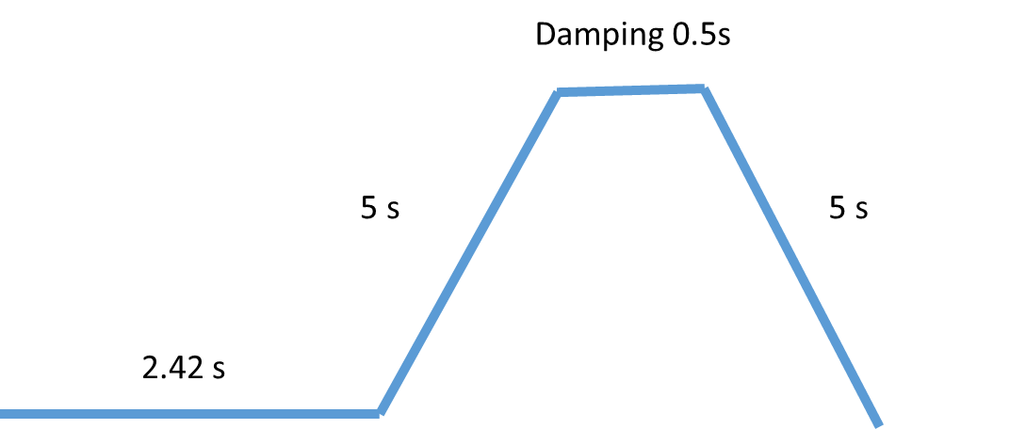
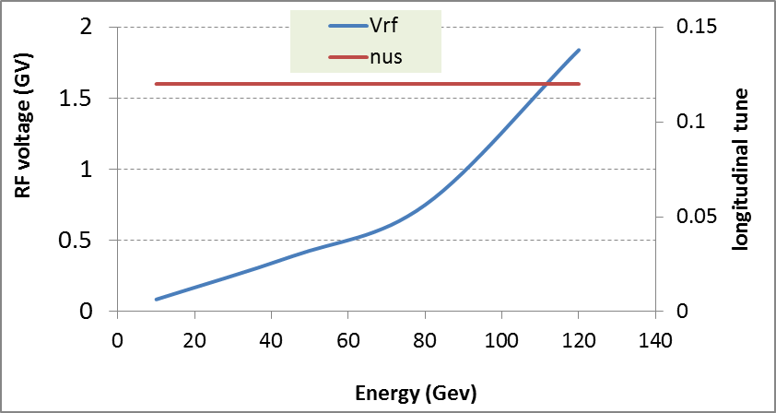
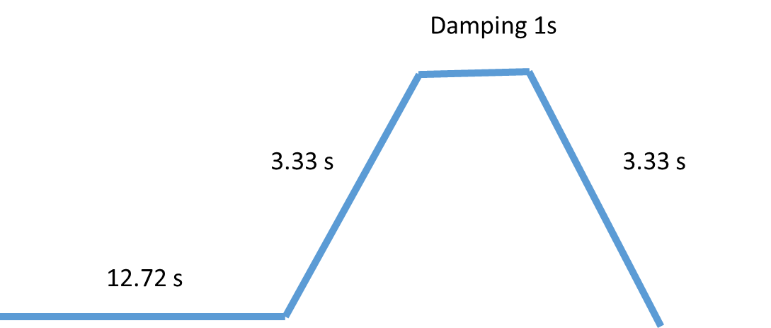

Injection time structure
Higgs
1 cycle
W
30Gauss @ 10GeV
Eddy current effect
4 cycles
Z
Transverse quantum lifetime@10GeV:
1.0 ×10⁸ min (ε_{inj}=120nm)
Beam loss due to lifetime << 1%
20 cycles

Slide 17
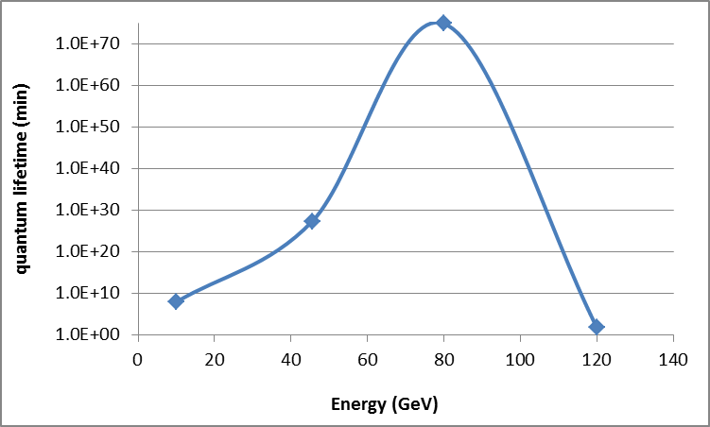
Quantum lifetime
60 min
1×10⁸ min
10 GeV & 45 GeV: tranaverse quantum lifetime
80GeV & 120 GeV: longitunidal quantum lifetime

Slide 18
Emittance evolution
Beam lifetime is dominated by transverse quantum lifetime at 10 GeV.
Beam lifetime is dominated by lonitudinal quantum lifetime at extraction energy.
Beam loss due to lifetime determined by the emittance of Linac and the DA.
H
W
Z

Slide 19
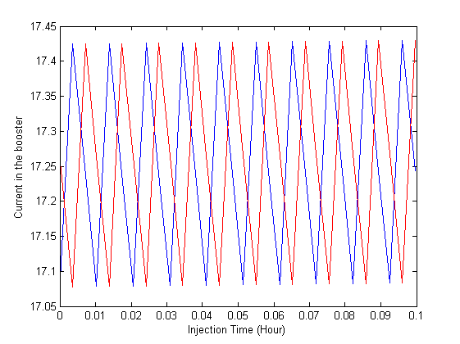
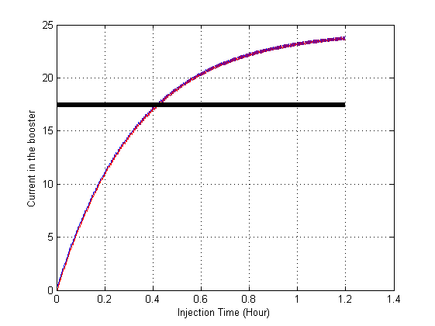
Current evolution-Higgs
Top up → one injection (26s) every 37s
Full injection → 25 min
Top up
Full injection

Slide 20
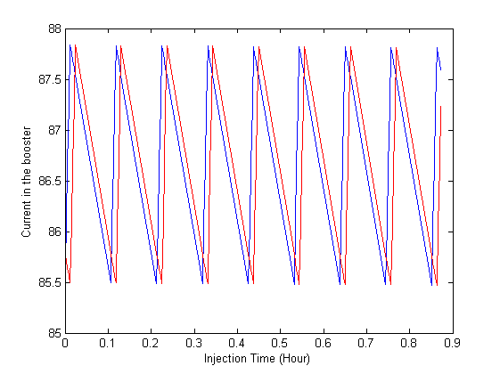
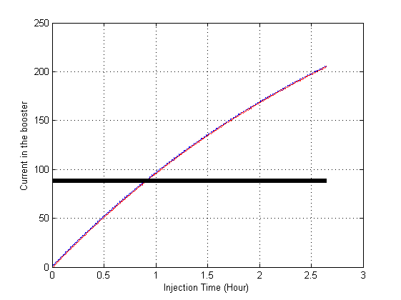
Current evolution-W
Top up → one injection (86s) every 383s
Full injection → 54 min
Top up
Full injection

Slide 21
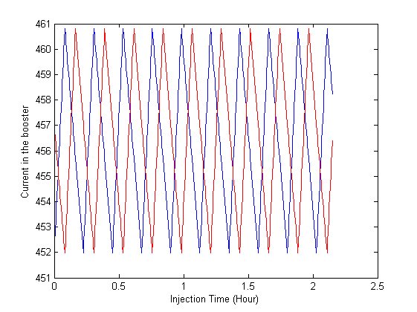
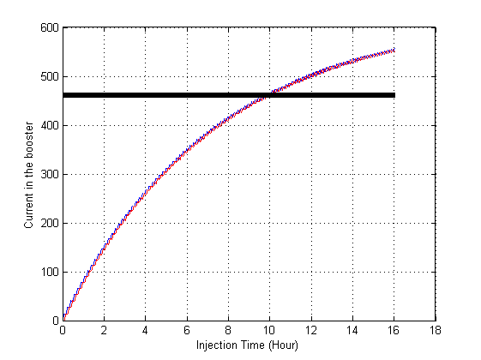
Current evolution-Z
Top up → one injection (592s) every 811s
Full injection → 10 hours
Top up
Full injection

Slide 22
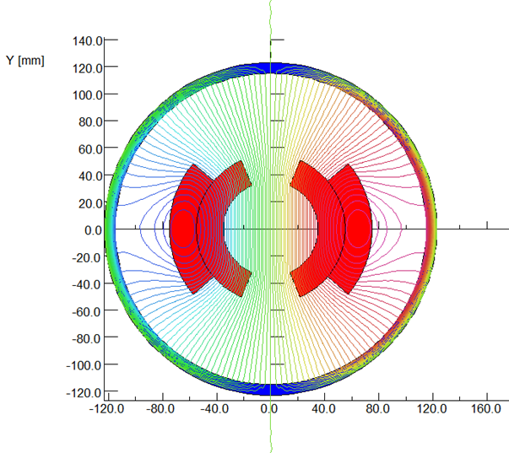
Low field dipole magnets
Challenges:
Solution in CDR
Field error <29Gs*0.1%=0.029Gs → how to design
Field reproducibility <29Gs*0.05%=0.015Gs → how to measure
The Earth field ~0.2-0.5 Gs, the remnant field of silicon steel lamination ~ 4-6 Gs.
Without magnetic core
Twice excitation current
Thinking beyond CDR
Wiggler dipole scheme
Ramp dipoles with groups
…

Slide 23
Summary
The booster design can meet the injection requirements at three energy modes.
The study of dynamic chromaticity correction and dynamic DA is ongoing.
Low magnetic field in the booster is still a challenge. Studies are underway.

