Slide 1
W/Z bosons classification
朱永峰
2018.03.04
Notes:
Hello, my topic is about classifing w and z bosons using machine learning.

Slide 2
The following is on generation level
Objective: classify w and z bosons with machine learning
Samples:
ww → ccbs zz → dtdt
ww → ccds zz → utut
ww → cusd
ww → uubd
Notes:
My sample is on generation level, including ww decay to ccbs……

Slide 3
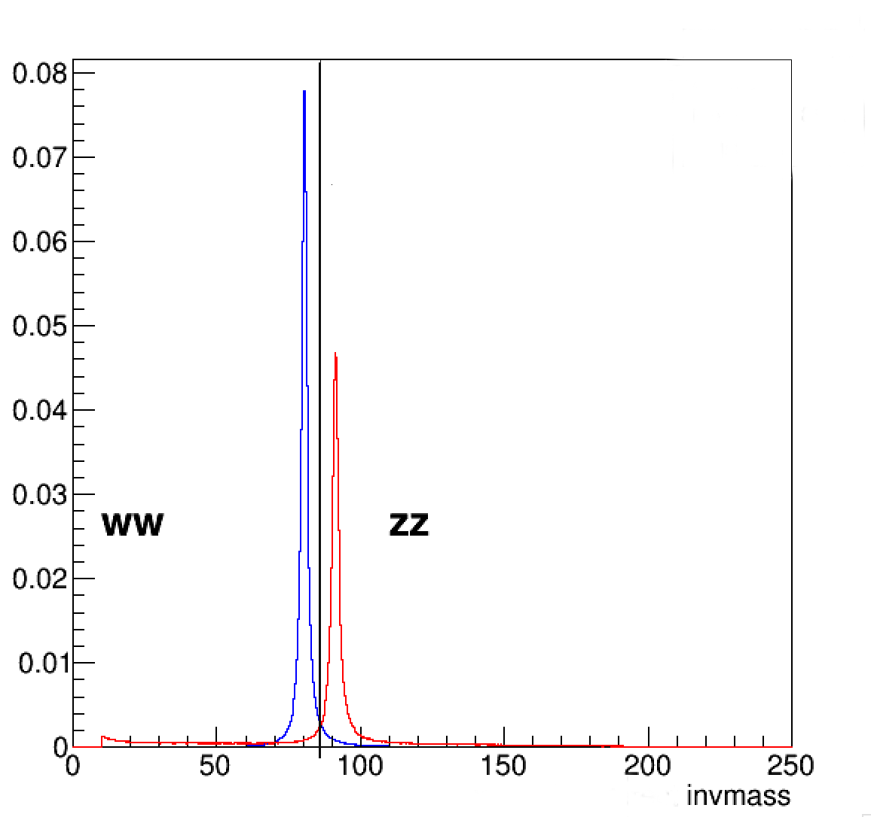
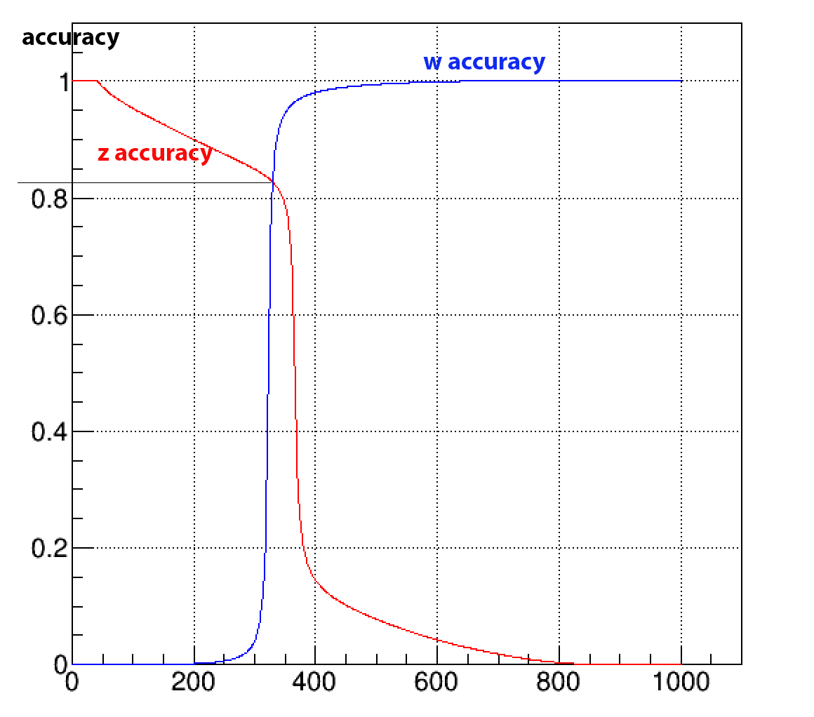
invariant mass of w and z bosson (four quarks correctly pairing to w or z)
w accuracy$=\frac{the w entries on the left of the black line}{total w entries}. z accuracy=\frac{the z entries on the right of the black line}{total z entries}$
Notes:
The left graph shows the invariant mass of w and z boson on parton level, the height difference is due to statistical magnitude. On the right graph, blue line and red line is about the accuracy of w and z boson separately, the bottom is the accuracy definition. On the right graph, we can see the intersection of two lines, the accuracy is less than 85 percent,we remember this value.

Slide 4
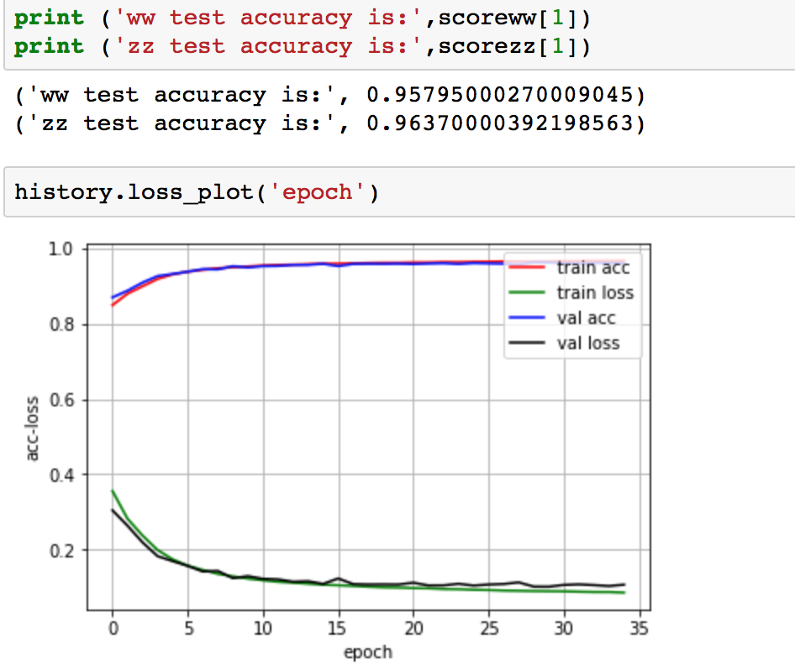
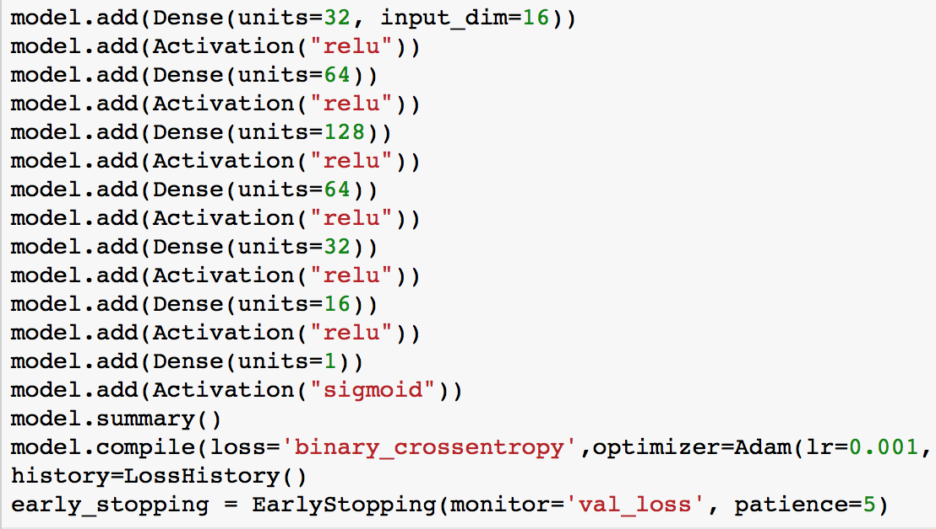
Parton level:
W accuracy$=\frac{correctly testing entries of w bosons}{total entries of w bosons}$
Z accuracy$=\frac{correctly testing entries of z bosons}{total entries of z bosons}$
Notes:
This slide is about calssifying accuracy using machine learning. The sample is four quarks decayed from ww or zz bosons, the left graph is testing accuracy and training process, from training curve we can say the testing result is ok. The right graph is model structure. The accuracy defined as same as last slide. We can say the way of machine learning doesn’t use invariant mass of w and z bosons.

Slide 5
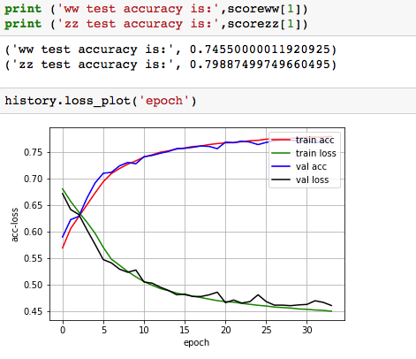
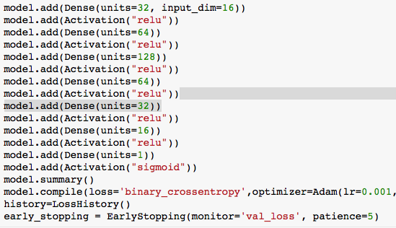
Jet level:
Notes:
On jet level, we use the same way and model to classify w and z, the result is bad than parton level.

Slide 6
For our problem, in theory, multi-layer-perceptron, convolutional-neural-network and recurrent-neural-network won’t work very well if we continue use four momentum.
Next : ☛ processing four momentum of pfo as pictures to use CNN
☛ try other type of samples, such as tracks in calorimeter, process tracks as pictures(3D?)
☛ try other models(reinforcement learning?) except MLP, DNN, CNN and RNN

Slide 7
Back Up

Slide 8
Interesting
The left graph is about using parton model to test jet, the right is about using jet model to test parton.

Slide 9
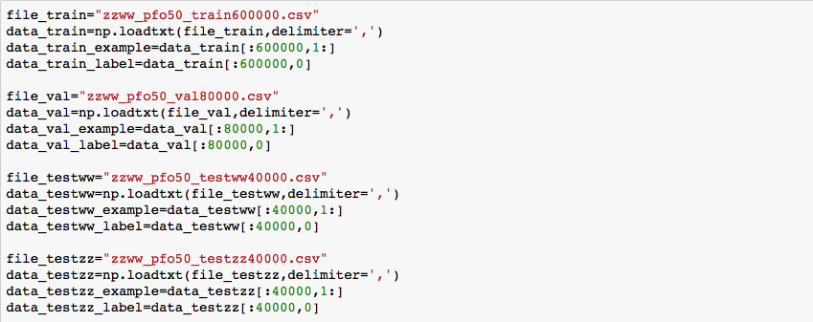
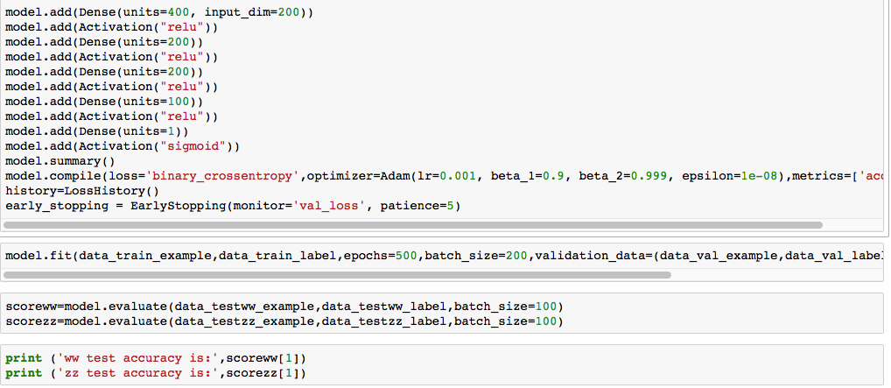
Code of DNN for my model

