Slide 1
Tutorial for the SNiPER Framework
Zou Jiaheng, Lin Tao, Huang Xingtao, Li Weidong
2018-05-13

Slide 2
Content
General introduction
Key concepts
Running the HelloWorld

Slide 3
Offline Software Environments
Programming language: hybrid programming of C++ and Python
Very popular in HEP field
Most frequently used software is implemented in C++ (ROOT, Geant4 …)
Job configuration interface: Python
Very flexible
Easy to glue different tools together (Job scheduling, Monitoring …)
Packages management tool: CMT(Configuration Management Tool)
Help developers to compile packages easily
Help users to setup the environment for running the application easily
Supported Operation System: Linux
Official recommendation: Scientific Linux 6 / CentOS 7
Some colleagues compile successfully on Ubuntu, Debian …
Codes Management: SVN
Keep the history of code evolution
Synchronization and sharing between developers
Tag and release

Slide 4
Overview of JUNO Offline Software
SNiPER: the underlying Framework
Offline: extension of SNiPER and applications for JUNO
External Libraries(EI): very frequently used software and tools
JUNO
Generator
Calibration
Analysis
Simulation
Reconstruction
External Libraries (EI)
Root CLHEP Boost
Geant4 Python
……
offline
SNiPER (Software for Non-collider Physics ExpeRiment)

Slide 5
Software Framework
What’s an offline software framework?
A framework helps users to write as less code as possible to achieve their goals
What does a framework provide?
Management of Event Data
Interfaces to define, read, access and write event data
Management of data processing
Sequence and/or filtering of algorithms
Common services and tools for data processing
HistogramSvc, RandomSvc, DatabaseSvc …
Friendly user interface
Simple interfaces for coding: abstract base classes for algorithms and services
Simple interfaces for running: configure jobs via text, python …

Slide 6
Software Framework for JUNO
SNiPER: Software for Non-collider Physics ExpeRiment
Main goals
Lightweight, less dependences on third-party software/libs
Fast and flexible execution
Easy to learn and convenient to use
Design and development
Learn a lot from other software frameworks, such as Gaudi
Based on the valuable experiences of Daya Bay Experiment
Coding from scratch
Current Status
Performs well for JUNO (and LHAASO, a cosmic ray exp. in China)
Several other projects and potential users (CSNS, nEXO …)

Slide 7
Key Functionalities of Framework
Dynamically loading packages and elements
User’s packages can be executed as plugins
It is easy to customize a job
Flexible execution
Task, TopTask, Incident
Very useful for event splitting and mixing
Event management in memory
Multiple events within time windows accessible
Very convenient for events correlation analysis
Parallel computing (will come soon)

Slide 8
Working with SNiPER
User’s Application Layer
In an User Algorithm:
get data from memory
execute calculation
put results back to memory
No need to care where the data comes from
No need to care where the data will go
features such as
geometry …
Prepare data to be processed
Collect algorithm results
SNiPER
Core Software Layer
I/O: disk, DB, network, grid…
Python UI Layer
run a batch job or interactively debug a module

Slide 9
Key Concepts
DLElement: Dynamically Loadable Element
Algorithm
Service
Task
Tool
Data Buffer
Incident
Property
Log (message output)
Each DLElement object has a unique string name

Slide 10
Algorithm
An unit of codes for Data Processing
the calculation during event loop
Most frequently used by users
AlgBase, the abstract base class in SNiPER
User’s algorithm must be inherited from AlgBase
Its constructor takes one std::string parameter
3 abstract interfaces must be implemented, they are called by SNiPER automatically
bool initialize() : called once per Task (at the beginning of a Task)
bool execute() : called once per Event
bool finalize() : called once per Task (at the end of Task)
We will show how to create an algorithm later

Slide 11
Service
Similar with Algorithm
An Dynamically Loadable Element
One Task probably composes of one or more services
But different from Algorithm
A piece of code for common use (RootIOSvc, GeometrySvc …)
They are called by user’s request, not limited to event loop
SvcBase, the abstract base class in SNiPER
A new service must be inherited from SvcBase
Its constructor takes one std::string parameter
2 abstract interfaces must be implemented
bool initialize() : called once per Task (at the beginning of a Task)
bool finalize() : called once per Task (at the end of Task)
We will show how to create a service later

Slide 12
Task
A lightweight traditional Application Manager
Management of algorithms, services and tasks
Controlling the execution of algorithms
Has its own data memory management
Has its own I/O management
One job can has more than one Tasks(e.g. event mixing)
All DLEs are organized in a tree structure
TopTask
Service
Algorithm
Task
Service
Algorithm
Task
Service
Algorithm
Task
Service
Algorithm
Service
Algorithm
Service
Algorithm

Slide 13
Data Processing with Task
Task means the event processing procedure (event loop)
SubTask provides nested event loop
It will be executed on demand
Task and SubTask provide more flexible execution
Meet the requirements of Event Mixing and Event Splitting
Multi-Thread Computing (run each task in an individual thread)
Task is a FSM (finite-state machine)
Startup
Ready
Running
Finalized
Endup
Event Loop
Algorithm 1
Executed on Demand
Algorithm 4
Executed on Demand
Algorithm 2
Algorithm 5
Algorithm 6
Algorithm 3
TopTask
SubTask
SubTask

Slide 14
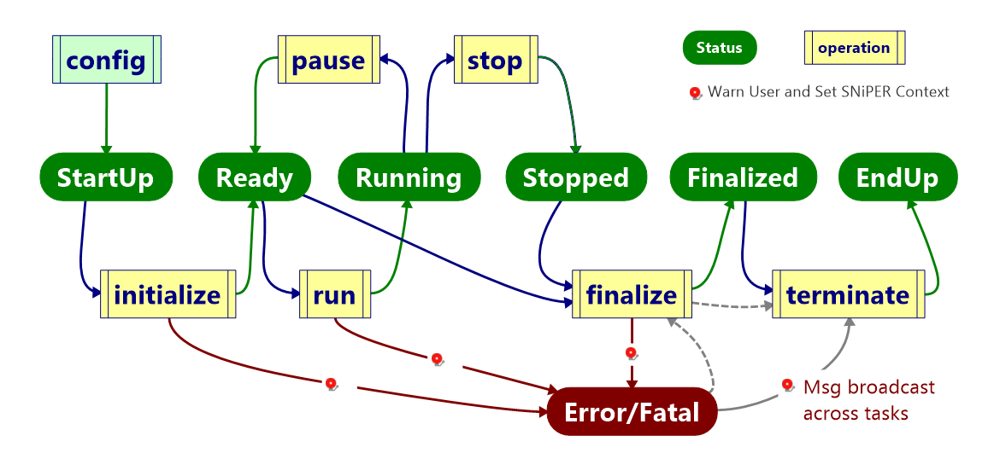
Task Status

Slide 15
Tool
Tool is also a Dynamically Loadable Element
It belongs to an algorithm and helps the algorithm to organize code more clearly
One algorithm can have one or more tools
A tool can be accessed via its name

Slide 16
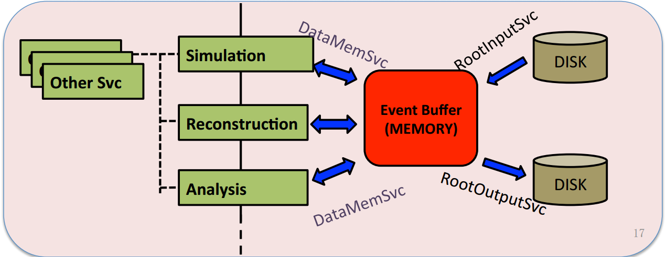
Data Buffer
Data Buffer is the dynamically allocated memory place to hold events data which are being processed
Applications (in terms of algorithms) get events data from the buffer and update them after processing

Slide 17
Data Buffer in Memory
Current event
Other events
Buffer: a sequence of events in a time window
Event buffer
Exe Num
EvtNum: 0 1 2 3 4 5 6 7
correlation analysis of events in buffer
0
1
2
3
4
5
6
7

Slide 18
Incident
Provides an additional degree of execution freedom:
Incident: trigger the execution of corresponding handlers
IncidentHandler: the wrapper of any specific procedure
Regular Procedure
Extra Procedure
IIncidentHandler
Incident
1, fire()
IIncidentHandler
handle(Incident&)
regist(string)
string name()
fire()
handle(Incident&)
regist(string)
2, handle()
Regular execution procedure jumps to another extra procedure
Back to the original procedure after all corresponding Handlers are executed
Both Algorithms and Services can fire incidents according to their needs

Slide 19
Incident Management
IncidentMgr correlates incidents with their handlers
Incidents are distinguished by its name, such as “BeginEvent”, “EndEvent”
One IncidentHandler can be registered to several Incidents
One Incident can be handled by several IncidentHandlers
Currently Event I/O and SubTask execution are based on incident mechanism
Incident
IIncidentHandler
string name()
fire()
handle(Incident&)
regist(string)
IncidentMgr
handle(Incident&)
Incident::name()
Handler
name1
Handler
Handler
name2
Handler

Slide 20
Property
Configurable variable at run time
Declare a property in DLElement (C++ code)
Configure a property in Python script
Types can be declared as properties:
scalar: C++ build in types and std::string
std::vector with scalar element type
std::map with scalar key type and scalar value type
This mechanism is also used to create and load algorithms and services:

Slide 21
Log Mechanism
SniperLog: a simple log mechanism supports different output levels
0: LogTest
2: LogDebug
3: LogInfo
4: LogWarn 5: LogError
6: LogFatal
Each DLElement has its own LogLevel and can be set at run time
very helpful for debugging
The output message includes more information
where it happens
the message level
The message contents

Slide 22
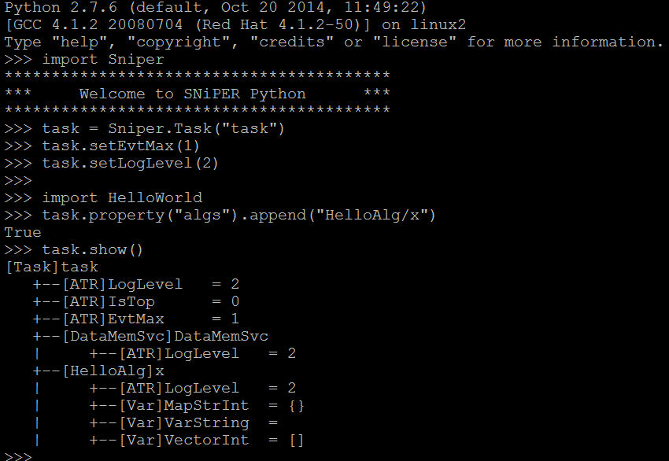
HelloWorld (I)
The HelloWorld algorithm in SNiPER
@ Examples/HelloWorld
configuration of the Task
svn co http://juno.ihep.ac.cn/svn/sniper/trunk/Examples/HelloWorld

Slide 23
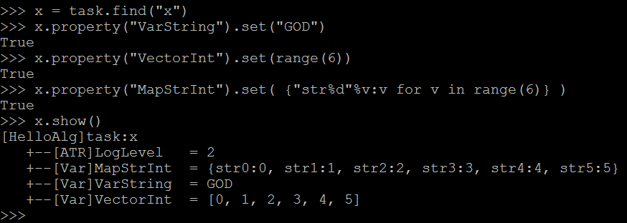
HelloWorld (II)
Configuration of the algorithm properties

Slide 24
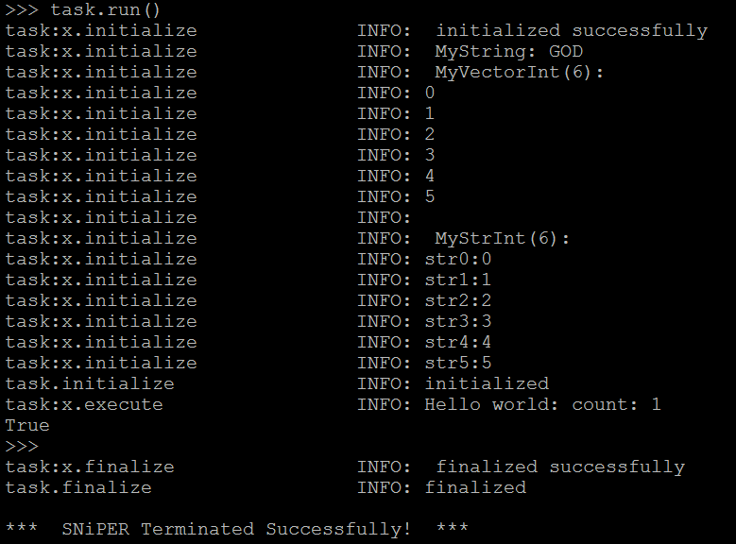
HelloWorld (III)
Run the Task

Slide 25
Create an Algorithm and a Service
Package management
C++ and Python coding
CMT configuration
Compile and run
Advanced topic: a job with multiple-tasks
svn co http://juno.ihep.ac.cn/svn/juno/people/zoujh/example/FirstToy

Slide 26
Preparation
ExternalLibs
sniper
offline
User’s own
project
Official Software Release
Users’ own code (workspace)
Setup the official release environment
$ source ~/juno-dev/setup.sh
Create your own project
$ cmt create_project Tutorial
$ cd Tutorial
$ vi cmt/project.cmt (→ use offline)
$ vi cmt/version.cmt (→ v0)
Create your own package
$ cmt create MyPackage v0
$ source MyPackage/cmt/setup.sh

Slide 27
Package Management
Create a new package with CMT
$ cmt create TestAlg v0
Orgnization of subdirectory and files
Subdirectory cmt/
File requirements: tell CMT how to setup and compile this package
Subdirectory src/: the directory for source code (C++)
Subdirectory FirstAlg: an optional directory for header files to share
Subdirectory python/: an optional directory for python code
Subdirectory share/: an optional directory for scripts of tutorial
Subdirectory Linux-x86_64 or anything like this: the compiling results that automatically generated by CMT

Slide 28
Coding and Running
FirstToy C++
FirstAlg, our first algorithm
Show different level of logs
FirstSvc, our first service
A string message as property (can be modified in python)
An interface to print the string message (answer())
SecondAlg
Call the service in an algorithm
FirstToy Python
Comple and run the example
$ cmt make ## in any subdirectory of the package (cmt/ recommended)
$ python run.py ## details in run.py
vs.

Slide 29
CMT Configuration
The package name and author
package SecondAlg
Author Zou Jiaheng <zoujh@ihep.ac.cn> ## optional
Dependencies while compiling
use SniperKernel v*
use FirstSvc v* FirstToy
How to generate the .so library file
library SecondAlg *.cc
apply_pattern linker_library library=SecondAlg ##Whether load all dependencies automatically while loading this library. Some times it is not necessary
Copy C++ headers and Python into CMT InstallArea
apply_pattern install_more_includes more=FirstSvc ## unnecessary if no shared headers
apply_pattern install_python_modules

Slide 30
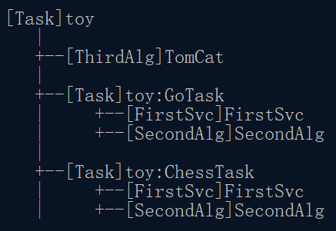
Advanced Topic: multiple-tasks job
The DLElement Map of
ThirdAlg + SecondAlg + FirstSvc + Task
SubTask(s) are executed on demand
Odd execution of toy::TomCat
Event Loop
[SecondAlg]
Tomcat
[ThirdAlg]
TomCat
[Task] GoTask
Even execution of toy::TomCat
[SecondAlg]
Tomcat
[Task] toy
Details can be found in ThirdAlg of FirstToy
[Task] ChessTask

Slide 31
Thanks !
Any questions?

Slide 32
Accounts
AFS (IHEP computer cluster) account
http://afsapply.ihep.ac.cn:86/ccapply/userapplyaction.action
JUNO SVN account
We use subversion as the version control system
A public read only account: juno/jiangmen
A personal account is necessary for updating purpose
Register an account in juno trac first: http://juno.ihep.ac.cn/trac/
Send email to lintao@ihep.ac.cn or maqm@ihep.ac.cn
Your user name in trac
Your affiliation (institute or university)

Slide 33
Possible Use Cases of Multi-Task Job
1, Multi I/O streams, such as background mixing
create a Task for each I/O stream
each Task holds its own data memory
each Task handles only one Input (and Output) stream
I/O service can be much simplified
2, Event amount changed, such as IBD simulation
(Sim)Task
(Gen)Task
Incident
update
TriggerGenAlg
SimAlg
…
GenAlg
SimAlg
e⁺ + Ν
ν
3, Multi-Thread Computing (run each task in an individual thread)

