Slide 1
Status of JUNO distributed computing
Xiaomei Zhang
IHEPCC
May 11，2018， WuHan

Slide 2
Content
Data volume and Computing Model
Workload management system
Data management system
Condition database system
Software distribution
Some new tries

Slide 3
Data volume and Resource requirements
Data volume estimated
Raw data 2PB/year
Rec data 200TB/year
Sim data 20TB/year
Basic requirements
Storage 3PB disk, ?PB tape
Computing 12000 CPU cores
After the JUNO electric workshop on May 14, the number can be updated
News from the Italian group

Slide 4
Planned computing model
Onsite
Fast reconstruction for data quality checking and compression
IHEP as central centre
Play major role for raw data processing, bulk reconstruction, also take care of simulation and analysis….
Hold central storage for all the data
European sub-centres
Mainly for simulation and analysis
Hold storage for simulation data and analysis data, even raw data
Small sites for analysis and production
Italy padovana site
Opportunistic resources for supplement and Redundancy
Commercial cloud, National Super Computing center, Volunteer Computing……
onsite
Opportunistic
IHEP centre
other sites
sub-centres

Slide 5
Data centers to join
List of data centers
IHEP
CNAF
Lyon
Moscow
Dubna
To sort out
Resources? Role in future?
Giuseppe Andronico is discussing with European collaborations
Expect to have a face-to-face meeting on July together with the next JUNO collaboration meeting
News from CNAF when visiting on April
Computing on the Italian side of the JUNO collaboration is based at CNAF
CNAF would like to hold whole copy of data, including raw data
The CNAF Data Centre is interested in close cooperations with IHEP in JUNO distributed computing
CNAF is T1 to support all the four experiments

Slide 6
Work flow
Official simulation will be distributed by production groups to centers and sites
Analysis can be sent from groups and individuals to any centers and sites where data is located
To well organize tasks and use resources, we need a global WMS (workload management system)
Opportunistic
sub-centers
IHEP center
other sites
Analysis
Official production

Slide 7
Data flow
Raw data transferred from onsite to IHEP center for rec and cal, other centers for backup as well
Sim data produced in sub-centres and sites will be transferred back to IHEP for backup
Sim data sets will be copied and stored to sub-centres
Ana data will be distributed to sub-centres and sites for analysis
Need a data management system
a global view to admins and users
a unique interface to access data for jobs
Tools to manage data flow
onsite
Opportunistic
IHEP center
other sites
sub-centre
Ana data
Sim data
Raw data

Slide 8
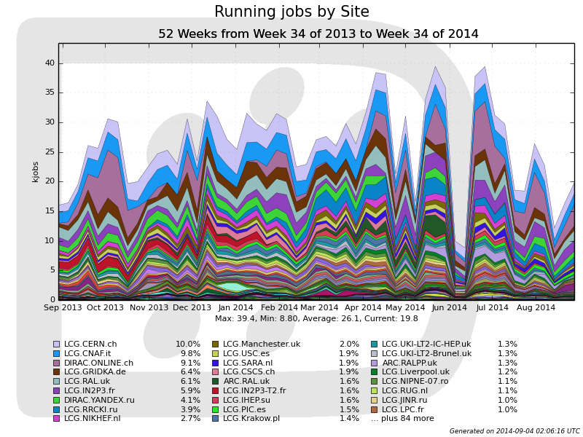
WMS with DIRAC
DIRAC is widely used by many HEP experiments
LHCb, BelleII, CTA, ILC, BESIII….
It is proved by LHCb that the framework can deal with 40K jobs at the same time
The experience of BESIII distributed computing showed
Can be customized according to experiment requirements
Extensible and reliable
Able to integrate various heterogeneous resources
CNAF and JINR also have knowledge and experience on DIRAC

Slide 9
Resources integration
Some trials have been done on DIRAC
Private Cloud (Openstack and Opennebula)
Commercial cloud (AWS)
Elastic integration has been done and used in production for BESIII
Cloud resource can be used and released dynamically according to number of job in task queue
Distributed Computing
Distributed Computing
Distributed Computing
No Jobs
User Job Submission
Job1, Job2, Job3…
Job
Finished
No Jobs
Create
Get Job
Delete
Cloud
Cloud
Cloud
VM1, VM2, …
VM

Slide 10
WMS and DIRAC
JSUB (production system)
Massive job submission and management tool
Automatically split jobs, create, submit and manage massive sub jobs
Prototype is worked out
DIRAC
Receive jobs in Task Queue
Schedule jobs to proper resources with pilot scheme
tasks
JSUB
DIRAC
WMS
site
site
site
Worknode
Software
Pilot
ConData
EvtData
10

Slide 11
Grid storage
Enable secure data sharing and transfers between different storage systems of sites
StoRM + Lustre in IHEP
500TB, will have 1PB this year
StoRM + GPFS in CNAF
230TB
Gridftp transfers among two SEs are ok
Other data centers are not clear

Slide 12
Bookkeeping and File Catalogue
In distributed env, storage could be distributed and data can be everywhere, to provide a unique interface to users and jobs
Bookkeeping provides definition of dataset to a group of files with file metadata , each with logical address
File Catalog provide a logical view and do the mapping between logical address and physical address
Dataset
Bookkeeping
Logical address
File Catalog
Physical address
site
site
site
data
site
data
data
data
12

Slide 13
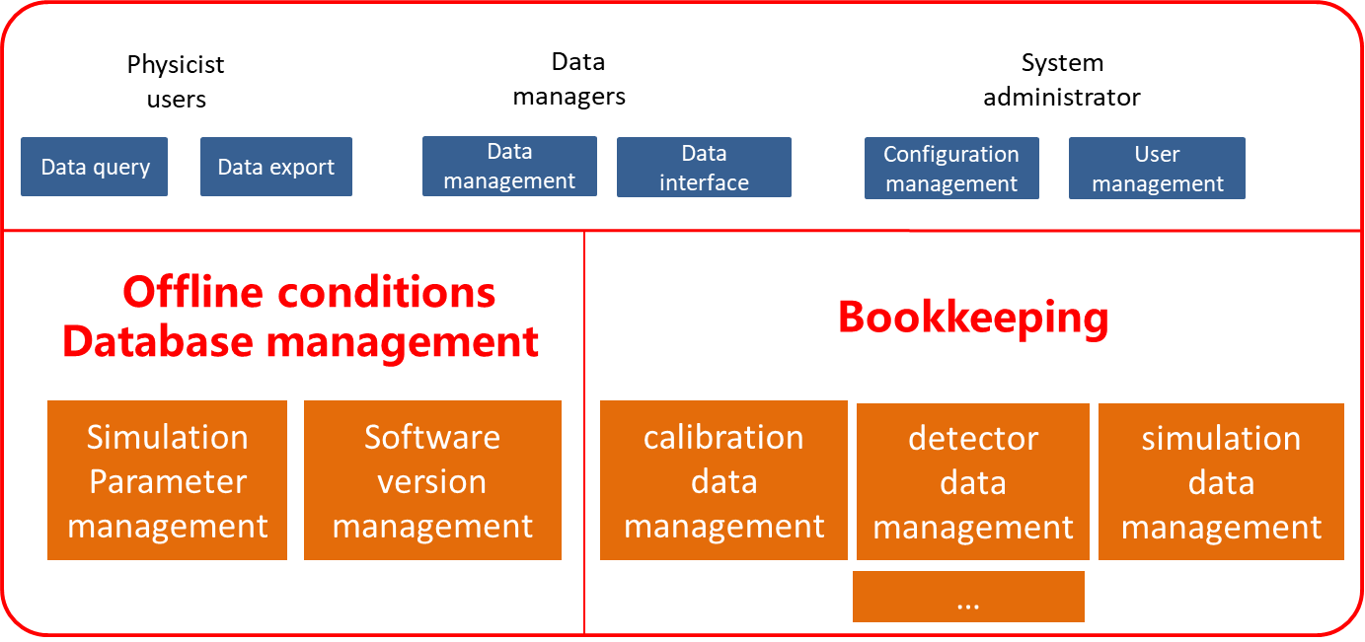
Bookkeeping
The Bookkeeping system is being designed and developed
Manage job info and file metadata
Provide query and management interface for various users

Slide 14
File Catalogue
Plan to use Dirac File Catalogue (DFC) for File Catalogue
Good cooperation with WMS
Enough and stable functions
Prototype has been set up
Provide a global view with linux-like file system
Easily get physical address with simple commands
Connection between Bookkeeping and DFC is undergoing
Still have other choices
Eg. Rucio, need more discussions
Linux-like file system
Logical name of files
Physical address of files

Slide 15
Data Transfer
Tools to enable automatic data transfers among data centers
SPADE for transfer of raw data
What about simulation and analysis data?
Closely work with “File Catalog”, dataset based
Users and sites involved
More complicated data flows
Two possible choices:
Built based on the data transfer system in BESIII, which is dataset-based, gridftp, closely work with DIRAC
Rucio, more powerful and advanced, but new
Need further discussions among data centers and physics groups

Slide 16
Condition database Management System
Provides fast, reliable and unique connectivity to cond data in distributed env from various condition data resources
Use CREST to implement restful http interface and transparent connections to backends
Use Frontier/squid to accelerate access with Cache layer
Work is undergoing

Slide 17
CVMFS and Software Distribution
CVMFS is used to distribute SW in a fast, scalable, reliable way
JUNO software installed and published in repositories of CVMFS server
Users can find JUNO software everywhere in “/cvmfs/juno.ihep.ac.cn/”
CVMFS server has been set up in IHEP
Stratum0 and Stratum1, each with a pair of servers using heartbeat to get high availability
Two squids in IHEP are in front of the servers to share load
17

Slide 18
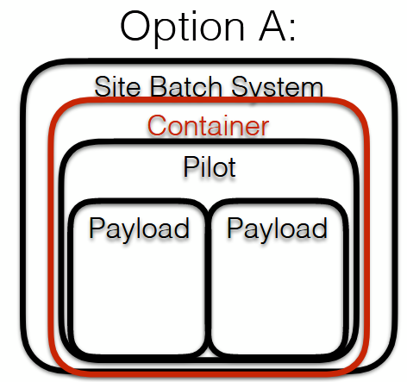
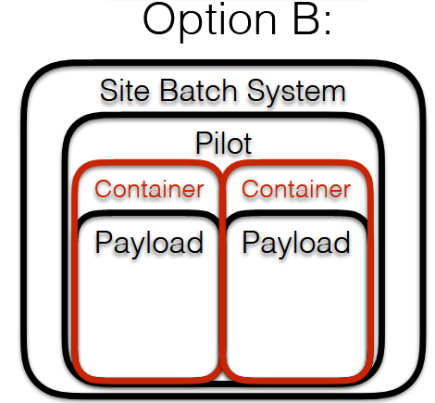
Singularity
Singularity is a container solution
Protect jobs from each other
Allow users to have a portable runtime OS versions
Allow sites to decide OS for hardware
Two options to use singularity
Site batch system can use singularity for its jobs (Pilots)
Trial are ok with HTCondor 8.3.6
WMS can start singularity by Pilots
Even protect pilots from jobs
Prototype is set-up and progress is made

Slide 19
Multi-core supports
Parallel computing are going to be supported in JUNO software
Multi-core supports have been tried in DIRAC
The two modes have been successfully implemented and tested
Independent pilots
Shared partitionable pilots
Resource utilization rate need to be studied and be optimized with JUNO use cases
Varies with user cases

Slide 20
Summary
Prototype is set up and tested
Progress has been made on WMS and DMS
Singularity and multi-core supports have been successfully tried recently
Need to work more closely with other data centers to establish common agreements on future computing model and tools
Plan a face-to-face meeting among data centers joined
Need more inputs from the offline group to make the system more close to production
Update of data volume estimation
Detailed user cases
Real work flow and data

