Slide 1
Update on SPMT Electronics Simulation
Main contributors:
Tao Lin
Yan Zhang
2018/5/10

Slide 2
Motivation
The old version of LPMT electronics simulation software didn’t consider the joint simulation of multiple sub detectors.
The old framework is too complicated and has some unnecessary code replication, which affects the speed of operation.
Need to develop a new framework to resolve these problems.

Slide 3
Outline
1. Update design
Old electronics simulation work flow
New design
2. New framework
Electronics in real life
New framework prototype
New data structure
3. Status on electronics simulation
Status of algorithm

Slide 4
Old Electronics Simulation work flow
Trigger Buffer
Pulse Buffer
Hit Buffer
Sniper Buffer
check Trigger
check Pulse
check hit
Get trigger infor.
Get pulses
get hits
get event
Push trig to buffer
Push pulse to buffer
Push hit to buffer
Push event to buffer
ReadoutAlg
TriggerSimAlg
PMTSimAlg
UnpackingAlg
No Trig
if no enough pulses
if no enough hits
return ElecSim
has a trig
WaveFormSimAlg
DetSim
EvtMixingAlg
Push ElecSim to buffer
Trig DetSim
get event
Output file
Sniper Buffer
BKG Root File
Root IO
Root IO

Slide 5
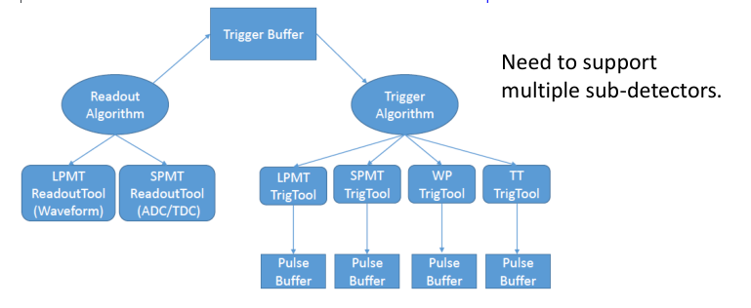
New design
Use Trigger Buffer handle the Readout and Trigger Algorithm.
Trigger Algorithm invoke each trigger tool to generate a trigger.
If has a trigger, Readout Algorithm will be invoked.

Slide 6
New framework prototype
Main components
• ElecSimAlg and ITriggerHandler (readout stage)
• TriggerSimAlg and ITriggerTool (trigger simulation)
• PMTSimAlg and IPMTTool (pmt simulation)
• ElecSimSvc: pulse buffer and trigger buffer.
Execution order:
• ElecSimTask -> TriggerSimTask -> PMTSimTask -> inputs
Create a new package (~ 1,500 LOC) •http://juno.ihep.ac.cn/svn/offline/trunk/Simulation/ElecSimV3/ElecSimAlg

Slide 7
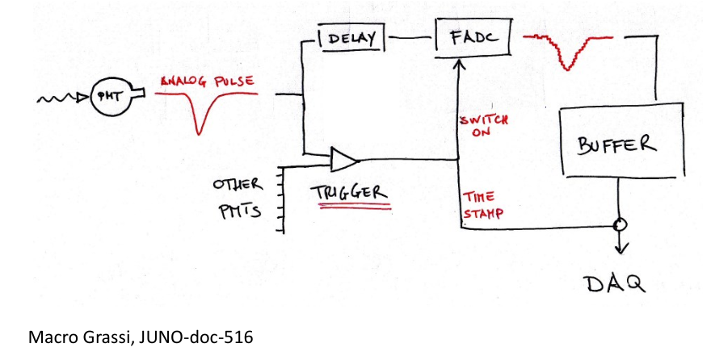
Electronics in Real Life

Slide 8
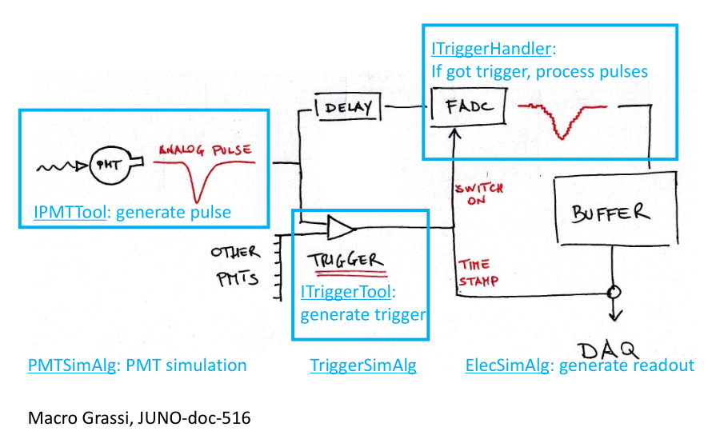
Electronics in Real Life
Design by Lin Tao

Slide 9
New data structure
enum PMTType: identify PMT type • kPMT_CD_Lpmt, kPMT_CD_Spmt, kPMT_CD
• kPMT_WP, kPMT_TT
enum TriggerType (same as PMT Type) • kTriggerLpmt, kTriggerSpmt, kTriggerCD (both L/S pmts)
• kTriggerWP, kTriggerTT
struct Trigger • TriggerType and TimeStamp
struct Pulse • pmtid, amplitude, TTS, hit time

Slide 10
Status of algorithms
PMTSimAlg
• Mix events and generate pulses.
• Replace the original packages: EvtMixing, Unpacking, PMTSim.
• Get hits from SimPMTHit, and sorted by hittime.
• For Large PMT
• Generate pulses as several factors: Relative quantum efficiency, Single PE response, TTS and Time offset.
• Dark pulse: Add dark pulse as Poisson distribution in a time window.
• After pulse: Each pulse have a probability to generate a after pulse.

Slide 11
Status of algorithms
TriggerSimAlg
• Read pulses and generate triggers, don’t modify the pulse buffer.
• If there are not enough pulses, invoke PMTSim.
• Invoke each trigger tool to generate a trigger.
• LPMT trigger scheme (Global Trigger) : Counting fired PMT number in a time window.
• SPMT trigger scheme: Self-trigger.
Pulse
firstPulseTime
PulseBuffer
t（global time）
300ns slip 25ns slip step
time window
buffer total length> 2000ns
Global Trigger

Slide 12
Status of algorithms
ITriggerHandler (Waveform Simulation for LPMT)
• Select pulses in the readout window.
• With TriggerTime we open a time window and use all the pulse which belong to the window to do waveform simulation.
TriggerTime
preWaveSimWindow
postWaveSimWindow
200ns
800ns
Pulse
firstPulseTime
PulseBuffer
t（global time）
pulse to be converted
buffer total length> 2000ns

Slide 13
Status of algorithms
ITriggerHandler (Waveform Simulation for LPMT)
• Generate waveform: Average 2000 single p.e. waveforms from experimental measurement.
• Other factors: Noise, Overshoot, Saturation
• FADC simulation:
• Sampling rate: 1 GHz,
• ADC resolution: 8 bit, 3 range (VULCAN); 12 bit, 2 range (Tsinghua).

Slide 14
Status of algorithms
ElecSimAlg
• Generate readouts (by ITriggerHandler).
• Get a trigger first, then read pulses and remove used pulses.
• It’s possible to get ElecHeader with LPMT/SPMT events.
ElecSimSvc
• Manage trigger buffer and pulse buffer.
• Provide the PMT parameters service such as dark pulse rate, TTS etc.
• Provide time service.

Slide 15
Summary
Design the new framework to simulate large and small PMT together.
Give a brief introduction of the work flow and data structure of the new framework.
Introduce the status of each algorithm.
Next to do:
• Testing the physical and computational performance of electronic simulation under the new framework, memory consumption.

Slide 16
Thanks for your attention!

