Slide 1
Water Cherenkov detector update Haoqi Lu IHEP JUNO software workshop 2018-05-08

Slide 2
Outline
Veto PMT position optimization
Untagged muon study.
Veto trigger consideration.
Summary

Slide 3
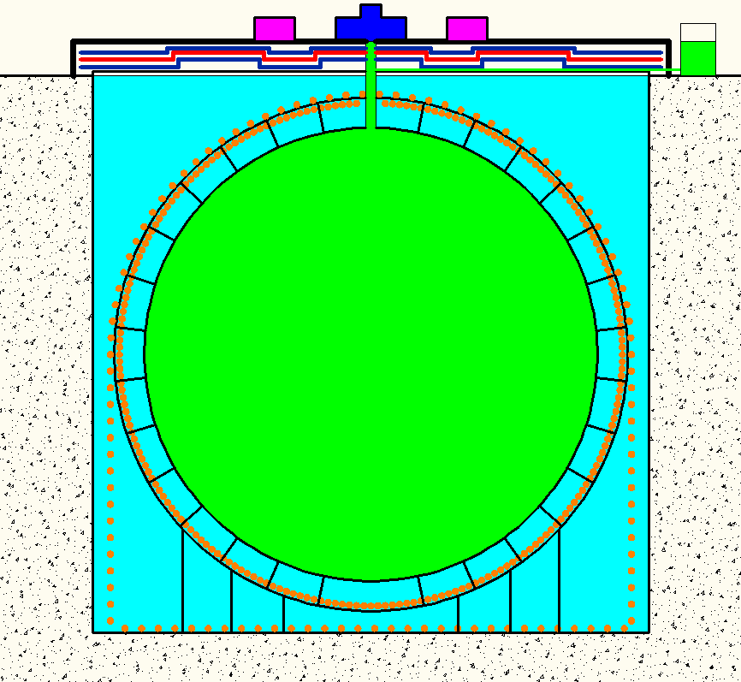
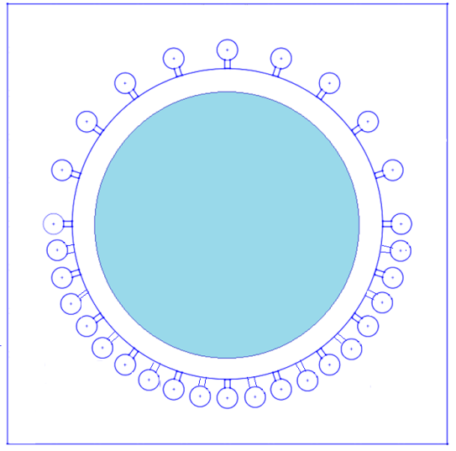
Veto PMT optimization
Earth magnetic field shielding coils(DocDB2878)
2 Sets of coils->1 Sets of colis
Installation：No big difference between 1 and 2 sets(There are support structure on the stainless steel frame)
Cost reduced ~50%; installation work reduced 50%.
One sets of Coils shielding is better.
DocDB2953: After consideration the shielding material and resident magnetic intensity(PMT magnetic shielding(Doc2084))， we intend to move all the bottom to the SS frame to reduce the magnetic field influence

Slide 4
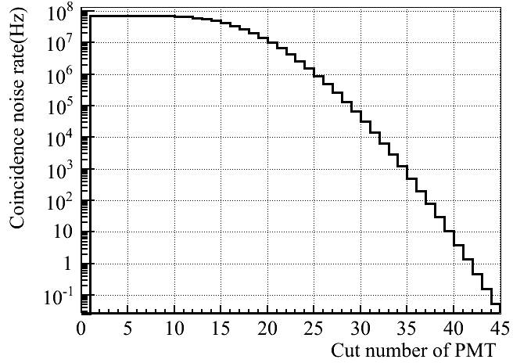
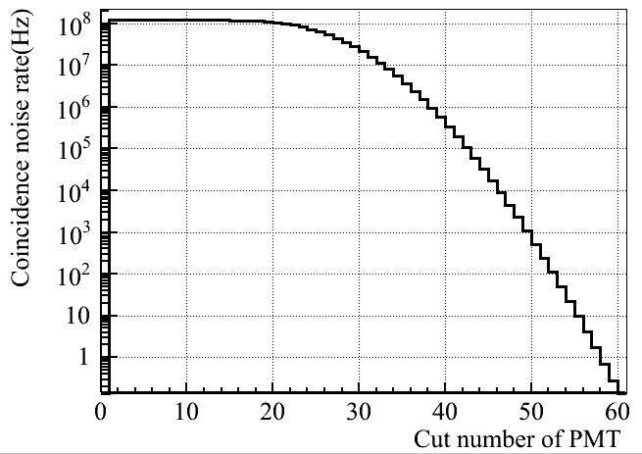
Untagged muon
PMT dark noise vs Npmt threshold:
If one muon going through the detector at 43.5 dimension, it takes ~130ns.It’s assumed 200ns time window for Cherenkov light collection for trigger.
We intend to see the PMT noise coincidence in 200ns by different PMT noise level.
Assumed PMT dark noise 30kHz, 50kHz.(Now, the average of MCP-PMT ~30kHz.)
Assumed veto window 1ms for future analysis and we can afford the 1% dead time from noise coincidence. The coincidence rate should <10Hz.
Since the veto will the PMTs are not so good as central detector. We’ll use 50kHz as the average PMT dark noise value.
30kHz,200ns
50kHz,200ns
 | 50kHz | Trigger time window
Number of pmt threshold | 54 | 200ns

Slide 5
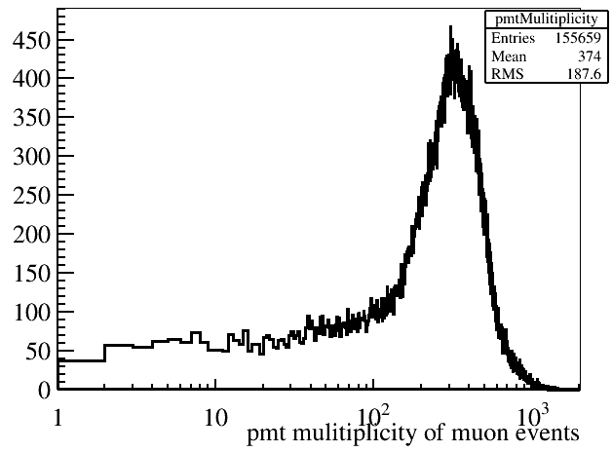
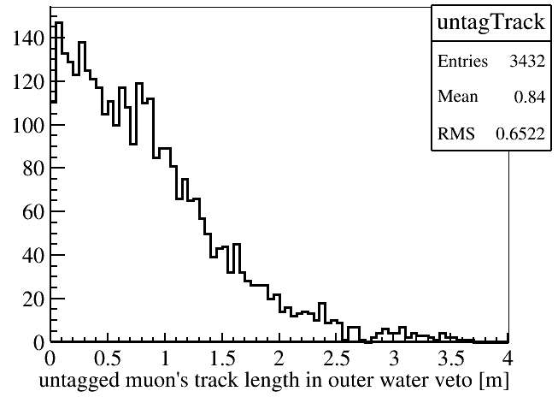
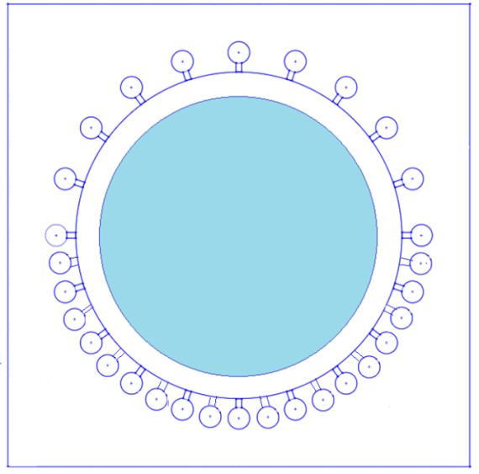
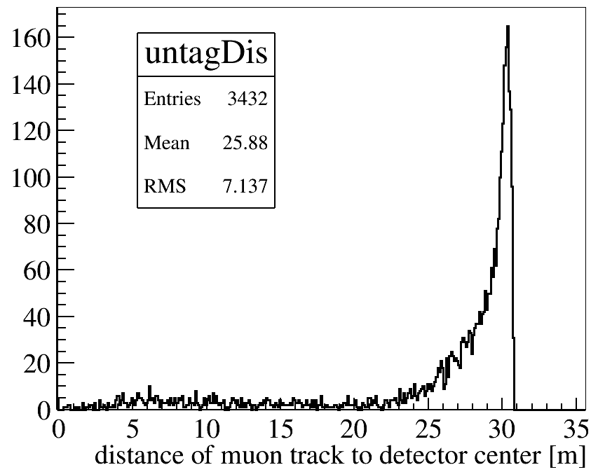
PMT multiplicity distribution
Untagged muon track length
Effi =(97.72+/-0.04)%@54Npmt threshold
distance

Slide 6
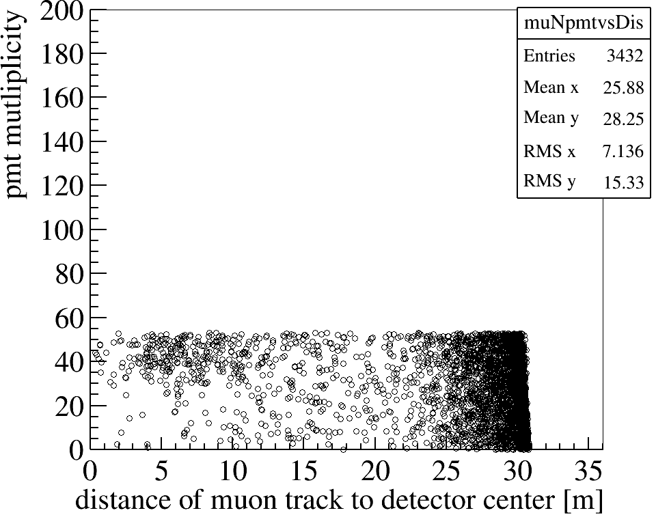
Pmt multiplicity vs distance to detector center

Slide 7
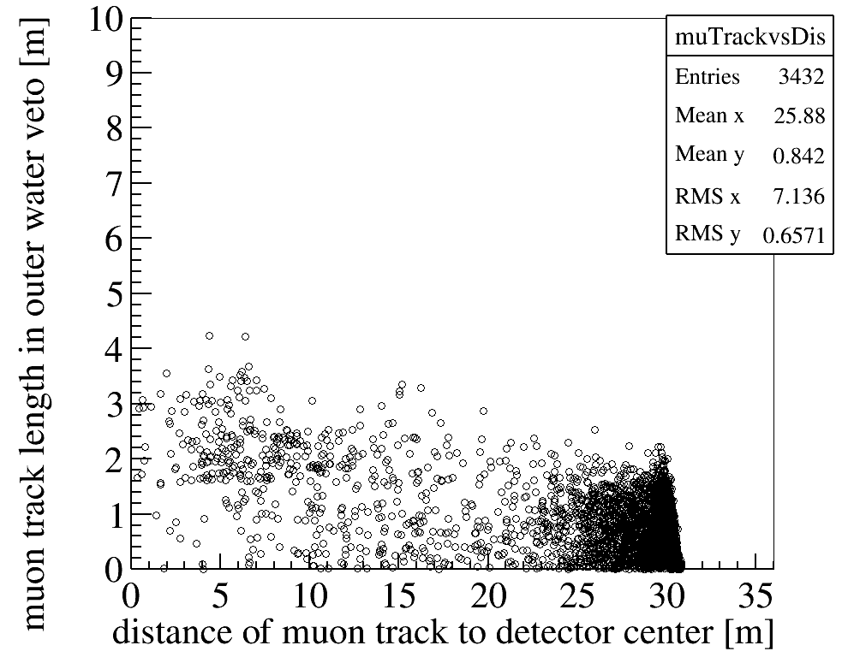
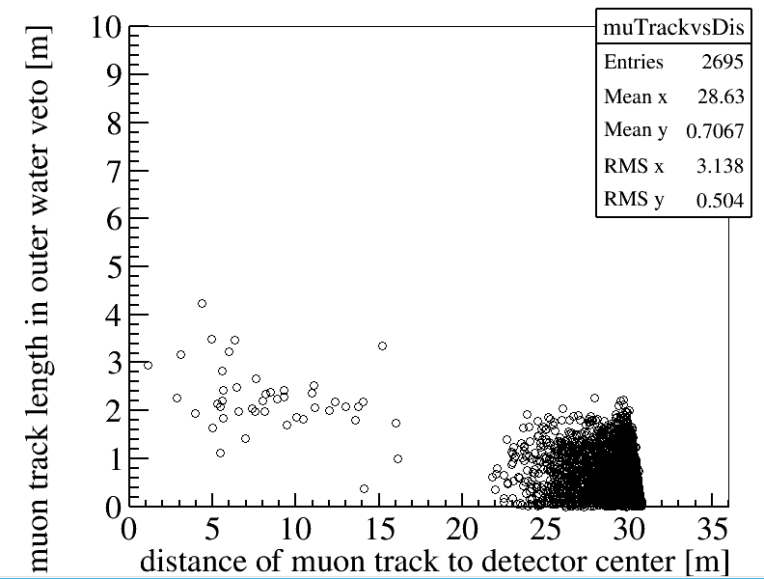
Remove 1.stop muon
2
3
2
3
1
 | 1.Stop mu | 2. Going through LS | 3.Corner clipping muons | Sum
Untagged Muon | 0.473% | 0.03% | 1.697% | 2.2%

Slide 8
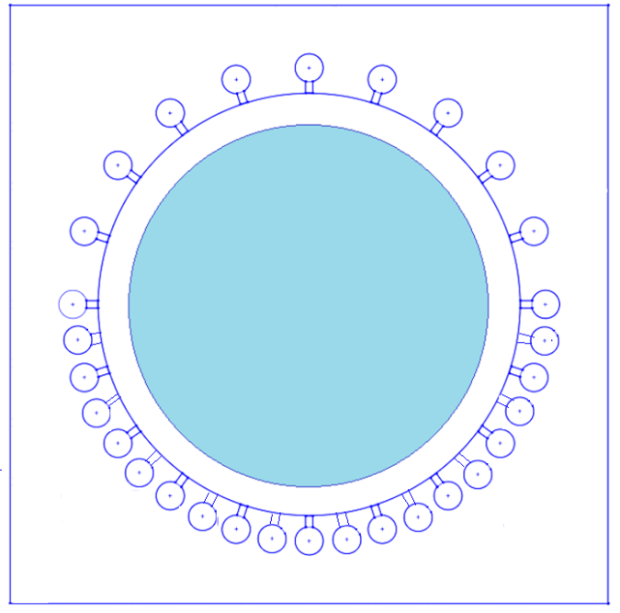
3.Corner clipping muons
 | Upper half sphere PMT | Lower half sphere PMT
Untagged Muon | 1.16% | 0.59%
The corner clipping muon is far from central detector.
Fast neutron contribution can be neglect.
Include the TT muon detection ability
 | Upper half sphere PMT | Lower half sphere PMT
Untagged Muon | 0.6% | 0.59%

Slide 9
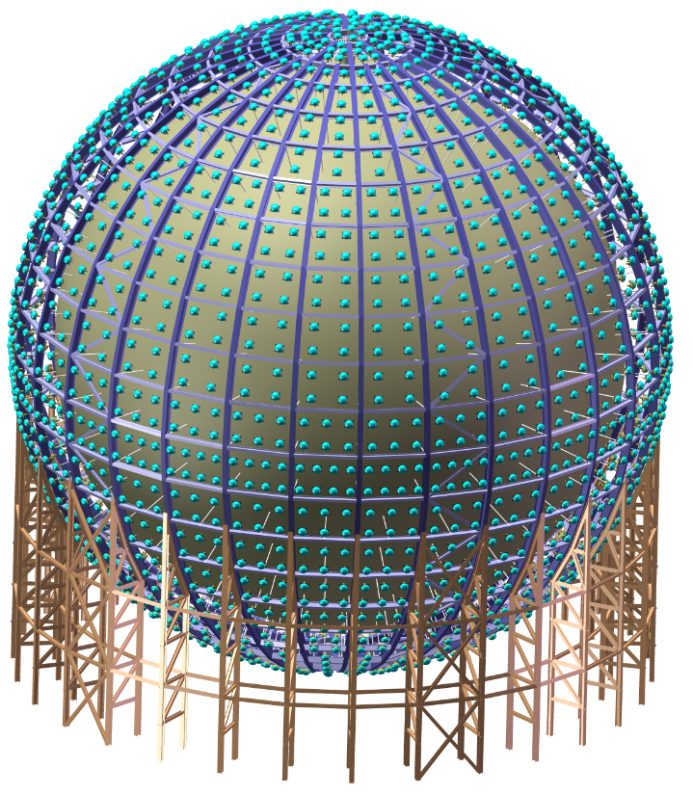
Veto PMT placement in real situation
PMTs are in the windows of the stainless steel frame;
Top half:1045 PMTs;
Bottom half:1355 PMTs.

Slide 10
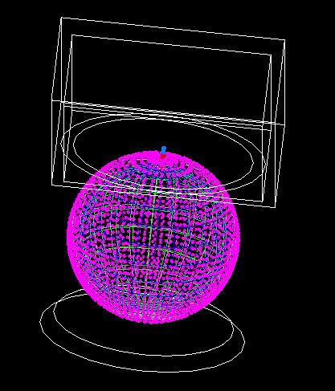
MC configuration
MC configuration
Based on JUNO software J17v1r1
Tyvek are coated on ball surface and water pool wall surface;
Water attenuation length ~max. 20m;
Tyvek reflectivity ~92%;
Total PMT~2400;

Slide 11
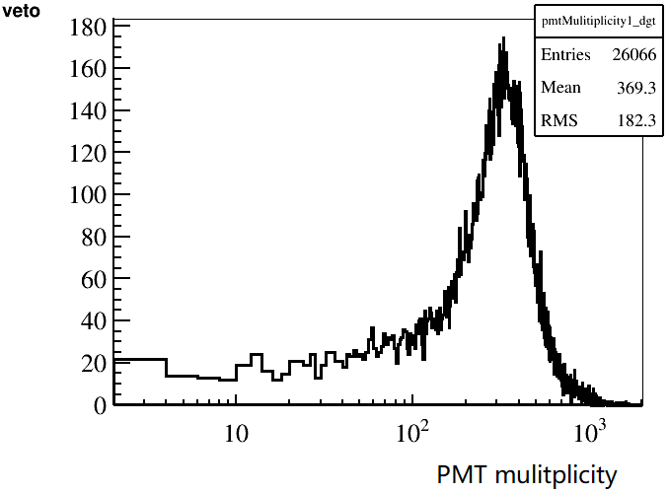
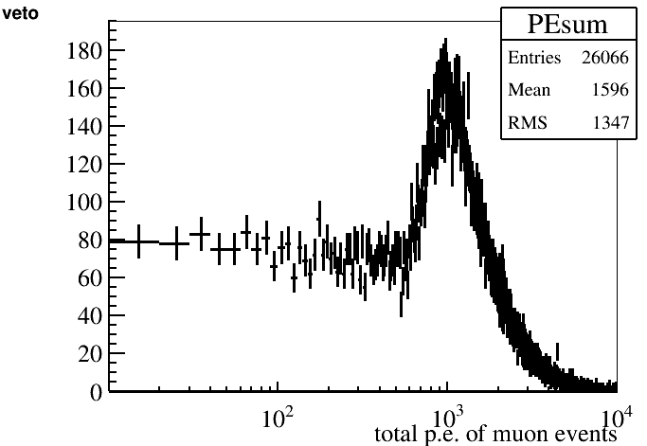
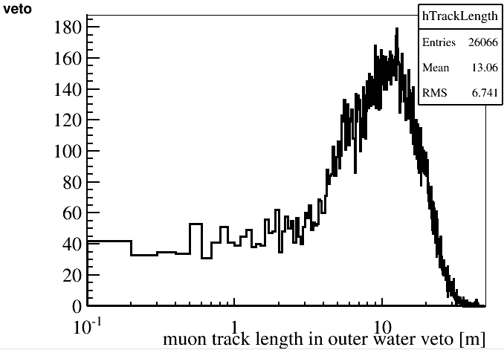
Basic distribution
Whole detector trigger | Cut nPMT=54
Efficiency | (98.04+/-0.09)%

Slide 12
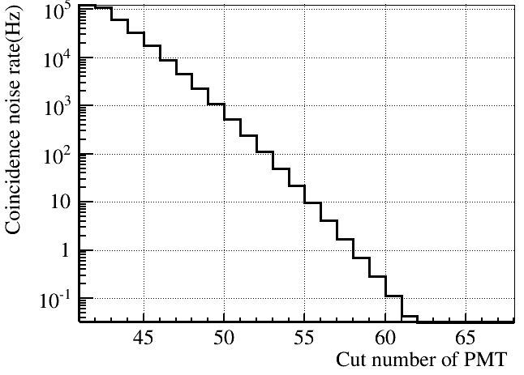
Trigger optimization
Tirgger from local region
If event is triggered by whole detector , npmt threshold >50。
The NPmt threshold should >45 for data taking. If the trigger rate is too high, the DAQ can’t record so high rate data.
When muon going through the Water Cherenkov detector，the inject point and exit point should have many PMTs locally fired. We can use this character to trigger in local region to reduce the Npmt threshold.

Slide 13
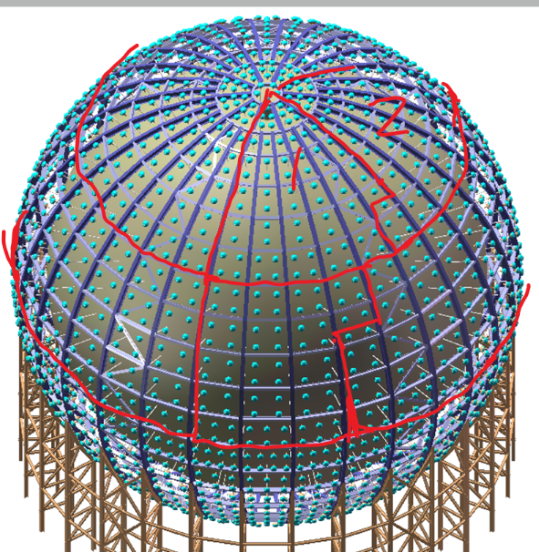
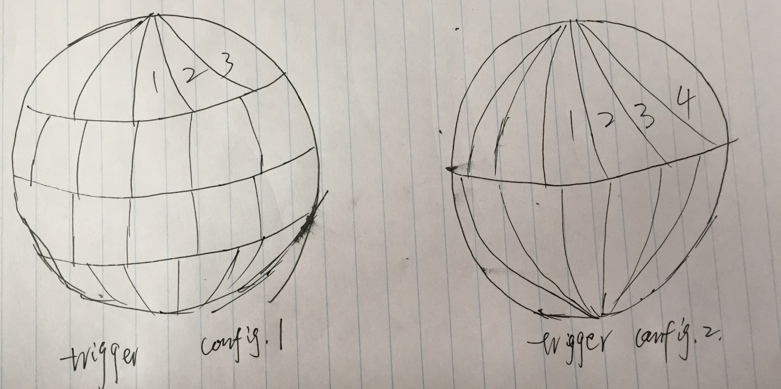
Trigger consideration(I)
The trigger requirement(discuss with GuangHua Gong) :
144(72 channels) channels per section;
Config.1: from top to bottom,72 PMTs/section. If one section have event above the threshold, it’ll give a trigger.
Config.2: 72 PMTs/section. If one section have event above the threshold, we’ll give a trigger.

Slide 14
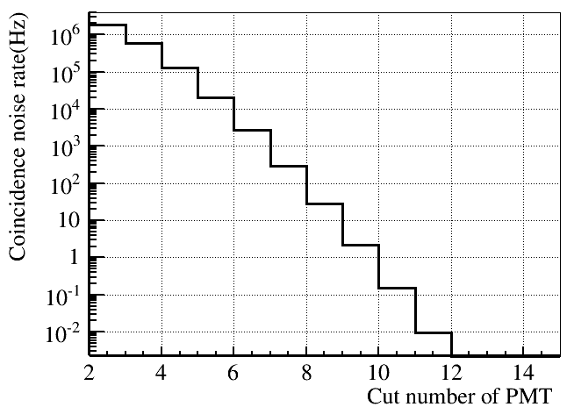
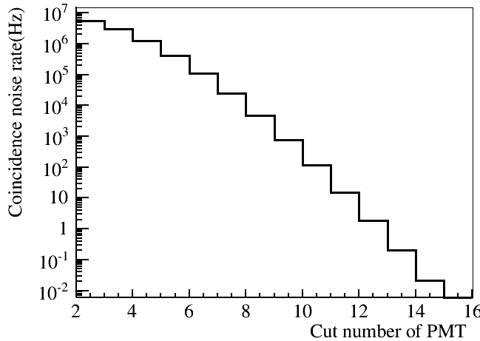
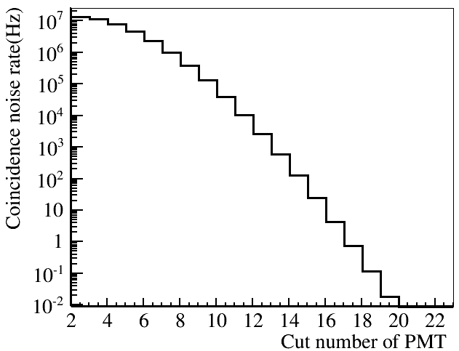
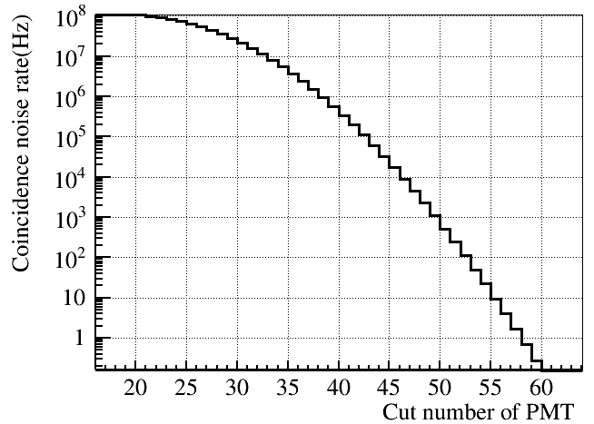
Different PMT number trigger threshold
Trigger windows200ns,
PMT dark noise level,50KHz
72PMT/section
144PMT/section
288PMT/section
2400PMT
PMTs/section | 72 | 144 | 288 | 432 | 576 | 864 | 2400
Section number | 34 | 17 | 9 | 6 | 5 | 3 | 1
Threshold | >9 | >12 | >16 | >20 | >23 | >29 | >54
Total coincidence rate(<10Hz) | 34*0.153 = 5 | 17*0.2=3.4 | 0.74*9 = 6.7 | 6*0.55=3.3 | 5*1.0=5 | 3*1.34=4 | 9.6

Slide 15
Different pmt number in one section
PMTs/section | 72 | 144 | 288 | 432 | 576 | 864 | 2400
Section number | 34 | 17 | 9 | 6 | 5 | 3 | 1
Threshold | >9 | >12 | >16 | >20 | >23 | >29 | >54
Total coincidence rate(<10Hz) | 34*0.153 = 5 | 17*0.2=3.4 | 0.74*9 = 6.7 | 6*0.55=3.3 | 5*1.0=5 | 3*1.34=4 | 9.6
Efficiency(Config.1) | (99.02±0.06)% | (99.02±0.06)% | (98.87±0.07)% | (98.73±0.07)% | (98.70±0.07)% | (98.61±0.07)% | (98.05+/-0.09)%
Efficiency(Config.2) | (98.98±0.06)% | (99.17±0.06)% | (99.22±0.06)% | (99.05±0.06)% | (99.01±0.06)% | (98.72±0.07)% | (98.05±0.09)%
Effective efficiency(Config.1) | (99.65±0.04)% | (99.65±0.04)% | (99.51±0.04)% | (99.38±0.05)% | (99.34±0.05)% | (99.26±0.05)% | (98.71±0.07)%
Effective efficiency(Config.2) | (99.60±0.04)% | (99.78±0.03)% | (99.80±0.03)% | (99.64±0.04)% | (99.63±0.04)% | (99.36±0.05)% | (98.70±0.07)%
Effective efficiency : remove the very short track length muon(<0.5m) to calculation the muon detect efficiency.
288 PMT/section will give the best results.

Slide 16
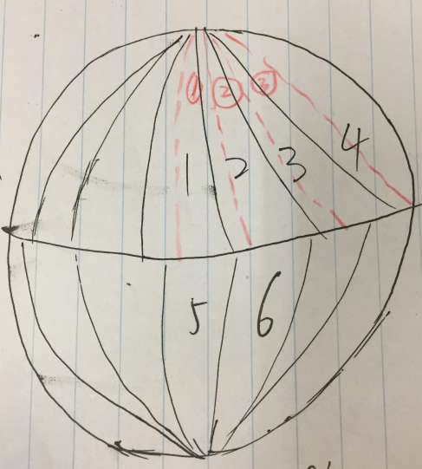
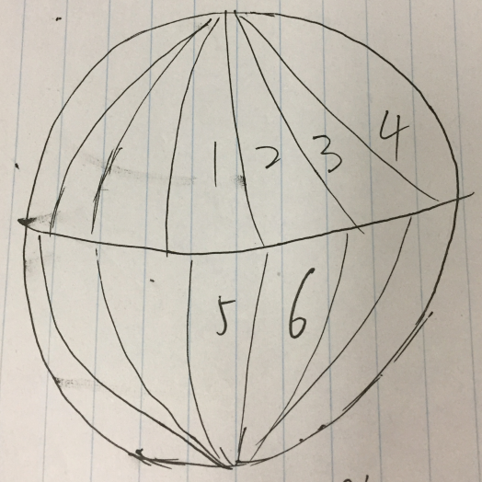
Trigger consideration(II)
For Config.2, 288PMT/section。
A：default division method；
B：start from the center of A(1),288PMT/section，A and B have half section overlap;
D：adjacent region OR to lower the threshold；
B
D
A
Read line
For example:1OR2, 1OR5, 2OR6, 5OR6

Slide 17
Efficiency
Use OR to combine different options to see the performance
PMTs/section | 288(A) | 288（B） | A OR B | Double region Coincidence(D) | A OR B OR D | Whole detector | A OR B OR D OR Whole Detector
Section number | 9 | 9
Threshold | >16 | >16 |  | >13 |  | >54
Total coincidence rate(<10Hz) | 0.74*9 = 6.7 | 6.7 |  | 0.1 |  | 9.6
Efficiency | (99.22±0.06)% | (99.16±0.06)% | (99.32±0.05)% | (99.36±0.05)% | (99.42+0.05)% | (98.04±0.09)% | (99.42+0.05)%
Effective efficiency | (99.80±0.03)% | (99.75±0.03)% | (99.89±0.03)% | (99.88±0.03)% | (99.93+0.02)% | (98.70±0.07)% | (99.93+0.02)%
We can get a very high efficiency after the combine.

Slide 18
Summary
We’ll move all veto PMTs to the stainless steel frame to get better EMF shielding.
We can use locally trigger to reduce the trigger threshold.
288 PMT per section get the best results.
Local triggered efficiency is higher than all PMT triggered(~1.4%).
The new PMT placement will be update to svn later.

Slide 19
Thanks!

