Slide 1
Calibration strategy and MH sensitivity
Feiyang Zhang
2018-05-10

Slide 2
Outline
Calibration strategy
Calibration status in sniper
Non-linearity correction
Non-uniformity correction
MH sensitivity
Prediction of IBD spectrum
Observation of IBD spectrum in sniper
$χ^{2}$ fit and MH sensitivity
Summary

Slide 3
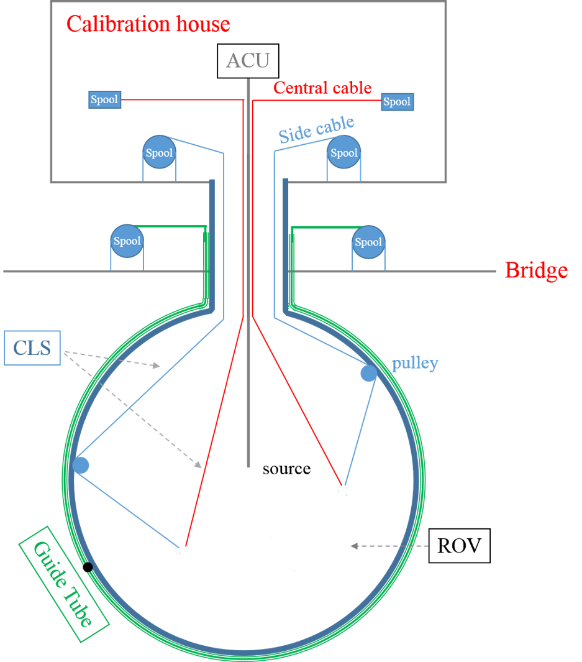
Calibration device in sniper
Calibration system:
1-D: Automatic Calibration Unit (ACU)
2-D: Cable Loop System (CLS)
3-D: Remotely Operated Vehicle (ROV)
Outer surface: Guide Tube (GT)
Geometry in sniper:
GT geometry is written into sniper as default option.
ROV, source enclosure, quick connector and weights are written into sniper as alternative option.
All these geometries can be enable or disable if necessary during simulation,
Quick connector
20cm
20cm
weights

Slide 4
Radioactive source generator in sniper
Calibration sources
$γ:$ ⁶⁸Ge, ¹³⁷Cs, ⁵⁴Mn, ⁶⁰Co, ⁴⁰K
e⁺: ⁶⁸Ge, ²²Na
n: ²⁴¹Am-Be, ²⁴¹Am-C or Pu-C
Usage
Use standard script “tut_detsim.py” by Lin Tao.
$ python tut_detsim.py --source_weight_QC \ # enable source enclosure and quick connector
--OffsetInX 1000 --OffsetInY 1000 --OffsetInZ 1000 \ # move source center at (1m,1m,1m)
gendecay --nuclear K40 --volume pSource # Use ⁴⁰K (you can also use ⁶⁸Ge, ¹³⁷Cs..)
or
hepevt --exe AmC --volume pSource # Use AmC (you can also AmBe or PuC)

Slide 5
Calibration strategy
Calibration status in sniper
Non-linearity correction
Non-uniformity correction
MH sensitivity
Prediction of IBD spectrum
Observation of IBD spectrum in sniper
$χ^{2}$ fit and MH sensitivity
Summary

Slide 6
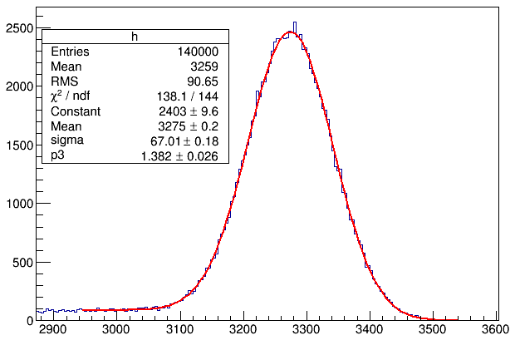
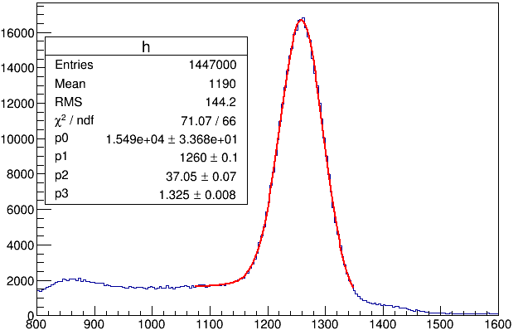
Energy scale
⁶⁰Co at CD center with source enclosure
⁶⁸Ge at CD center with source enclosure
Compton tail
Full absorption peak as measure.
⁶⁰Co as energy scale: $\frac{3275 PE}{2.5057 MeV}$=1307 PE/MeV
Reconstructed energy for ⁶⁸Ge: $E_{rec}=\frac{1260 PE}{1307 PE/MeV}$ =0.964 MeV
Non-linearity:
Reconstruct energy for ⁵⁴Mn, ¹³⁷Cs, ⁴⁰K, n-H, n-C, Am-C with same energy scale.

Slide 7
Gamma to e-/e+ converting
Gamma convert to e-/e+:
Pair production
Compton scattering
Photoelectric
Gamma energy non-linearity can be deduced from non-linearity of primary e-/e+
The electron from annihilation gamma should also be considered.
e⁻
e⁺
0.511 MeV
Pair production
0 MeV
$$γ$$
e⁻
$$γ$$
e⁺
annihilation
$$γ$$
0.511 MeV
e⁻
One example of annihilation with e+ in flight
3 MeV
e⁻
e⁺
Residual energy
1.5 MeV
$$γ$$
Pair production
2 MeV
$$γ$$
e⁻
7 MeV
e⁺
annihilation
$$γ$$
1.5 MeV
3 MeV
e⁻
residual energy should be subtract.

Slide 8
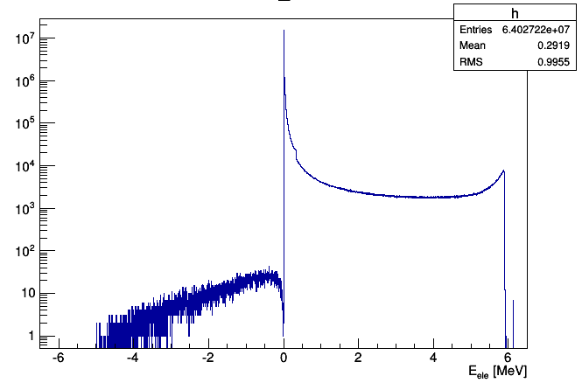
Model of gamma energy non-linearity
Empirical formula to describe electron non-linearity:
E_{kinetic} distribution of primary e-/e+
gamma energy: 6.13 MeV
Construct model of gamma energy non-linearity with PDF and electron non-linearity:
Residual energy
6.128±0.003 MeV
Energy bias to gamma = 0.03%
Ref:
Liangjian Wen, et al., Ref: Daya Bay DocDB 8240-v2
Fengpeng An, et al (Daya Bay Collaboration): PRL 112, 061801(2014)

Slide 9
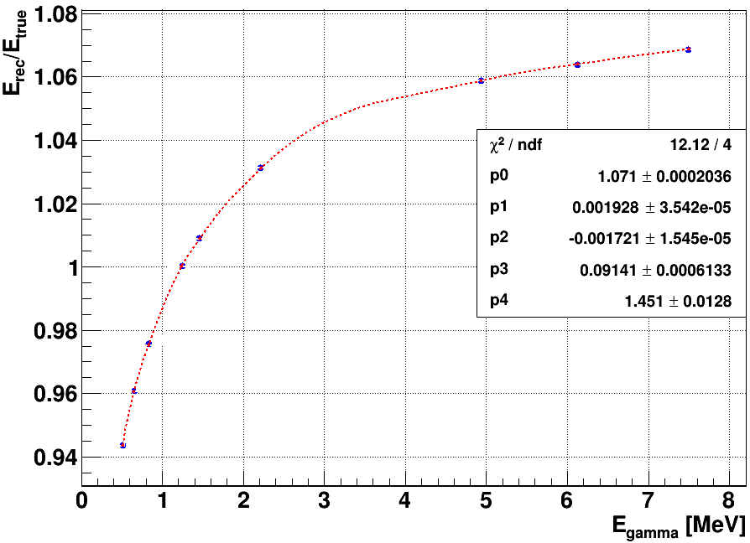
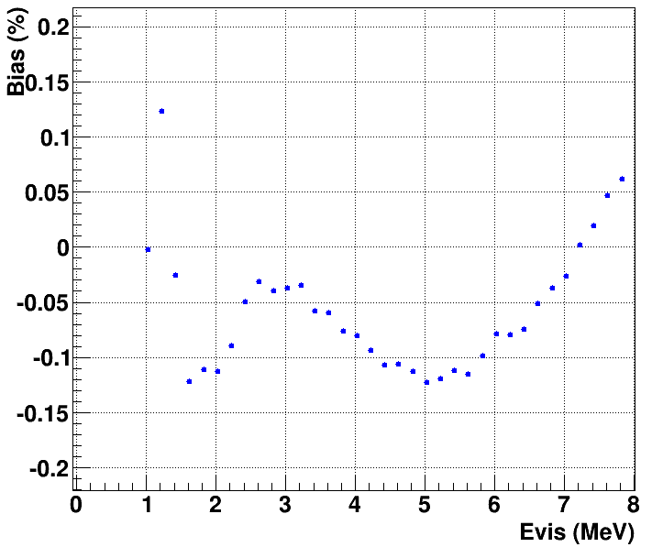
Bias of energy non-linearity correction
Bias of e+ after correction
n-C
²⁴¹Am-C
n-Fe
n-H
Bias < 0.15%
⁶⁰Co
⁴⁰K
⁵⁴Mn
¹³⁷Cs
⁶⁸Ge
Fit non-linearity of gamma to extract parameters.
Calculate bias between true and reconstructed energy of e+ from 1 to 8 MeV based on fit result.

Slide 10
Calibration strategy
Calibration status in sniper
Non-linearity correction
Non-uniformity correction
MH sensitivity
Prediction of IBD spectrum
Observation of IBD spectrum in sniper
$χ^{2}$ fit and MH sensitivity
Summary

Slide 11
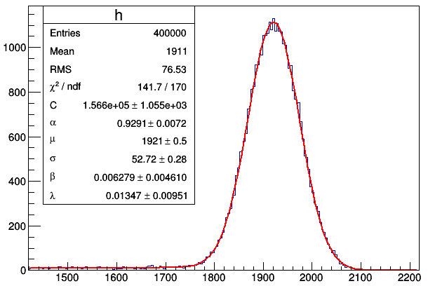
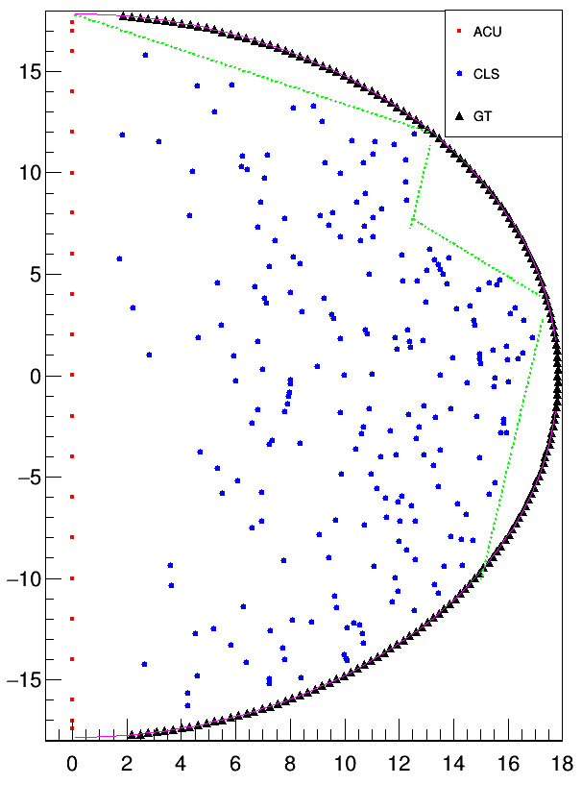
Calibration sources
⁴⁰K with source enclosure
Calibration points
Low Compton tail
The calibration mapping is constructed by
ACU(21), CLS(219), and GT(168)
⁴⁰K with source enclosure
~40000 events for one calibration point.
For GT calibration:
Source is outer of CD surface.
Used as points in inner CD.

Slide 12
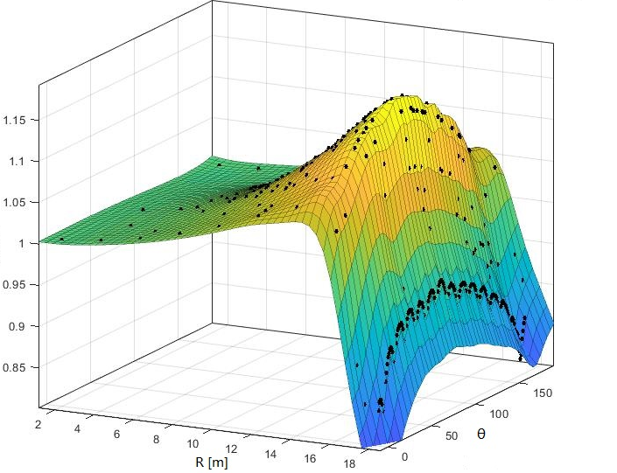
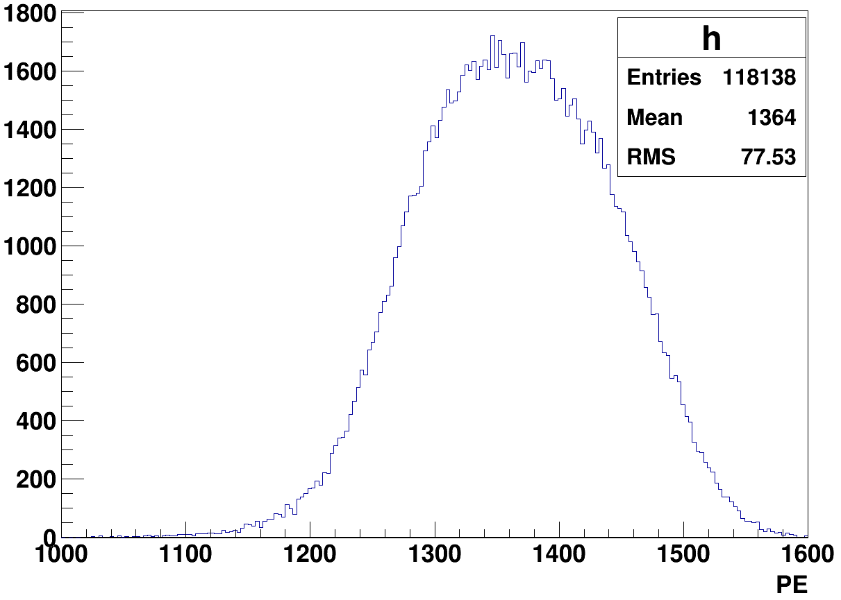
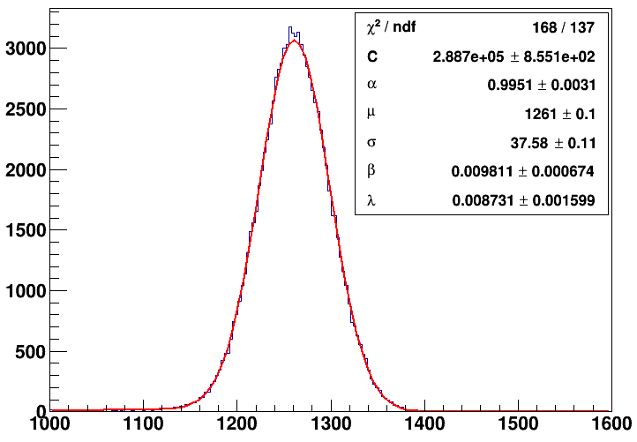
Correction mapping
ratio = $f(R,θ)$
Corrected
with $f(R,θ)$
Spline function to describe the correction mapping
The resolution is sigma/mean = 2.98%
Mean PE of 1 MeV e+ at CD center is 1262
Mean bias is 0.05 % with visible energy 1 MeV of e+.
Mean = 1261.4±0.1
Sigma = 37.58 ±0.11

Slide 13
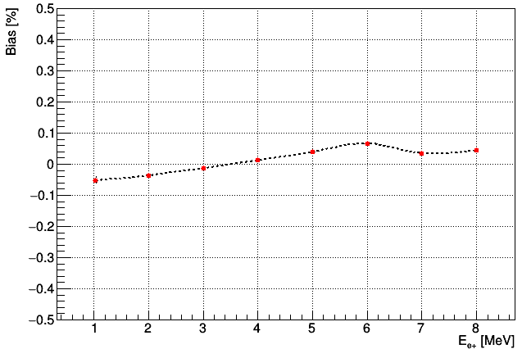
Bias and energy resolution
Mean bias after correction
Energy resolution after correction
Mono energy e+ (1-8 MeV) uniformly distribution in CD.
Corrected it with non-uniformity correction mapping.
Use true position of event in MC simulation.
The overall bias is less than 0.1% from 1 to 8 MeV for e+.
Energy resolution: $\sqrt{a^{2}+{(1.6b)}^{2}}=3.04\%$ $(requirement in Yellow book:<3\%)$

Slide 14
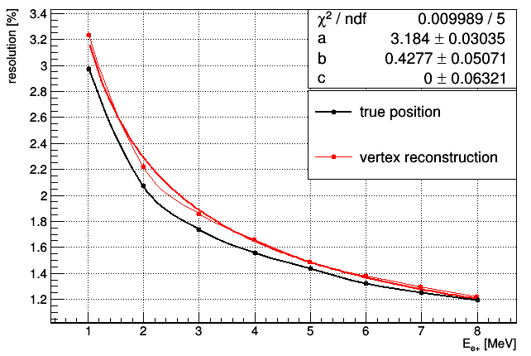
Combined with Vertex reconstruction
Energy resolution:
3.25% @ 1MeV
$\sqrt{a^{2}+{(1.6b)}^{2}}=3.26\%.$
We need better vertex reconstruction

Slide 15
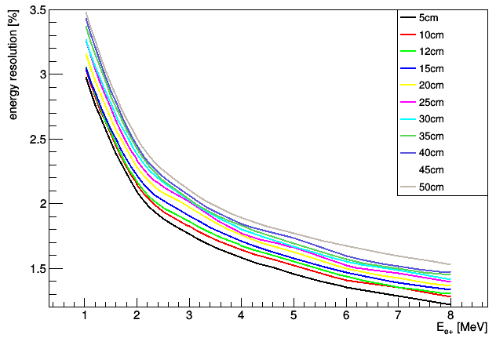
Assumption of vertex reconstruction
Energy resolution
Resolution (cm) | a (%) | b(%) | $$\sqrt{a^{2}+{（1.6b）}^{2}}$$
5 | 2.89 | 0.65 | 3.07
10 | 2.94 | 0.74 | 3.17
12 | 2.95 | 0.78 | 3.20
15 | 2.95 | 0.84 | 3.24
20 | 3.07 | 0.83 | 3.34
25 | 3.16 | 0.82 | 3.43
30 | 3.18 | 0.86 | 3.46
35 | 3.27 | 0.83 | 3.53
40 | 3.32 | 0.84 | 3.58
45 | 3.36 | 0.87 | 3.64
50 | 3.35 | 0.94 | 3.67
Assume resolution of vertex reconstruction: 5,10,12,15,20,25,30,35,40,45,50 cm
Non-uniformity correction with the assumption, and calculate corresponding resolution.
Fit with $\sqrt{a^{2}/E+b^{2}}$to get parameter a and b.
Energy resolution is sensitive to vertex reconstruction.

Slide 16
Calibration strategy
Calibration status in sniper
Non-linearity correction
Non-uniformity correction
MH sensitivity
Prediction of IBD spectrum
Observation of IBD spectrum in sniper
$χ^{2}$ fit and MH sensitivity
Summary

Slide 17
Procedure of study
Response matrix
Energy resolution model
Energy smearing
Prediction
Neutrino energy
Deposit energy
Visible energy
Detected energy
Apply non-linearity
Calibration
$χ^{2}$ fit
MH
Non-uniformity correction to center
Energy scale
Observation
IBD simulation in sniper
totalPE
PE at center
Detected energy

Slide 18
Calibration strategy
Calibration status in sniper
Non-linearity correction
Non-uniformity correction
MH sensitivity
Prediction of IBD spectrum
Observation of IBD spectrum in sniper
$χ^{2}$ fit and MH sensitivity
Summary

Slide 19
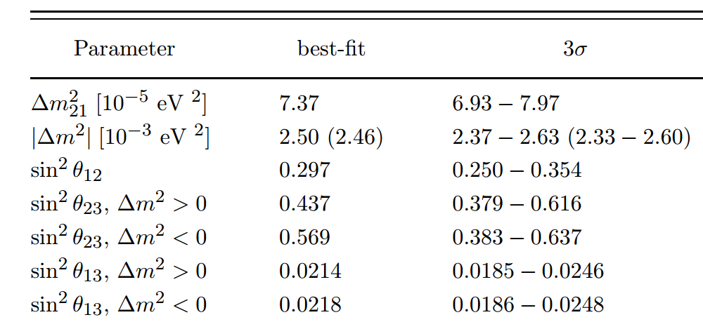
Probability of neutrino
Oscillation probability
Cross section

Slide 20
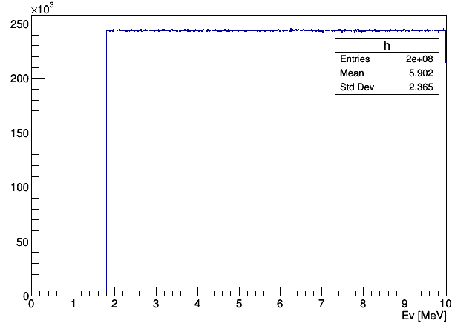
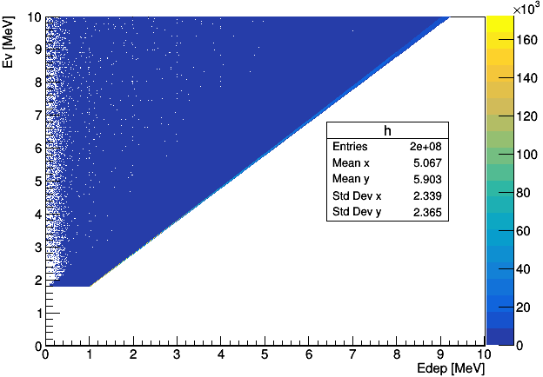
Neutrino energy to deposit Energy
Neutrino energy spectrum
Response matrix between Ev and Edep
Energy leakage
Neutrino events uniformly distribute in CD.
Get the corresponding deposit energy for every event.
Construct response matrix between neutrino energy and deposit energy.
Bins of matrix are 4000×4000.

Slide 21
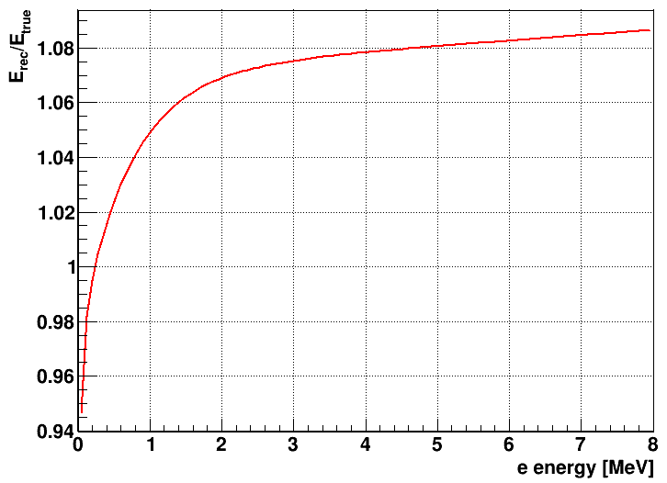
Deposit energy to visible energy
Energy non-linearity obtained from calibration.
Non-linearity exists between deposit energy and Visible energy.

Slide 22
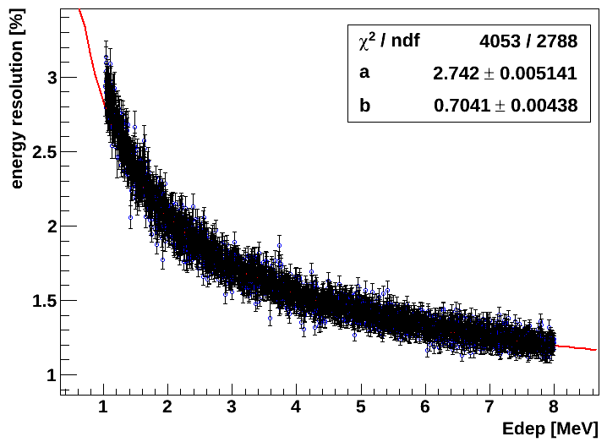
Visible energy to detected energy
Construction of energy resolution model:
e+ uniformly distribute in CD, with continuous energy from 1 to 8 MeV.
Non-uniformity correction.
Energy resolution as function of deposit energy.
Fit it with to get “a” and “b”
“a” and “b” will be used to construct energy resolution model.
This method can only be used simulation.
Should try to obtain model of energy resolution from calibration in real experiment.

Slide 23
Calibration strategy
Calibration status in sniper
Non-linearity correction
Non-uniformity correction
MH sensitivity
Prediction of IBD spectrum
Observation of IBD spectrum in sniper
$χ^{2}$ fit and MH sensitivity
Summary

Slide 24
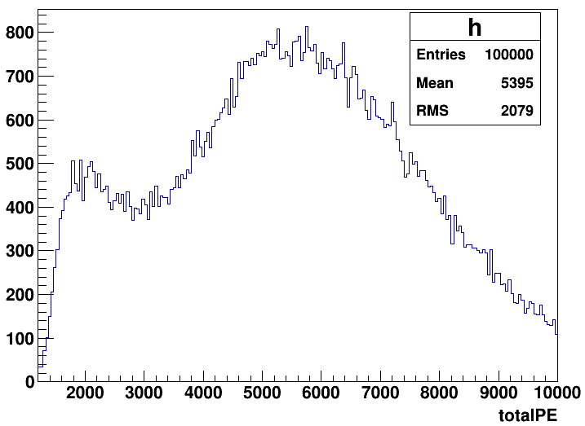
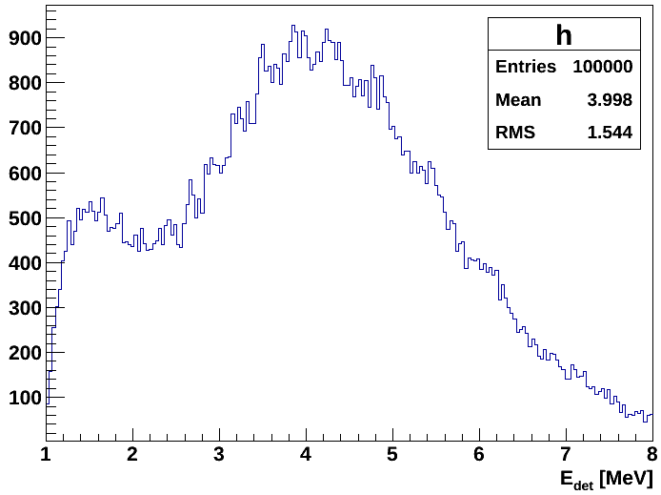
Observation of IBD spectrum
Correction mapping
Before correction
PE / energy scale
Simulation: IBD events uniformly distribute in CD.
100,000 events (~6 years data )for one experiment.
Correct them with correction mapping
Energy scale: 1307 PE/MeV (⁶⁰Co)

Slide 25
Calibration strategy
Calibration status in sniper
Non-linearity correction
Non-uniformity correction
MH sensitivity
Prediction of IBD spectrum
Observation of IBD spectrum in sniper
$χ^{2}$ fit and MH sensitivity
Summary

Slide 26
Definition of $χ^{2}$ and $∆χ^{2}$
$χ^{2}$ is constructed to qualify the consistent of data and prediction:
Fit the IBD detected energy spectrum with normal hierarchy(NH) or inverted hierarchy(IH) predicted.
MH discriminator is defined as:
$$∆χ^{2}=χ^{2}\left(NH\right)−χ^{2}\left(IH\right)$$

Slide 27
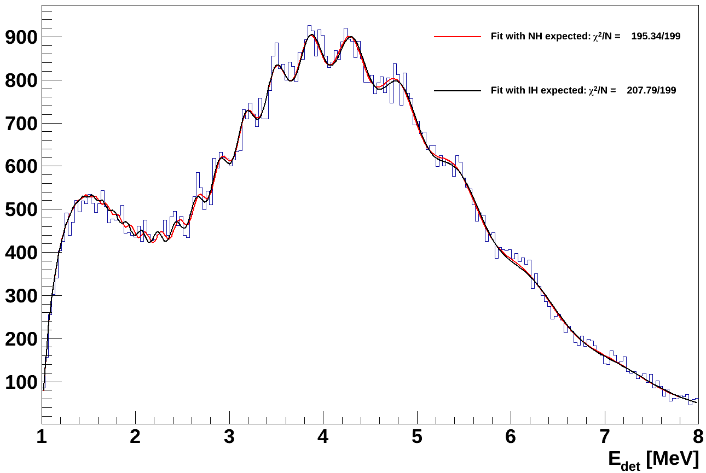
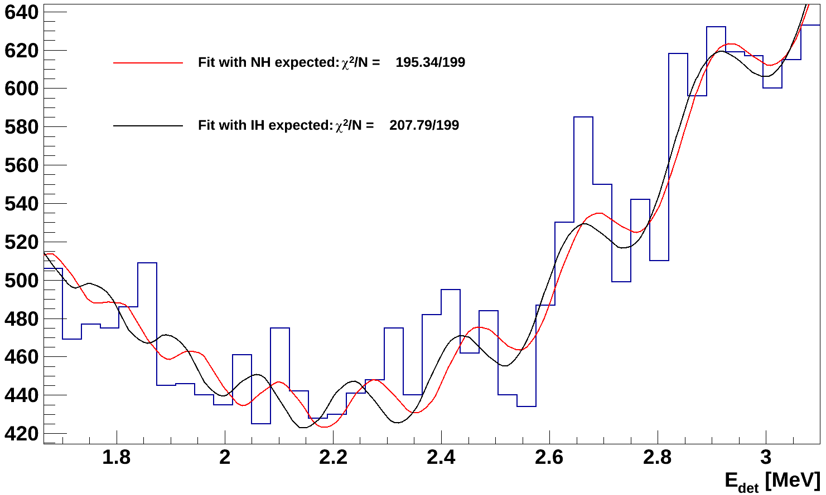
Fit the IBD detected energy spectrum
NH is true
Fit the IBD spectrum with prediction.
Number of bins is 200. So NDF = 200 -1 = 199.
$χ^{2}$ for NH expected: 195 and $χ^{2}$ for IH expected: 208.
$Δχ^{2}$ is 13.
There is only one experiment (100,000 events for ~6 years data)
Simulate multiple times of experiment, and get the distribution of $χ^{2}$ and $∆χ^{2}$.

Slide 28
$χ^{2}$ and $∆χ^{2}$ distribution
Simulate times of experiment: 170.
$χ^{2}$ is 199.4 with right MH predicted , which seems good since the NDF is 199.
And $∆χ^{2}$=14.63
MH sensitivity is $\sqrt{Δχ^{2}}σ$=3.82$σ$ refer to standard sensitivity definition in Yellow book.

Slide 29
Summary
With Daya bay‘s model of energy non-linearity, it’s promising to make the bias less than 0.2%.
Combining ACU, CLS and GT, we can construct a correction mapping of non-uniformity. But this correction rely on vertex reconstruction, and we need better vertex reconstruction.
Considering non-linearity and non-uniformity correction, the MH sensitivity can reach to 3~4 σ.
But We need energy resolution model from calibration for prediction of IBD energy spectrum. That’s what we will consider for next step.

Slide 30
Thank you！

