Slide 1

Earth magnetic field shielding(EMF) system status
Haoqi Lu
JUNO software workshop
2018-05-08

Slide 2
Outline
Introduction
One set of coils system vs two set of coils system
Coils performance
EMF measurement on JUNO site
Hardware progress
Summary

Slide 3
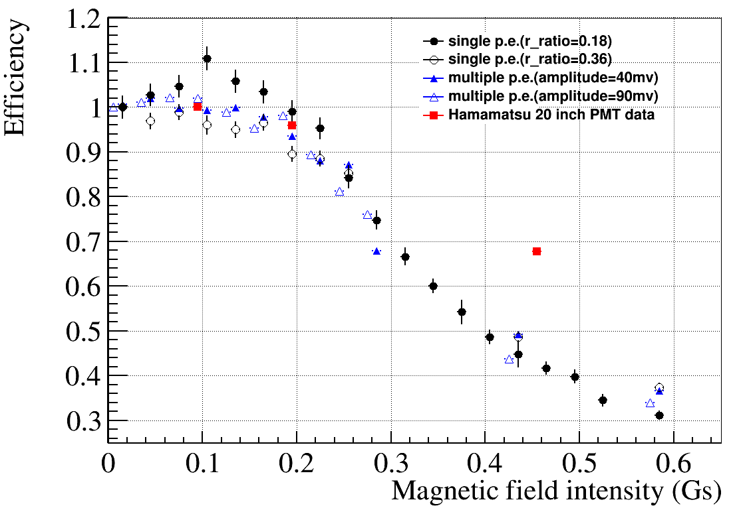
1. Introduction
PMT detect efficiency was effected by earth magnetic field. More large dimension, there will be more obvious effect on efficiency loss.
For JUNO, most of the PMTs we used is 20-inch PMTs . We need a magnetic shielding system for 20-inch PMTs.
20 inch MCP-PMT:The detect efficiency will lose 50%-60% at 0.45Gs(earth magnetic field intensity);

Slide 4
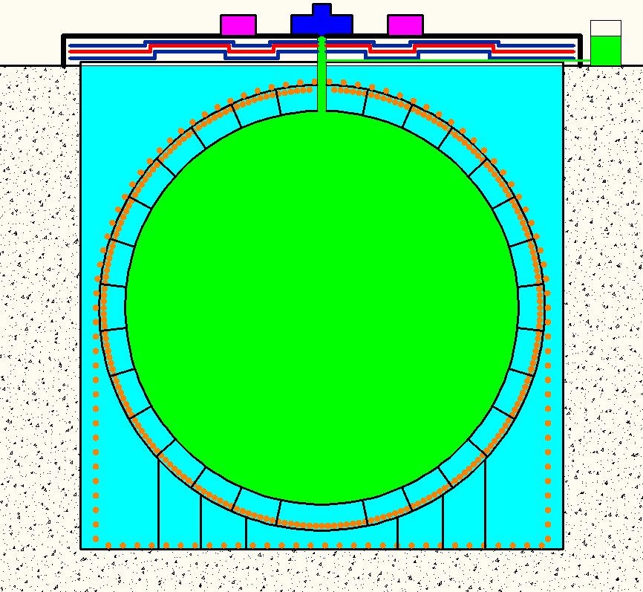
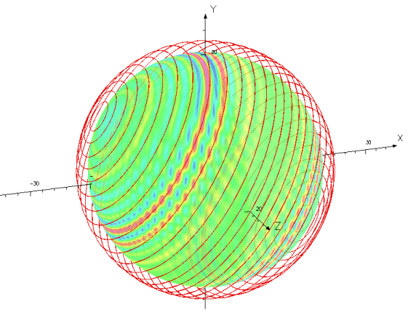
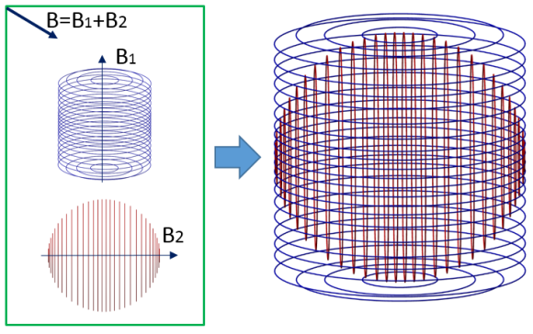
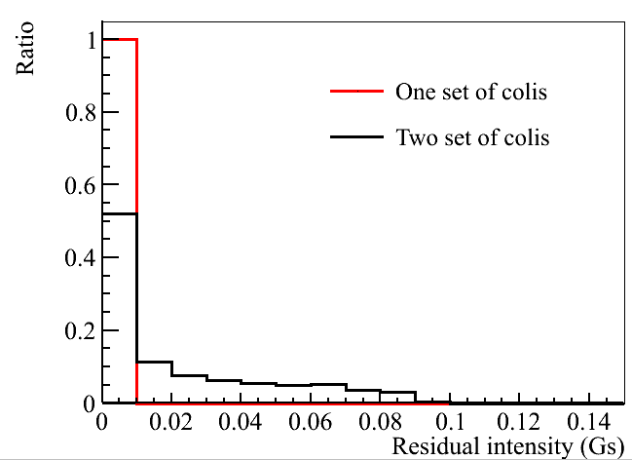
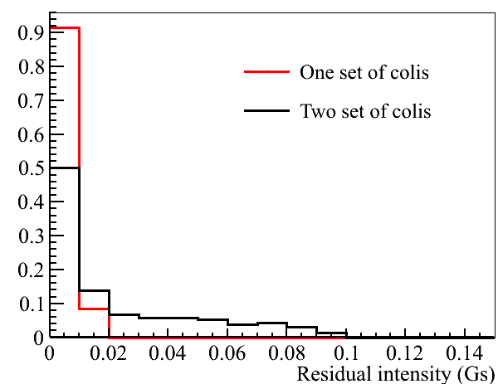
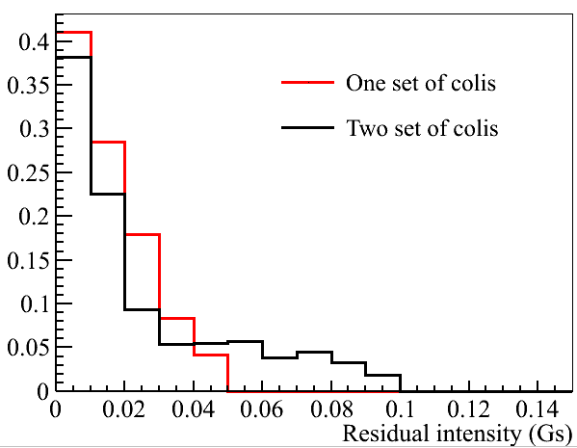
  Earth magnetic field shielding coils
Consideration of compensation coils：
      At early time, we use one sets of coils. It’s too hard to installation for that time(The coils are not allowed support by stainless steel(SS) frame). We change one sets of coils to two sets of coils.
      Now, our suggestion is to return back to one sets of coils.
    One sets of coils vs. two sets of coils：
      Installation：there are no big difference between one sets or two sets coils(we can have support structure on SS frame)
      Coils and installation work quantity reduce ~50%;save cost；
      One sets of coils performance are better than two sets’s as right figure shown.
      The coils direction should be accurate in installation.
Resident intensity on different diameter surface）
39m-40m diameter
39m diameter surface
40m diameter surface
41m diameter surface is the veto PMT region
41m diameter surface

Slide 5
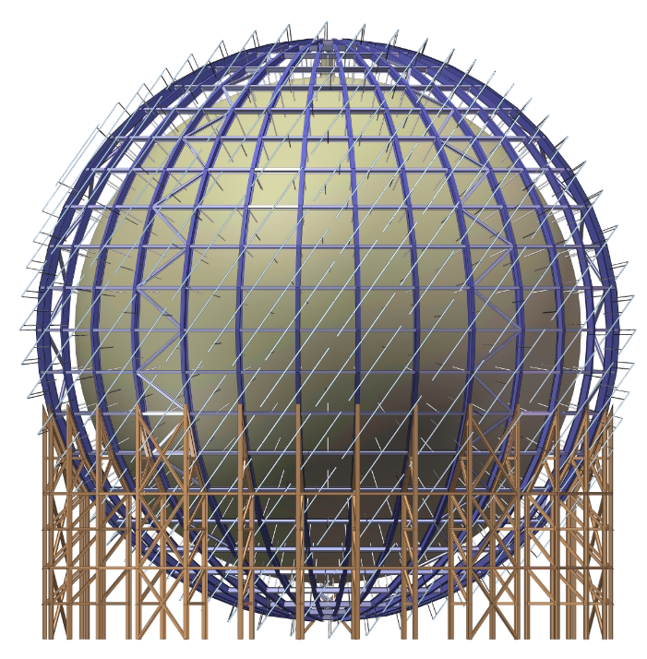
  One set of coils system

Slide 6
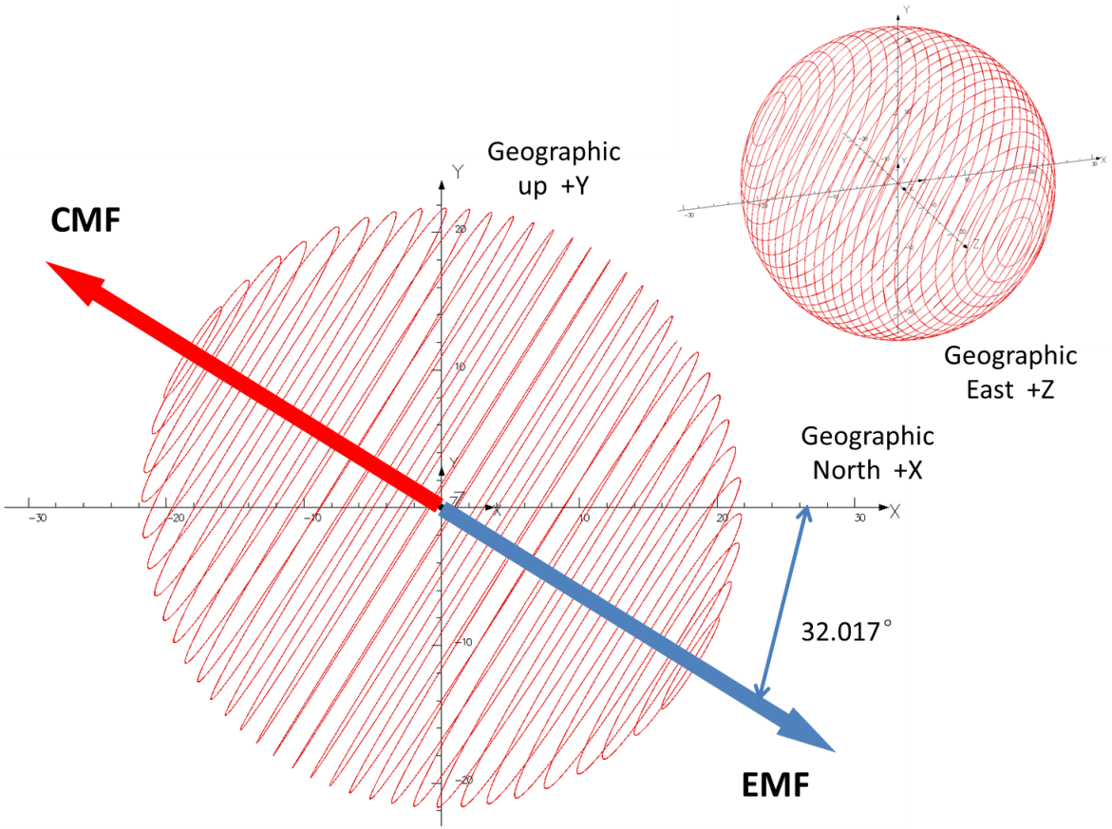
EMF intensity at JUNO
One set coils shielding scheme
X component = 0.37988 G (Geo. N)
Y component = -0.23772 G (Down)
Z component = 0.01505 G (Geo. W)
Declination = -2.269°
Inclination = 32.017°
Horizontal Intensity = 0.38018 G
Total Intensity = 0.44839 G
One set of coils:
Generate the opposite direction of the geomagnetic field to compensate the total earth magnetic field

Slide 7
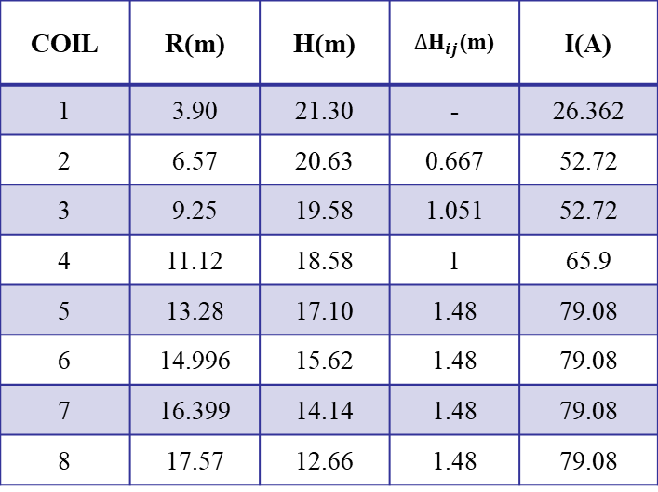
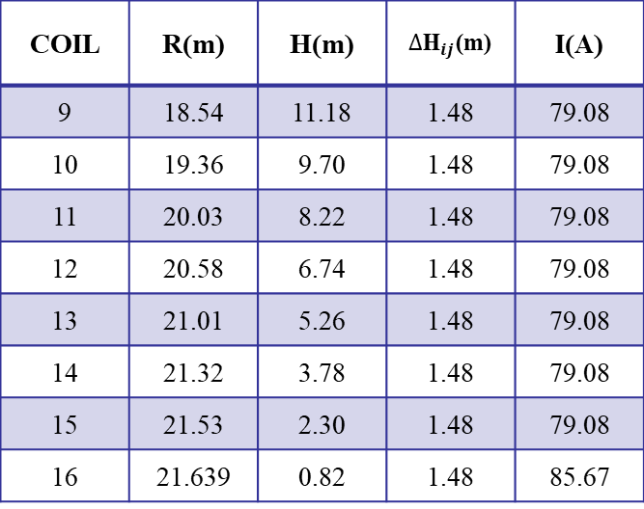
16 pairs shielding coils scheme
  Give lower residual B-field for Veto PMT
  More uniform current distribution for each pair of coils
  Most of the space between coils are equal
Locations and currents of Coils for calculating magnetic fields
COIL | R(m) | H(m) | ${∆\text{H}}_{ij}$(m) | I(A)
1 | 3.90 | 21.30 | - | 26.362
2 | 6.57 | 20.63 | 0.667 | 52.72
3 | 9.25 | 19.58 | 1.051 | 52.72
4 | 11.12 | 18.58 | 1 | 65.9
5 | 13.28 | 17.10 | 1.48 | 79.08
6 | 14.996 | 15.62 | 1.48 | 79.08
7 | 16.399 | 14.14 | 1.48 | 79.08
8 | 17.57 | 12.66 | 1.48 | 79.08
COIL | R(m) | H(m) | ${∆\text{H}}_{ij}$(m) | I(A)
9 | 18.54 | 11.18 | 1.48 | 79.08
10 | 19.36 | 9.70 | 1.48 | 79.08
11 | 20.03 | 8.22 | 1.48 | 79.08
12 | 20.58 | 6.74 | 1.48 | 79.08
13 | 21.01 | 5.26 | 1.48 | 79.08
14 | 21.32 | 3.78 | 1.48 | 79.08
15 | 21.53 | 2.30 | 1.48 | 79.08
16 | 21.639 | 0.82 | 1.48 | 85.67
${∆\text{H}}_{ij}=H_{i}−H_{j}$; j = $i$+ 1, and i and j stand for the ith and jth coils.
JUNO-doc DB-3221-v1

Slide 8
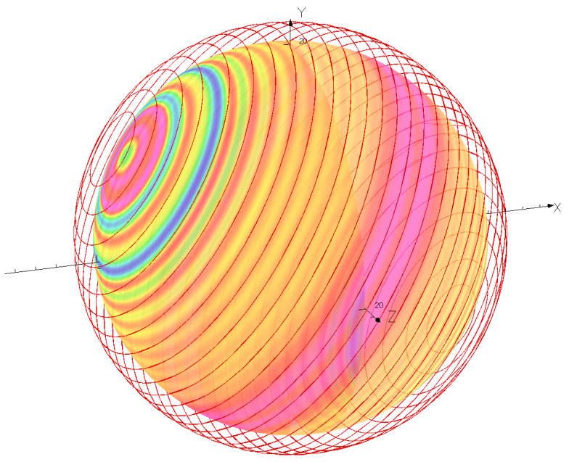
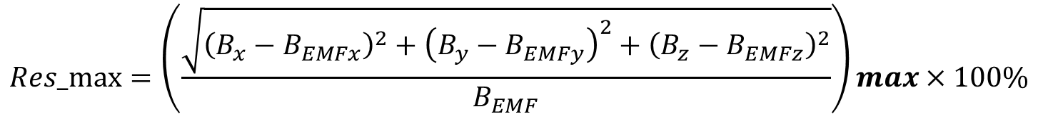
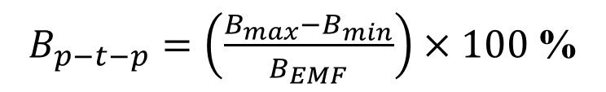
Error analysis
Perfect coils
Peak to peak field deviation
$B_{p−t−p}=\left(\frac{B_{max}−B_{min}}{B_{EMF}}\right)×100$ %
Max of Residual field to EMF deviation
$$Res_max=\left(\frac{\sqrt{{\left(B_{x}−B_{EMFx}\right)}^{2}+{\left(B_{y}−B_{EMFy}\right)}^{2}+{\left(B_{z}−B_{EMFz}\right)}^{2}}}{B_{EMF}}\right)max×100\%$$
Item | CD |  |  |  | Veto
Dia.(m) | 39 | 39.5 | 40 | 41 | 41.5 | 41.8
P-T-P(%) | 2.23 | 3.06 | 4.57 | 11.7 | 20.77 | 29.72
Res_max(%) | 1.54 | 2.09 | 2.97 | 6.84 | 10.85 | 15.29

Slide 9
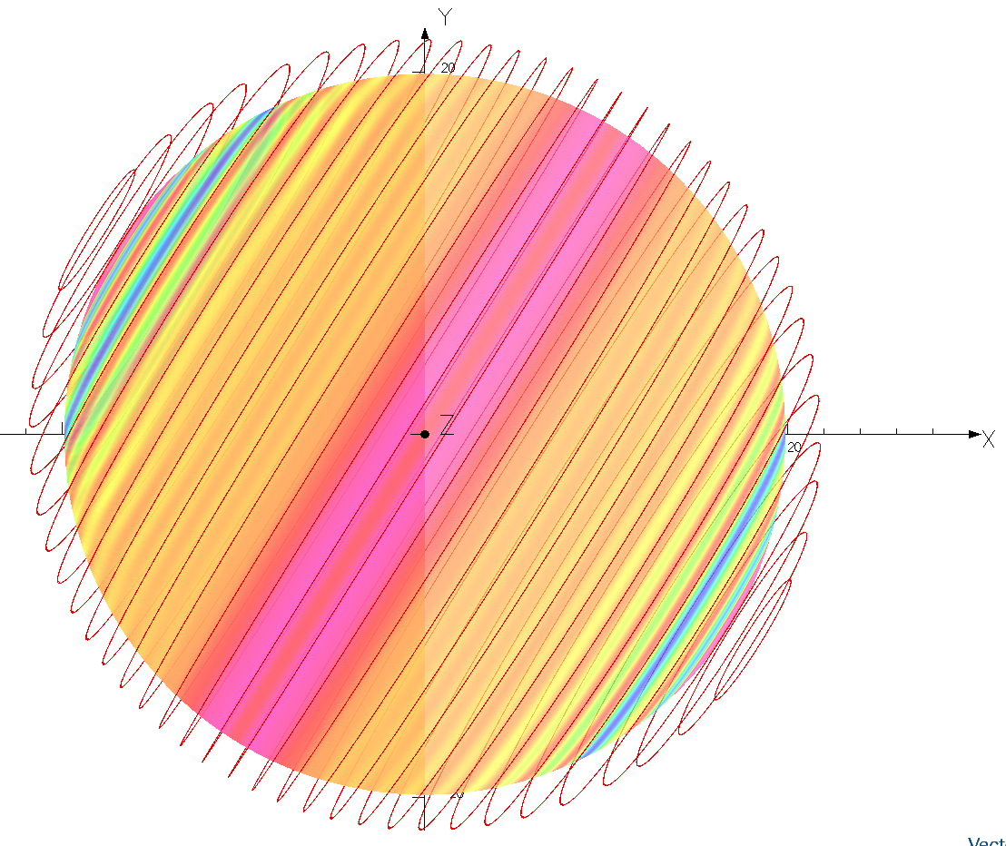
Installation error
4
Angle of Installation error ±1°,6.8cm~37cm/°
2
3
1
Assumed that:
1. The coil angle deviation makes coil surface is not perpendicular to the direction of the earth magnetic axis.
2. Some coils position move 10cm.
15
16

Slide 10
Result for the error analysis
Result for different diameter spherical surface
Item | CD |  |  |  | Veto
Dia.(m) | 39 | 39.5 | 40 | 41 | 41.5 | 41.8
Perfect coils P-T-P(%) | 2.23 | 3.06 | 4.57 | 11.7 | 20.77 | 29.72
R_10cm move up P-T-P(%) | 3.93 | 4.84 | 6.22 | 13.41 | 22.57 | 31.53
Incline 1 degreeP-T-P(%) | 8.19 | 9.79 | 11.98 | 19.44 | 26.99 | 35.94
Perfect coils Res_max(%) | 1.54 | 2.09 | 2.97 | 6.84 | 10.85 | 15.29
CD PMT region
Veto PMT region

Slide 11
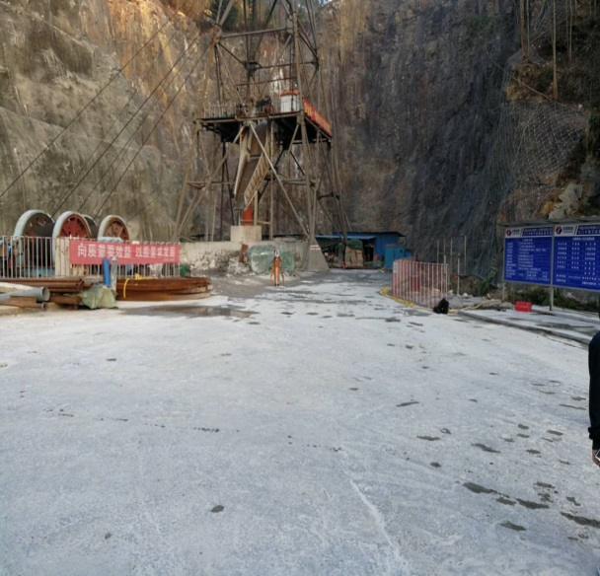
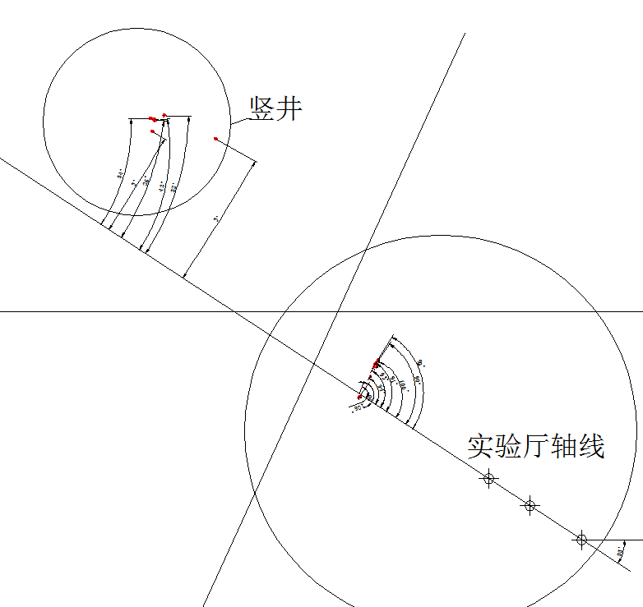
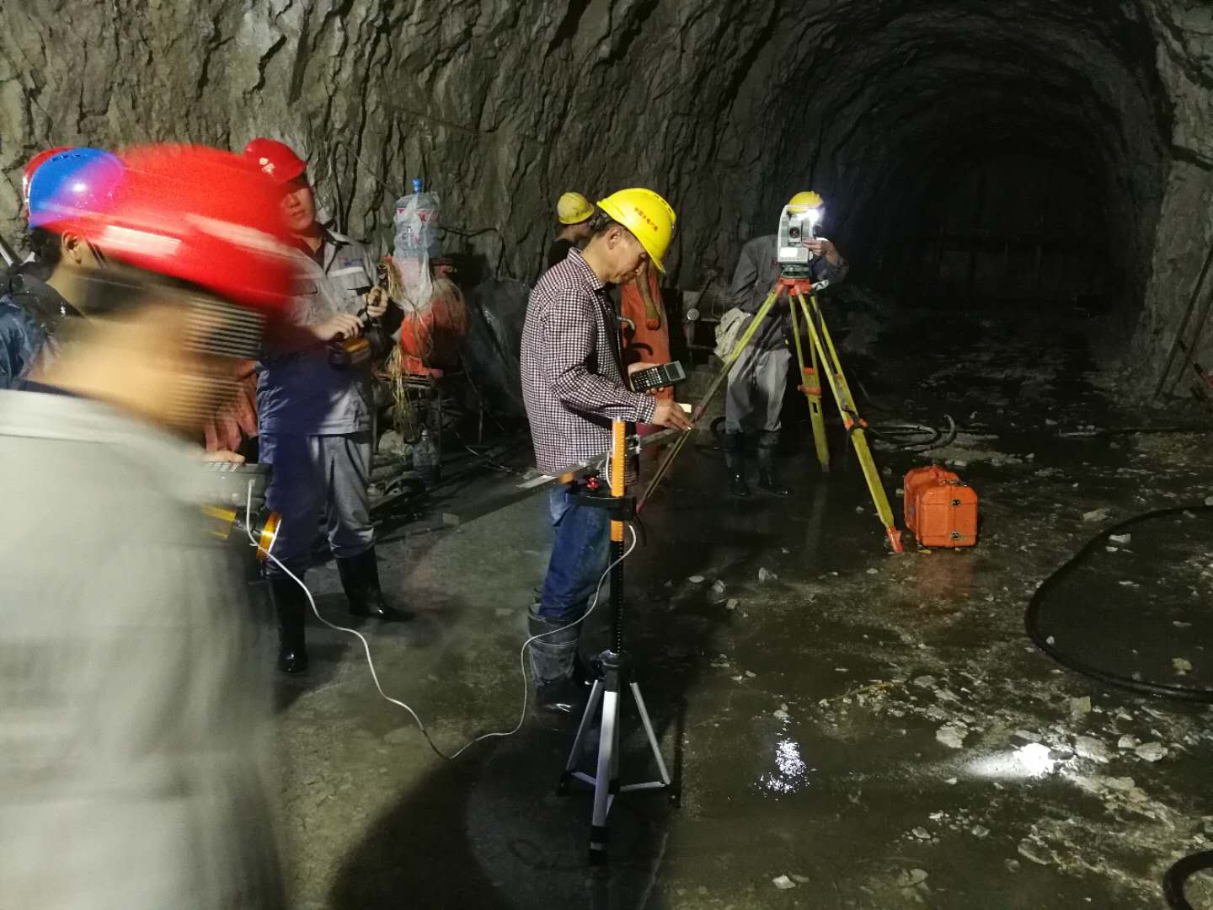
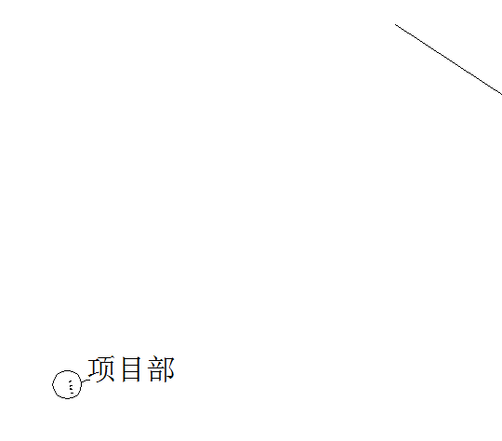
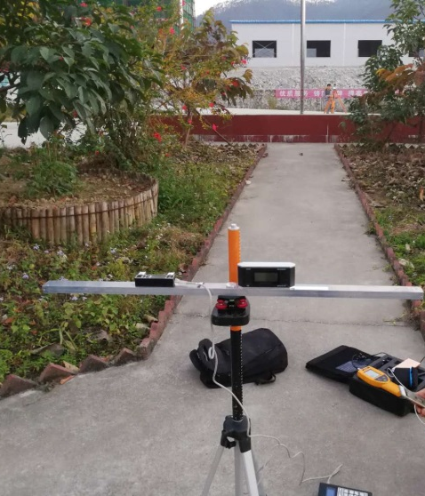
EMF measurement at JUNO site
Ground(drilled shaft)
North
Underground(nearest place to the experiment hall~70m)
Ground(project department)

Slide 12

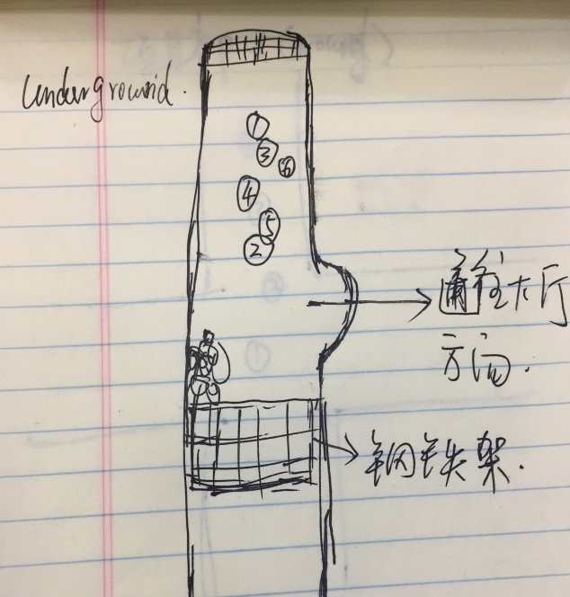
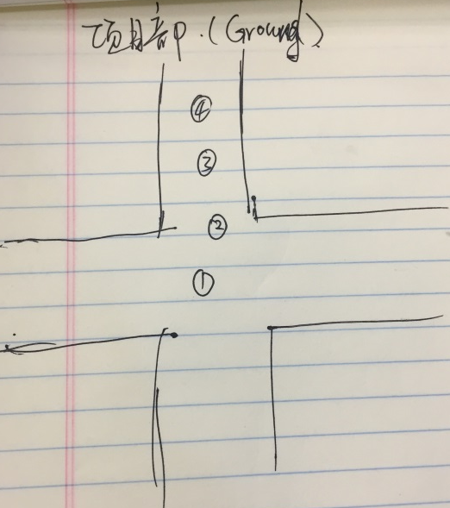
Measurement
1
4
3
5
2
6
4
3
2
1

Slide 13
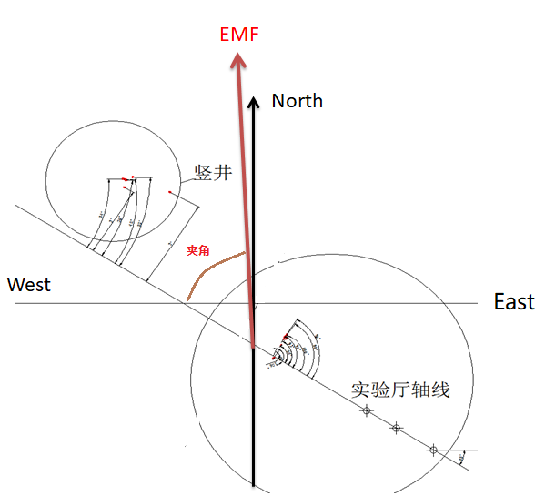
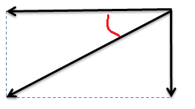
EMF direction
Horizontal
Inclination(deg)
Vertical
East
 | Angle between EMF and exp. Hall axis | Inclination(deg)（朝下角度） (+Down|+Up)
Underground | 54.75±0.56 | 33.03±0.32
Ground | 53.79±0.52 | 33.40±0.38
Average value | 54.27 | 33.22
Change/year(deg) | -0.0584 | 0.147
Consider the change and compensate | 54.0 | 34.0

Slide 14
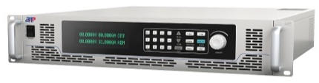

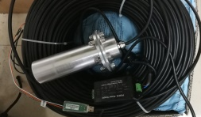
The hardware progress
Control Scheme:
  One center symmetrical pair of coils is powered by one DC power supply
  The power supply is controlled by computer remotely
……
……
……
process computer
DC power
magnetic field monitoring sensor
Shielding coils
The diagram of shielding system control

Slide 15
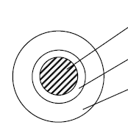
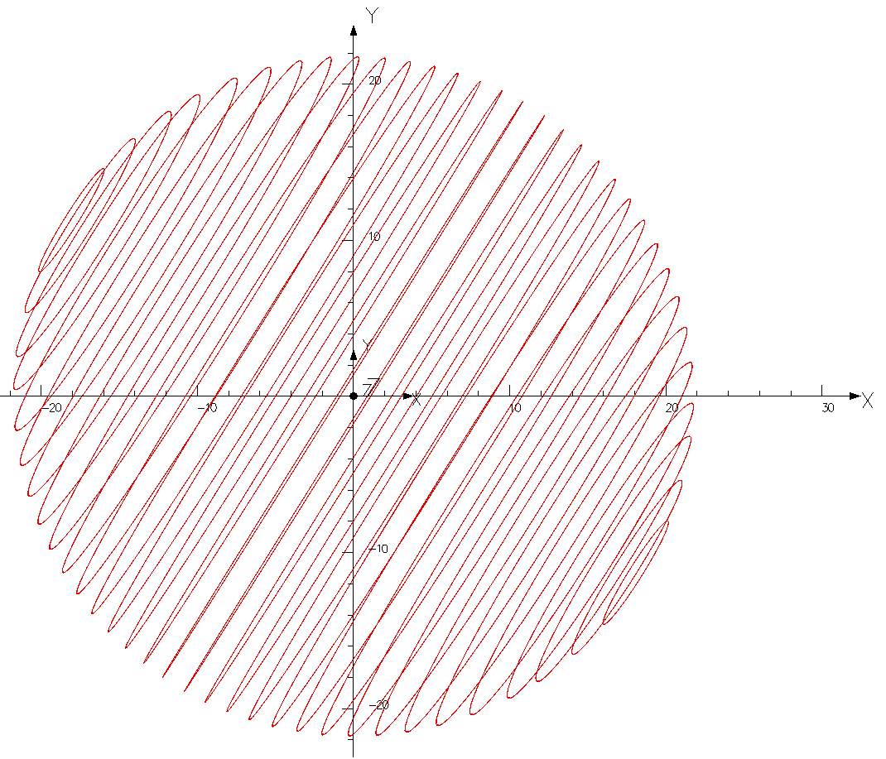
The cable design for coils
  To control the wire cost, we have determined that each coil will be winded by one type of cable, the joint between coils will be fixed above the water pool
  The copper cross section of cable is determined to be 25mm²
  Coil 1~3 will need two cables: One use, the other is spare
  Coil 4~16 need three cables to be wound: Two parallel, one spare.
  The underwater heating power of shielding coils is about 11.5KW
1 2 3 4 5 …… 15 16
…
Copper core
Intermediate layer
Insulator
HDPE
Schematic diagram of cable section
Photo of cable sample
Multifilament with single core

Slide 16
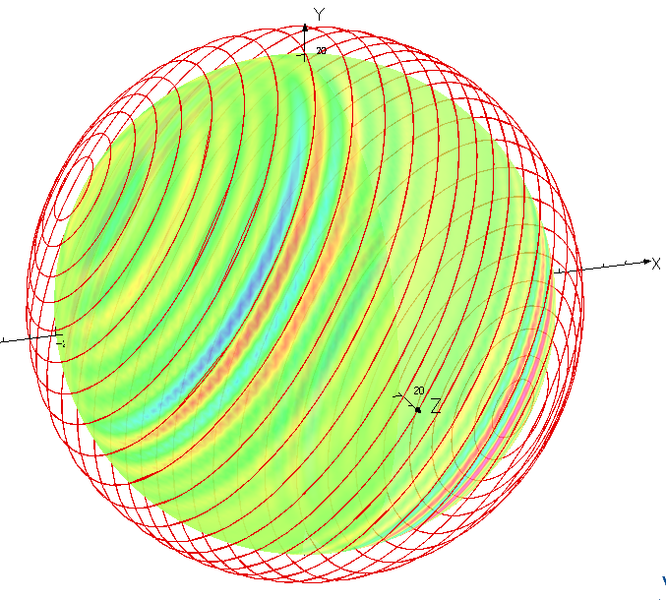
Monitoring sensor placement
The magnetic field monitoring in experimental hall
UP
  The monitoring sensor possible position:
8 monitoring sensors will be needed, for real-time monitoring of magnetic field changes.
Two custom sensors have been purchased and arrived in time.
Geo. north
32.02°
Geo. east
Sensor’s possible position

Slide 17
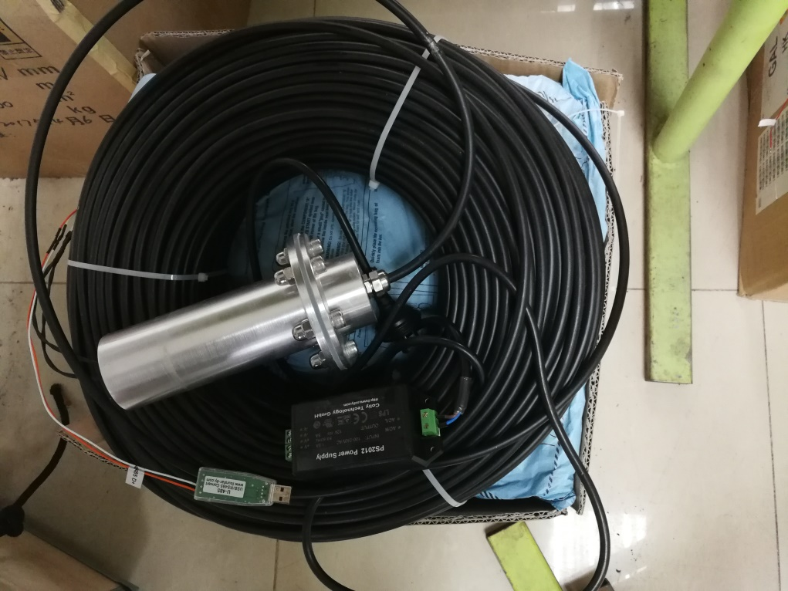
Sensor
The parameter of custom measuring geomagnetic field sensor
  Measurement range: 5G (0.5mT)
  Measuring accuracy: 0.5%
  Power supply: 24V DC
  Cable length: 200m
  Diving package: ≥ 50m
  Mean time to failure (MTTF): ≥10 years
Standard sensor
Custom sensor
24VDC power
USB-485
Smart PC software for data monitoring

Slide 18
Summary
We’ll use coils system to shielding EMF intensity to ensure the 20inch PMT performance.
Chose one sets of cols system
  16 pair coils used.
  It can reach our requirement after consider the installation error.
We’ve measured the EMF at JUNO site and determine the detector and coils orientation.
We’ve already determined the cable type and test the sensor.
I’m not quite sure we need to put the EMF intensity to the detector simulation or not.
Comments and suggestions are welcome!

Slide 19
Thanks！

