Slide 1
Binning research of Hough map in 3D reconstruction and tracking eficiency
黄震
2018.03.08

Slide 2
Outline
Binning research of Hough map in 3D reconstruction
Efficiency

Slide 3
Binning research of Hough map in 3D reconstruction (Pt=150MeV)
In 3D reconstruction, we can calculate helix parameters $tanλ$ and $dz$ from the peak of the Hough map.
Then we collect stereo wire hits whose residual is smaller than the given cuts.
These given cuts should come from the residual distribution which is affected by the binning of Hough map.
So, we need to research the binning of the Hough map first.

Slide 4
Residual of Z
Residual of Cgem is symmetry
Residual of Mdc is asymmetry
So we put the residual of Cgem together to fit. Same as residual of Mdc.

Slide 5
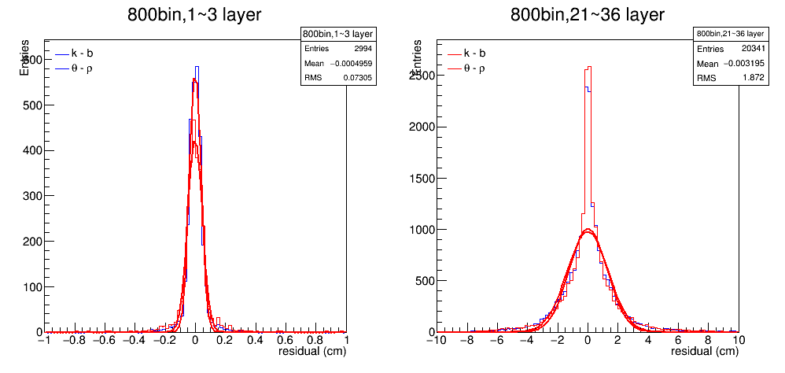
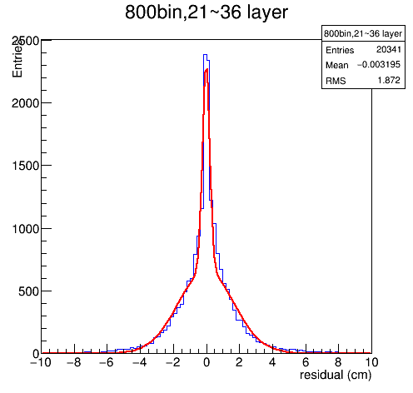
Fit the residual of Cgem and Mdc
Fit
Residual of Cgem can be fit with a Gaussian function, while Mdc is not that good.
So we fit Mdc residual with double Gaussian function of same $μ$
We calculate $σ_{mean}$of the double Gaussian function as:
where c is the constant of the Gaussian function

Slide 6
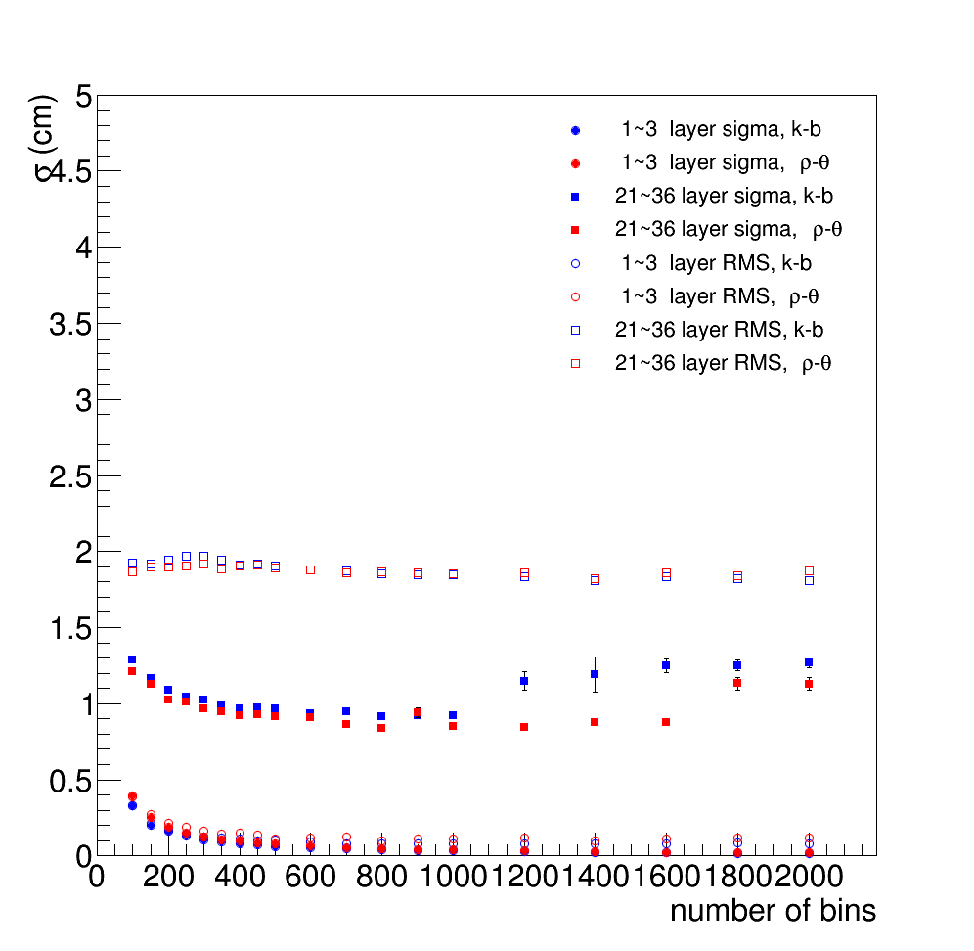
$σ$ & bin
$σ$of double Gaussian function
For Mdc, binning at 800 comes the minimum of$σ$

Slide 7
Fit the residual of each layer to get the cuts
For Cgem, we fit with Gaussian function
For Mdc, we fit with a broken Gaussian function of different $σ$ on each side and use the larger $σ$.
For now, we take 5$σ$ as the cuts.

Slide 8
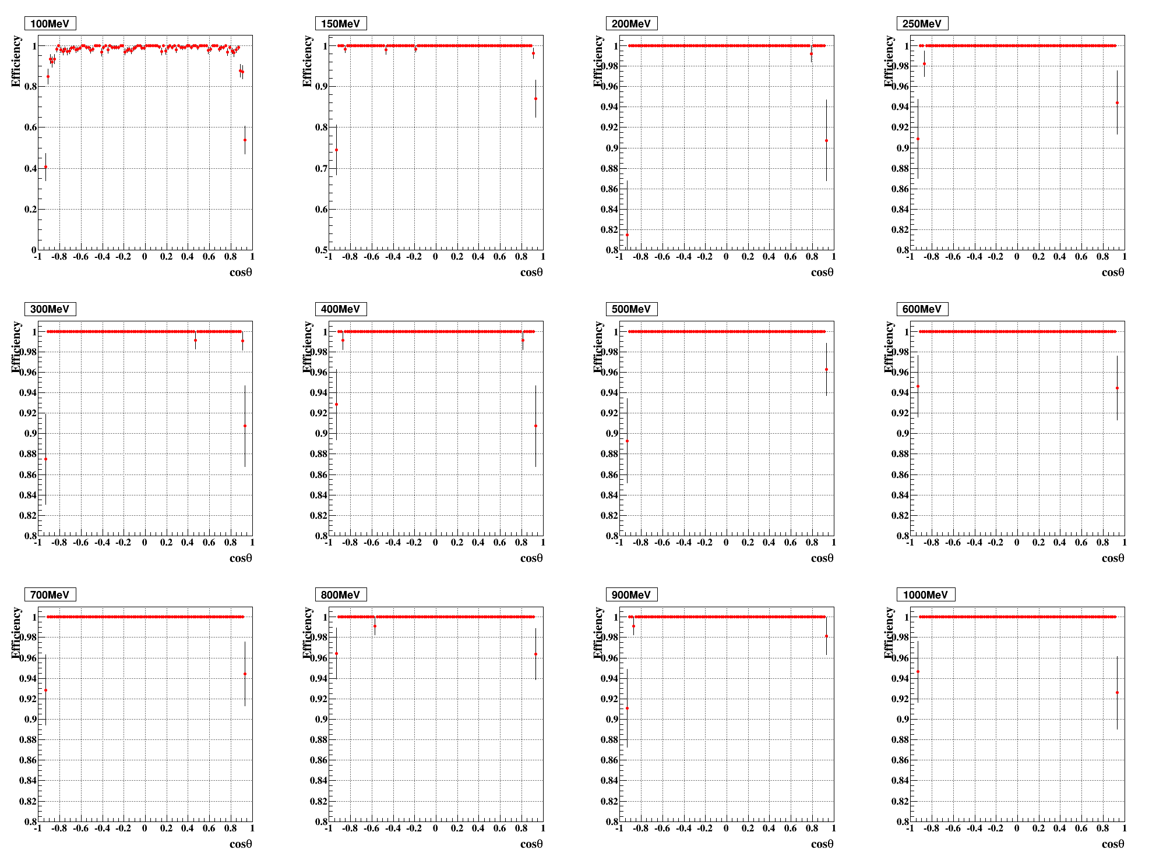
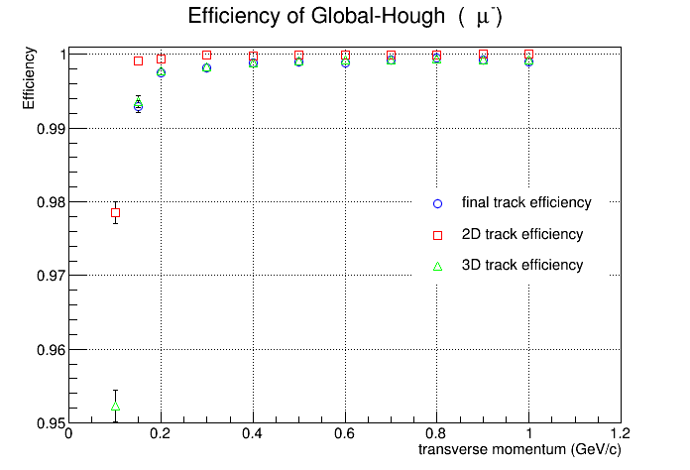
Tracking Efficiency
Cut: |dr|<1 cm, |dz|<10 cm

Slide 9
Hit efficiency

Slide 10
Set different points in each bin of Hough map in 3D reconstruction
1 point
10 points

Slide 11
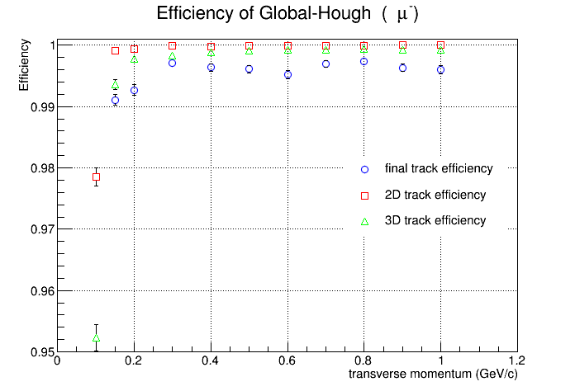
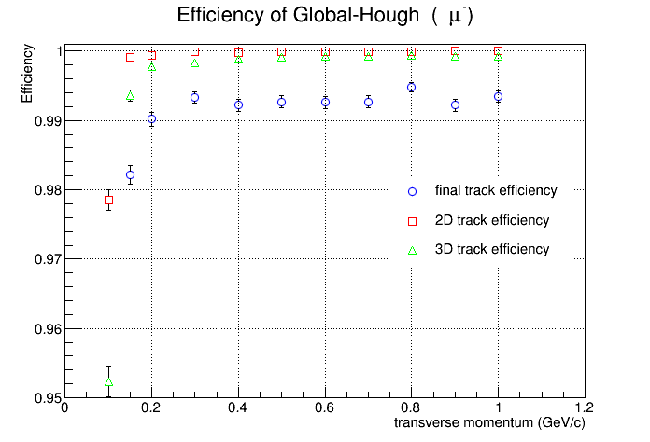
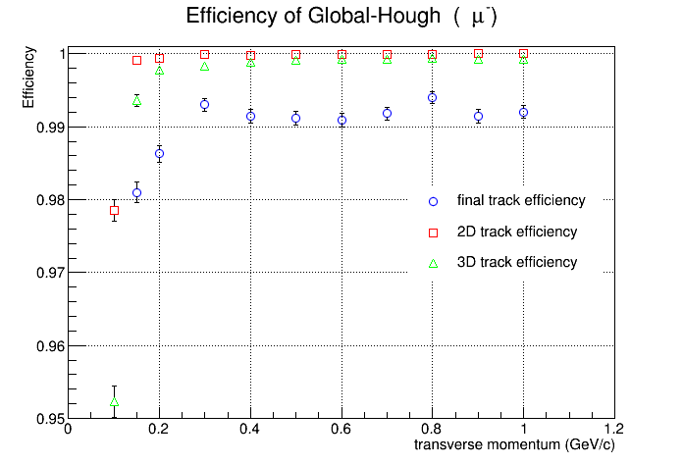
Several cuts
Delete Hits<10
Gap<8
Gap<8, Delete Hits<10

Slide 12
Next to do
Reconstruction of multi-track events need test
Pt <120 MeV need more research

