Slide 1
CGEM Strips Display
Long Peixun
2018.3.8

Slide 2
Outline
Weekly Report
Structure of CGEM readout plane
Problems of CGEM strips display
A simple test of X-strip display in XY view

Slide 3
Weekly Report
Run Besvis in CgemBOSS 6.6.5.b.
Import CgemGeomSvc package into Besvis.
CgemGeoSvc contains several classes: CgemGeoFoil, CgemGeoLayer, CgemGeoReadoutPlane, CgemGeoSeparator, etc.
I will use this package to calculate CGEM’s X-strips and V-strips.
Fix destructor of CgemGeoReadoutPlane.
At present, the destructor of CgemGeoReadoutPlane has declaration, but no implementation.
It causes linking failure after compile.
Test X-strip display.

Slide 4
Structure of CGEM readout plane
3 layers: layer 0 ~ layer 2
Layer 0 has one sheet, rolling into a cylinder.
Layer 1, 2 have two sheets, rolling into two semi-cylinders.
layer2 sheet1
layer1 sheet0
layer0 sheet0
layer1 sheet1
layer2 sheet0

Slide 5
Structure of CGEM readout plane
X-strip number
Layer0: 859
Layer1: 641 in each sheet, 1282 total
Layer2: 834 in each sheet, 1668 total
V-strip number
Layer0: 1180
Layer1: 1090 in each sheet, 2180 total
Layer2: 1400 in each sheet, 2800 total
X pitch: 0.660mm
V pitch: 0.659mm

Slide 6
Problems of CGEM strips display
According to the data in last page
There are 9969 strips in CGEM.
As a comparison, the number of wires in Mdc is 8684.
The number of wires in Mdc inner 8 layers, which will be replaced by CGEM, is 484.
The size of CGEM strips is very small (pitch < 1mm).
Problems
Too many wires/strips will decrease the performance of Besvis.
If display all strips, it is difficult for users to distinguish each strip.

Slide 7
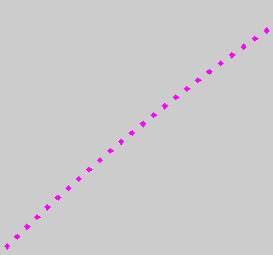
A simple test of X-strip display in XY view

