Slide 1

Can We Witness the Disappearance of an Astronaut Falling into a Black Hole?
Shuang Nan Zhang 张双南
Institute of High Energy Physics
Chinese Academy of Sciences

Slide 2

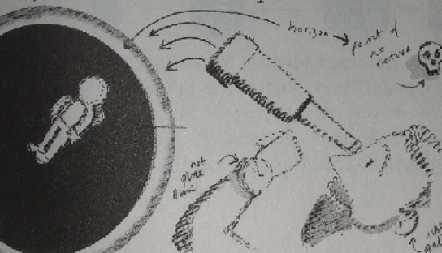
？？？
Dear Professor, we all know this!

Slide 3

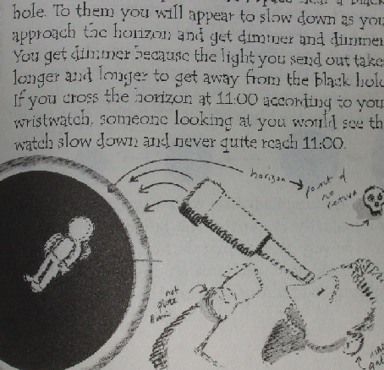

In “George's secret key to the universe”: Publication Date: October 23, 2007
The man appears being frozen just outside the event horizon!

Slide 4
What is a black hole?
Dear Professor, we all know this too!
^
也

Slide 5
What is a black hole?
Mathematical BH: a spacetime singularity as a solution of Einstein's field equation in GR.

Slide 6
What is a black hole?
Physical BH: all its gravitating mass is enclosed within its event horizon.
  Not necessarily a point-mass “singularity”.
However, Birkhoff’s Theorem secures that an observer cannot distinguish between mathematical or physical BHs

Slide 7
What is a black hole?
Astrophysical BH: a physical BH that can be formed through astrophysical processes in the physical Universe and within a time much shorter than or at most equal to the age of the Universe.

Slide 8
Can astrophysical black holes be formed in the physical universe?

Slide 9
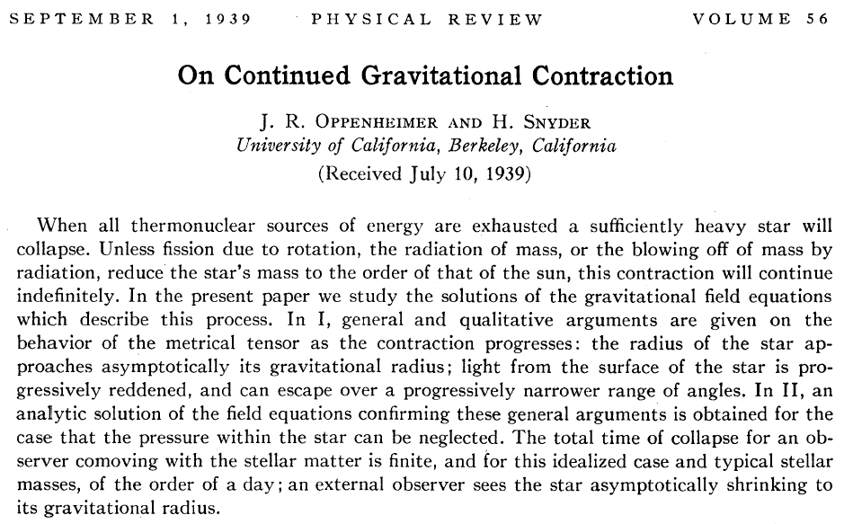
OS39 solution
“Every statement of this paper is in accordance with ideas that remain valid today”
(Novikov & Frolov, 2001)
(1) A singularity is formed for an co-moving observer; (2) “BH” is “frozen star” for external observer

Slide 10
OS39 solution: Singularity or Frozen Star?
The co-moving observer sees a singularity formed.
  However he/she cannot communicate with outside, so an outside observer does not know his conclusion.
The outside observer sees a frozen star formed, because within a finite time matter does not cross the event horizon.
  Observers and the universe have finite lifetimes, so in a physical universe, astrophysical collapse of OS39 cannot form a singularity.

Slide 11
Mathematical or Astrophysical BHs
Choosing proper coordinates a mathematician can indeed make a BH
However for an astronomer (external observer in Schwarzschild coordinates), an astrophysical BH would never be completely formed, because it takes infinite time for all matter to cross the event horizon.
  What is the fate of matter falling towards a BH within a finite time for an external observer?

Slide 12
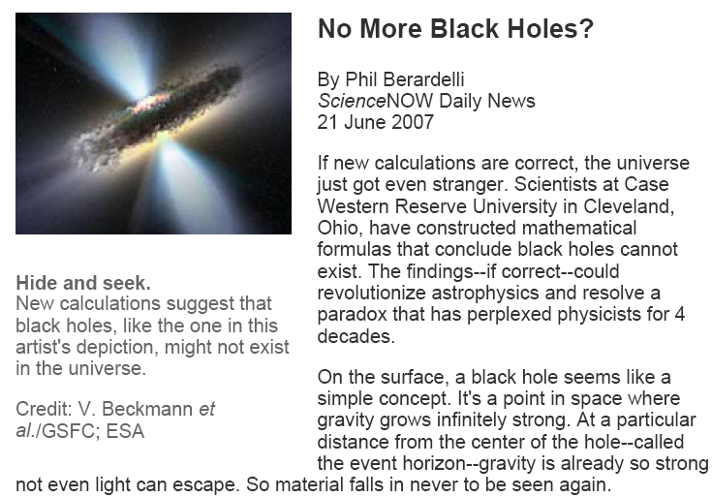

Slide 13
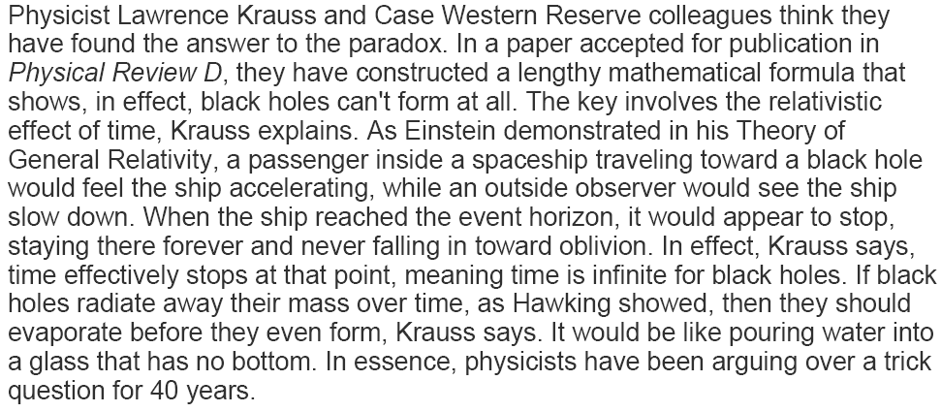
Vachaspati, T., Stojkovic, D. & Krauss, L.M.
Physical Review D 76(2), 024005 (2007)

Slide 14

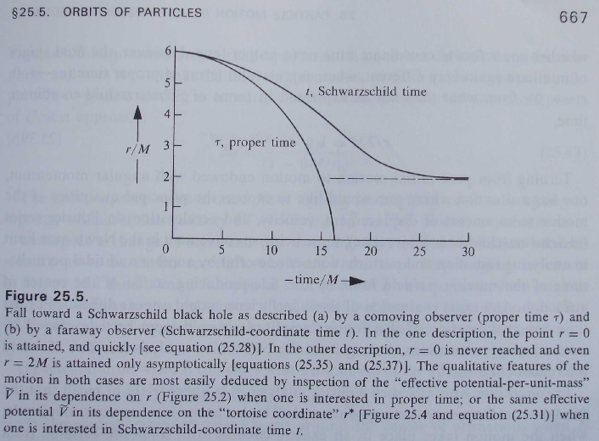
A test particle free-falling towards a black hole from r=6M
External observer
Infalling observer

Slide 15
The “frozen star”-BH paradox
An in-falling observer sees matter falling into the BH
A distant observer sees matter stopped just outside the BH’s horizon: BH = “frozen star”
  Is matter inside or outside a BH’s horizon？
For a single “frozen star”, we probably do not care
  The light from the “frozen star” diminishes and its wavelength also increases rapidly.

Slide 16
Towards solving the “paradox”
The seminal work of Oppenheimer & Snyder (39): a complete solution of a spherically self-collapsing system of dust matter in absolute vacuum.
  However that work is not on matter falling into a pre-existing BH.
  And an astrophysical collapse could not occur in absolute vacuum.
The test particle falling towards a BH fails to consider the influence of the particle’s gravitating mass to the global metric.
  Event horizon is a global property of spacetime.

Slide 17
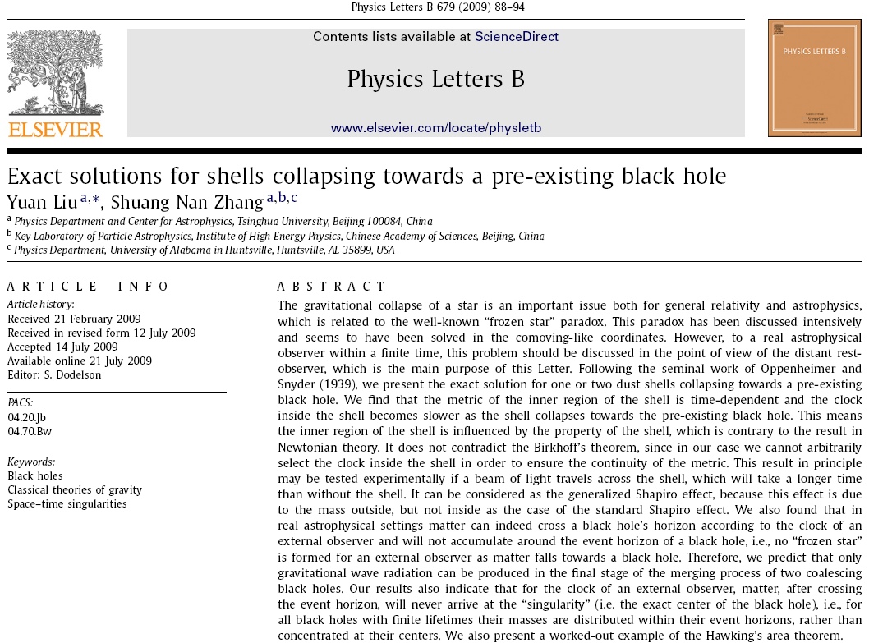

Slide 18
Question: metrics in zones 1, 3 & 5?
Given in almost all GR textbooks and monographs：
Schwarzschild-like：
redefine
The famous Birkhoff Theorem：
Vacuum metric of spherically symmetric G-field is static and Schwarzschild-metric (S-metric).
5
3
1
m₀
4
2
m₁
But two issues to be clarified:
m₂
(1) Clock references of different zones
(2) Metric continuity cross boundaries

Slide 19
Clock reference problem
External zone 5：r→∞→flat, take f₅=1→t (r→∞) is the clock of the observer at ∞: this is the physical meaning of S-metric and the fundamental reason an outside observer must use S-metric.
Interior zones 1 & 3, taking
→ f_{1,3}=1 → the interior clock must be different from the external clock: finite interior time may be infinite outside!
5
3
1
m₀
4
2
m₁
m₂

Slide 20
Metric continuity problem
f₅=1 is fine. But zones 2 & 4 are not vacuum → f_{2,4}=<1 (OS39), so not S-metric: forcing f_{1,3}=1→ discontinuous metric across boundaries.
Birkhoff Theo. extended to interior zones results in:
(1) Inconsistent clock ref.
(2) Discontinuous metric
5
3
1
m₀
4
2
Conclusion: Birkhoff Theorem (BT) can only be applied to the exterior zone in spherically symmetric G-field.
m₁
m₂

Slide 21
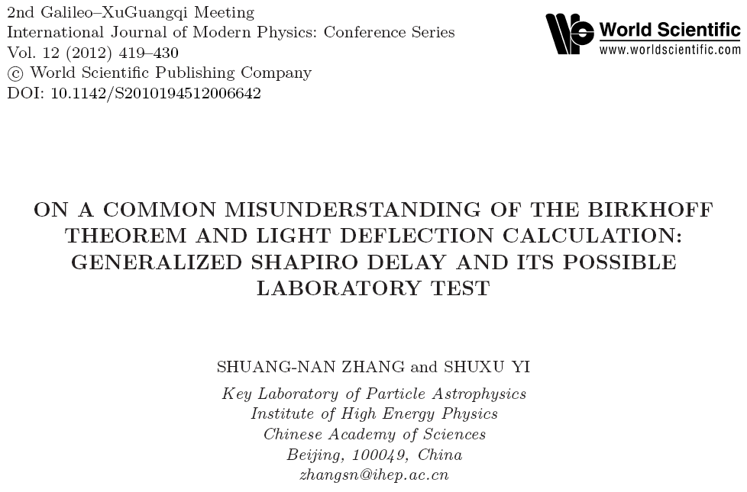
But most books are misleading on BT.

Slide 22
Common statement: outside matter does not influence interior gravitational field!
We listed 11 well known GR books with wrong statements on BT, including the classical textbooks by Weinberg and Peebles.
“Principles of Physical Cosmology” (Peebles,1993)：
  “The acceleration of the radius of the sphere is given by the Newtonian equation (D.24), because Birkhoff’s theorem says the material outside the sphere cannot have any gravitational effect on the behavior of what is inside.”

Slide 23
11 Books with wrong statements on BT
H.C. Ohanian, Gravitation and Spacetime (1976)
M. Harwit, Astrophysical Concepts, Fourth Edition (2006)
S. Weinberg, Gravitation and Cosmology: Principles and Applications of the General Theory of Relativity (1977)
V. Mukhanov, Physical Foundations of Cosmology (2005)
J.A. Peacock, An Introduction to the Physics of Cosmology (2002)
P. Coles, F. Lucchin, Cosmology: The Origin and Evolution of Cosmic Structure, Second Edition (2002)
Grupen, Astroparticle Physics (2005)
R. Ferraro, Einstein’s Space-Time: An Introduction to Special and General Relativity (2007)
J.A. Peacock, Cosmological Physics (1998)
P.J.E. Peebles, Physical Cosmology (1971)
P.J.E. Peebles, Principles of Physical Cosmology (1993)

Slide 24
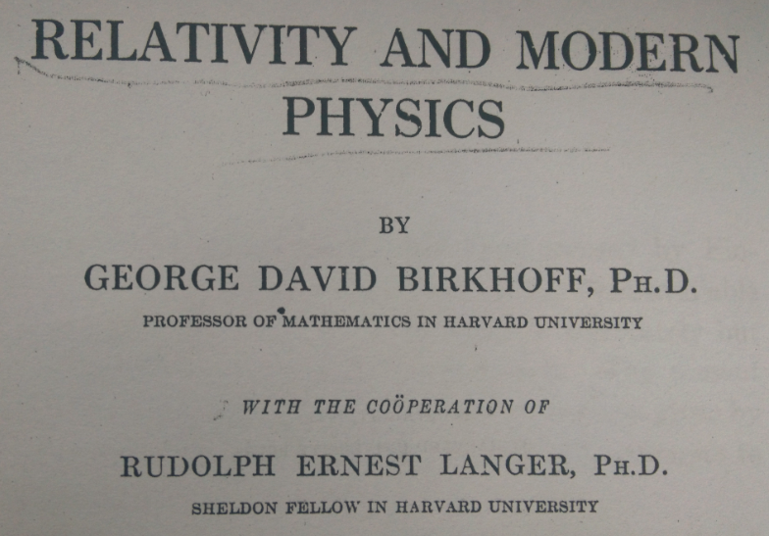


What did Birkhoff really say about his Theorem？

Slide 25
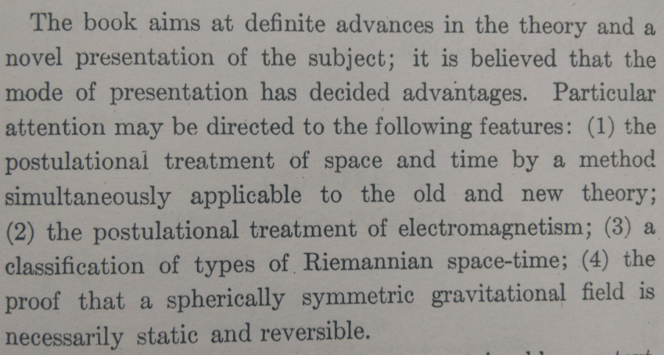
Birkhoff’s Introduction
（4）Birkhoff’s Theorem: a spherically symmetric gravitational field is necessarily static and reversible.

Slide 26
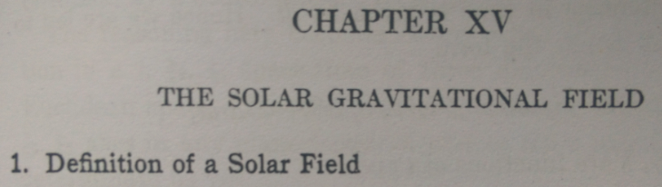
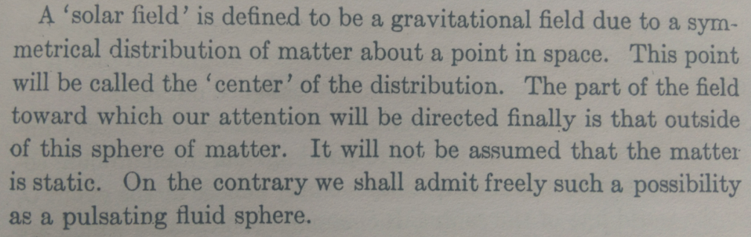
How did he prove it and what did he prove?
The proof of Birkhoff Theorem is in “The solar gravitational field”.
The G-field due to symmetrical distribution of matter around a point.
He then said, our attention is “the field outside of this sphere of matter”, i.e., he did not study the interior field. So the statement that “outside matter does not influence interior field” has nothing to do with Birkhoff Theorem.

Slide 27
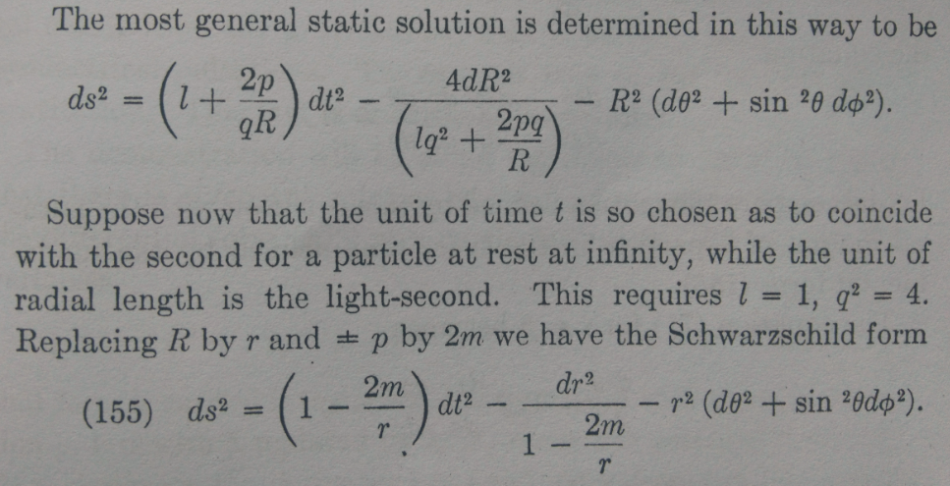
Birkhoff’s Proof
Metric at r determined by mass interior to r ; however, there is no mass outside r (forgotten by almost all)!

Slide 28
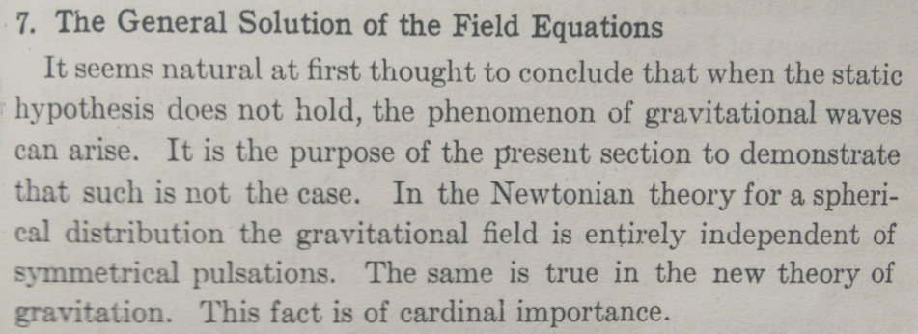
Birkhoff’s Interpretation
He did say this is the same as Newtonian theory; however the condition is that there is no matter outside “r” ！
However, we cannot blame others, since in Newtonian theory outside matter indeed has no influence to the interior field:
  OK, since Birkhoff said it’s same as Newtonian case, so it’s the same regardless if there is outside matter or not！

Slide 29
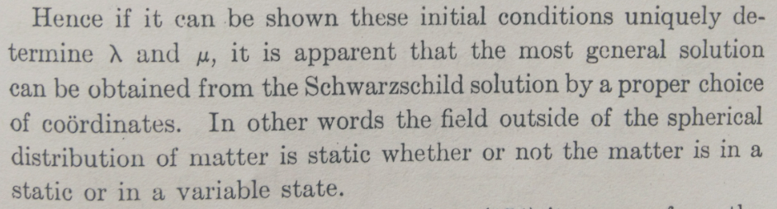
Birkhoff’s Summary on BT
Birkhoff was still emphasizing the field outside of spherical distribution of matter.
So Birkhoff did nothing wrong; it’s just that he did not clarify the issue every where, such that it was mis-understood and mis-quoted by many people later.

Slide 30
Global solution
Flat at ∞ →
OS39 + Metric continuity →
5
3
1
m₀
4
2
(1) Same clock reference: observer ‘s clock at ∞
(2) Interior metric is not S-metric: f(t) is a function of external mass distribution.
m₁
m₂

Slide 31
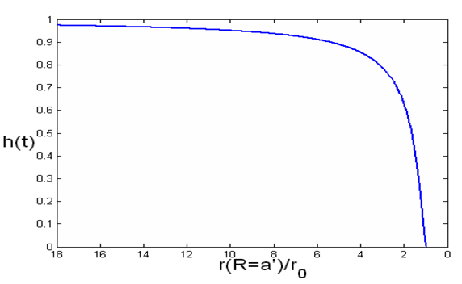
Metric of free-infalling shell
Zone III
a
Zone II
Zone I
a’
BH
m
Metric in zone 1: obviously not S-metric

Slide 32
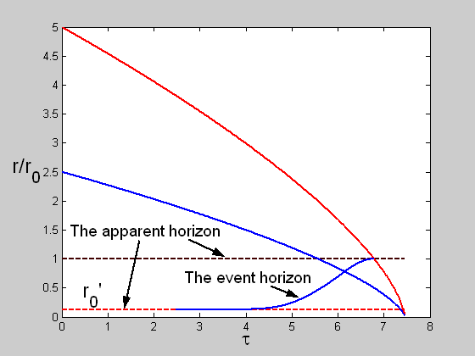
Shell in-falling in co-moving frame: straight to the coordinate origin r=0
R=a outer boundary
R=a’ inner boundary

Slide 33
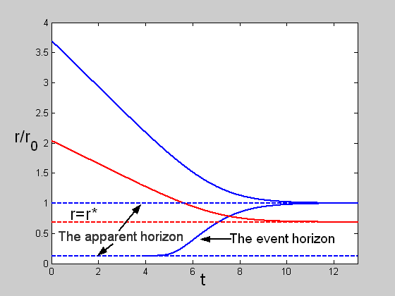

Shell in-falling for external observers: expanding event horizon eats the shell!
The outer surface is trapped just outside the event horizon; the inner surface will fall through the event horizon, but will eventually be trapped inside it.
No physical singularity inside a BH!
Test
particle

Slide 34
Double in-falling shells: mimicking the real astrophysical setting
Any matter outside shell 1
a₁
a₁’
V
III
I
m
IV
II
a₂’
a₂
m₁
m₂

Slide 35
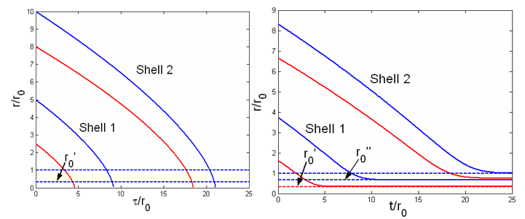
Matter does cross the event horizon
Comoving observer
External observer
For the external observer: shell 1 crossed the event horizon completely, no “frozen star” and no “physical singularity” in BH

Slide 36
Detailed free-fall process of shell 1: influence of shell 2
External shell influence the motion of the internal shell
very different from the common (mis-)understanding of Birkhoff’s Theorem.
With shell 2
No shell 2

Slide 37
What is a BH?
Mathematical BH: singularity or point mass
Physical BH: all its gravitational mass inside its event horizon
  Not necessarily a singularity
Astrophysical BH: a physical BH which can be formed in a physical universe
  In a physical universe formed by gravitational collapse: not a singularity.

Slide 38
Testing the paradox using BH merge
For two “frozen stars” merging together
  Gravitational waves & EM waves are produced
Or “true” BHs merging together
  Only gravitational waves are produced
The two scenarios are distinguishable with future G-wave and X-ray telescopes pointed towards two merging “frozen stars” or “true” BHs.
  Extremely challenging, but utterly exciting!

Slide 39
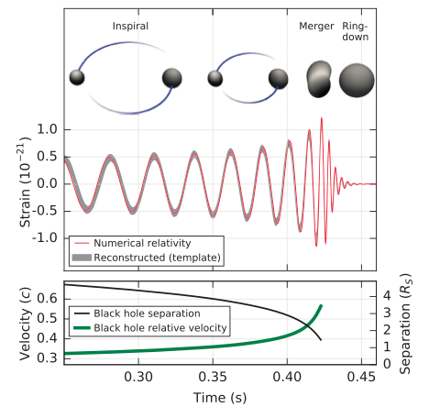
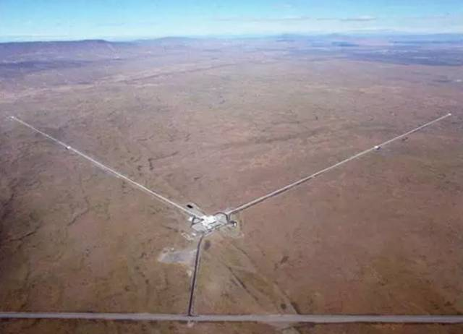
On 2016/02/11, LIGO announced discovery of GW predicted 100 yrs ago by Einstein!

Slide 40
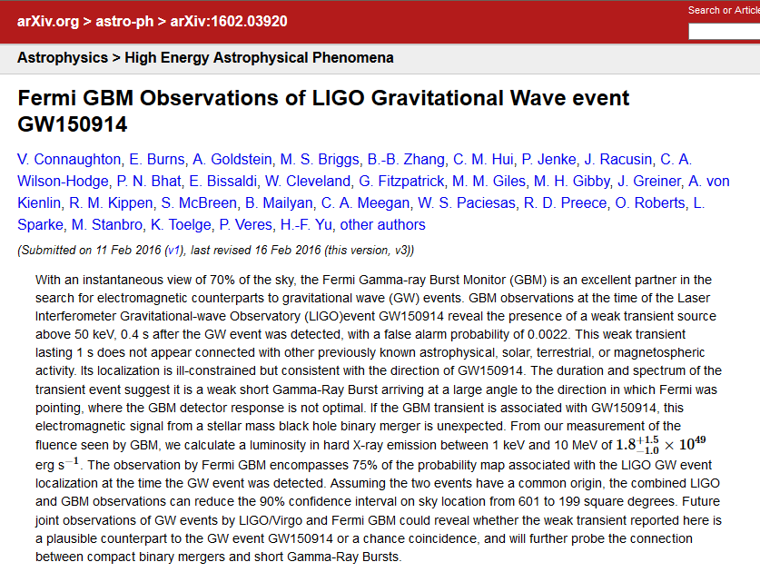
A gamma-ray burst with GW150914?

Slide 41
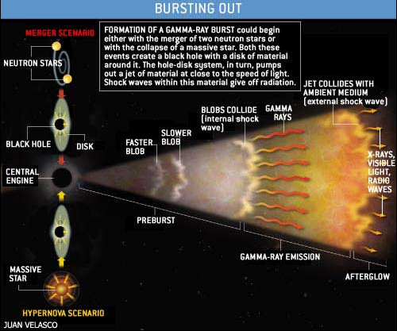
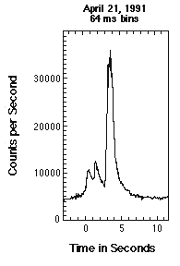
What is a gamma-ray burst？
Still not understood well!

Slide 42
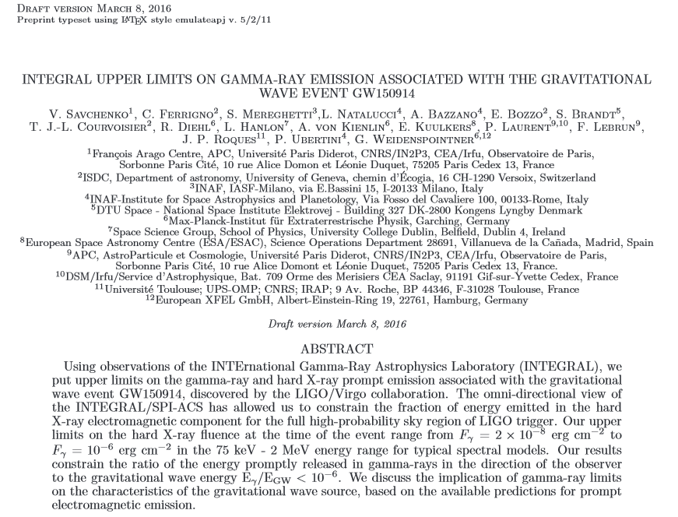
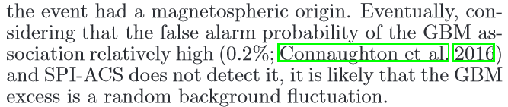
However, not detected by INTEGRAL!

Slide 43
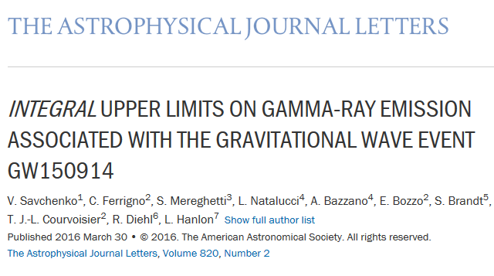
INTEGRAL paper on ApJL

Slide 44
How were the GW150914 BHs formed?
The only stellar mass black holes we know for sure are those in X-ray binaries
  ~10 Msun BH + regular star
GW150914 BHs: 30 Msun
Assume BH=“frozen star”
  10 Msun → 30 Msun of GW150914
    ~20 Msun outside BH’s EH
Zhang+ 2016: arXiv:1604.02537

Slide 45
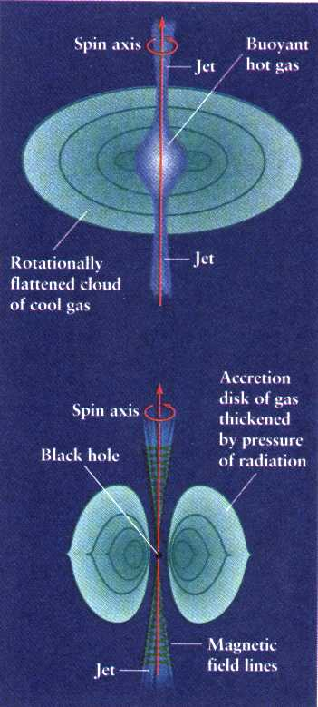
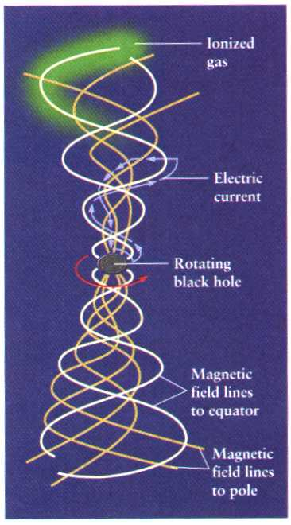
Blandford-Znajek (BZ) Mechanism
Meier et al

Slide 46
BZ-mechanism can produce strong EM radiation?
Assume “frozen star”
  BZ+20 Msun →GRB ~10⁵⁵erg >> all known GRBs or any other EM-bursts
“frozen star” completely rejected!
Zhang+ 2016: arXiv:1604.02537

Slide 47
Therefore with full and self-consistent general relativity calculation, we find that the in-falling matter will not accumulate outside the event horizon, and thus the quantum radiation and Gamma Ray bursts predicted in [2] and [3] are not likely to be generated. We predict that only gravitational wave radiation can be produced in the final stage of the merging process of two coalescing black holes. Future simultaneous observations by X-ray telescopes and gravitational wave telescopes shall be able to verify our prediction.
Liu & Zhang 2009, PLB, 679, 88

Slide 48
Growth of BHs of GW150914 clocked by LIGO
1 Msun in BH <10 ms
Zhang+ 2016: arXiv:1604.02537

Slide 49
BH merging results for outside observer
According to the clock of LIGO experiment
  Time-scale of BH merging via GW >> EH crossing time of outside matter;
  No matter accumulation before merging;
  No observable EM radiation from merging
    Unless in extremely dense medium, but very faint EM emission anyway!
Zhang+ 2016: arXiv:1604.02537

Slide 50
No EM from BH merging claimed by all?
~ All papers on GW150914 said no EM expected from BH merging, but no reference?
  Implied the two BHs are mathematical BHs!
  The OS39 solution will result in “frozen” or “black” stars, not mathematical BHs for LIGO!
Our 2009 paper is the only one that predicted the merging of two astrophysical BHs does not produce EM for LIGO
  Confirmed by the fact that no GRBs or any EM-bursts with 10⁵⁵ erg has ever been detected over past many decades!

Slide 51
How to tell what a BH is from GWs?
Clocked by LIGO: assume three possibilities
  Mathematical BH: singularity or point mass
  “frozen star”: all mass outside event horizon
  Astrophysical BH: all mass inside event horizon but not a singularity.
GWs calculated often for merging math BHs.
Mass not at singularity may result in different GWs at final stages of merging: colliding, ring-down
  Numerical GR should be done for merging “frozen stars” or astrophysical BHs, to be tested by future GW observations.
Zhang+ 2016: arXiv:1604.02537

Slide 52
Fate of matter in the Universe
No matter can escape from a BH once in it
  In a static Universe: all matter will eventually fall into BHs
  In an eternally expanding Universe: all matter in galaxies will end up in BHs, but matter in between may survive.
  In an eventually contracting Universe: all matter between galaxies will also end up in BHs
In either case the Universe will be made of almost all BHs, and thus a dead Universe, which is of extremely boring!

Slide 53
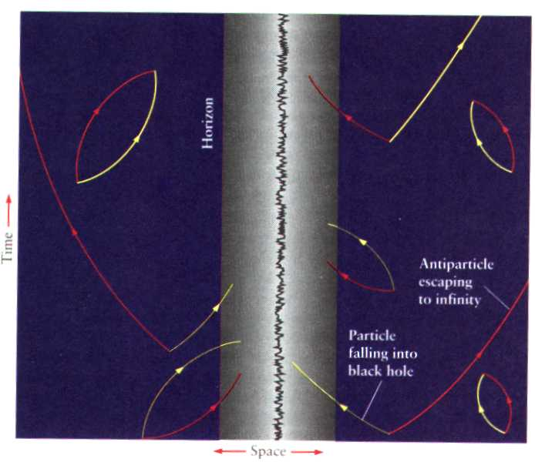
Can Hawking radiation rescue the eventually dead Universe?
The Hawking temperature of all known BHs is far below that of the cosmic microwave background.
The Hawking radiation is not important until essentially all matter falls into BHs.
The final state of the Universe is still dead!

Slide 54
Energy conversion efficiency of accretion disk: very efficient “naked” compact object

Slide 55
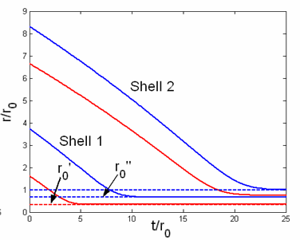
How to make a “naked” compact object (NCO) ?
Matter in BH is not at “singularity”.
If one can “peal off” the event horizon, then a NCO is formed.
This is not a “naked” singularity, so what Penrose was worried about would not happen.
External observer

Slide 56
NCO recycle conjecture
Energy conversion efficiency of a NCO can be more than 100%, so effectively it “spits out” what it has eaten previously.
If there is a non-zero probability of turning a BH into a NCO:
  BH and NCO are two states of the same object, some or even all matter sucked into BHs could be recycled out.
So the Universe can be rescued from being eternally dead.

Slide 57
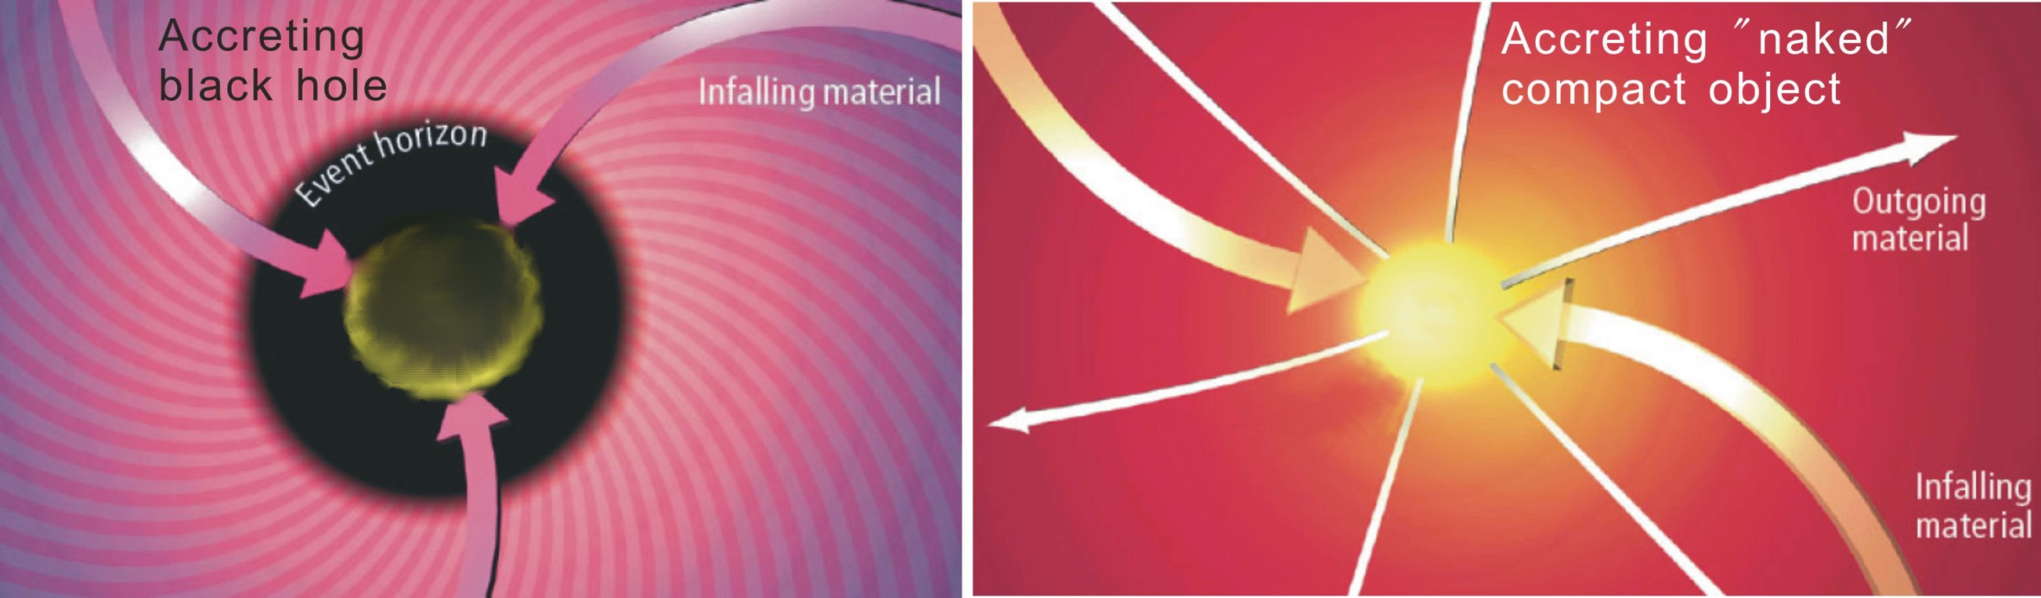
Accreting BH and NCO
Prediction for NCO：
Energy conversion efficiency ε >100%.
But not found yet!

Slide 58
Main Conclusions
In GR “outside” matter influences metric “inside”, qualitatively different from Newtonian gravity and also against the common (mis-)understanding of BT.
  The metric in the “vacuum” region between a shell and BH is not Schwarzschild.
In a physical universe, matter can indeed pass a BH’s event horizon within finite time of an external observer, but can never arrive in singularity.
  Astrophysical BH is formed, but no “frozen star” or singularity is formed in the physical universe.
Merging of two BHs can produce only GWs, no EM.
  Confirmed by non-detection of 10⁵⁵ erg GRBs
  Details of GWs may reveal BH interior structure.
All matters in the Universe may eventually fall into BHs.
  My BH theory may rescue the Universe, but not for sure!

Slide 60
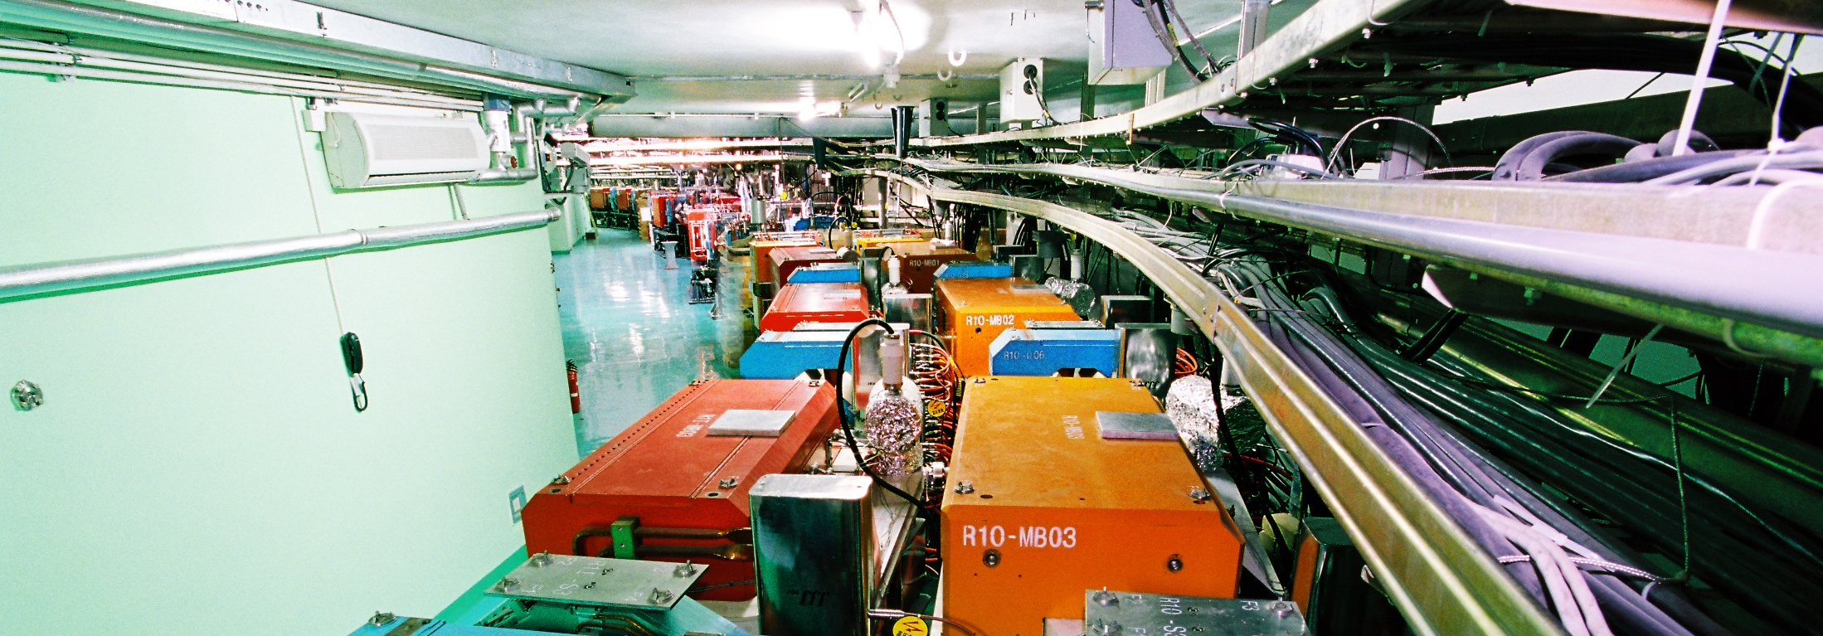
Introduction of IHEP
WANG Yifang
Institute of High Energy Physics
Jun. 13-15 , 2018
International assessment of 2018

Slide 61
Main Research Disciplines
Particle Physics
HEP Exp. Based on Accelerators
Particle Astrophysics & Neutrino Exp.
Particle Detection and Electronics
Particle Physics Theory
Science
Accelerator Physics and Technologies
Technology
High Luminosity Electron Accelerator
High Intensity Proton Accelerator
Applied Research and Technology Transfer
Radiation Technologies and Applications
Scientific infrastructure for multi-disciplinary studies
Synchrotron Radiation Techniques & Applications
Neutron Scattering Techniques & Applications
Nuclear Analytical Techniques & Applications

Slide 62
Large Science Facilities
In operation (6)
Beijing Electron Positron Collider (BEPCII) / (BESIII)
Beijing Synchrotron Radiation Facility (BSRF)
Yangbajing Cosmic Ray Observatory（YBJ）
Daya Bay Reactor Neutrino Experiment
Hard X-ray Modulation Telescope(HXMT)
China Spallation Neutron Source (CSNS)
Under construction (4)
Jiangmen Underground Neutrino Observatory (JUNO)
Large High-Altitude Air Shower Observatory (LHAASO)
Ali CMB Polarization Telescope (AliCPT-1)
High Energy Photon Source (HEPS/HEPS-TF)
Under planning(6)
China Initiative Accelerator Driven System(CiADS)
China Spallation Neutron Source II (CSNSII)
Enhanced X-ray Timing and Polarimetry mission (eXTP)
High Energy cosmic-Radiation Detection (HERD)
Circular Electron Positron Collider-Super proton-proton collider(CEPC-SppC)
Other LSS under consideration： Southern Light Source (SLS)、SCLS……

Slide 63
Organization
Experimental Physics Division
Particle Astrophysics Division
Accelerator Division
Multi-disciplinary Research Division
Theoretical Physics Division
Computing Center
Division of Nuclear Technology and Applications
Research
( 7 )
Science Committee
Directors’Office
Office of Human Resources
Office of Research and Planning
Office of Large Facilities
Office of Finance and Assets
Office of Education
Office of Technology Transfer
Supporting Services
Office of Retiree Services
IHEP Staff
Congress
Directors
Administration
( 9 )
Academic Degree Committee
Support
( 3 )
Division of Facilities Operation and Maintenance
Library and Information Services
Machine Shop
Branch（1）
Dongguan Campus

Slide 64
IHEP FUNDING
total: 3773
97%
total: 7434
State financial support for institute operation
State financial support for scientific research
Competitive funding
Competitive funding for construction of large facilities
Others
Institute Operation
Project Funding

Slide 65
Human Resources
December 2017
1401 permanent staffs
68 temporary employees
In which:
  1230 scientists and engineers
  49 recruited top-level staff: 8 within China, 41 abroad (2013-2017)
December 2012
1344 permanent staffs
93 temporary employees
In which:
  1081 scientists and engineers
  39 recruited recently from abroad(2008-2012)
Age distribution of professionals and technicians in 2017
34.1% Master’s degrees, and 49.6% doctorates

Slide 66

Report of Particle Astrophysics Division (PAD)
Prof. ZHANG Shuangnan
International Assessment, June 13, 2018

Slide 67
About PAD
High energy CRs
charged particle , neutrino,
γ-ray
Intense explosion
GRB, compact object,
BH accretion
Cosmic evolution
galaxy, cluster,
cosmology
Subjects
Deep Structure of Matter
Large-scale Physical law
Science Theme
Underground
neutrino, dark matter,
particle physics
High Altitude
ASγ, ARGO, LHAASO
Space-based
AMS, HXMT, DAMPE,
SVOM, POLAR,
EP, GECAM
Facilities
Neutrino group
AMS/CMS group
Astrophysics group
Theory group
Cosmic ray group
Groups
175 staff scientists and engineers, more than 160 graduate students, postdocs and visiting scholars

Slide 68
Funds and Publications
Funds in recent 5 years (2013 – 2017): 608 millions RMB
Funds in previous 5 years (2008 – 2012): 389 millions RMB
Percentage increase: ~56%
Since 2013, the Division has published 1225 papers, including 128 papers in Nature Astronomy, the Astrophysical Journal, Monthly Notices of the Royal Astronomical Society, and Astronomy & Astrophysics, and 82 papers in Physical Review D and Physical Review Letters.
Percentage increase: ~30%

Slide 69
Space projects roadmap
Roadmap for the development of space-based high energy astrophysics experiments：
Current Projects
Projects applying for mission adoption
Projects in planning and pre-research for mission adoption
HXMT
SVOM
EP/FXT
Enhanced X-ray Timing and Polarimetry mission (eXTP)
Gravitational wave high-energy Electromagnetic Counterpart All-Sky Monitor (GECAM)
Hot Universe Baryon Surveyor (HUBS)
X-ray Astrnomy
Space Particle Detection
AMS02
DAMPE
CSES
High Energy cosmic-Radiation Detection (HERD)
Wide-field MeV Gamma-Ray Observatory (WMEGRO)

Slide 70
Manpower
Number of Staff: Keeping Stable!
Number
~200 in 2020: LHAASO/eXTP/HERD
Age distribution
Research Group | Staffs |  |  |  |  | Student& Postdoc
 | Senior | Mid. | Jun. | Sup. | Total
High altitude balloon | 1 | 2 | -- | -- | 3 | 0
Astrophysics | 11 | 59 | 34 | 1 | 105 | 45
Theory | 3 | 6 | 1 | -- | 10 | 19
Cosmic ray | 7 | 20 | 6 | -- | 33 | 31
AMS/CMS | 3 | 7 | 2 | -- | 12 | 20
Neutrino | 2 | 6 | 2 | -- | 10 | 7
Secretariat | -- | -- | 1 | 1 | 2 | 0
Total | 27 | 100 | 46 | 2 | 175 | 122
2013:
PhD/59%; MSc/26%
Avg. age: 36
2017:
PhD/71%; MSc/21%
Avg. age: 38
Research groups are competent and adequately staffed!

Slide 71
Summary and Challenges
China’s leading center in particle astrophysics:
  Cosmic ray/space high energy astronomy/neutrino physics/cosmology; in house detector/electronics/ mechanics/observation/interpretation/simulation/theory
Internationally unique:
  With facilities from underground/sea level, high altitude mountain, satellite and space station.
Many challenges ahead:
  Scientific productivity and impacts from on-going projects;
  Adoption of eXTP and HERD, and intern. collaboration;
  Many large projects, but very young teams, though well staffed.
Many thanks for you evaluation!

Slide 72
Overall ranking: IHEP
Internationally: leading (A+), among the best (A), average (B), below average (C), very bad (D)
Specific comment: Not fare to compare with CERN, but at the same level as other world-leading institutions, e.g., FNAL, SLAC, …

Slide 73
Overall ranking: PAD
My interpretation: you have done very well in the past five years and you are internationally outstanding, but you guys should do a lot more!
Our response: many thanks for the very encouraging ranking; however, we are fully occupied with many current projects and our younger generation should develop a better and more ambitious program for the future!

