Slide 1
Progress of high resolution TOF system
Wang Yi
Department of Engineering Physics, Tsinghua University
yiwang@mail.tsinghua.edu.cn

Slide 2
Abstract:
  Introduction of MRPC
  Introduction of three generation MRPC TOF
  Status of TOF of STAR, CBＭ and SoLID
  Conclusion

Slide 3
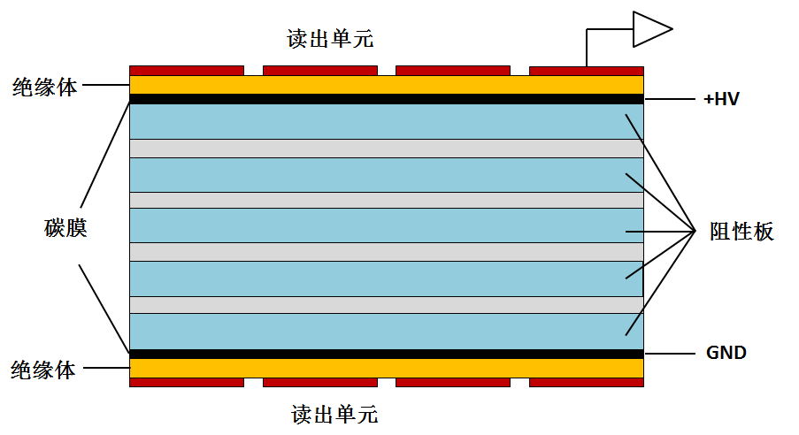
MRPC introduction
Read out
Standard parameters:
Resistivity of glass: ~10¹² Ω.cm
Working gas: 90%Freon+5%iso-butane+5% SF6
Time resolution <100ps
Efficiency >95%
Charge: a few PC
Dark current: a few nA
Noise ~1Hz/cm²
Rate <100 Hz/cm²
Large area, low cost
Insulator
Carbon
Resistive
plate
Insulator
Read out
MRPC structure
MRPC application：
Application in nuclear physics experiments
Application in industry（Muon tomography)
Application in medicine（TOF-PET）

Slide 4
How to increase rate of MRPC
The voltage drop in the gas gap:
The smaller the voltage drop, the higher efficiency and higher rate capability!
Two main ways to improve rate capability:
Reducing bulky resistivity of electrode glass (CBM)
Reducing the avalanche charge (ATLAS)
Other methods:
Reducing the thickness of glass
Warming the detector

Slide 5

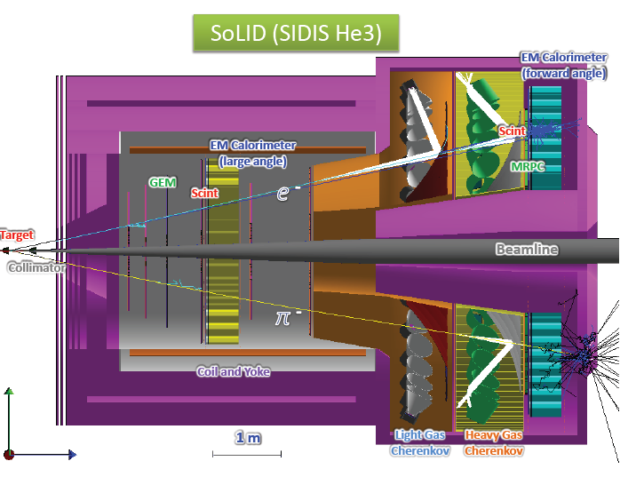
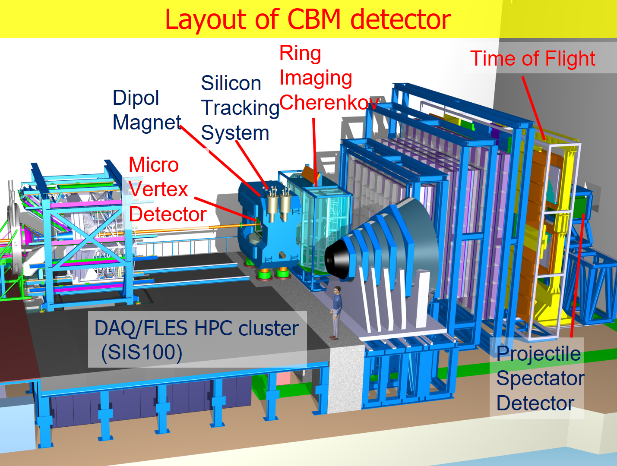
Typical MRPC TOF
RHIC-STAR TOF
Float glass
JLab-SoLID TOF
High rate and 20ps resolution
FAIR-CBM TOF
High rate- low resistive glass

Slide 6
Key technology
1st generation TOF:
Requirement: Time resolution: <80ps
Rate : <1kHz/cm²
Technology: common glass MRPC+NINOs +HPTDC
Analysis method: TOT slewing correction
2st generation TOF:
Requirement: Time resolution: <80ps
Rate : 30kHz/cm²
Technology: low resistive glass MRPC+PADI +GET4
Analysis method: TOT slewing correction
3st generation TOF:
Requirement: Time resolution: <20ps
Rate : 20kHz/cm²
Technology: low resistive glass MRPC+SCA +ADC
Analysis method: TOT slewing correction
Deep learning+ Neural network

Slide 7
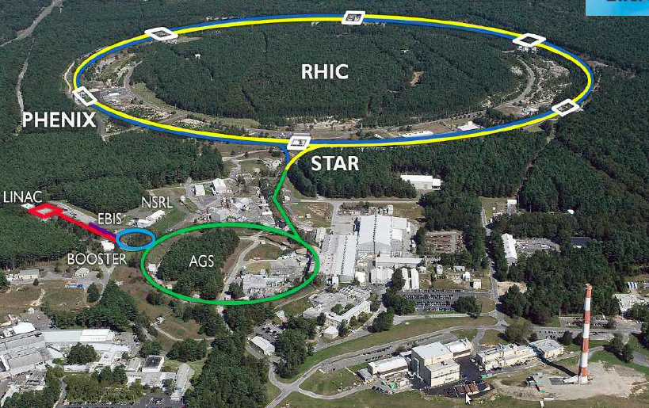
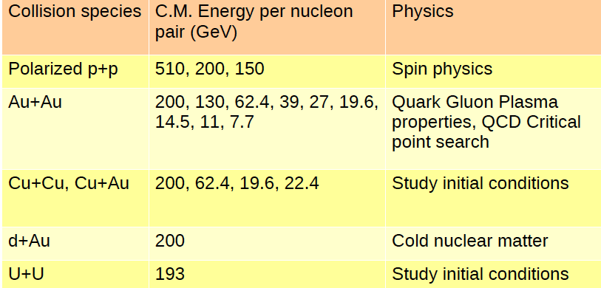
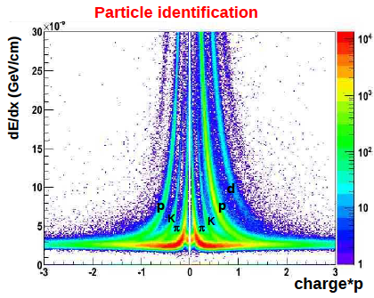
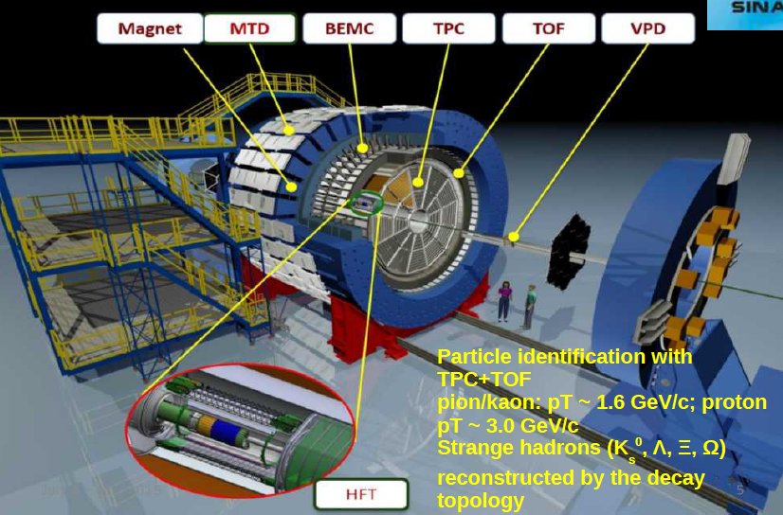
RHIC-STAR

Slide 8
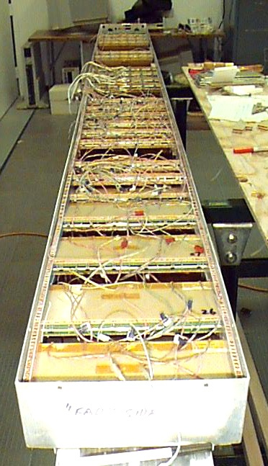
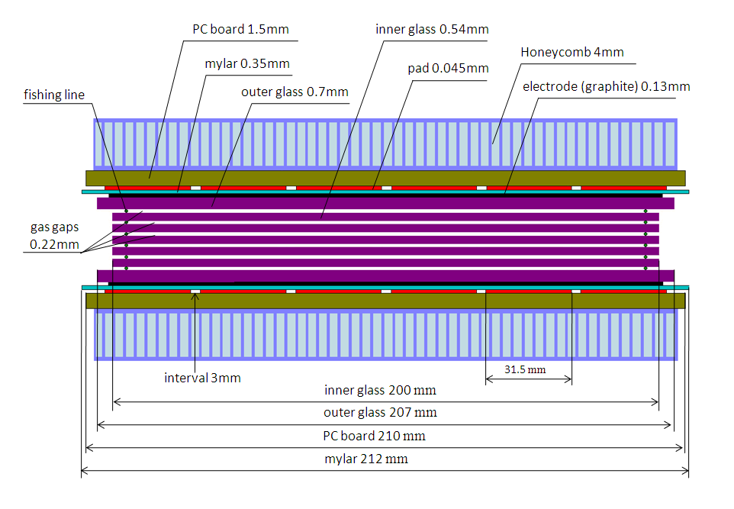
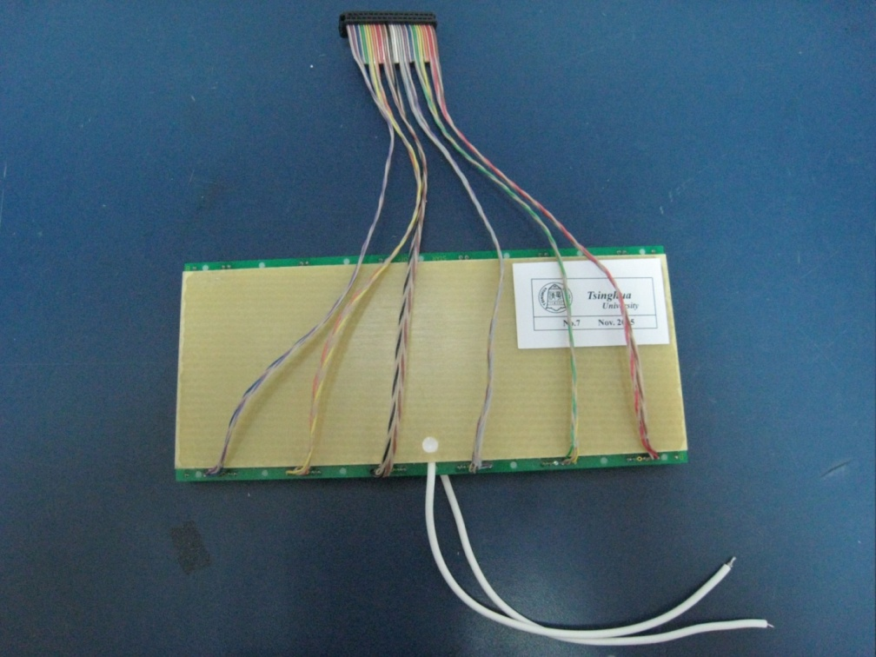
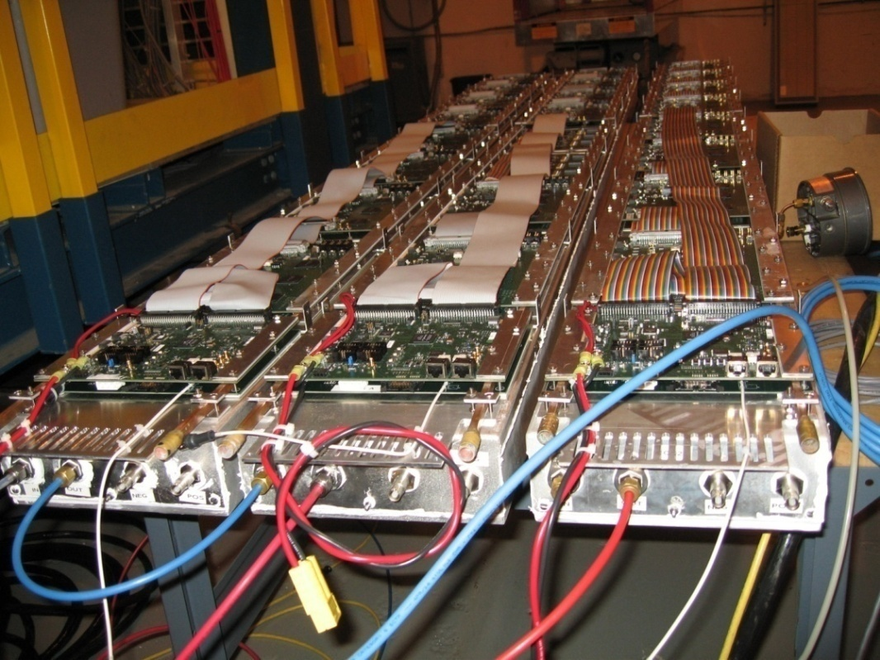
STAR-TOF MRPC
Long side view
8

Slide 9
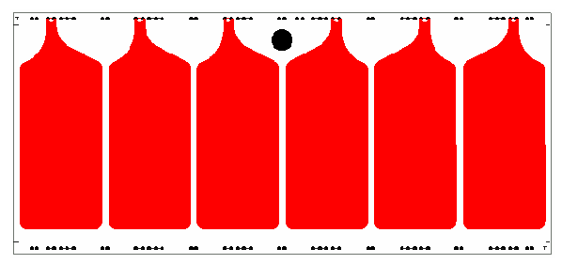
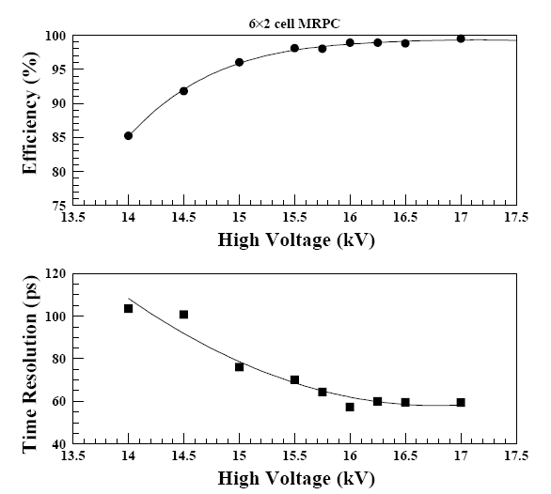
STAR MRPC performance
Readout pad
6cm
3cm
Glass: ～4×10¹²Ω.cm
Carbon tape: 500k Ω/
Gas gap: 6×0.22mm
Working gas: 95% F134a+5% iso-butane
Time resolution: 70ps
Efficiency >90%
Rates capability: <500Hz/cm² !

Slide 10
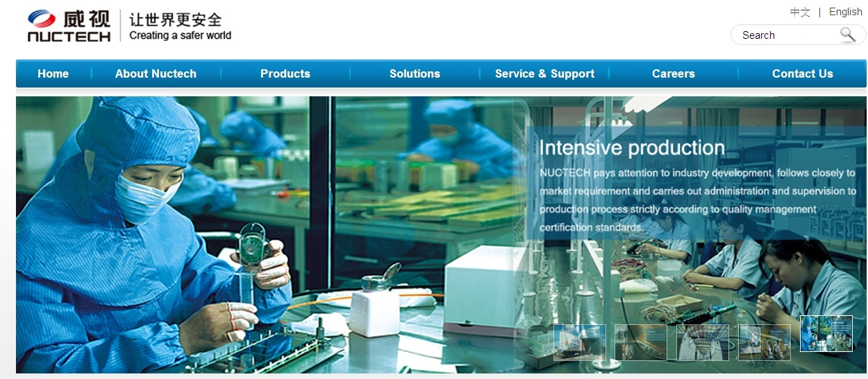

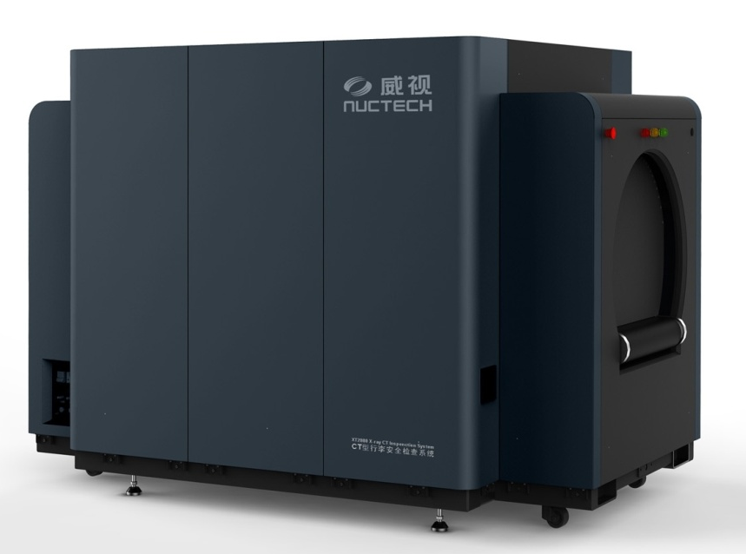
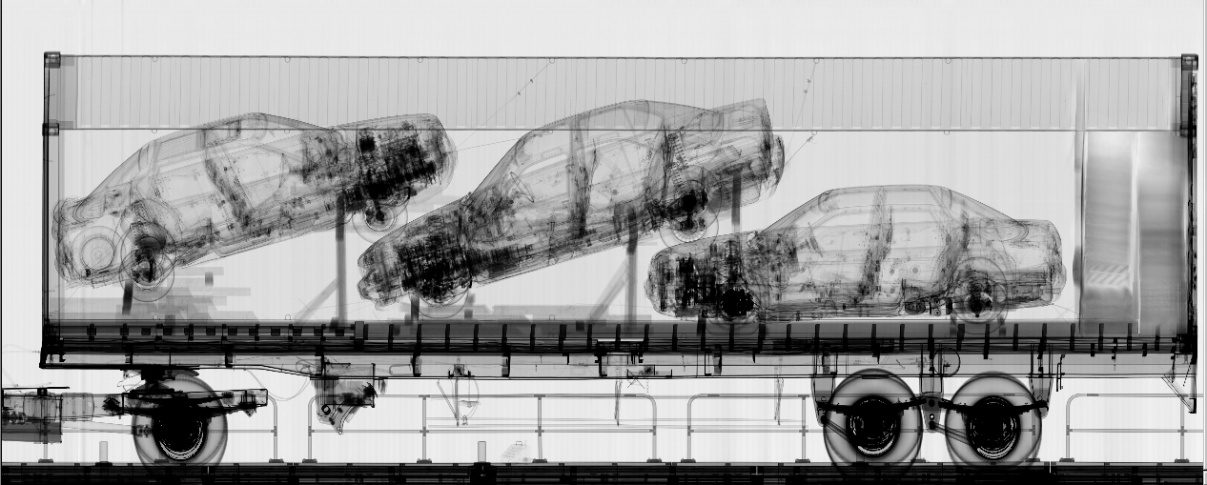
MRPC mass production
10
10

Slide 11
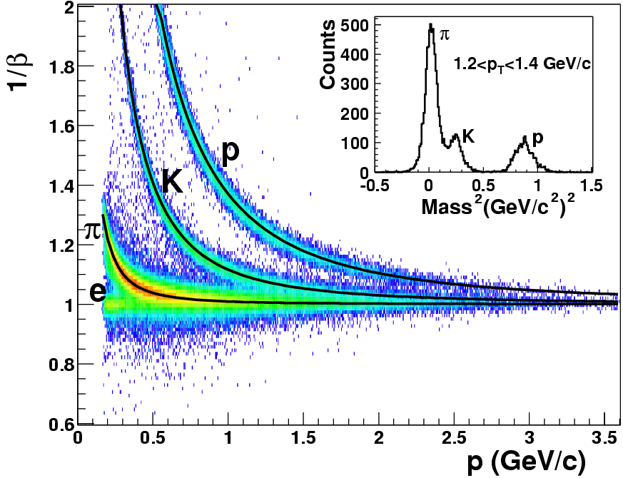
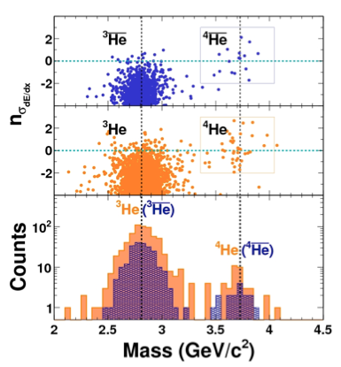

PID of STAR-TOF
TOF
TOF PID:
π /k ~1.6 GeV/c,
(π,k)/p ~ 3.0 GeV/c
Nature 473 (2011) 353

Slide 12
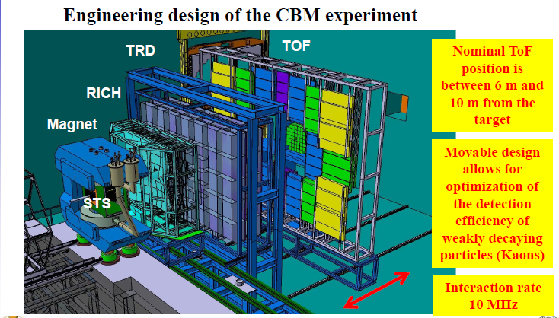
Layout of CBM detector

Slide 13
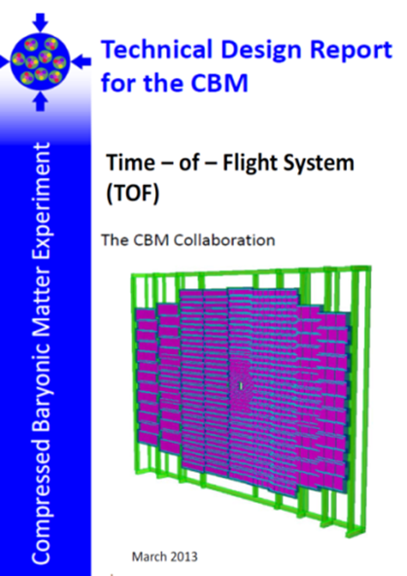
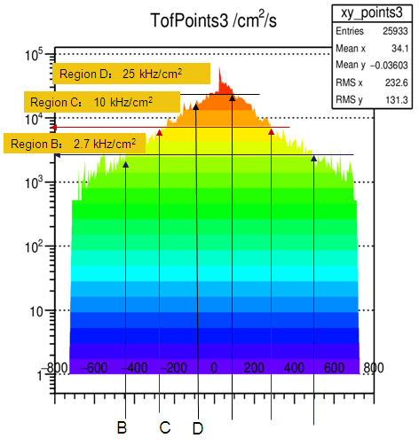
The structure of CBM-TOF wall
CBM-ToF Requirements
Full system time resolution σ_{T} ~ 80 ps
Efficiency > 95 %
Rate capability ≤ 30 kHz/cm²
Polar angular range 2.5°– 25°
Occupancy < 5 %
Low power electronics
(~100.000 channels)
Free streaming data acquisition
Au+Au, Center, 10AGeV
Simulated with CBM ROOT
13
13

Slide 14
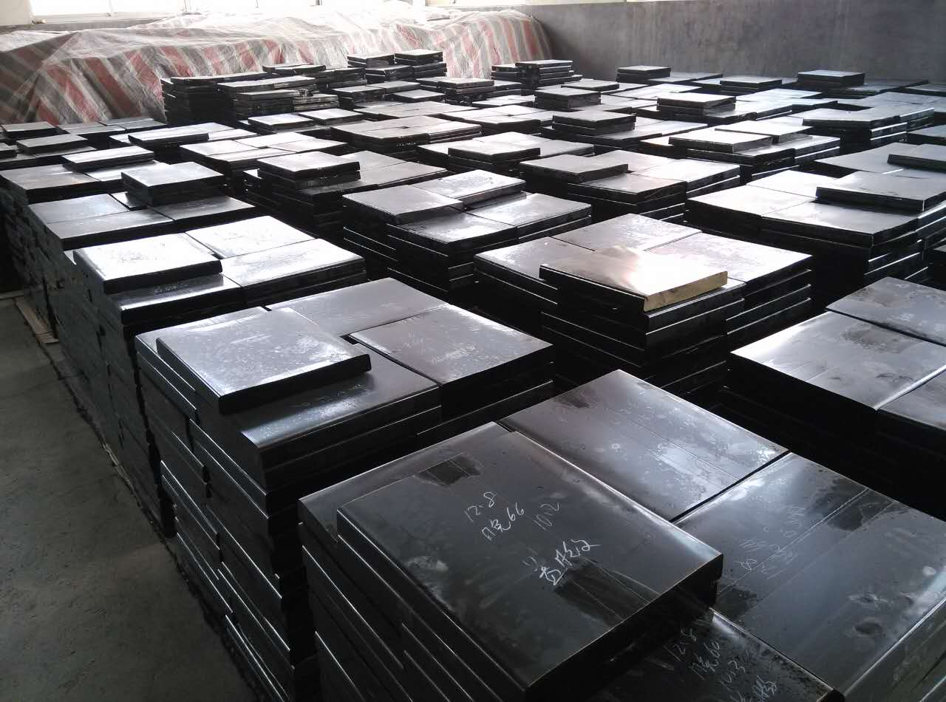
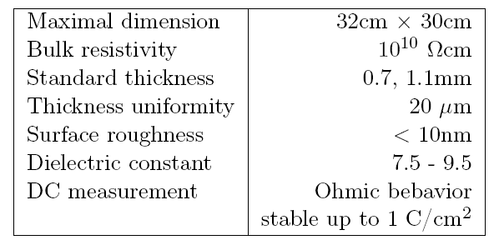
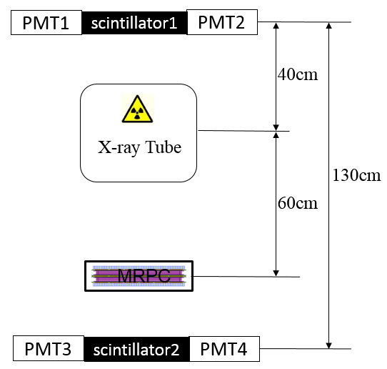
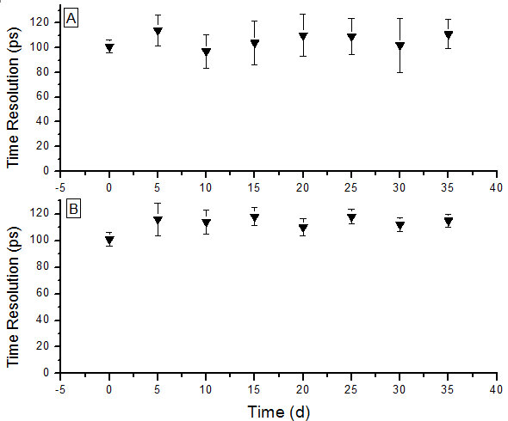
Development of low resistive glass
Performance of the glass
Glass mass production
Yield >100m²/month
Online test system. The efficiency and time resolution can be obtained by cosmic ray while irradiated by X-rays. 0.1C/cm² charge is accumulated in 35 days.
Aging test with X-ray source
14

Slide 15
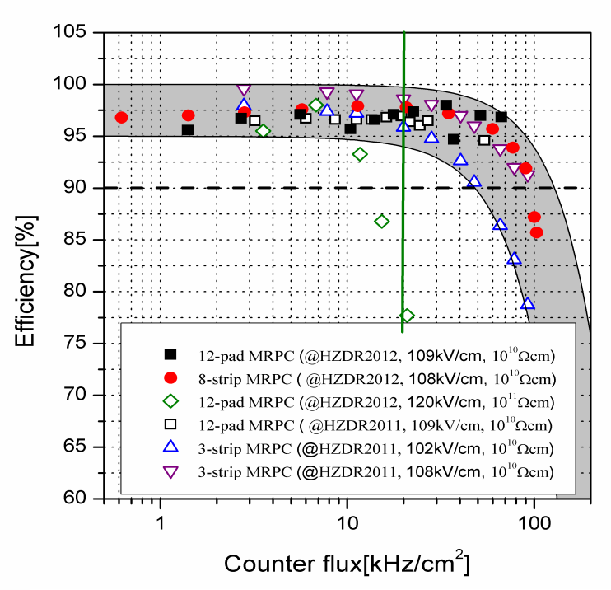
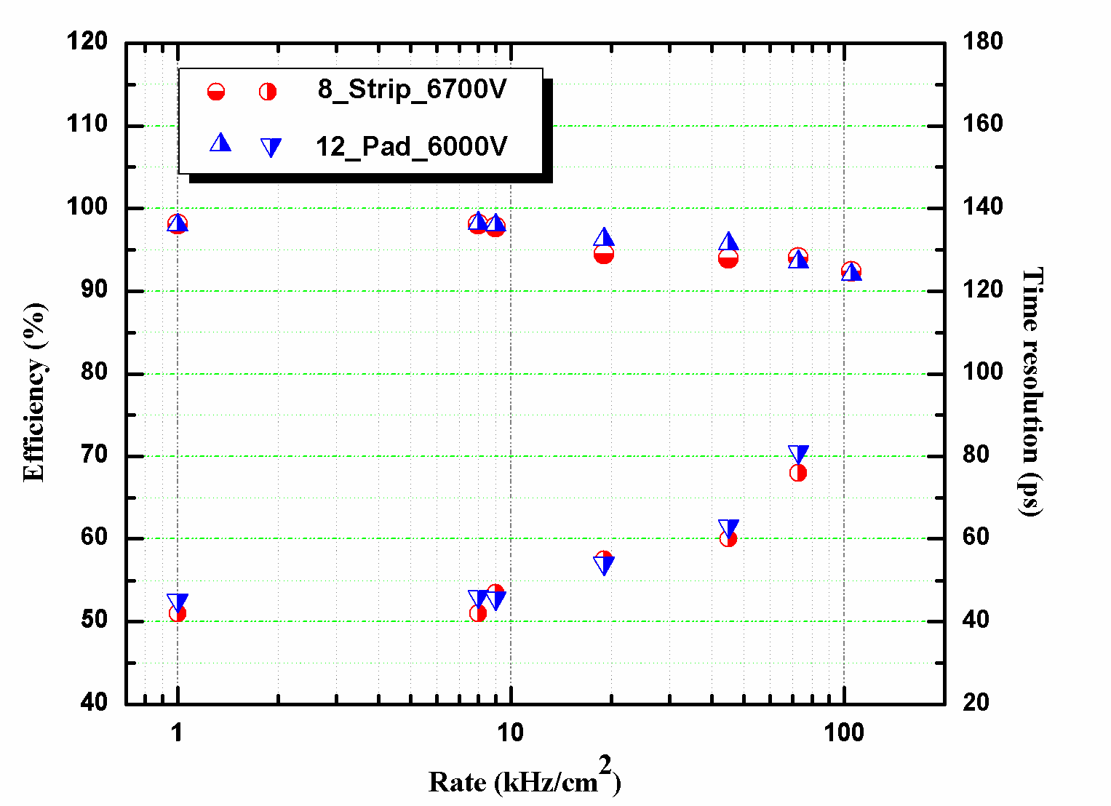
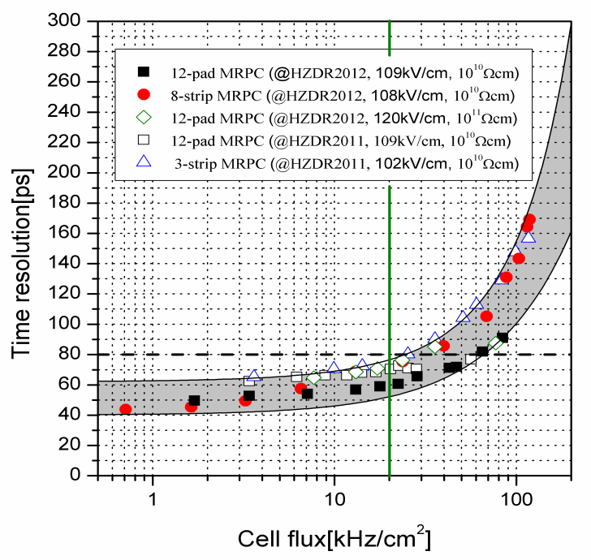
Rate capability of high rate MRPC
Test results at Nuclotron, Dubna，2013
Rate: 70kHz/cm²
Time resolution: 40 ps
Even though the rate is 70kHz/cm², the efficiency is still higher than 90% and the time resolution is about 80ps.

Slide 16
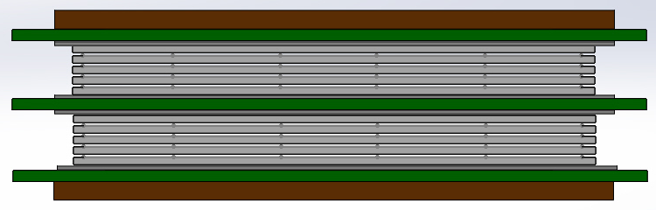
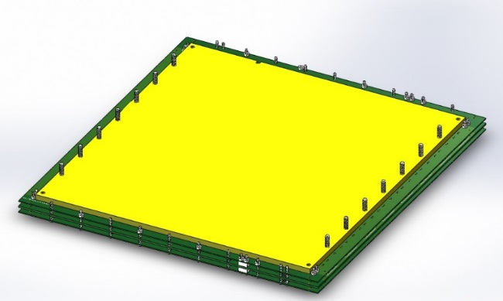
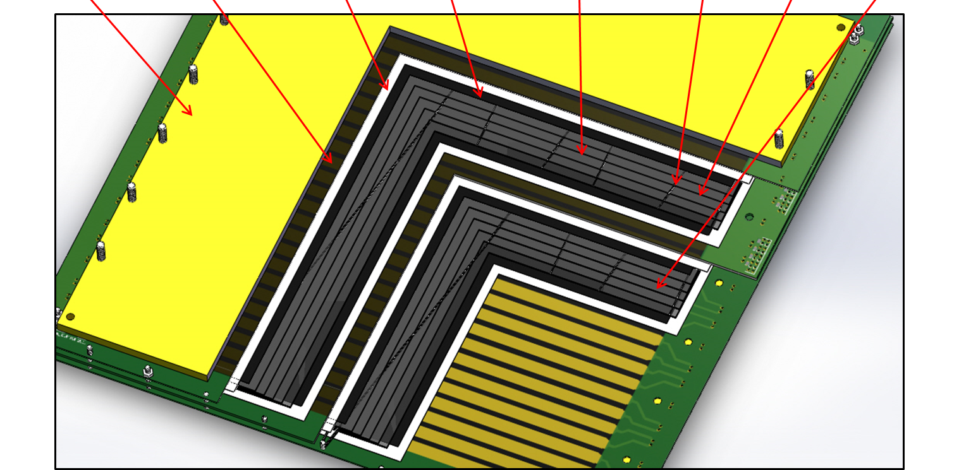
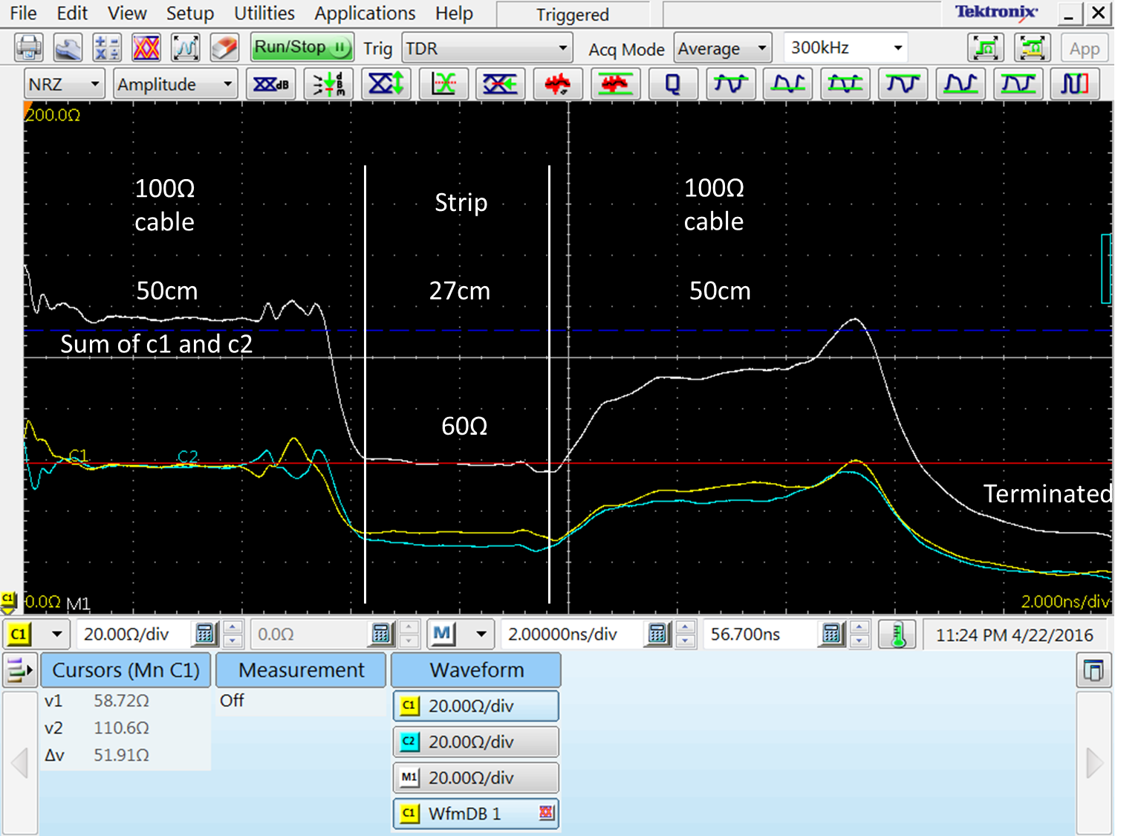
Design of strip-MRPC for high rate region
Glass: low resistive glass
0.7mm thick, 33cm x 27.6cm
Strip: 27cm x 0.7cm, 0.3cm interval, 32 strips
Gas gap: 8 x 0.25mm, two stacks
Honey
PCB
Mylar
Graphite
Glass
Fish line
Upper stack
lower stack

Slide 17
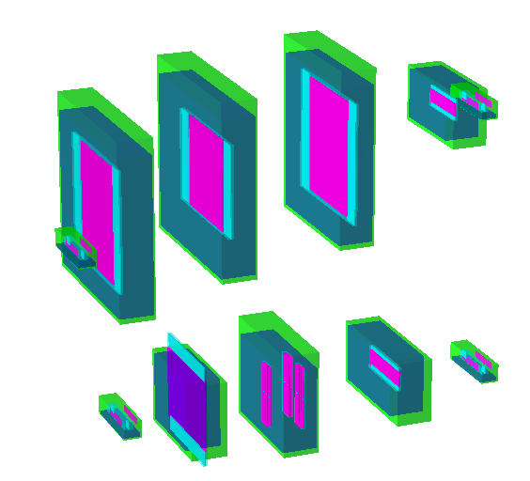
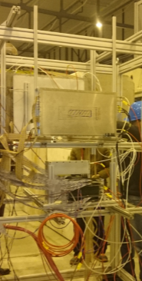
Beam test @ SPS Feb 2015
Experimental Setup:
USTC
THU-Strip
HD-Ref
HD-P2
Up setting
PMT
Down setting
High rate test in February 2015 at SPS CERN
13 GeV Ar beam
Flux rate around 1kHz/cm²
Buc-Ref
Buc-2013
THU-Pad
17

Slide 18
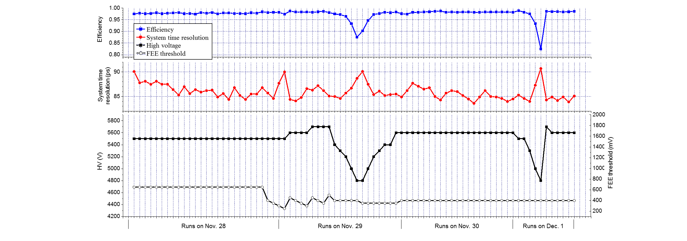
Performance of the prototype
SPS Nov 2015 THU-DU results
Results of each run
Time resolution from tracking method

Slide 19
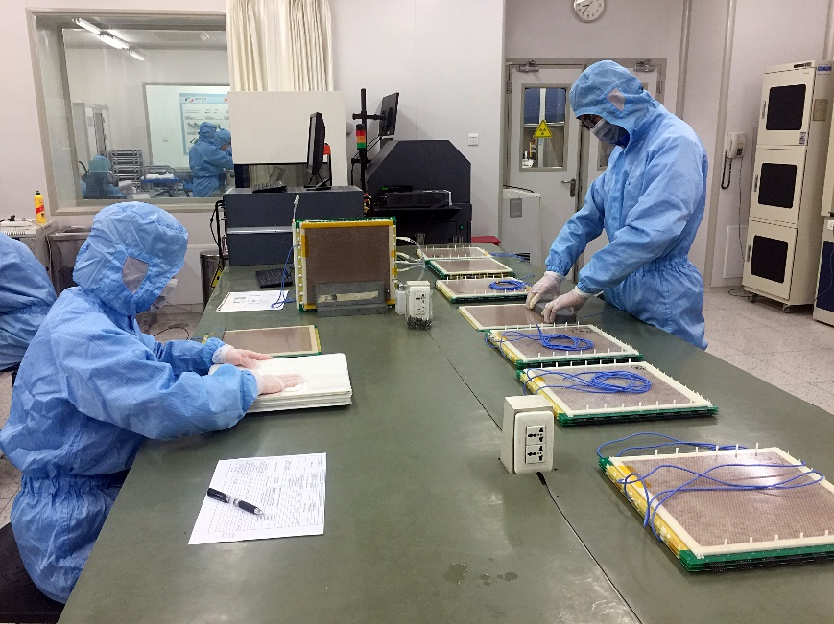

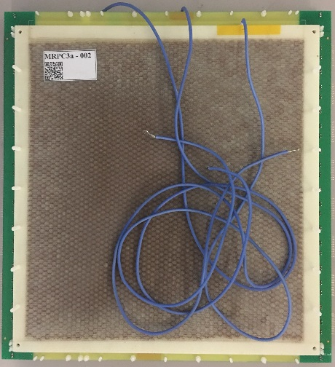
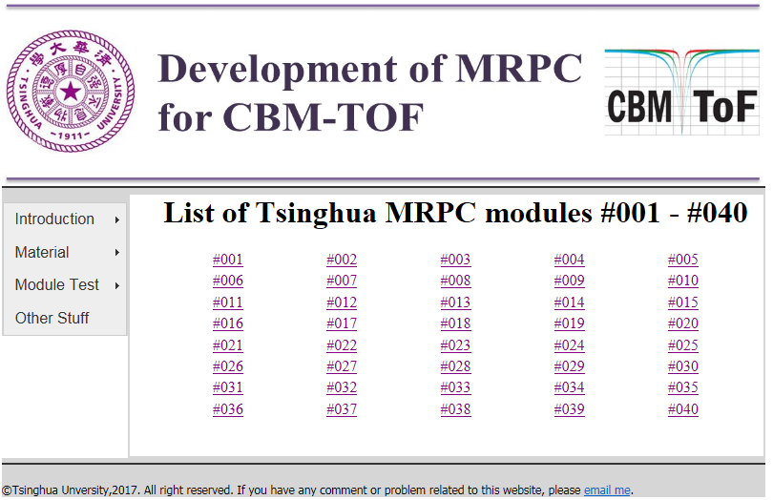
Mass production of high rate MRPC
Two-dimensional code of MRPC
Producttion website:
http://hepd.ep.tsinghua.edu.cn/CBM_TOF/
19

Slide 20
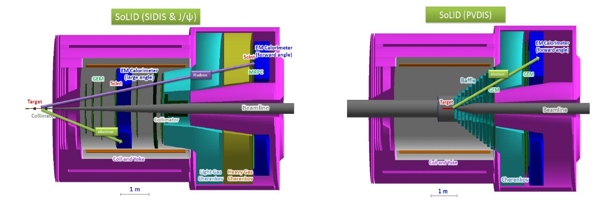
Overview of SoLID
Solenoidal Large Intensity Device
Full exploitation of JLab 12 GeV Upgrade
→ A Large Acceptance Detector AND Can Handle High Luminosity (10³⁷-10³⁹)
Take advantage of latest development in detectors , data acquisitions and simulations
Reach ultimate precision for SIDIS (TMDs), PVDIS in high-x region and threshold J/ψ
5 highly rated experiments approved (+3)
Three SIDIS experiments, one PVDIS, one J/ψ production (+ three run group experiments)
Strong collaboration (250+ collaborators from 70+ institutes, 13 countries)
Significant international contributions (Chinese collaboration)
20

Slide 21
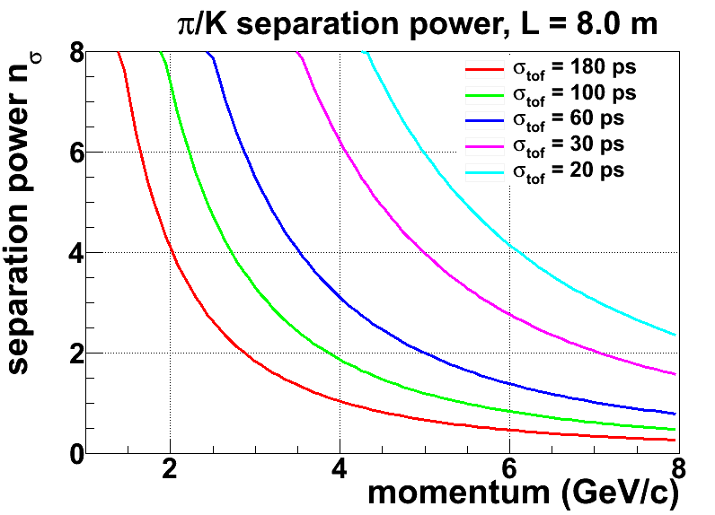
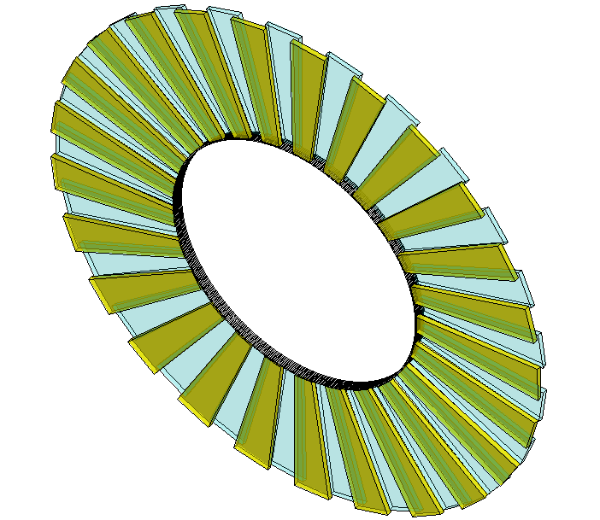
SoLID-TOF structure
The MRPC is developed for the TOF of SoLID
Main Requirements for TOF:
  π/k separation up to 7GeV/c
  Time resolution < 20ps
  Rate capability > 20kHz/cm²
MRPC3
28cm
MRPC2
16cmm
100cm
MRPC1
SoLID-TOF super module
SoLID-TOF structure

Slide 22
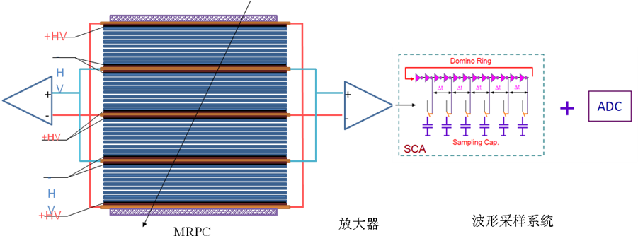
技术路线
Challenge for both MRPC and electronics.
Electronics: Fast amplifier + pulse sampling
New analysis method: take the advantage of the entire waveform

Slide 23
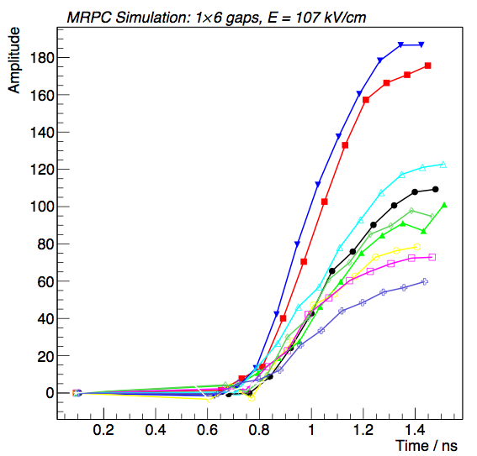
新的分析方法能够得到更精确定时
The analysis method is based on the neural network.
Artificial neural network(NN): powerful && widely used in high energy physics
Introduce NN to obtain good time resolution:
—— Find out the patterns from the MRPC signal and estimate the particle 1st interaction time more precisely.
Learn from the simulation waveforms
Test with simulation data
1
First interaction time
Test with experiment data
2

Slide 24
Neural network analysis method
Determine structure of MRPC
Construct NN
Detector simulation->Pulse shape
Training NN
Input measured pulse-> Timing

Slide 25
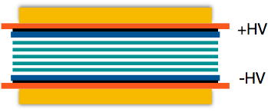


Waveform simulation
MRPC structure
Avalanche through drifting
Induced current:
Front-end electronics + noise
Design the structure
6-gas MRPC
Gap/glass thickness: 0.25/0.7 mm
Gas: 90% C2H2F4, 5% C4H10 and 5% SF6
Shoot a particle
Primary interactions
Drifting & Avalanche
Cosmic muons: ~ 4GeV
Original current signal
: Townsend coefficient
: Attachment coefficient
Electronics
*F. Wang, et al., A standalone simulation framework of the mrpc detector read out in waveforms, arXiv:1805.02387.

Slide 26

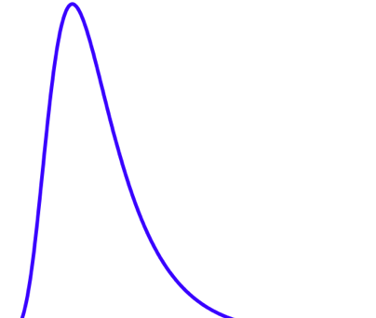
Simulation data
Simulation dataset :
: first interaction happens
: the signal reach the peak
7 uniformly distributed points along the
leading edge
MRPC
Source
Signal
Fixed threshold
t

Slide 27
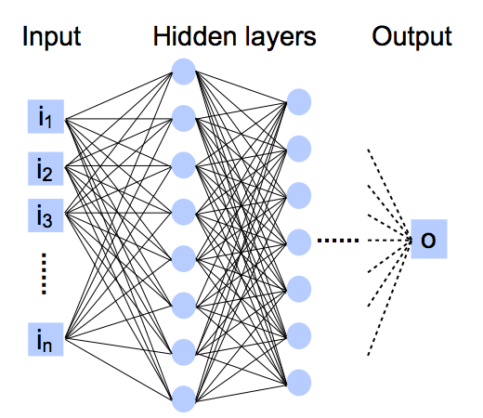


One NN：Multilayer perception (MLP)
Multilayer perceptron (MLP)
Output
Input
Activation function: g and h —— tanh
Weights:
“Dropout”: avoid overfitting
The length of the leading edge t l
Time of the very first interaction:
Train/validate/test set: 20/10/10 k
Tensorflow & GPU: GTX 1080 Ti
~ 10 mins for training
Several uniformly distributed points along the leading edge

Slide 28
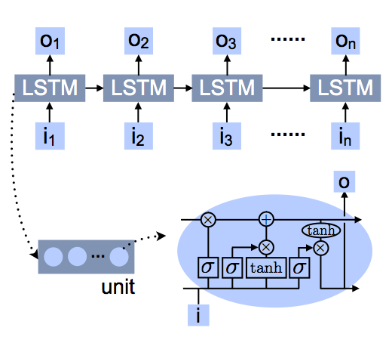
Another NN：LSTM
Recurrent neural networks(RNN): Long Short Term Memory network(LSTM)
Train/validate/test set: 20/10/10 k
Tensorflow & GPU: GTX 1080 Ti
The length of the leading edge t l
Several uniformly distributed points along the leading edge
f : forget gate: Whether to erase
I : Input gate, whether to write
g: gate gate, How much to write
o: output gate, How much to reveal
F
I
G
O
> 30 mins for training

Slide 29
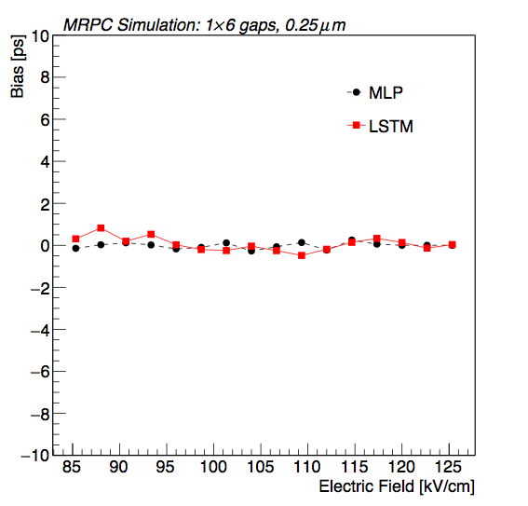
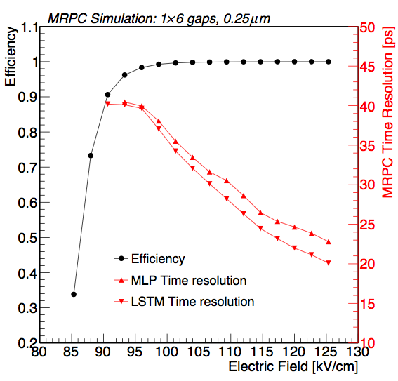
Simulation results
Define bias:
Accuracy is good and stable
The best time resolution can reach around 20 ps.
Accuracy
Precision
Experiment point
Streamer may happen
29

Slide 30
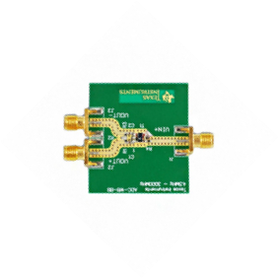


Experimental setup
Experiment of the cosmic ray
2 identical MRPC: 6-gap, 0.25mm gap, working at E=109 kV/cm
Oscilloscope bandwidth: 1 GHz
Sampling rate: 10 GS/s
PMT1
FEE
MRPC1
FEE
FEE
MRPC2
FEE
PMT2
Oscilloscope
trigger
Leading edge: 700~800 ps
7~8 points along the edge

Slide 31


Signal waveform
Compare the waveform
1L
1R
2L
2R
Waveforms of 1 event
Nearly the same!
Still with differences!

Slide 32




Experimental results
The 4 waveforms are estimated by the LSTM models separately
Define:
for vertical particles
The time resolution of two MRPCs
are independent:
With LSTM model, for vertical
particles, the time resolution is:

Slide 33

Design of 3^{g} MRPC for SoLID
Item | dimension/mm
Honeycomb | 90×265×7.5
Outer PCB | 120×298×0.6
Middle PCB1 | 120×298×1.2
Middle PCB2 | 120×328×1.2
Strip length | 268
Strip width | 7
Mylar | 90×268×0.25
Glass | 80×258×0.5
Carbon | 72×250
Gas gap width | 0.104
Number of gas gap | 32
Honey comb plate
PCB
Mylar
Carbon electrode
Glass
33

Slide 34
Analysis with neural network

Slide 35
Conclusions
Time of flight system (TOF) based on MRPC technology is widely used and played an important role in modern high energy nuclear physics experiments.
With the increase of accelerator energy and luminosity, many experiments have increasingly demand on the TOF for particle identification to have high resolution TOF under high data rate environment.
New technology such as New material (low resistive glass), New electronics (switched capacitor array (SCA) and precision TDC ) will be used in TOF system. New analysis method such as deep learning technology will play an very important role!

Slide 36
Thanks for your attention!

