Slide 1

课题3：CMS端盖μ子探测器升级
CMS-MRPC探测器
王义
清华大学工程物理系

Slide 2
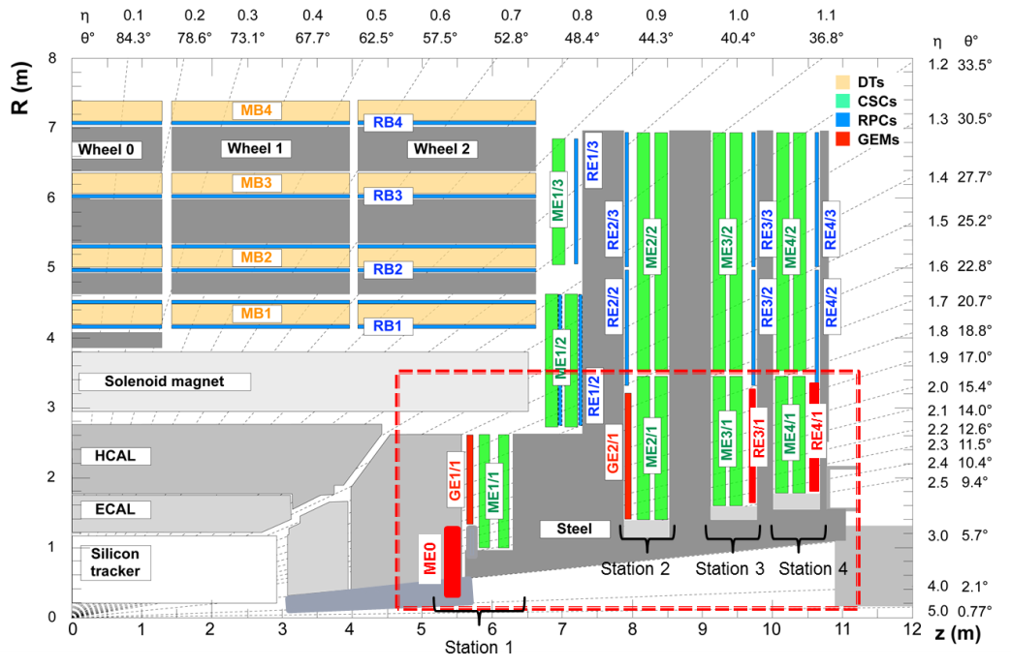
CMS端盖缪子探测器升级内容
In CMS PhaseII upgrade, station 3 and 4 of Muon system is intended to be constructed with RPC.
Requirement:
Rate >2kHz/cm²
Trapezoidal, space limit
Time resolution <100ps
Efficiency >95%
端盖μ探测器升级
清华大学, 玻璃MRPC
RE3/1+RE4/1

Slide 3
主要研究内容
根据物理条件要求及现场空间的限制，拟研制梯形MRPC。探测器长度达1米，上底宽度45cm，下底宽度55cm。由于我们研制的低电阻玻璃尺寸的限制，整个探测器由6个小梯形MRPC拼接而成，而整个探测器采用统一的PCB读出感应信号。每个MRPC包含5个气隙，气隙宽度为250微米，采用条形读出，读出条平均宽度为10mm。这种结构的优点是能够保证高的时间分辨，同时也能保证探测器的厚度在限定的范围内。
需要解决玻璃拼接，阻抗匹配，信号串扰及传输，探测器宇宙射线及粒子束流测试等关键技术问题。
同时还要研究高亮度实验中的气体污染问题，以保证探测器的长期稳定工作。
完成CMS前端缪子探测器ME3/1和ME4/1两个区的部分升级。

Slide 4
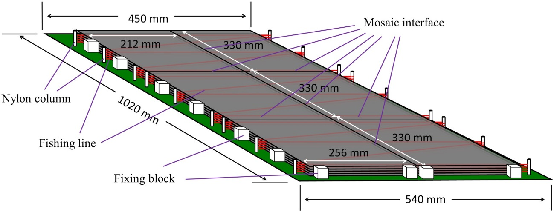
主要进展
20cm
27cm
全尺寸MRPC
25 cm
Gas gap number: 5
Gas gap width: 250 μm
Glass thickness: 0.7 mm
Glass bulk resistivity: ~ 10¹⁰ Ωcm
Mosaic interface: glass directly mosaic together
拼接原型探测器
Strip number: 44
Strip shape: trapezoidal (6 mm/8 mm)
Strip interval: 3 mm
Strip length: 1 m

Slide 5
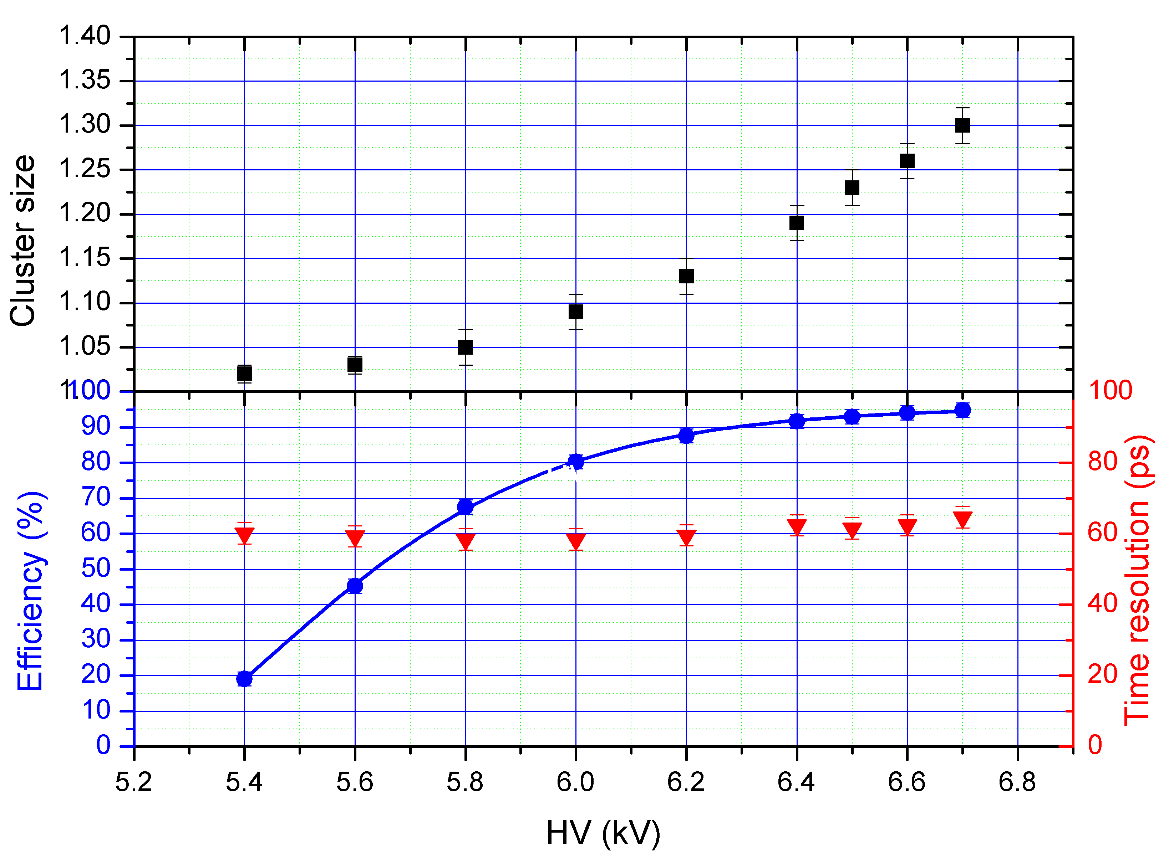
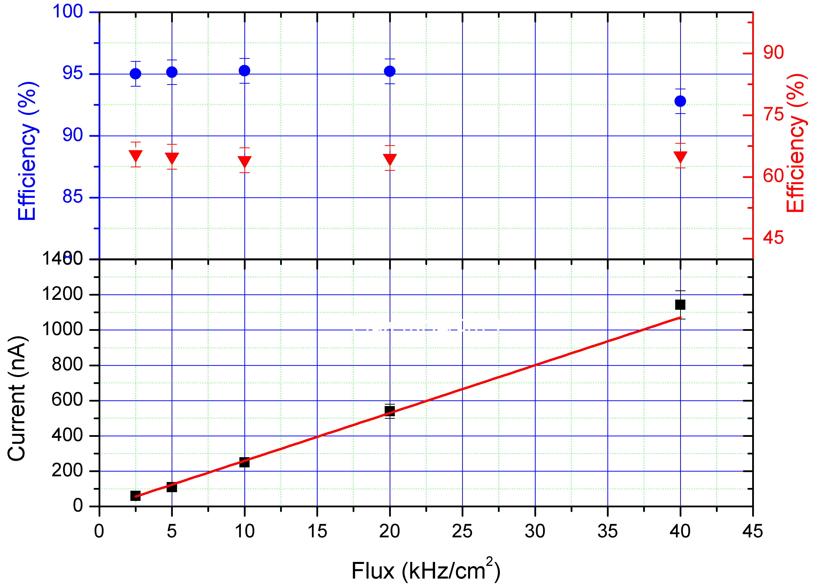
原型探测器的性能
Cluster size<1.3
Efficiency -> 95%
Time resolution ~60ps
计数率>40kHz/cm²

Slide 6
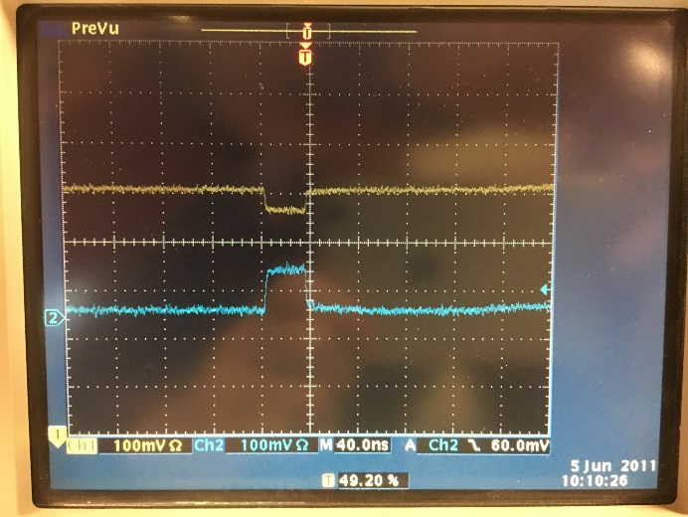
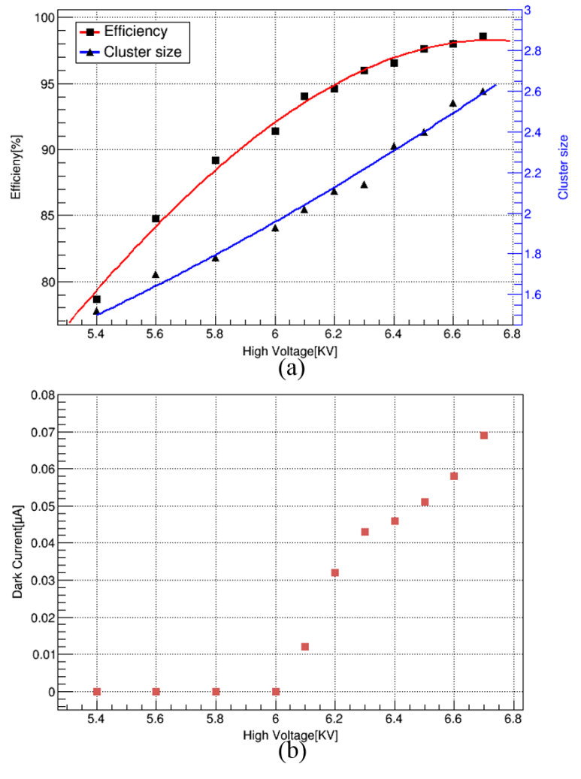
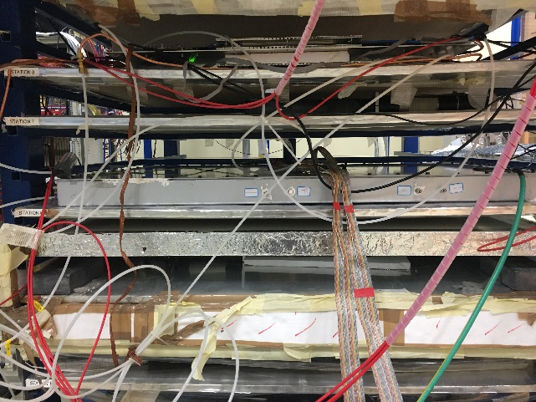
全尺寸测器的性能（@CERN 904）
Cosmic ray test at CERN in Feb, 2017:
Gas component: 90% C₂H₂F₄ + 5% i-C₄H₁₀ + 5% SF_{6.}
NINOs signal
Trigger PMT
Mosaic MRPC module
Trigger PMT

Slide 7
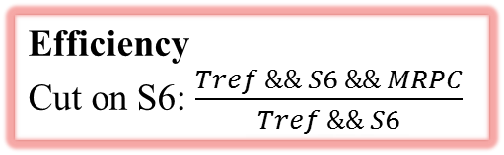
全尺寸测器的性能（@HZDR）
Rate: 11 kHz/cm².
Efficiency
Cut on S6: $\frac{Tref \&\& S6 \&\& MRPC}{Tref \&\& S6}$
Working gas :
90% C₂H₂F₄ + 5% i-C₄H₁₀ + 5% SF₆.

Slide 8
全尺寸测器的性能（@HZDR）
Run005 ~ Run009
Run017 ~ Run021
时间分辨岁高压的变化
不同计数率下的时间分辨

Slide 9
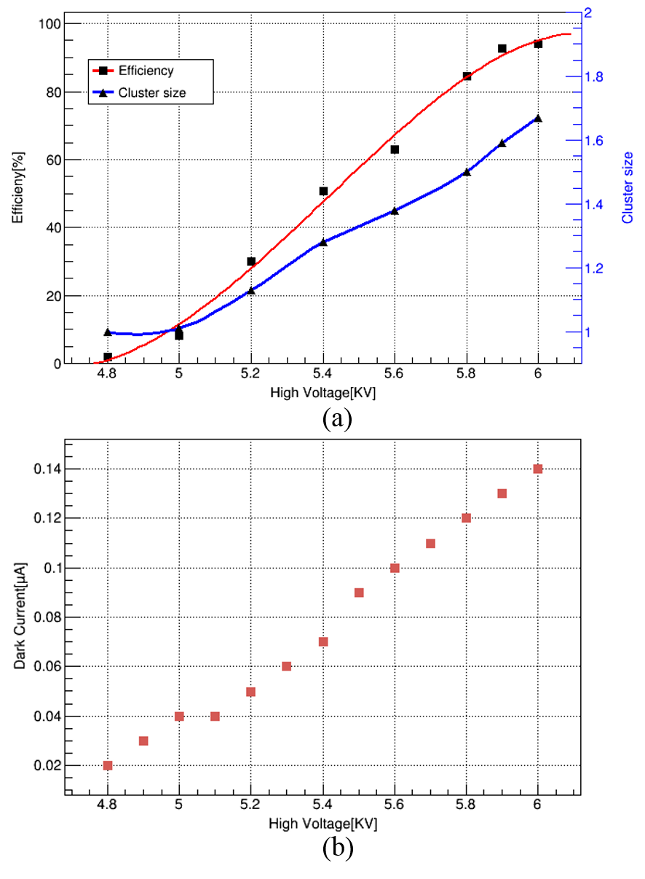
全尺寸测器的性能（@GIF⁺⁺）
Chamber has been repaired at CERN in Sep, 2017
Working gas:
CMS gas: 95.2% C₂H₂F₄ + 4.5% i-C₄H₁₀ + 0.3% SF₆.

Slide 10
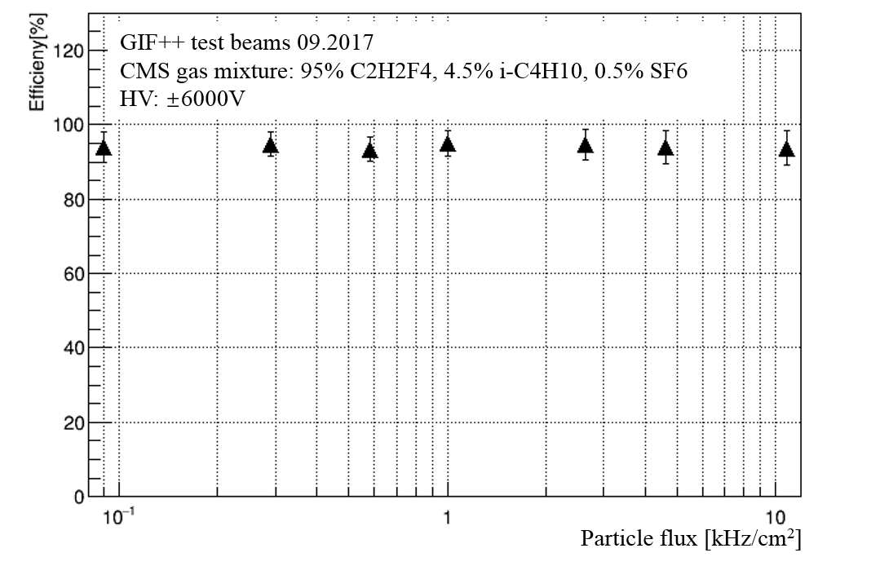
全尺寸测器的性能（@GIF⁺⁺）
Rate[kHz/cm²] | Efficieny[%]
0 | 94.12
0.29 | 94.81
0.58 | 93.41
1.007 | 95
2.64 | 94.68
4.64 | 93.93
10.83 | 93.75
There is no efficiency loss along with high rate. Efficiency always reaches about 94% at ± 6000V.

Slide 11
总结
Find a good technology to develop high rate, high time resolution and large area MRPC
30 MeV electron beam at HZDR at rate of 10kHz/cm²
Efficiency reaches 95% at ±6800V
Time resolution around 55ps.
Efficiency loss at mosaic interface is about 2%.
The real size mosaic MRPC can keep good performance with CMS dry gas.
Efficiency can reaches about 94% at ± 6000V at rate of 10kHz/cm².
高计数率MRPC是一种全新的技术，在不同工作气体下的性能（如工作点，时间性能等），与已有普通浮法玻璃MRPC的完全不一样。

Slide 12
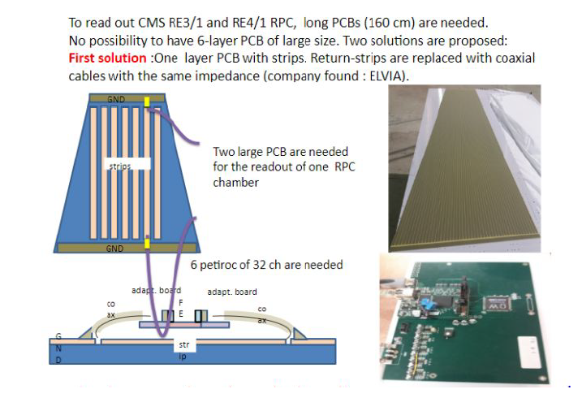
Next: 与新电子学联调
1、PETIROC2A: 单极性输入，快前放+ TDC
2、读出条两端读出，通过时间差得到击中位置

Slide 13
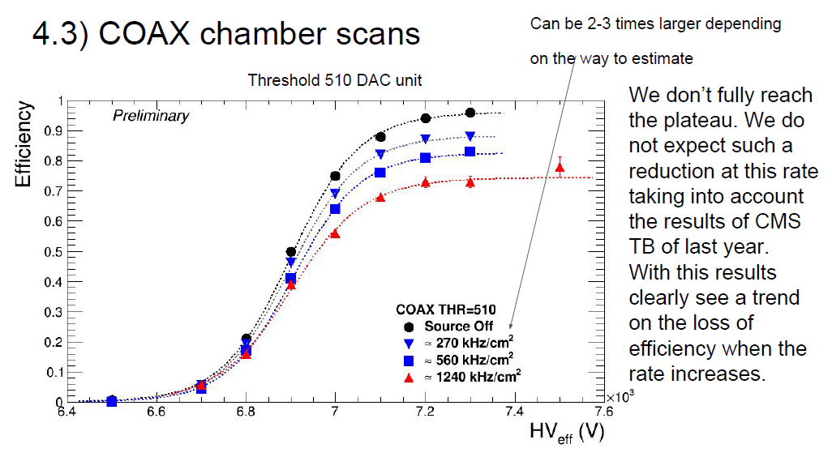
Bakelite RPC 与PETIROC2A测试不成功
甄别阈值与CMS RPC老电子学一样，50fC, 效率下降的原因还不清楚。

Slide 14
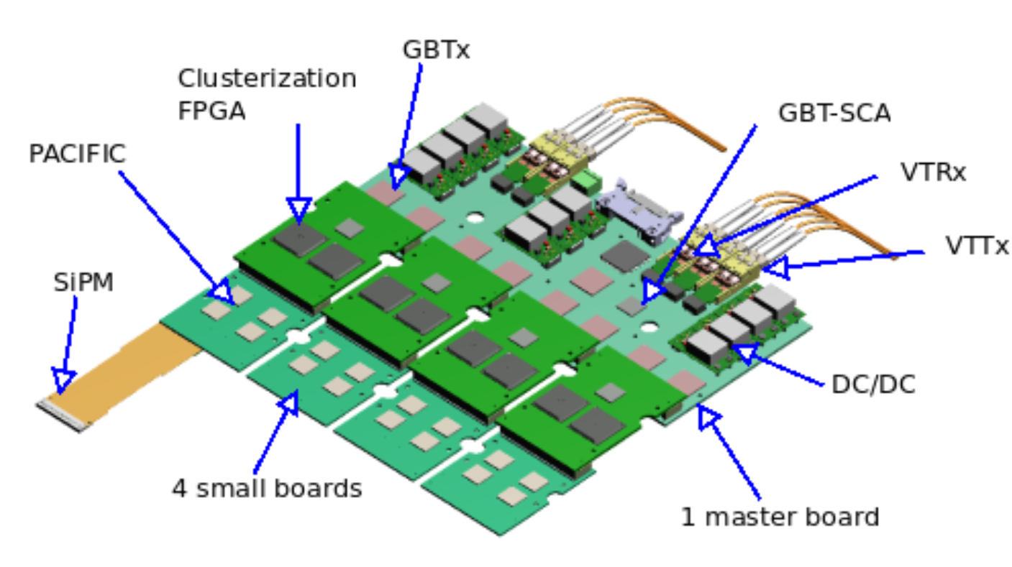
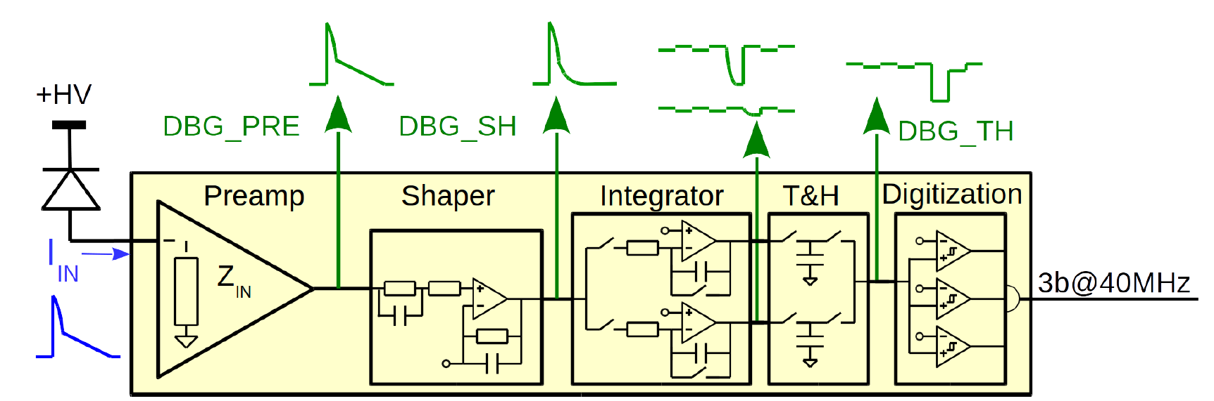
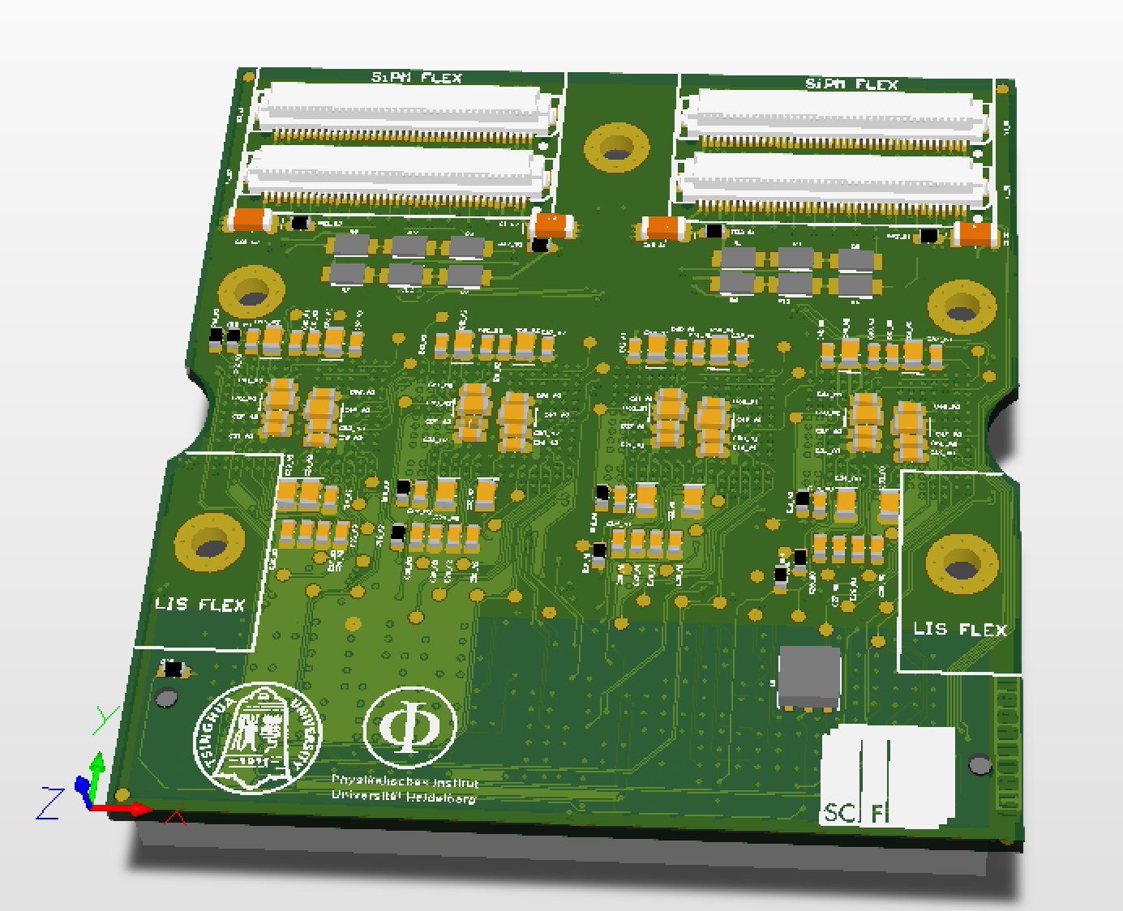
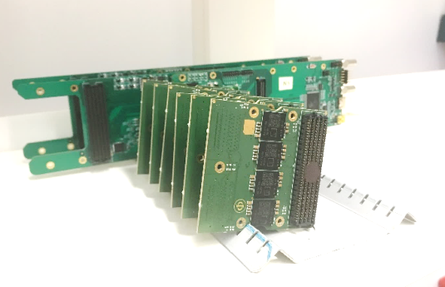
LHCb径迹探测器升级
<100 μm Resolution (for momentum)
~ 340 m² total active surface
250 μm Scintillating Fiber
524,000 SiPM Channels
PACIFIC – 64 channel SiPM readout ASIC
with 16 x 320 MHz digital outputs
> 12,000 Chips needed
> 2,500 Frontend Electronics Boards
LHCb China Group:
  Readout Electronics for Detector Performance Evaluation (> 20 Setups in SciFi Group)
  Co-design SciFi Frontend Electronics Boards
  SciFi Readout Electronics (PACIFIC) Quality Assurance System (for chips, and frontend boards)
  Manufacturing and testing all Frontend Boards (2,500 boards) in China

Slide 15
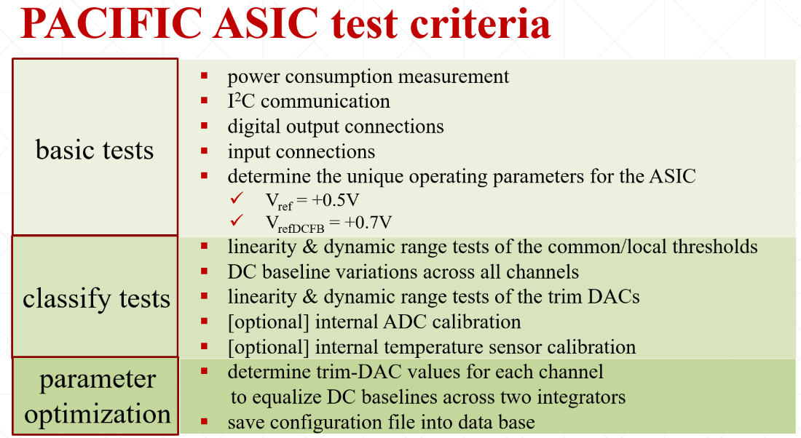
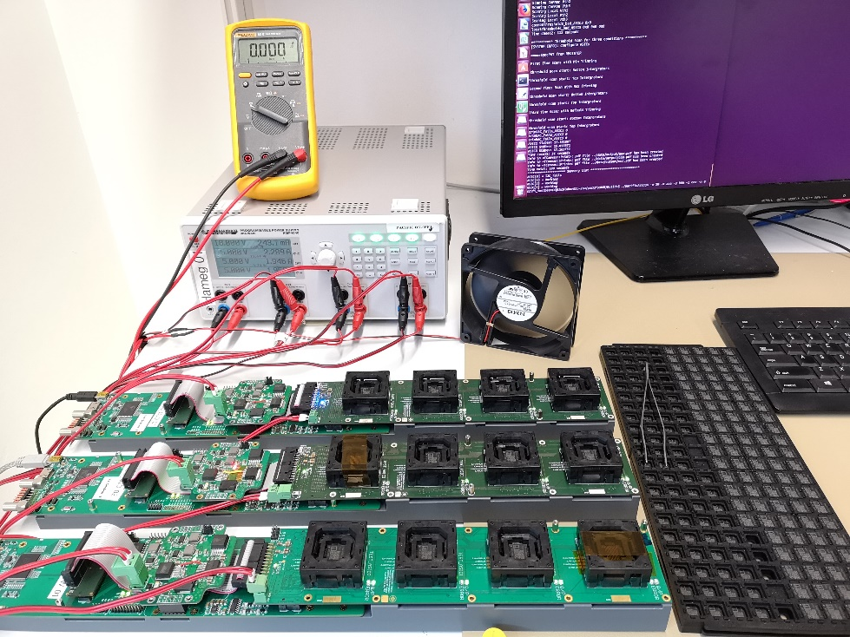
LHCb SciFi – Scintillating Fiber Tracker
Automatically in FPGA firmware,
5 mins/ASIC, 13 mins/Frontend Boards
Basic Tests:
Power, I2C, Digital Output
Classify Tests
Linearity, Dynamic range, DC Baseline
Parameter Optimization (in to Database)
Configuration, DAC values (for baseline)
LHCb China Group (2018) finished:
  > 1500 PACIFIC ASICs tested
  20 Frontend Boards manufactured and tested
  4 Readout Electronics Quality Assurance System were set up at Heidelberg, Germany
2018 Summer To Do:
  ALL 12,000 PACIFIC ASICs test (with Spain group)
  ALL 2,500 Frontend Boards manufacture and test in China
  >5 Readout Electronics Quality Assurance System should be set up at Spain and Germany

Slide 16
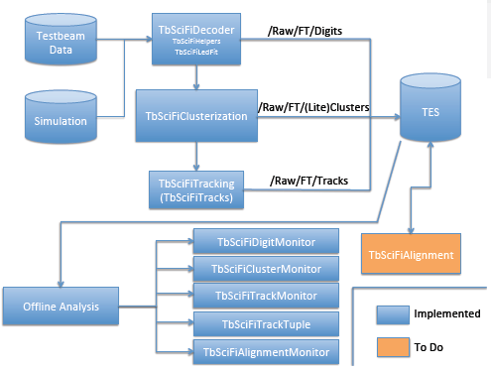
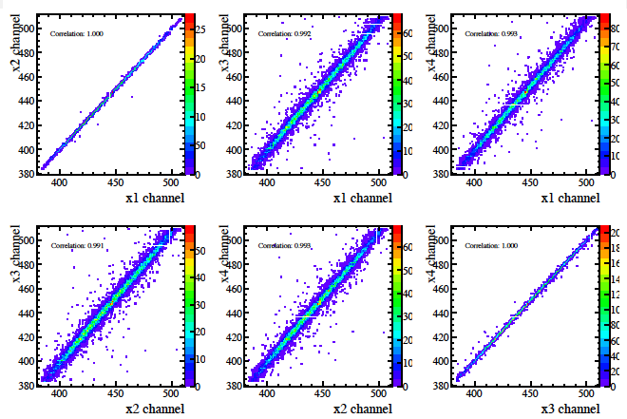
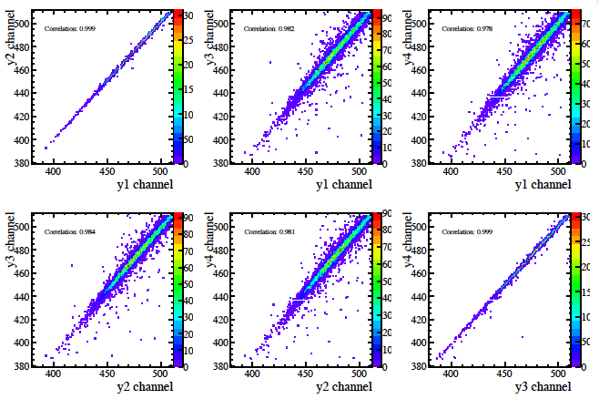
LHCb SciFi Tracker: software
Build new sequence for SciFi specific processing of 2017 Testbeam data, which allows for the tuning of simulation to data
Correlations between Y channels
Correlations between X channels
16

Slide 17
文章和专利
Wang Fuyue, Wang Yi. Performance study of new style mosaic MRPC. Chinese Physics C, 2016, 40(11) , 116006 . DOI：10.1088/1674-1137/40/11/116006.
Wang Fuyue, Han Dong and Wang Yi. Performance study of a Mosaic high rate MRPC. 2016 JINST 11 C09016
Lyu Pengfei, Wang Yi. et al. Gas related effects on multi-gap RPC performance in high luminosity experiments. 2016 JINST 11 C11041
Lyu Pengfei, Wang Yi. Development and performance of self-sealed MRPC. JINST，12，C03055
Yancheng Yu, Wang Yi. R&D of a real-size Mosaic MRPC within the framework of the CMS muon upgrade, JINST (已投稿）
一种新型的阻性板室探测器, 发明专利号：ZL201410190976.X
快时间响应射线探测器，实用新型，ZL 201520890740.7

Slide 18
Thank You!

