Slide 1
Forward-Backward Asymmetry Study in
$e^{+}e^{−}→μ^{+}μ^{−}$ at Z Boson mass
Mengran Li
March 12th 2018

Slide 2
Plan for Re-do Z-> $μ^{+}μ^{−}$ A_{FB} Analysis with 3T Magnetic Field
Redo 100k full-simulation Z->mumu with 3T magnetic field and new geometry,
Estimate the angular resolution and its impact to acceptance.
Estimate the Z->tautau background contamination based on fast sim using the selection cut from OPAL paper (https://arxiv.org/pdf/hep-ex/0012018.pdf).
Produce about 100M Z->mumu fast simulation for weak mixing angle fit.

Slide 3
Some Result with Old Settings (2.5T Magnetic Field)
Distribution of Polar Angle
Fit of A_{fb} in E_{cm}

Slide 4
Some Result with Old Settings (2.5T Magnetic Field)
Di-muon Reconstruction Efficiency
Resolution of $cosθ$ in different $θ$ region

Slide 5
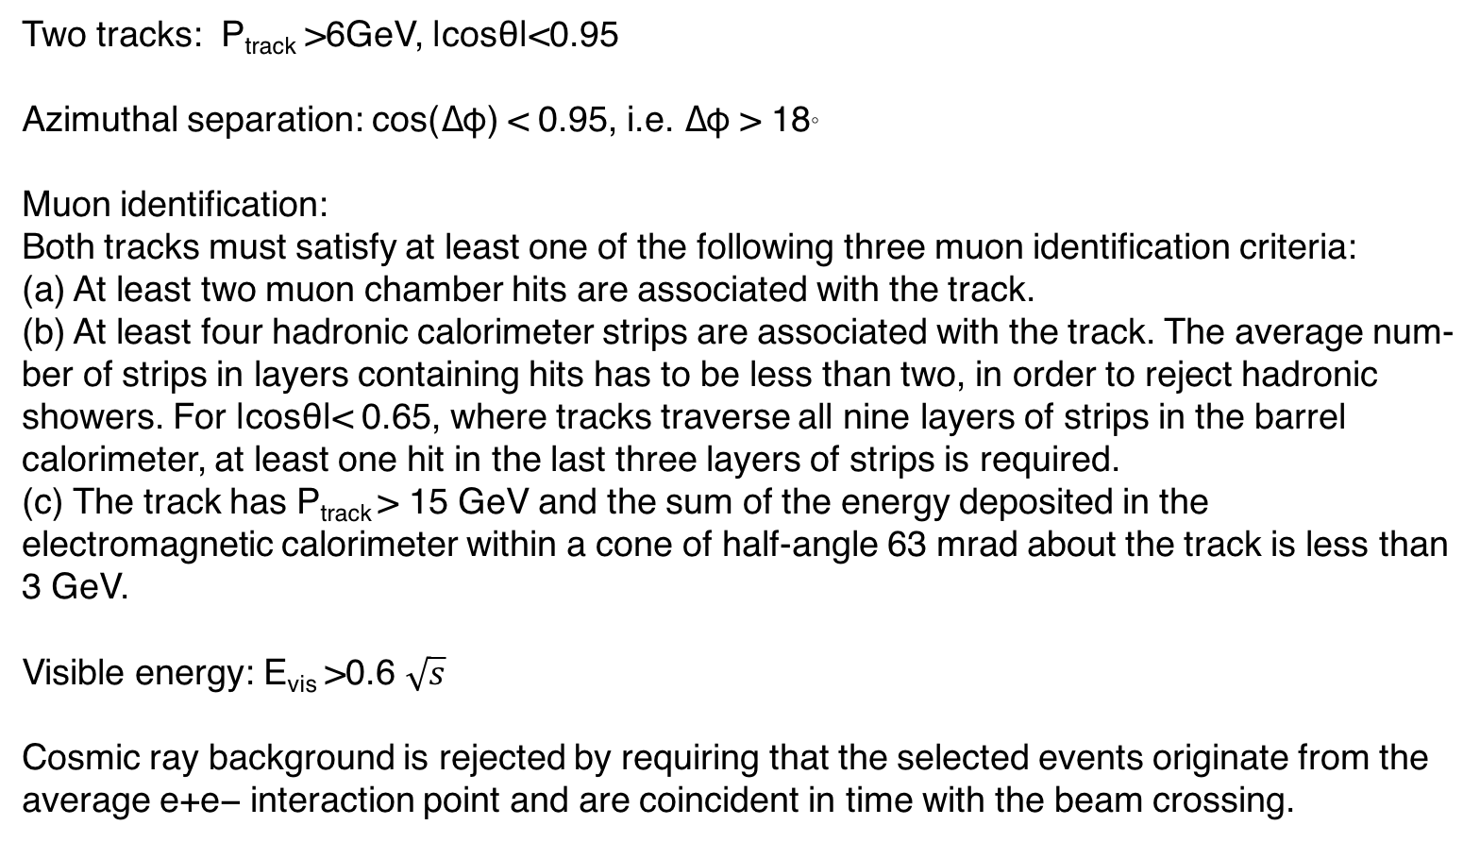
Estimate $Zττ$ Backgrounds Using Selection Cut from OPAL Paper
Two tracks: P_{track} >6GeV, |cosθ|<0.95
Azimuthal separation: cos(∆φ) < 0.95, i.e. ∆φ > 18。
Muon identification: Both tracks must satisfy at least one of the following three muon identification criteria: (a) At least two muon chamber hits are associated with the track. (b) At least four hadronic calorimeter strips are associated with the track. The average num- ber of strips in layers containing hits has to be less than two, in order to reject hadronic showers. For |cosθ|< 0.65, where tracks traverse all nine layers of strips in the barrel calorimeter, at least one hit in the last three layers of strips is required. (c) The track has P_{track} > 15 GeV and the sum of the energy deposited in the electromagnetic calorimeter within a cone of half-angle 63 mrad about the track is less than 3 GeV.
Visible energy: E_{vis} >0.6 $\sqrt{s}$
Cosmic ray background is rejected by requiring that the selected events originate from the average e+e− interaction point and are coincident in time with the beam crossing.

Slide 6
End

