Slide 1

Design of High Quality Electron Gun and Experimental Test of Cathode Activity for CEPC Klystron
Chung-Yao Chao Fellowship 2018
Speaker:
Zaib Un Nisa
Advisors:
Prof. Pei Guoxi
Prof. Shigeki Fukuda
Institute of High Energy Physics, Chinese Academy of Sciences
Beijing, China

Slide 2
Brief Curriculum Vitae
Personal data
● Date of birth
05 July 1985
● Place of birth
Gujranwala, Pakistan
● Email:
zaib@ihep.ac.cn
zaib.ucas@gmail.com
Education
● Sept. 2013-Nov. 2017
PhD student at IHEP
● Sept. 2009-Dec.2011
M. S. (Material Science)
% age= 72%
● Sept. 2005-Aug. 2009
BS (Hons). Physics.
% age= 70%
Career
March 2018-date
Postdoc at IHEP
● 2012-2013
Lecturer Physics
Punjab University, Pakistan
I joined IHEP in Sept. 2013 and started my PhD thesis work entitle,
“Design of High Quality Electron Gun and Experimental Test of Cathode Activity for CEPC Klystron”
➔ I defended my PhD thesis on Nov. 20, 2017
➔ I started post doc at IHEP
➔ My main focus on “Multi-beam Klystron”
➔ I have published two article as a principle author in SCI journal.
➔ I have also published four conference proceedings in IPAC’16.
Today I will focus on the recent results achieved at IHEP and future plans

Slide 3
Contributions
Head Author Article
Design Consideration of 650-MHz Circular Electron-Positron Collider
Klystron and Simulation of Its Beam Tester.
Published in CHIN. PHYS. LETT. Vol. 34, No. 1 (2017) 012902.
DIP Test: Rapid Cathode Activity Evaluation of the Klystron used in
Accelerator.
Published in Prog. Theor. Exp. Phys., Volume 2017, 113G02.
Design Study of Electron Gun for 650 MHz CEPC Klystron.
Published in Proceedings of IPAC2016, ISBN 978-3-95450-147-2.
Co- Author Article
CEPC 650 MHz Klystron Development.
Published in Proceedings of IPAC2016, ISBN 978-3-95450-147-2.
Design Study of Collector for 650 MHz CEPC Klystron.
Published in Proceedings of IPAC2016, ISBN 978-3-95450-147-
Design Study of RF Section and Cavities for 650 MHz CEPC Klystron.
Published in Proceedings of IPAC2016, ISBN 978-3-95450-147-2.
My Thesis

Slide 4
CEPC Klystron Gun Study

Slide 5
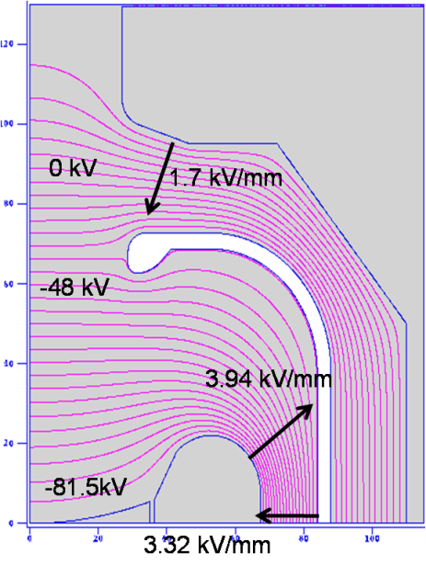
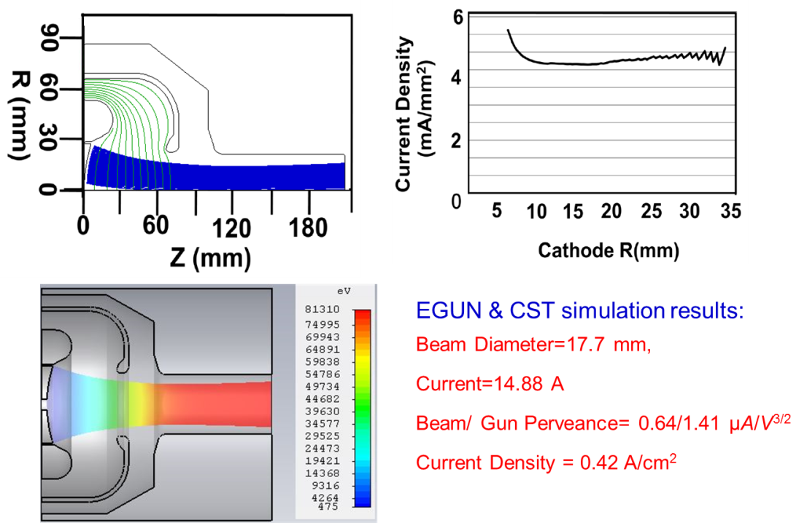
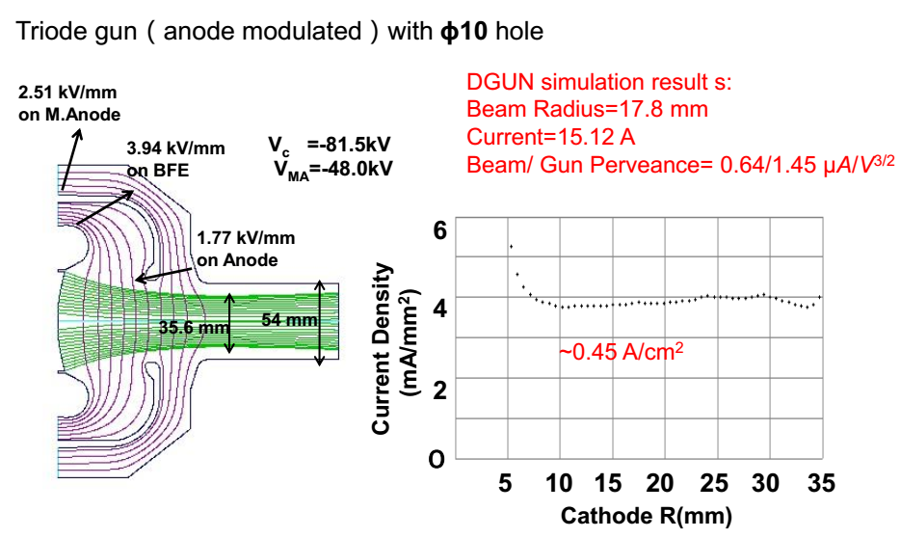
Design Parameters for CEPC
Klystron
Electric Field using Poisson
Parameters | Units | Values
Operating frequency | MHz | 650
Output RF power | kW | 800
Maximum beam Voltage | kV | 81.5
Maximum beam current | A | 15.1
Efficiency | % | > 70
Drift tube radius | mm | 27
Beam Radius | mm | ~17.8
Magnetic Field Focusing | G | 180 ~ 200
Current Density | A/cm² | ~0.45
33.5
Electron Gun Simulation Results by DGUN Code
Comparison with EGUN & CST
33.5 kV

Slide 6
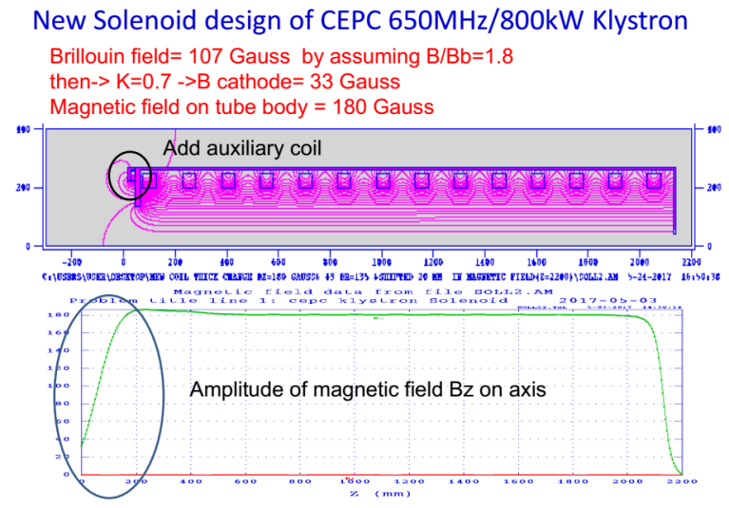
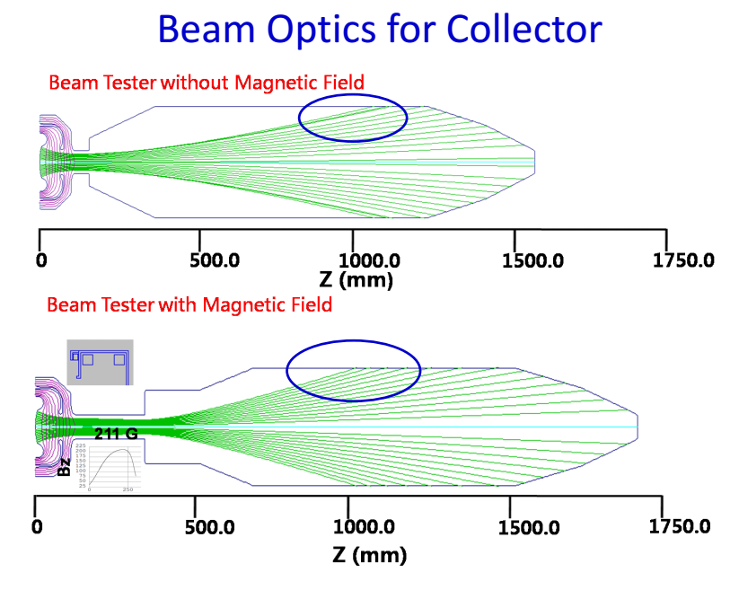
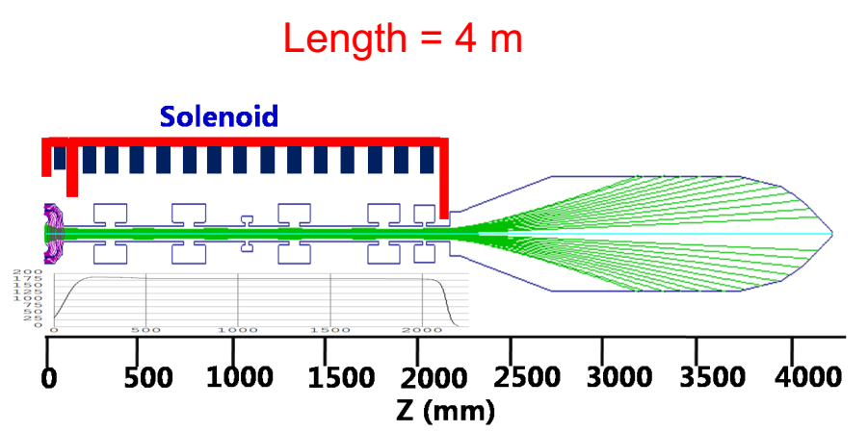
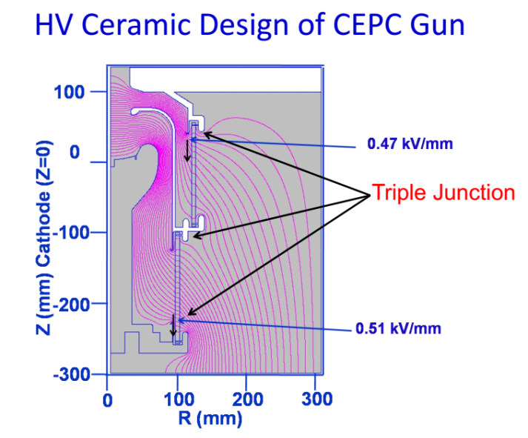
Solenoid Design of CEPC 650 MHz/800 kW Klystron
Beam Optics for Collector
Gun Assembly with Drift Tube and Collector
HV Ceramic Design of CEPC Gun

Slide 7
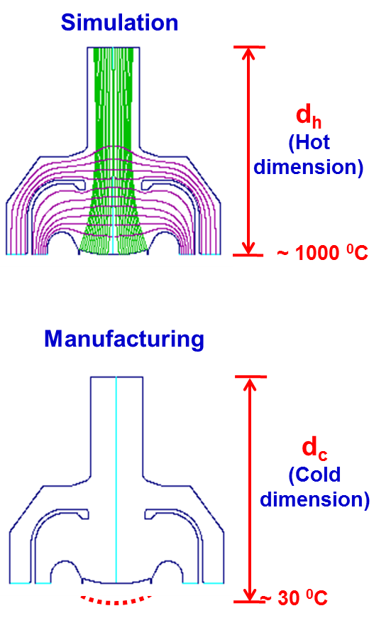
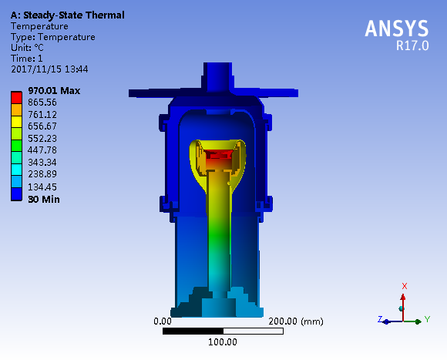
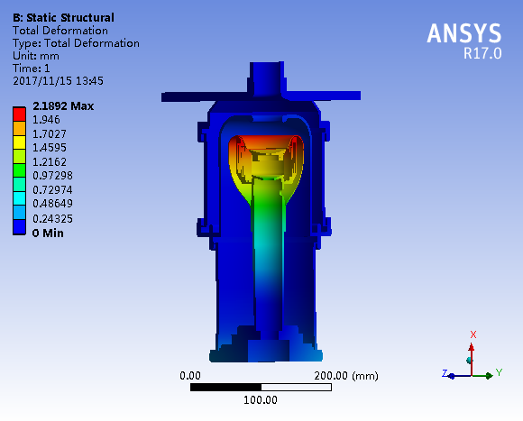
CEPC Gun Thermal Analysis
Cathode Temp. | ANSYS Results
 | BFE (dx) | BFE Total Deform. | BFE (dy, dz) | Cathode (dx) | Cathode (dy,dz)
950 ⁰C | 1.99 | 2.01 | 0.72 | 1.74 | 0.15
Expansion length change (dx) = 1.87 mm
1.87 mm of cathode dx is corresponds to ~4% microperveance of beam perveance

Slide 8
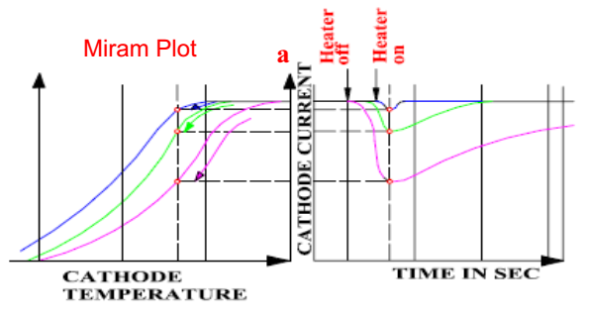
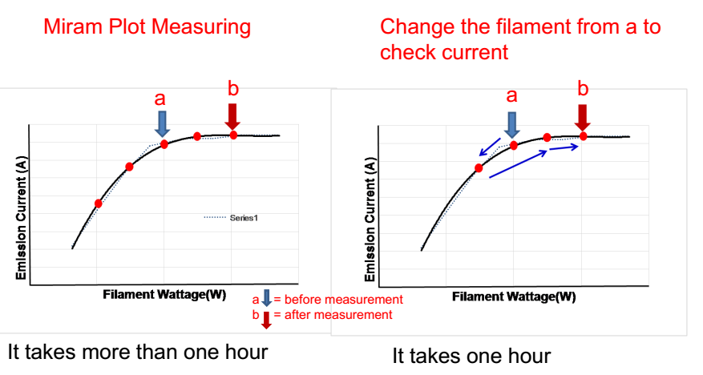
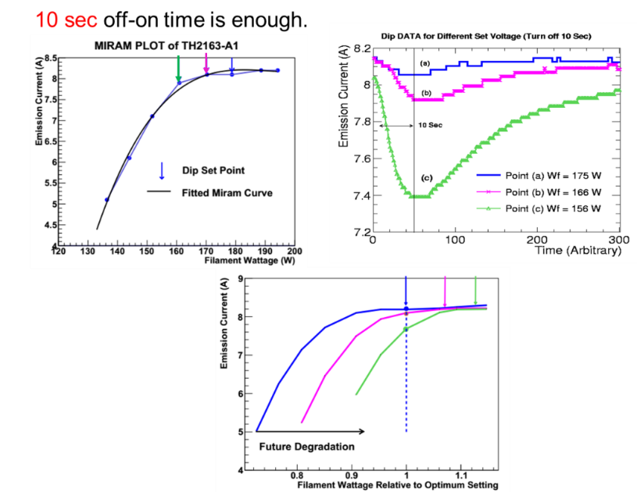
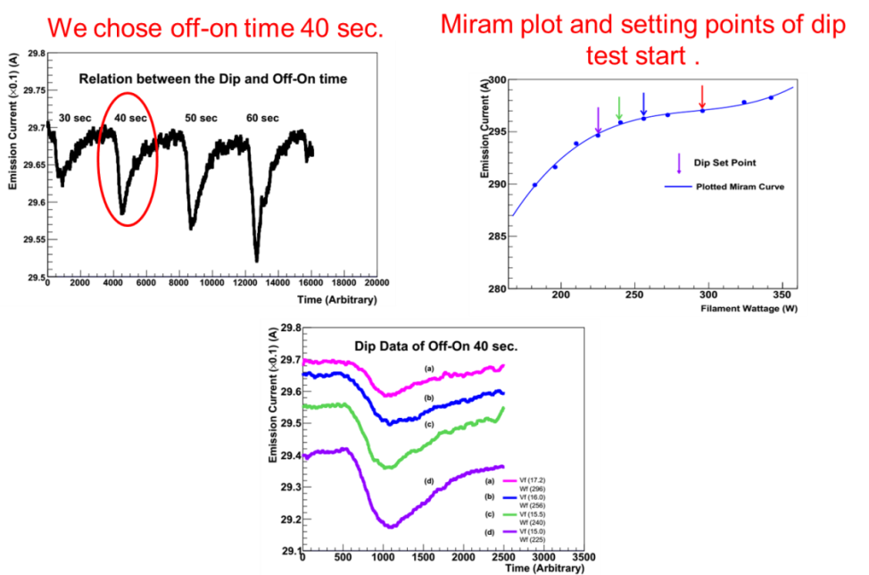
Prog. Theor. Exp. Phys., Volume 2017, 113G02
DIP Test: Rapid cathode activity evaluation of the Klystron used in an accelerator
How to determine the operating
point of Klystron
Miram Plot Measurements
Rapid Way
Dip Test
Using dip test method it is more quickly to evaluate the cathode activity
Example of Dip Test Results of CW Klystron and Pulsed Klystron

Slide 9
Advantage of Dip Test
Very quick way to evaluate the cathode activity
CW klystron → off-on time is 10 sec
Pulse Klystron → off-on-time is 40 sec
Due to the quick measurement, useful to apply large scale accelerator facility such as CEPC project
We can understand the long time tendency for cathode activity
Blue circle shows no deterioration, and orange circle shows cathode activity lowering.

Slide 10
Future Plan

Slide 11
Future Research Work Plan at IHEP
Make diverse contributions for the CEPC project
Accelerating Structures
High Gradient Structures
Simulation of accelerating structure using HFSS and CST software.
An experiment of measuring the dark current during the RF processing, and analyze the Fowler-Nordheime plot. It strongly relates to the surface fineness, Cleanness and chemical processing.
Electron Gun Study for CEPC Klystrons
Development of electron gun for multi-beam Klystron (MBK).
Electron gun study for LINAC
Work on the design and simulation of LINAC gun including photocathode.
RF gun studies using thermal and photo cathodes.

Slide 12
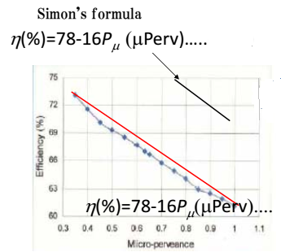
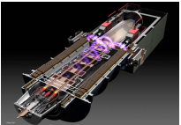
Why MBK is required?
MBK configuration is suited to high efficiency operation
Low perveance beam gives the high efficiency of klystron but it required high
voltage and obtained power is limited
To avoid the high voltage, multi-beam solution is favored
Cut-off model of MBK and MBK Gun
Multi-beams with the same perveance (the same efficiency) are used, and single beam power goes to smaller and voltage goes lower.

Slide 13
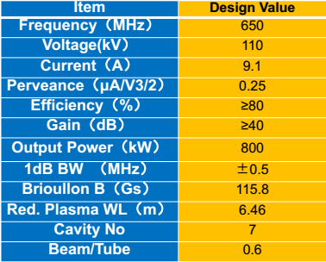
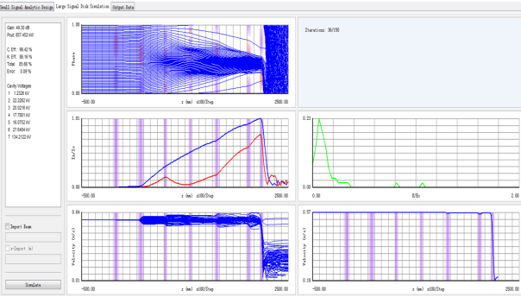
Application of MBKs for CEPC
At IHEP, there is a plan of single beam low perveance klystron was designed but the applied voltage is too high for cw operation. MBK approach is desirable..
High Efficiency Klystron parameters by OZ Xiao
AJDISK simulation Results by OZ Xiao
Example for 4 beam case ;
Power of each beamlet= 800kW/4=200kW
P_{rf}=ηP_{μ}V^2.5->P_{rf}/ηP_{μ}=V^2.5->V=(P_{rf}/ηP_{μ})^0.4
=(200000/0.8/0.00000025)^0.4
~63090V
Too high Voltage and easy to occur arcing
In the case of cw operation
If we choose 4-beam MBK, and assume
The same perveance and efficiency,
Applied voltage decreases from 110kV
To 63kV, and it is no problem.

Slide 14
MBK Focusing
Configuration of
Single beam Kly
Multiple beam klystrons use Brillouin focusing (0 field at cathode).
The off axis nature of the electron guns makes it difficult to achieve the field profile required (all magnetic field on multi-beam gun should be same). It is not so easy.
Configuration of
MBK
All magnetic field on multi-beam gun should be same. Especially the Transverse component of B should be minimized but same
Uniform B in the klystron tube region is required.

Slide 15
Summary
4 exciting years of PhD at IHEP and China
I have joined RF power group in 2013
Starting from March 2018, I am post doc at IHEP
Mainly, I am involved in following projects,
Circular Electron- Positron Collider (CEPC) and BEPC II
Simulation and design of electron gun with a modulating anode for CEPC klystron has been achieved successfully.
The design of HV CEPC klystron gun envelop has been designed.
For the importance of thermal and mechanical designed, cold dimensions of electron gun has been obtained using ANSYS Software.
Dip test method was successfully applied to the BEPC ring hall CW klystron (First time in the world) and LINAC pulse klystron (First time at IHEP) to evaluate the cathode activity.
I am author of six articles (see previous slide for articles with head author)
Tentative future plans for post doc at IHEP is also presented.

Slide 16
Thanks for your attention !

Slide 17
Back Up

Slide 18
Contributions
Principal Author Articles
Zaib un Nisa et al., “Design Consideration of 650-MHz Circular Electron-Positron Collider Klystron and Simulation of Its Beam Tester”, CHIN. PHYS. LETT. Vol. 34, No. 1 (2017),012902.
Zaib un Nisa et al.,“Dip Test:Rapid Cathode Activity Evaluation of the Klystron used in an Accelerator”, Progress of Theoretical and Experimental Physics, Volume 2017, Issue 11,113G02.
Zaib un Nisa et al.,“Design Study of Electron Gun for 650 MHz CEPC Klystron”
in Proceedings of IPAC2016, ISBN 978-3-95450-147-2.
Co- Author Articles
CEPC 650 MHz Klystron Development.
Published in Proceedings of IPAC2016, ISBN 978-3-95450-147-2.
Design Study of Collector for 650 MHz CEPC Klystron.
Published in Proceedings of IPAC2016, ISBN 978-3-95450-147-2.
Design Study of RF Section and Cavities for 650 MHz CEPC Klystron.
Published in Proceedings of IPAC2016, ISBN 978-3-95450-147-2.

Slide 19
Conferences
2017: 42nd INSC on Physics and contemp. needs, Islamabad, Pakistan.(Speaker)
2016: 41st INSC on Physics and contemp. needs, Islamabad, Pakistan. (Poster)
2016: International Particle Accelerator Conference (IPAC’16), Busan, Korea. (Poster)
2015: International Workshop on Breakdown Science and High-Gradient Technology, Beijing, China. (Participant)
2015: 40th INSC on Physics and contemp. needs, Islamabad, Pakistan. (Poster)
2015: Workshop on the LHeC at CERN and Chavannes-de Bogis, Geneva, Switzerland. (Participant)
2015: 16th International Vacuum Electronics Conference, Beijing, China. (Participant)
2014: School on LHC Physics, ISB, Pakistan. (Speaker)
2014: Korean Particle Accelerator School (KoPAS), Daejeon, Korea.

Slide 20
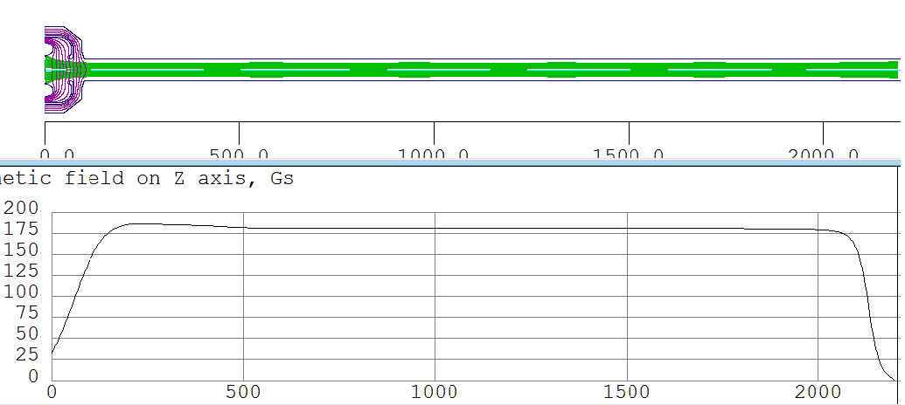
DGUN Results using Magnetic field with Auxiliary Coil
Magnetic field density at cathode= 33 Gauss
Magnetic field density at tube body = 180 Gauss
Beam Radius = 17.4 mm
Ripple rate = 3.7 %
Amplitude of magnetic field Bz on axis
Bz (Gauss)
Z (mm)

Slide 21
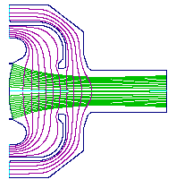
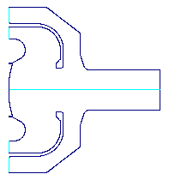
Thermal Analysis and Mechanical Design
Simulation
An Electron gun works under high operational temperatures
Analyze its operation under thermal load
d_{h}
(Hot dimension)
Any geometrical change as a result of internal temperature distribution
Using Ansys software, the evaluation of thermal quantities
Potentially degrade the performance of the klystron
0utput beam parameters (Perveance)
~ 1000 ⁰C
Manufacturing
d_{c}
(Cold dimension)
Temperature and heat flux to determine the stability
of the gun
Cathode position change and radial expansion
~ 30 ⁰C

Slide 22
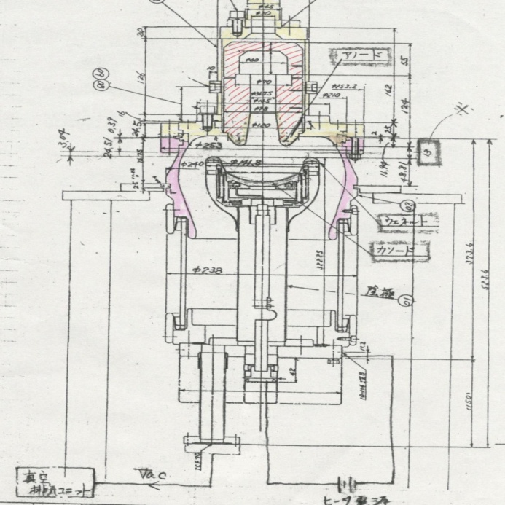
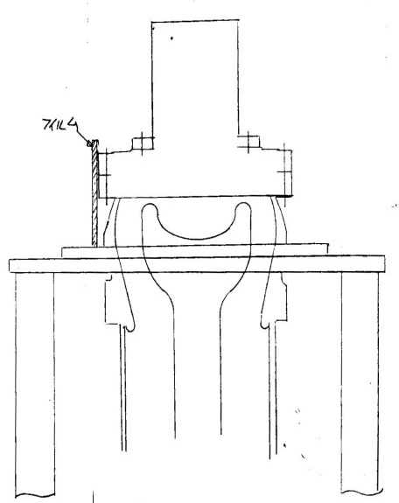
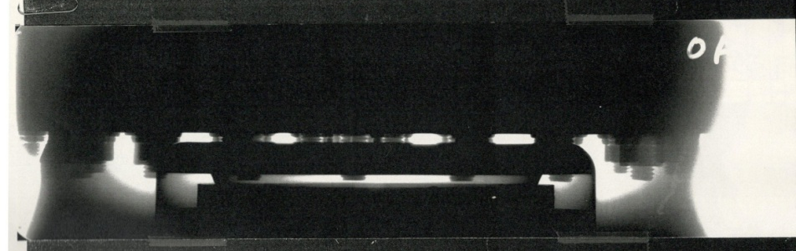
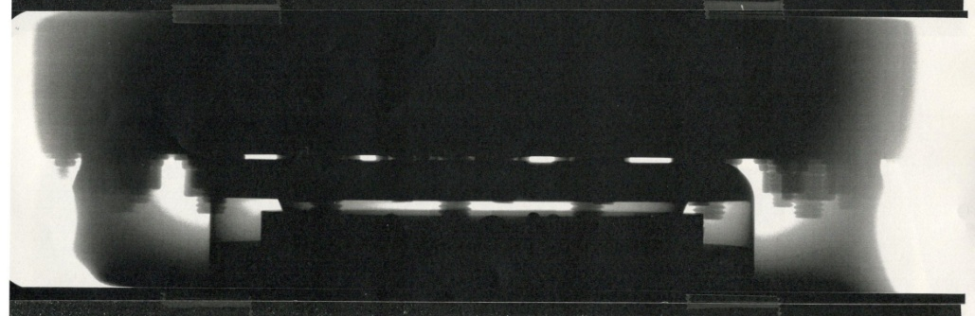
Thermal Analysis Results of KEK Pulse Klystron
Thermal analysis using X-ray Source
Film
X-ray
130
1000
Current = 0 A
Current=32 A Temperature = 1040 ⁰C
Gap Change= 1.89 mm

Slide 23
New Innovative Results from Doctor Thesis
Design of CEPC electron gun has been successfully achieved and make clarified the efficient operation of modulating anode gun. Cold dimension of the gun assembly for CEPC klystron gun was determined by ANSYS.
We applied the dip test to BEPC CW & pulse klystrons and succeeded in the cathode activity measurements in a very short time. For CW high power klystron it was a first time to do dip test in the world and for pulsed high power klystron it is first time introduced in China. This will be very useful for the large scale accelerator such as CEPC.

