Slide 1
CGEM Strips Display
Long Peixun
2018.3.22

Slide 2
Content
Class structure design of CGEM strips
Compare with MDC wires
Coordinates of CGEM sheet
X-strip display
V-strips display
About CGEM V-strips
Class CgemVStripCalculator
Test of partial display
Summary

Slide 3
Class structure design of CGEM strips
In other detector, there are some C++ files about detector important components.
MDC: Mdc2DWire.h, Mdc2DWire.cxx
TOF: Tof2DScin.h, Tof2DScin.cxx
EMC: Emc2DCrystal.h, Emc2DCrystal.cxx
MUC: Muc2DStrip.h, Muc2DStrip.cxx
In CGEM, I also created C++ files about CGEM strips.
CGEM: Cgem2DStrip.h, Cgem2DStrip.cxx

Slide 4
Compare with MDC wires
Both CGEM strips and MDC wires have two type:
MDC wires include axial wires and stereo wires
CGEM strips include X-strips and V-strips
However, the shape of CGEM V-strip is very different from X-strip, while MDC axial wire and stereo wire are similar.
So in Mdc2DWire.h, 2 kinds of wires are designed as one class, using a variable to distinguish them.

Slide 5
Class structure design of CGEM strips
Because of the large difference between the shape of X-strip and V-strip, I designed Cgem2DStrip as 2 classes inherited from a public base class.
Cgem2DStripBase
Cgem2DXStrip
Cgem2DVStrip
X-strip geometry objects
V-strip geometry objects
Public properties:
Identifier
Style
Tip text
Set highlighted and fired
Draw function (virtual)
Mouse event (virtual)
…

Slide 6
Coordinates of CGEM sheet
φ
x
V
y
X
z
Z
X-V Coordinate
φ-z Coordinate
xyz Coordinate
In X-V coordinate, X-axis perpendiculars to X-strip, and V-axis perpendiculars to V-strip.
φ-z Coordinate is cylinder coordinate of rolled-up sheet.
xyz Coordinate is 3D coordinate in detector space.

Slide 7
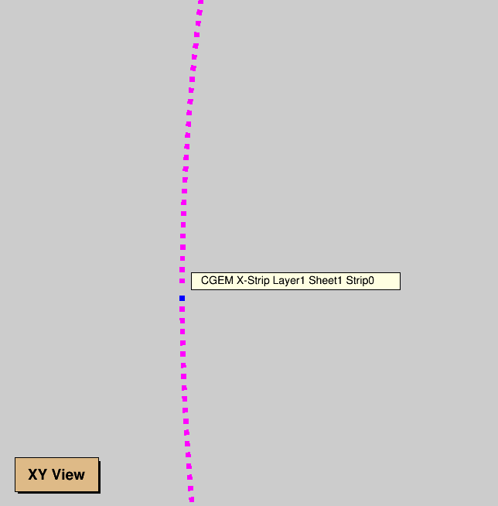
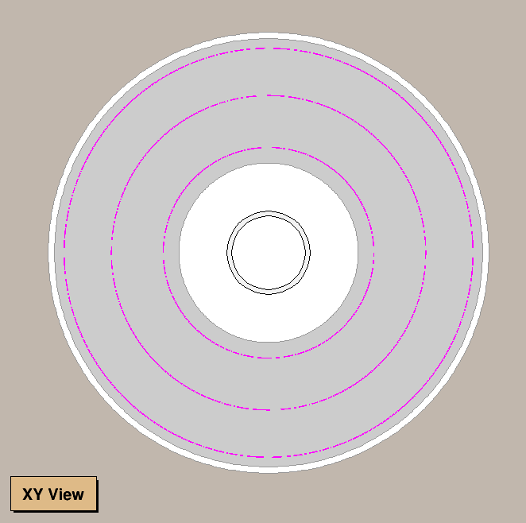
X-strip display
2000%
30000%

Slide 8
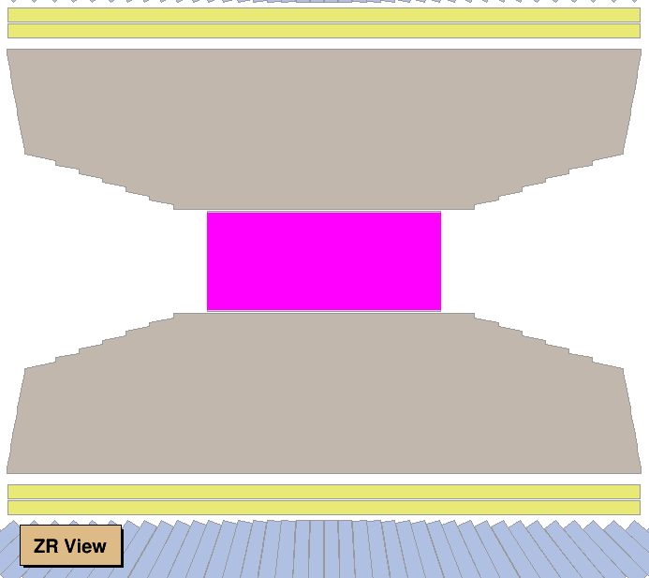
X-strip display
400%
90000%
It is difficult to distinguish each X-strip in ZR view.

Slide 9
About V-strips
V-strips display is more difficult than X-strips display.
V-strip is spiral in 3D space.
We can use CgemGeomSvc package to get X-strip’s φ coordinate from XID (index of X-strip).
However, there is no function in CgemGeomSvc package to get V-strip’s coordinate from VID (index of V-strip).
Even more important, knowing start point of V-strip is not enough to draw V-strip. We have to know several mid-points of the V-strip.
So I created a class – CgemVStripCalculator, to yield data which are need in V-strip display.

Slide 10
Class CgemVStripCalculator

Slide 11
V-strip display
2000%
In XY view, V-strips are overlapping

Slide 12
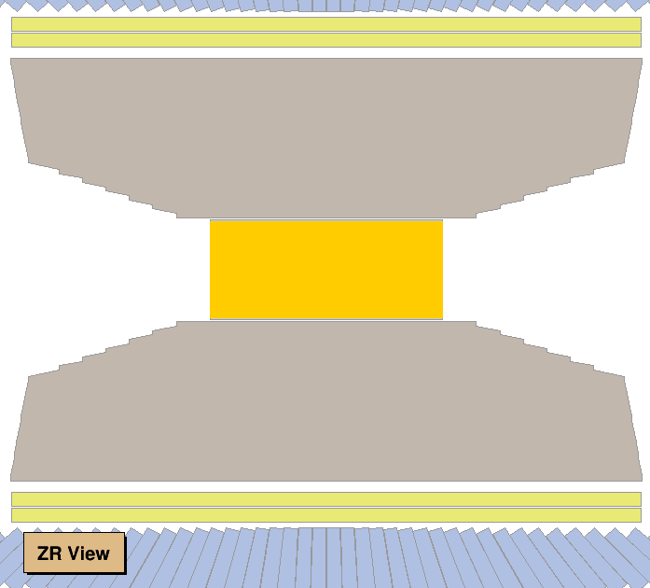
V-strip display
400%
90000%
It is also difficult to distinguish each V-strip in ZR view.

Slide 13
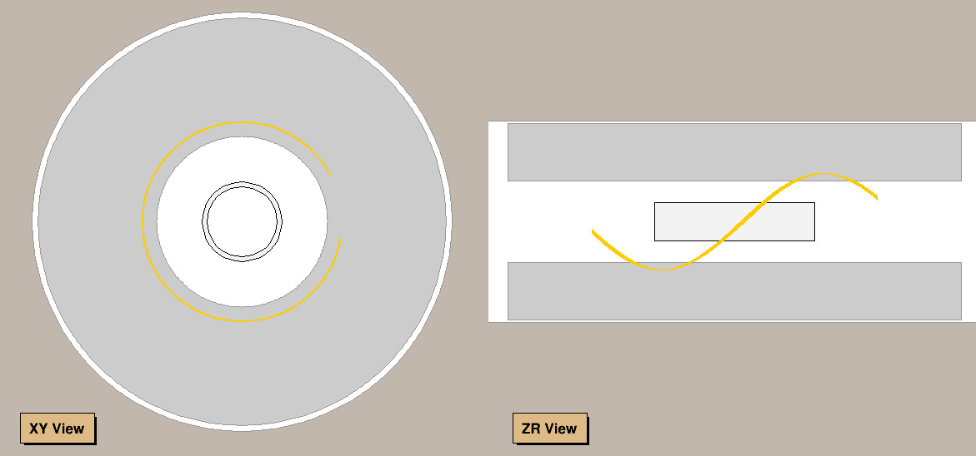
Test of partial display
If we only display fraction of V-strips, we can see the spirals clearly.
This picture shows V-strips in layer0, VID = 601~610.

Slide 14
Test of partial display

Slide 15
Summary
Class Cgem2DXStrip and class Cgem2DVStrip derive from class Cgem2DStripBase.
There are 3 kinds of coordinates to describe position in CGEM sheet.
V-strip display is more difficult than X-strip display.
Class CgemVStripCalculator is used to yield necessary data of V-strip display.
It is difficult to distinguish strips in XY view and ZR view.
It is necessary to display unfolded view of each sheet.

