Slide 1
VBF Higgs at LHC
方亚泉
高能物理研究所
April 2nd, 2018

Slide 2
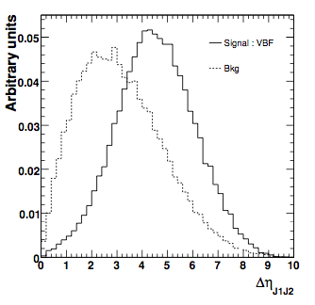
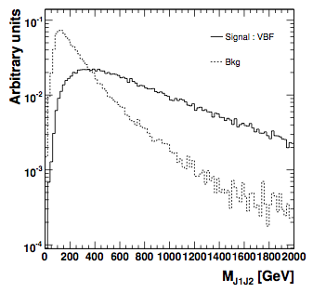
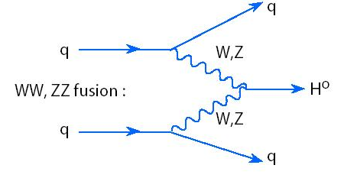
Event signature of VBF
Two forward highly boosted jet.
High invariant mass of the di-jet M_{jj},
No much jet activities in the
center region of the detector.
Central jet veto…
feasible to play
with Multivariate
analysis (MVA).
Forward jets
φ
Higgs Decay
η

Slide 3
Discriminating variables used in ATLAS
variables used in Run2
Separation power
two forward jet → large Δη_{jj}
high pT and large Δη_{jj} → large m_{jj}
central diphoton and forward dijet → large ΔR^{min}_{γ,j},η^{Zepp}
two balance high pT jet → high pTt

Slide 4
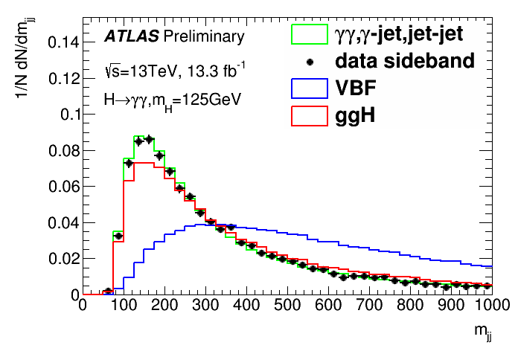
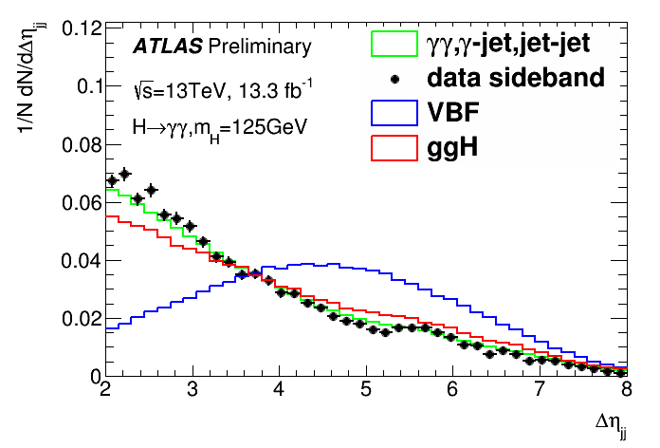
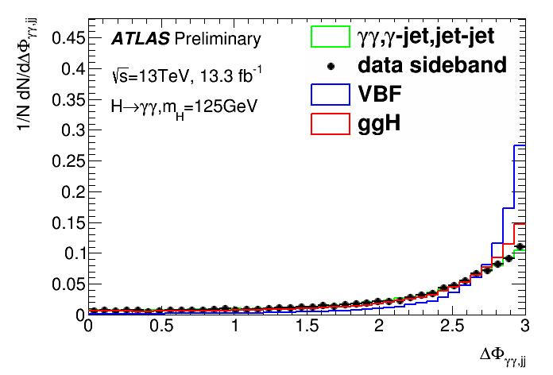
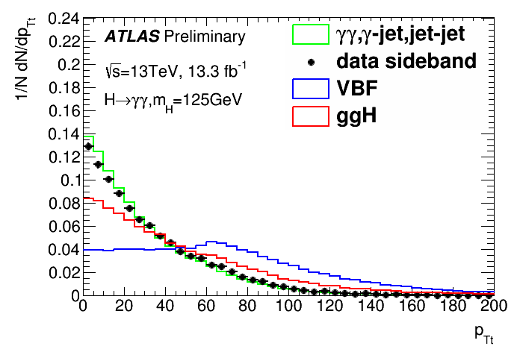
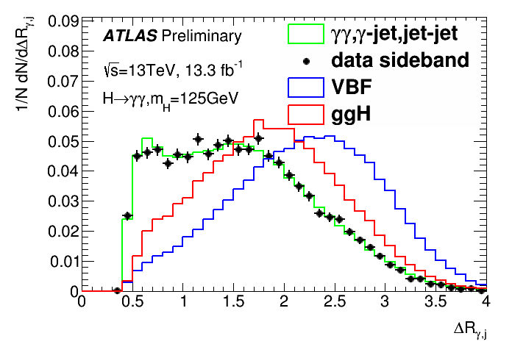
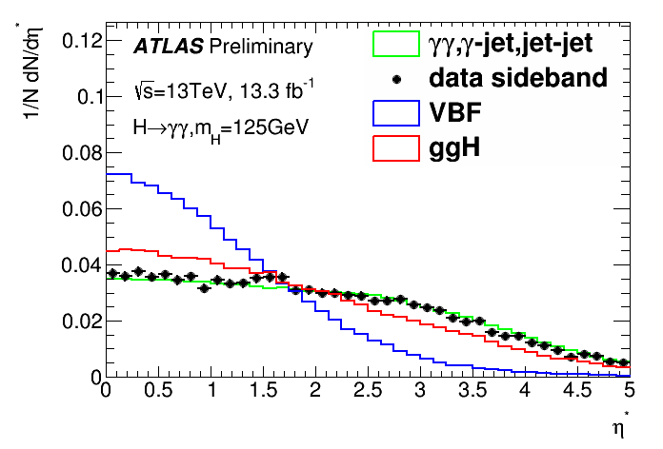
Distributions of variables
data sideband (exculde 120-130GeV ) is consistent with γγ+γj+jj background
these variables show good separation power
they are to be used in category optimization

Slide 5
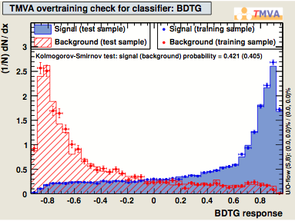
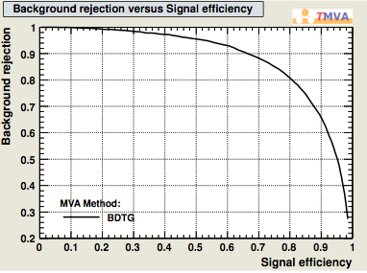
Training/optimization the MVA
[120,130] GeV window is blinded during the
process for data.
Signal : VBF 125 GeV.
Background :
ϒϒ : SHERPA Monte-Carlo normalized to
4 fb⁻¹.
ϒjet+jets : data with at least
one photon not isolated.
The components are normalized
to the fraction from data-driven method.
Other samples such as revIso,
MC+revID, sideband were tried as well.
The performances are worse than
the first one.
For the optimization, both sideband fit
from data and MC+revIso are tested.
MC+revIso is used as the baseline
(no bias)
example
example

Slide 6
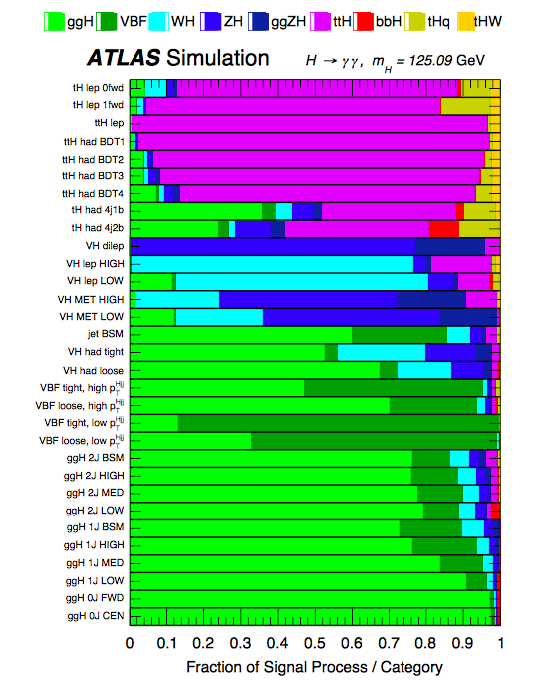
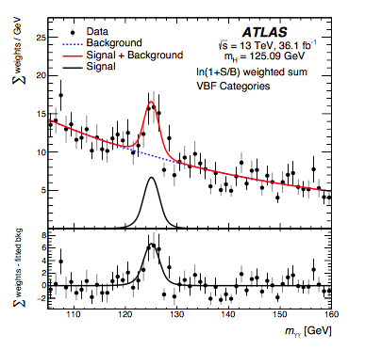
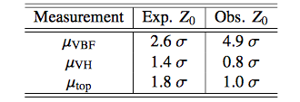
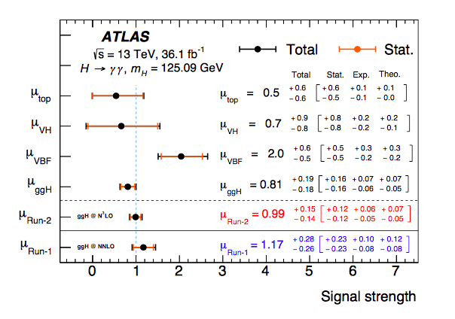
ATLAS VBF H->γγ
~5σ and 2 SM
for VBF has been seen.

Slide 7
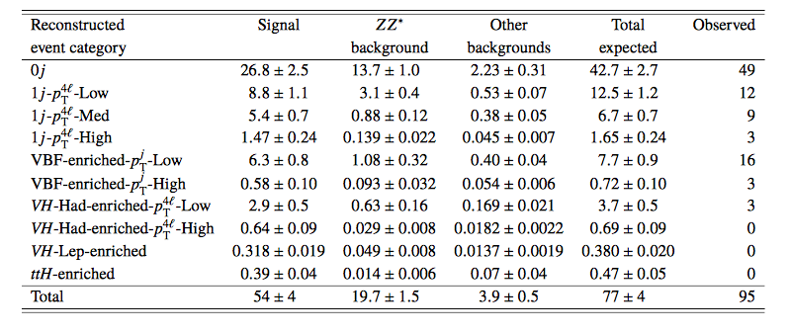
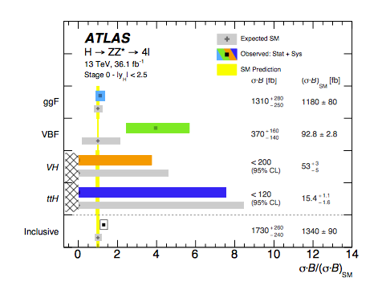
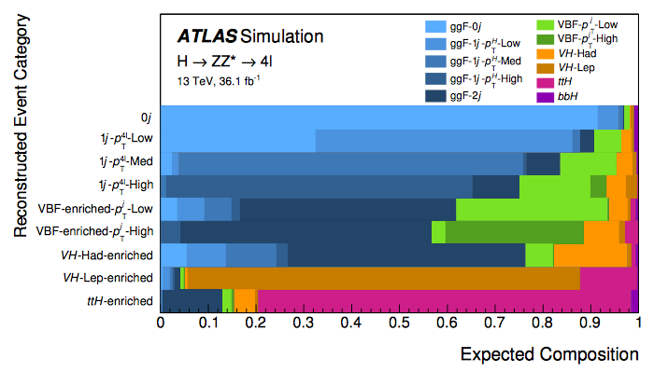
ATLAS VBF H->ΖΖ
The excess has been seen as well for ATLAS VBF H->ZZ

Slide 8
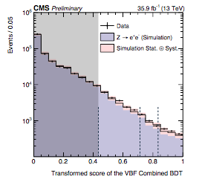
CMS VBF H->γγ strategy
BDT training :
VBF Higgs vs ggH+jets
How do we understand 3rd jet for ggH?
Divided into 3 cats.
Validated with Z->ee events
Selections:

Slide 9
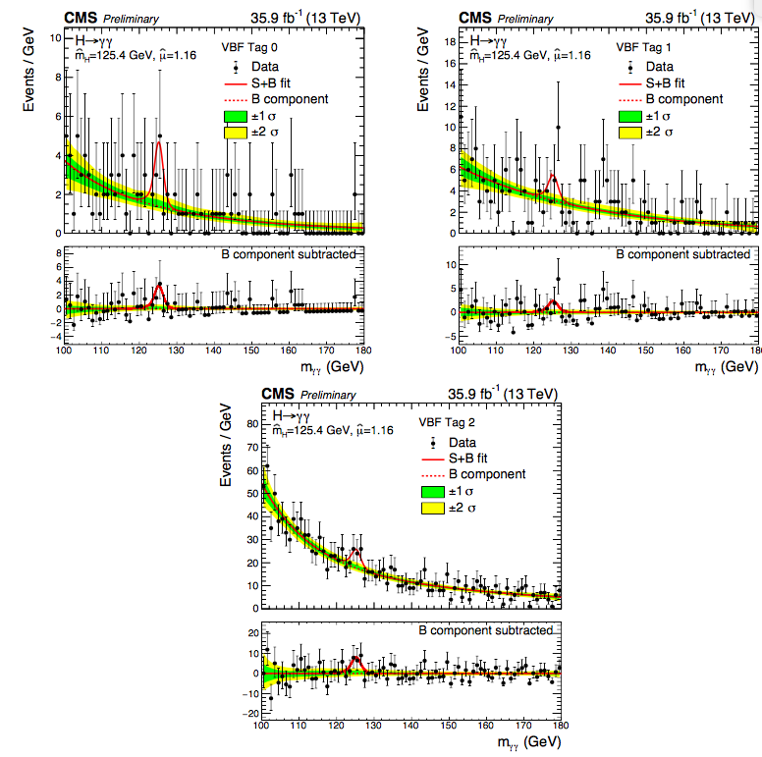
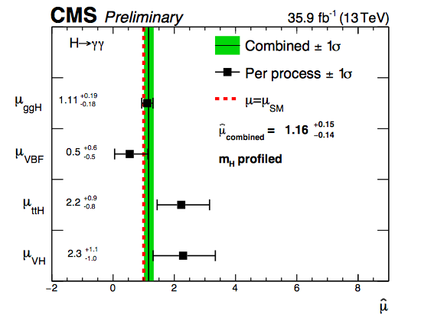
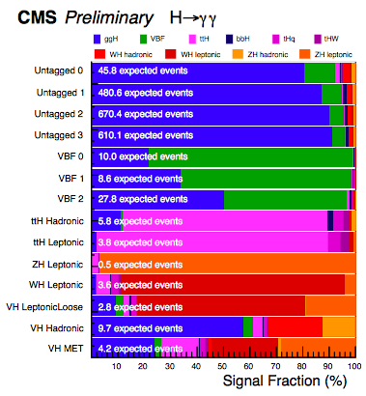
CMS VBF H->γγ
Observed (expected) Significance =
1.1σ/1.9σ

Slide 10
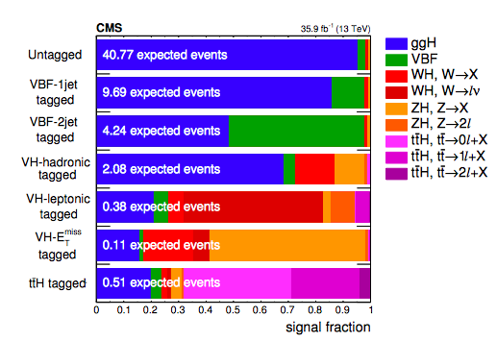
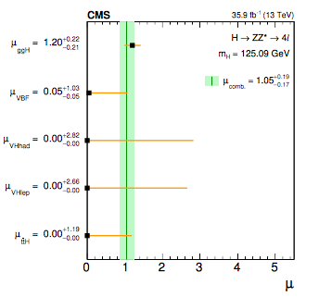
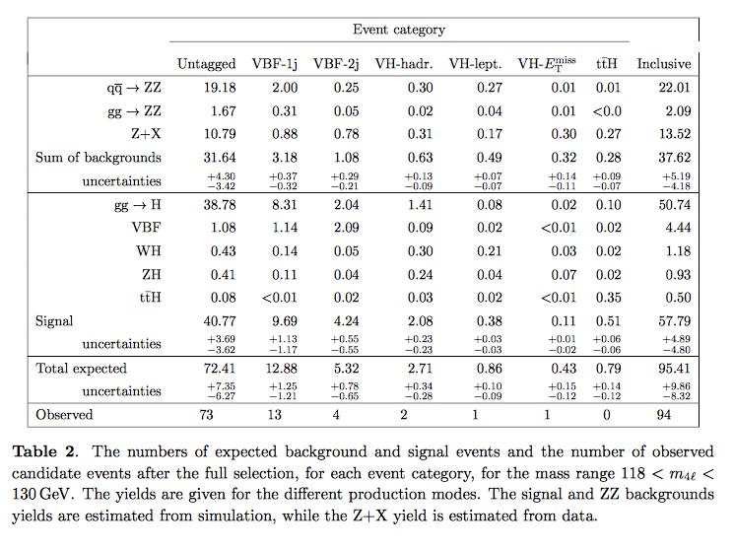
CMS VBF H->ΖΖ

Slide 11
Some personal thoughts:
VBF analysis has obvious event signature and could be sensitive to pile-up which can introduce some forward jets.
The description of the third jet for ggH is important for VBF analysis.
Theorists can contribute a lot ….
Two dimensional BDT vs SM backgrounds and ggH can help.

