Slide 1
W/Z physics in CDR
Zhijun Liang
IHEP,CAS

Slide 2
News: CEPC Workshop
CEPC workshop
24-26 May 2018
Università degli Studi Roma
https://agenda.infn.it/conferenceDisplay.py?confId=14816

Slide 3
News: CEPC R & D funding application
CEPC is applying for R & D in Ministry of Science and Technology of the people republic of China (MOST)
~32 Million RMB
Project leader : Joao Costa
Application book submitted
Defensed last week.

Slide 4
Backup

Slide 5
News
Some discussion about CEPC Z pole running .
http://indico.ihep.ac.cn/event/7709/
Two possibility:
E=240GeV, L=1.6 X 10³⁵ cm⁻²s⁻¹, solenoid field = 3T ( new default )
Two year running proposed by accelerator team
WW threshold scan
Proposal from accelerator team
One year running about 160GeV
Total luminosity 3.2 ab⁻¹

Slide 6
CEPC W/Z physics Plan for CDR
Plan to cover the prospects of 6-7 key parameters.
Text for CDR need to ready soon
Contributions are welcome

Slide 7
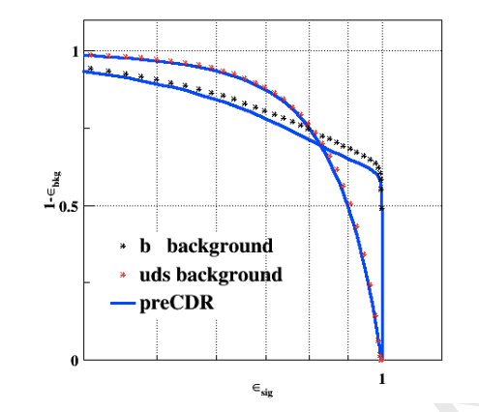
Performance input
Identify some performance input needed to support the W/Z physics prospect study
May need to repeat some study with 3T magnetic field and new detector geometry
Afb(l): lepton angular resolution
R_b: “B jet efficiency” vs “cjet/light rejection “
W mass (direct approach)： jet energy resolution
W mass (threshold scan): ?
N_v : photon energy resolution

