Slide 1




希格斯玻色子的发现
方亚泉
（fangyq@ihep.ac.cn）
中国科学院高能物理研究所
ISTEP2018， 武汉大学
July 18, 2018

Slide 2
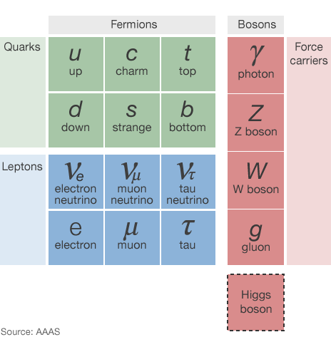
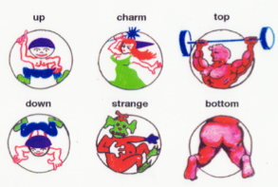
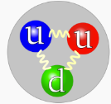
什么是标准模型(Standard Model)？
描述物质世界构成
e.g. 质子：up-up-down
和相互作用－粒子载体
quark, lepton
force carrier
quark, lepton
力(Force) | 载体(Carrier)
强（Strong） | 胶子Gluons (g)
电磁(EM) | 光子
弱（Electro-Weak) | 玻色子bosons W/Z
引力（Gravitation） | ?
Notes:
为什么夸克是6个，不是8个？

Slide 3
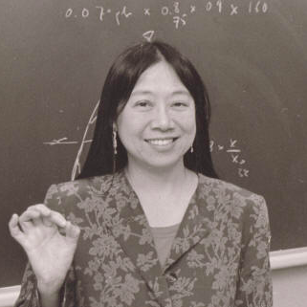
在标准模型下粒子发现进展 ：
Year | Particle | Lab
1974 | c quark | BNL & SLAC
1975 | τ lepton | SLAC
1977 | b quark | FermiLab
1979 | gluon | DESY
1983 | W,Z | CERN
1994 | t quark | FermiLab
2012 | Higgs | CERN
Sau Lan Wu
Force Carriers
The Standard Model is very successful BUT:
希格斯粒子 ： 最后一个待发现的粒子<2012
Notes:
The tau lepton was detected through a series of experiments between 1974 and 1977 by Martin Lewis Perl with his colleagues at the SLAC-LBL group. Their equipment consisted of SLAC's new e+-e− colliding ring, called SPEAR, and the LBL magnetic detector. They could detect and distinguish between leptons, hadrons and photons. They did not detect the tau lepton directly, rather they discovered anomalous events
e+e- -> e+ mu- with missing energy
Proton on Berilium

Slide 4
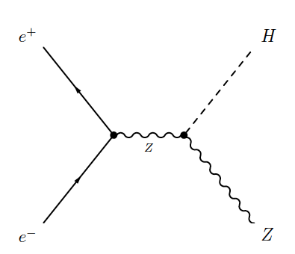
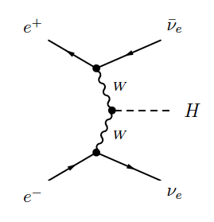
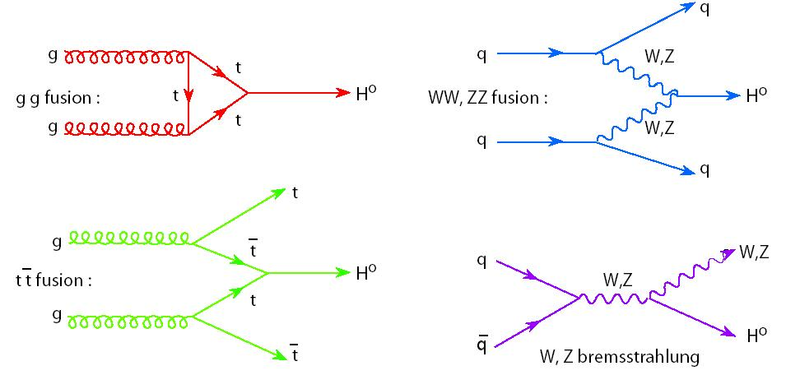
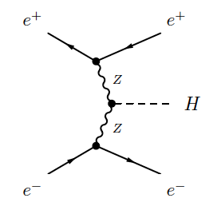
希格斯粒子寻找的路径图(1)
难点：理论无法预测希格斯粒子的质量。
四大产生模式
e⁺e⁻ 碰撞
PP 碰撞
胶子熔合
矢量玻色子熔合
顶夸克熔合
W／Z伴随产生

Slide 5
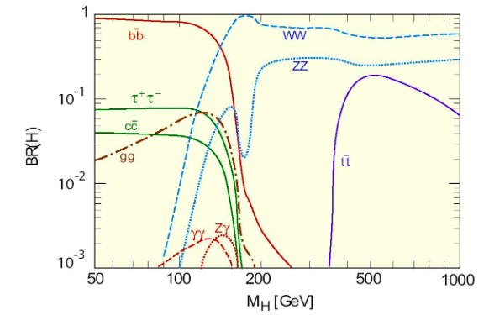
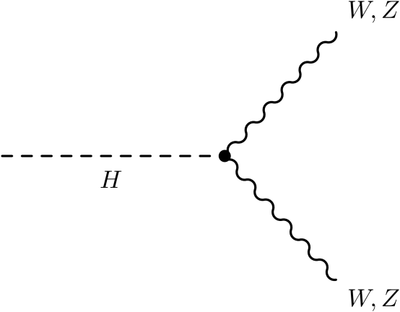
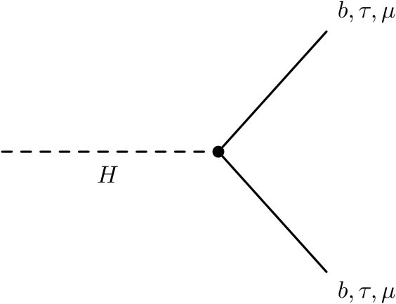
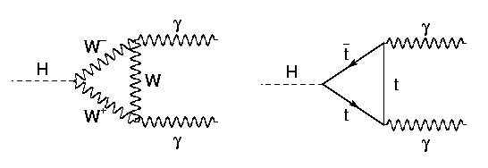
希格斯粒子寻找的路径图(1)
希格斯粒子可能的衰变：

Slide 6
寻找希格斯粒子（The hunt for the Higgs）
因为理论无法预测希格斯粒子的质量，科学家进行广泛质量的寻找。
实验物理学家通过不同途径寻找 nuclei, π, K, B, Y, etc… 得到质量的下限 7，8 GeV
大型正负电子对撞机(LEP)的一个重要目的就是寻找希格斯粒子 (e⁺e⁻ collisions 1989-2000)
最高能量209GeV

Slide 7
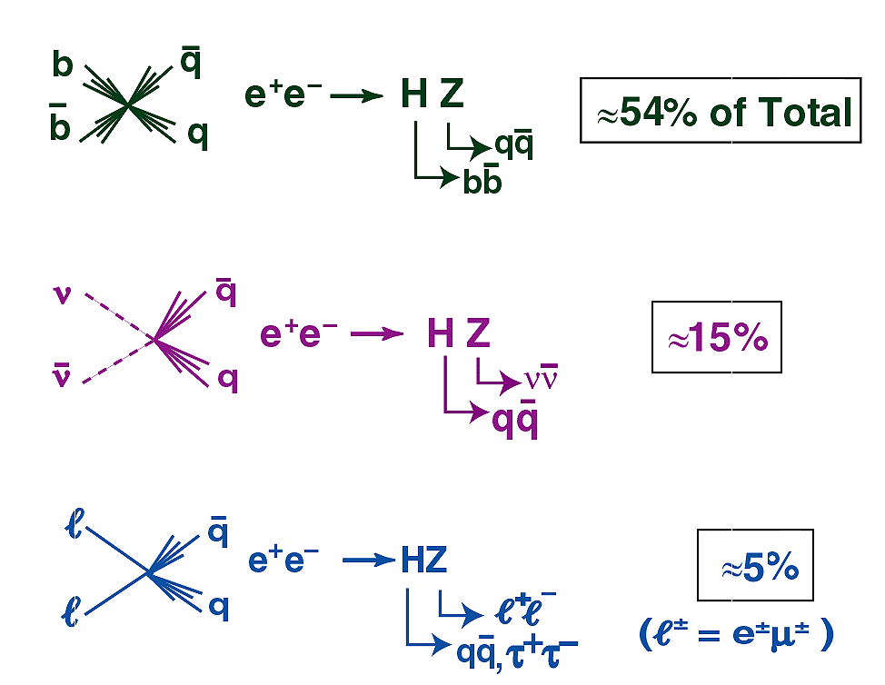
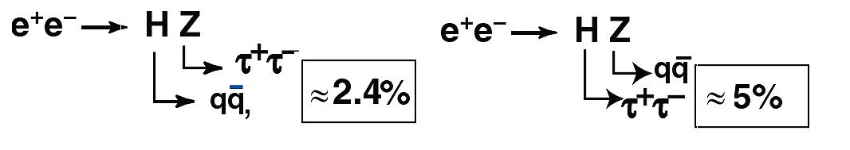
LEP Higgs Searches (M_{H}=115)
2.6%

Slide 8
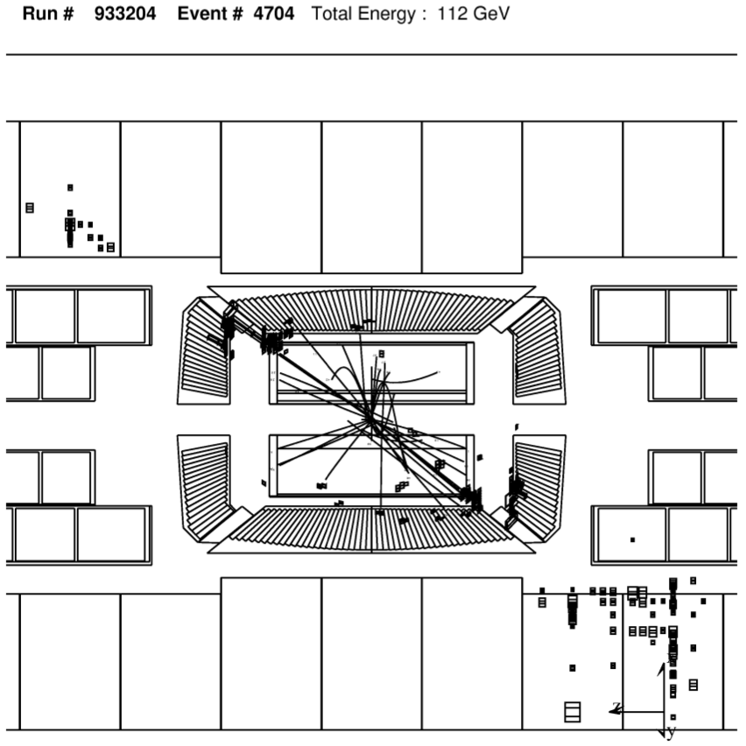



LEP conclusion
LEP计划2000年9月关闭，为LHC的建设让路。
LEP的四个实验将希格斯粒子质量排除的上限推到114.4GeV
有一些希格斯粒子的迹象（3σ）
最终于2000年11月2日，LEP关机。
Late June: ALEPH candidate (first one) at ~114 GeV (4jet)
Early July: ALEPH candidate (e) at ~115 GeV
End of July: ALEPH candidate (b) at 113 GeV
August: ALEPH candidates (a) and (d) at 110 GeV and 115 GeV
L3 (vvbb)

Slide 9
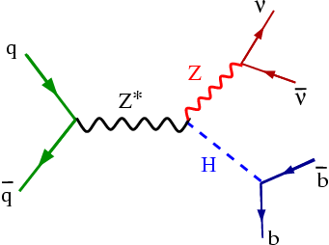
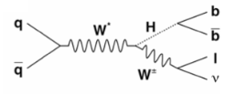
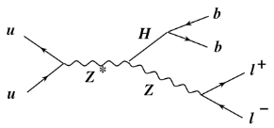
在Tevatron上寻找希格斯粒子
ZH ⇒ ν ν bb
WH ⇒lνbb
2 b jets ~ 1/2 M_{H} each
1 lepton ~ 50 GeV each
Missing E_{T} ~ 50 GeV
Highest production X-sec
2 b jets ~ 1/2 M_{H} each 0 leptons
Missing E_{T} ~ 100 GeV
Largestexpected signal
ZH ⇒l⁺l⁻ bb
2 b jets ~ 1/2 M_{H} each
2 leptons ~ 50 GeV each
Z mass constraint
Cleanest signal

Slide 10
寻找希格斯粒子的坎坷路 : LEP and Tevatron
排除的结果
LEP 看到10 个黄金事
例~115GeV
2000年: 质量排除的范围 <114.3 GeV from LEP.
2009年冬: Ｔevatron的第一个排除的范围 LEP
(at 95%CL): 160<m_{H}<170 GeV

Slide 11
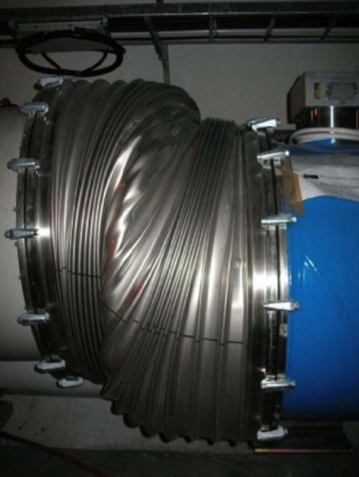
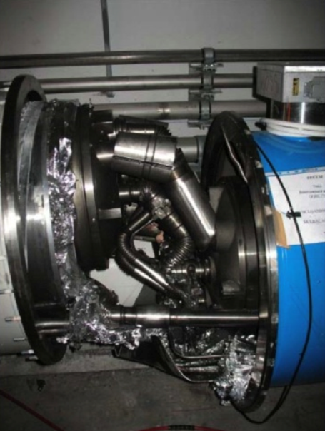
September 2008: LHC on hold
First protons around full ring on September 10, 2008
But on Sept 19, an electrical fault triggered a major setback
cause: faulty electrical connection between two of the accelerator’s magnets; this resulted in mechanical damage and release of tons of liquid helium
Actually: no beam for over a year; low energy beams circulated in Nov 2009 for the first time since the accident

Slide 12
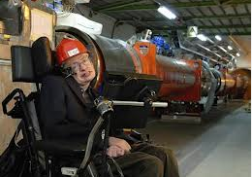
一个世纪之“赌”
霍金愿意出 100$ 打赌希格斯粒子不存在。。。
这不是给我们找希格斯粒子的添“堵”嘛？！

Slide 13

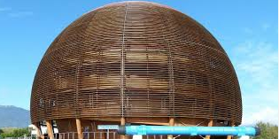
欧州核子研究中心(CERN)
位于日内瓦的近郊。
ＷＷＷ的诞生之地
诺贝尔奖的摇篮

Slide 14
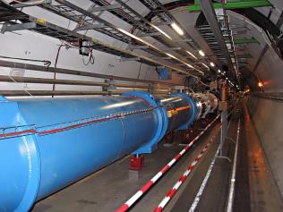
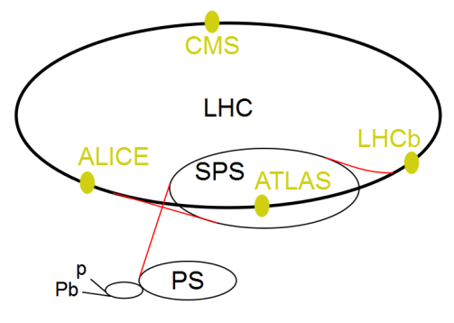
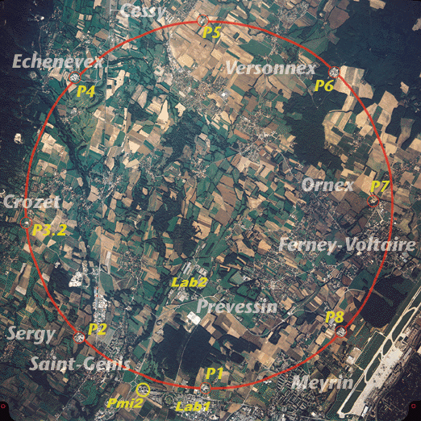

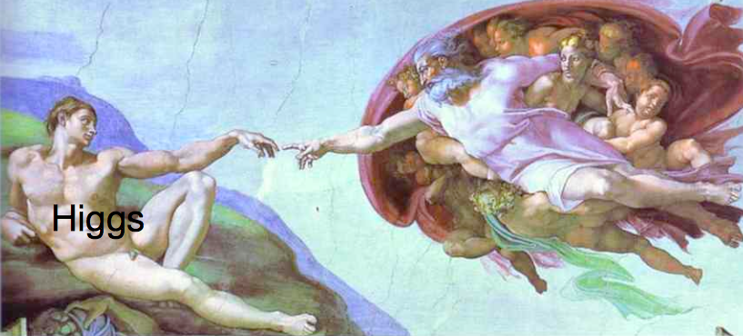
大型强子对撞机(Large Hadron Collider，简称LHC)
4 TeV
Super proton synchrotron : 450 GeV
proton synchrotron : 26 GeV
地下100米的圆环, 半径4.3 公里。
四个实验 ：ATLAS，CMS, ALICE，LHCb
质心能量 : 2012，8 TeV； 2011, 7 TeV
4.3 kilometers
Higgs Particle
4 TeV
4 TeV
in 2012

Slide 15
LHC简史 (short LHC history)
1983 LEP - S. Myers and W. Schnell propose
twin-ring pp collider in LEP tunnel with 9-T dipoles
1991 CERN Council: LHC approval in principle
1992 EoI, LoI of experiments
1993 SSC termination
1994 CERN Council: LHC approval
1995-98 cooperation w.Japan,India,Russia,Canada,&US
2000 LEP completion
2006 last s.c. dipole delivered
2008 first beam
2010 first collisions at 3.5 TeV beam energy
2012 collision at 4 TeV, Higgs particle found!!!!
>30 years!
未来史：now is the time to plan for ~2040

Slide 16
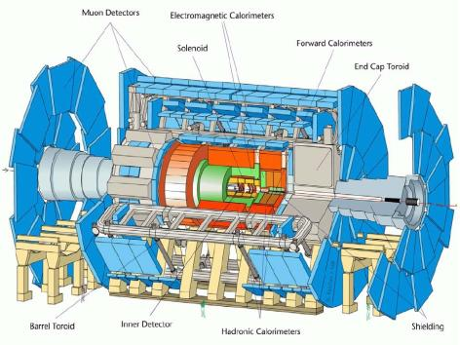
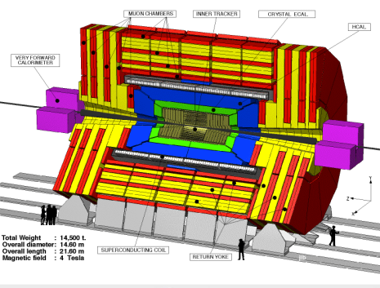

ATLAS and CMS 探测器
A Toroidal LHC ApparatuS
Compact Moun Soleniod
长: 44米，截面半径12.5米，
~7000 吨.
(One Eiffel tower ,~100 jet 747).
探测器就象一个照相机，将我们感兴趣的碰撞事例照下来，通过Grid传到世界各地，
科学工作者可以进行远程分析。最后将结果收集起来。

Slide 17
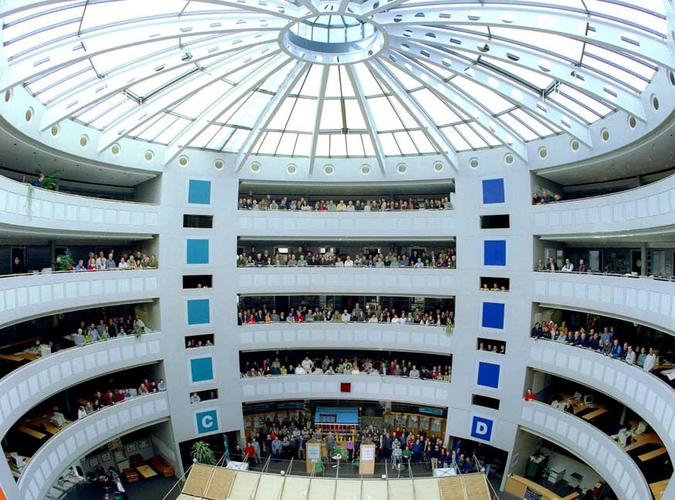
ATLAS 合作组
3000 scientists
including 1000 graduate students
38 countries
174 universities and research labs
17

Slide 18
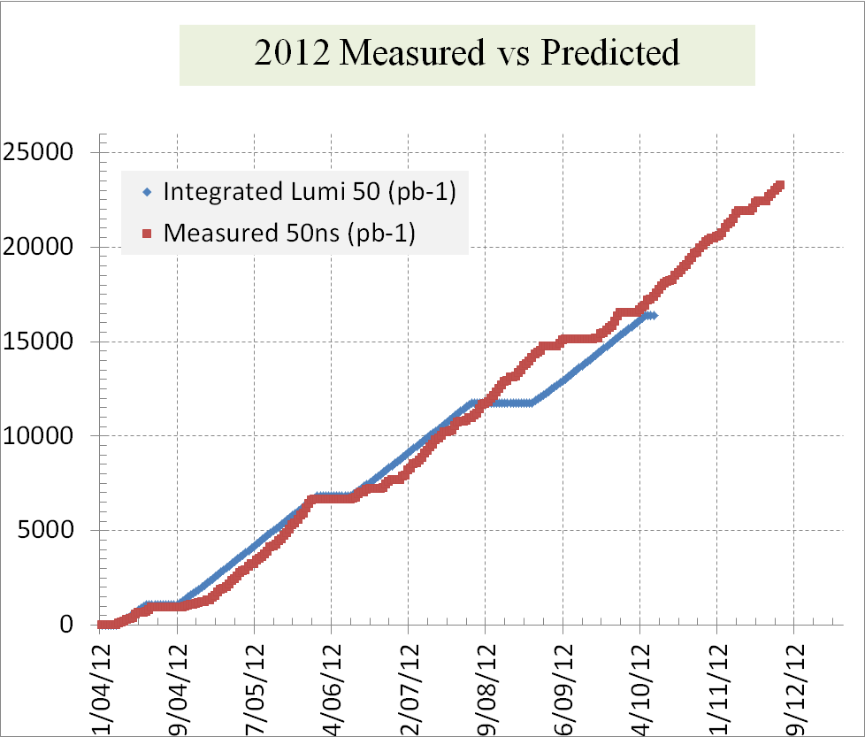
亮度： 运行vs预言
亮度＝收集的数据的多少！！！
能Hold住！！！

Slide 19
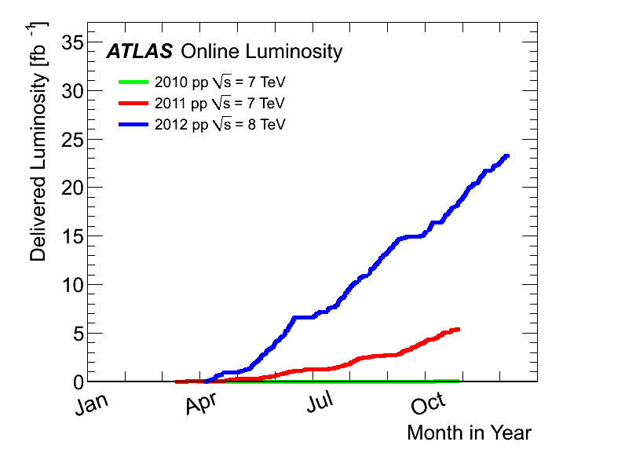
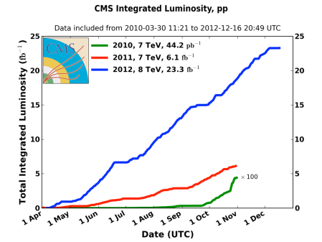
ATLAS/CMS的数据采集
2012:
23 fb⁻¹
at 8 TeV
4th July seminar
and ICHEP
2011
5.6 fb⁻¹
at 7 TeV
2010
0.05 fb⁻¹
at 7 TeV
ＬＨＣ是史上最强的粒子产生工厂
目前(ATLAS)上有：
> 2,000,000,000 W
> 700,000,000 Z
> 8,000,000 top pair
> 600,000 Higgs

Slide 20

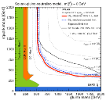
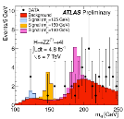
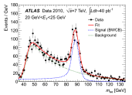
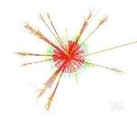
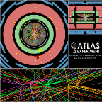

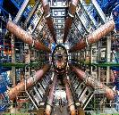
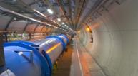
物理分析
Performance of the Reconstruction
Event Generation
& Simulation
Event Reconstruction & Calibration
Detectors
Construction & Commissioning
Trigger &
Data Acquisition
LHC

Slide 21
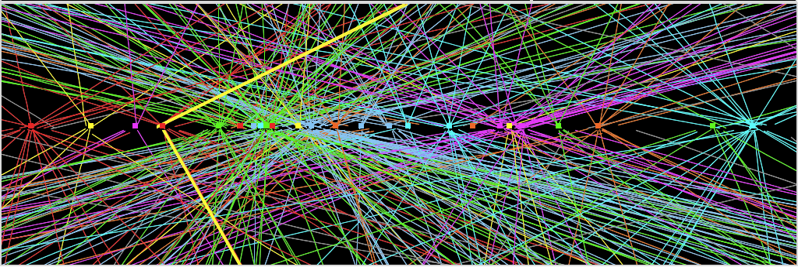
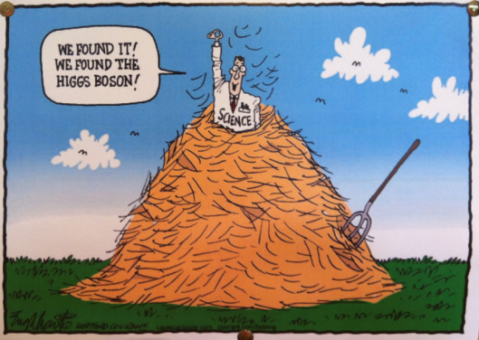
难点 : Pile-up
Z→ μμ event from 2012 data with 25 reconstructed vertices
Huge efforts over last months to prepare for high lumi and pile-up expected in 2012:
optimized trigger and offline algorithms (tracking, calo noise treatment, physics objects)
→ mitigate impact of pile-up on CPU, rates, efficiency, identification, resolution
in spite of x2 larger CPU/event and event size → we do not request additional computing
resources (optimized computing model, increased fraction of fast simulation, etc.)
Z→ μμ
21
简直就是：
荆棘丛生难下足！！！
利用各种技术将它们
CUT掉

Slide 22
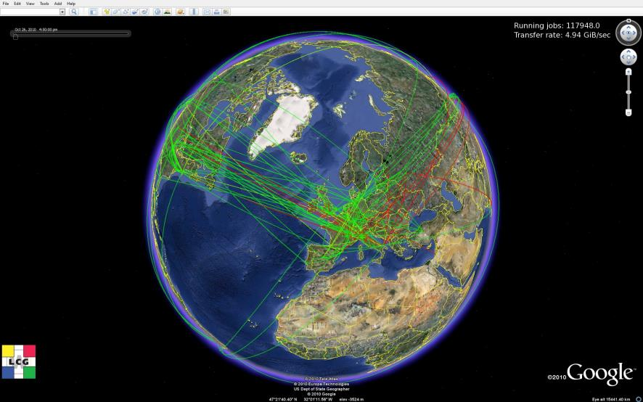
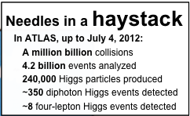
With the Help of the Worldwide LHC Computing Grid
如何处理数据 : 网格计算 (Grid Computing)
The Worldwide LHC Computing Grid combines the computing resources of more than 100,000 processors from over 170 computing centers in 36 countries, producing a massive distributed computing infrastructure that provides
more than 8000
physicists around the
world with near
real-time access
to LHC data,
and the power
to process it.
~170 computing
Centers
~36 countries
~250K cores
~100 million
gigabytes
of disk
(10 million DVDs)
真正的联合国，地球村！！！！
Lessons learned in managing, securing and linking up on this global scale have driven innovation in computing grids all over the world. Grids are being used in the fight against disease, climate change, air pollution, etc.

Slide 23
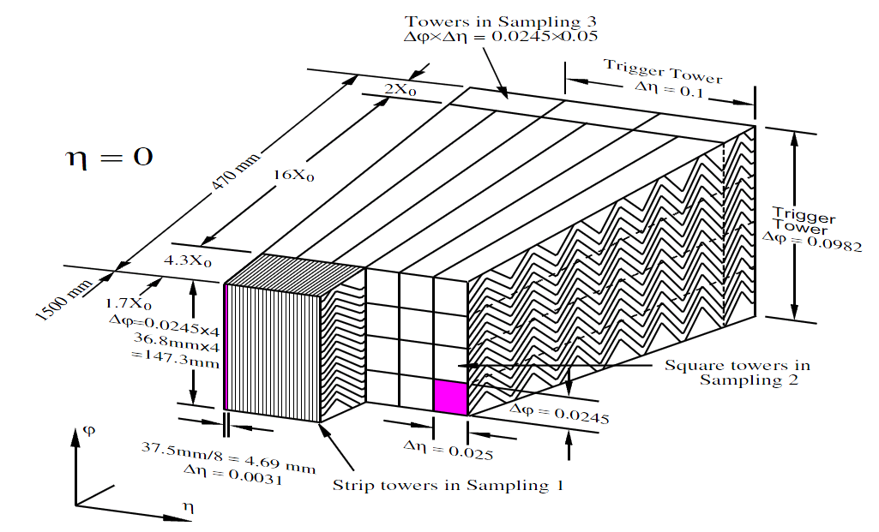
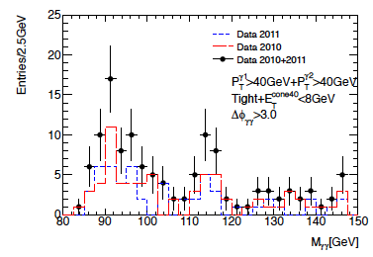
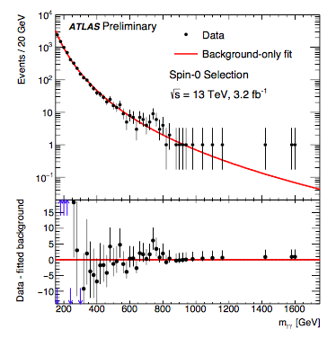
2011复活节的小插曲
Not official
Fake resonance
该特点是当光子的隔离变松(isolation)，峰值反而变高。从喷注 (jet)而来的伪光子
有这一特点。
去年750 GeV的峰也有这一特点。

Slide 24
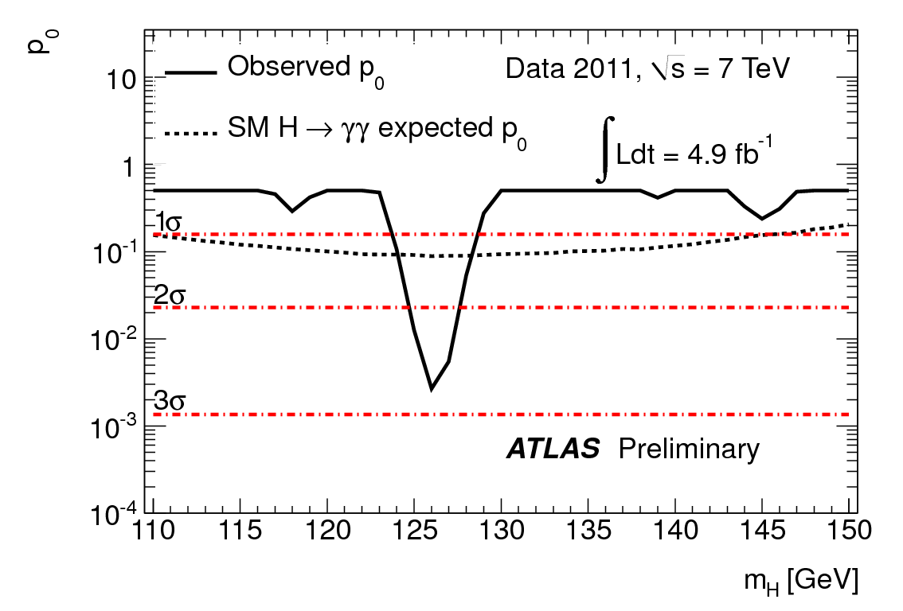
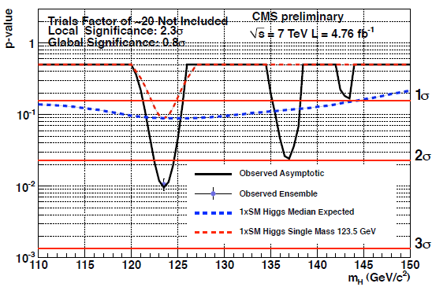
2011年12月 CERN Council 会议 (Dec 2011) H→ γγ
This was the point at which a major excitement started building up
ATLAS: γγ , ZZ → 4l updated with ~5 fb⁻¹ of 7 TeV data
CMS: all channels updated with ~5 fb⁻¹ of 7 TeV data
Lowest p₀: m_{H}=126 GeV
Lowest p₀: m_{H}=123.5 GeV
p₀
2.8σ
2.3σ
ATLAS γγ only
CMS γγ only
Both experiments see large excesses at similar m_{H}

Slide 25
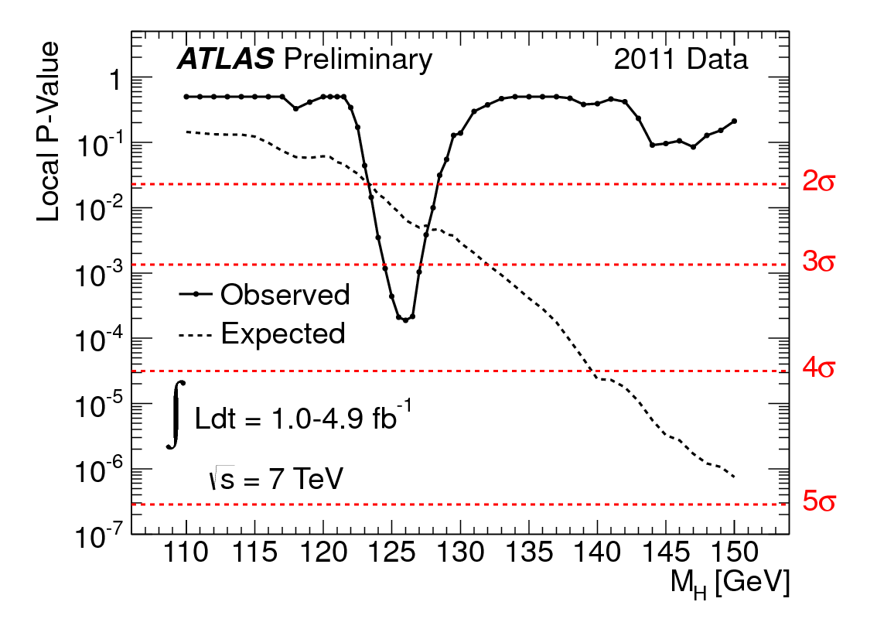
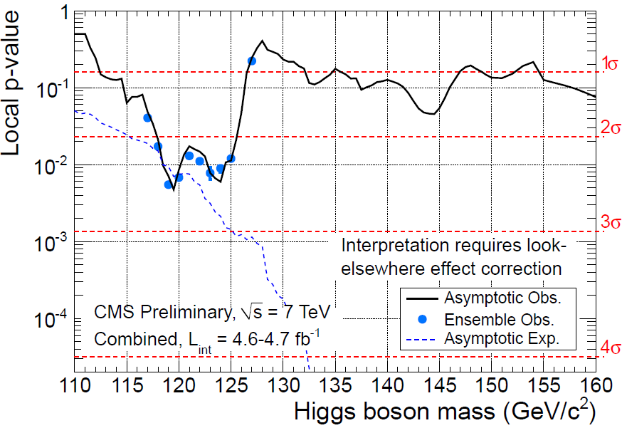


LHC CERN Council (Dec 2011) Higgs combined
ATLAS
H→γγ, ττ, WW(lvlv, lvqq), ZZ(4l, llvv, llqq, llbb)
red: 5fb⁻¹ green: 1fb⁻¹, black: 2 fb⁻¹
CMS
H→γγ, bb, ττ, WW(lvlv), ZZ(4l, llττ, llvv, llqq)
3.6σ
2.6σ
Largest local excess: 3.6σ at 126 GeV
Largest local excess:
2.6σ at ~120 GeV
“Tantalizing hints”
Guido Tonelli
Fabiola Gianotti

Slide 26



The discovery on July 4th, 2012
5σ
A milestone discovery announced in
July, 2012.
  Both ATLAS and CMS observed a new
  particle with ~5σ evidence .
  Will the signal be confirmed in the
additional 2012 data? SM Higgs?
  Properties, future?
4.9σ

Slide 27

We found Higgs
Right after the seminar on July 4th, Sau Lan Wu walked towards Peter Higgs and said :
We have worked for many years looking for you.
You found me.

Slide 28







Is the New Boson the SM Higgs?
Signal strength
Higgs production (m_{H} = 125 GeV)
Vector Boson Fusion
Higgs decays
W, Z
f
H
H
W, Z
f
Couplings
g_{F} (Yukawa coupling) =√2 x m_{F}/ν
g_{V} (Gauge coupling) = 2m_{V}²/ν
(ν is the vacuum expectation value)
Spin-Parity

Slide 29


Signal strength
μ= 0.80±0.14
Consistent with SM prediction within 2σ.
Systematic and theoretical uncertainties become more
and more important.

Slide 30



Coupling Measurements
Coupling strengths κ_{i} & ratio: κ_{F} =g_{F}/g_{F,SM}, κ_{V} =g_{V}/g_{V,SM}, λ_{ij} = κ_{i} /κ_{j}
CMS
Agree with SM within 2σ.

Slide 31


Summary results for Spin study
0⁻ hypothesis excluded at 97.8% CL in
favor of 0⁺ by H→ ZZ*→ 4l analysis
1⁺ and 1⁻ excluded at 99.7% CL,
respectively by WW and ZZ analysis
2⁺ excluded at 95.2% to 99.96% CL
Excluded at
99.4% CL
Spin 1 is strongly disfavored with the
observation of H→γγ.
Data favor the SM Higgs 0⁺

Slide 32

Combined signal strength
μ= 0.80±0.14
μ= 1.33^{+0.21}_{-0.16}
Consistent with SM prediction within 2σ.
Systematic and theoretical uncertainties become more
and more important.

Slide 33
Coupling Measurements
Coupling strengths κ_{i} & ratio: κ_{F} =g_{F}/g_{F,SM}, κ_{V} =g_{V}/g_{V,SM}, λ_{ij} = κ_{i} /κ_{j}
CMS
Agree with SM within 2σ.

Slide 34
Summary results for Spin study
0⁻ hypothesis excluded at 97.8% CL in
favor of 0⁺ by H→ ZZ*→ 4l analysis
1⁺ and 1⁻ excluded at 99.7% CL,
respectively by WW and ZZ analysis
2⁺ excluded at 95.2% to 99.96% CL
Excluded at
99.4% CL
Spin 1 is strongly disfavored with the
observation of H→γγ.
Data favor the SM Higgs 0⁺

Slide 35



Tevatron result
Tevatron observes 3σHiggs as well.
The main contribution is from VH(bb).
Spin 2 Higgs is excluded with 99.95%
CL.
2+ is excluded with 99.95% CL

Slide 36

H→ γγ (Moriond EW 2013 )
ATLAS
How to get there ?

Slide 37

H→4 leptons (Moriond EW 2013 )
ATLAS
How to get there ?

Slide 38


Breakthrough is awarded
The Nobel prize in 2013: François Englert and Peter Higgs

Slide 39


其它希格斯产生模式 VBF
VBF process has the event signature with 2 forward jets and no much jet activity in the central region.
MVA (BDT) can maximize the discriminating power of the signal from the background.
  Improvement is above 10-20% w.r.t cut based one.

Slide 40



VBF Higgs
3.3σevidence
First 3σ VBF Higgs evidence has been seen with ATLAS detector with RUN1 data.
The most important contribution to the 125.5 GeV VBF Higgs is from H→ γγ
With the combination between ATLAS and CMS with RUN1 data, one observed 5.4σ.
With Run2 data, combining channels $H→γγ, WW,ZZ, ττ$ with ATLAS detector, we observed 6.5σ/5.3σ(observed/expected)

Slide 41



Observation of ttH Production
4.1σ
CMS: PRL 120 (2018) 231801
ATLAS: 1806.00425

Slide 42


H→ττ decay
Run 1 + Run 2
ATLAS: ATLAS-CONF-2018-021; CMS: PLB 779 (2018) 283

Slide 43



VH Production with H→bb decay
Run 1 + Run 2
ATLAS: 5.4σ/5.5σ (observed/expected)
ATLAS: ATLAS-2018-036 CMS: PLB 780 (2018) 501

Slide 44




Topics after Higgs discovery (BSM di-Higgs search)
a bit excess
One Higgs
“Multi-Higgs”
The measurements of the signal strength are consistent with SM prediction within 2σ.
Some channels (e.g. Di-photon) still show some deviation.
It is possible that some Beyond Standard Model (BSM) Higgs mixed inside?

Slide 45


Combination of H->hh->γγbb, γγWW, tautaubb,4b
Due to the downward fluctuation of tatutaubb, the overall
significance is 2.5σ.
No excess observed with RUN2 data.

Slide 46
Forward looking

Slide 47

Forward looking of LHC
30 fb⁻¹ (done)
A lot of things can be done with Run2 considering the lum. will be
300 fb⁻¹ around 2023
More precise measurement of Higgs.
VBF Higgs, VH, ttH, BSM Higgs.
Explore wide phase space in SUSY, Dark matter, exotic, CP violation etc..

Slide 48

Exciting Physics in the future
LHC :14 TeV; 400 fb⁻¹, 3000 fb⁻¹
Precision Higgs physics
  Establish fermion decay signals
  Precision coupling measurements
  Observe rare decay modes, including Higgs self interactions
Study of vector boson scattering – key processes to connect EWSB
Continue to search for BSM Higgs – if there are more scalar particles?
Dark Matter signature ?
Suppersymmetry (still highly motivated)
  Weakly produced new physics
  Significantly increase chargino-neutralino mass sensitivity from ~350 GeV to ~ 1TeV
Explore unknown at 14 TeV!
The precision reaches the limit of theoretical uncertainties.

Slide 49
Higgs factories (希格斯工厂)
Precise measurement of the Higgs property, coupling, etc.
  For e+e- collider, background is cleaner.
  Low theoretical uncertainties.
Can be upgraded to new hadron collider.
  New physics at TEV level.
    Susy, dark matter, etc.

Slide 50

Japan: International Linear Collider

Slide 51

European Strategy
Pre-Feasibility Study for an 80-km tunnel at CERN
- John Osborne and Caroline Waaijer
even better
100 km?

Slide 52
Chinese Strategy: Circular Electron-Position Collider) + Super pp Collider
pp collider
e⁻e⁺ Higgs Factory
20000 Higgs/year → 100 fb⁻¹/year
A Higgs factory +
A machine of discovery

Slide 53
Conclusion
The Higgs particle around 125 GeV was announced in 2012 at LHC experiments.
  The additional 2012 data confirm the discovery.
The new particle is consistent with the expectations from the Standard Model Higgs boson within current uncertainty.
  Coupling strengths, production rates…
  First observation of the VBF Higgs production has been seen with ATLAS detector.
  Favor spin-0 particle.
LHC has a successful run in Run1 (2011-2012) (with a lot experience).
  Run 2 aims at 13/14 TeV with a few hunderd fb⁻¹ data.
  HL-LHC will achieve ~3000 fb⁻¹ data
  There will be exciting time to study the Higgs boson with high precision and new physics at LHC experiments.
  All production modes as well as most decay modes have been observed with the combination of Run1 and Run2 (partial) data.
Beyond LHC, Higgs factory is widely discussed:
  ILC, TLEP, CEPC

Slide 54
backup

Slide 56


availability
“There are a lot of things that can go wrong – it’s always a battle”
Pretty good availability considering the complexity and principles of operation
Cryogenics availability in 2012: 93.7%

Slide 57






some issues in 2011-12 operation
Beam induced heating
Local non-conformities (design, installation)
  injection protection devices
  sync. Light mirrors
  vacuum assemblies
UFOs
20 dumps in 2012
time scale 50-200 µs
conditioning observed
worry about 6.5 TeV and 25 ns spacing
Radiation to electronics
concerted program of mitigation measures (shielding, relocation…)
premature dump rate down from 12/fb⁻¹ in 2011 to 3/fb⁻¹ in 2012
T. Baer

Slide 58




another issue in 2011-12 operation
Electron cloud
beam induced multipactoring process, depending on secondary emission yield
LHC strategy based on surface conditioning (scrubbing runs)
worry about 25 ns (more conditioning needed) and 6.5 TeV (photoelectrons)
25-ns scrubbing in 2011 – decrease of SEY
25-ns scrubbing in 2012 – conditioning stop?
G. Iadarola, G. Rumolo

Slide 59




Slide 60

ggFusion and VBF

Slide 61


Slide 62

Pile up in proposed colliders

Slide 63
Main beam parameters for 50km CEPC
Parameter | Unit | Value | Parameter | Unit | Value
Energy | GeV | 120 | Circumference | km | 50
Number of IP |  | 1 | SR loss | (GeV/turn) | 2.96
N_{e}/bunch | 1E11 | 3.52 | N_{b}/beam |  | 50
Beam current | mA | 16.9 | SR power/beam | MW | 50
Partition Je |  | 2 | Long. damp. time | ms | 6.7
Dipole field | Tesla | 0.065 | Bending radius | km | 6.2
Dipole length | m | 9.978 | Bending angle | mrad | 1.609
Emittance (x/y) | nm | 6.69/0.033 | β_{IP} (x/y) | mm | 200/1
Trans. size (x/y) | μm | 36.6/0.18 | Mom. compaction | 1E-4 | 0.4
ξ_{x,y} /IP |  | 0.1/0.1 | Bunch length | mm | 3

