Slide 1
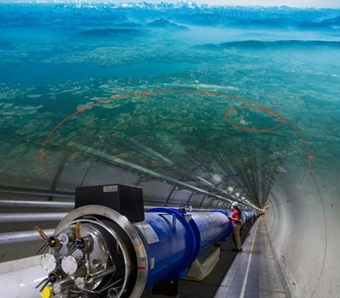

bsm Searches @ LHC
Xuai Zhuang (庄胥爱)
xuai.zhuang@cern.ch
IHEP, Beijing, China
Jul. 15-21, Wuhan, iSTEP2018

Slide 2
希腊神话中的怪物“Uroboros”与格拉肖的“宇宙圈”
最小
最大
新粒子，
新物理？
星系
基本粒子
太阳系
原子核
太阳
原子
分子
地球
微生物
动物
2

Slide 3
希腊神话中的怪物“Uroboros”与格拉肖的“宇宙圈”
引力和电磁力占主导地位
3

Slide 4
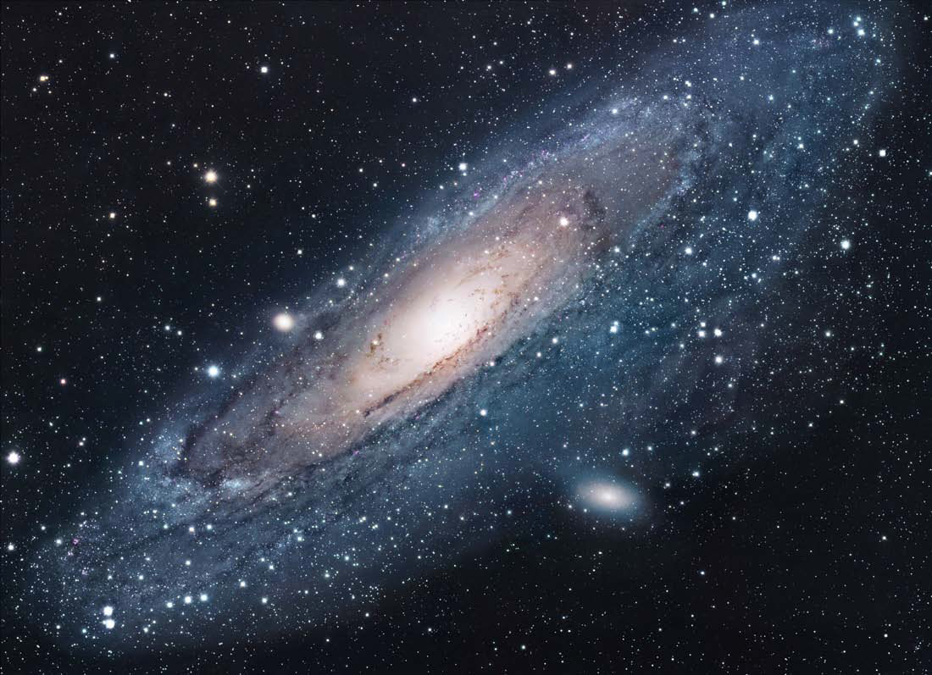
希腊神话中的怪物“Uroboros”与格拉肖的“宇宙圈”
引力主导，
爱因斯坦的广义相对论
引力和电磁力占主导地位
4

Slide 5
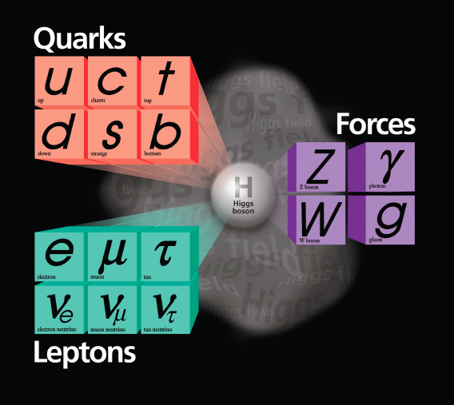
希腊神话中的怪物“Uroboros”与格拉肖的“宇宙圈”
引力主导，
爱因斯坦的广义相对论
粒子“微观世界”，强弱相互作用主导，理论模型是标准模型
引力和电磁力占主导地位
5

Slide 6
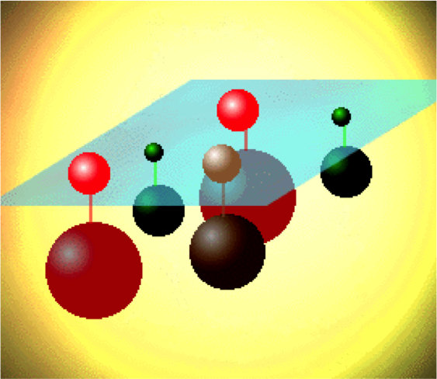
希腊神话中的怪物“Uroboros”与格拉肖的“宇宙圈”
新物理，新粒子？
引力主导，
爱因斯坦的广义相对论
粒子“微观世界”，强弱相互作用主导，理论模型是标准模型
引力和电磁力占主导地位
6

Slide 7
希腊神话中的怪物“Uroboros”与格拉肖的“宇宙圈”
新物理，新粒子？
引力主导，
爱因斯坦的广义相对论
粒子“微观世界”，强弱相互作用主导，理论模型是标准模型
引力和电磁力占主导地位
7

Slide 8
希腊神话中的怪物“Uroboros”与格拉肖的“宇宙圈”
新物理，新粒子？
引力主导，
爱因斯坦的广义相对论
粒子“微观世界”，强弱相互作用主导，理论模型是标准模型
引力和电磁力占主导地位
8

Slide 9

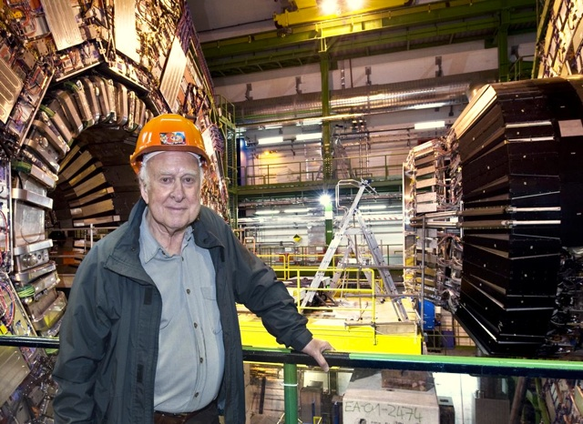
Higgs boson observed, SM is complete. SM fits the experimental data very well ➔ big success in EW scale
P. Higgs at CMS

Slide 10
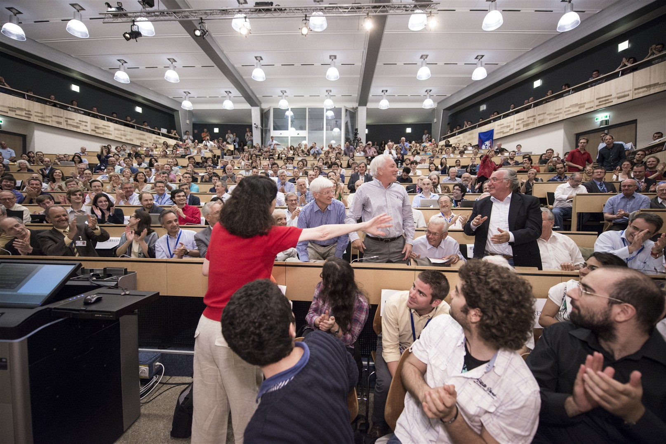
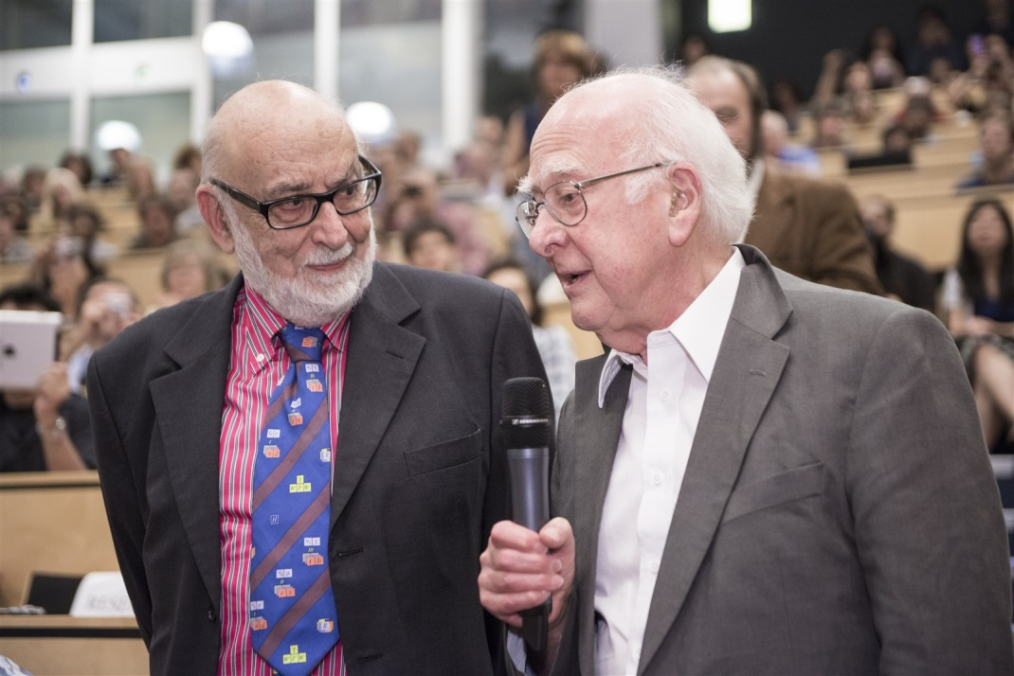
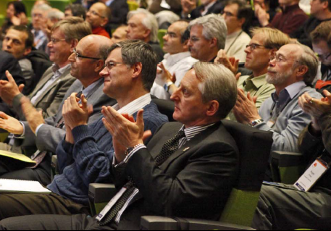

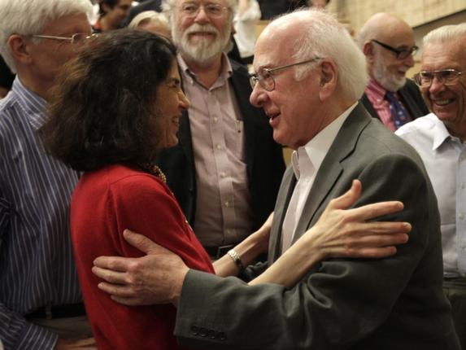

Very happy faces after the announcement of the discovery on 4th July 2012
at CERN and at ICHEP Melbourne

Slide 11

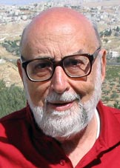
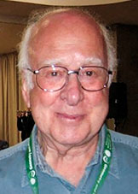
Announced on 8th October and celebrated on 10th December 2013:
“for the theoretical discovery of a
mechanism that contributes to our
understanding of the origin of mass
of subatomic particles, and which
recently was confirmed through
the discovery of the predicted
fundamental particle, by the
ATLAS and CMS experiments at
CERN’s Large Hadron Collider”

Slide 12
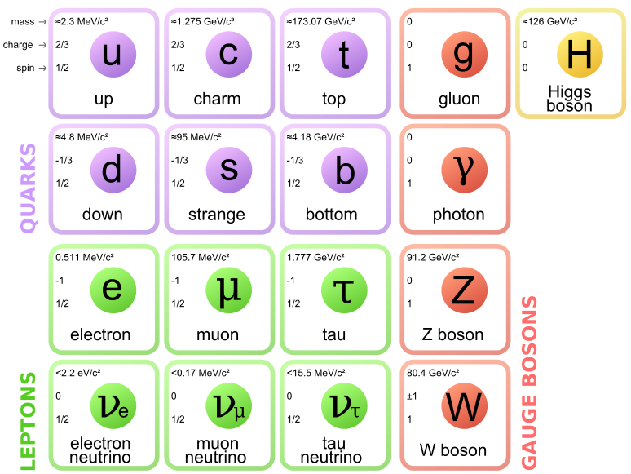
Standard Model of Elementary Particles
The elementary
particles arranged
according to their
properties
Three families of
quarks and leptons
Fermionen
Bosonen

Slide 13
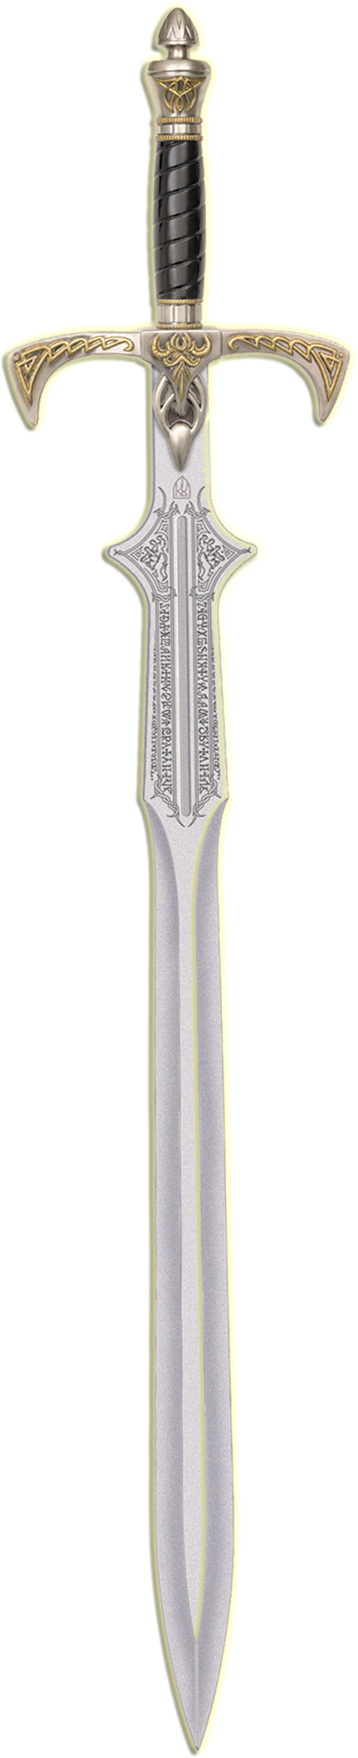
Need a more fundamental theory of which SM is only a low-energy approximation ➔ New Physics
While has problem in Planck scale:
  Naturalness and “hierarchy” problem
  Unification of gauge coupling
  Dark Matter
  ……
Unfortunately, there is a problem with the Higgs!
P. Higgs at CMS

Slide 14
SUSY
exotics

Slide 15
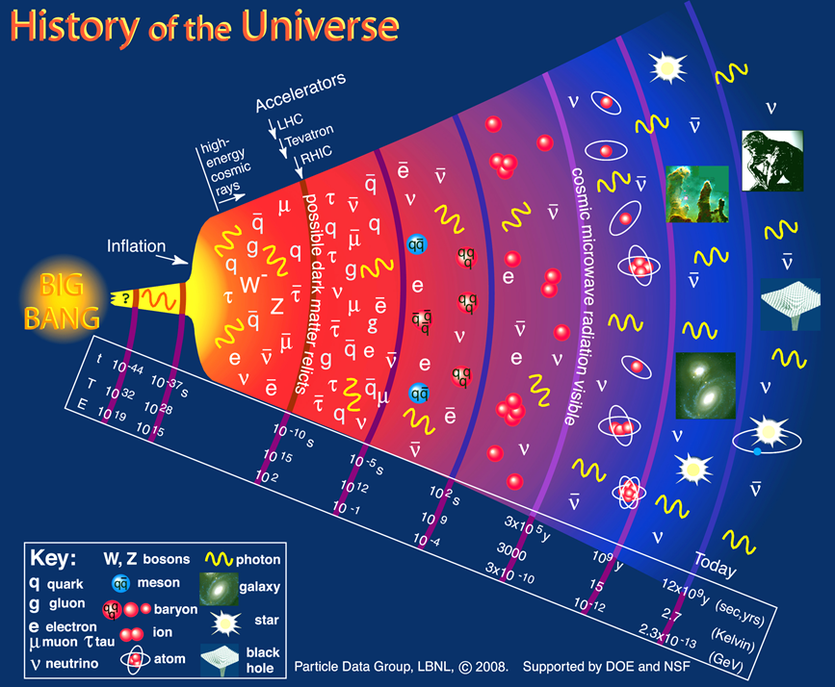
大爆炸宇宙学

Slide 16

LHC 大型强子对撞机
Large Hadron Collider
日内瓦湖
CMS
LHCb
机场
ALICE
ATLAS
CERN
周长 27 公里，隧道深100米，跨越瑞士法国国境
世界最大，能量最高的加速器，进行最前沿的粒子物理研究
质心系能量14TeV (Tevatron的7倍)，可以发现5TeV以下的较重的新粒子
积分亮度10³⁴ cm⁻² s⁻¹ (Tevatron 的100倍), 可以发现微小衰变截面的稀有事例

Slide 17
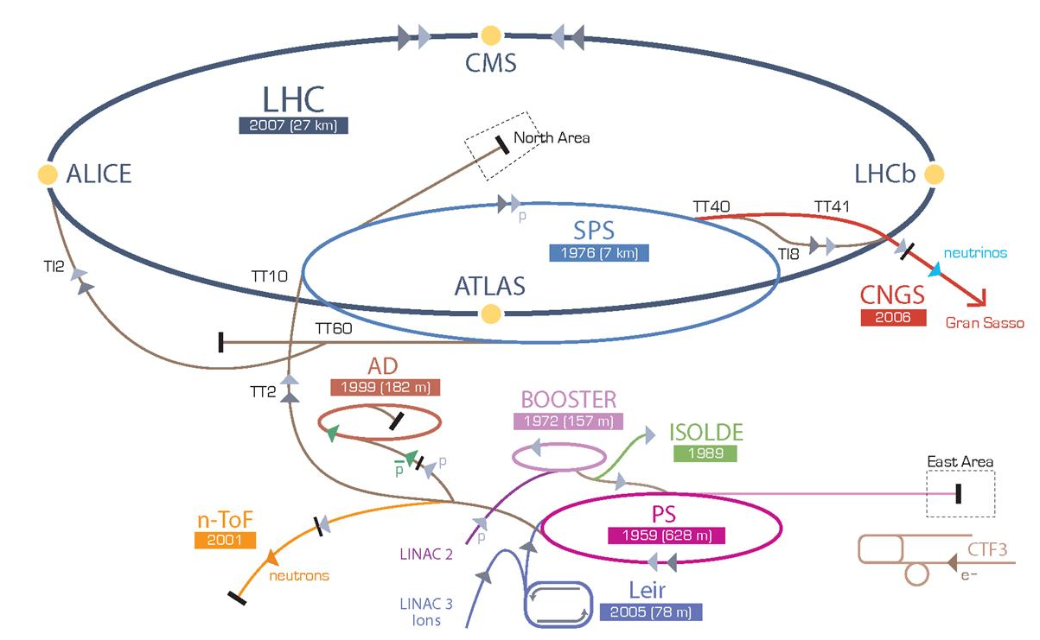
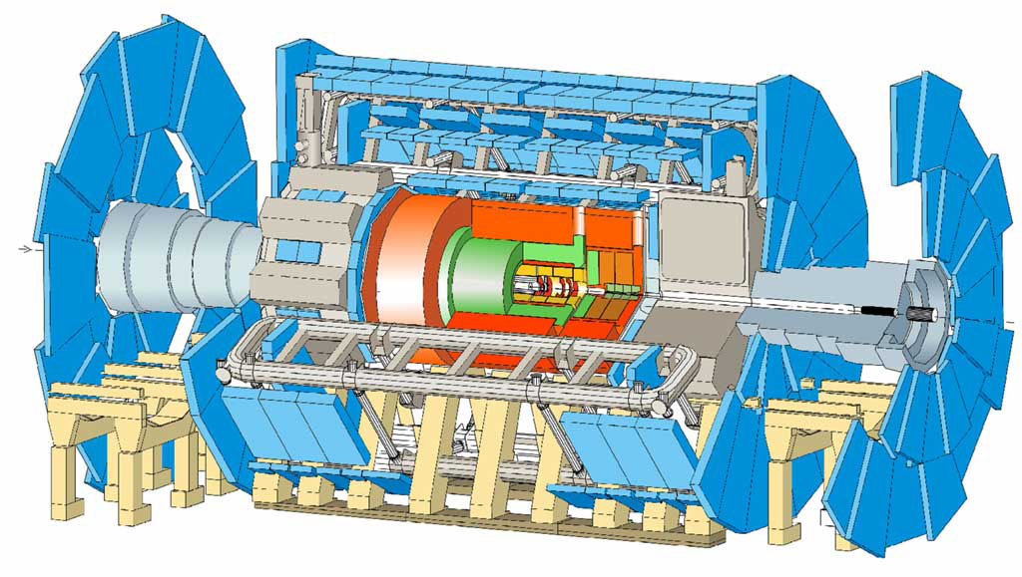
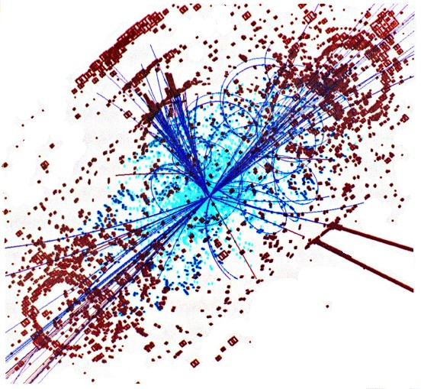
CERN’s particle accelerator chain
17
17

Slide 18
25 ns
Event rate:
N = L x σ (pp) ≈ 10⁹ interactions/s
Mostly soft (low p_{T}) events
Interesting hard (high-p_{T}) events are rare
→ very powerful detectors needed

Slide 19
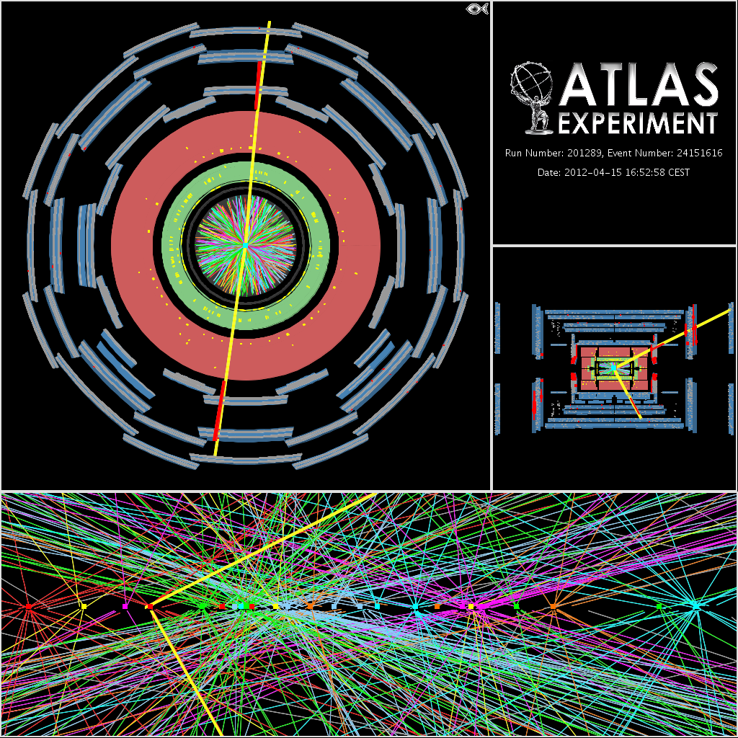
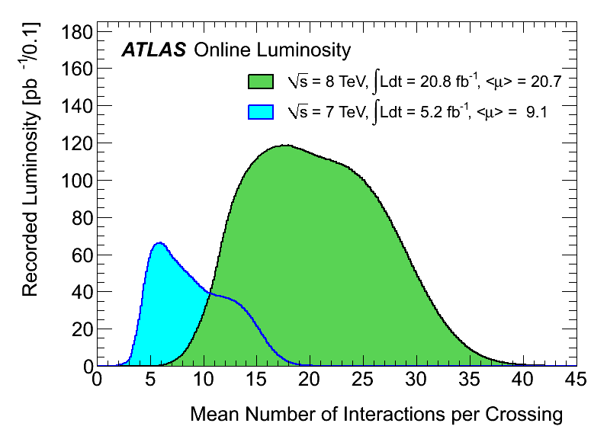
Excellent LHC performance
is a (nice) challenge for the
experiment:
- Trigger
- Pile-up
- Maintain accuracy of the
the measurements in this
environment
Inner Detector for a Z → μμ event with 25 primary vertices

Slide 20
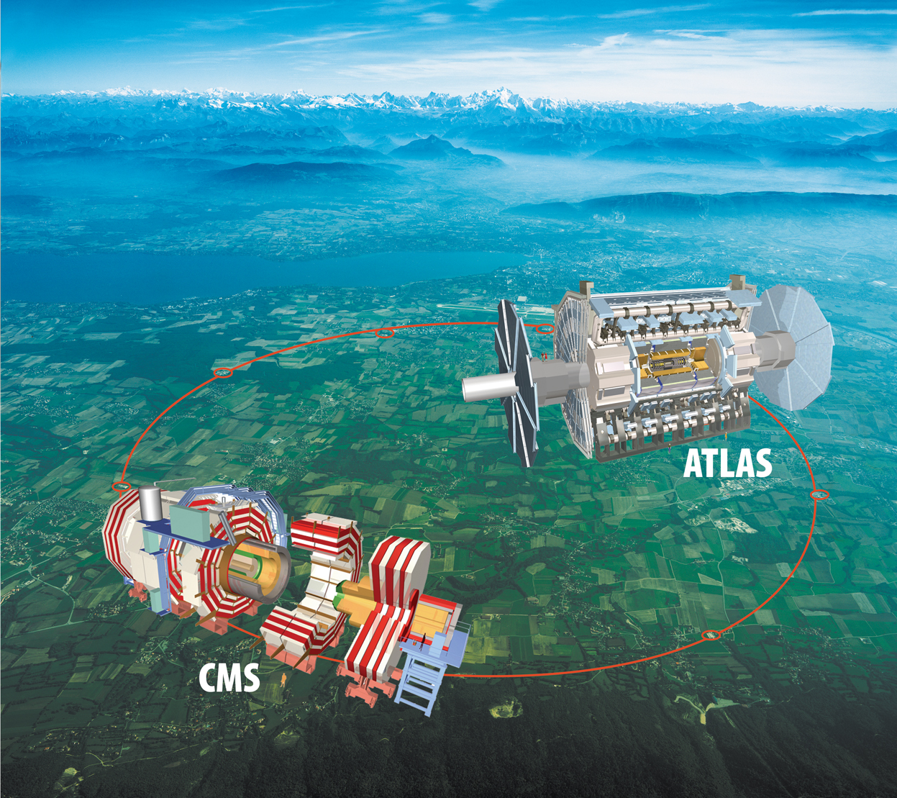
ATLAS and CMS detector @ LHC
ATLAS and CMS: two multi-purpose detectors @LHC
A Toroidal LHC ApparatuS
- 42m×22m, 7000 ton
- Solenoid + Toroidal magnet (2T)
- Fine granularity liquid Ar/Tile calorimeters
Large Hadron Collider (LHC):
Proton-Proton synchrotron
World’s highest and largest collider
Compact Muon Spectrometer
- 21m×15m, 125000 ton
- All silicon trackers, 4T solenoid magnet
- PbWO4+Tile calorimeters

Slide 21
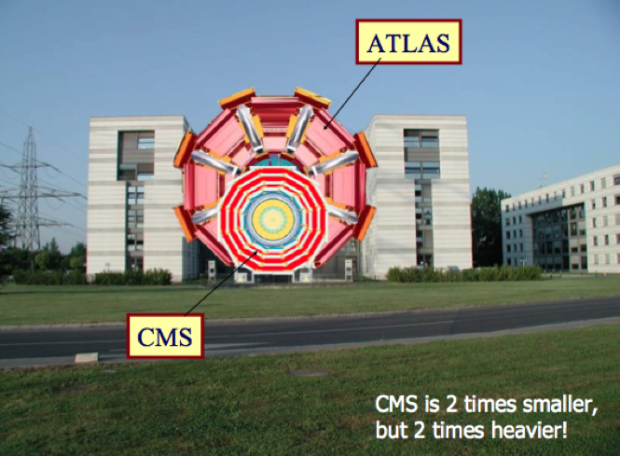


ATLAS and CMS

Slide 22
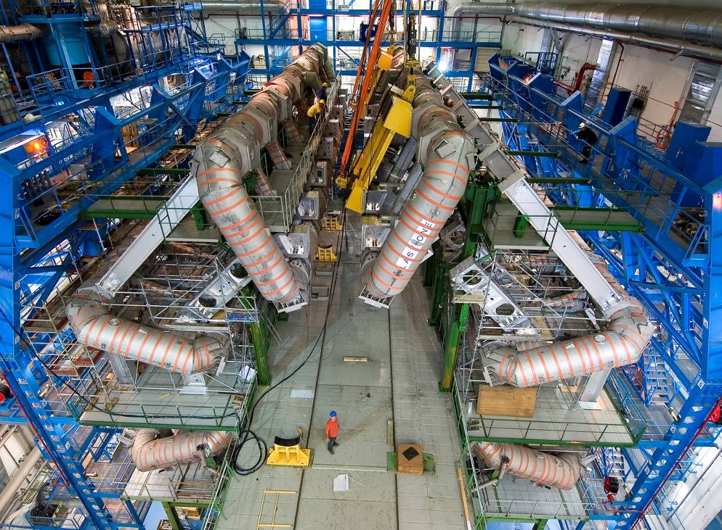
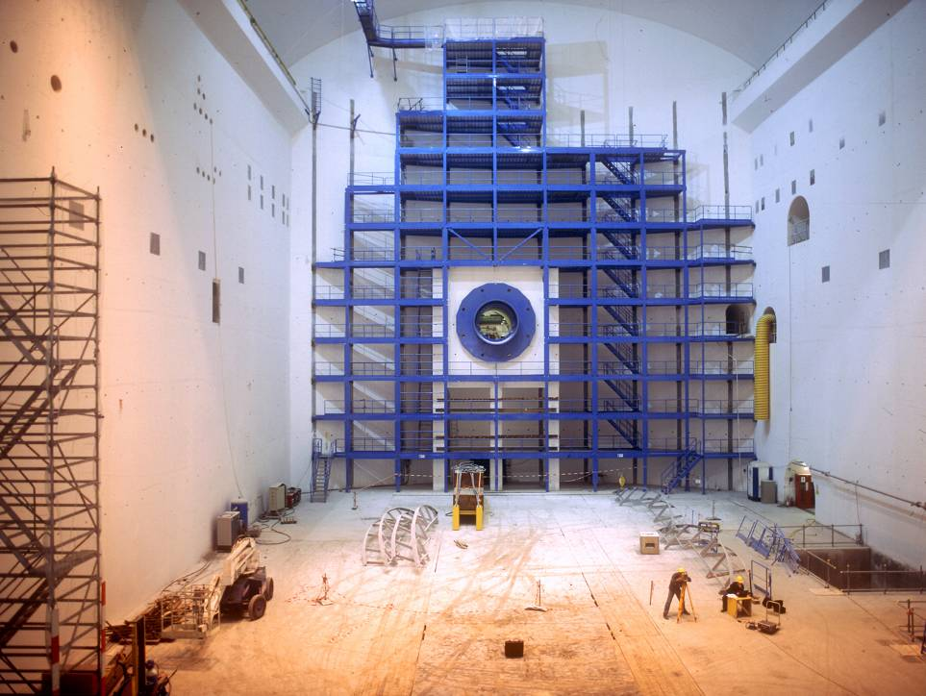
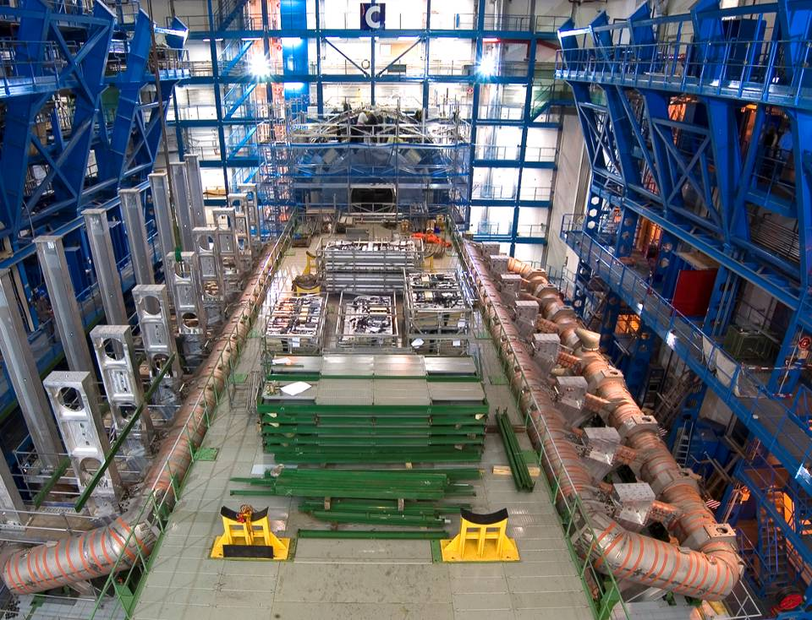
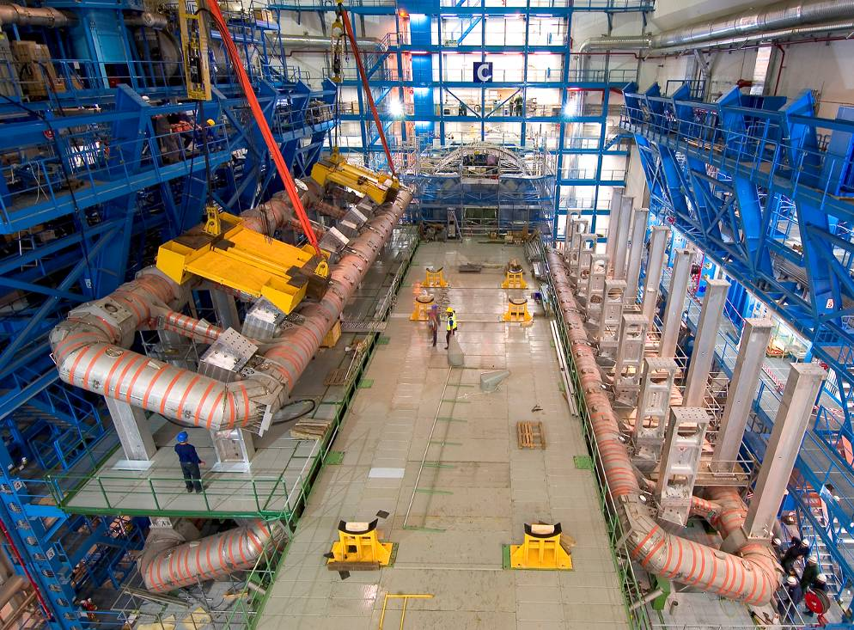
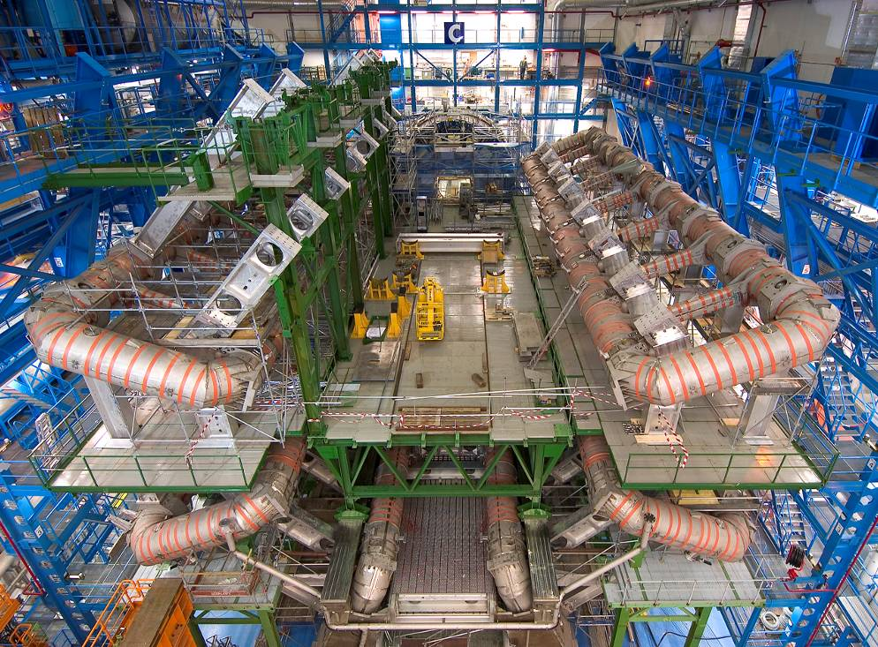
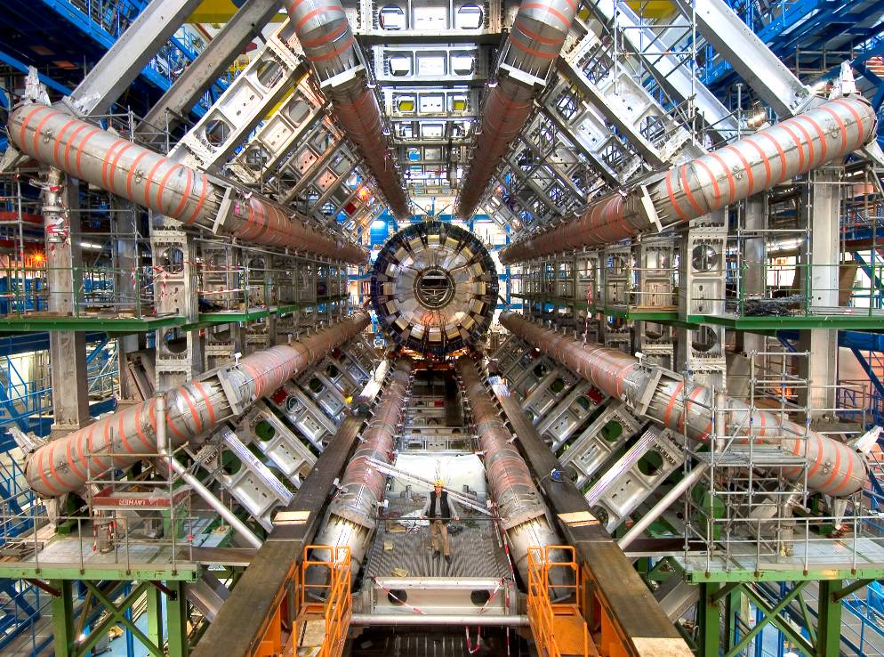
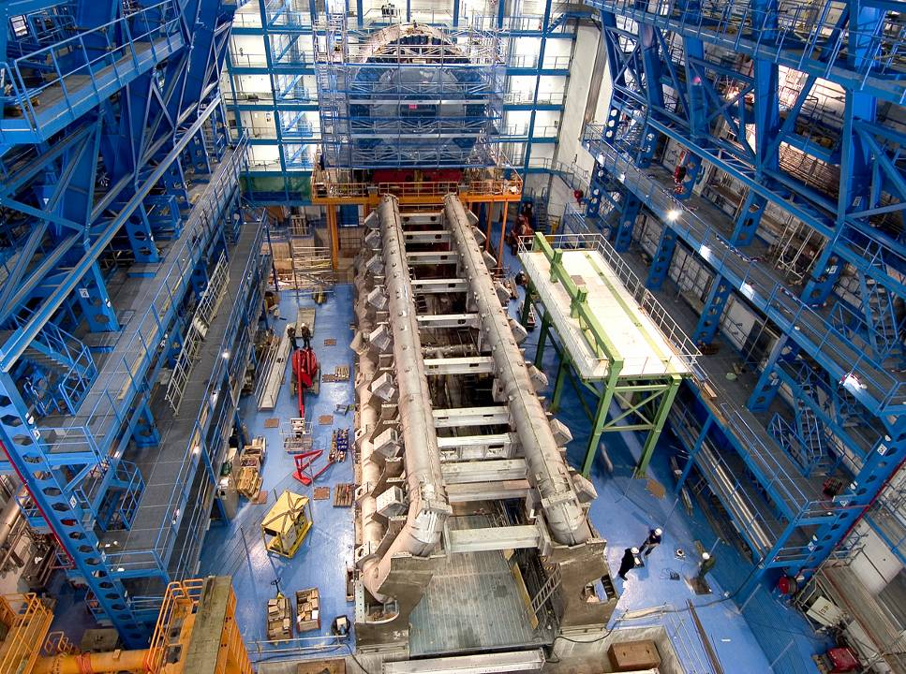
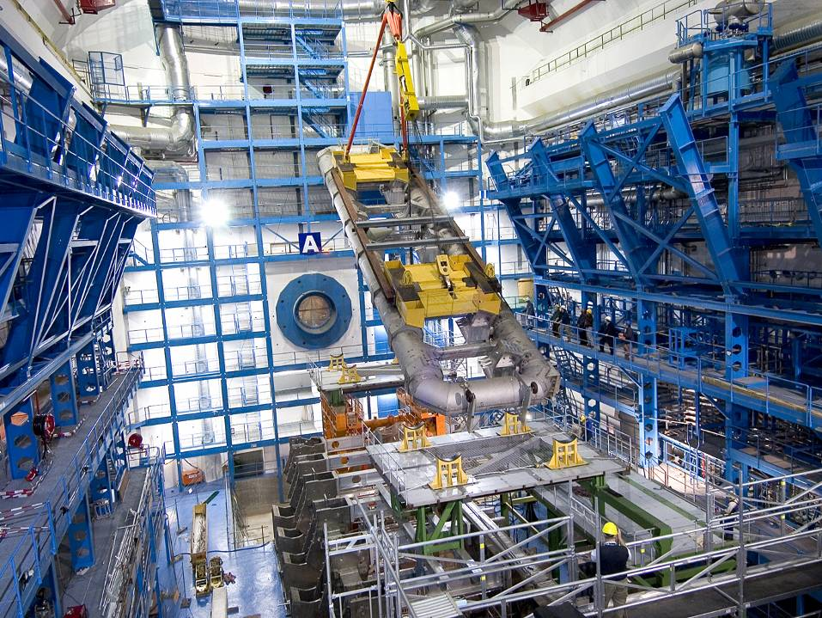
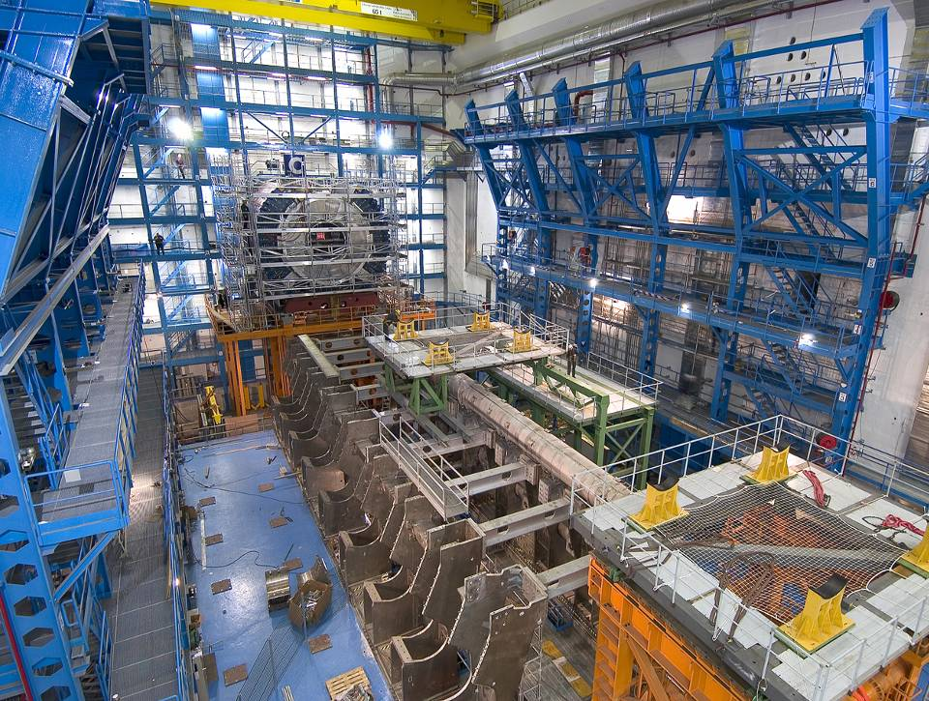
ATLAS Cavern

Slide 23
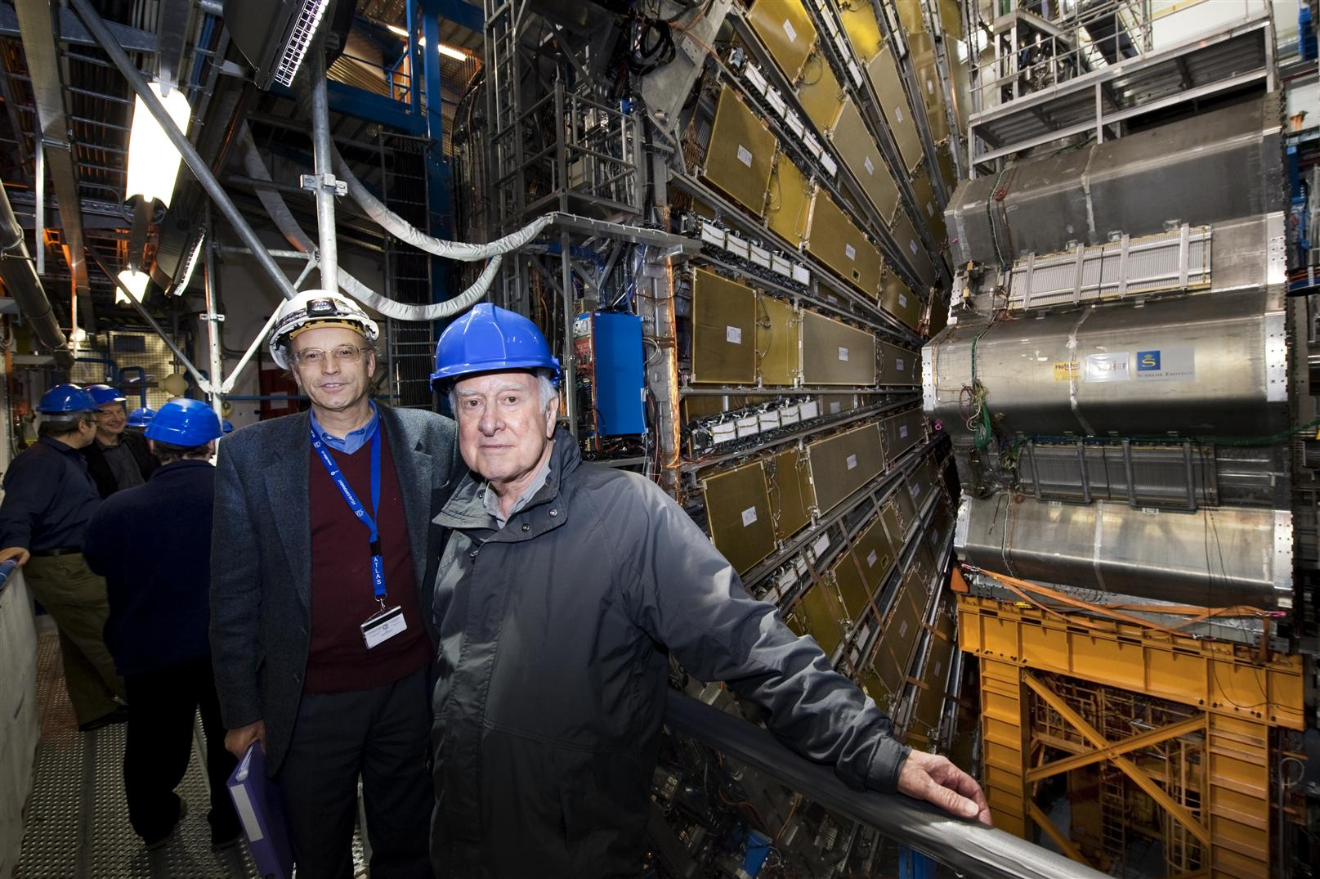
Chinese muon chambers installed in the ATLAS detector
ATLAS 4 April 2008
TGC end-cap trigger
MDT chambers on ECT,
built at IHEP
Peter Jenni
Peter Higgs

Slide 24
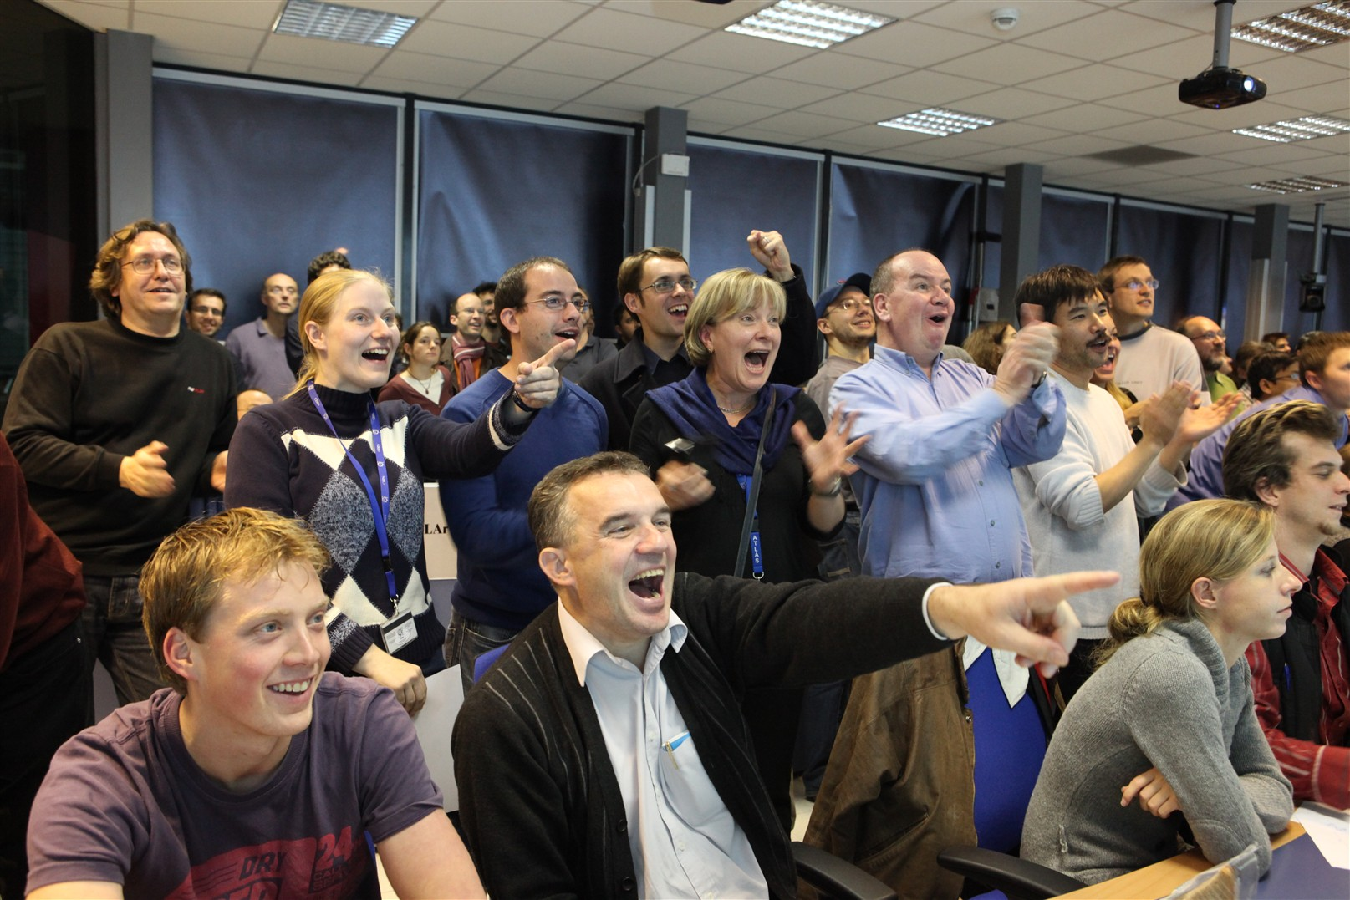
The joy in the ATLAS Control
Room when the first LHC beam
collided on November 23rd, 2009....

Slide 25
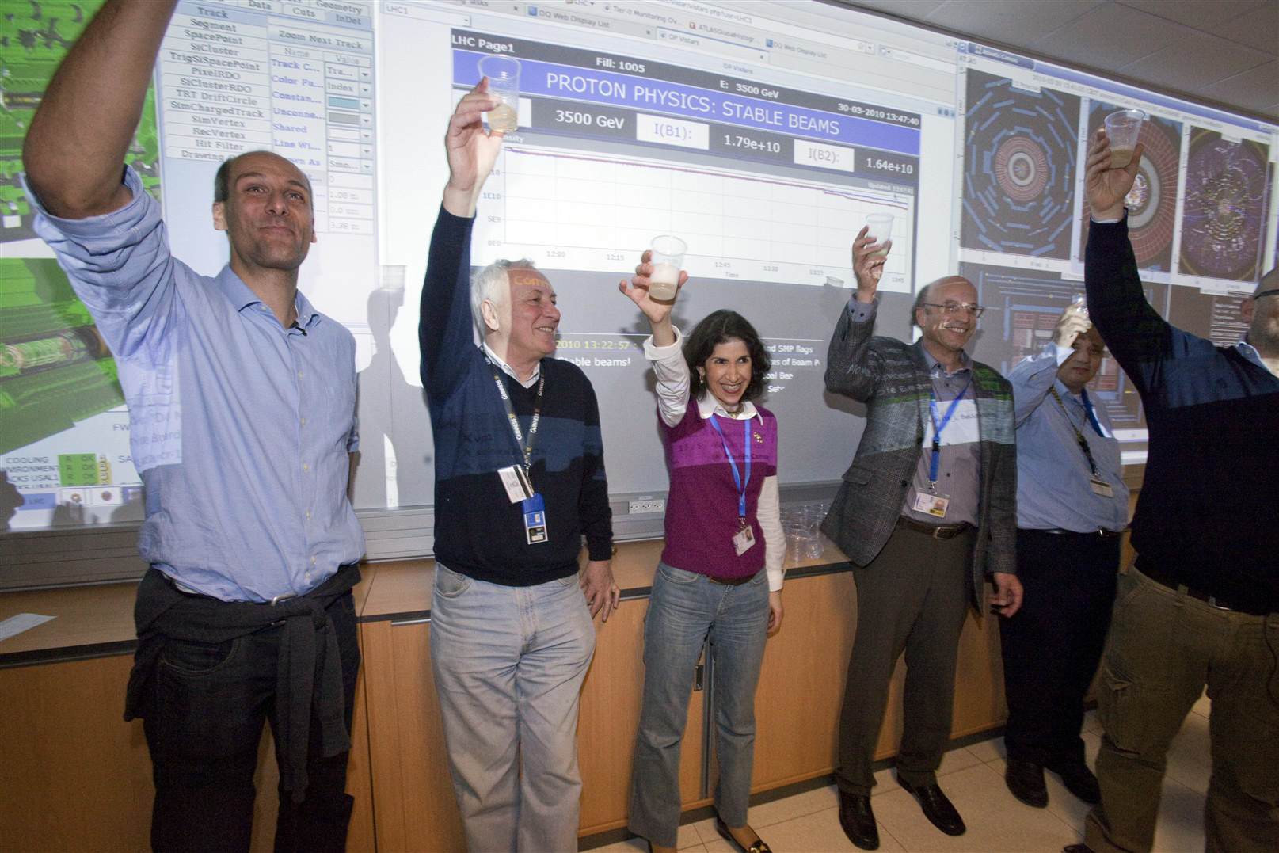
A well-deserved toast to all who have built such a marvelous
machine, and to all who operate it so superbly
(first 7 TeV collisions on 30th March 2010)

Slide 26
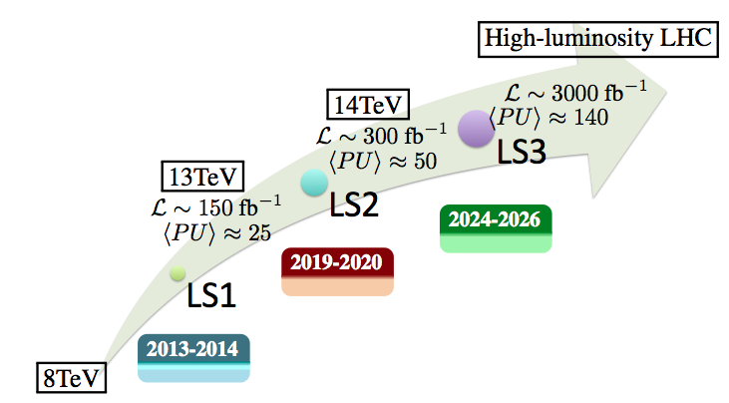
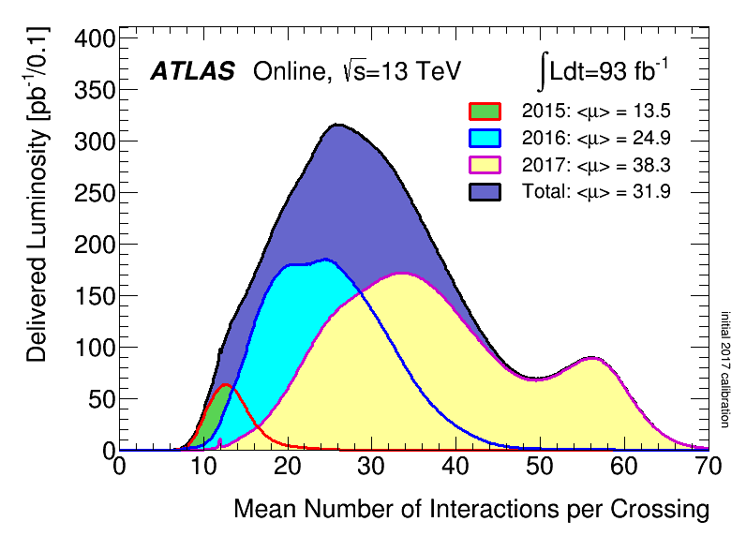
We are here :
2015-2017: ~80 fb⁻¹(13TeV) 2015 ~ 3 fb⁻¹
2016 ~ 33 fb⁻¹
2017 ~ 50 fb⁻¹
The results are based on 36-80 fb⁻¹ @ 13 TeV (RUN2 2015-2017) ~ 2-3% of total
Run3
2021-2023
Run2
2015-2018
Run4-5 …
2027-2037
Run1
Long Stop
2010-2012
~25 fb⁻¹

Slide 27
SUSY

Slide 28

SUSY search at colliders (mainly at LHC)

Slide 29
What is SUSY?
How SUSY do help?
(TeV-scale) Supersymmetry (SUSY)
Higgs
SUSY
P. Higgs at CMS

Slide 30
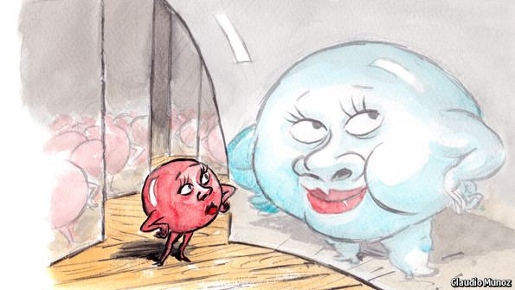
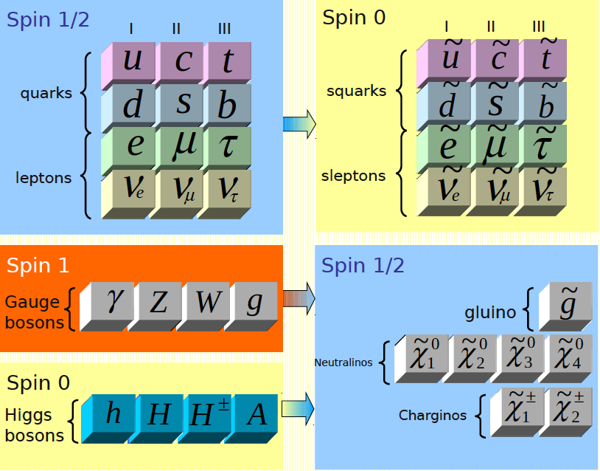
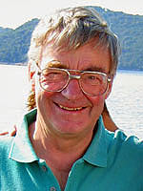
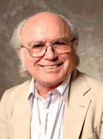
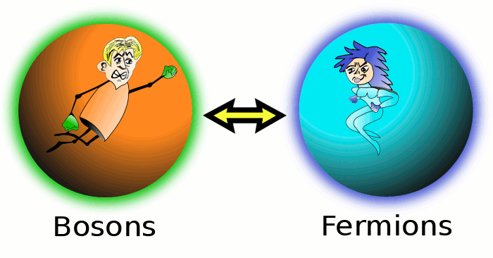
SUSY Introduction
OUR WORLD…
NEW WORLD?
Julius Wess
(1934 – 2007)
Bruno Zumino
(1923 – 2014)
(Julius Wess and Bruno Zumino, 1974)
Establishes a symmetry between fermions
(matter) and bosons (forces)
Motivation:
  Unification (fermions-bosons, matter-forces)
  Solves some deep problems of the SM
  Provide Dark Matter candidate
  ……
Q |boson> = |fermion>
Q |fermion> = |boson>
Spin differ by 1/2

Slide 31
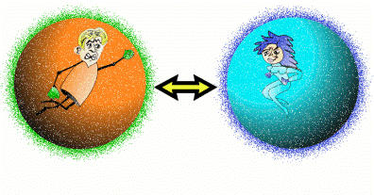
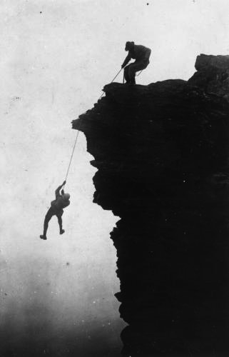
SUSY Introduction
Solve hierarchy problem without “fine tuning”
  Fermion and boson loops contribute with different signs to the Higgs radiative corrections
  Supersymmetric partner contributions to Higgs mass cancel SM contributions
Mrs. SUSY
Mr. Higgs
Fermion loop
Boson loop

Slide 32
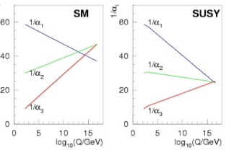
SUSY Introduction
Unification of gauge couplings
  New particle content changes running of couplings
  requires SUSY masses below few TeV

Slide 33
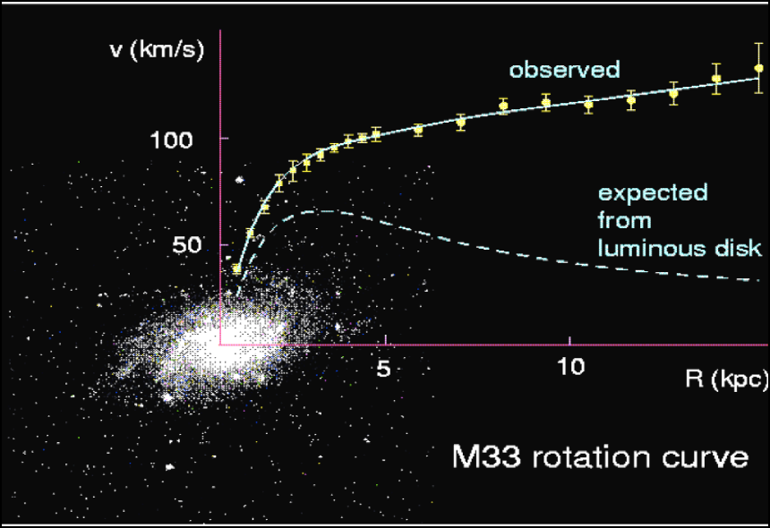
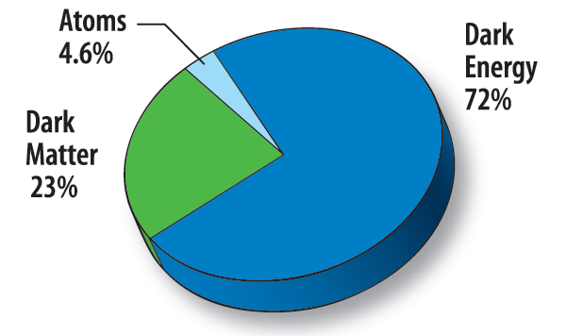
Provide Dark Matter candidate
天文学家发现宇宙中很大一部分是我们看不见的 暗物质（明物质只占4.6%）
Provide perfect dark mater candidate - WIMP(lightest neutralino in R-parity conserving models)
  stable
  electrically neutron
  same density as DM
‘Supersymmetric’ particles ?
0.094 < Ω_{CDM}h² < 0.136 (95% CL)
→ 通过寻找SUSY，可以为暗物质寻找提供实验证据 ！
33

Slide 34

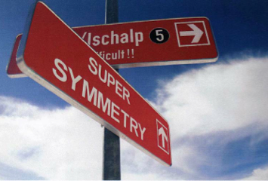
How to hunt SUSY?
(TeV-scale) Supersymmetry (SUSY)
Higgs
SUSY
P. Higgs at CMS

Slide 35
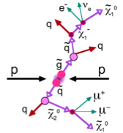

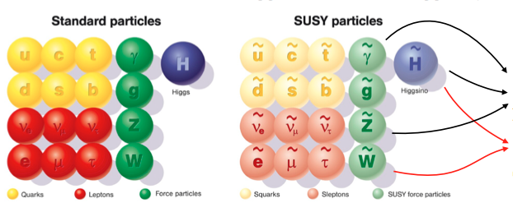
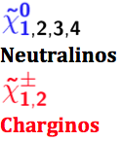
How do we start? - SUSY Signature
Conserved R parity (originally introduced for stability of proton)
  SUSY particles produced/annihilated in pairs
  Lightest SUSY particle (LSP) stable (DM candidate)
  Typical signature: jets/leptons/photons + MET (key signature: large MET)
R=+1 (SM)
R=-1 (SUSY)

Slide 36

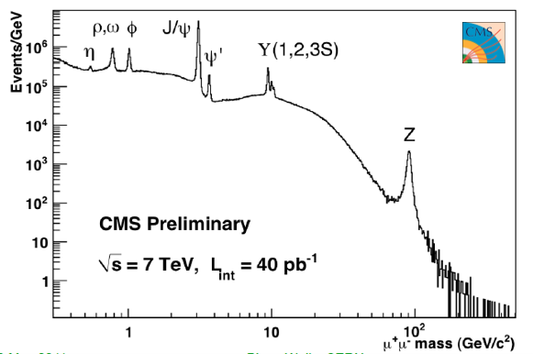
How do we search for SUSY?
Not like general particles with peak in mass spectrum ☹
2010
[uu]
[dd]
[ss]
[cc]
[bb]
~1960
1974
1978
How do we search for SUSY?
1983

Slide 37


How do we search for SUSY?
SUSY search strategy: search for deviation from SM from the tails
  SUSY sensitive variables: Try to establish excess of events in some sensitive kinematic distribution
SM background: the discovery of new physics can only be claimed when SM backgrounds are understood well or under control
  SM bgs understood very well ☺
  No hints for new physics ☹
  Slightly overshoot in WW cross section, but consistent with NNLO xsec.
SM “backgrounds”– the big picture

Slide 38




SUSY Sensitive Variables
E_{T}^{miss}
M_{eff}
E_{T}^{miss} from escaping LSP, to suppress bg from mis-measured jets and oth. SM BG
Related to the sparticle mass scale, like effective mass (M_{eff})
mT, mT2 (stransverse mass): suppress BG with Ws
Many others …
mT
mT2

Slide 39
How do we search for SUSY?
-Analysis Procedure (similar for exotics)
Be aware of SUSY signature, design signal grid
Pre-selection: select good objects (e, mu, tau, jet, ...), apply trigger depending on analysis, remove bad events (bad runs, not from pp collisions, in transition region ...)
SR definition and optimization
  Define signal regions based on decay topologies occurring in generic models
  Set final cut on discriminating variables (e.g. Meff) to optimize sensitivity to reference models with appropriate mass scale
SM Background estimations (data-driven + MC)
Compare SM predictions with data
If no excess, interpret results in different SUSY models

Slide 40


Be aware of SUSY signature, design signal grid
W ➔ l nu
➔ qq
gluinos decaying via charginos
Final states:
  ≥ 1 lepton + multi-jets + large E_{T}^{miss}

Slide 41

2: Pre-selection Reconstructed Objects
径迹探测器
电磁量能器
强子量能器
缪子探测器
Photons: no track but energy in el-m (and not in the hadronic) calorimeter
Electrons: track and energy in el-m (and not in the hadronic) calorimeter
Muons: track in inner tracker and muon chamber
Jets: cluster in hadronic calorimeter
光子
电子
缪子
强子
中性粒子
探测器内层 → 外层

Slide 42


MET: Missing Transverse Energy
At the LHC an unknown proportion of the energy of the colliding protons escapes down the beam-pipe
Invisible particles (neutrinos, neutralinos?) are created their momentum can be constrained in the plane transverse to the beam direction
Missing Transverse Energy

Slide 43

Triggering on Physics
Apply trigger depending on analysis
Only pick up what we are interested events
MissingET trigger used here
Final states:≥ 1 lepton + multi-jets + large E_{T}^{miss}

Slide 44

3: SR definition and optimization
    arXiv:1605.04285
Final states: ≥ 1 lepton + multi-jets + large E_{T}^{miss}
According to signal signature, select interested final states objects: number of jets, leptons requirement
Suppress background using SUSY discriminating variables
The cuts are from optimization with signal significance
44

Slide 45
4: SM Background estimations (data-driven + MC)
SUSY searches rely primarily on the understanding of the SM BG
Standard Model
Top, multijets
V, VV, VVV, Higgs & combinations of these
Reducible backgrounds
Determined from data
Backgrounds and methods depend on analyses
Irreducible backgrounds
Dominant sources: normalise MC in data control regions
Subdominant sources: MC
Validation
Validation regions used to cross check SM predictions with data
blinded
Signal regions
blinded
45

Slide 46

SM Background Estimation
SUSY searches rely primarily on the understanding of the SM BG
Standard Model
Top, multijets
V, VV, VVV, Higgs & combinations of these
Reducible backgrounds
Determined from data
Backgrounds and methods depend on analyses
Irreducible backgrounds
Dominant sources: normalise MC in data control regions
Subdominant sources: MC
Validation
Validation regions used to cross check SM predictions with data
Signal regions
46

Slide 47


SM Background Estimation
SUSY searches rely primarily on the understanding of the SM BG
Standard Model
Top, multijets
V, VV, VVV, Higgs & combinations of these
Reducible backgrounds
Determined from data
Backgrounds and methods depend on analyses
Irreducible backgrounds
Dominant sources: normalise MC in data control regions
Subdominant sources: MC
  No significant excess except for 6jet-SR
    arXiv:1605.04285
Validation
Validation regions used to cross check SM predictions with data
5: Compare SM predictions with data
Signal regions
47

Slide 48


SM Background Estimation
SUSY searches rely primarily on the understanding of the SM BG
Standard Model
Top, multijets
V, VV, VVV, Higgs & combinations of these
Reducible backgrounds
Determined from data
Backgrounds and methods depend on analyses
Irreducible backgrounds
Dominant sources: normalise MC in data control regions
Subdominant sources: MC
    arXiv:1605.04285
  excludes gluino masses up to 1.6 TeV
Validation
Validation regions used to cross check SM predictions with data
6: Interpretations
Signal regions
48

Slide 49
SUSY search results @ LHC and prospects at future colliders
(TeV-scale) Supersymmetry (SUSY)
Higgs
SUSY
P. Higgs at CMS

Slide 50



SUSY Search @ LHC
Strong production:
targeting gluinos and 1st and 2nd generation squarks
by far largest cross-sections
3rd generation:
targeting stop and sbottoms
Should be lowest mass squarks for naturalness reasons
Electroweak production:
targeting Electroweakinos, sleptons
Lowest mass sparticles, clean signature
RPV/LL:
targeting R-parity violating models and long lived sparticles
More exotic models
ATLAS public link
CMS public link

Slide 51




squark & gluino search (all had.)
Signal: jets and missing energy
EPJC 77 (2017) 710
Phys. Rev. D 97 (2018) 112001
Corresponding sparticle mass limits for BF=100%:
  Squarks: up to 1.55 TeV assuming 8-fold squark degeneracy
  Gluinos: up to 2.05 TeV with neutralinos up to 1.1 TeV

Slide 52




Gluino decays to 3rd Gen. squarks
Signal: 4b-jets (right) up to 4 top quarks (left)
arXiv:1711.01901
Corresponding sparticle mass limits for BF=100%:
  Gtt: Gluinos up to 1.97 TeV with neutralinos up to 1.19 TeV
  Gbb: Gluinos up to 2.05 TeV with neutralinos up to 1.2 TeV

Slide 53






Multi-step decays
Signal: 1 or 2/3 leptons, jets and MET
Single lept.
OS Di-lept.
SS Di-lept.
JHEP 09 (2017) 084
arXiv:1805.11381
arXiv:1708.08232
Corresponding sparticle mass limits for BF=100%:
  Gluino mass up to 1.8-2 TeV, LSP up to 1-1.2 TeV

Slide 54




3rd Generation: stop/sbottom (leptonic)
Single lept.
SS Di-lept.
arXiv:1711.11520
JHEP 09 (2017) 084

Slide 55




Gaugino search:
via slepton decay (2l/3l)
arXiv:1803.02762
arXiv:1709.05406
arXiv:1708.07875
arXiv:1709.05406

Slide 56





Slepton search
arXiv:1803.02762
Phys. Rev. D 93, 052002 (2016)
CMS-PAS-SUS-17-003

Slide 57

57

Slide 58
exotics

Slide 59

额外维粒⼦
W′, Z′
Contact interactions
暗物质
leptoquark
额外夸克
重费米子
其他
59

Slide 60



Resonance (di-jet)
EXO-16-056
Results interpreted in many models e.g.:
String resonance ~ 7.7 TeV
Excited quark ~ 6 TeV
W’ ~ 3.3 TeV
Z’ ~ 2.7 TeV

Slide 61



Dark Matter （暗物质）
Searches with MET+X or mediator
Searches in the Mono-X final states: Many models constrained up to 1-2 TeV
Searches also in the Di-Jet final states exclude up to 2.6 TeV for almost whole DM range

Slide 62





Leptoquarks
Leptoquarks (LQs) arise in many models, such as grand unified theories, compositeness models and superstring theories.
LQs: carry colour charge, fractional electric charge, and both lepton and baryon quantum numbers.
If exist, decay into a lepton and a quark. Search for resonance of lepton+jet in experiment.
m(LQ1,LQ2) > 1.1TeV
m(LQ3) > 0.9 TeV
New J. Phys. 18 (2016) 093016
CMS-PAS-B2G-16-028
eq
µq
τt
No significant excess observed in 2~36fb -1 . Results in terms of β = BR(LQ→lq)

Slide 63

Heavy quarks (额外夸克）

Slide 64
Prospects at Future Collider
14 TeV, 3000 fb⁻¹
33 TeV, 3000 fb⁻¹
100 TeV, 3000 fb⁻¹
arXiv:1311.6480, 1406.4512, 1410.6287
Long term prospects for 2 more collider scenarios have been studied (14, 33, 100 TeV @3000 fb⁻¹)
Use same search strategy as 8-13TeV @LHC
Use simple analysis strategies, assume 20% syst. uncertainty, avoid assumption on detector design, pileup sensitivity, etc

Slide 65







Prospects at HL-LHC
ATL-PHYS-PUB-2014-010
ATLAS studied long term prospects for the (HL-)LHC with 300, 3000 fb⁻¹@14TeV
Discovery potential up to 2.5 TeV gluinos, 1.3 TeV squarks/sbottom and 800 GeV Electroweakinos, 500 GeV stau with 3000 fb⁻¹.
2023:~300 fb⁻¹
2037:~3000 fb⁻¹
ATL-PHYS-PUB-2016-021

Slide 66


Prospects at HL-LHC
ATL-PHYS-PUB-2015-004
ATL-PHYS-PUB-2017-002
Exited quark q*→qg: di-jet
Z’→ttbar
6→8 TeV
3→4 TeV

Slide 67



Future hadron collider projects in a nutshell
-- The next discovery machine

Slide 68
Prospects at Future Collider
14 TeV, 3000 fb⁻¹
33 TeV, 3000 fb⁻¹
100 TeV, 3000 fb⁻¹
arXiv:1311.6480, 1406.4512, 1410.6287
Long term prospects for 2 more collider scenarios have been studied (14, 33, 100 TeV @3000 fb⁻¹)
Use same search strategy as 8-13TeV @LHC
Use simple analysis strategies, assume 20% syst. uncertainty, avoid assumption on detector design, pileup sensitivity, etc

Slide 69





Prospects at Future Collider
Discovery potential (exclusion) up to 11(13) TeV gluinos, 6.5(8) TeV squarks/sbottom and 2.1(3.2) TeV Electroweakinos.
Discover 2.1 TeV EWKino
Discover 11 TeV gluino
Discover 6.5 TeV stop
Exclude 3.2 TeV EWKino
Exclude 13 TeV gluino
Exclude 8 TeV stop

Slide 70


Slide 71

The journey into new physics territory
has just only begun, and for sure, exciting times are
ahead of us!
J Blaeu 1664

Slide 72

New World !!!

Slide 73

CERN Circular Colliders & FCC
1980
1985
1990
1995
2000
2005
2010
2015
2020
2025
2030
2035
2040
Constr.
Physics
LEP
14 TeV, 300 fb⁻¹
Design
Proto
Construction
Physics
LHC – operation run 2
14 TeV, 3000 fb⁻¹
HL-LHC - ongoing project
Design
Construction
Physics
~20 years
FCC – design study
Design
Proto
Construction
Physics
100 TeV, 3000 fb⁻¹
See Michael’s talk

Slide 74
Long-Lived particles in SUSY
PRD88.112006
PRD88.112003
PRD90.112005
PRD93.112015
PRD92.072004
PLB(2016)647-665

Slide 75
Minimal Supersymmetric Standard Model
Standard Model Particles and Fields |  | Supersymmetric Partners
 |  | Interaction Eigenstates |  | Mass Eigenstates
Symbol | Name | Symbol | Name | Symbol | Name
 | quark |  | squark |  | squark
 | lepton |  | slepton |  | slepton
 | neutrino |  | sneutrino |  | sneutrino
 | gluon |  | gluino |  | gluino
 | W-boson |  | wino |  | chargino
 | charged Higgs boson |  | charged higgsino
 | B-field |  | bino |  | neutralino
 | W⁰-field |  | wino
 | neutral Higgs boson |  | neutral higgsino
75

Slide 76
LHC
√s = 14 TeV (7 times higher than Tevatron/Fermilab)
→ search for new massive particles up to m ~ 5 TeV
L_{design} = 10³⁴ cm⁻² s⁻¹ (>10² higher than Tevatron/Fermilab)
→ search for rare processes with small σ (N = Lσ )
pp
ATLAS and CMS :
pp, general purpose
LHC housed in former LEP tunnel
with 27 km circumference
ALICE :
heavy ions
Start : Winter 2009
LHCb :
pp, B-physics
76

Slide 77


Discovery and exclusion
P-value=probability that result is as/less compatible with the hypothesis

Slide 78






Interpretation strategy
Likelihood function: L(μ,θ)
μ: signal strength (POI);
θ: nuisance parameters(NP)
Profile Likelihood: constrain uncertainty (NP) as part of a likelihood fit
Construct test statistics t_{μ} based on likelihood ratio λ:
Construct the PDF of test statistic t_{μ:} generate toy Monte Carlo or using asymptotic formula
From the constructed distribution of test statistic for s+b, find the p-value of the observation
Based on the number of observed, expected events in all regions with all uncertainties: Probability density function (PDF)
If CLs<0.05: the value of signal is excluded at 95% CL……….
The above check has been done for each signal grid points on the SUSY model.
The line can be drawn for the area where points are excluded
Find the observed test statistic for tested μ: t_{μ,obs}

Slide 79
Simultaneous fit
Background estimates in SRs are obtained by a simultaneous fit in each channel based on the profile likelihood method. Three dedicated fit for different purpose…
  Background-only fit
    Fit for all CRs, excluding SRs.
      Get background-only estimates.
      Also extrapolate to VRs (non used in fit, only for cross-check) and SRs.
  Discovery fit
    Fit for all CRs and SRs.
    Signal contamination is turned off in CRs and set as a dummy number 1 in SR (so, the fitted non-SM signal strength = the excess in Nevents of SR)
      Get model-independent upper limit on signal in SR.
  Exclusion fit
    Fit for all CRs and SRs.
    Signal is turned on in all regions, according to model-dependent prediction.
      Got signal model-dependent exclusion from all CRs+SRs →final exclusion contours for SUSY model
The basic strategy is to share background information in all regions (CR,SR,VR). The background parameters are predominantly constrained by CRs with large statistics, which in turn reduces the impact of uncerts in SR.

Slide 80


A Toroidal LHC ApparatuS
- 42m×22m, 7000 ton
Inner Detector: Highly segmented silicon strips, determine very accurately charged particles trajectories
Solenoid Magnet: Solenoid coil that generates a 2T magnetic field in the region of the Inner Detector
Electromagnetic Calorimeter: Electron and photon energies are measured through electromagnetic showers
Hadronic Calorimeter: Hadrons interact with dense material and produce a shower of charged particles
Toroid Magnets: 8 toroidal coils that create a 0,4T magnetic field in the area of the Muon Spectrometer
Muon Spectrometer: Muons traverse the rest of the detector and are measured in its outer layers

Slide 81



The Higgs mechanism, an analogy...
D. Miller
(UC London)
The Higgs field fills all space
A ‘particle’ that moves in
the Higgs field ...
... moves slower the more it
attract attention (interacts with
the Higgs field, generating its
mass, the larger, the stronger
its interactions...)

Slide 82


The Higgs particle, an analogy...
Somebody whispers a rumour into
the room...
... and the field starts to get excited
and interact with itself giving birth
to a massive particle

Slide 83
SM Background Estimation
SUSY searches rely primarily on the understanding of the SM BG
Standard Model
Top, multijets
V, VV, VVV, Higgs & combinations of these
Multijet background: “ABCD method” or jet smearing method
Fake leptons or heavy-flavour jets determined with “matrix method” in different-purity samples using “real” and “fake” probabilities measured in data.
Charge flip rate measured in Z events
Irreducible backgrounds
Dominant sources: normalise MC in data control regions
Subdominant sources: MC
Reducible backgrounds
Determined from data
Backgrounds and methods depend on analyses
Validation
Validation regions used to cross check SM predictions with data
Signal regions
83

Slide 84

SM Background Estimation
SUSY searches rely primarily on the understanding of the SM BG
Normalise MC prediction in SRs using dedicated CRs → transfer factor: T
Standard Model
Top, multijets
V, VV, VVV, Higgs & combinations of these
Reducible backgrounds
Determined from data
Backgrounds and methods depend on analyses
Irreducible backgrounds
Dominant sources: normalise MC in data control regions
Subdominant sources: MC
Validation
Validation regions used to cross check SM predictions with data
Signal regions
84

Slide 85


SM Background Estimation
SUSY searches rely primarily on the understanding of the SM BG
Top CR
Normalise MC prediction in SRs using dedicated CRs → transfer factor: T
Standard Model
Top, multijets
V, VV, VVV, Higgs & combinations of these
Reducible backgrounds
Determined from data
Backgrounds and methods depend on analyses
Irreducible backgrounds
Dominant sources: normalise MC in data control regions
Subdominant sources: MC
W CR
Validation
Validation regions used to cross check SM predictions with data
Signal regions
85

Slide 86



基础物理学的三大前沿
质量起源
物质-反物质
暗物质
不对称
宇宙起源
自然力的统一
新物理
中微子振荡
暗能量
质子衰变

Slide 87


The Worldwide LHC Computing Grid (WLCG)
Tier-0 (CERN):
  Data recording
  Initial data reconstruction
  Data distribution
Tier-1 (12 centres):
Permanent storage
Re-processing
Analysis
Simulation
Tier-2 (68 federations
of >100 centres):
Simulation
End-user analysis

Slide 88
SUSY models: good sale in market
Simplified Models:
  Not really a model (Br~100%, most masses fixed at high scales)
  Important tool for signal region optimization & interpretation
Phenomenological models:
  pMSSM: captures “most” of phenomenologic features of R-parity conserving MSSM
    19 free parameters: M1,M2,M3 ; tan β, μ and m_{A;} 10 sfermion mass parameters; A_{t}, A_{b} and A_{τ}
    Comprehensive and computationally realistic approximation of the MSSM with neutralino LSP
  GGM (gravitino)
Complete SUSY models: mSUGRA, GMSB …

