Slide 1
CGEM Unfolded Display
Long Peixun
2018.3.29

Slide 2
Content
About width of CGEM strips
CGEM unfolded display modes
CGEM Unfolded View
Strips in CGEM unfolded display
CGEM Unfolded All View
Summary

Slide 3
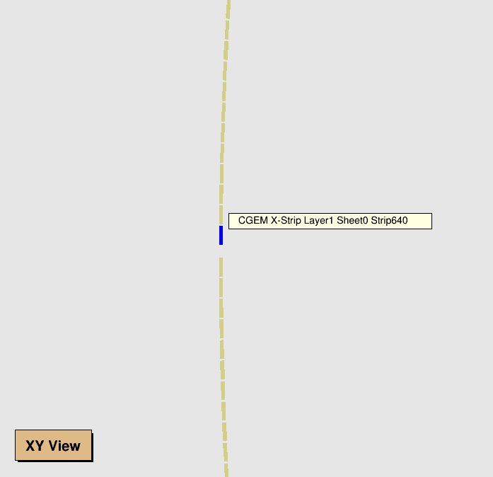
About width CGEM strips
The width of X-Strip is 580 μm;
The width of V-Strip is 130 μm;
The pitch of X-Strip is 660 μm;
The pitch of V-Strip is 659 μm.

Slide 4
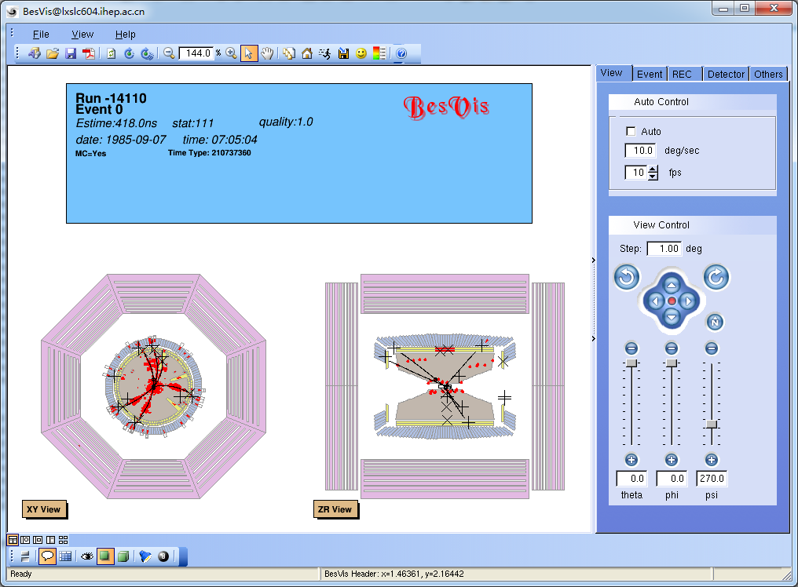
CGEM unfolded display modes
Current BesVis includes 5 display modes:
XY+ZR view, XY view, ZR view, 3D view, All view

Slide 5
CGEM unfolded display modes
To draw CGEM unfolded layers, I add 2 extra display modes.
CGEM Unfolded View
Only one layer will be displayed in this view.
Users can set which layer will be displayed.
CGEM Unfolded All View
CGEM all three layers will be displayed in this view.
Layers will be displayed side by side.
CGEM Unfolded View
CGEM Unfolded All View

Slide 6
CGEM Unfolded View
Click [Switch Among Pads] button to switch display CGEM layer.

Slide 7
Strips in CGEM unfolded display
Layer1 X-strips, 1000%
Layer1 V-strips, 1000%

Slide 8
Strips in CGEM unfolded display
Layer1 X-Strips, 50000%
Layer1 V-Strips, 50000%

Slide 9
Strips in CGEM unfolded display
Layer1 X-Strips and V-Strips, 50000%

Slide 10
CGEM Unfolded All View

Slide 11
Summary
There is no shield problem in Unfolded View, so users can see all strips directly.
However, it is still difficult to distinguish each strip if does not zoom in.
Actually, users only care fired strips. It will be clear enough if just shows fired strips.

