Slide 1
Higgs Physics Now and Future
Higgs measurements now
Higgs measurements at CEPC
Notes from Higgs white paper
Jianming Qian
University of Michigan
mini-CEPC workshop, IHEP, Beijing, June 27-29, 2018

Slide 2
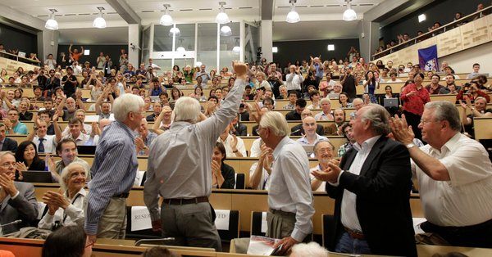
The 2012 Discovery
Seminar of July 4, 2012
Phys. Lett. B716 (2012) 1
Phys. Lett. B716 (2012) 30

Slide 3
Historical Development
In 1964, three teams published proposals on how mass could arise in local
gauge theories. They are now credited for the BEH mechanism and the
Higgs boson.
2013 Nobel Prize!
Francois Englert and Peter Higgs

Slide 4
LHC Run Plan
Now
>90% of the data is yet to be taken !

Slide 5
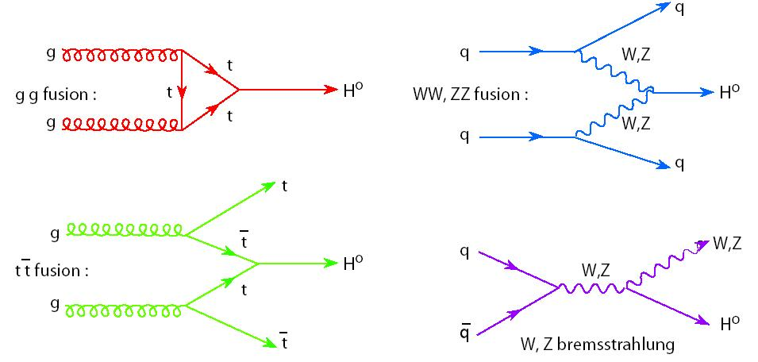
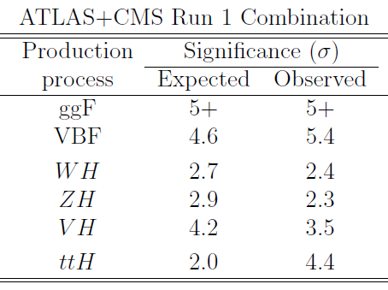
Higgs Boson Production Processes
Four main processes
ATLAS and CMS: arXiv:1606.02266

Slide 6
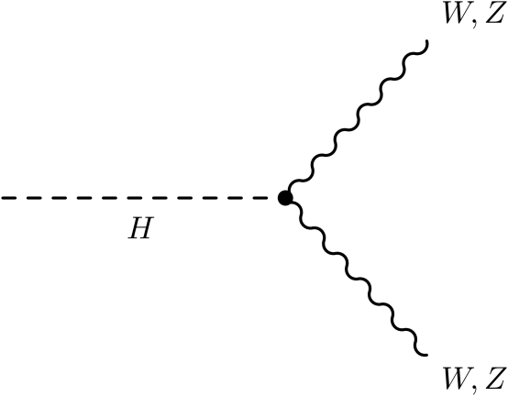
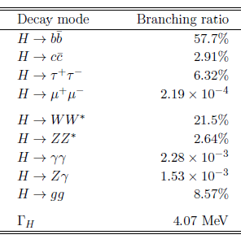
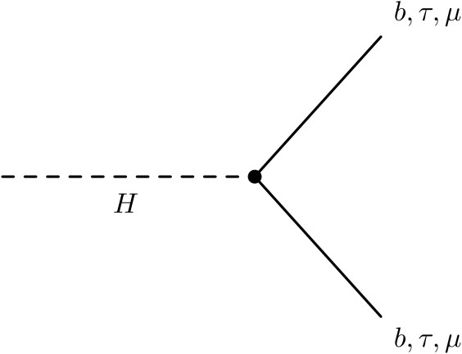
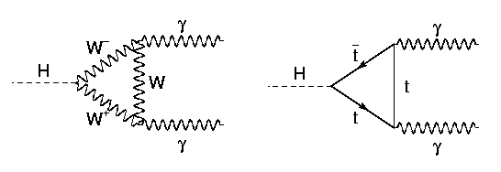
Higgs Boson Decay
Higgs boson couples to particle mass
⇒ decay to heaviest particle possible

Slide 7
Higgs Boson Decays
Run 1 combination
Bosons
Fermions
ATLAS and CMS: arXiv:1606.02266

Slide 8
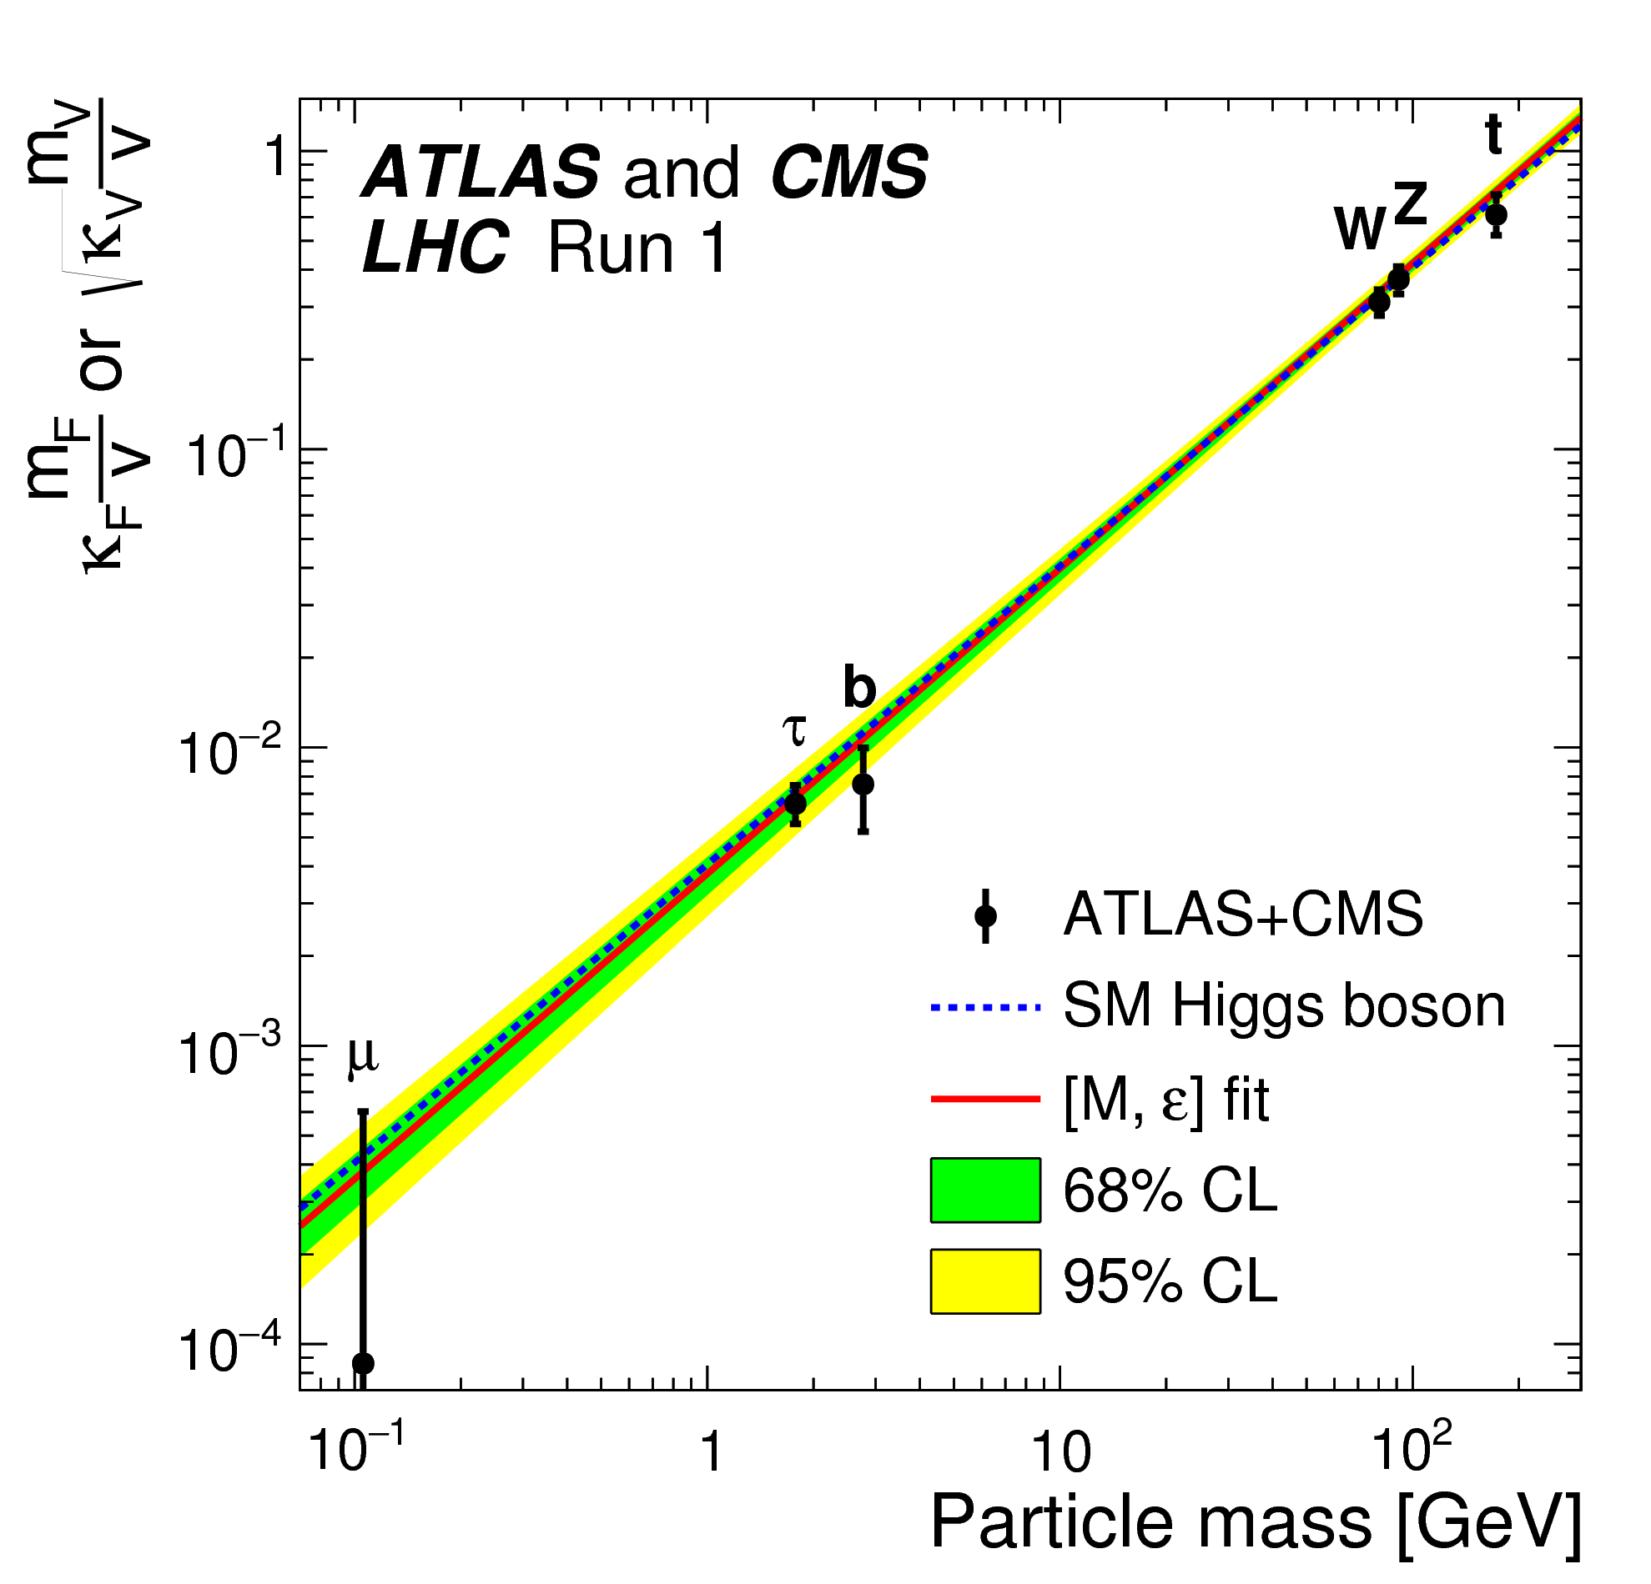
ATLAS and CMS Run 1 Summary
Measured couplings are very Standard Model like
ATLAS & CMS: JHEP 08 (2016) 04

Slide 9
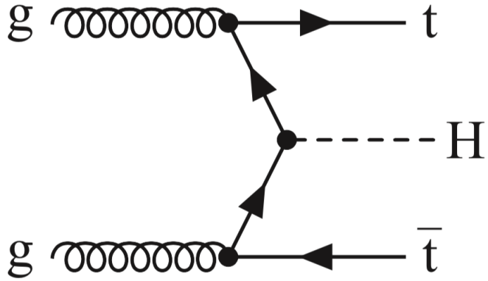
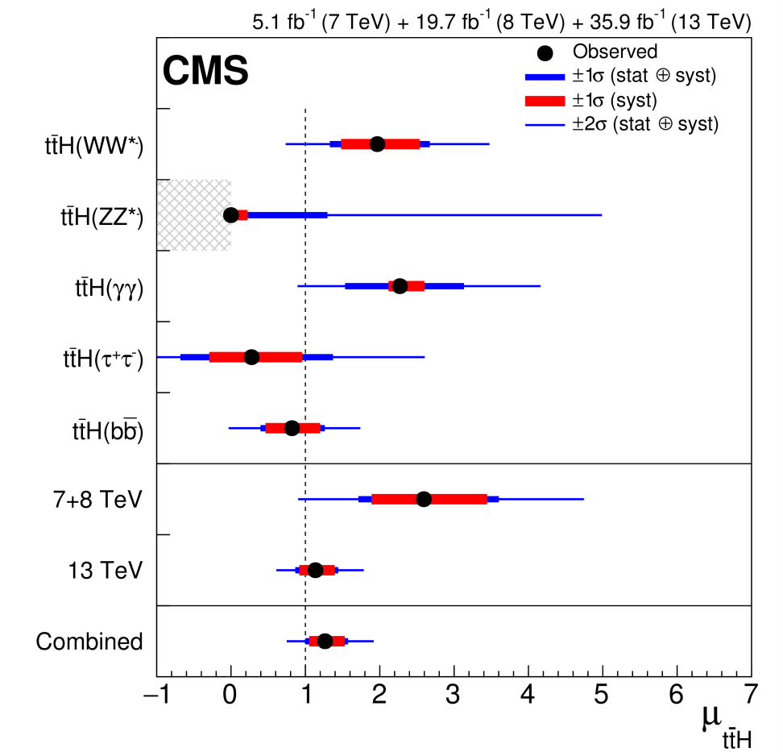
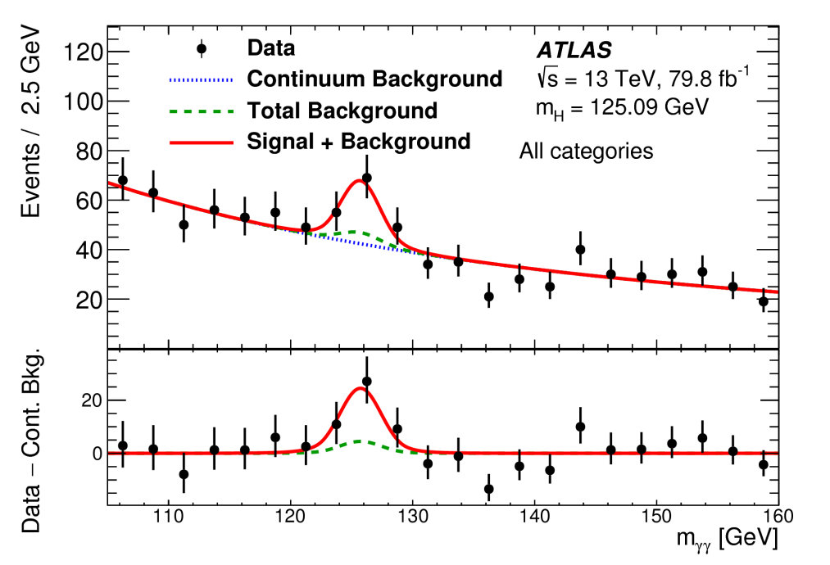
Observation of ttH Production
CMS: PRL 120 (2018) 231801
ATLAS: 1806.00425

Slide 10
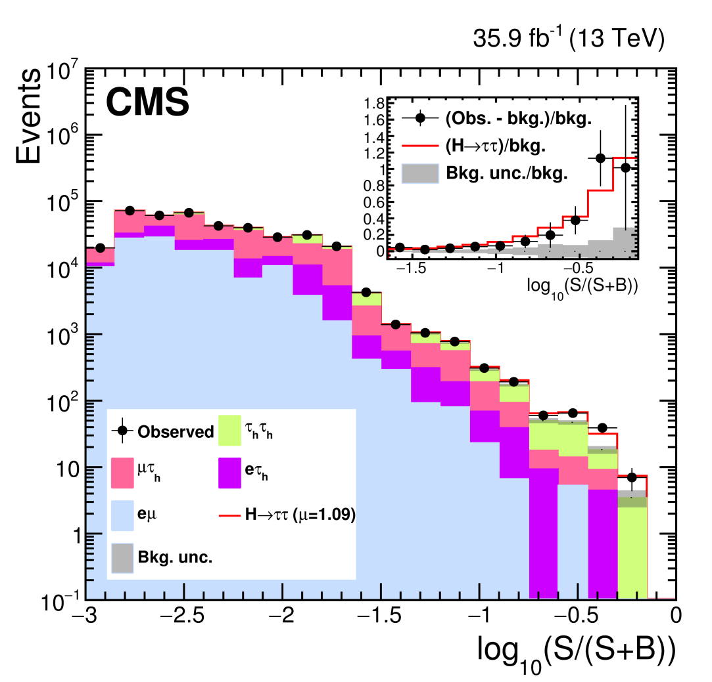
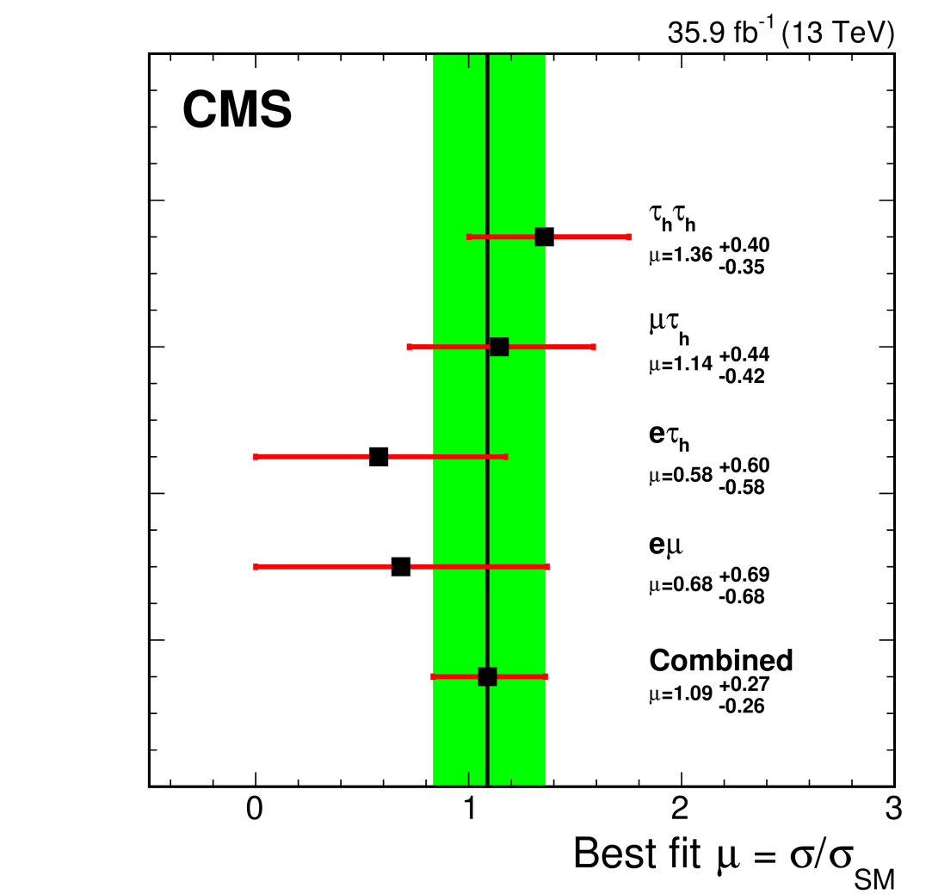
H→ττ decay
Run 1 + Run 2
ATLAS: ATLAS-CONF-2018-021; CMS: PLB 779 (2018) 283

Slide 11
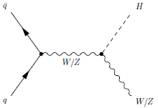
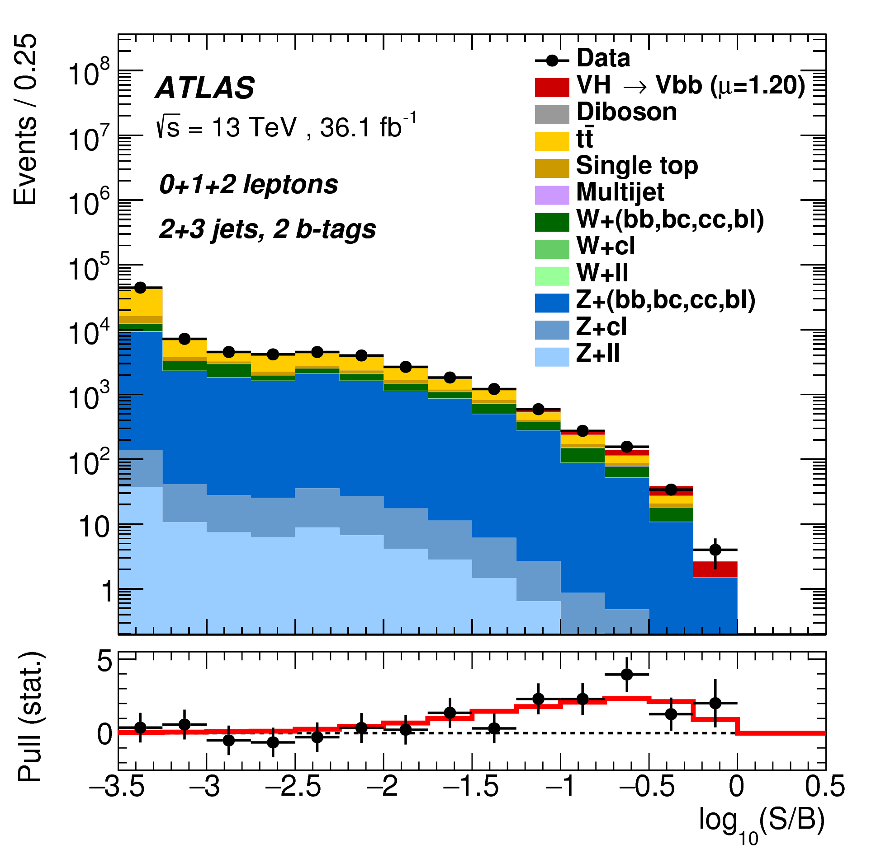
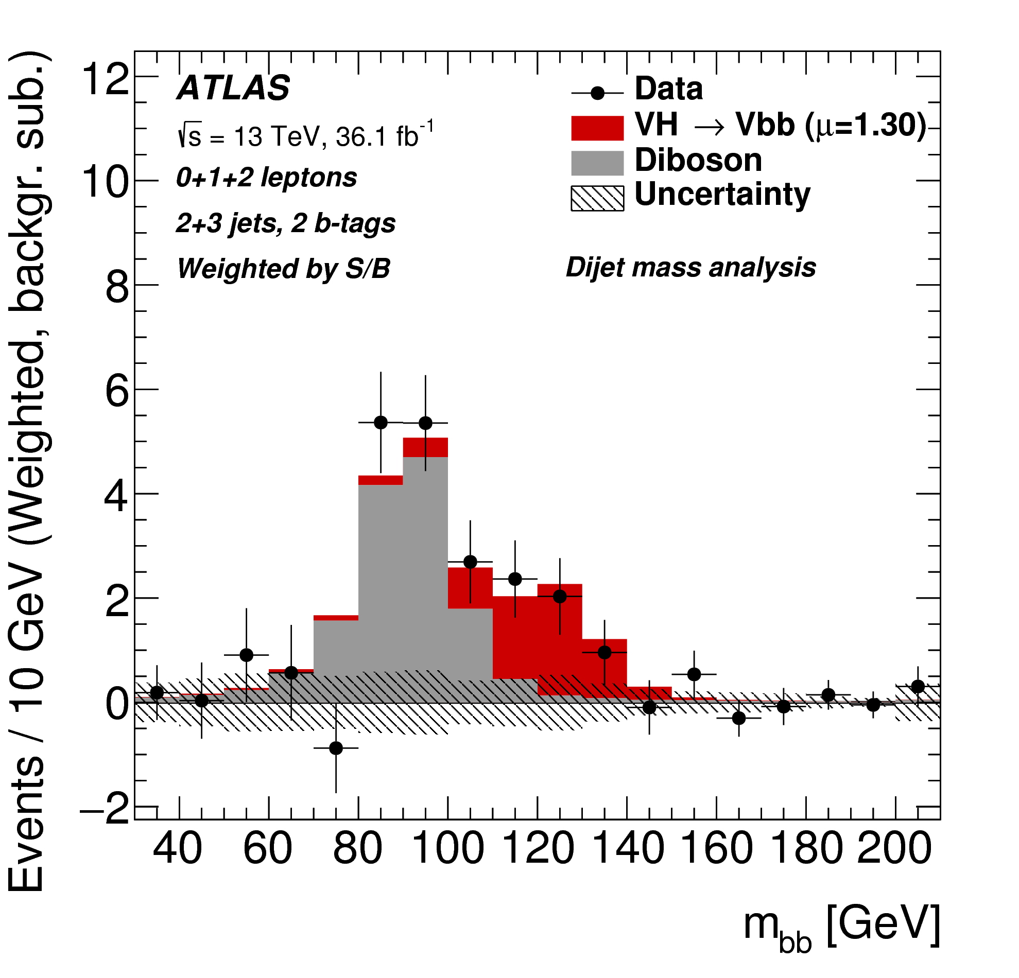
VH Production with H→bb decay
Run 1 + Run 2
ATLAS: JHEP 12 (2017) 024; CMS: PLB 780 (2018) 501

Slide 12
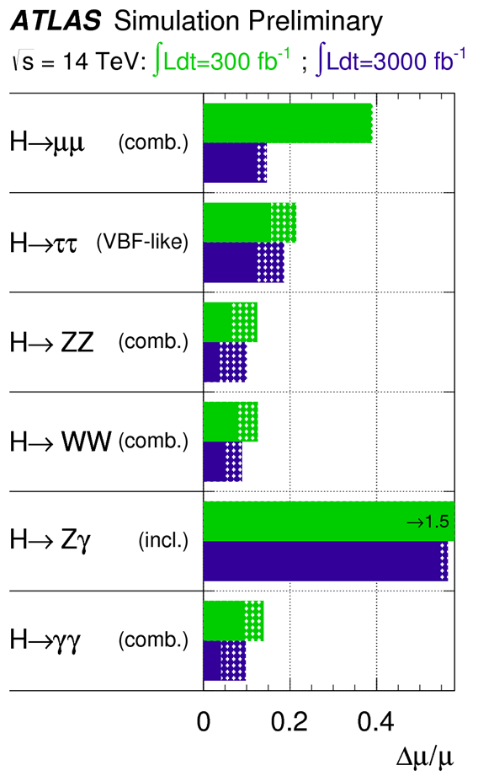
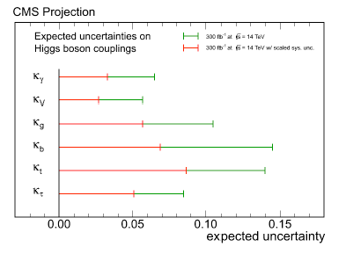
HL-LHC Coupling Projections
Many studies done for US Snowmass process, Europe ECFA studies.
150 millions of Higgs bosons produced per experiment
300 fb⁻¹
Snowmass Higgs report, arXiv:1310.8361
(Extrapolated from 2011/2012 results)
(Based on parametric simulation)

Slide 13
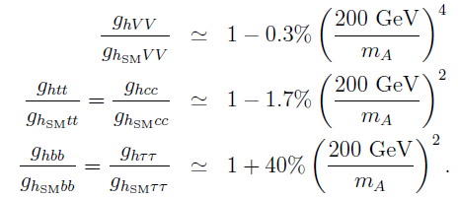
Cases for a Precision Higgs Program
How large are potential deviations from BSM physics? How well do we
need to measure them to be sensitive?
To be sensitive to a deviation Δ, the measurement precision needs to be
much better than Δ, at least Δ/3 and preferably Δ/5!
Since the couplings of the 125 GeV Higgs boson are found to be very close
to SM ⇒ deviations from BSM physics must be small.
Typical effect on coupling from heavy state M or new physics at scale M:
(Han et al., hep-ph/0302188, Gupta et al. arXiv:1206.3560, …)
MSSM decoupling limit
Δ at sub-percent to a few percent,
will be challenging to distinguish
the MSSM decoupling limit from
the SM in the case of no direct
discovery.
(ILC DBDPhysics)

Slide 14
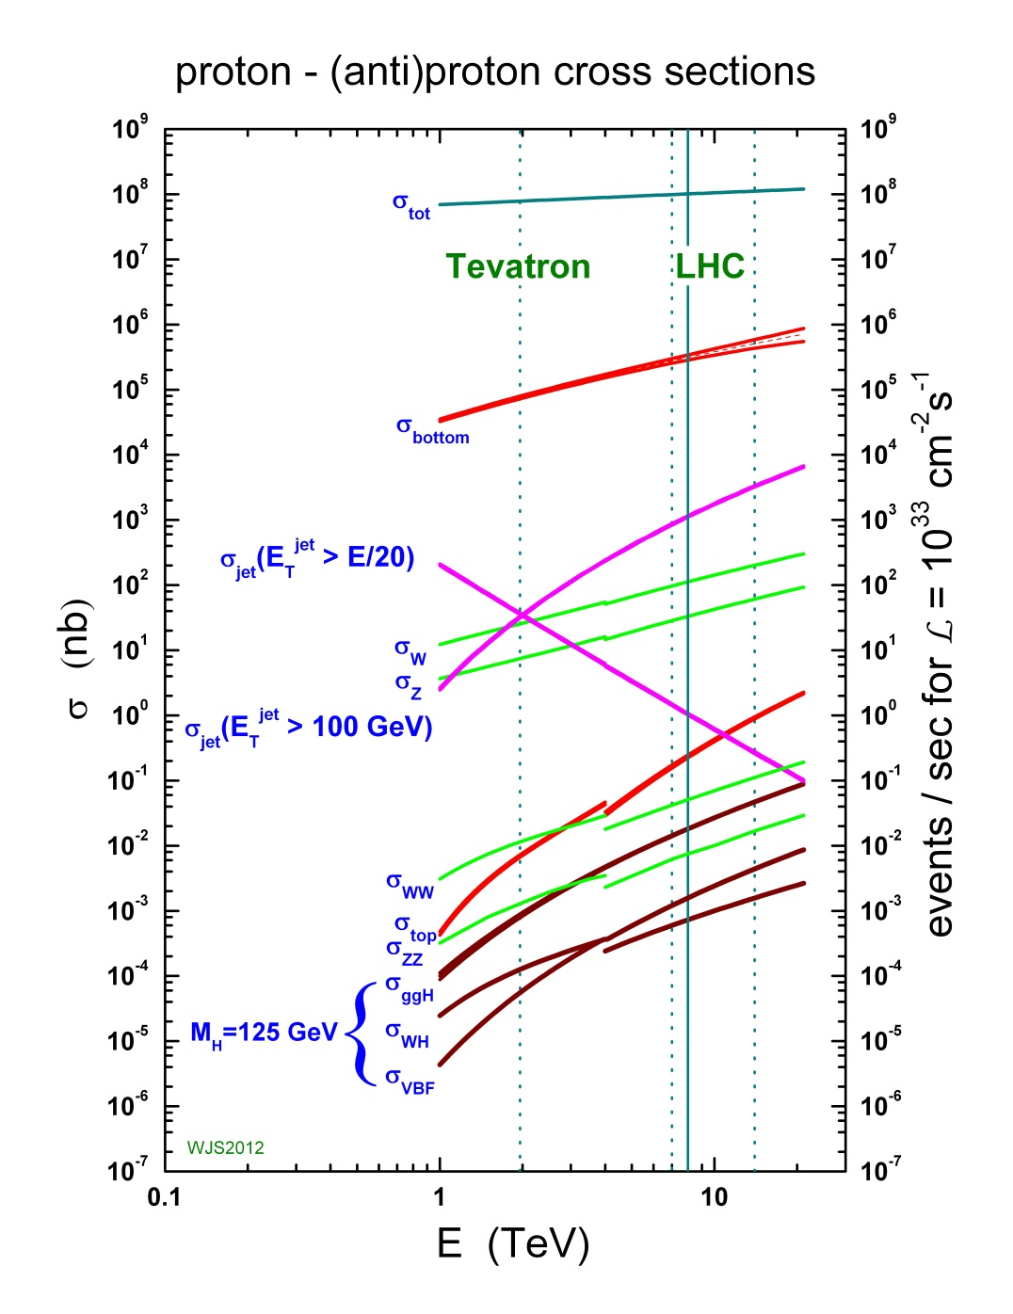
Hadron Colliders
Huge background
On the other hand…
HL-LHC will deliver 150 millions
of Higgs events per experiment !

Slide 15
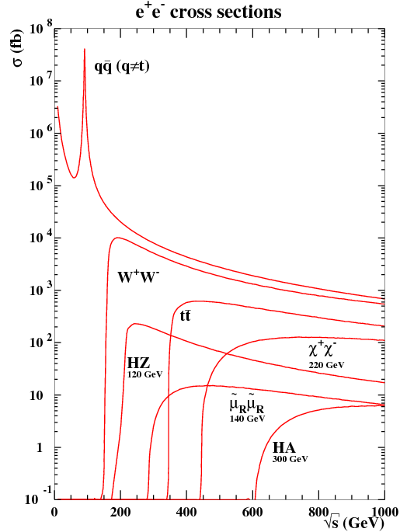
e⁺e⁻ Collider
Electroweak production
cross sections are predicted with
(sub)percent level precisions in
most cases
Relative low rate
can trigger on every event
Well defined collision energy
allow for the “missing” mass
reconstruction (eg recoiling mass)
Clean events, smaller background
small number of processes
Lepton colliders have unique
role in precision measurements

Slide 16
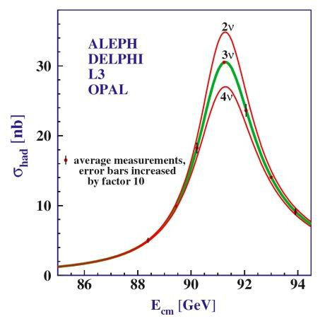
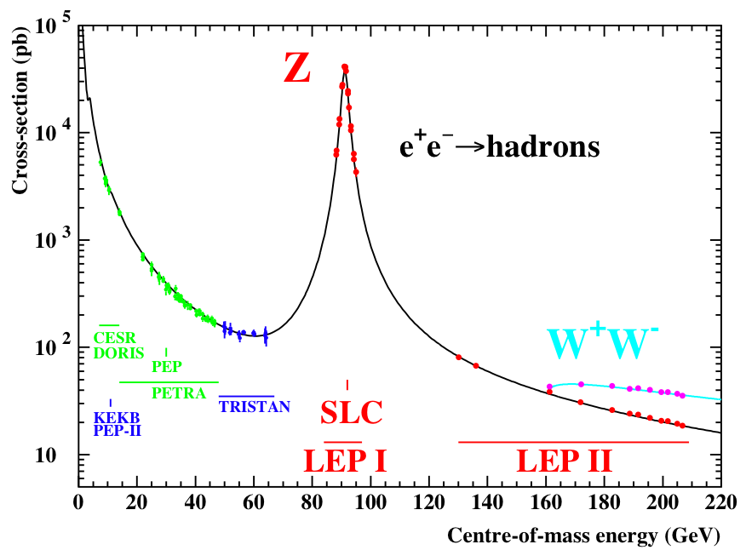
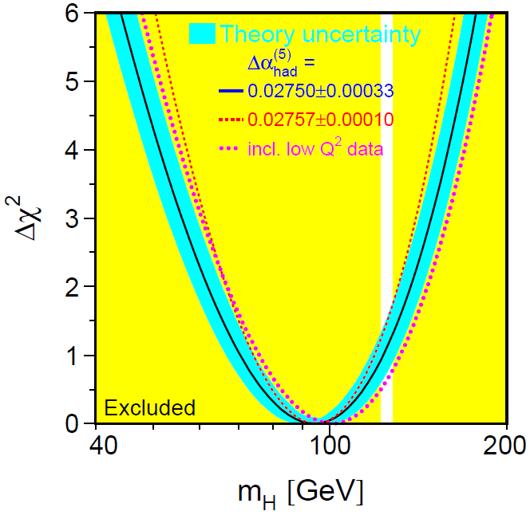
A Success Story: LEP
LEP-1 was first built as a Z factory (though it initially had top quark
in sight), it was widely successful…
About 17 millions of Z bosons were produced, key physics
Number of light neutrino species;
Precision electroweak measurements;
Direct search and indirect constraint
on the Higgs boson; ...

Slide 17
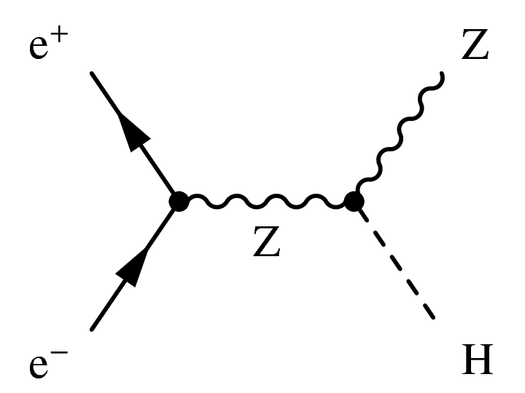
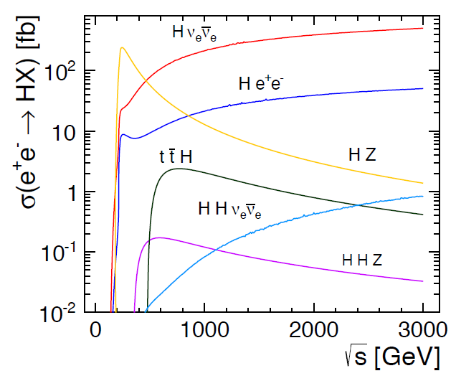
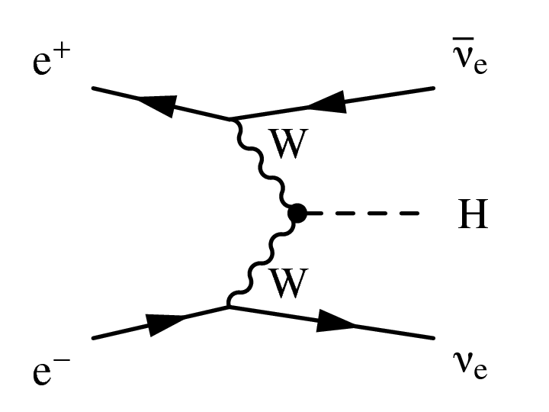
Higgs Boson Production

Slide 18
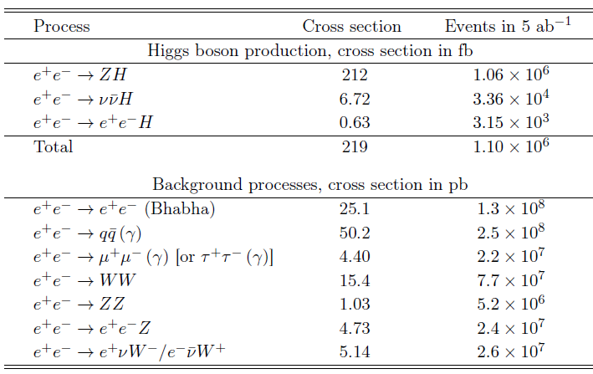
Cross Sections and Event Rates

Slide 19
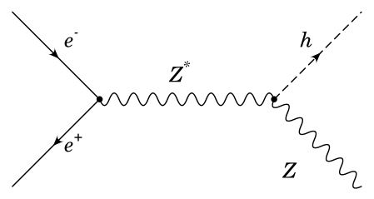
Know your process
The energy and momentum of the Z and H bosons are fixed. However,
both radiations and Z boson width will change these values.

Slide 20
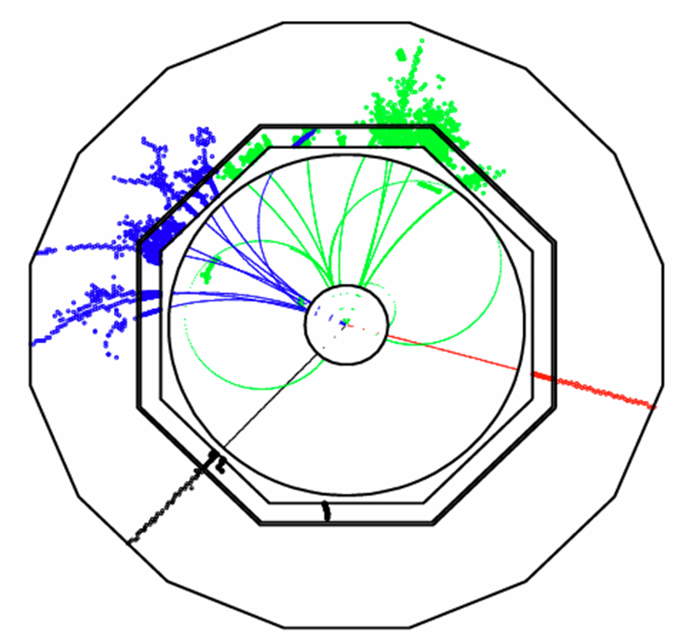
Higgs Tagging
Recoil mass reconstruction:
identify Higgs without looking at Higgs.

Slide 21
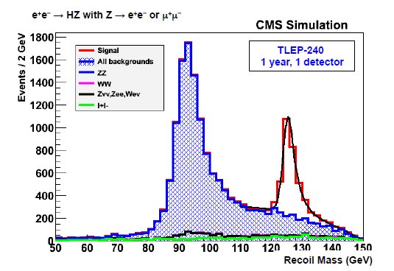
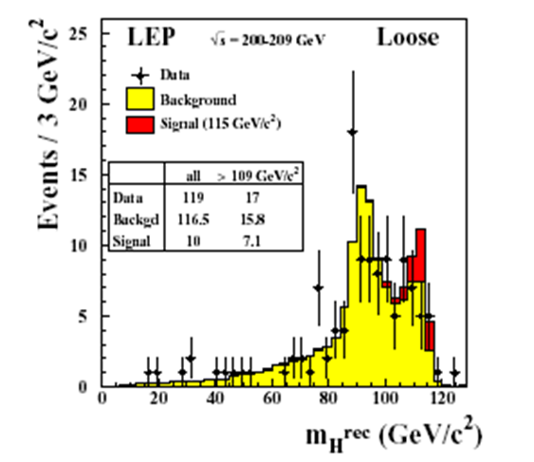
Recoiling Mass Distributions
TLEP study
Utilized extensively for Higgs searches
at LEP

Slide 22
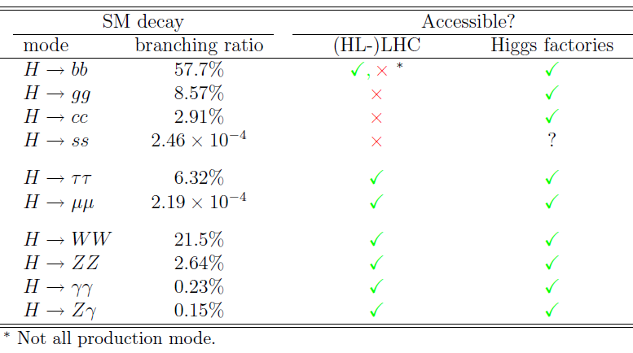
Accessible Decay Modes
Limitations: statistics at Higgs factories,
trigger and systematics at (HL-)LHC
Higgs factories are sensitive to unknown unknown decays while
HL-LHC may be sensitive to known unknown decays (eg H→inv).

Slide 23
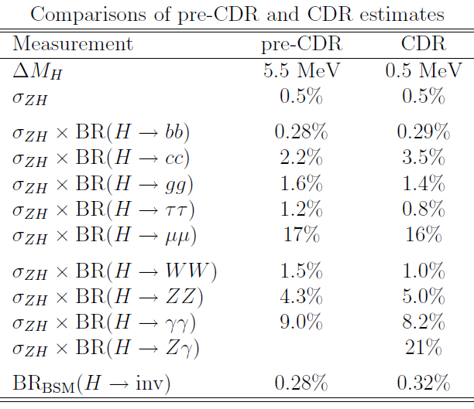
pre-CDR and CDR Comparison

Slide 24
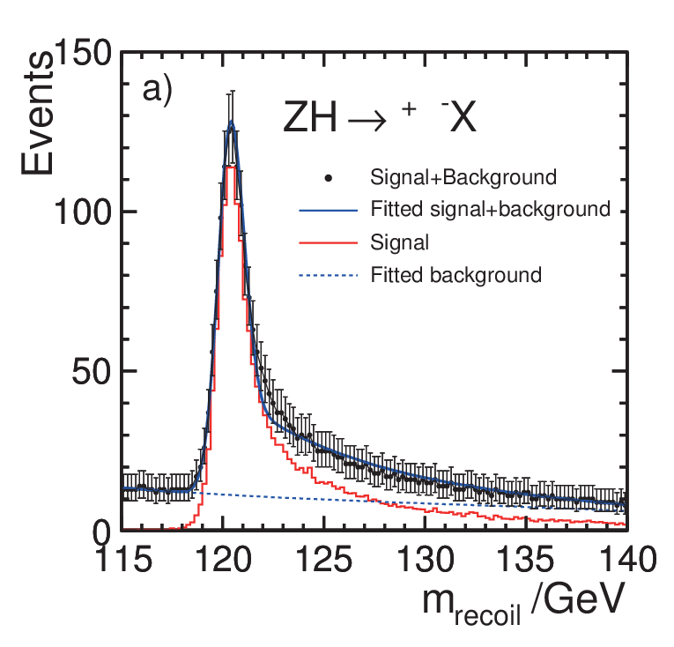
Sensitivity Estimates
The goal of CEPC studies is to estimate expected precision on physical
quantifies of interest, not the values of physical quantities.
The central values or distributions should always be the those expected
in the model of interest.
Estimate the statistical and
systematic uncertainties
expected from CEPC
Ideally, MC statistics should be far
greater than the expected data
statistics to minimize fluctuations
as illustrated by the plot on the right:
The histogram is smooth from
large MC statistics;
The error bars are expected
uncertainties from expected
data (not MC) statistics

Slide 25
Event Selections
Know your signal and background processes: what are their
most important differences, what are key detector performance
requirements, …
Example: ννH and Z(νν)H, the missing mass has a continuum distribution
for the former and a resonance structure for the later.
Selections should be logical (and factorized if possible), cuts should
be simple and easy to explain;
Should always have a cut-flow table of expected events or cross
sections, plot distributions of key variables before cutting on them
Consider to use MVAs to explore subtle S/B differences and use
shape information to improve sensitivities
Every analysis should have at least one PR/money plot!
Some are obvious: m_{γγ} distribution for H→γγ analysis;
Some are more complicated:

Slide 26
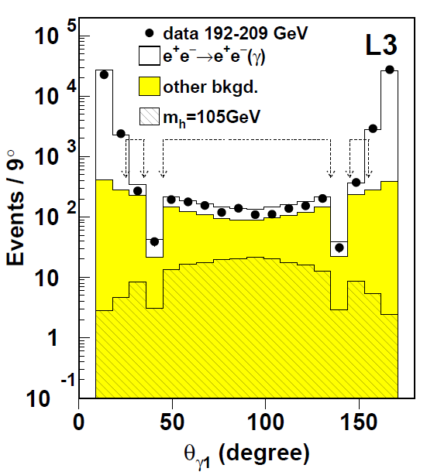
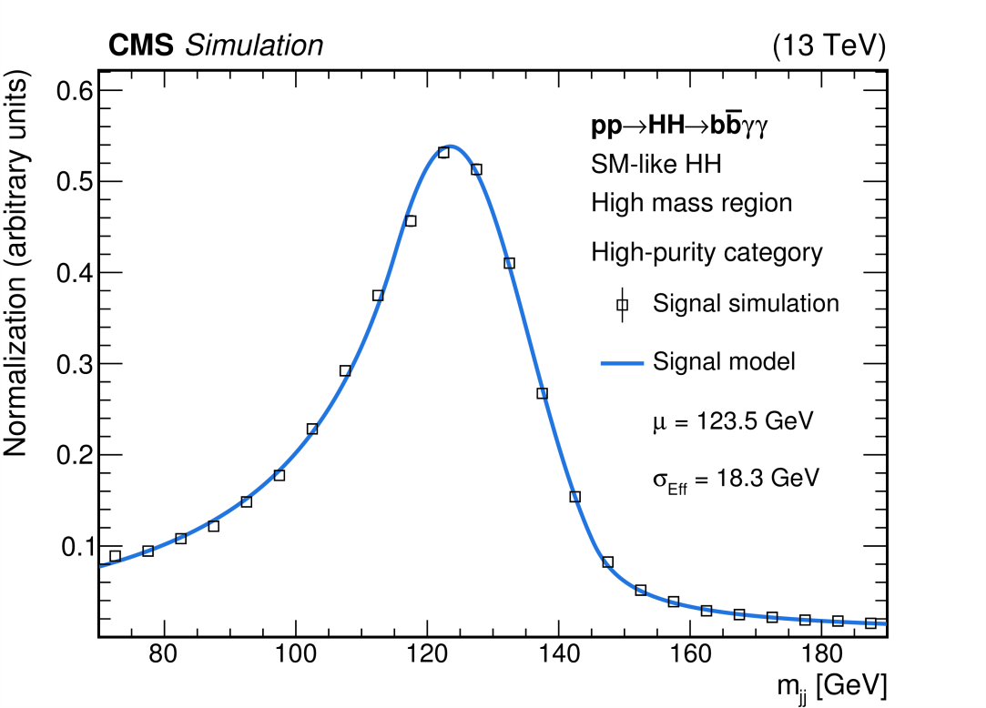
Examples

Slide 27
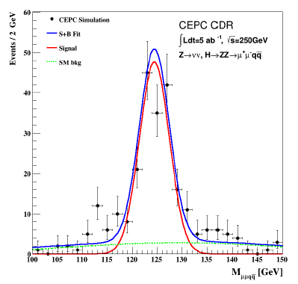
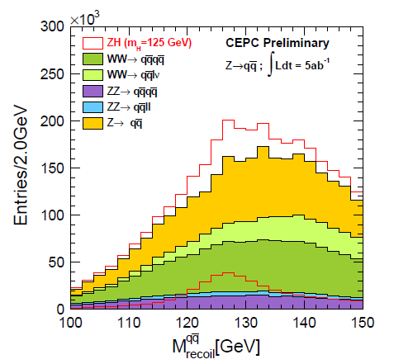
Examples
This analysis suffers from low MC statistics,
resulting in large fluctuations unrelated to
the expected data statistics.
Consider smearing or fit the distribution to
generate Asimov data if increasing MC statistics
is not practical.
The upper range of this plot should
be extended to show more sidebands

Slide 28
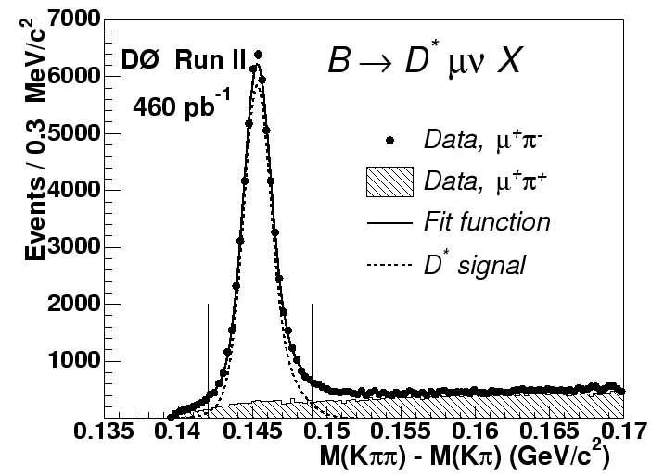
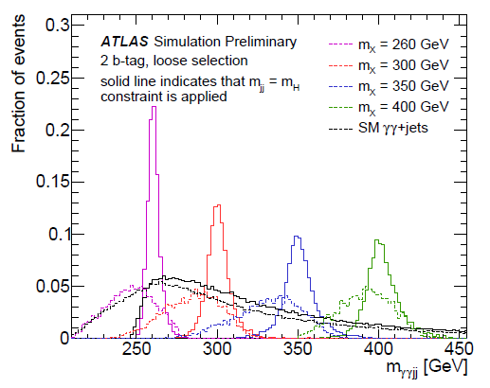
Event Kinematics
Use polar angle θ or cosθ, not η! η is a creation for hadron colliders
for which the initial longitudinal momentum is unknown. Minimize
the usage of E_{T} or p_{T} .
Use known resonance mass to improve the mass resolution of parent
particles:

Slide 29
Standardization
Many of the analyses for CDR were done independently and through
times led to differences that are hard to justify.
Example, Z→μμ mass window used are 80-100, 81-101, 76-106 GeV
It will be good to have some common starting points for new people
and to ensure some consistencies among different analyses. We can
start with simple ones such as
and expand the list as we gain experience.
The standardization should not limit analysis sensitivity. Those
benefiting from non-standard selections should be free to do so
with some justification.

Slide 30
Analysis Final States
Electron-positron collisions are clean, but it does not mean that
analyses are easy! While HL-LHC will deliver ~150 millions Higgs
events per experiment, CEPC will only produce ~1 million two
experiments combined.
What CEPC lacks in quantity is made up by quality. Most of the Higgs
events produced at the LHC are indistinguishable from backgrounds,
practically every event at CEPC counts.
A large number of final states need to be analyzed to fully realize
CEPC’s potential.

Slide 31
Analysis Final States
For the Higgs white paper, sensitivities from ~32 final states (counting
different W and Z decay modes) are quoted. Probably less than half
of all final states, though likely the most sensitive ones.
A mixed approach of final states and Higgs decay modes driven:
Are there other ways to organize the analyses with the aim to improve
efficiencies and cover more final states?

Slide 32
A few other thoughts
Cross contaminations of different Higgs boson decay modes are real
issues for many analyses. Need to treat them consistently without
complicating individual analyses.
Suggest to treat contributions from other Higgs boson decay modes
as part of the SM background in most cases, but with separate handlers
to facilitate combination.
In a few cases in which contributions from other Higgs processes are
larger than the signal itself, e.g. Z(νν)H contribution to ννH, combined
analysis may be necessary.
Always compare your results with those of ILC and FCC-ee, if available,
to check if they are consistent. If not, understand why.
Individual analysis measure σ×BR, so quote precision on it, not on BR
(need independent measurement of σ to extract BR)

Slide 33
Discussion
What’s our plan next?
What can we improve?
How do we go from here to there?

Slide 34
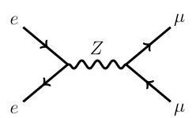
Physics processes

