Slide 1
Bc→J/ψμx analysis
Xianyou Wang，Guoming Chen, Xiangwei Meng,
Junquan Tao, Jianguo Bian, Zheng Wang, Jian Wang
Institute of High Energy Physics, CAS, Beijing
Institute of theoritical physics, CQU, CQ

Slide 2
Outline
Motivation
Theoretical status
Experimental status
Event generation
Related parameters
Event selection
Event selection strategy
Generate and Reconstruction
The Cuts:
Bc candidate mass window
Jpsi candidate mass window
Dimuon muon pt
The third muon pt
High level trigger
Jpsi nomalnized χ²
Bc candidate Pt
Bc nomalnized χ²
The results
The efficiency of the cuts
Invariant mass of Bc candidate

Slide 3
Motivation
Motivation
Theoretical status
Experimental status
Event generation
Related parameters
Event selection
Event selection strategy
Generate and Reconstruction
The Cuts:
Bc candidate mass window
Jpsi candidate mass window
Dimuon muon pt
The third muon pt
High level trigger
Jpsi nomalnized χ²
Bc candidate Pt
Bc nomalnized χ²
The results
The efficiency of the cuts
Invariant mass of Bc candidate

Slide 4
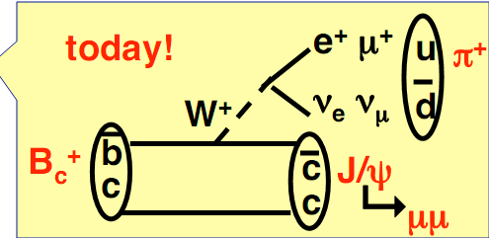
Theoretical status
Goal: measure mass and lifetime of Bc-meson with CMS
Theory-predictions:
Bc production in hadron collider: many theoretical uncertainties!
σ (Bc) ~ 10⁻³ σ(other B-mesons) [E.g:Chang&Wu,EPJC38,267]
Bc mass: M=6.24±0.05 GeV See e.g: [Kwong,Rosner, PRD44, 212]
[Eichten, Quigg, PRD49, 5845]
Bc decay (only weak!):
b-decay with c as spectator: 20-25%
c-decay with b as spectator: 64-72%
annihilation decays: 6.6-7.2%
ground state of bc
unique properties!!
6/5/2009
CMS B-Physics Meeting
4

Slide 5
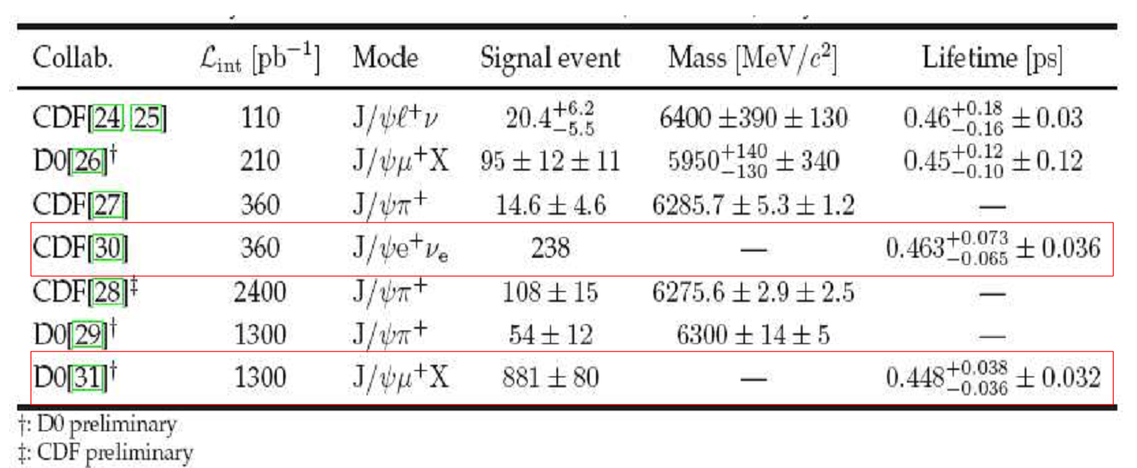
Experimental status
LHC: p-p collisions at ECM = 14.0 TeV,
Initial L ~ 2 x 10³² cm-2 s-1, nominal L ~ 1 x 10³⁴ cm-2 s-1
CMS: Competition with ALICE, LHCb, (ATLAS)...
but...CMS has excellent muon system, tracker, large acceptance!
Most analyses here based on medium and high PT muons
6/5/2009
CMS B-Physics Meeting
5

Slide 6
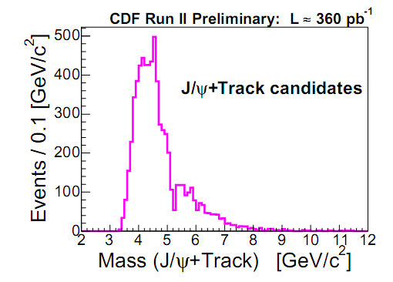
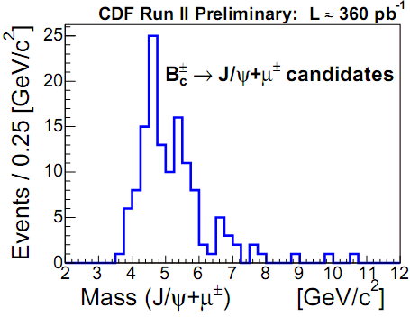
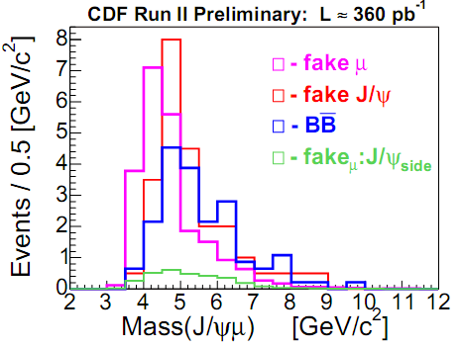
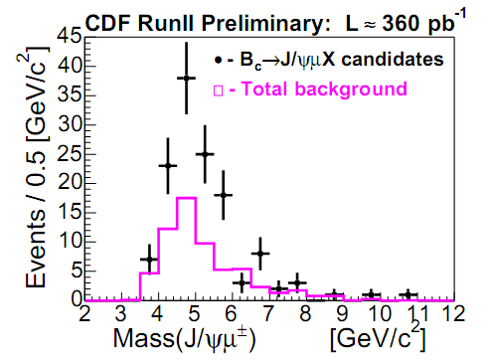

Slide 7
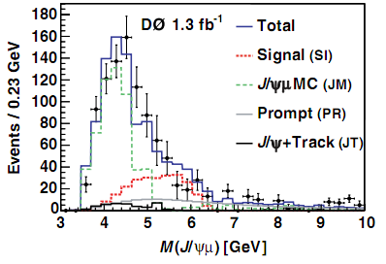
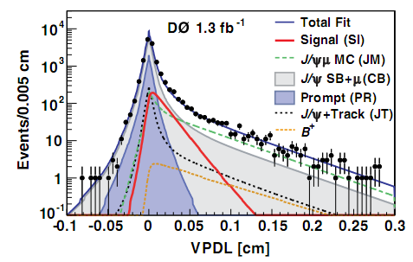

Slide 8
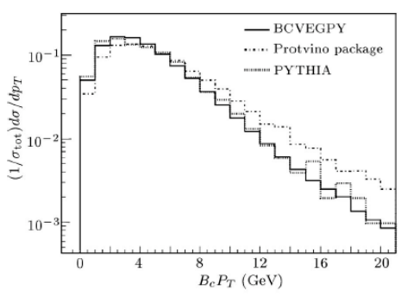
Event generation
Signal: Bc→J/ψ µ, J/ψ → µµ generated with BCVEGPY 2.1 generator
[Chang&Wu, EPJC38:267,2004]
GeneratorInterface/GenExtension(BCVEGPY 2.1) in CMSSW_3_1_x
https://twiki.cern.ch/twiki/bin/view/CMS/BcGenerator
http://indico.cern.ch/getFile.py/access?contribId=8&resId=0&materialId=slides&confId=52322
I generate and analyze the signal
in CMSSW_2_2_3
Generator cuts (simulate L1 and HLT trigger):
µ pair (from JPsi) pT≥2.5GeV |η|≤2.5
InvMass(3.096GeV, 3.098GeV)
Third µ(µ from Bc) pT≥2.5GeV |η|≤2.5
6/5/2009
CMS B-Physics Meeting
8

Slide 9
Related parameters
Br (b->Bc) =1.3*10⁻³ [from HERWIGM. Phys. Lett. B 266, 142 (1991).]
[E.g:Chang&Wu,EPJC38,267]
Br (QCD->bb(bar))=1.16%
Bc cross section 51.56 mb*0.0116*0.001*2=0.00119619 mb≈1000 nb
Br (Bc2JPsiMuNu) = 1.9 %
Br (J2MuMu = 6 %) = 5.93±0.06 %
so three muon Branch = 5.93 %*2 % ≈ 0.0012
1000 nb*0.0012 = 1.2 nb = 1.2*10⁶ fb
After filter.
Signal cross section 1000 nb*0.0012*0.057 = 0.0684 nb= 68400fb
So I asked for generate 2 fb⁻¹ data in official
Filter efficiency
6/5/2009
CMS B-Physics Meeting
9

Slide 10
Event selection
Motivation
Theoretical status
Experimental status
Event generation
Related parameters
Event selection
Event selection strategy
Generate and Reconstruction
The Cuts:
Bc candidate mass window
Jpsi candidate mass window
Dimuon muon pt
The third muon pt
High level trigger
Jpsi nomalnized χ²
Bc candidate Pt
Bc nomalnized χ²
The results
The efficiency of the cuts
Invariant mass of Bc candidate

Slide 11
Event selection
Step 0: trigger(Level 1 and High level trigger)
Step 1: J/psi candidates:
2 muons, same vertex, different charge, M_{inv} (3.0,3.2) GeV
Step 2: Bc candidates:
Find the third muon and fit vertex with J/psi candidates, M_{inv} (3.0,7.0) GeV
Step 3: Suppress prompt J/psi background
Cut on proper decay length (L^{PDL}_{xy})
and signiﬁcance (L^{PDL}_{xy} /σ_{xy})
µ⁺
µ⁻
Reco Bc
µ
Secondary
vertex
decay
length L_{xy}
beamspot
Production vertex
6/5/2009
CMS B-Physics Meeting
11

Slide 12
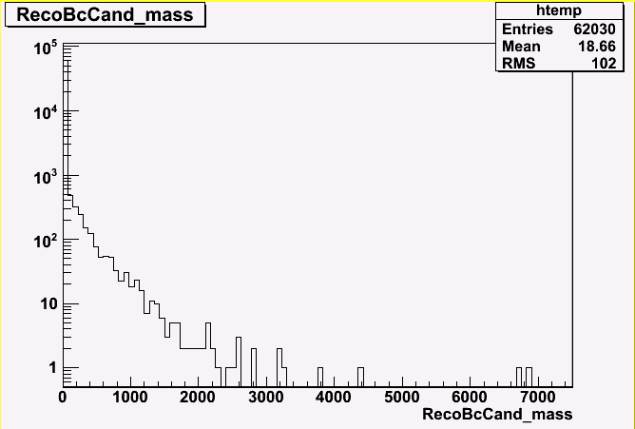
Generate and Reconstruction
Generator cuts (simulate L1 and HLT trigger):
Dimuon (from JPsi) pT≥2.5GeV |η|≤2.5
InvMass(3.096GeV, 3.098GeV)
Third µ(µ from Bc) pT≥2.5GeV |η|≤2.5
 | Signal |  | B→J/ψμμ background
 | Events | Efﬁciency | Events | Efﬁciency
Generation | 2.4*10⁶ | -
Gen-Sim-Reco | 136610 | 0.057 | 2434076
Dimuon select and vertex fit The three muon vertex fit | 62030 | 0.454 | 47578 | 0.020

Slide 13
The Cuts
Motivation
Theoretical status
Experimental status
Event generation
Related parameters
Event selection
Event selection strategy
Generate and Reconstruction
The Cuts:
Bc candidate mass window
Jpsi candidate mass window
Dimuon muon pt
The third muon pt
High level trigger
Jpsi nomalnized χ²
Bc candidate Pt
Bc nomalnized χ²
The results
The efficiency of the cuts
Invariant mass of Bc candidate

Slide 14
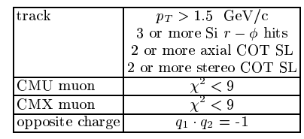
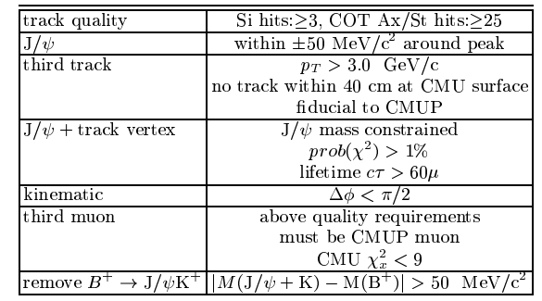
Select Criteria
Jpsi selection
My cut
Bc candidate mass window(2,12)
Jpsi candidate mass window(3.047,3.147)
Dimuon muon pt(>2.5Gev/c)
The third muon pt(>3.0Gev/c)
High level trigger(HLT_MU3)
Jpsi nomalnized χ²(<8)
Bc candidate Pt(>3.0Gev/c)
Bc nomalnized χ² (<8)
Third muon selection

Slide 15
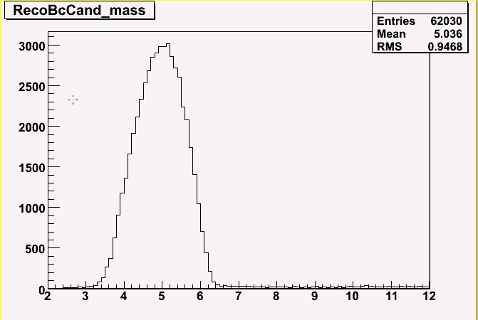
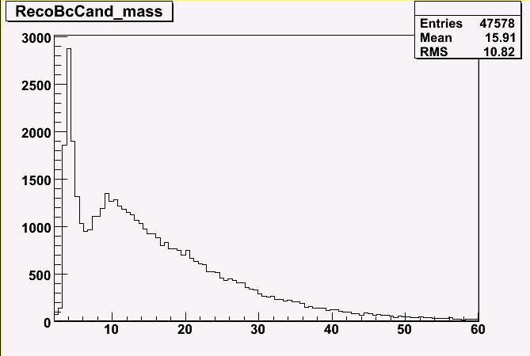
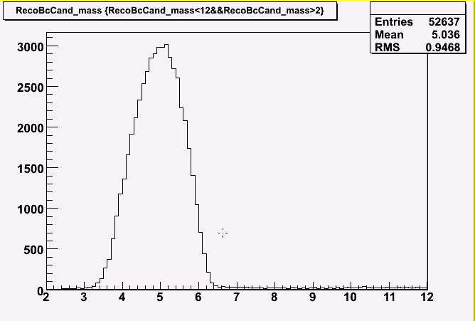
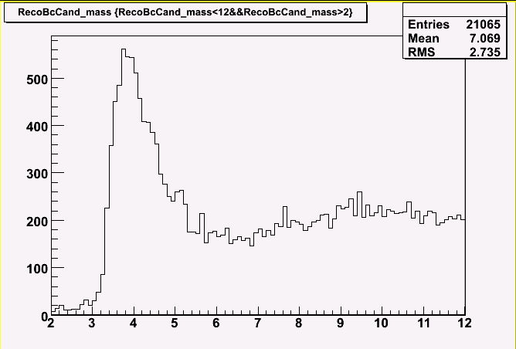
Bc candidate mass window
Select condition:
1) Inverse charge dimuon, the best one.
2) kalman vertex fit
Select Criteria :
3)Bc mass window(2,12)

Slide 16
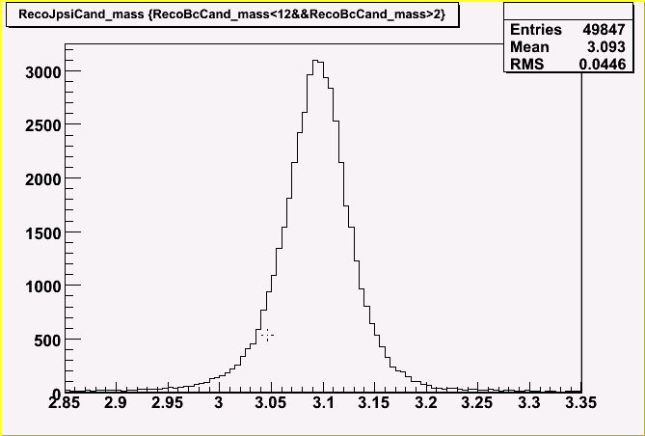
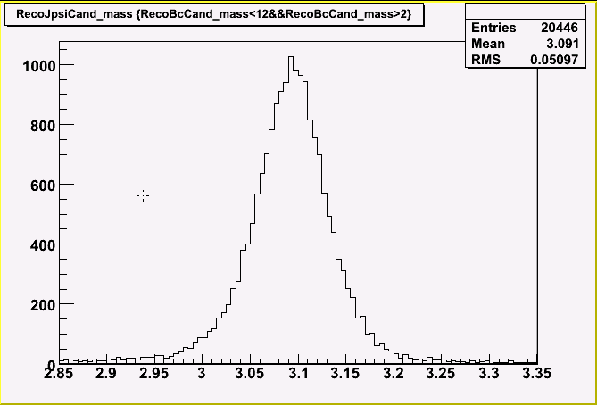
Jpsi candidate mass window
This is the reference to CDF
Select Criteria :
3)Jpsi mass window(3.047,3.147)

Slide 17
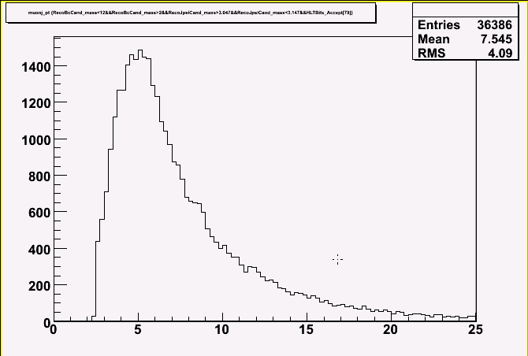
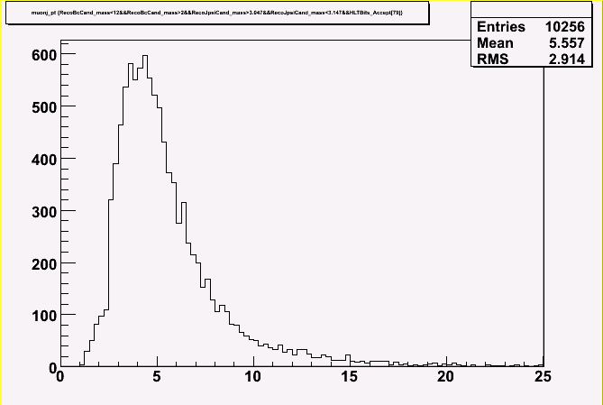
Dimuon pt
Select condition:
1) Inverse charge dimuon, the best one.
2) kalman vertex fit
3)Bc mass window(2,12)
Select Criteria :
4)Dimuon pt >2.5Gev

Slide 18
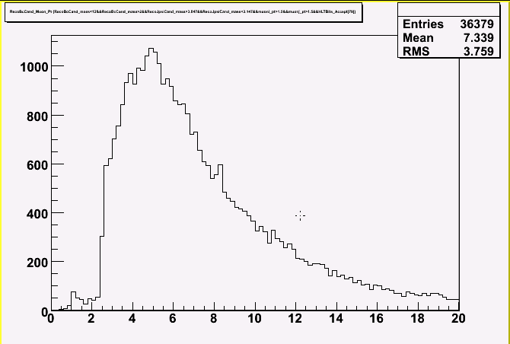
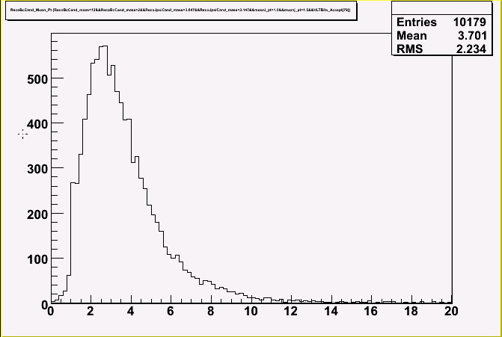
The third muon pt
Select Criteria :
5)The third muon pt >3Gev/c

Slide 19
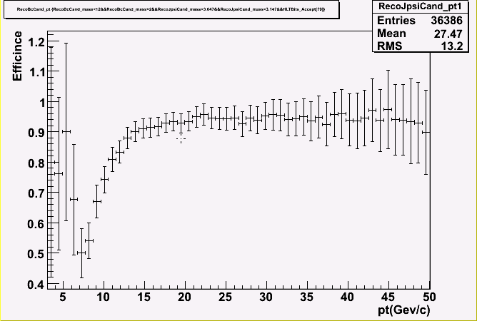
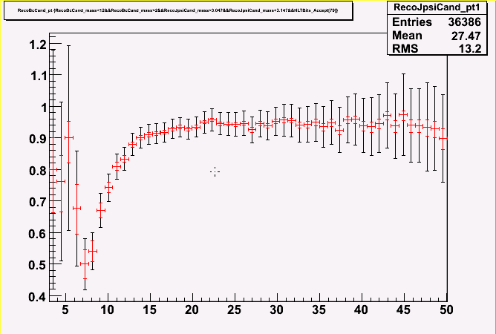
High level trigger
Bc High level trigger efficiency
Select Criteria :
6) High level trigger HLT_Mu3

Slide 20
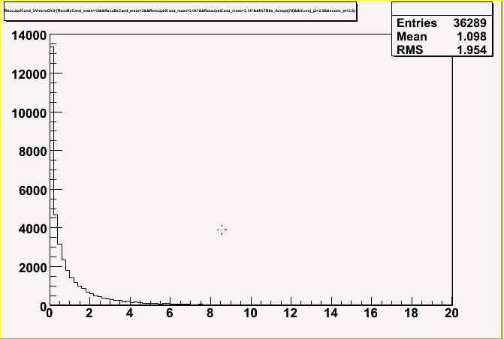
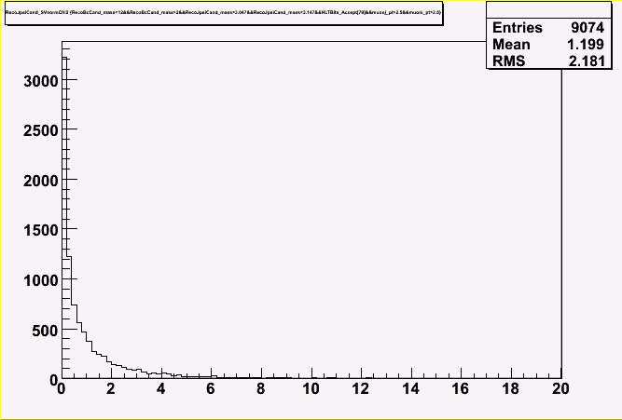
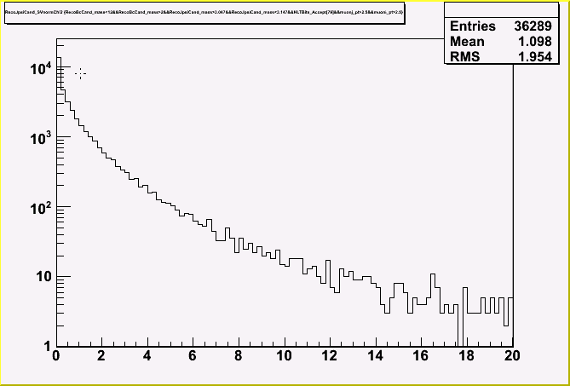
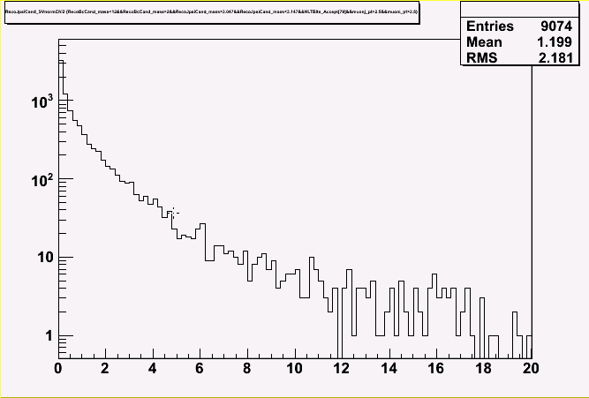
Jpsi nomalnized χ²
Select Criteria :
7)Jpsi nomalnized χ²<8(χ²/ndof)

Slide 21
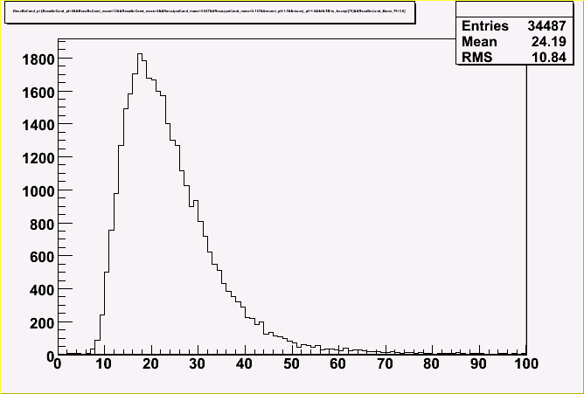
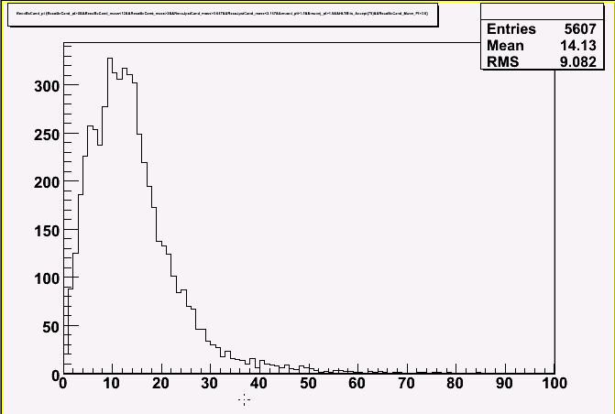
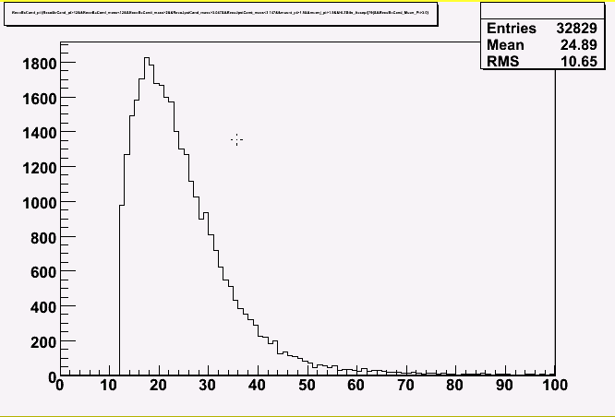
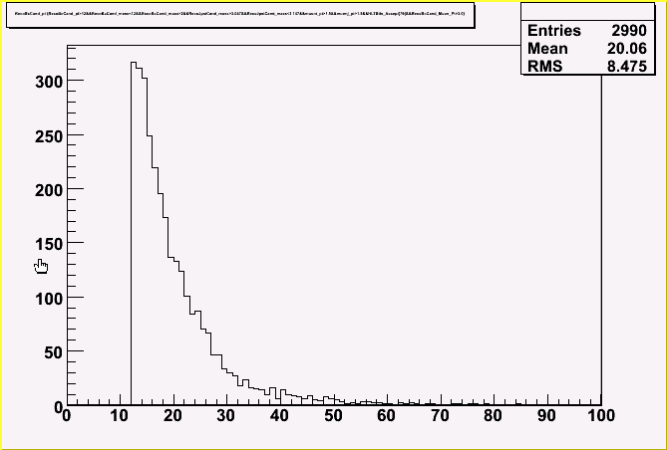
Bc candidate Pt
Select Criteria :
8)Bc candidate pt >12Gev/c

Slide 22
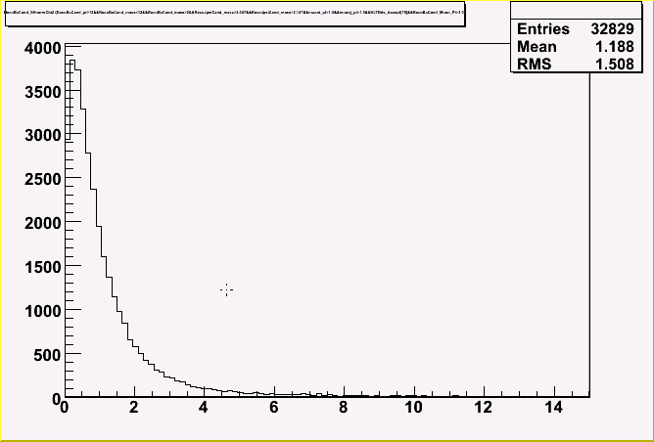
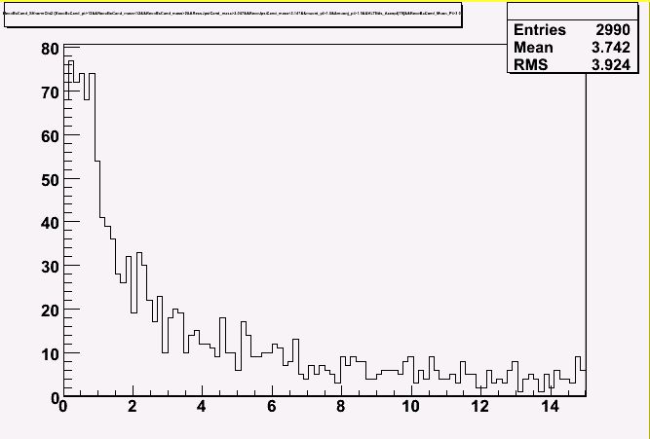
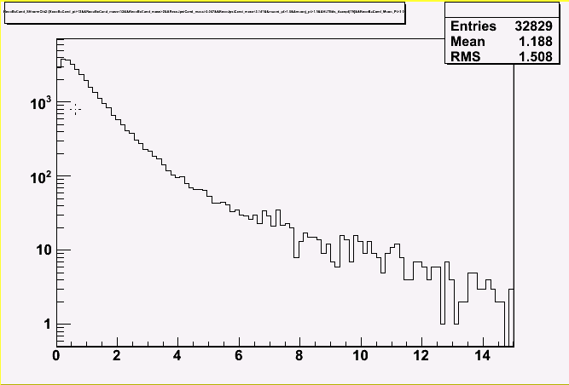
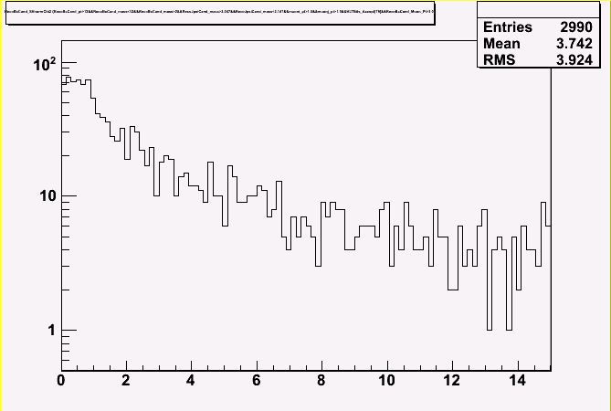
Bc nomalnized χ²
Select Criteria :
9)Jpsi nomalnized χ²<8(χ²/ndof)

Slide 23
The results
Motivation
Theoretical status
Experimental status
Event generation
Related parameters
Event selection
Event selection strategy
Generate and Reconstruction
The Cuts:
Bc candidate mass window
Jpsi candidate mass window
Dimuon muon pt
The third muon pt
High level trigger
Jpsi nomalnized χ²
Bc candidate Pt
Bc nomalnized χ²
The results
The efficiency of the cuts
Invariant mass of Bc candidate

Slide 24
The efficiency of the cuts
 |  | Signal |  | B→J/ψμμ background
description | Selection Criteria | Events | Efﬁciency | Events | Efﬁciency
Bc mass window | (2,12) | 52637 | 0.38531 | 21065 | 0.00865
J/ψ mass window | (3.047,3.147) | 39669 | 0.29038 | 14267 | 0.00586
HLTigger | HLT_Mu3 | 36386 | 0.26635 | 10256 | 0.00421
Dimuon pt | >2.5 | 36289 | 0.26564 | 9074 | 0.00373
J/ψ Nomalized χ² | <8 | 35503 | 0.25989 | 8802 | 0.00362
Third muon pt | >3.0 | 33676 | 0.24651 | 4605 | 0.00189
Bc candidate pt | >12 | 32098 | 0.23496 | 2818 | 0.00116
Bc Nomalized χ² | <8 | 31730 | 0.23227 | 1149 | 0.00047

Slide 25
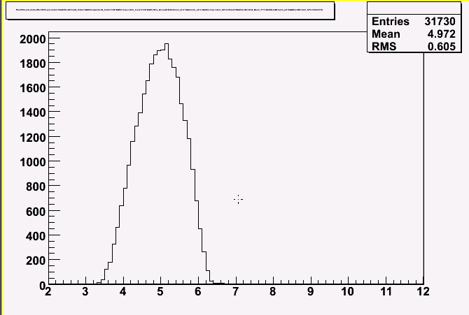
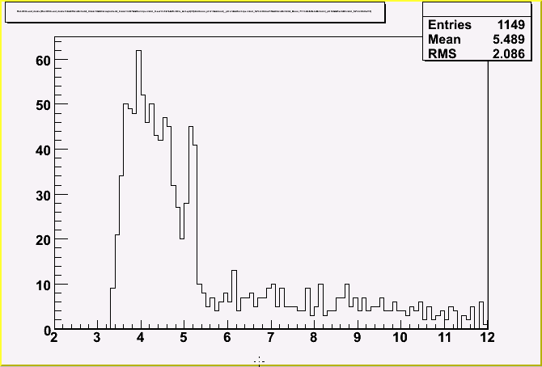
Invariant mass of Bc candidate
Select Criteria :
1) Inverse charge dimuon, the best one.
2)Bc mass window(2,12)
3) Jpsi mass window(3.047,3.147)
4) Single muon pt>2.5Gev/c
5)The third muon pt>3.0Gev/c
6) High level trigger HLT_Mu3
7)Jpsi nomalnized χ²<8(χ²/ndof)
8)Bc pt>12.0Gev/c
9)Bc nomalnized χ²<8(χ²/ndof)

Slide 26
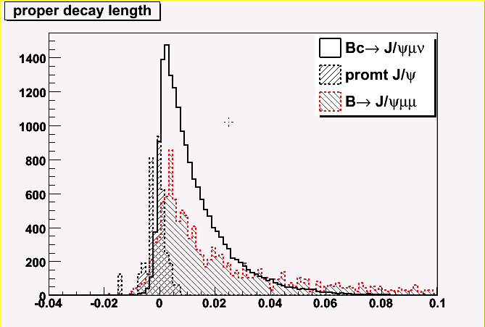
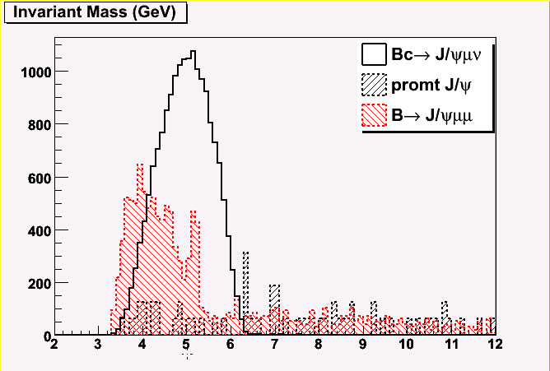
The results
Integrated in 1fb⁻¹

Slide 27
Next step
Add QCD backgruond.
Add Criteria signiﬁcance (L^{PDL}_{xy} /σ_{xy})

Slide 28
Thank you!

