Slide 1
全国第十六届重味物理和CP破坏研讨会(HFCP-2018)
Probing Stop in Natural SUSY
Lei Wu
（武 雷）

Slide 2
Outline of Topics
Implications of SUSY naturalness for LHC
Hunting for Stop @ LHC
Conclusions
arXiv:1811.xxxxx,
arXiv:1807.09088,
JHEP 1709 (2017) 037,
JHEP 1703 (2017) 091,
EPJC 77 (2017) 93

Slide 3
1. Implications of SUSY naturalness for LHC

Slide 4
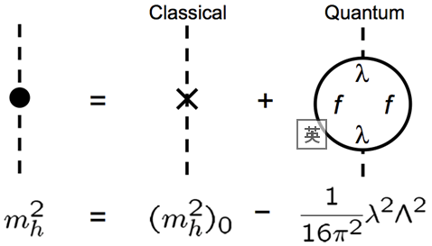
Discovery of Higgs boson completes the SM particle zoo. But the origin of the EWSB is still unclear.
Naturalness problem

Slide 5
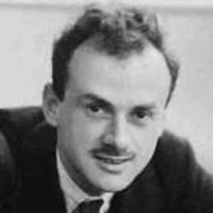
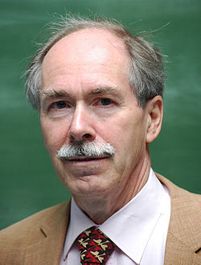
What are the natural sizes of parameters in the QFT?
Dirac Naturalness (Large Numbers Hypothesis):
“Any two of the very large dimensionless numbers occurring
in Nature are connected by a simple mathematical relation,
in which the coefficients are of the order of magnitude
unity.” P. A. M. Dirac, “New basis for cosmology," Proc. Roy. Soc. Lond.
A165 (1938) 199-208.
't Hooft Naturalness (Technical Naturalness):
“Coefficients can be much smaller than their Dirac natural
value if there is an enhanced symmetry of the theory when
the coefficient is taken to zero. e.g. fermion mass and chiral
symmetry.” G.'t Hooft et al. Plenum Press, New York, 1980, page 135.
Naturalness is one of guiding principles to extend the SM.

Slide 6
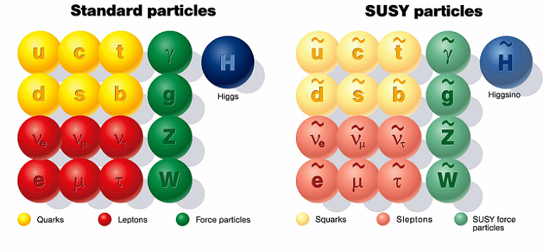
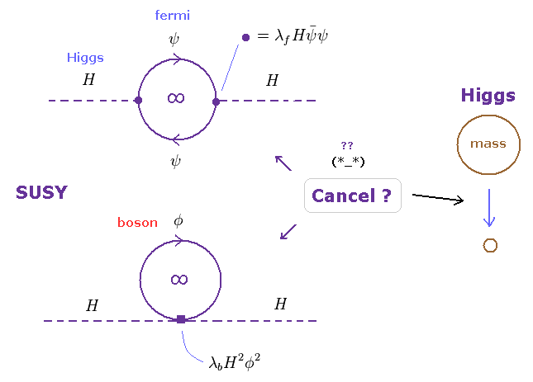
SUSY

Slide 9
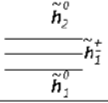
Roadmap of NSUSY at LHC
< 3-4 TeV
< 2.5 TeV
100-300 GeV

Slide 10
2. Hunting for stop @ LHC

Slide 11
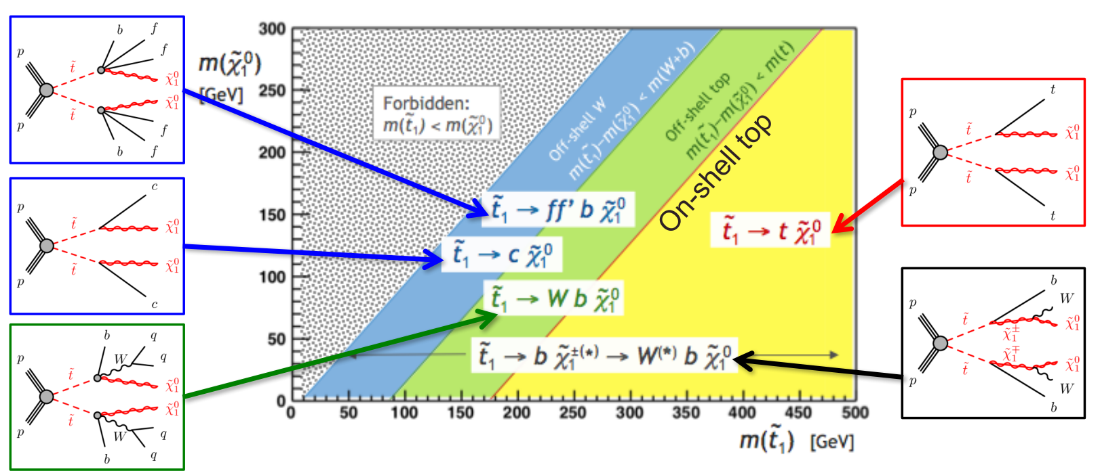

Slide 12
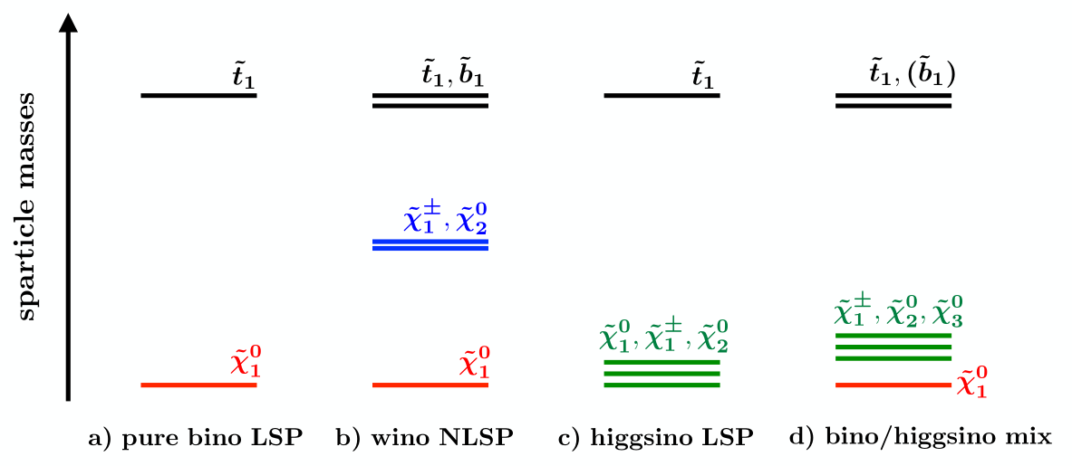
NSUSY

Slide 13
Stop Pair production
,2
,2
Left-handed
,2
,2

Slide 14
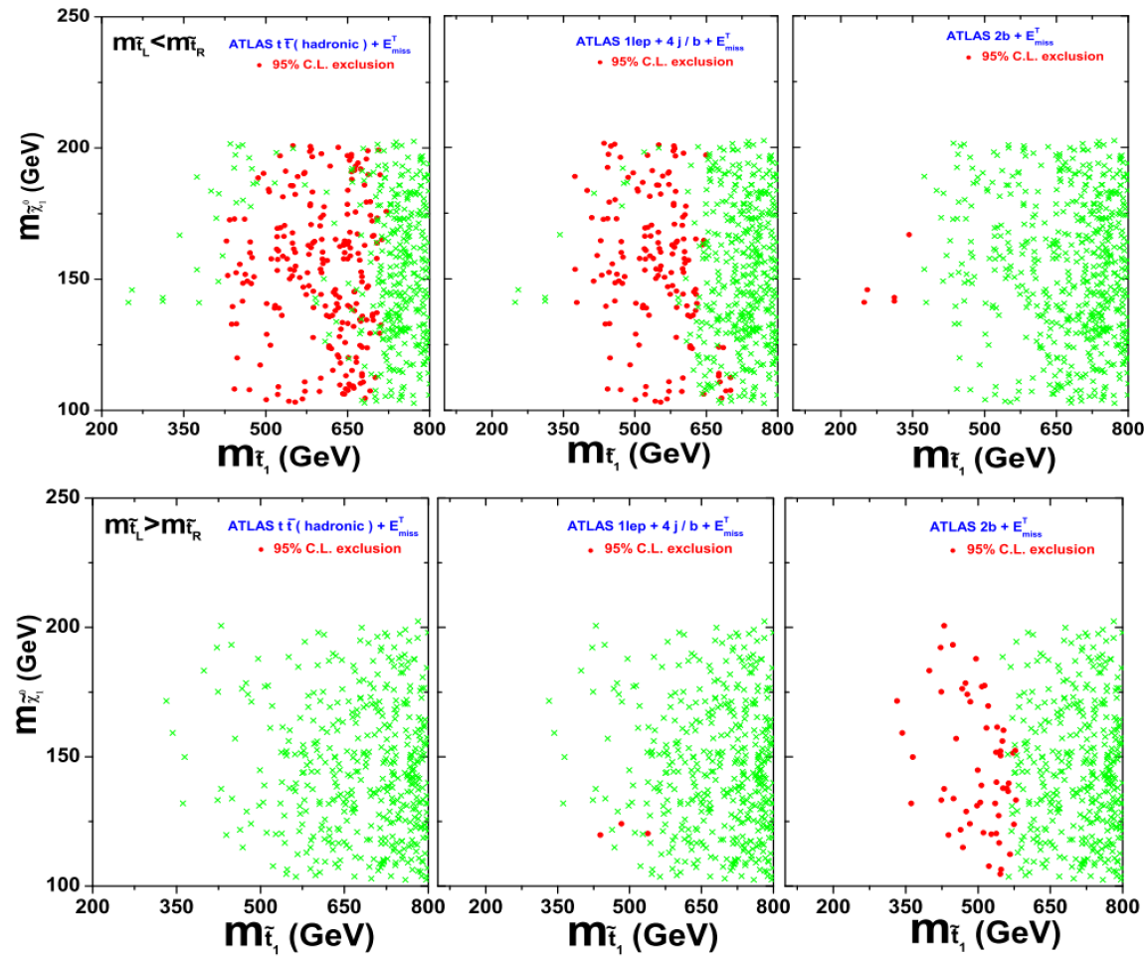
Han, Hikasa, LW, Yang, Zhang
arXiv:1308.5307, JHEP
LHC-8TeV, 20 fb-1
Left-handed stop is constrained more tightly than right-handed stop!

Slide 15
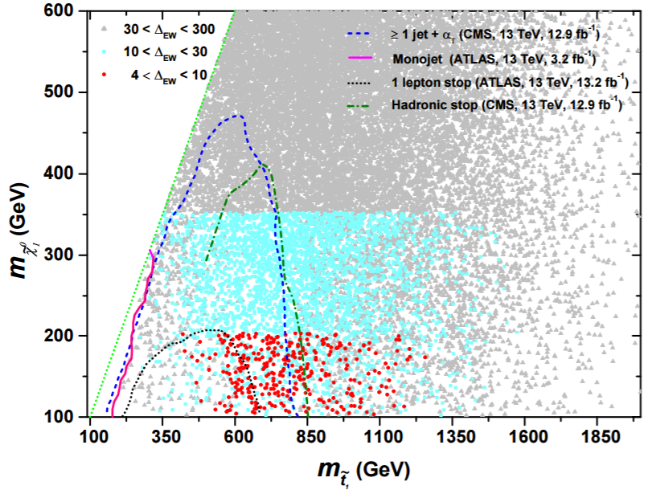
Kobakhidze, Liu, LW, Yang, Zhang
arXiv:1511.02371, PLB
Han, Ren, LW, Yang, Zhang
arXiv:1609.02361, EPJC
Inclusive SUSY analysis can give a stronger bound than specific stop searches

Slide 16
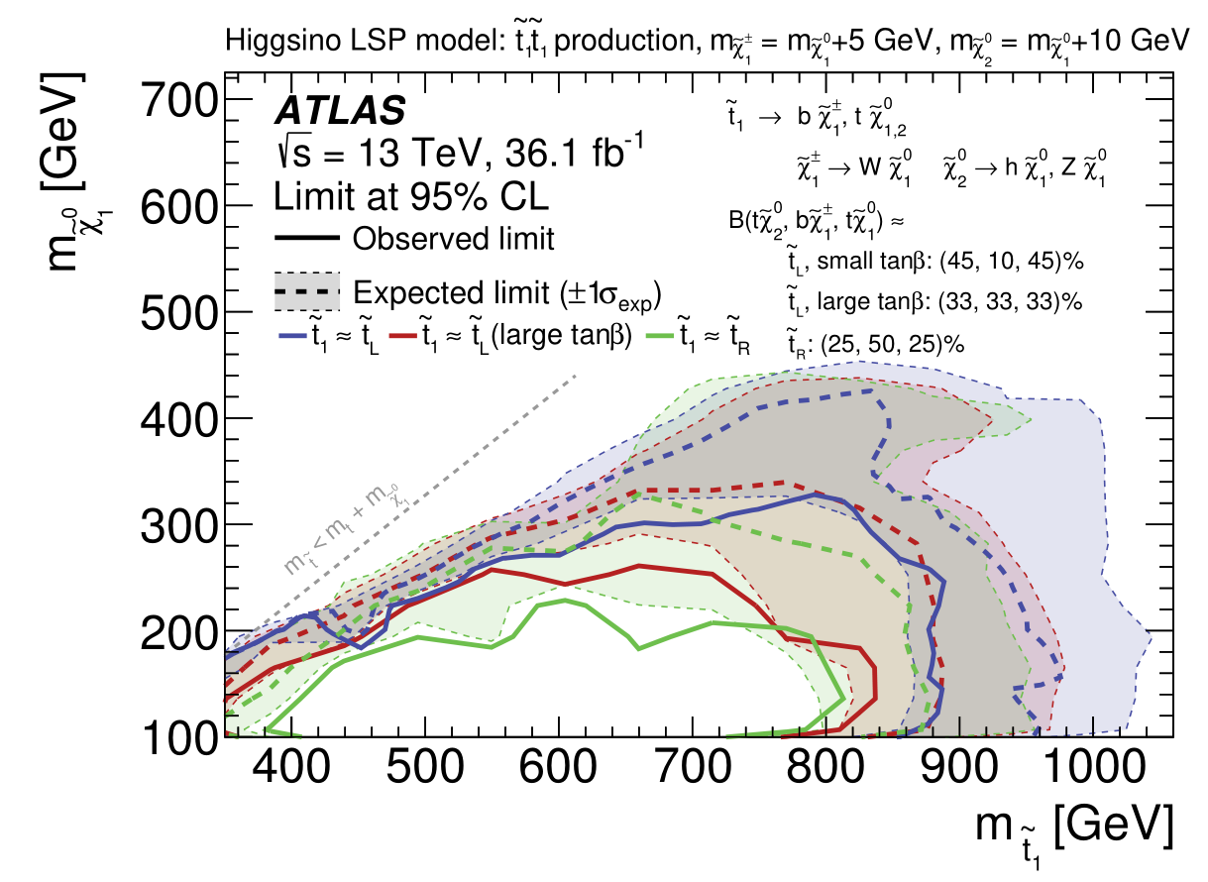

Slide 17
LW, Zhou
arXiv:1811.xxxxx
Polarization and Spin correlation
But in NSUSY,

Slide 18
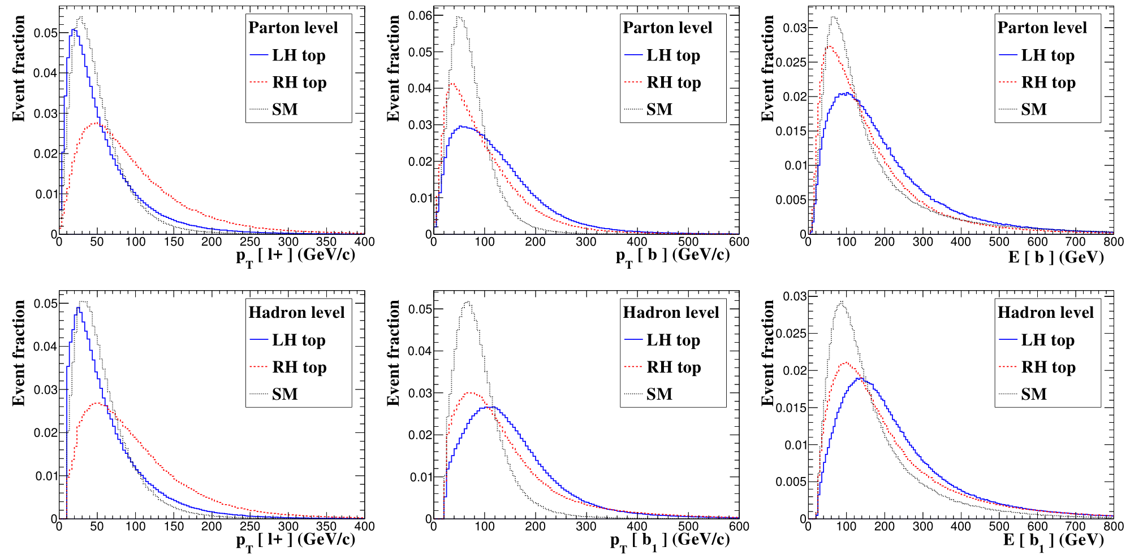
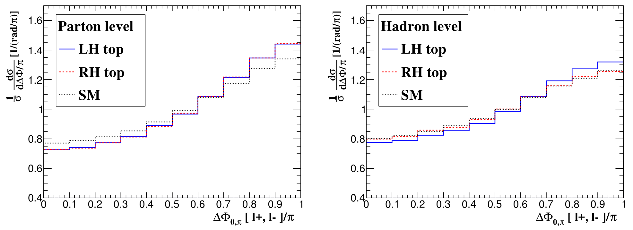

Slide 19
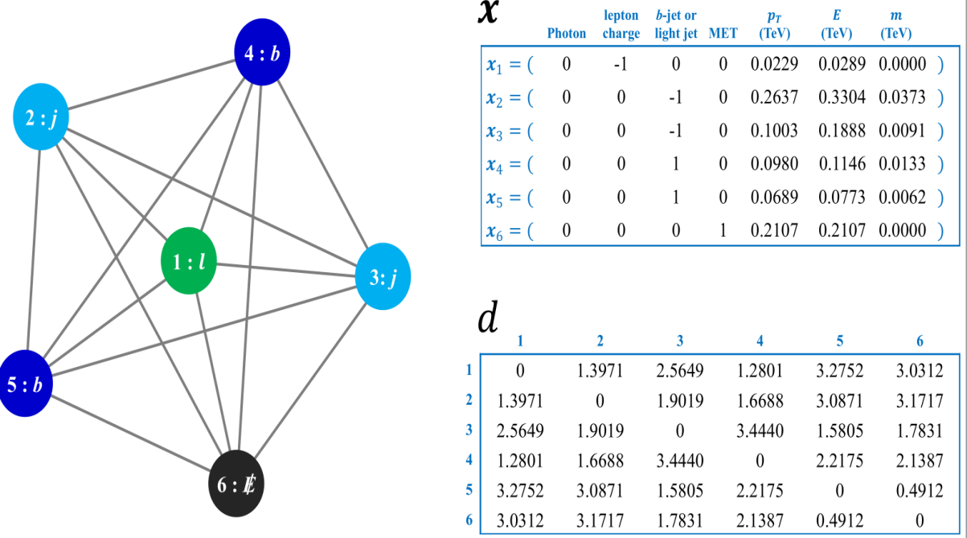
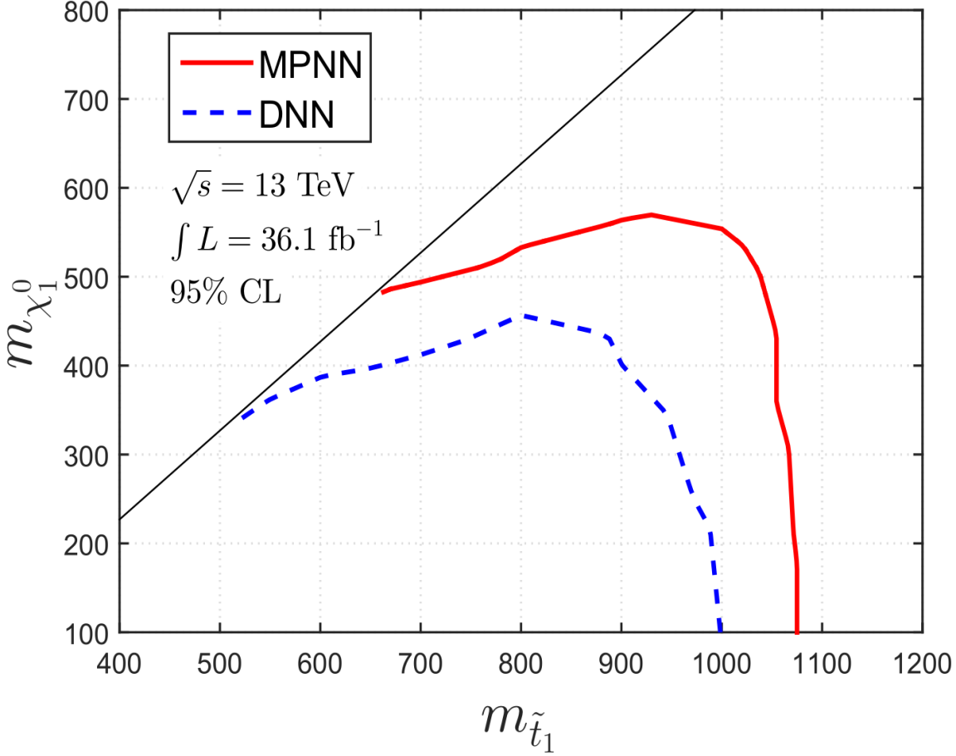
Message passing neural networks for stop search
Abdughani, LW, Ren, Yang
arXiv:1807.09088

Slide 20
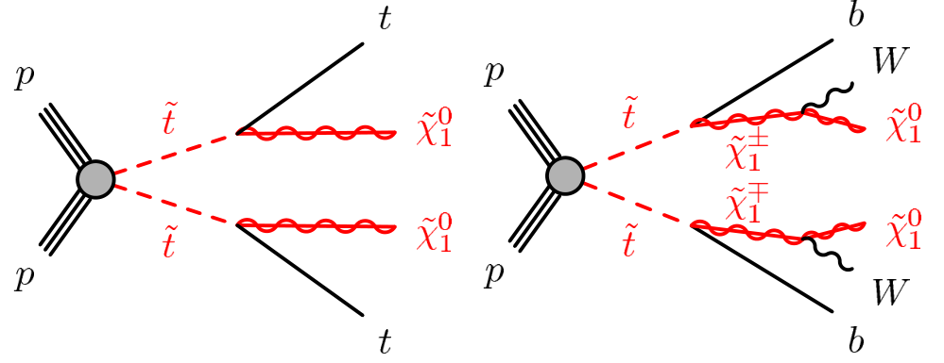
Single stop production
Li, Hikasa, LW, Yang
arXiv:1505.06006, PRD

Slide 21
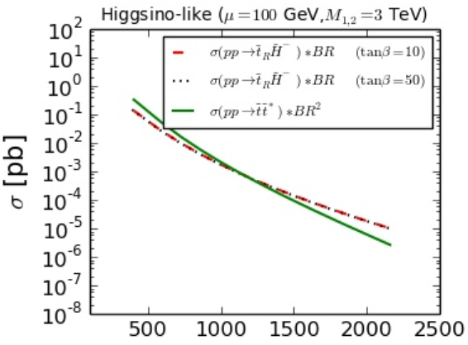
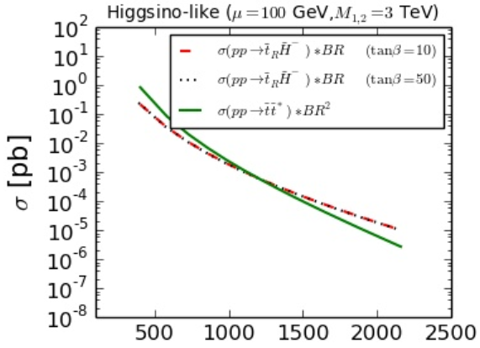
Its cross section is larger than that of stop pair when stop heavier than about 1.2 TeV

Slide 22
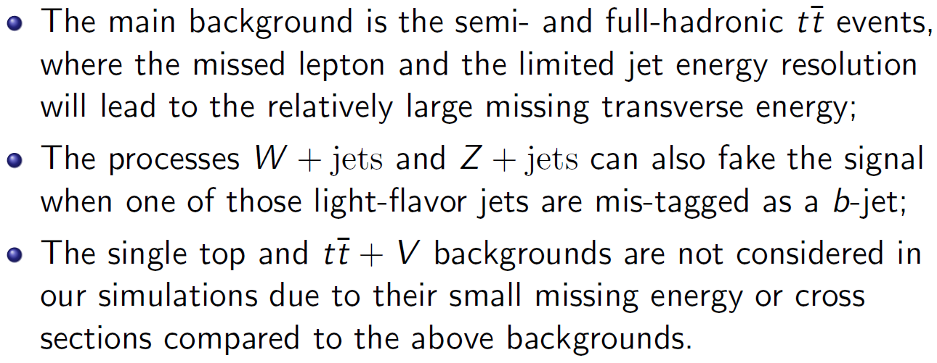
Mono-top:
Backgrounds:

Slide 23
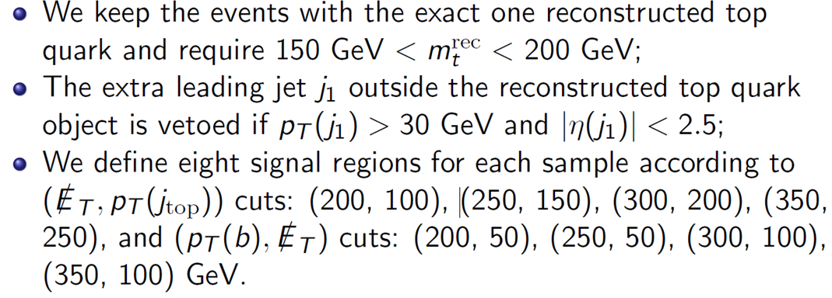
Event selections:

Slide 24
Mono-b:
Backgrounds:

Slide 25
Event slections:

Slide 26
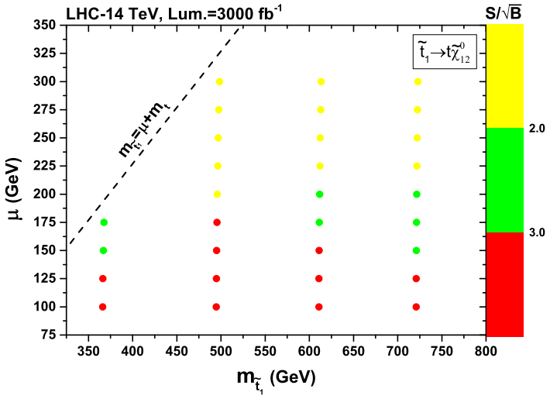
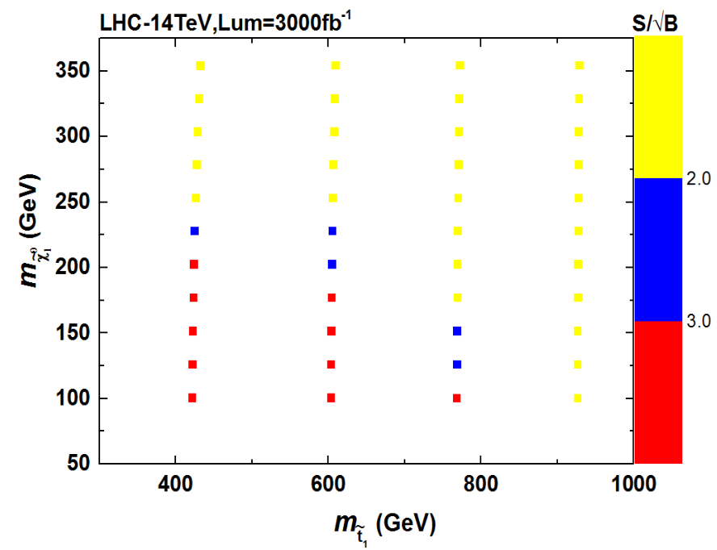
Li, Hikasa, LW, Yang
arXiv:1505.06006, PRD
Duan, Hikasa, LW, Yang, Zhang
arXiv:1611.05211, JHEP
Mono-top(hadronic)
Mono-top(leptonic)

Slide 27
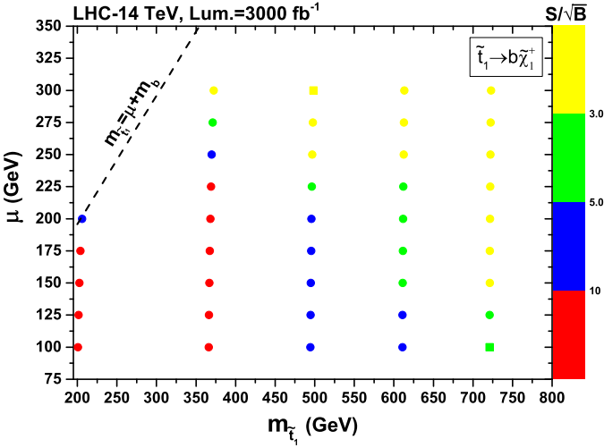
Mono-bottom

Slide 28
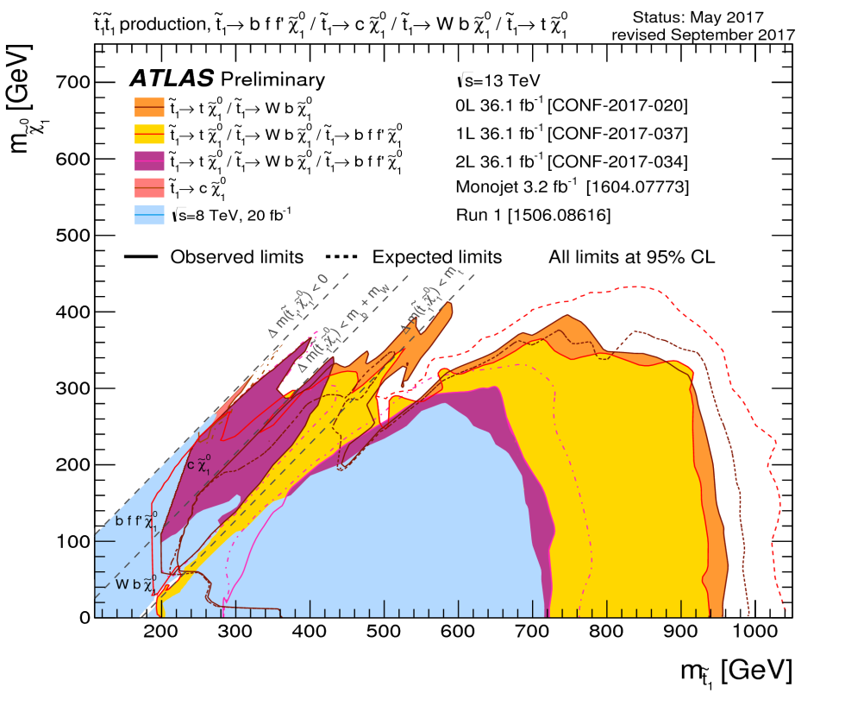
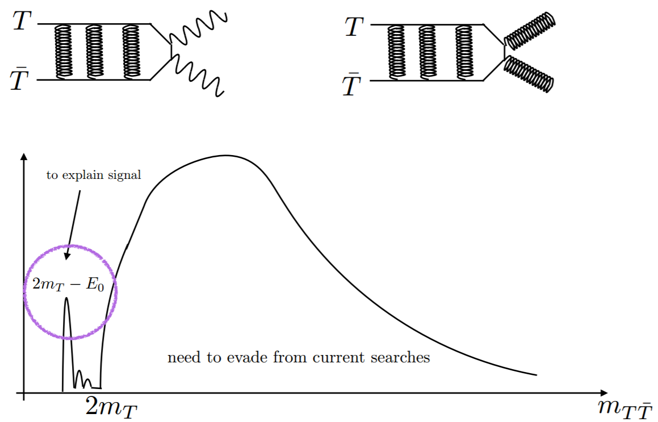
Bound state of stop: stopnium
When two-body decay of stop are forbidden, the stops can form bound state near the threshold, if :

Slide 29
In contrast to existing direct stop pair searches,
stoponium if formed,
will resonantly decay to a pair of the SM particles and
can be independent of the assumptions of the LSP mass and the branching ratios of the stop.
Therefore, the search of stoponium can provide a
complementary probe to the direct stop pair
production at the LHC.

Slide 30
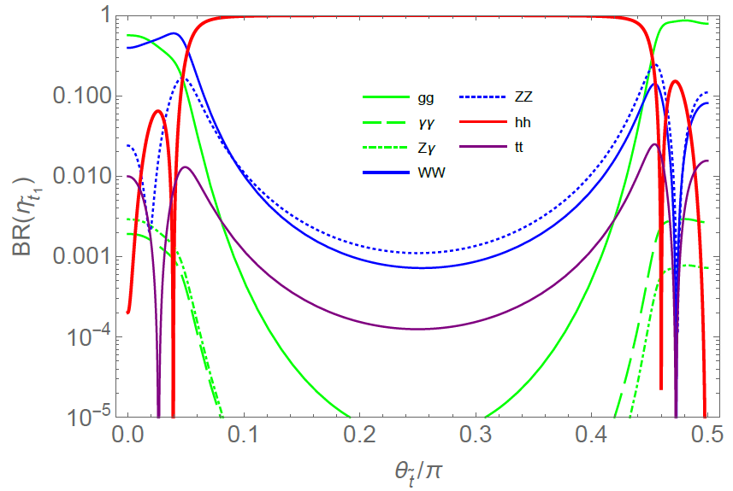
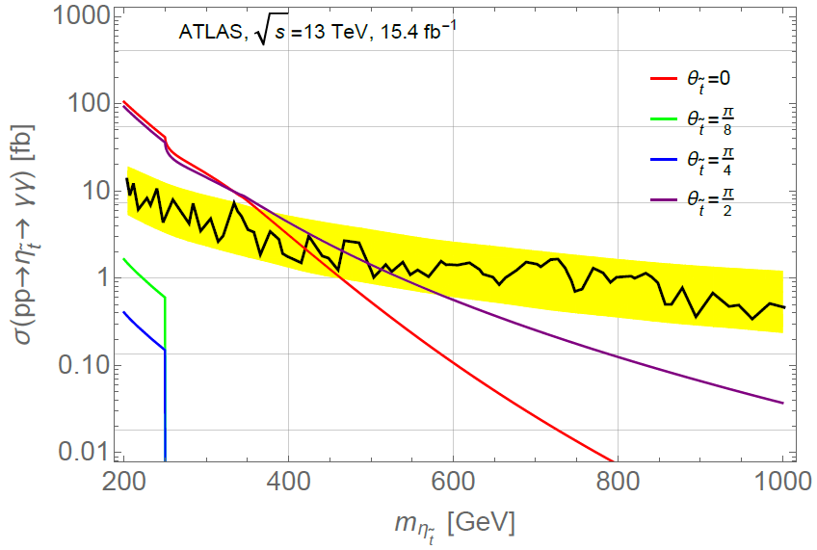
Duan, LW, Zheng
arXiv:1706.07562, JHEP

Slide 31
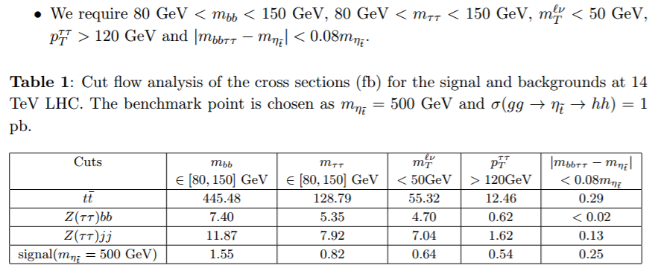

Slide 32
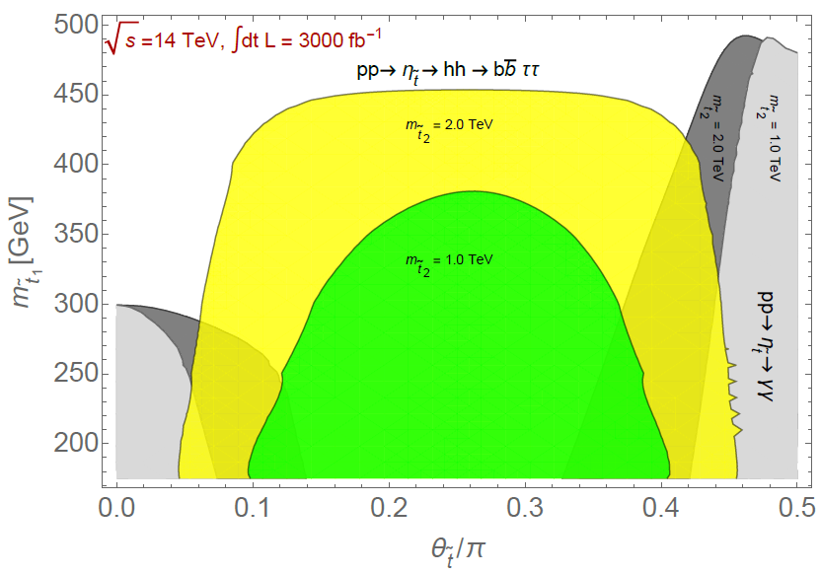
2σ

Slide 33
3. Conclusions
SUSY will be there for a long time!
A large portion of parameter space of NSUSY (Delta_ew<30%) has not been explored yet.
Of course, we may live in a corner rather than favored region.

Slide 34
Thanks!
Understand data deeply!

Slide 35
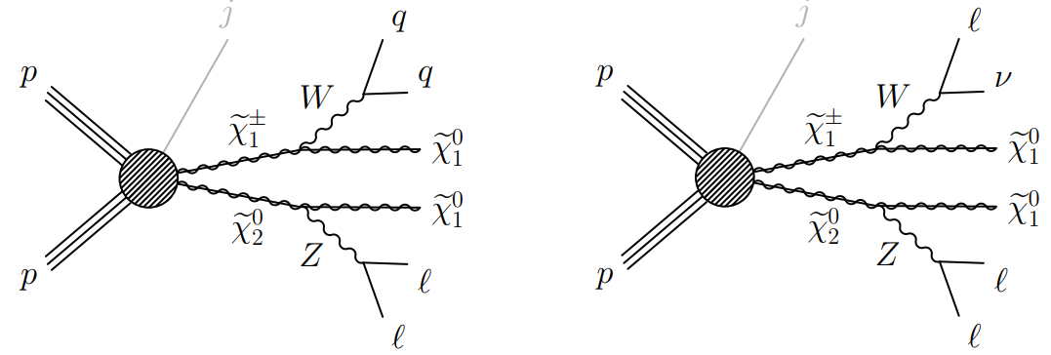
Are they reliable?

Slide 36
Backup

Slide 37
Some predictions of SUSY
Top quark mass, is within the range required to trigger a radiatively-driven breakdown of electroweak symmetry
Higgs mass, fall squarely with the narrow window of MSSM prediction

Slide 38
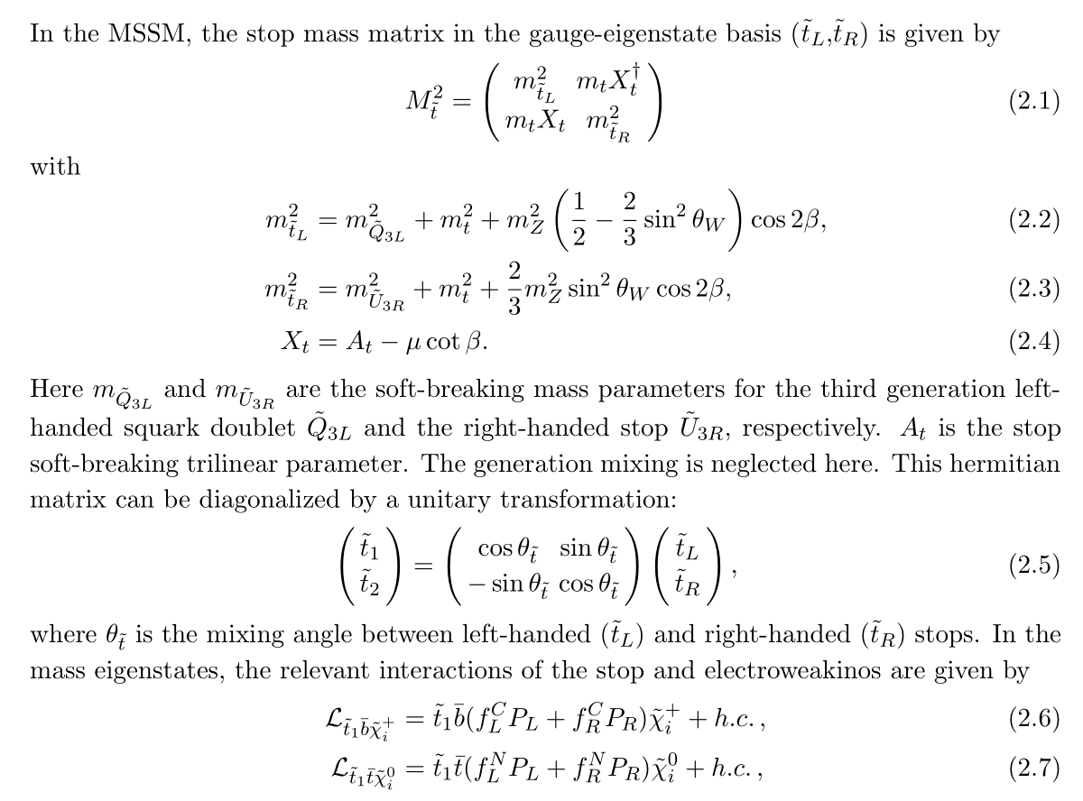

Slide 39
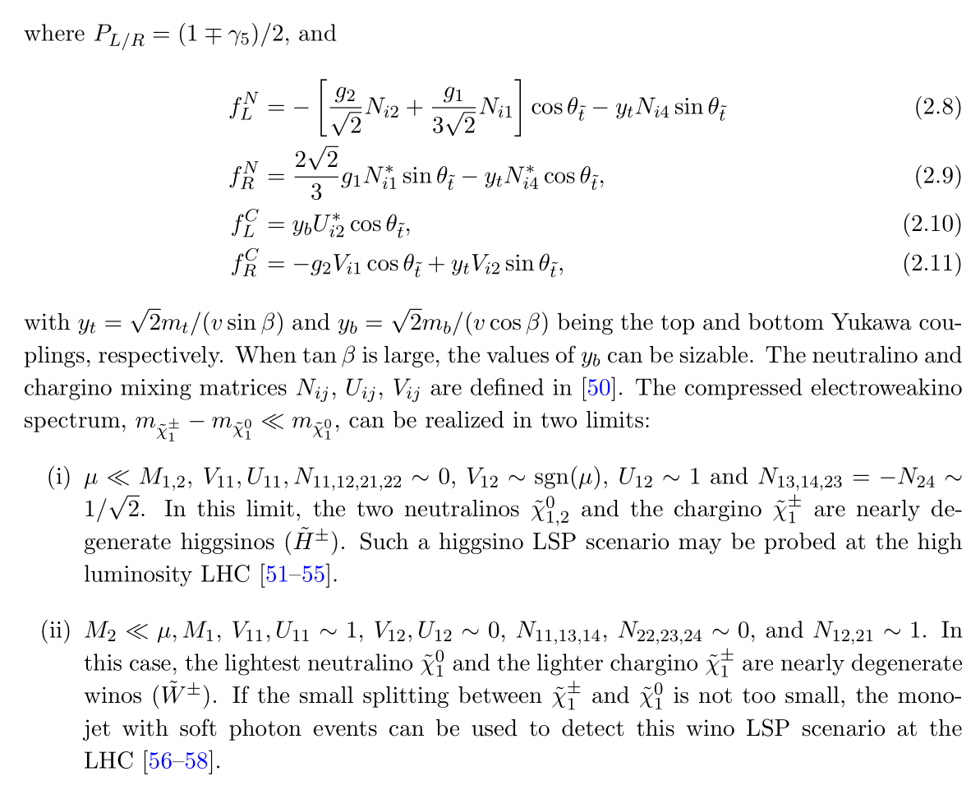

Slide 40
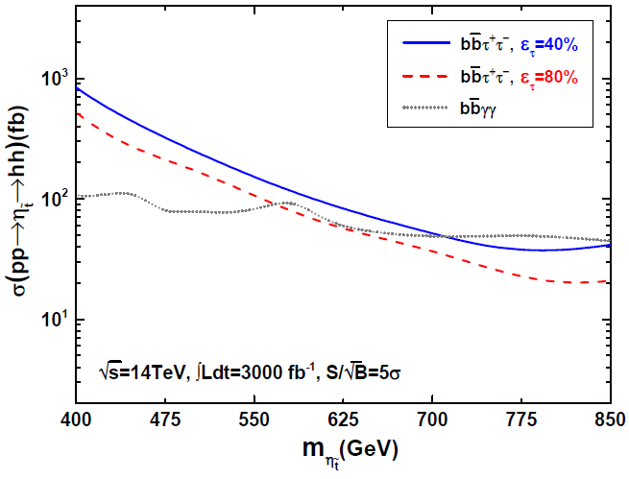

Slide 41
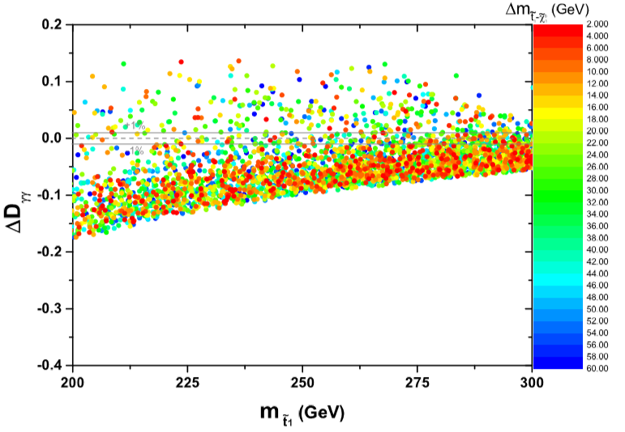
Indirect effect of stop

