Slide 1
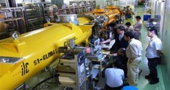
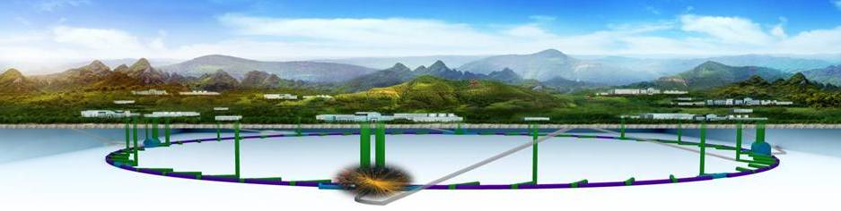
ILC & CEPC Status
Dou Wang
Institute of High Energy Physics, Beijing
Mini-Workshop on HEP, June 16, 2018

Slide 2
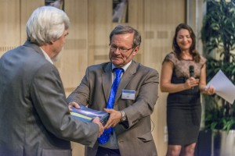
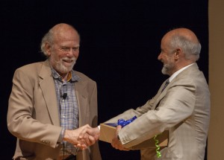
ILC TDR Completed
June 12, 2013
Tokyo
CERN
Fermilab
TDR 5 volumes
Culmination of many years of R&Ds
ILC is in principle ready to go technically
(apart from some loose ends, cost reductions, etc.)

Slide 3
Proposal for ILC250 Higgs Factory
At LCWS2016 Morioka, it was proposed that the first stage at 250 GeV is defined as a Higgs factory that defines one whole project which should be justified by its own scientific case.
The idea was discussed and a general agreement was obtained.

Slide 4
Staging：ILC250 Higgs Factory
After Dec. 2016
Generally agreed by ILC community
To be formalized this fall
Up to Dec. 2016 (LCWS Morioka)
500 GeV start sample scenario
ILC250 Higgs Factory
Build the ILC250 Higgs factory as the first stage ‘program’
Up to 40% cost reduction compared to ILC500 (TDR)

Slide 5
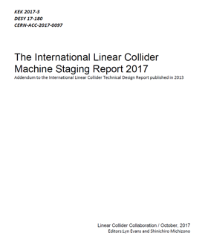
ILC-500 (TDR) → ILC250
Damping Rings
250 GeV e+
TDR update:
250 GeV e-
Turnaround &
Bunch compressors
Options A, A’: 250 GeV
125GeV e-
125GeV e+
Key issues (physics impact ):
Higgs precision depends significantly on HiLumi performance and theory assumptions (link)
Below ttbar threshold
Reduced search capabilities
https://arxiv.org/abs/1711.00568
Nevertheless, provides impressive precision, and remains upgradable.
TDR costs of ~8 BILCU for 500 GeV (ILCU = 2012 US$ estimate used in the TDR) can be reduced to ~4.8 BILCU.

Slide 6
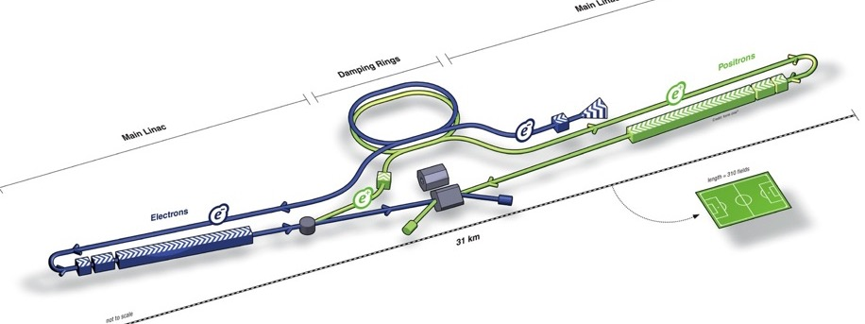
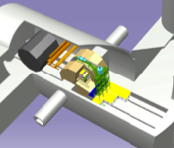
ILC250 Acc. Design Overview
Damping Ring
e- Source
e+ Main Liinac
Physics Detectors
Item | Parameters
C.M. Energy | 250 GeV
Length | 20.5 km
Luminosity | 1.35 x10³⁴ cm⁻²s⁻¹
Repetition | 5 Hz
Beam Pulse Period | 0.73 ms
Beam Current | 5.8 mA (in pulse)
Beam size (y) at FF | 7.7 nm
SRF Cavity G. Q₀ | 31.5~35 MV/m Q₀ = 1 ~1.6x10 ¹⁰
e+ Source
e- Main Linac
Key Technologies
Nano-beam Technology
SRF Accelerating Technology

Slide 7
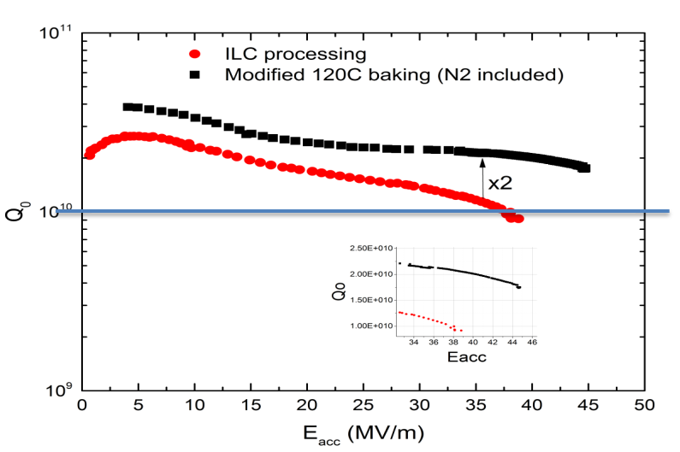
ILC since the TDR in 2012-13: Technical focus and changes
Site specific studies
Nano-beam Technology
    -KEK-ATF2: FF beam size (v): 41 nm at 1.3 GeV (equiv. to 7 nm at ILC@250）
Technical developments for most accelerator systems
- high Q improvements at high G
E-XFEL at DESY successfully constructed and put into operation
– a key technology demonstration
LCLS-II, H-FEL (Shinghai)…
Nitrogen infusion appears very promising*
    45.6 MV/m → 194 mT
    with Q ~ 2x10¹⁰
*A Grassellino et al 2017 Supercond. Sci. Technol. 30 094004

Slide 8
IHEP ILC Collaboration Since 2005
J. Zhai, T. Zhao, J. Chen, Z. Liu, S. Jin, H. Zheng, D. Gong, …
D. Li, B. Sha, D. Wang, Y. Wang, M. Xiao, F. Su, T. Bian, …

Slide 9
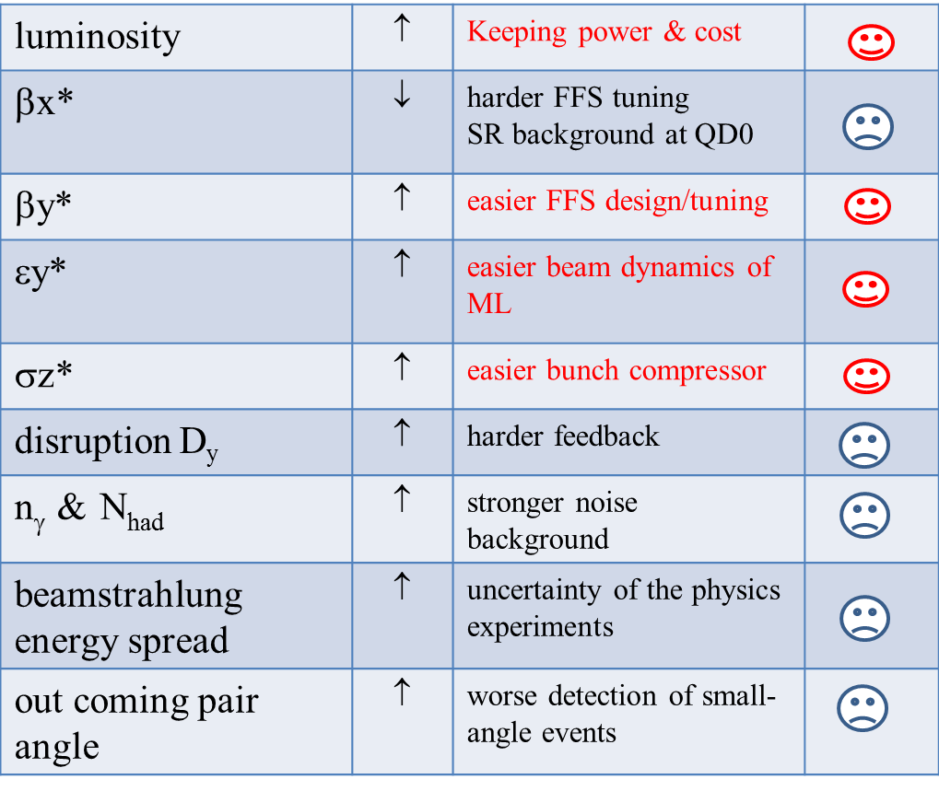
IHEP High Luminosity Study on ILC250
ILC@250GeV | Yokoya | IHEP
β_{x} (mm) | 13.0 | 9.0
β_{y} (μm) | 410 | 469
γε_{x} (μm) | 5.0 | 5.0
γε_{y} (nm) | 35 | 37.5
σ_{x} /σ_{y} (nm) | 515.5/7.66 | 428.9/8.5
σ_{z} (μm) | 300 | 328
δ_{B} | 0.024 | 0.0315
n_{γ} | 1.62 | 1.88
Dy | 34.5 | 40.8
H_{D} | 2.43 | 3.39
Disruption angle θ (rad) | 0.00088 | 0.00105
N_{had} | 2.1 | 4.4
θx/θy (urad) | 39.7/18.7 | 47.6/18.1
L₀ (cm⁻²s⁻¹) | 1.285×10³⁴ | 1.946×10³⁴
It is worthwhile to explore more possibilities to increase the luminosity tolerated by the detector
Try to increase higher luminosities with higher back ground level

Slide 10
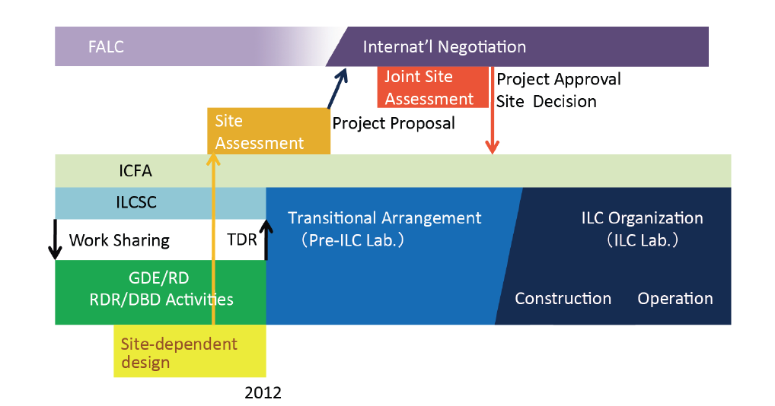
ILC Time Line: Progress and Prospect
Example of earliest case (Shin Michizono):
2019-2022 Preparation
2023-2031 Construction
2032 Commissioning start
(Pre-Preparation) and
Preparation Phase
Assuming (~2+) 4 year
(9 year)
We are here,
2018

Slide 11
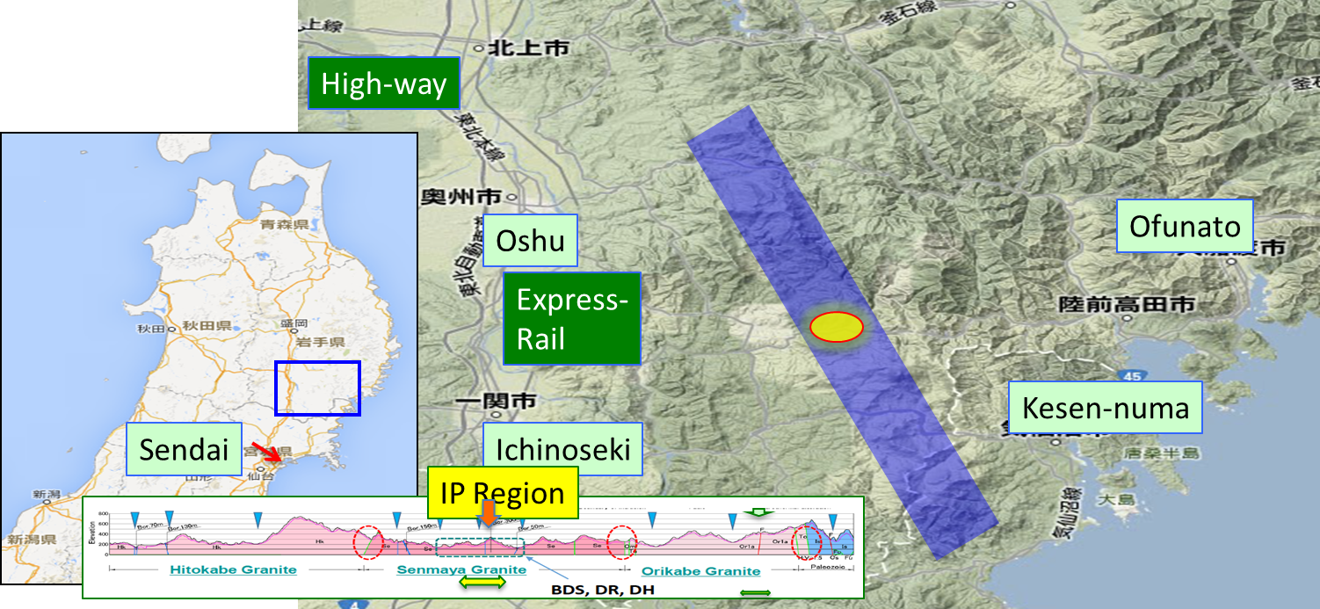
ILC Candidate Location: Kitakami, Tohoku

Slide 12
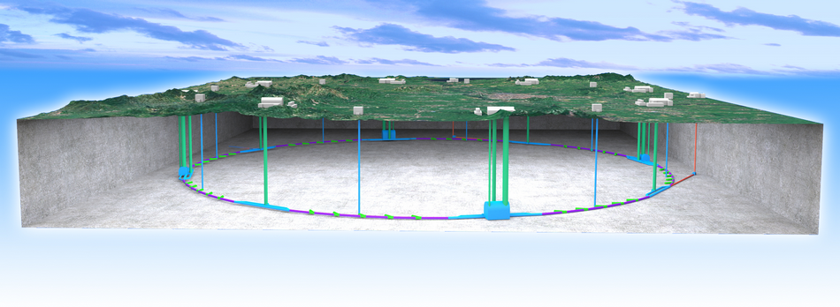
CEPC：A Higgs Factory
Since 2005, we were discussing the next machine after BEPC/BEPCII
Thanks to the low mass Higgs, there is the possibility to build a Higgs Factory: Circular e+e- Collider(CEPC)
  Looking for Hints (from Higgs) ➔ direct searches
  The tunnel will allow us to build pp, AA, ep colliders in the far future: Super proton-proton Collider(SppC)
The idea to build a circular Higgs factory followed by a proton machine, was discussed for the first time at the Higgs factory workshop in Oct. 2012

Slide 13
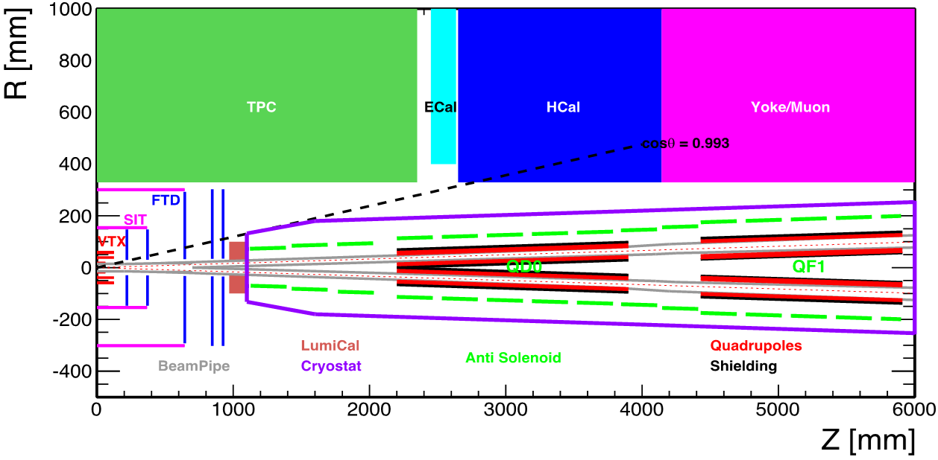
CEPC CDR Accelerator Chain and Systems
Energy Ramp
10 ->45/120GeV
10 GeV
Electron
1) Injector
2) Booster
L=1.2km
Positron
C=100km
Three rings in the sane channel：
  CEPC & booster
  SppC
Booster Cycle (0.1 Hz)
The key systems of
CEPC:
1) Linac Injector
2) Booster
3) Collider ring
4) MDI
5) Civil Eng.
5) Civil Eng.
3) Collider
C=100km
2IP
45/120 GeV
4) Detector Machine
Interface (MDI)
CEPC Booster
CEPC Collider
SppC

Slide 14
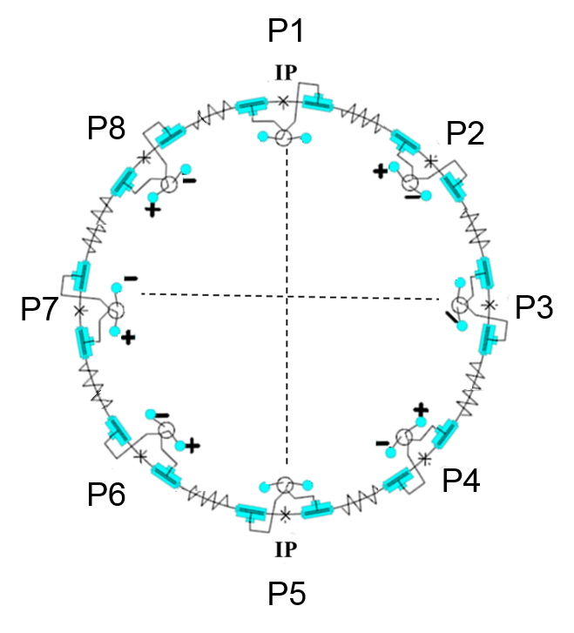
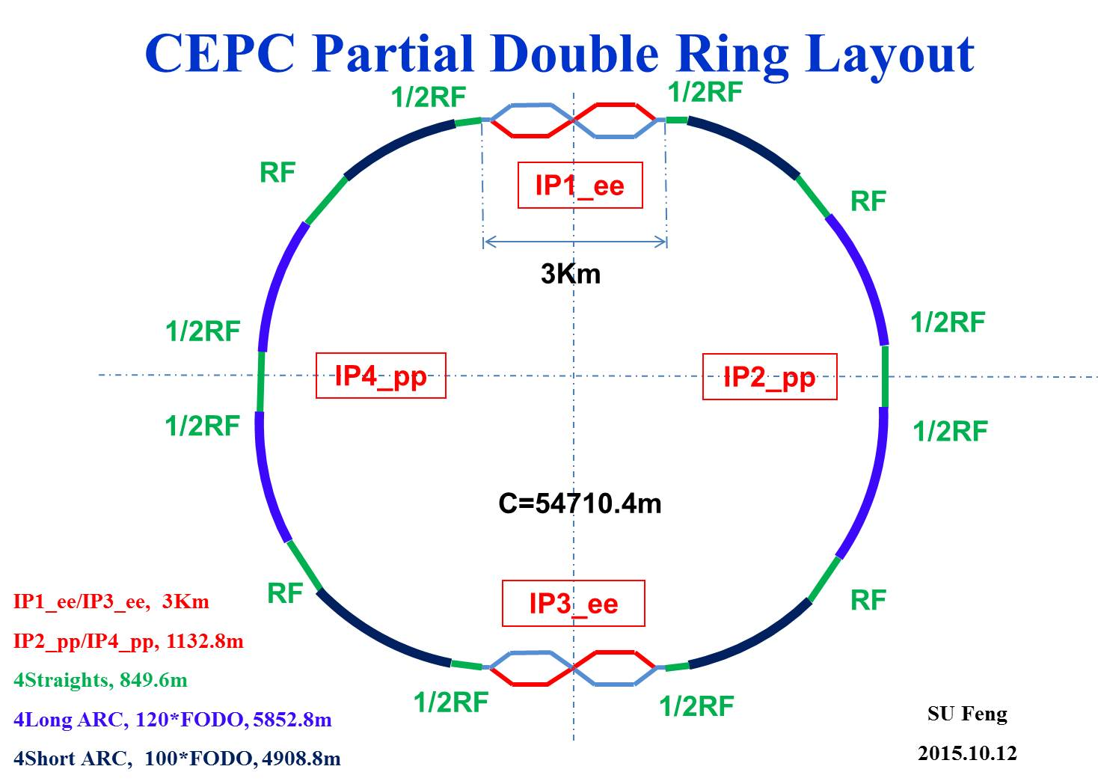
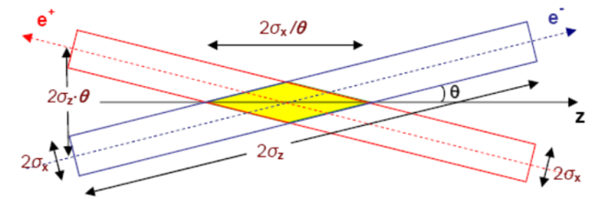
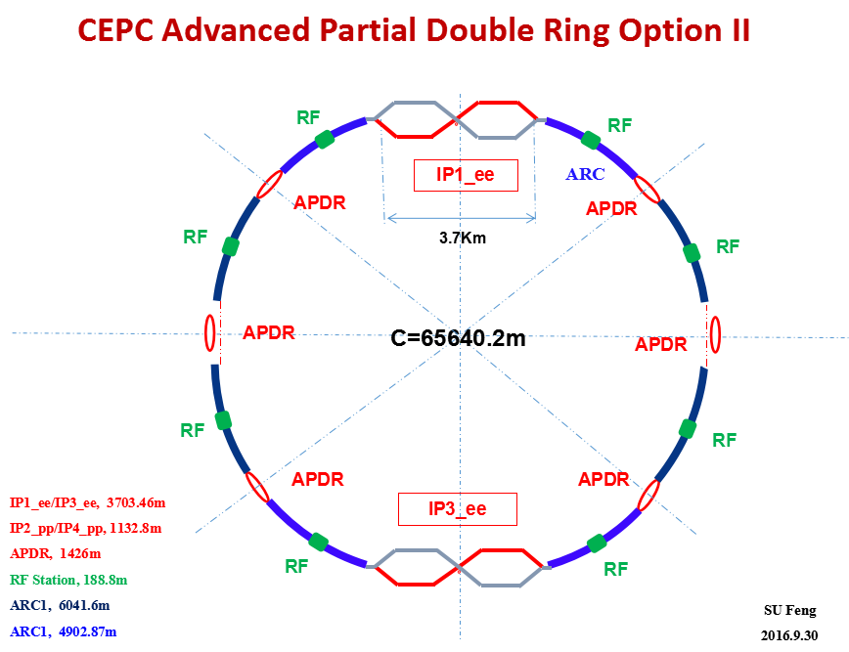
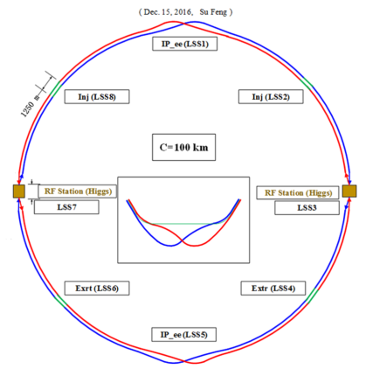
CEPC Four Options Evoluting towards CDR
CEPC Pre-CDR Scheme (head -on collision, single ring)
50km
Crab-waist collision
Since Oct 2012
Since May 2015
CEPC Alternative Design
Lower cost and reaching the
fundamental requirement for
Higgs and Z luminosities, under the condition that sawtooth and beam loading effects be solved
CEPC Baseline Design
Better performance for Higgs and Z compared with alternative scheme, without bottle neck problems, but with higher cost
Since May 2016
Since Nov 2016
CEPC baseline and alternative options have been decided on Jan. 14, 2017

Slide 15
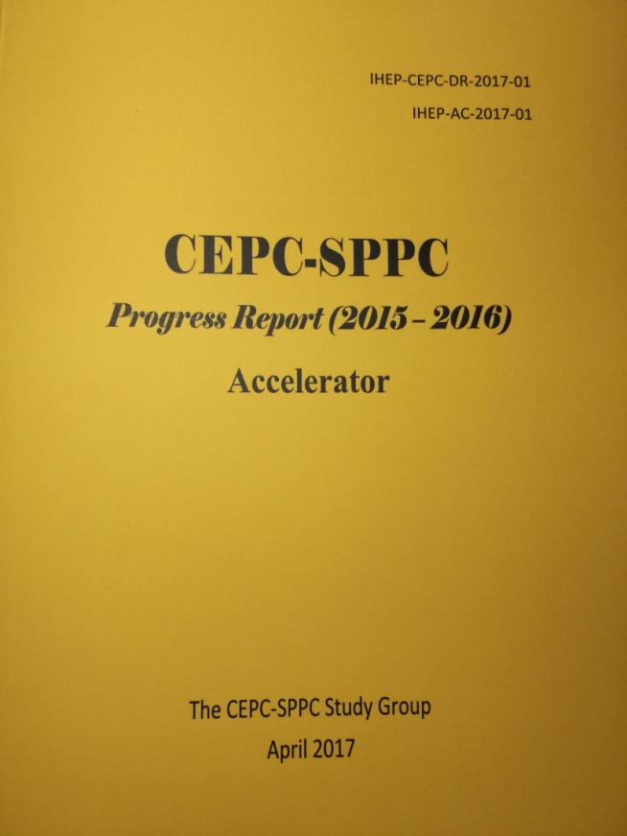
CEPC Accelerator CDR Completed
CEPC accelerator CDR completed in June 2018
  Executive Summary
  Introduction
  Machine Layout and Performance
  Operation Scenarios
  CEPC Collider
  CEPC Booster
  CEPC Linac
  Systems Common to the CEPC Linac, Booster and Collider
  Super Proton Proton Collider
  Conventional Facilities
  Environment, Health and Safety
  R&D Program
  Project Plan, Cost and Schedule
  Appendix 1: CEPC Parameter List
  Appendix 2: CEPC Technical Component List
  Appendix 3: CEPC Electric Power Requirement
  Appendix 4: Operation for High Intensity γ-ray Source
  Appendix 5: Advanced Partial Double Ring
  Appendix 6: CEPC Injector Based on Plasma Wakefield Accelerator
  Appendix 7: International Review Report
March 2015
April 2017
Draft Nov 2017,
final version
June 2018

Slide 16
Current Status of CDR
A first draft at the end of last year. More international participation than pre-CDR
A mini-international review was organized soon after the draft and a lot of inputs was taken
International review will be taken this month
The final version is almost ready, to be published formally next month
TDR will start next year, hopefully more international participation

Slide 17
Motivation, physics potential
Capability of precision measurement, Higgs and Z factories (overview).
Physics goals
  Electroweak symmetry breaking: naturalness, nature of electroweak physics transition.
  Dark sector searches through Higgs and Z exotic decays.
  Connection to neutrino physics.
  Connection to baryogenesis
  Flavor physics at Z-factory
  Precision QCD measurements

Slide 18
CEPC Operation Plan
Particle type | Energy (c.m.) (GeV) | Luminosity per IP (10³⁴ cm⁻²s⁻¹) | Luminosity per year (ab⁻¹, 2 IPs) | Years | Total luminosity (ab⁻¹, 2 IPs) | Total number of particles
H | 240 | 3 | 0.8 | 7 | 5.6 | 1 x 10⁶
Z | 91 | 32 | 8 | 2 | 16 | 0.7 x 10¹²
W | 160 | 12 | 3.2 | 1 | 3.2 | 1 x 10⁷
CEPC yearly run time assumption:
    Operation – 8 months, or 250 days, or 6,000 hrs
    Physics (60%) – 5 months, or 150 days, or 3,600 hrs, or 1.3 Snowmass Unit.
Compared to known e+e- collider yearly run time:
  KEK-B 11-year average (2000-2010, Y. Funakoshi):
    Operation – 6,000 hrs
    Physics (70%) – 4,200 hrs
  PEP-II 6-year average (2003-2008, J. Seeman):
    Operation – 6,500 hours
    Physics (60%) – 4,000 hrs
  BEPC-II 3-year average (2015-2017, Q. Qin):
    Operation – 7,000 hrs
    Physics (70%) – 4,800 hrs (BES 3,100 hrs, SR 1,700 hrs)

Slide 19
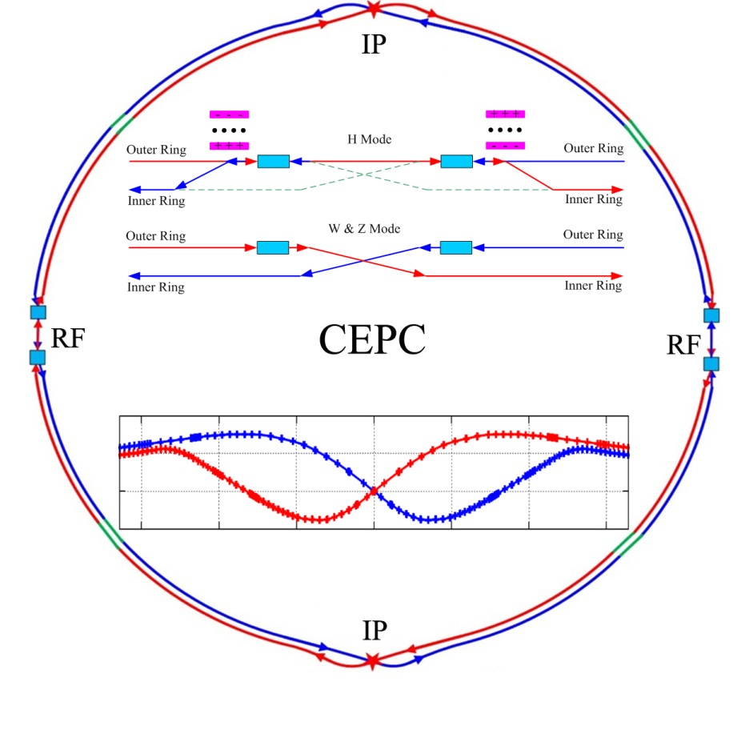
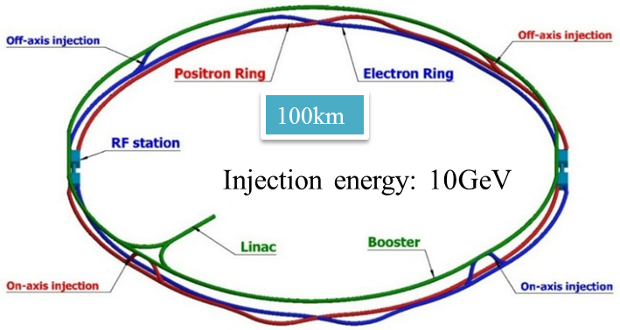
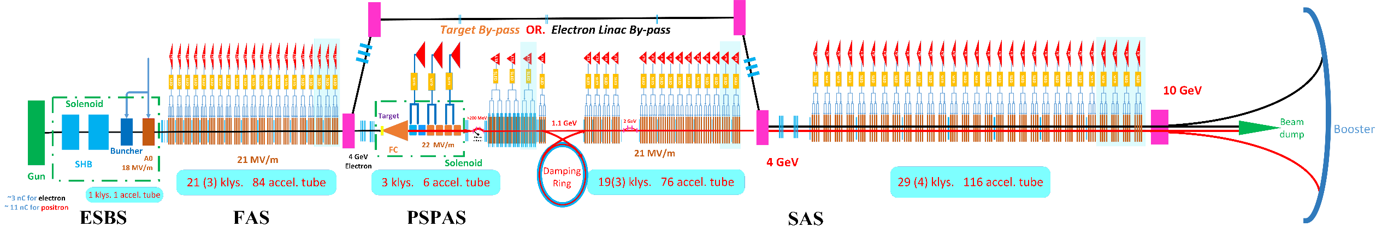
CEPC CDR Baseline Layout
Collider ring
Linac injector
Baseline: 100 km, 30 MW; Upgradable to 50 MW, High Lumi Z
Try all means to cut cost down

Slide 20
CEPC Main Parameters
 | Higgs | W | Z（3T） | Z（2T）
Number of IPs | 2
Beam energy (GeV) | 120 | 80 | 45.5
Circumference (km) | 100
Synchrotron radiation loss/turn (GeV) | 1.73 | 0.34 | 0.036
Crossing angle at IP (mrad) | 16.5×2
Piwinski angle | 2.58 | 7.0 | 23.8
Number of particles/bunch N_{e} (10¹⁰) | 15.0 | 12.0 | 8.0
Bunch number (bunch spacing) | 242 (0.68μs) | 1524 (0.21μs) | 12000 (25ns+10%gap)
Beam current (mA) | 17.4 | 87.9 | 461.0
Synchrotron radiation power /beam (MW) | 30 | 30 | 16.5
Bending radius (km) | 10.7
Momentum compact (10⁻⁵) | 1.11
β function at IP β_{x}* / β_{y}* (m) | 0.36/0.0015 | 0.36/0.0015 | 0.2/0.0015 | 0.2/0.001
Emittance ε_{x}/ε_{y} (nm) | 1.21/0.0031 | 0.54/0.0016 | 0.18/0.004 | 0.18/0.0016
Beam size at IP σ_{x} /σ_{y} (μm) | 20.9/0.068 | 13.9/0.049 | 6.0/0.078 | 6.0/0.04
Beam-beam parameters ξ_{x}/ξ_{y} | 0.031/0.109 | 0.013/0.106 | 0.0041/0.056 | 0.0041/0.072
RF voltage V_{RF} (GV) | 2.17 | 0.47 | 0.10
RF frequency f _{RF} (MHz) (harmonic) | 650 (216816)
Natural bunch length σ_{z} (mm) | 2.72 | 2.98 | 2.42
Bunch length σ_{z} (mm) | 3.26 | 5.9 | 8.5
HOM power/cavity (2 cell) (kw) | 0.54 | 0.75 | 1.94
Natural energy spread (%) | 0.1 | 0.066 | 0.038
Energy acceptance requirement (%) | 1.35 | 0.4 | 0.23
Energy acceptance by RF (%) | 2.06 | 1.47 | 1.7
Photon number due to beamstrahlung | 0.1 | 0.05 | 0.023
Lifetime _simulation (min) | 100
Lifetime (hour) | 0.67 | 1.4 | 4.0 | 2.1
F (hour glass) | 0.89 | 0.94 | 0.99
Luminosity/IP L (10³⁴cm⁻²s⁻¹) | 2.93 | 10.1 | 16.6 | 32.1

Slide 21
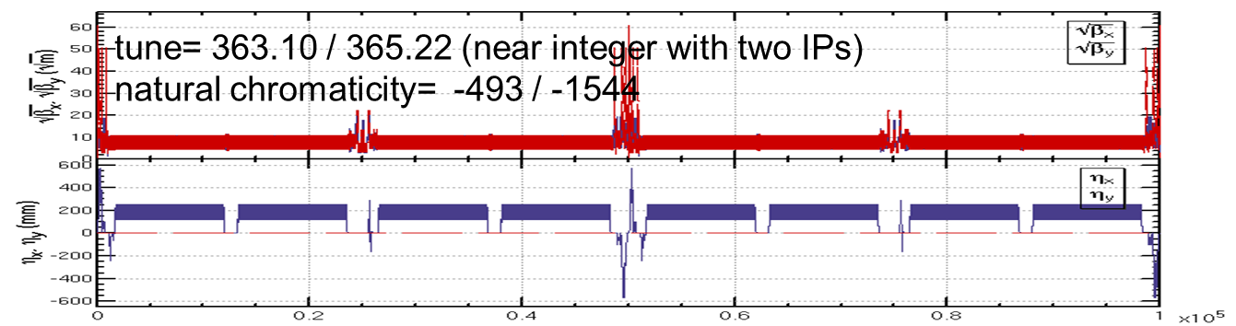
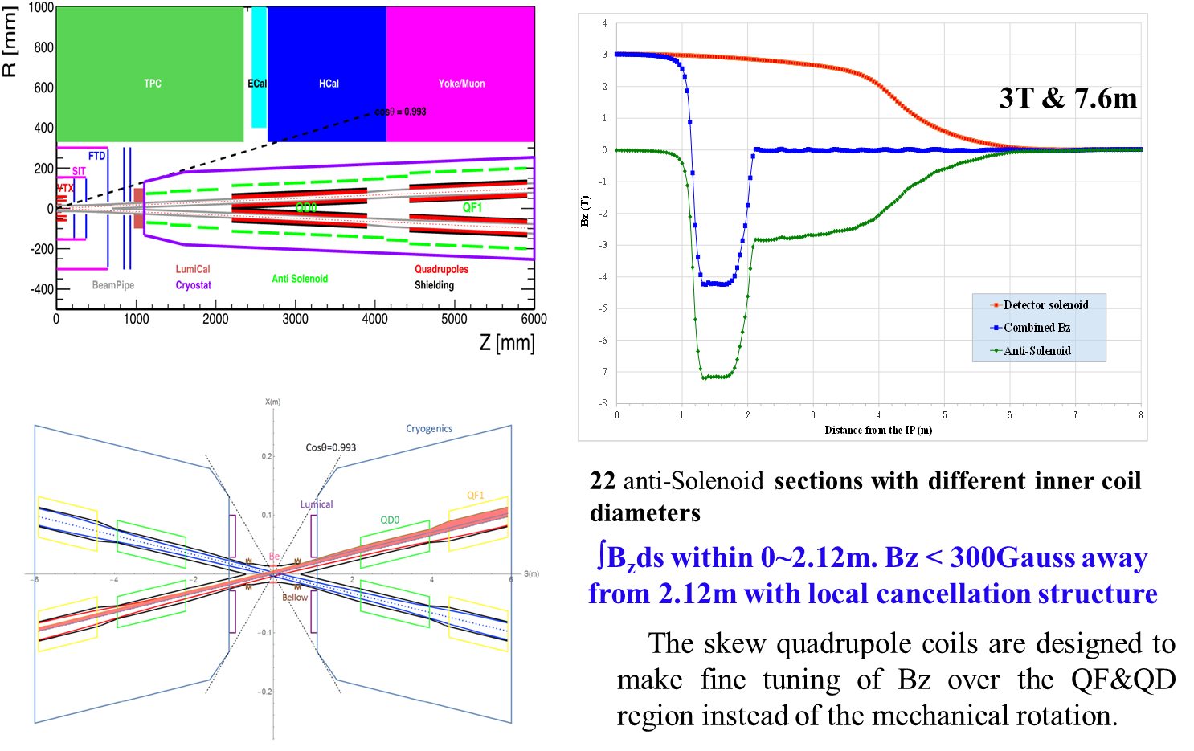
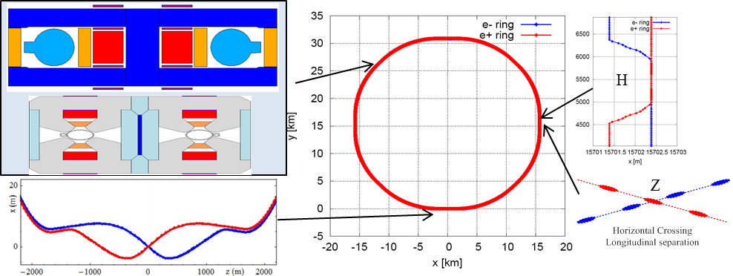
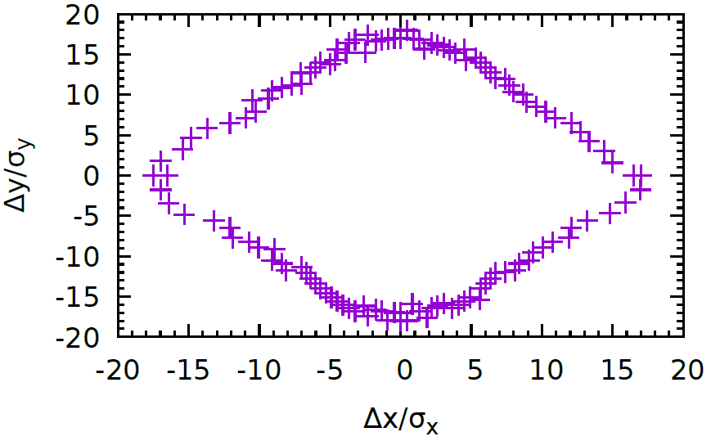
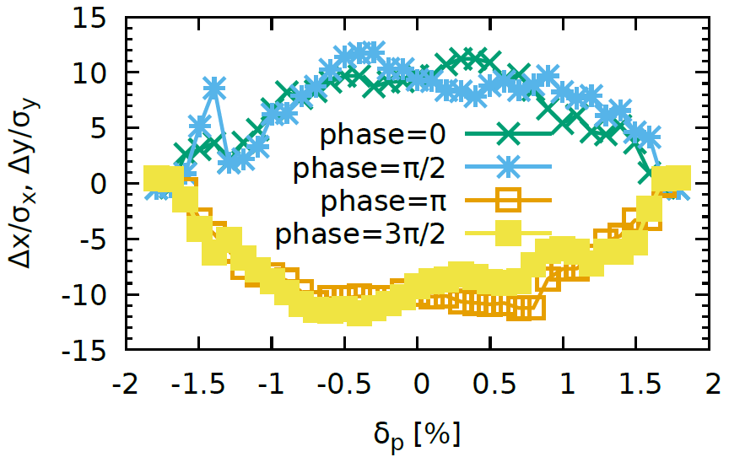
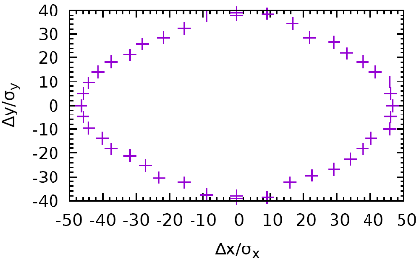
CEPC Collider CDR Design
S. Bai, C. Yu, Y. Zhu,…
H. Zhu, X. Wang, …
Y. Wang…
Y. Zhang…
H
H
Z pole
  Accelerator design fulfills requirements of the physics and key hardware.

Slide 22
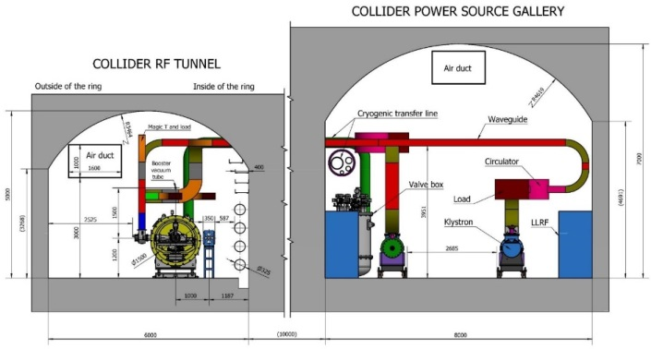
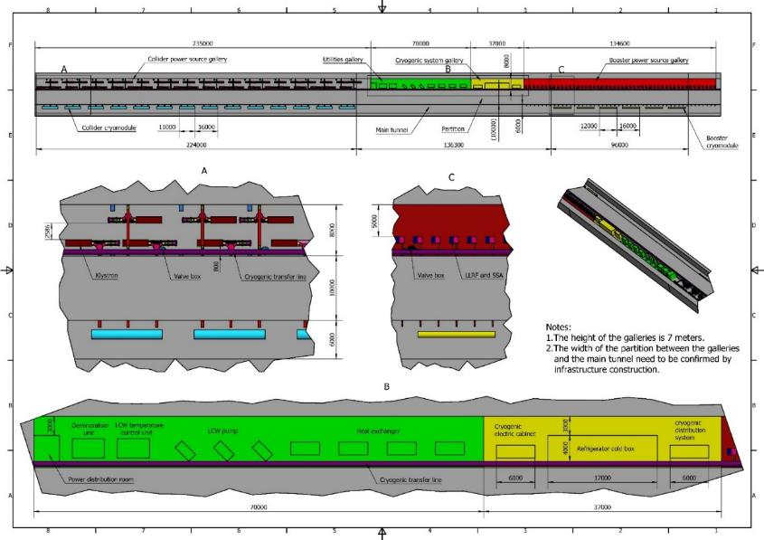
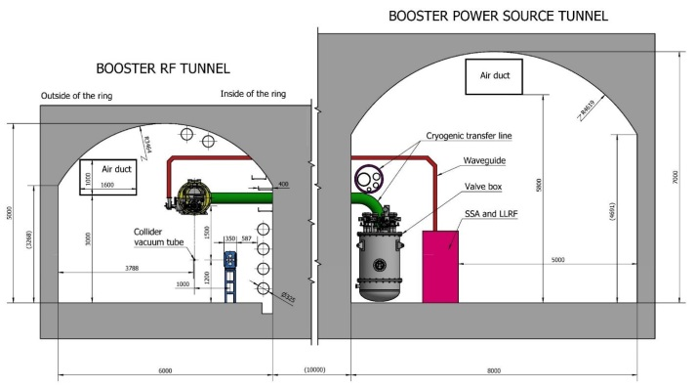
CEPC RF Layout
For 30 MW Higgs:
Collider: 240 650 MHz 2-cell cavities in 40 cryomodules (6 cav./ module).
Booster: 96 1.3 GHz 9-cell cavities in 12 cryomodules (8 cav. / module).
J. Zhai
For 50 MW Higgs:
add 16 Collider
modules.
CEPC SCRF Gallary
Space was reserved for ttbar upgrade

Slide 23
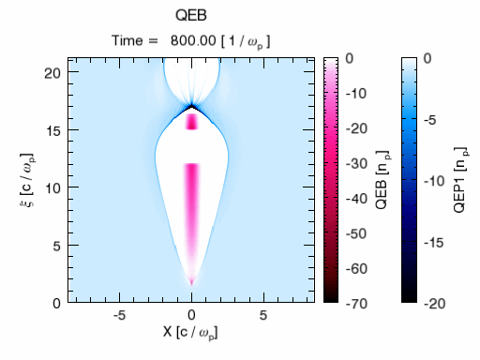
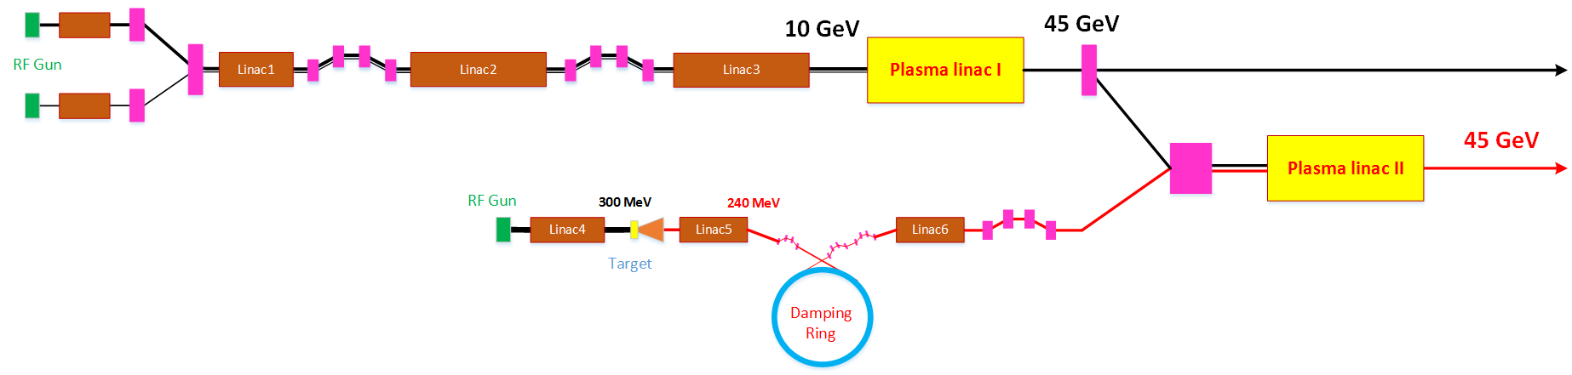
A High Energy CEPC Injector Based on Plasma Wakefield Accelerator
W. Lu
Driver/trailer beam generation through Photo-injector
HTR PWFA with good stability (single stage TR=3-4, Cascaded stage 6-12, high efficiency)
Positron generation and acceleration in an electron beam driven PWFA using hollow plasma channel (TR=1)
@45GeV the plasma accelerated electron and positron beams satisfy the CEPC booster injection requirements

Slide 24
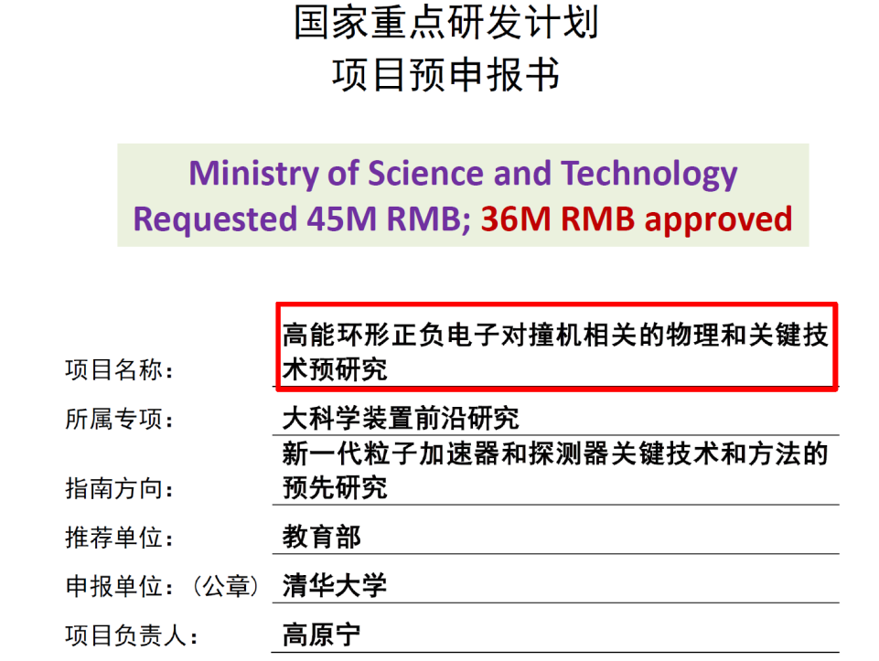
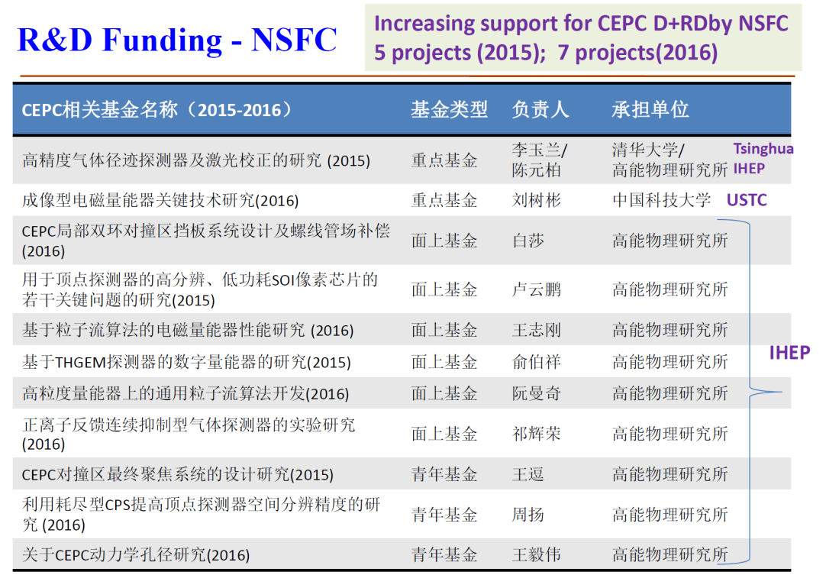
CEPC Funding in China
  HEP seed money
  11 M RMB/3 years (2015-2017)
Funding from the MOST
36 M in 2016
31 M in 2018
40M RMB CAS talent program
>200M RMB CAS fund for HTS
500M RMB Beijing city for light source
~100M RMB other agencies
Funding needed for CEPC design and R&D are mostly satisfied

Slide 25
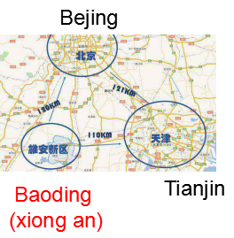
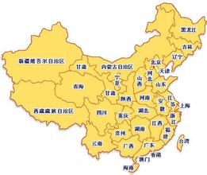

CEPC Site Selections
1
1)
2
4
2)
1) Qin huang dao, Hebei （Completed in 2014）
2) Huang Ling, Shanxi（Completed in 2017)
3)Shen shan, Guangdong (Completed in 2016)
4) Baoding (Xiong an), Hebei (Started in August 2017, near Beijing )
5) Zhejiang (started in March 2018, near Shanghai)
6) Jiangsu (started in May 2018)
3
3)
Longitudinal profile of tunnel （at Funing site, 1）

Slide 26
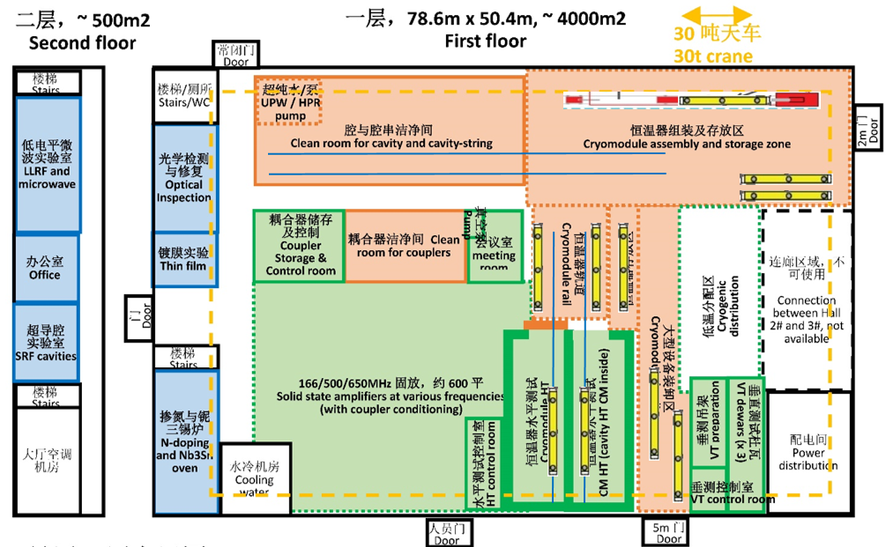
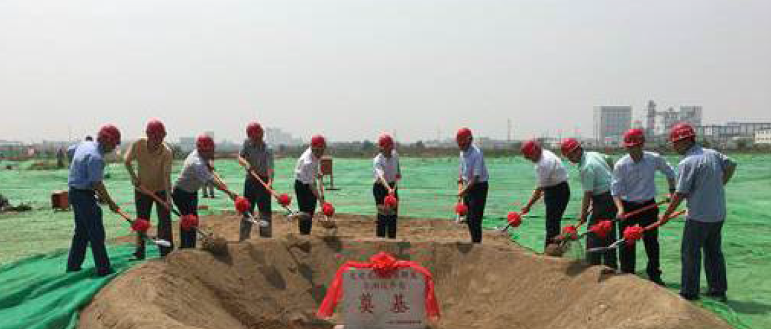
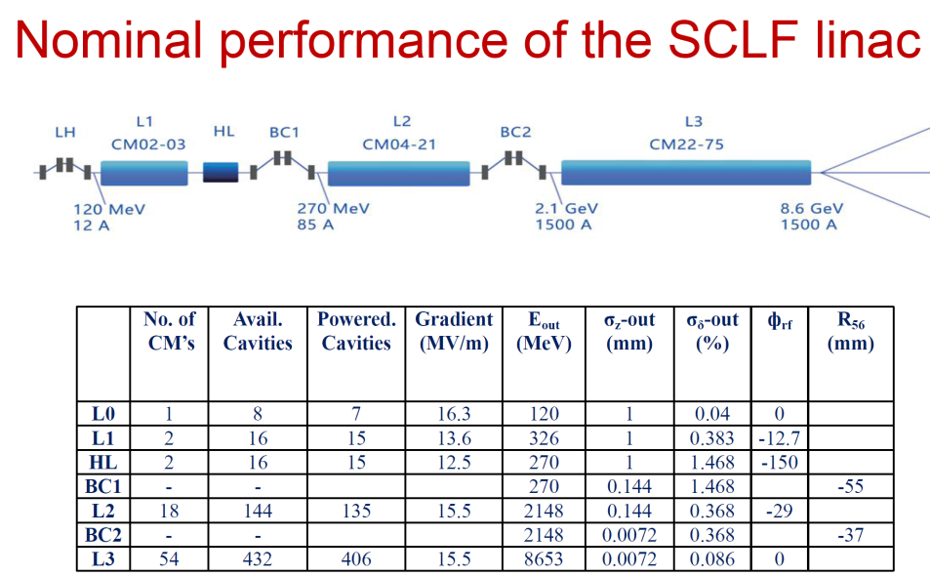
SRF Cavities
J. Zhai
A new SRF testing facility is under construction, thanks to Beijing municipal government
Shanghai government decided to support significantly the Shanghai Coherent Light Facility(SCLF).
  432 1.3 GHz cavities
  54 Cryomodules
IHEP plans to collaborate with SINAP and provide > 1/3 of cavities and cryomodules, an excellent exercise for us.
4500 m² SRF lab in the Platform of Advanced Photon Source Technology R&D (PAPS)

Slide 27
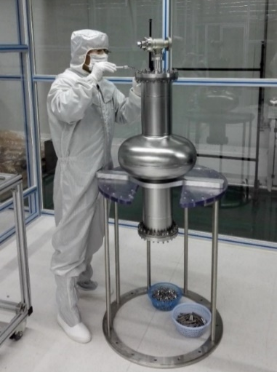
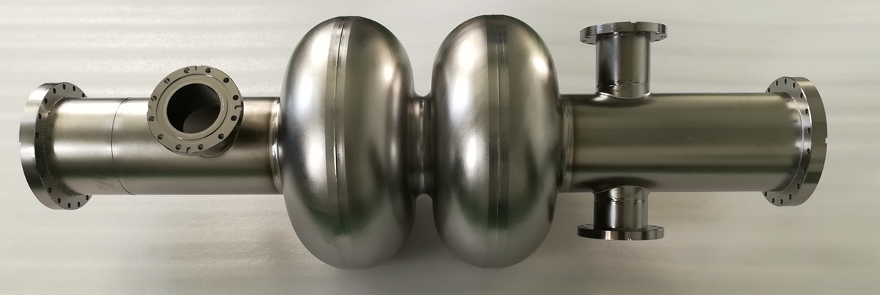
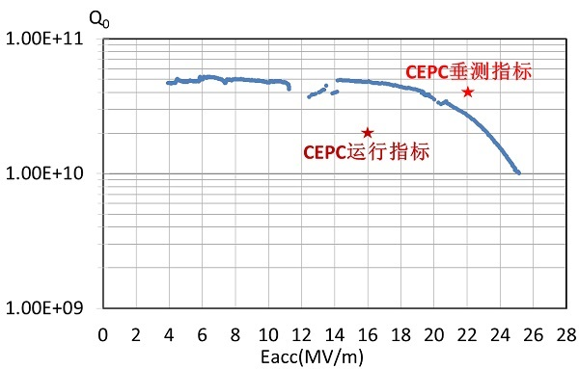
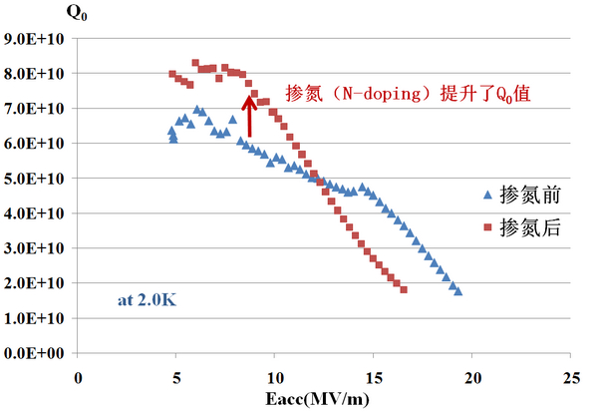
Current R&D results
A CEPC 650MHz 1-cell cavity completed the vertical test.
A CEPC 650MHz 2-cell cavity completed, to be test soon
1st EP facility is under construction(ADS funding and others), ready this autumn
Two CEPC 650MHz 1-cell cavities tried N-doping, Q₀ increase is seen.
P. Sha

Slide 28
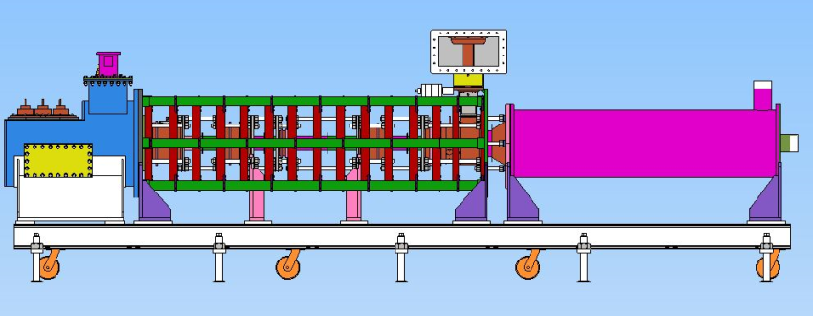
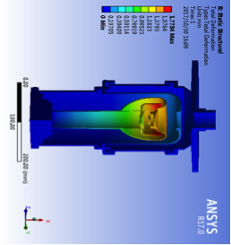
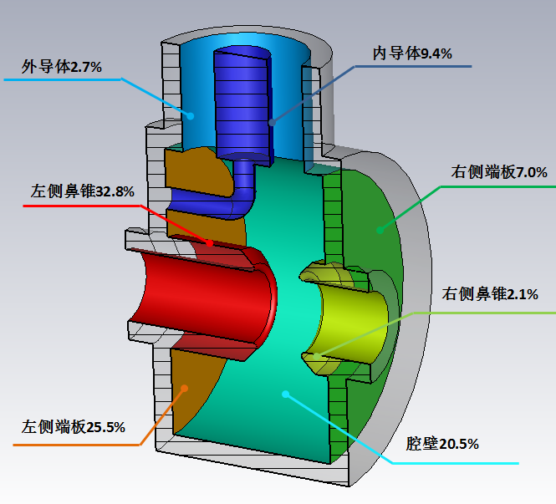
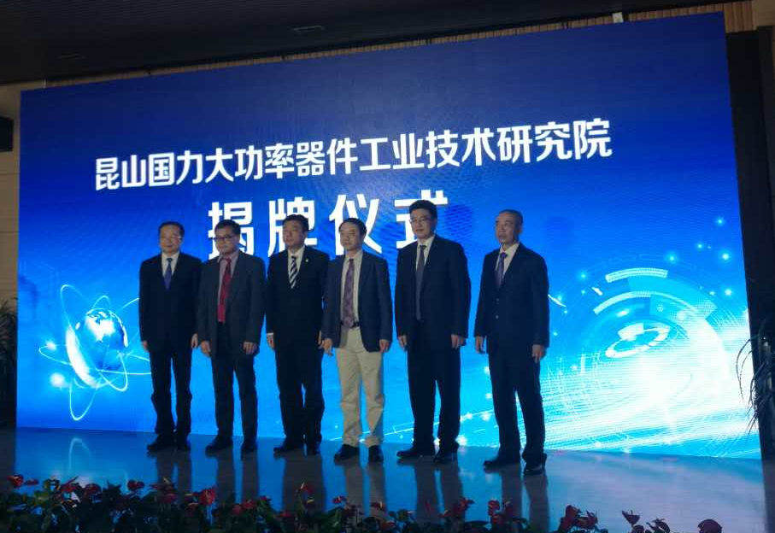
High Efficiency Klystrons
Z. Zhou
Goal: CW Power > 800 kW, Efficiency > 80%, Lifetime > 100 k hrs
A collaboration with the Institute of Electronics of CAS, and Kunshan Guoli
Design of the first klystron with an efficiency of 65% has completed. Manufacturing contract signed. Available this year.
Design of the second higher efficiency (70%) klystron will be finished soon. Production next year.
Based on the test results, the high efficiency klystron (80%) will be built in 2020-2021

Slide 29
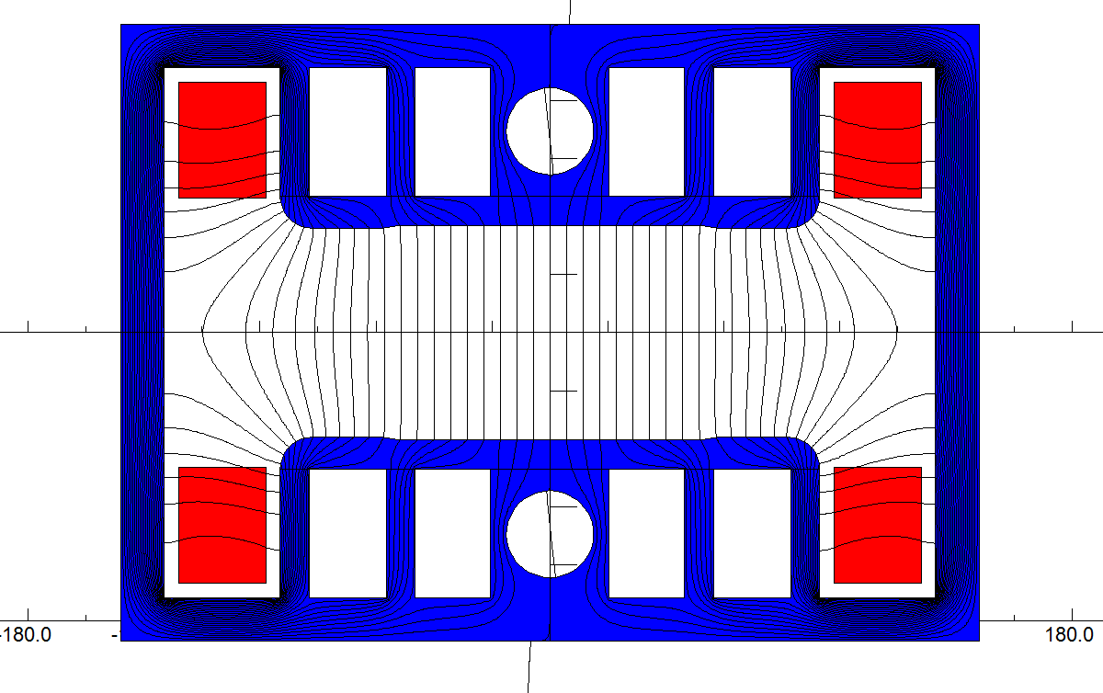
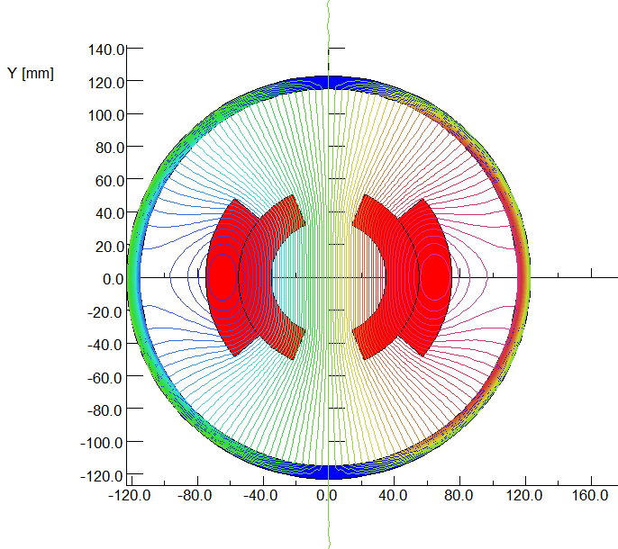




Other prototypes
High precision, low field dipole magnet
Electrostatic separator
6m long vacuum pipes(Al & Cu)

Slide 30

High Field Magnet based on HTS Material
Huge impact If advanced HTS materials (IBS)
can be used for 10-20T magnets
  Huge cost reduction of high field magnets
  Huge applications in other area and industry
Fe-based HTS material (IBS)
  Advantages: Metal, easy to process; Isotropic; Cheap in principle
  Good start at CAS
    World highest Tc Fe-based materials
    World first ~ 115 m Fe-based SC conductor: 12000 A/cm² @ 10 T
A collaboration on “advanced HTS materials ” established
  IOP, USTC, IEE, SC conductor companies
  Two approaches:
    IBS
    ReBCO & Bi-2212
Q. Xu
CAS has allocated 12Million RMB on HTS
In 2017, and >200Million RMB will be allocated from 2018 to 2023.

Slide 31




High Field Magnet R&D for SPPC
CCT magnet development for HL-LHC
R&D of the high field dipole magnets
NbTi+Nb₃Sn, 2*ф10 aperture
Nb₃Sn+HTS, 2*ф30 aperture
All HTS
10.2T @ 4.2K
First dipole magnet in China (NbTi+Nb₃Sn) test successful

Slide 32



CEPC Power for Higgs and Z
CEPC Cost Breakdwon
(no detector)
S. Jin
Wall plug efficiency = 23%
Wall plug efficiency = 22%

Slide 33
CEPC vs. ILC
 | CEPC-Higgs | ILC 250-Yokoya
Circumference or site length(km) | 100 | 20
Beam energy (GeV) | 120 | 125
Luminosity/IP (10³⁴cm⁻²s⁻¹) | 2.93 | 1.35
IP numbers | 2 | 1
Beam current (mA) | 17.4 | 5.8
Bunch intensity (10¹⁰) | 15.0 | 2.0
Bunch Number | 242 | 1312
β function at IP β_{x}*/β_{y}* (m) | 0.36/0.0015 | 0.013/0.00041
Emittance x/y (nm) | 1.21/0.0031 | 5000/35
Beam size x/y (nm) | 20900/68 | 515.5/7.66
Bunch length (mm) | 3.26 | 0.3
Photon number_ beamstruhlung | 0.1 | 1.62
Total AC power (MW) | 266 | 110
Advantages of circular machine: higher luminosity with lower background, pp option, larger IP beam size (easier BI/FB devices)
Disadvantage: higher power consumption

Slide 34






CEPC Civil Engineering
Y. Xiao

Slide 35



International Collaboration
Limited international participation for the CDR
  Not in any roadmap
  No funding support
Hopefully it will be included in the roadmap of Europe, Japan and the US
International advisory board worked very well
  A lot of suggestions
MOUs signed with many institutions
Welcome recommendation/suggestions
  Workshop on the Circuar Electron Positron Collider-EU edition
  May 24-26, 2018, Università degli Studi Roma Tre, Rome, Italy
1/3 international participation
35

Slide 36


CEPC Industrial Promotion Consortium (CIPC)
1) Superconduting materials (for cavity and for magnets)
2) Superconductiong cavities
3) Cryomodules
4) Cryogenics
5) Klystrons
6) Vacuum technologies
7) Electronics
8) SRF
9) Power sources
10) Civil engineering
11) Precise machinary.....
More than 40 companies joined in first phase of CIPC，
and more will join later....
Established in Nov. 7 , 2017

Slide 37

CEPC Schedule (ideal)
design issues
R&D items
preCDR
design, funding
R&D program
Intl. collabration
site study
seek approval, site decision
construction during 14th 5-
year plan
commissioning

Slide 38
Latest Politics
Science & Technology is strongly supported by this government ➔ also a “requirement” to local governments (difference seen at Beijing & Shanghai since 2016)
Not difficult to find local support for the site
State Council announced in March “Implementation method to support China-initiated large international science projects and plans”
  Science of Matter, Evolution of the Universe, life science, earth, energy, …
  Goal:
    up to 2020, 3-5 preparatory projects; 1-2 construction projects
    up to 2035, 6-10 preparatory projects; ? construction projects
  Possible competitors: ~ 50 ideas collected, Fusion reactor, space program, brain program, Investigation of the Qinghai Tibet Plateau, CEPC, …
We are working with the MOST to be included in the roadmap planning, project selection, etc.

Slide 39
Summary
ILC
  European XFEL is large-scale prototype
  Focus on cost reduction
  Scope reduction to 250 GeV centre-of-mass
  Political process ongoing
CEPC
  CEPC CDR is progressing and will be completed soon
  Design + R&D needs are largely met with various sources of funding and support; people are hard working on DRD
  Effort to a stronger CEPC team w. intl. collab. & participation
  Push CEPC for construction from 2022 after TDR
ILC and CEPC are complementary: joint measurement precision, different energy region scenarios

Slide 40
Thanks for your attention!

