Slide 1
Precise measurement of hadron cross section with ISR method at e⁺e⁻ machines
Learn how to do precise measurements

Slide 2
Physics in and beyond the Standard Model at colliders
Energy frontier: LHC, SPPC …
=> direct searches for physics in and beyond the SM
Luminosity frontier: B-factories(BaBar, Belle/Belle-II), super τ-charm factories, ILC, CEPC …
=> understand better the SM
=> precise measurement
=> search for hint beyond SM

Slide 3
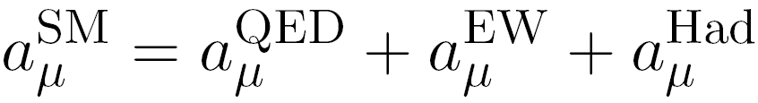
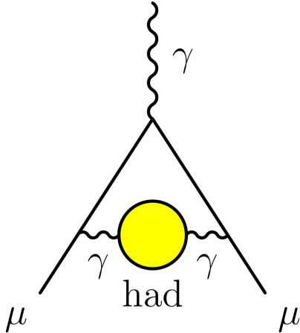
Low energy QCD and hadronic Vacuum Polarization
Low energy QCD: theoretical results model dependent
physics rich and interesting: e.g. hadron spectra, glue-ball, multi-quark states …
Hadronic Vacuum Polarization
Im[ ] ∝ | hadrons |²
Bouchiat-Michel 1961
LO hadronic

Slide 4
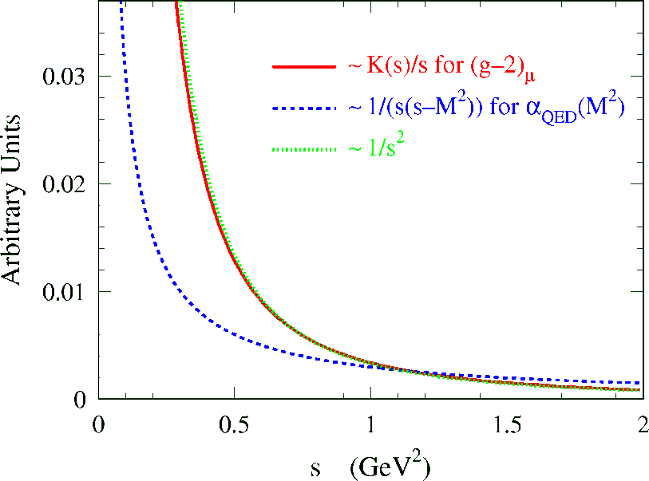
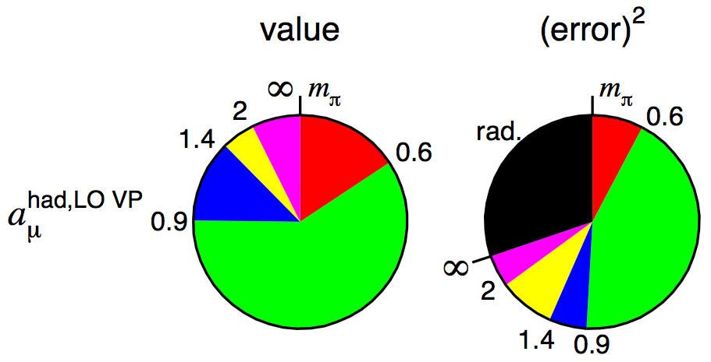
Lowest order hadronic contribution a_{μ}^{had,LO}
Dispersion relation
HLMNT 11
Energy region 0.6-0.9 GeV dominates
2π channel contributes more than 70%
ππ
ππ
2π

Slide 5
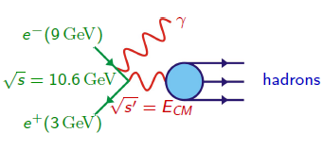
ISR method
Initial State radiation => ee annihilation at lower energy
High luminosity => enough statistics to measure cross section at lower energy with ISR events
For instance, ISR at BaBar:
  High energy (E*_{γ} >3 GeV) detected at large angle → defines √s’ = E_{CM} and provides strong background rejection
  Final state can be hadronic or leptonic (QED) → μ⁺μ⁻γ(γ) events used to get ISR luminosity
  Kinematic fit including ISR photons
  removes background; improves mass resolution (a few MeV)
  continuous measurement from threshold to 3-5 GeV

Slide 6
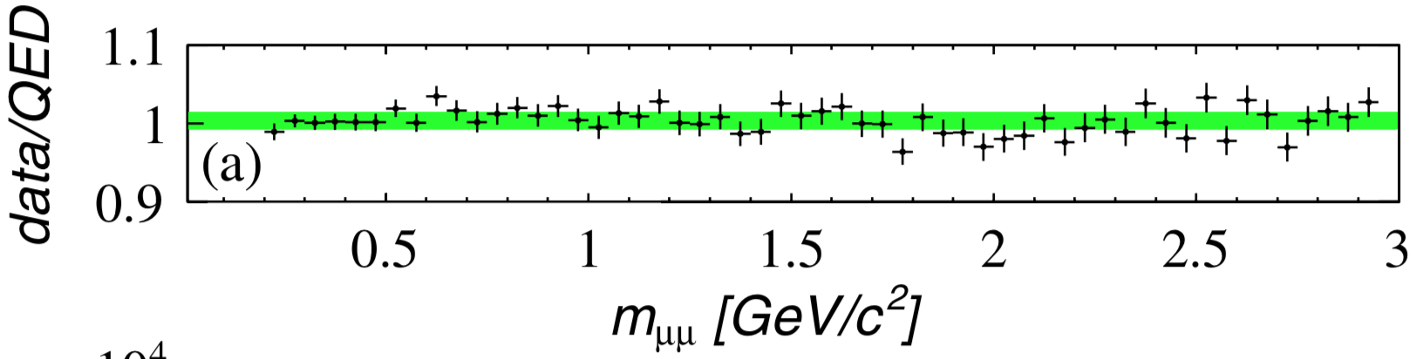

Precise measurement of ee→ππγ(γ) with ISR at BaBar
Michel Davier, Anne-Marie Lutz,
Bogdan Malaescu, Liangliang Wang, Wenfeng Wang
L=232fb⁻¹, E_{cm}=10.6 GeV
Full reconstruction of μμγ(γ) and ππγ(γ) (as well as ΚΚγ(γ))
kinematic fits with additional ISR/FSR photon
Extensive and delicate studies of efficiency corrections (% level in magnitude and 0.1% level or better in precision)
including trigger, tracking, particle identification, additional radiation and so on
At least six BaBar internal documents (~500 pages) produced
QED test within 1.1% after all correction applied for μμγ(γ) (limited by the total lumi error)

Slide 7
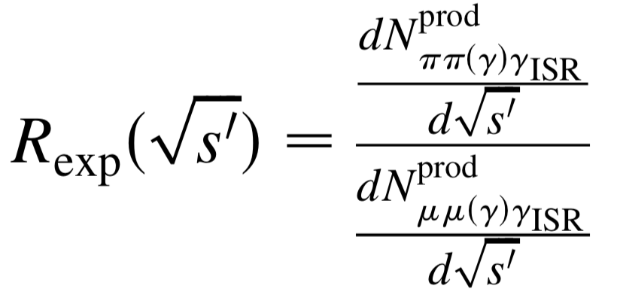
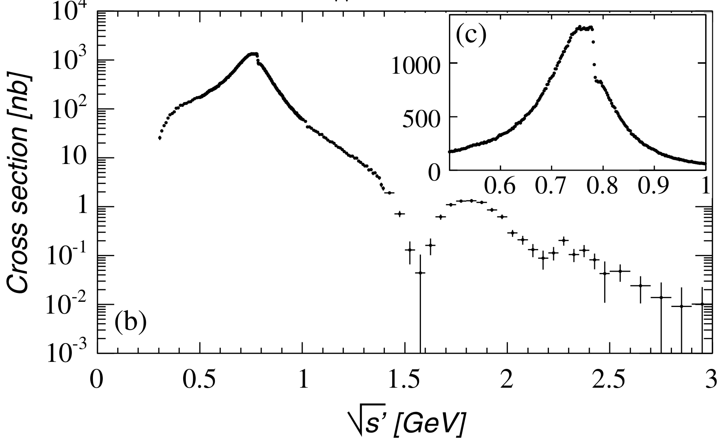
Measured cross section of e⁺e⁻ → π⁺ π⁻(γ)
Independent of the total luminosity
ISR luminosity from data independent of QED calculation
ISR photon efficiency cancels out
Vacuum polarization cancels out
systematic uncertainties do not exceed statistical errors in (0.3~1.2 GeV/c²)

Slide 8
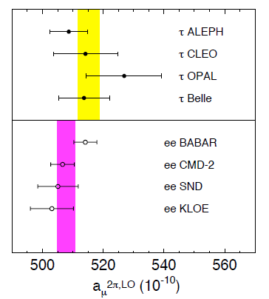
Impact of BaBar π⁺π⁻ data for g-2
Integral from threshold to 1.8 GeV: BABAR most precise (with CMD-2)
Reduces tension between e⁺e⁻ and τ
Weights of different experiments in combining their results (DHMZ 2010)
BABAR dominates everywhere, except between 0.8 and 0.93 GeV where KLOE is the most precise

Slide 9
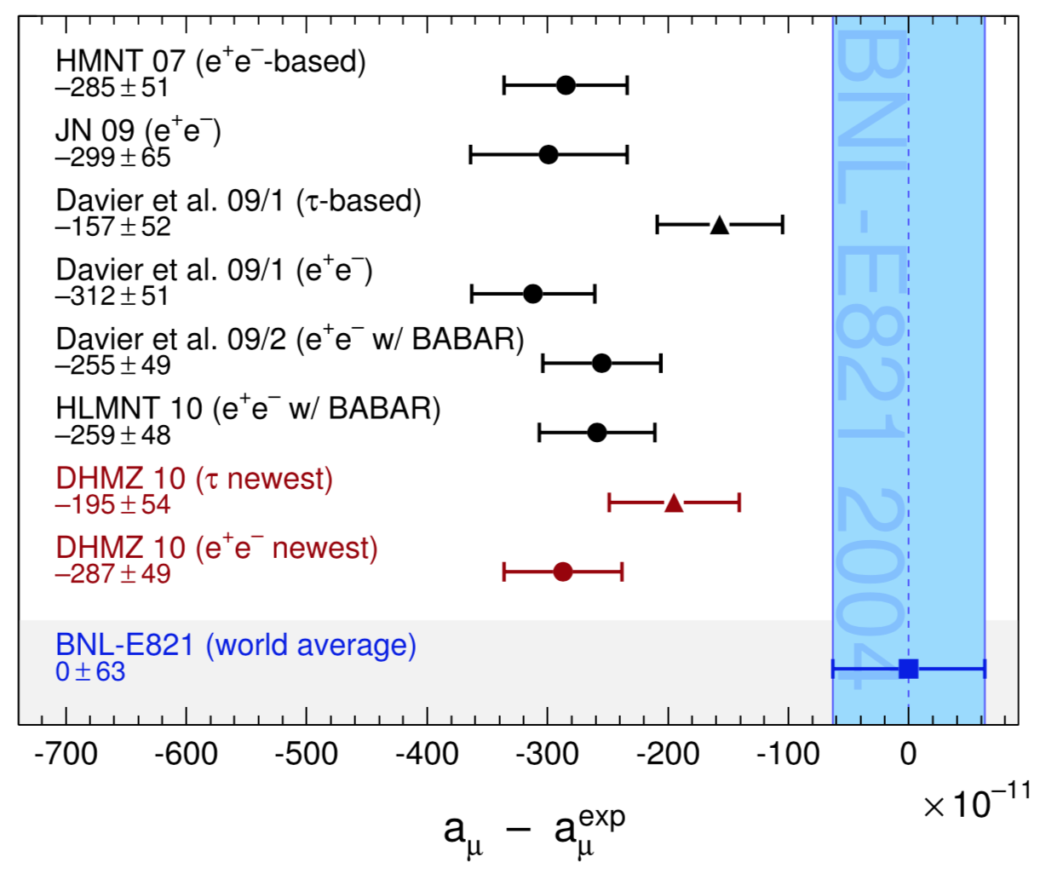
Impact of BaBar π⁺π⁻ data for g-2

Slide 10
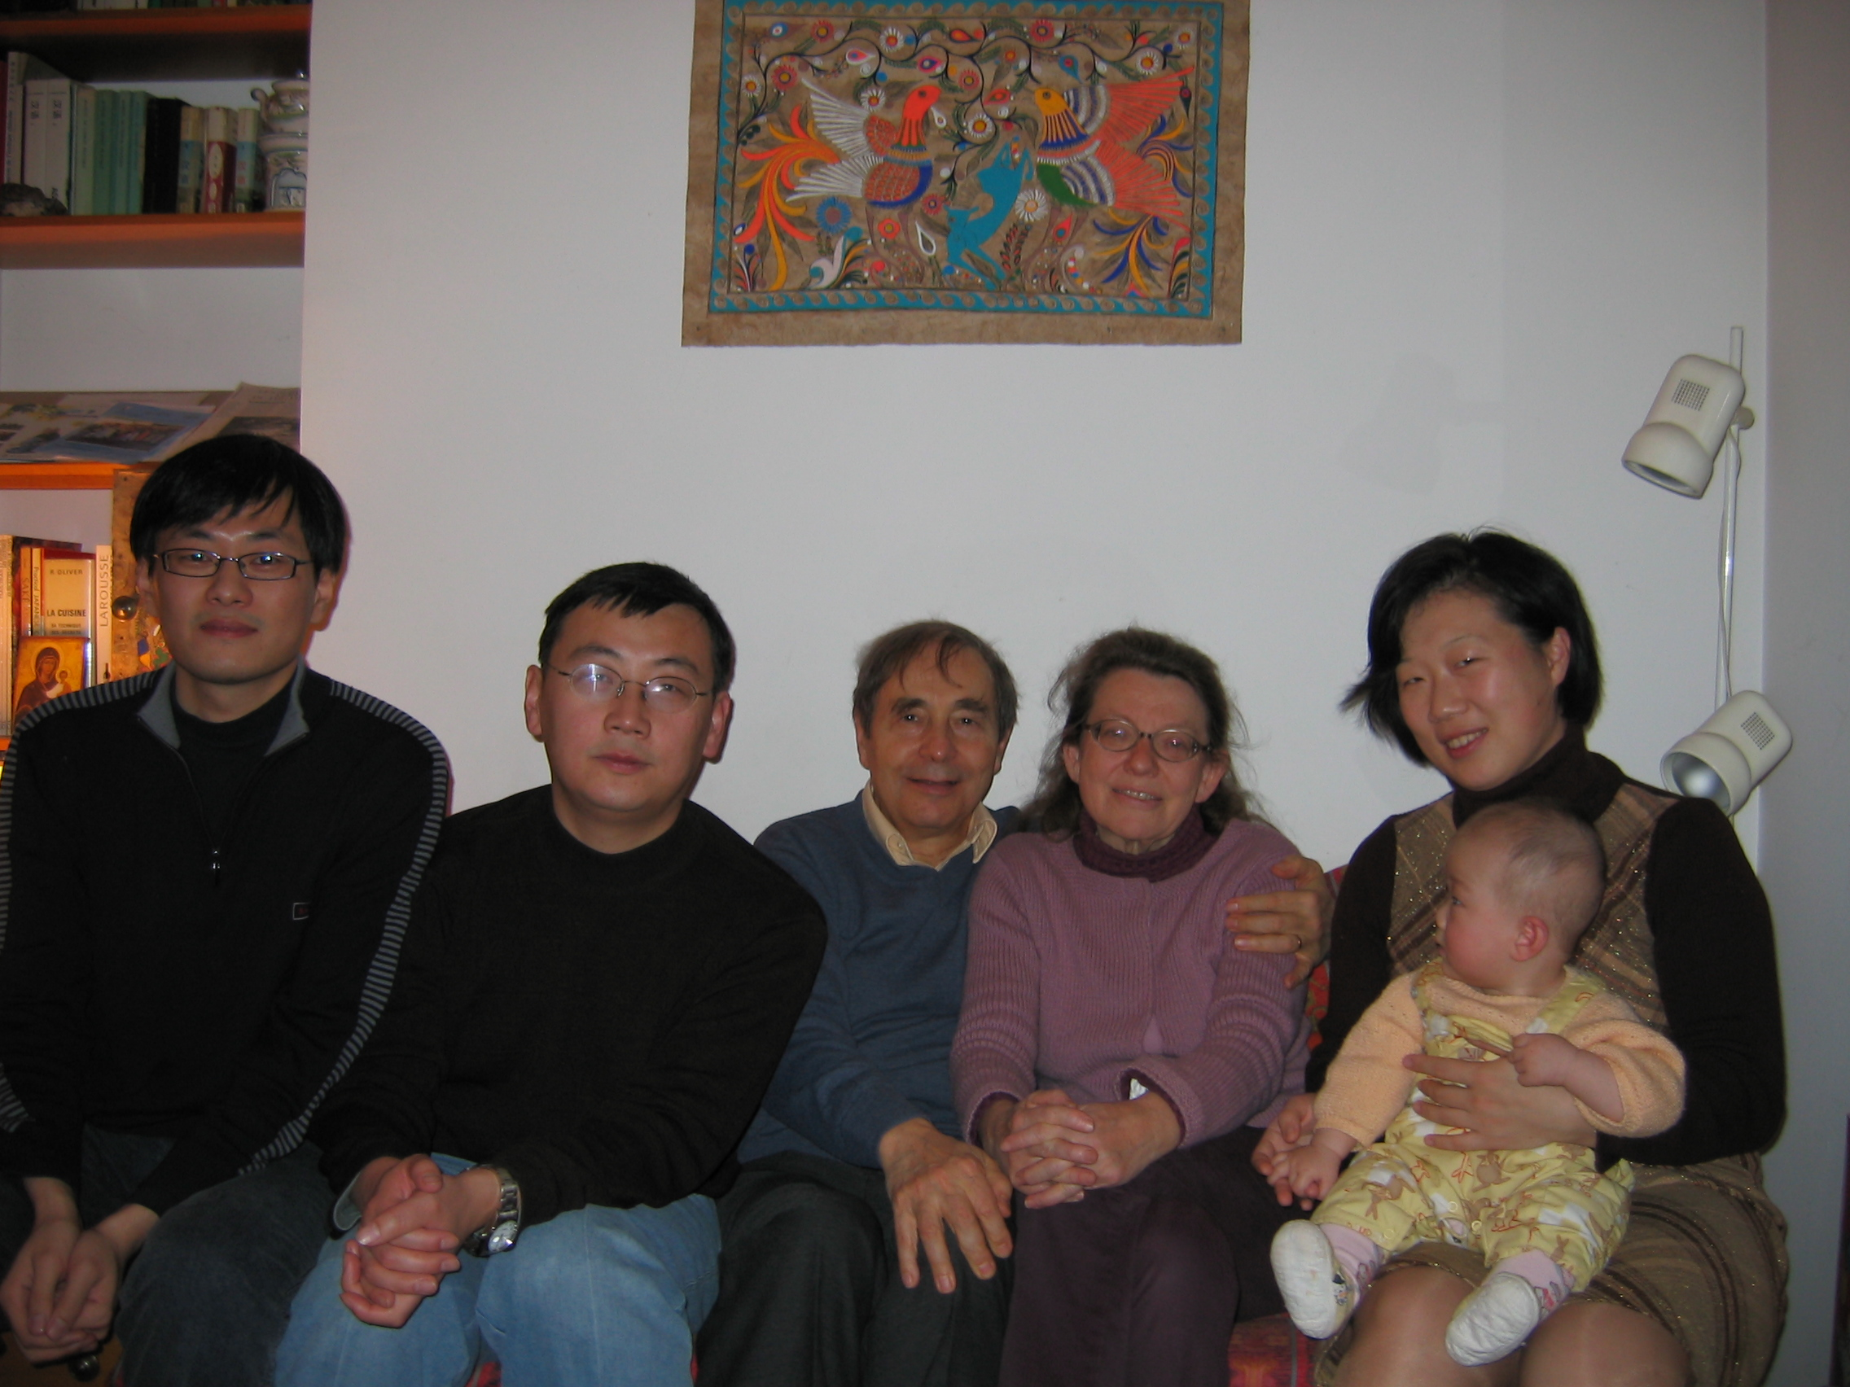
Wenfeng Wang
Wenfeng had a lot of contribution on tracking/trigger, μ/π/K identifications
Very complicated, extensive and delicate studies
(Global) consistence tests
I got much help from Wenfeng
Now Wenfeng is working in other field (about big data analysis / machine learning)

Slide 11
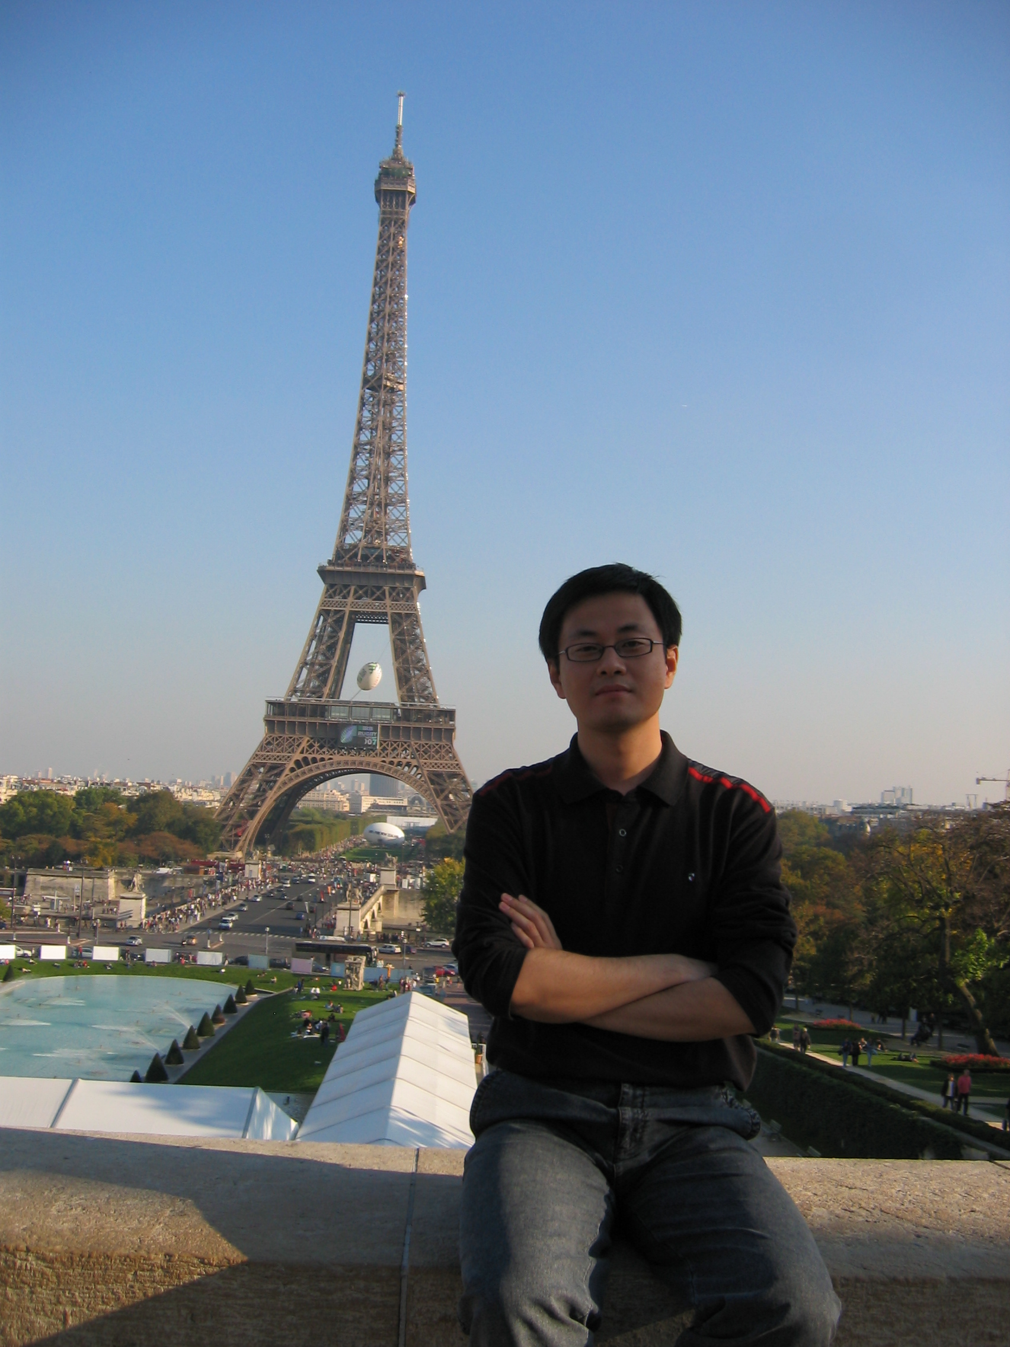
Impact of this work for me
Main topic of my Ph.D thesis
Start working with English
C/C++/ROOT + Fortran/PAW
Learn how to manage/organize a complicated work
Publish the first Physics paper (in English)
Learn how to do precise measurements
Impressive passion/motivation
……
First time to go abroad
French keyboard => I have to master touch-typing (盲打)
LAL, Orsay not far from Paris …

Slide 12
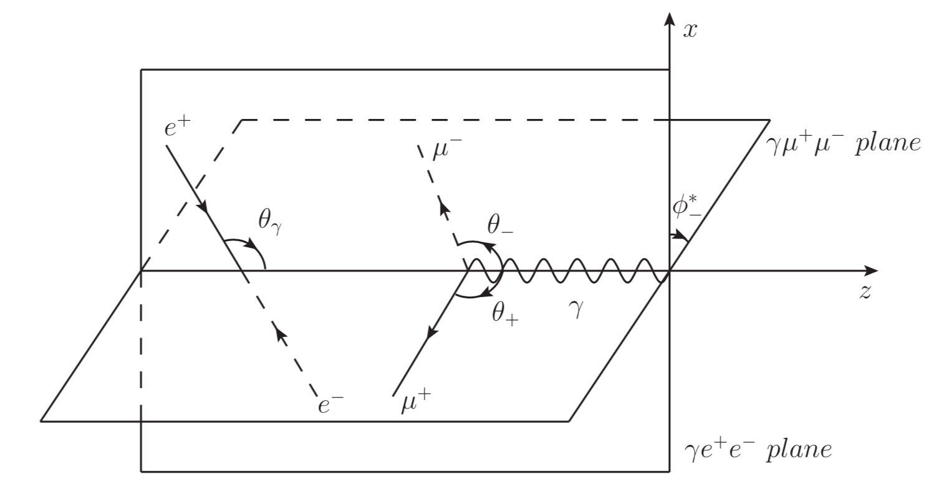
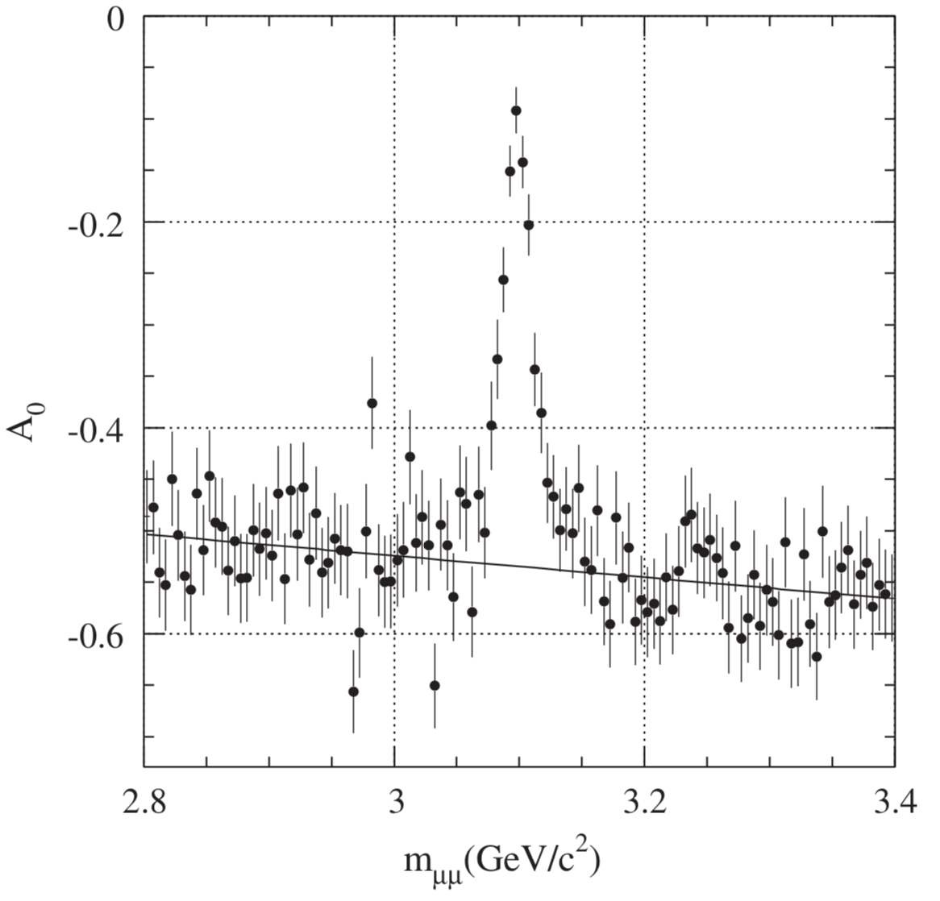
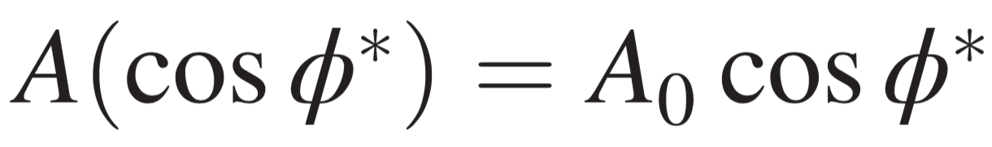
ISR-FSR interference in ee→μμγ and ππγ
Interference => charge asymmetry
A₀ => relative ratio ISR/FSR
Need precise efficiency correction

Slide 13
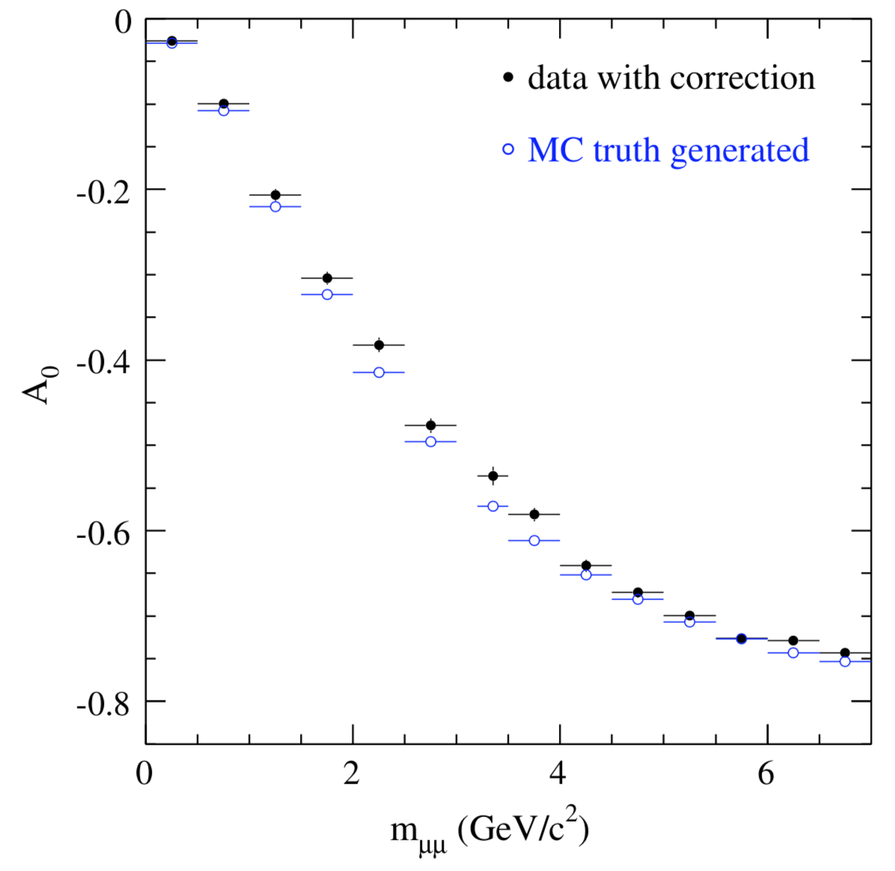
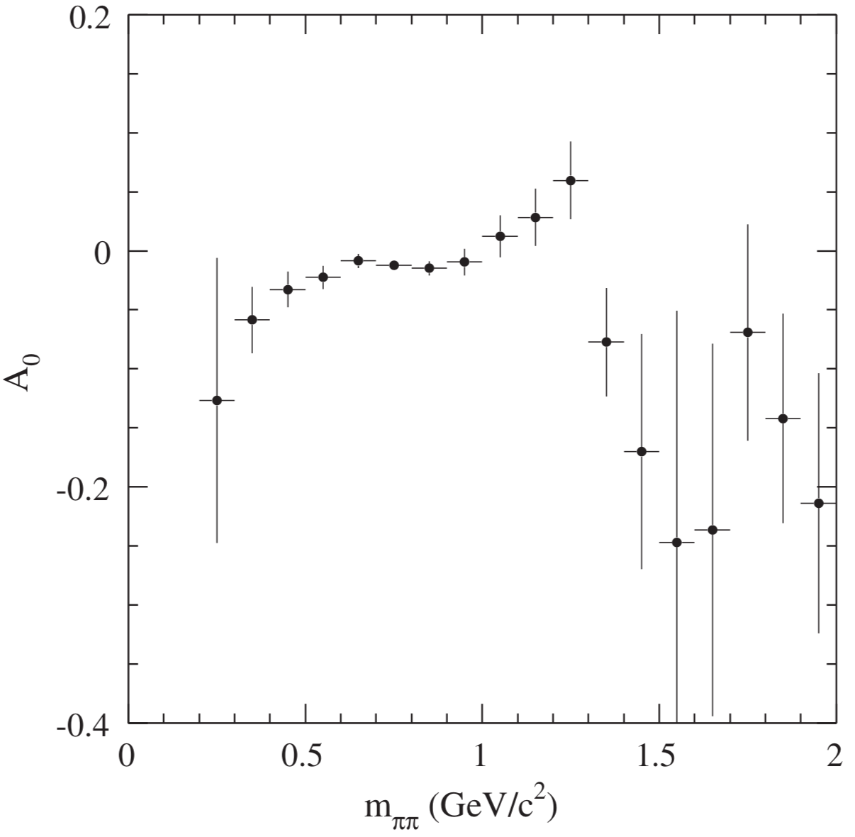
Charge asymmetry for ee→μμγ and ππγ
ISR + FSR f₂(1270)
ISR ρ + FSR S-wave
First measurements

Slide 14
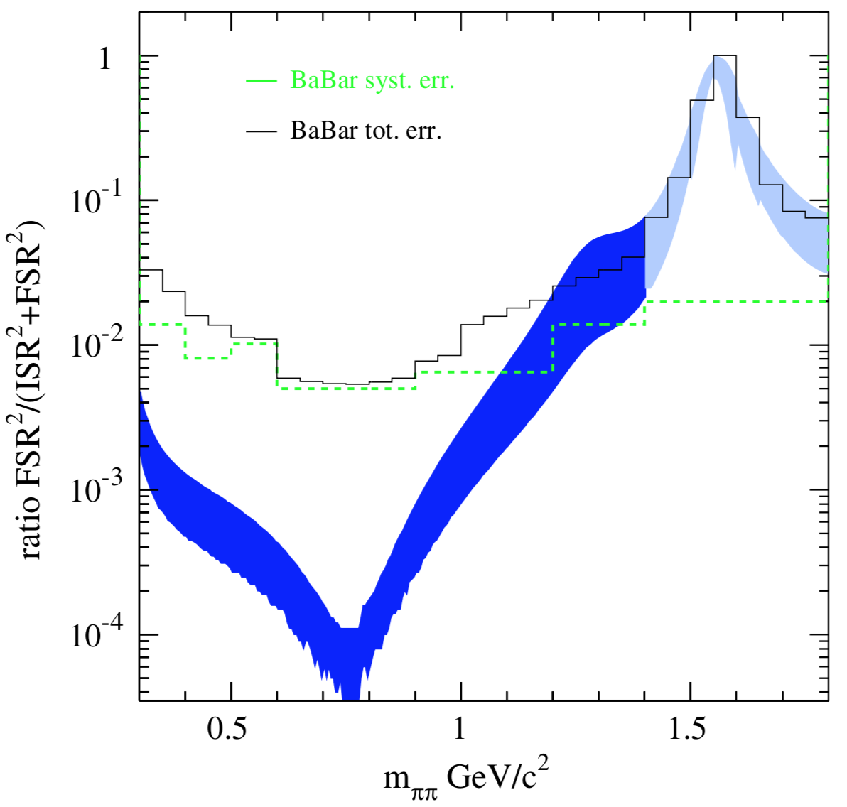
FSR fraction in ee→ππγ data
reduces the value of a_{μ}^{ππ} by (5.1+/-2.3)×10⁻⁴ relative to the BABAR determination
Uncertainty of a_{μ}^{ππ} is 7.4 × 10⁻³
This measurement justifies that FSR contribution is negligible

Slide 15
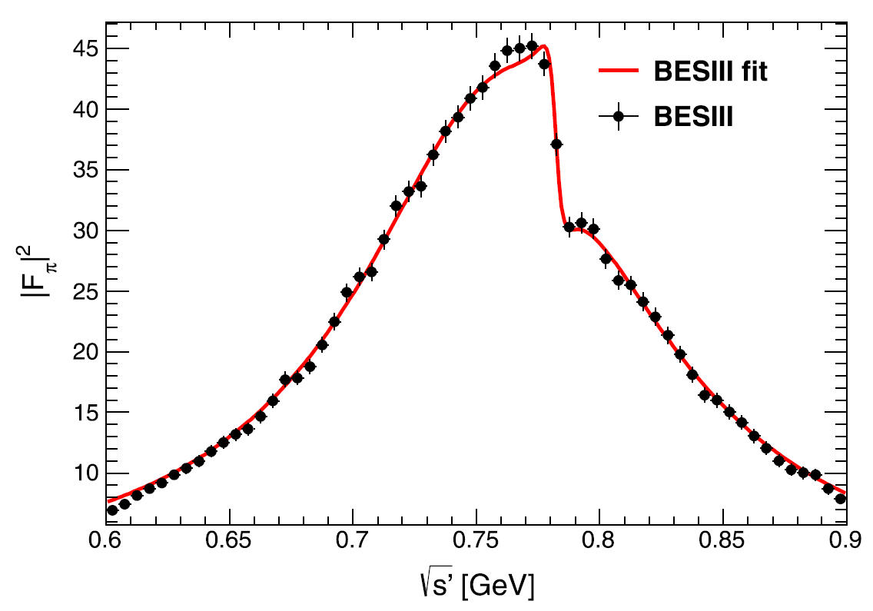
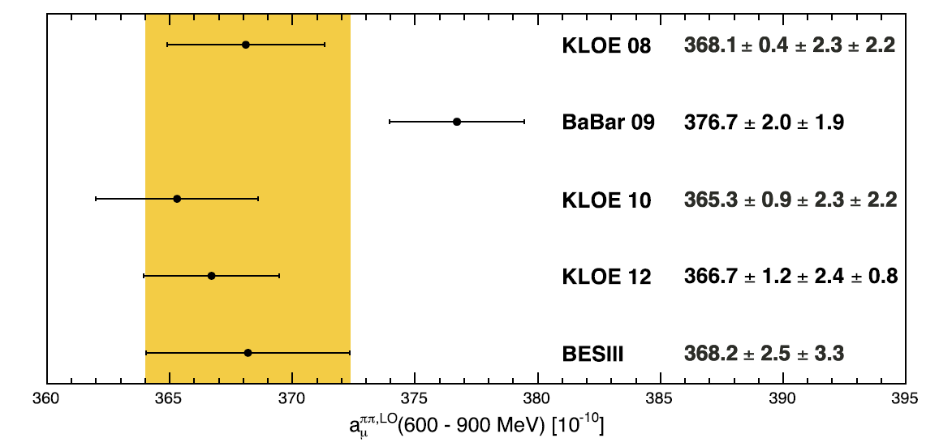

ISR ππ at BESIII
Using 2.93fb⁻¹ ee data at 3.773 GeV
Similar procedure
Pion form factor around the rho peak obtained
a_{μ}^{ππ,LO} is between KLOE and BaBar

Slide 16
The story continues
ISR Physics and muon g-2
New ππ ISR results at BaBar (full data set, new method)
=> new a_{μ} prediction within SM
New direct a_{μ} measurement
Discrepancy > 5 σ ? => new physics?
Experience and spirit in the work with Michel influence my subsequent work
First observation of ψ(3686)→γη_{c}(2S) (a new method to suppress fake photon)
Open charm cross section measurement (ISR/VP correction)
BESIII inner tracker upgrade (offline software system)
……

