Slide 1
Tau and more
Changzheng Yuan
IHEP, Beijing
June 16, 2018

Slide 2
Timeline of the story
June 1997 — postdoc at CCAST working with Prof. Minghan Ye
Shaomin’s message, Prof. Ye’s recommendation
Jan. 1999 — Aug. 2001: postdoc at LAL
Aug. 29, 2005: seminar at LAL on my way back from Hadron’05 (Rio de Janerio): Recent BESII results and BESIII status
Oct. 2 — Nov. 1, 2006: visit LAL as scientifique de haut niveau
Jul. 20 — Aug. 5, 2017: Higgs + more

Slide 3
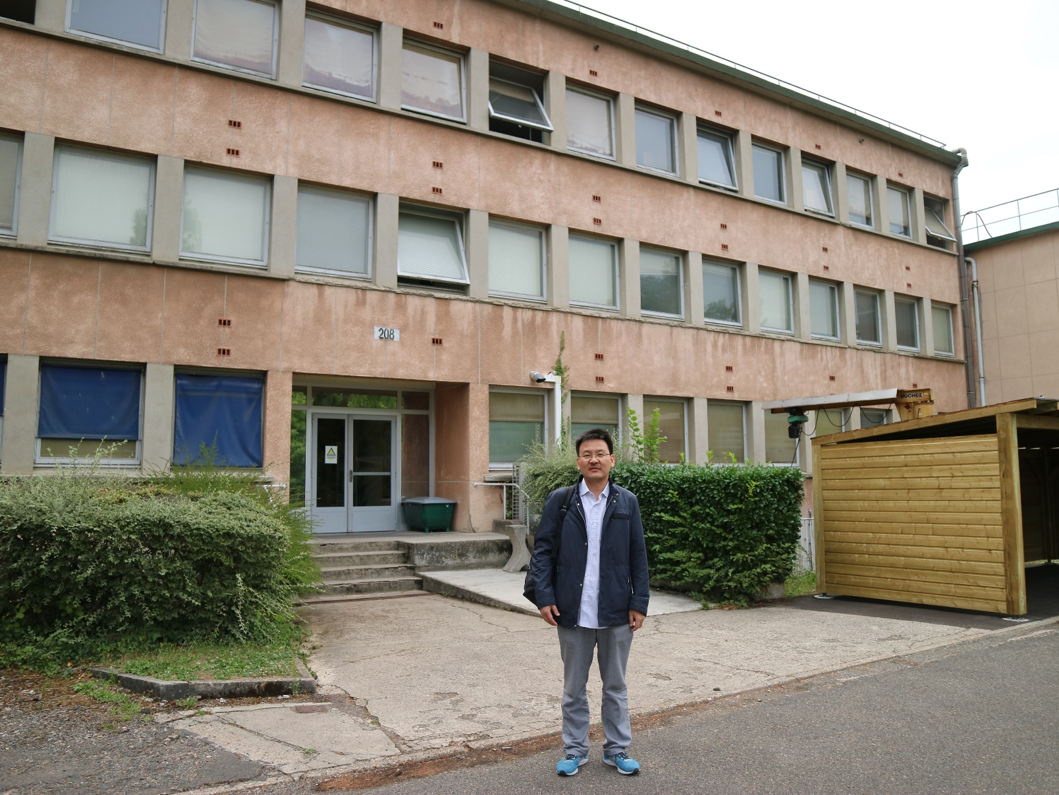
Where all these happened

Slide 4
The 1st class
My Notebook one

Slide 5
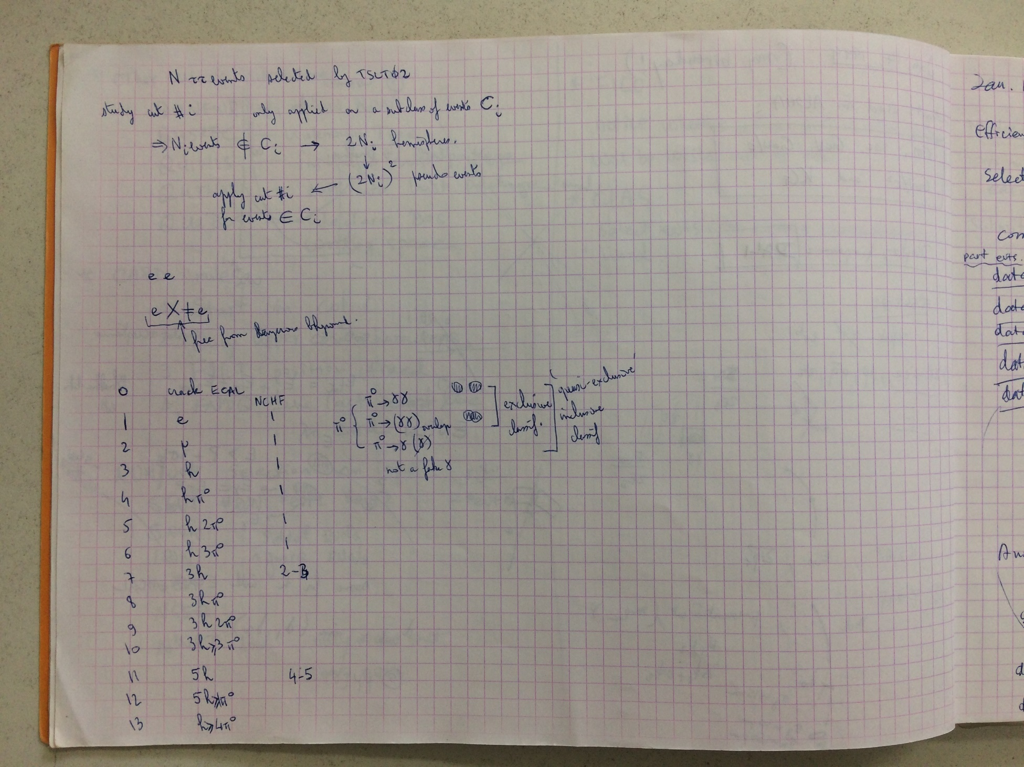
The 1st class

Slide 6
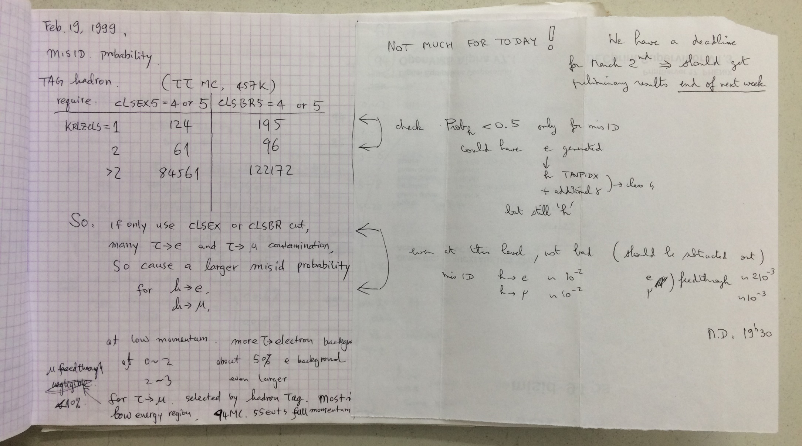
What happened? And what can we infer from this note?

Slide 7
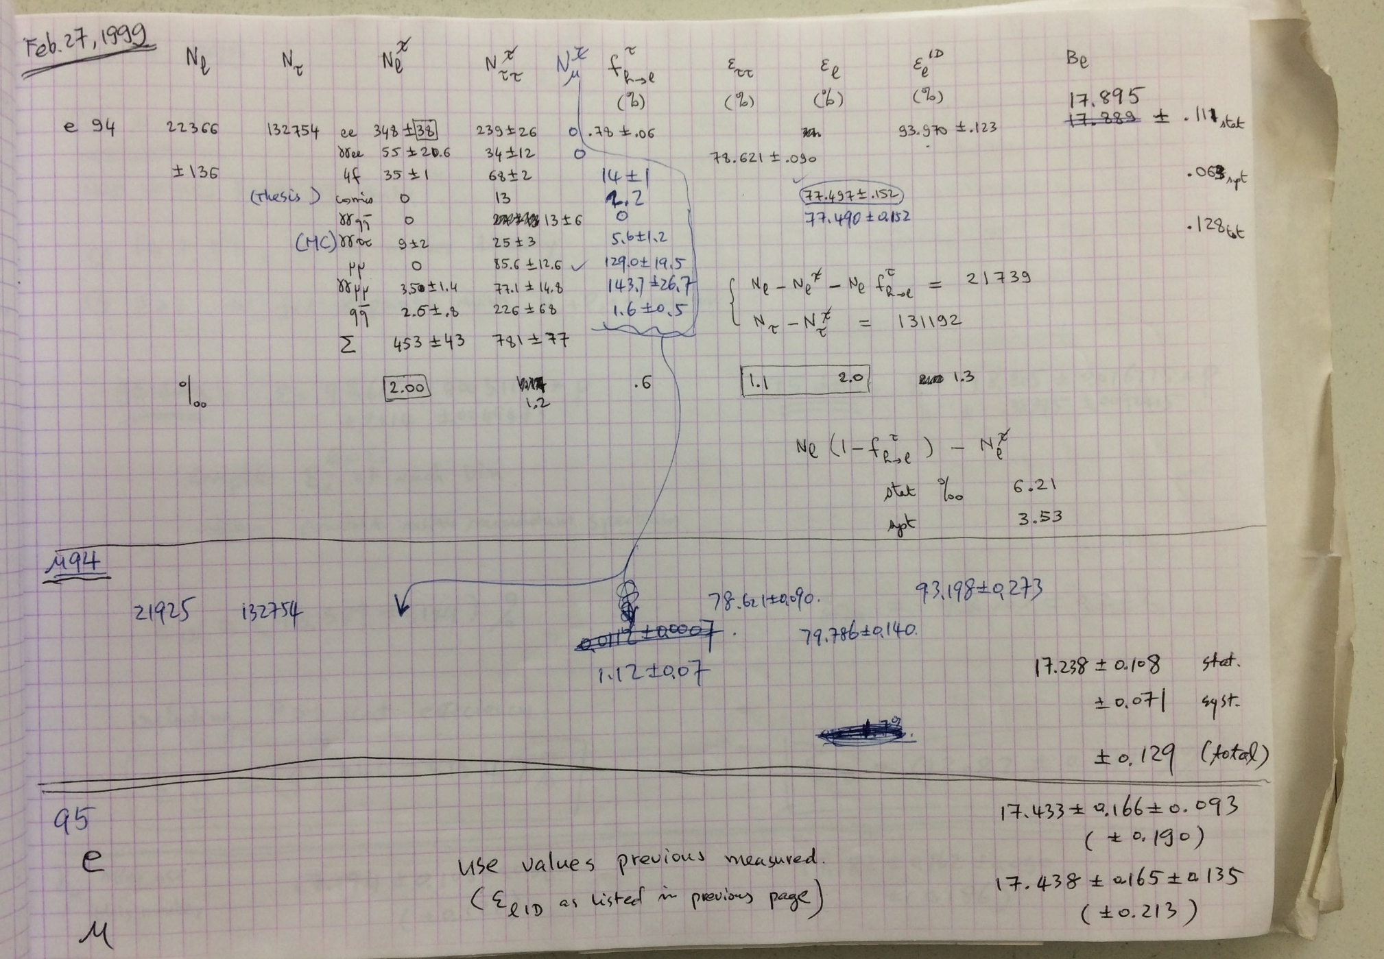
My 1st blind analysis

Slide 8
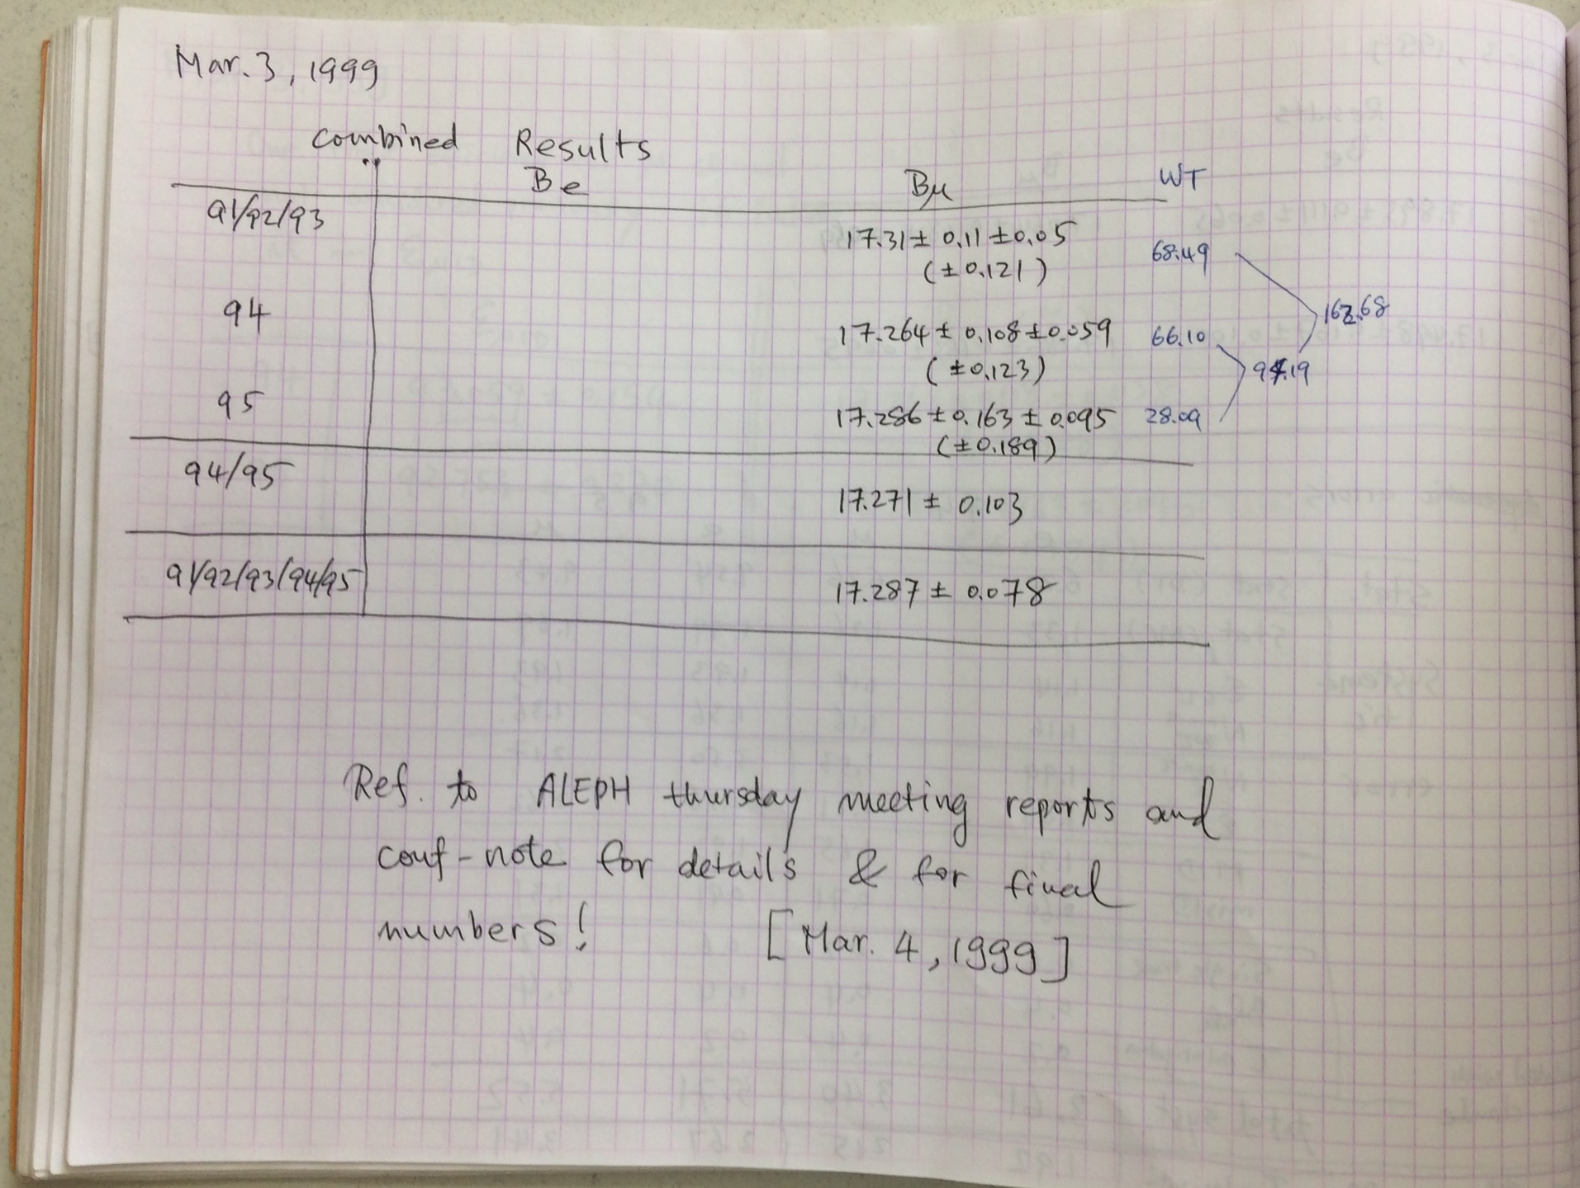
Yes, we did it in < 2 months!
Obviously I was proud of myself! And I had a sound sleep on the train back to Paris!

Slide 9
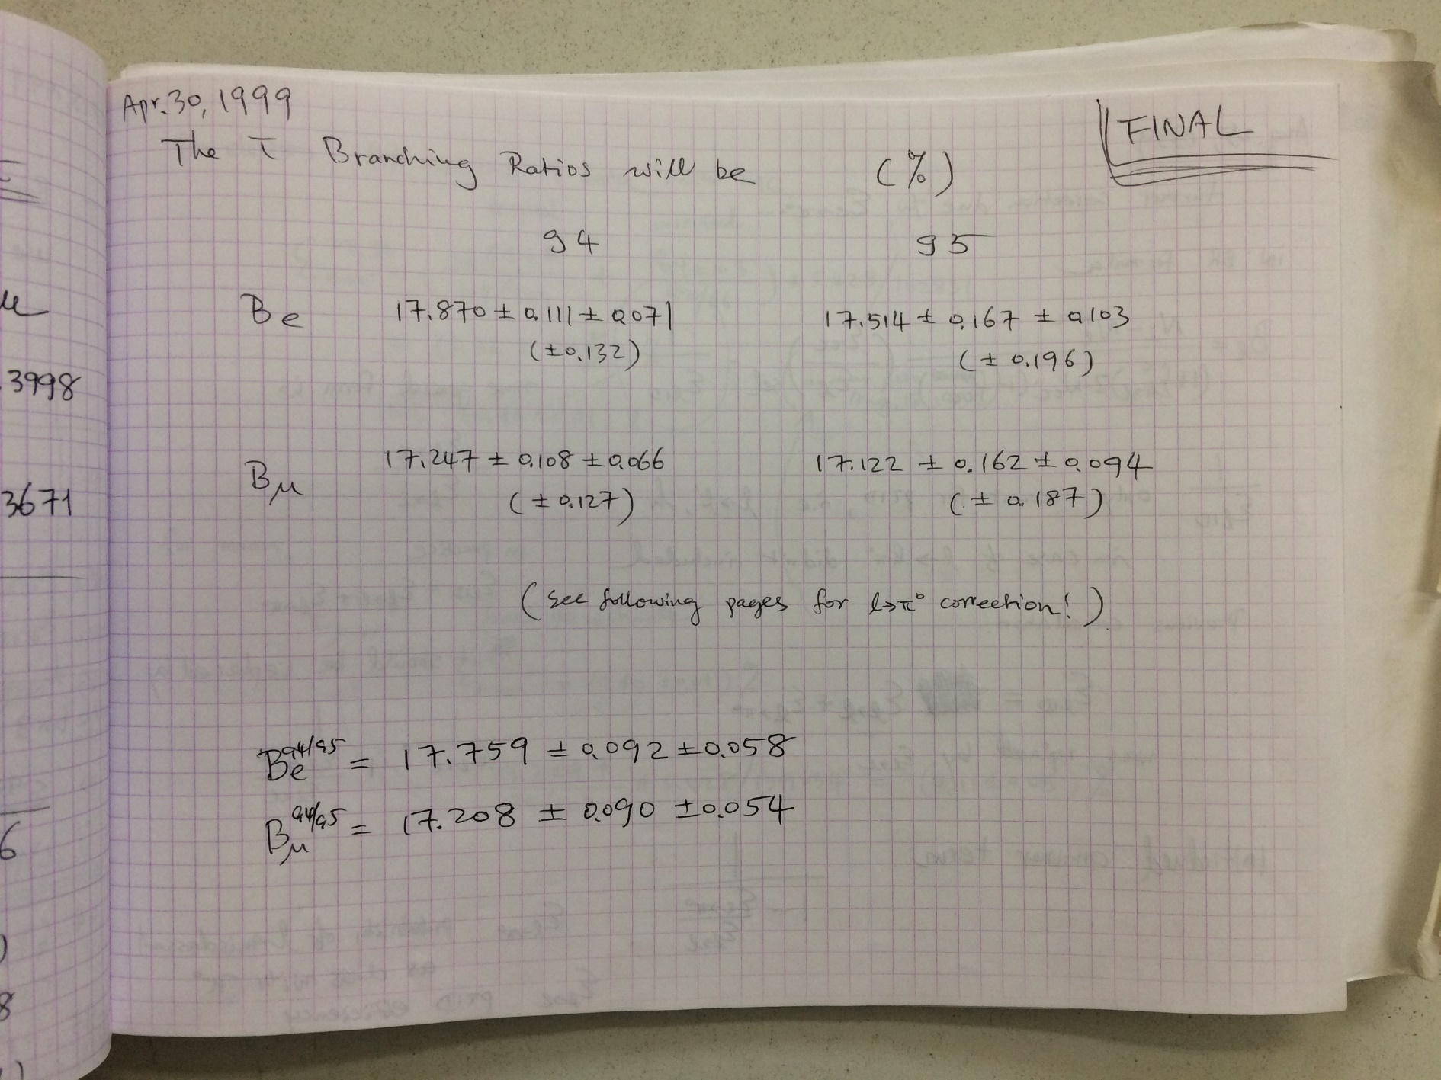
Final results?

Slide 10
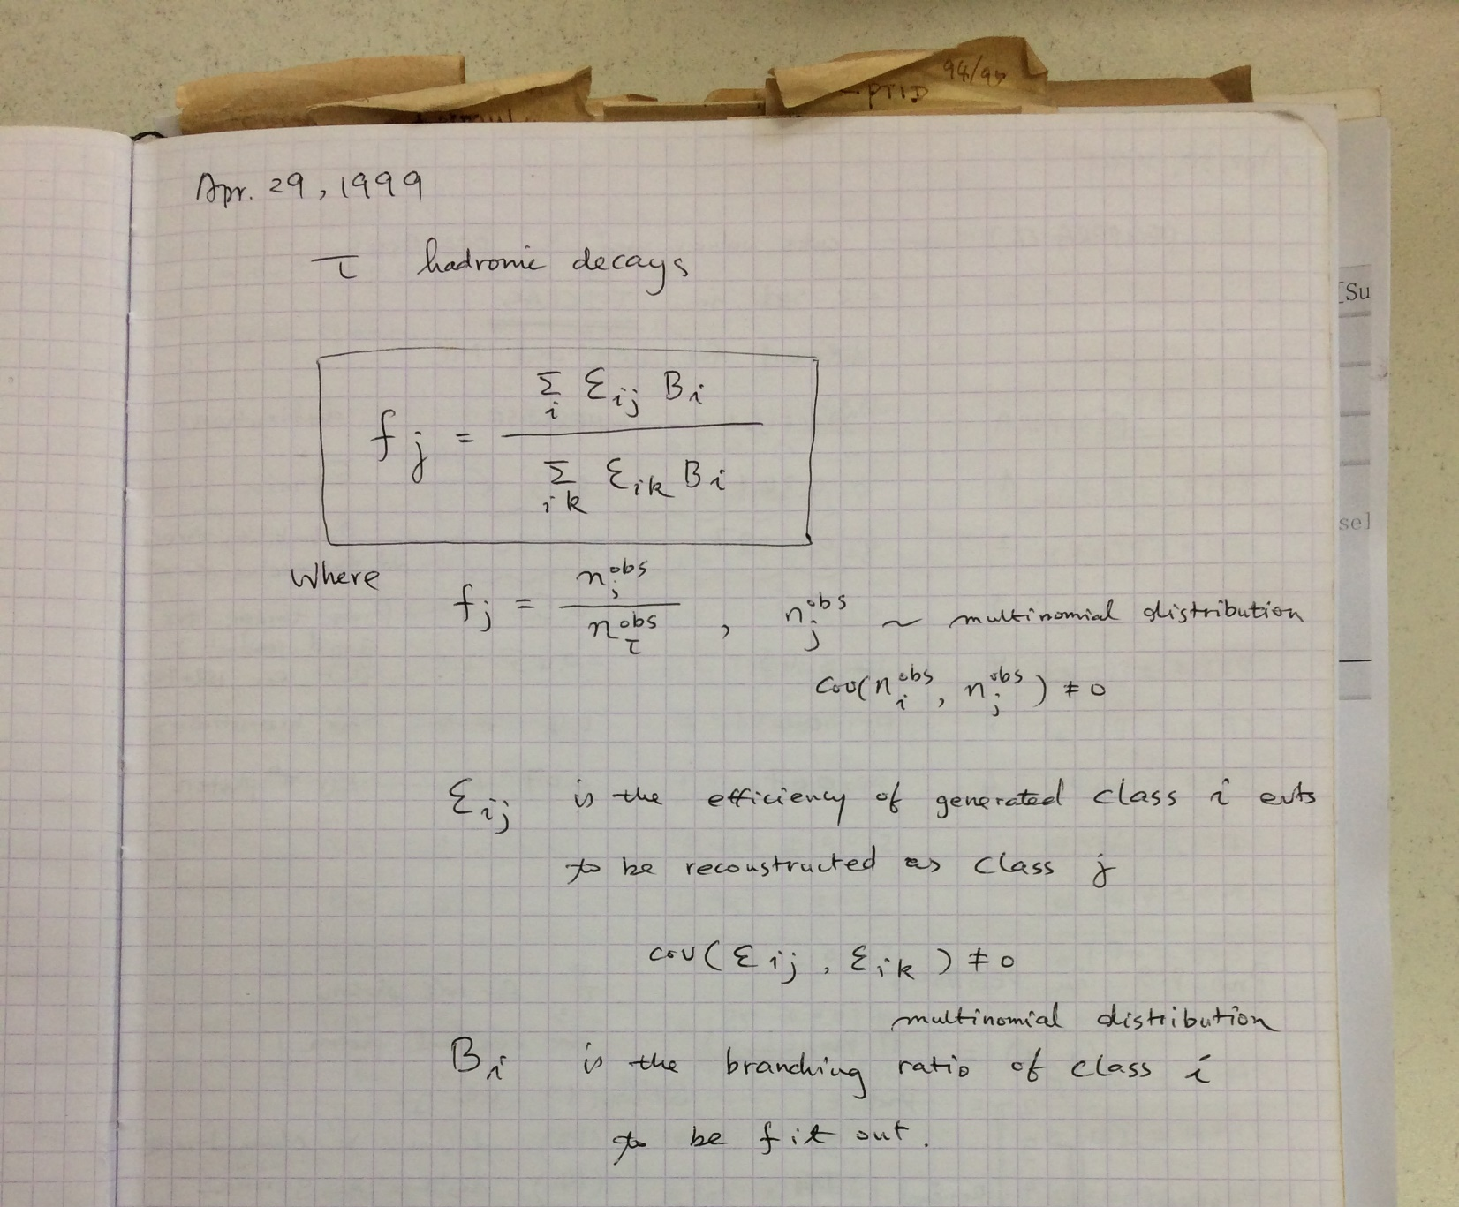
We had a bigger plan one day before!
My Notebook two

Slide 11
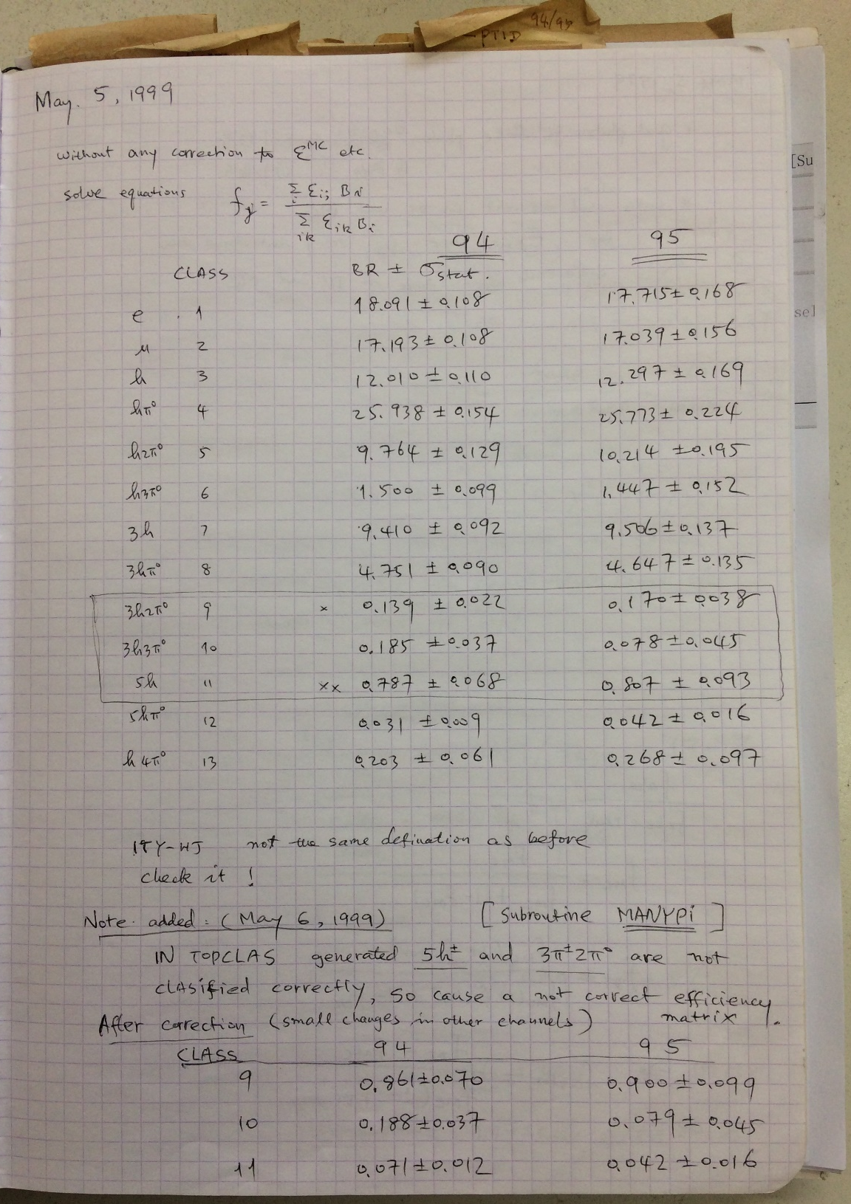
It was quite easy to get 1st round of results! Thanks for contributions from many persons in this room!

Slide 12
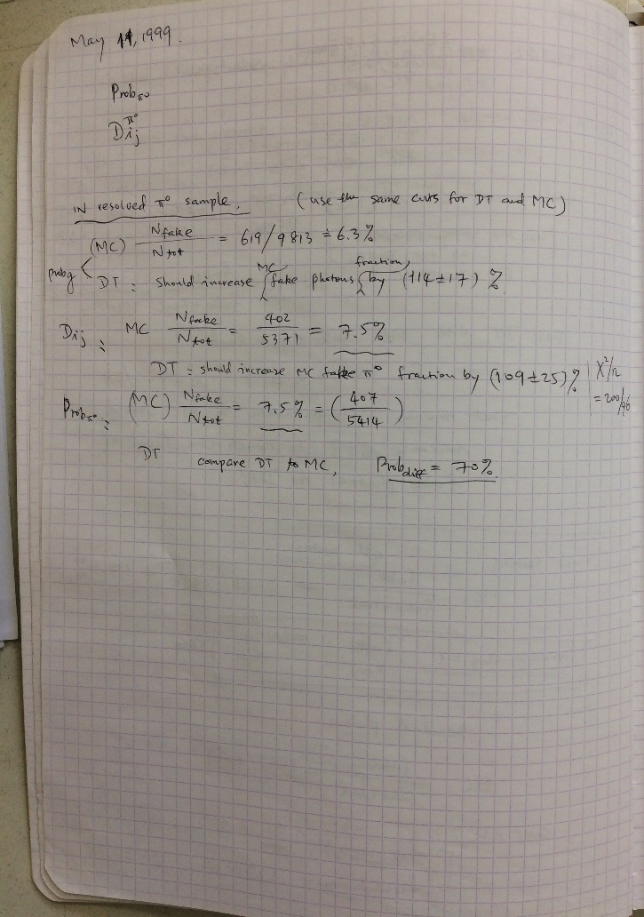
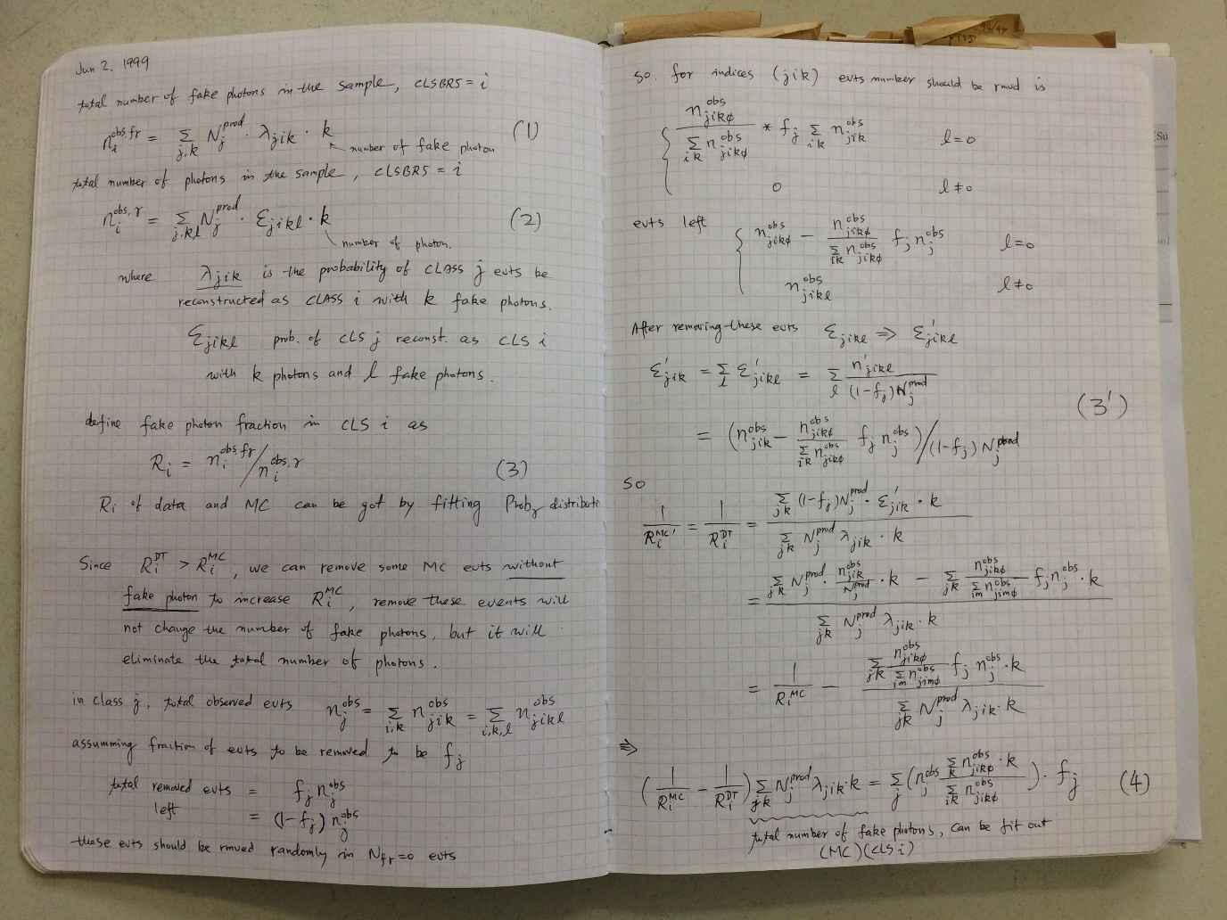
Struggling with the fake photons
From May to June to July to August to September ……

Slide 13
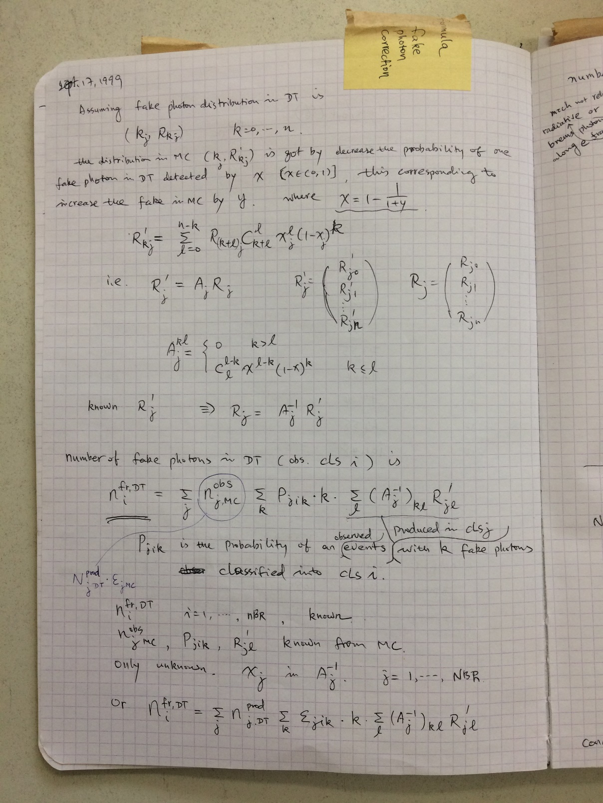
We found a rigorous method to the problem in September 1999!

Slide 14
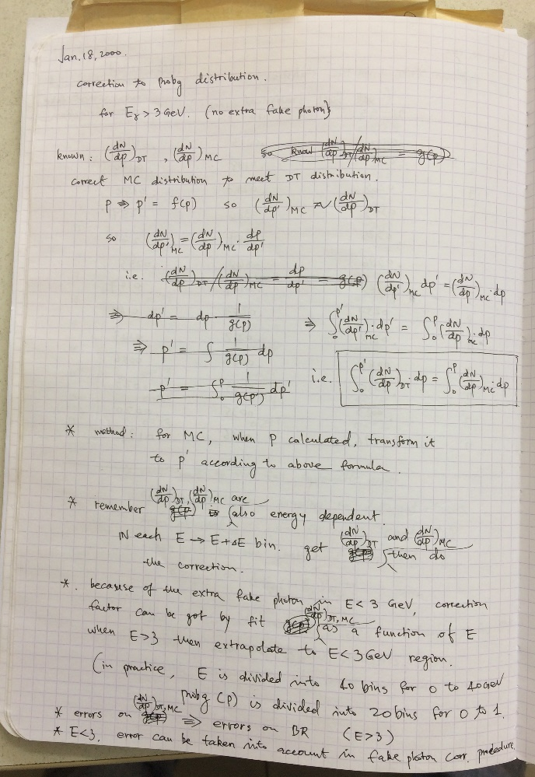
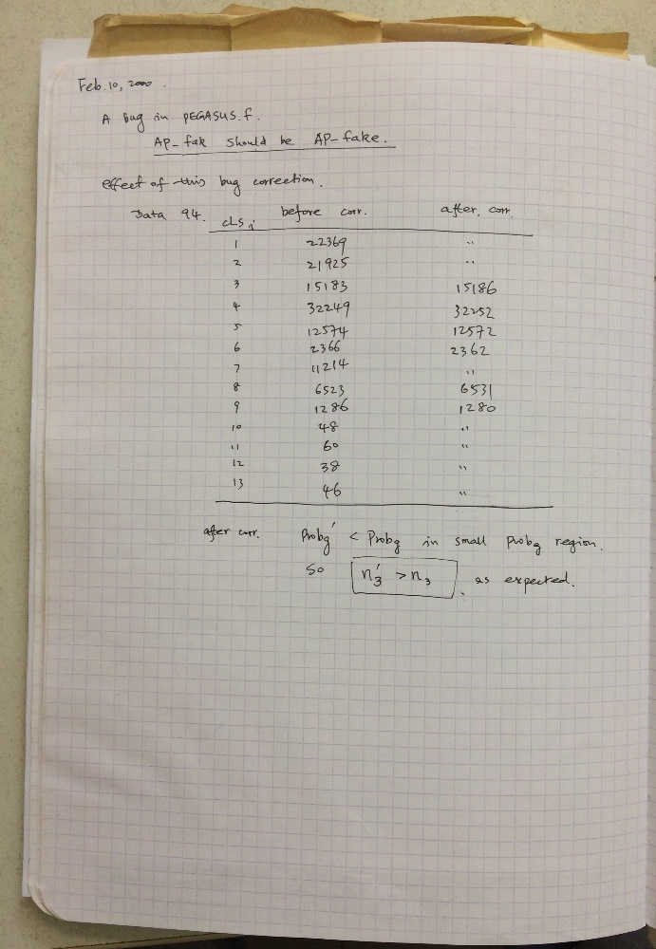
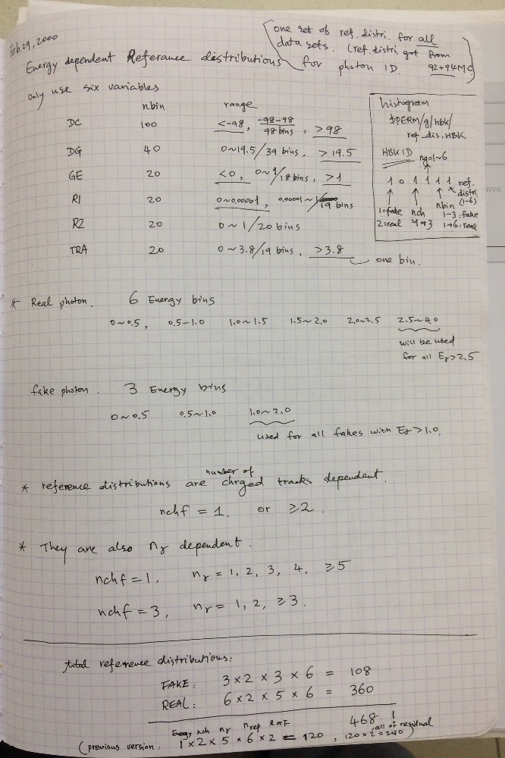
There were still more to handle
A solution to Photon ID?
Bug in code
Update Photon ID

Slide 15
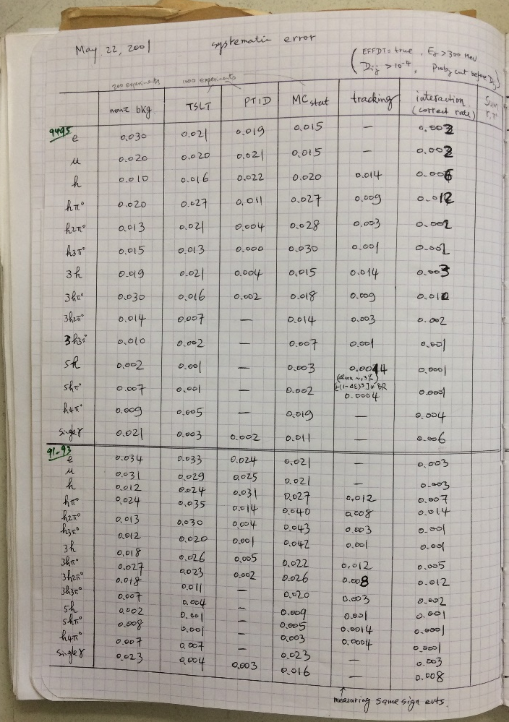
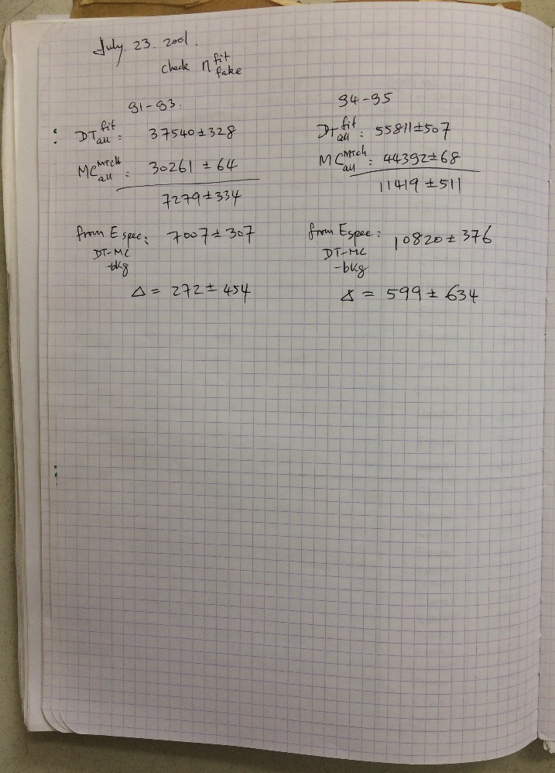
Final results? No, we had a bigger plan!
Systematic errors
Consistency checks
We would update all the QCD analyses in one paper!
OK, I produced all the ntuples and returned to IHEP ……

Slide 16
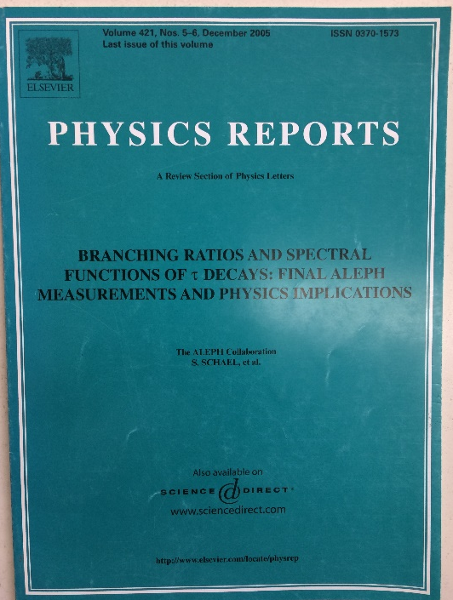
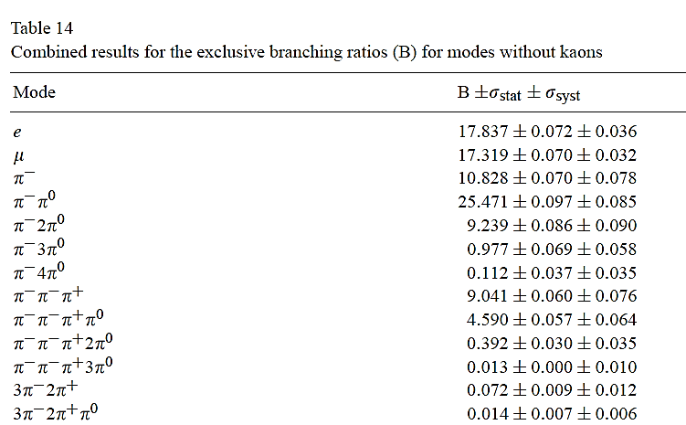
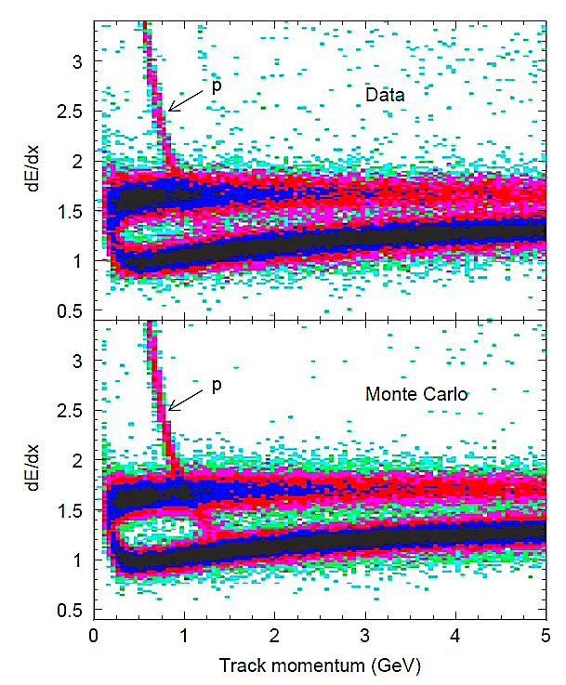
Yes! It was published in PR!
We wait for ILC or/and CEPC to improve the precisions of many measurements reported in this paper!

Slide 17
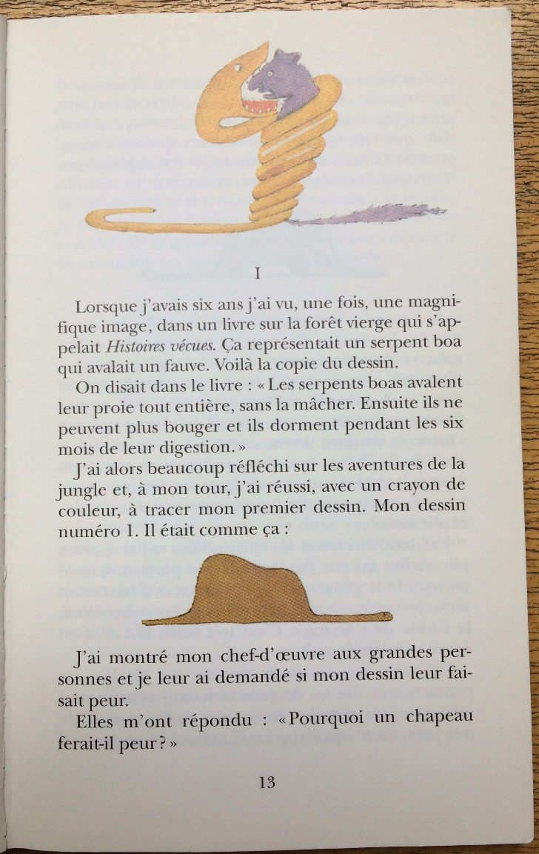
Beyond physics
This is a book not only for kids but also for ……

Slide 18
Beyond Saint-Exupery
I like magic and physics!
Vivid imagination is one of the key ingredients of research!

Slide 19
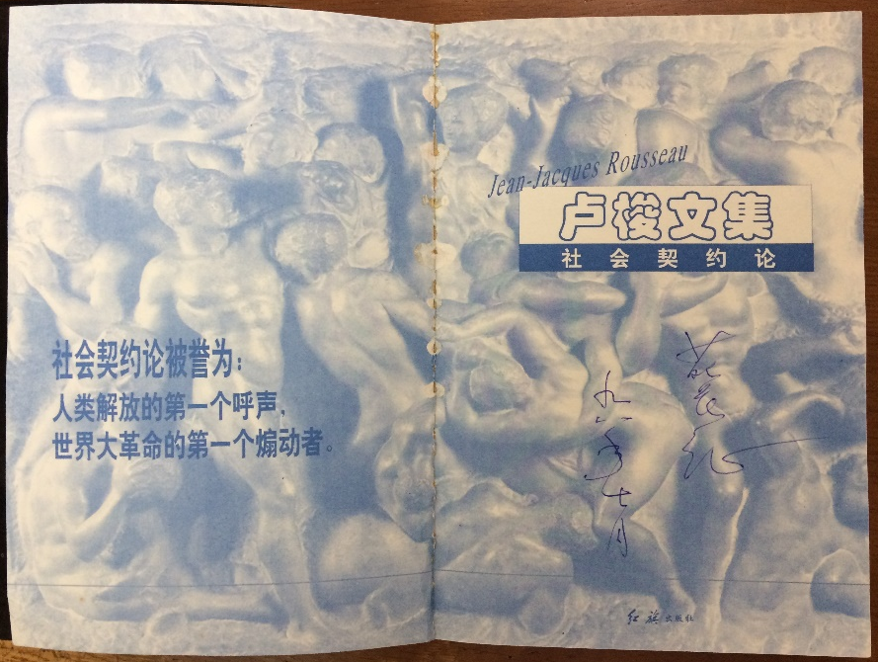
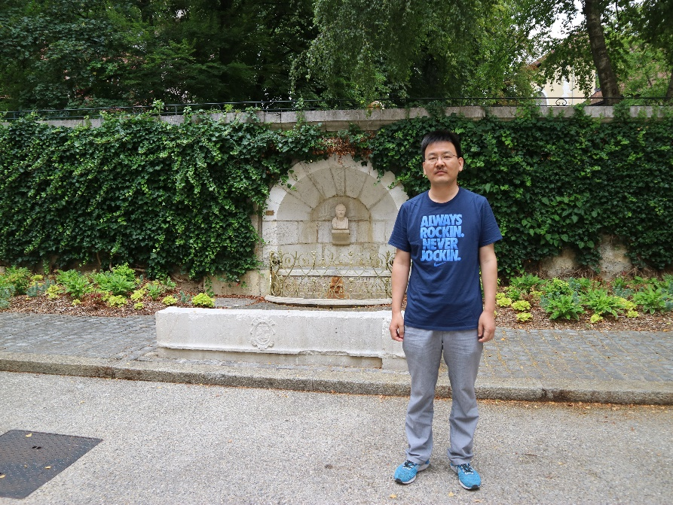
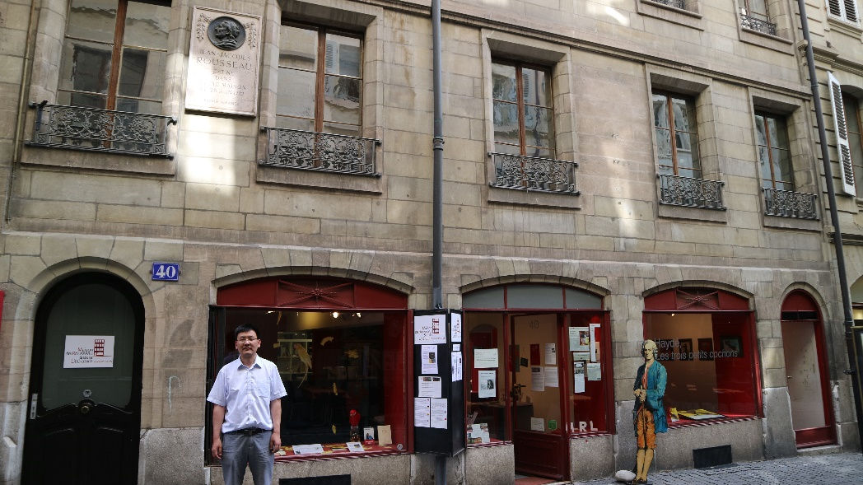
We also discuss other stuff
We discussed Jean-Jacques Rousseau on the way to CERN
Annecy: where Rousseau met Madame de Warrens
Siècle des Lumières
(The Enlightenment)
Geneva: Birth place

Slide 20
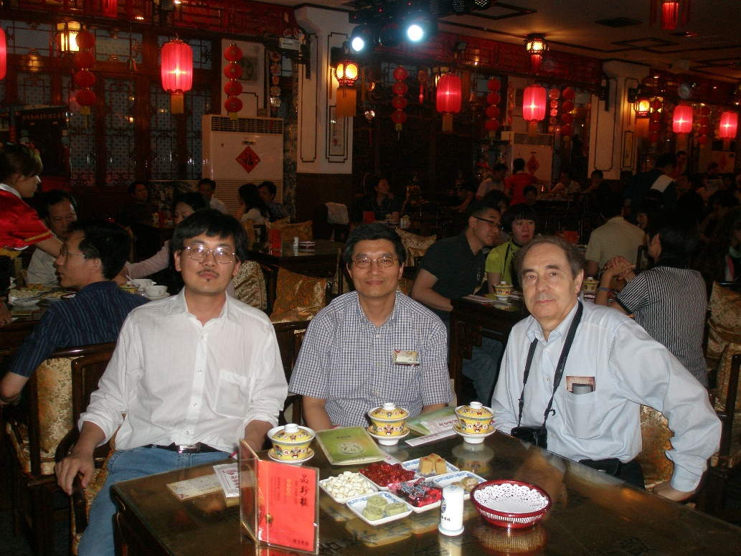
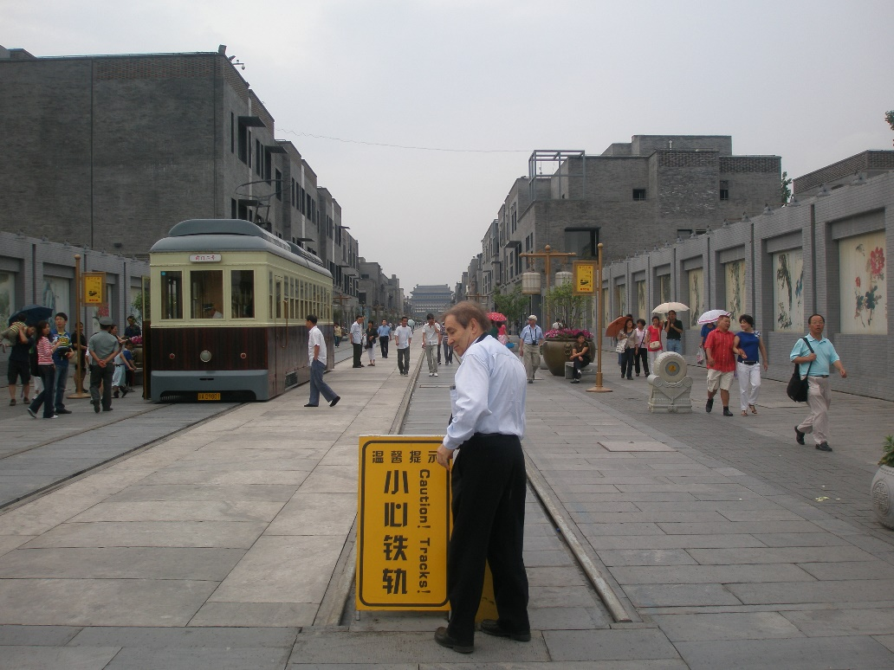
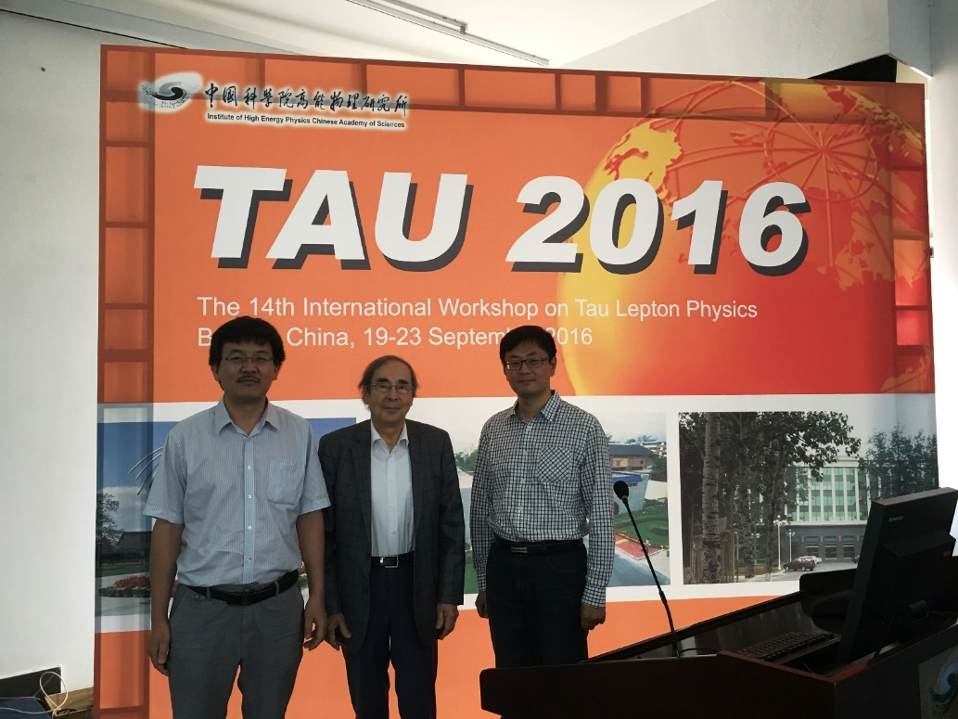
A few photos

