Slide 1
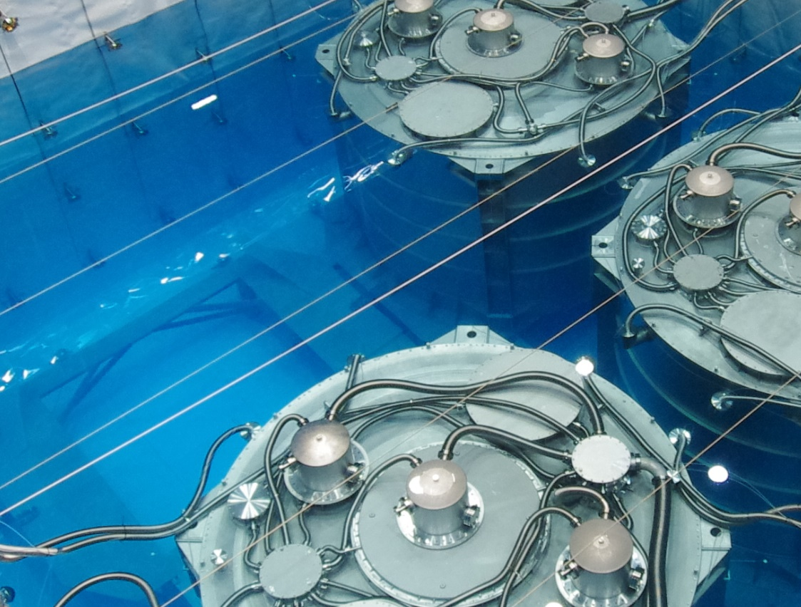
Daya Bay
Design from Scratch
Jun Cao
Institute of High Energy Physics
2018-6-16

Slide 2
From Th to Ex
I was a theorist (folding chair).
  pQCD application on exclusive processes (1998) 5 PR
  Why change to Ex (computer, plug)
Change direction frequently
  1998-2000, LAL, H1 experiment, Xsec analysis, Lar/Tracker alignment, E calibration (high level correction), trigger simulation, background finder
  2000-2003, FNAL, MiniBooNE, reconstruction/PID
  2004-2006, IHEP, design of Daya Bay, simulation + LS
  2007-2009, Daya Bay, neutrino detector, hardware
  2009-, Daya Bay data analysis, JUNO

Slide 3
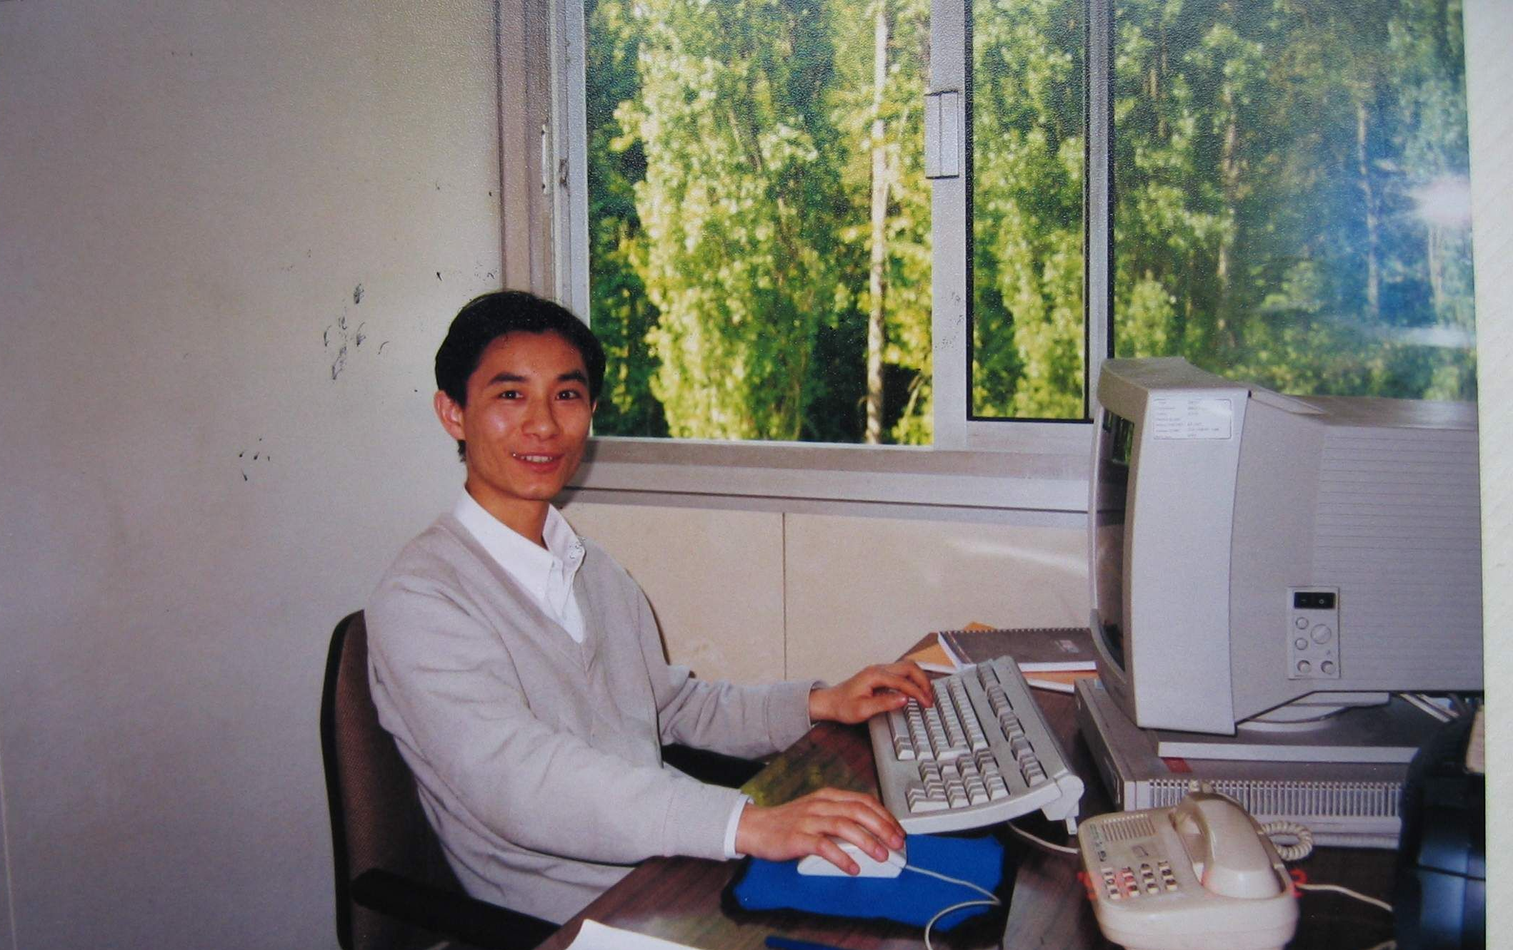
In Office at LAL

Slide 4
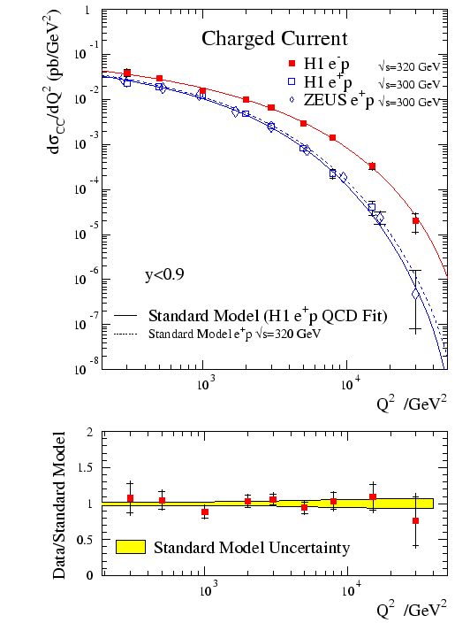
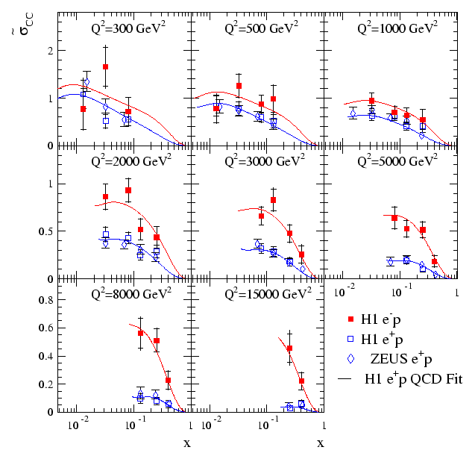
CC Xsec
Th and Ex have differences (MC and modularization)

Slide 5
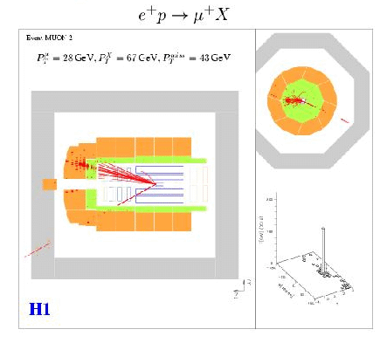
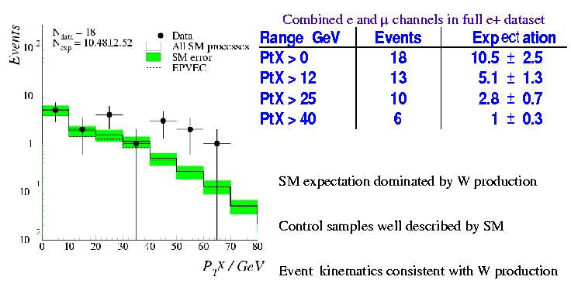
Isolated lepton with miss Pt
Lepto-quark

Slide 6
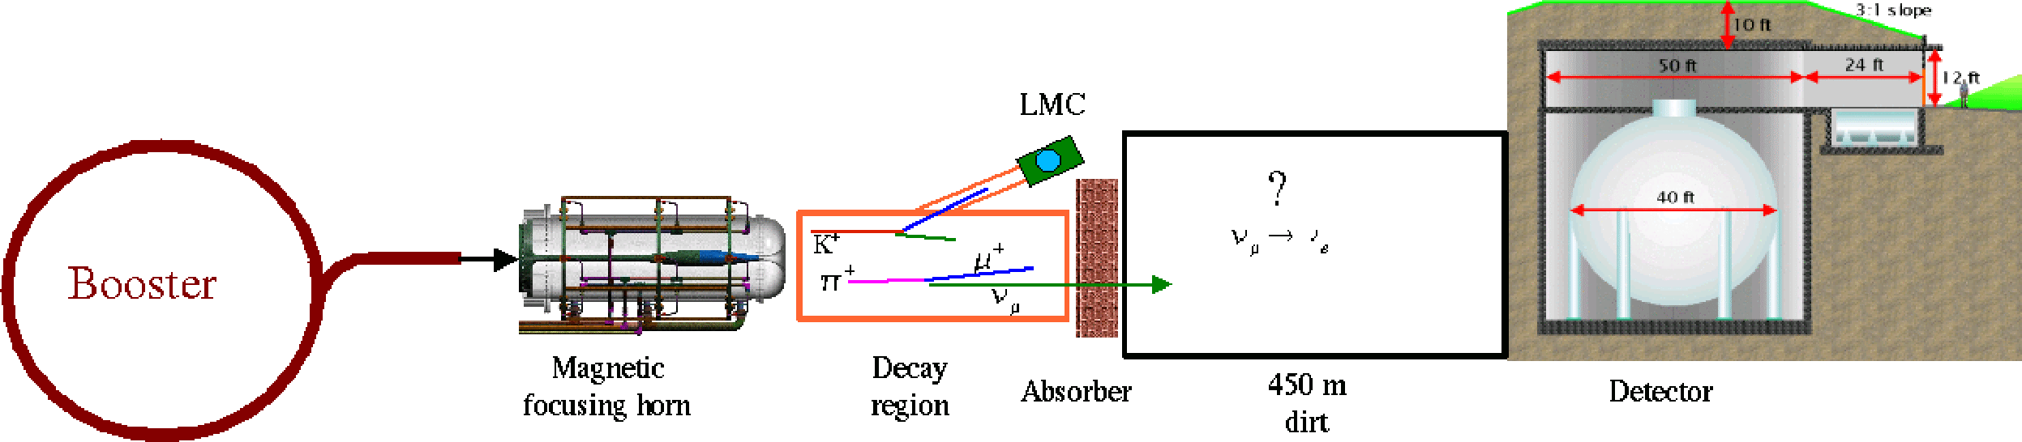
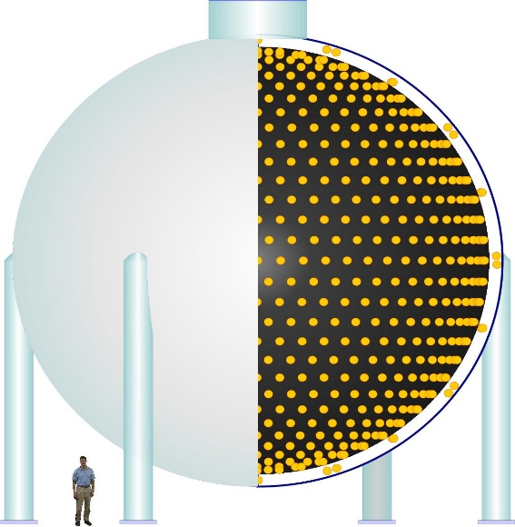
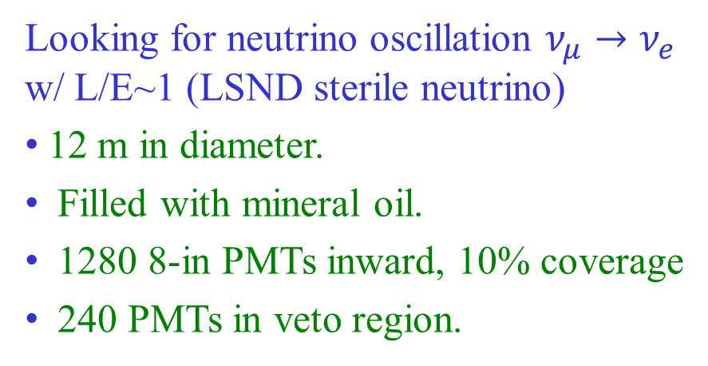
Another Exotic Search: MiniBooNE
Looking for neutrino oscillation $ν_{μ}→ν_{e}$ w/ L/E~1 (LSND sterile neutrino)
12 m in diameter.
Filled with mineral oil.
1280 8-in PMTs inward, 10% coverage
240 PMTs in veto region.

Slide 7
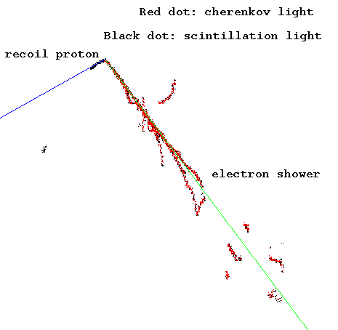
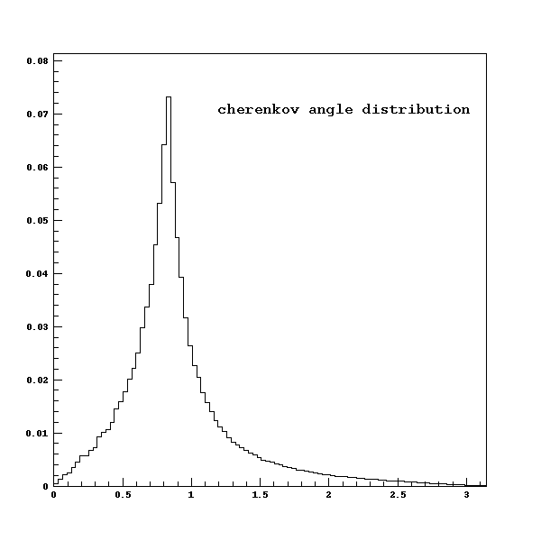
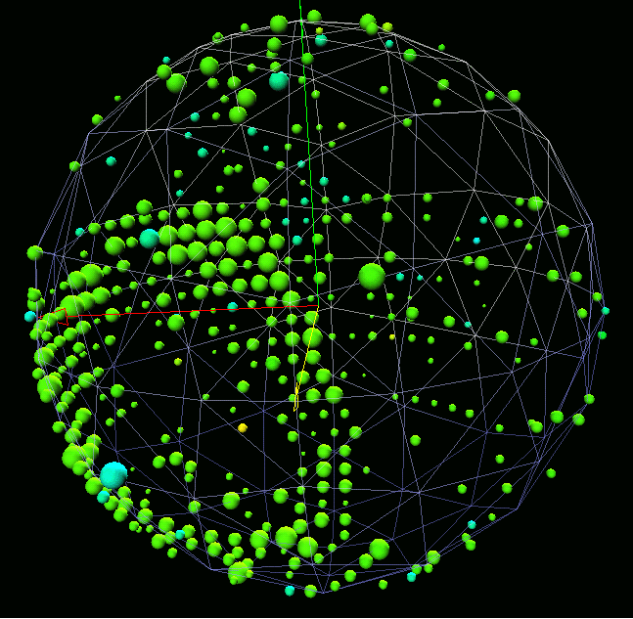
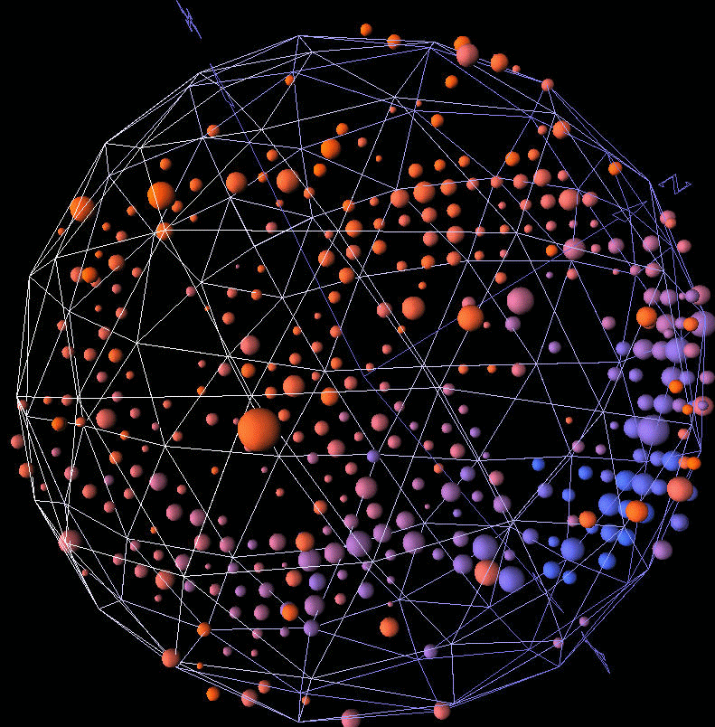
Reconstruction and PID
χ² fit to reconstruct electron track and π⁰ mass
PID
  Construct variables
  Fisher Discrimination
  Neural Network

Slide 8
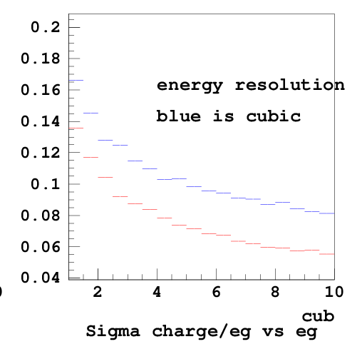
My First Daya Bay Task
In early or middle September, 2003
Spherical, cylindrical, or cubic detector?
Handmade MC + likelihood reconstruction
Cylindrical!
Sep. 2003

Slide 9
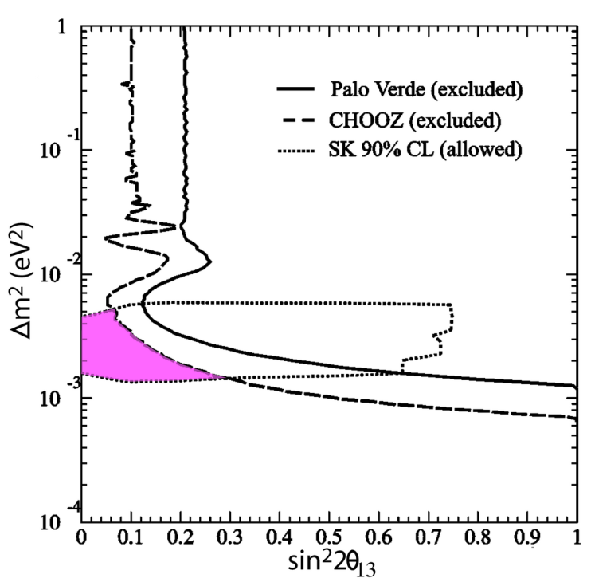
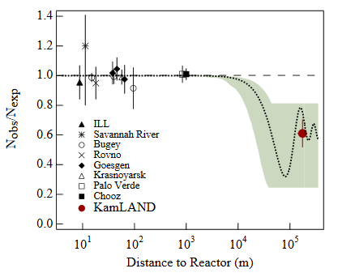
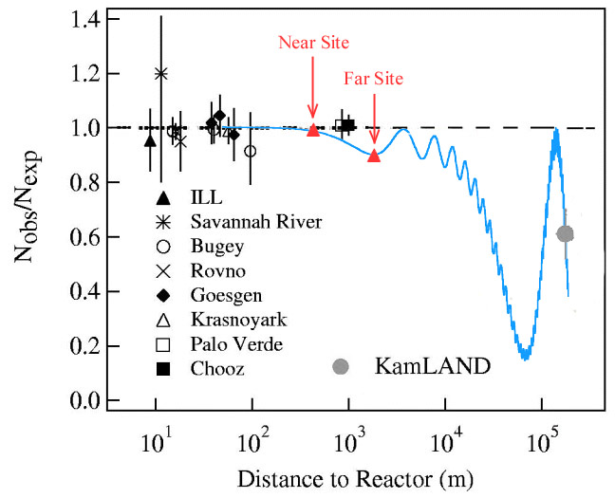
Looking for θ₁₃ Oscillation
Atmospheric ν (1998) and solar ν (2001, 2002) well established. θ₂₃ and θ₁₂ very large.
θ₁₃ is very small
  Chooz in France (1999)
  Palo Verde in US (2000)
KamLAND: Phys.Rev.Lett.90, 021802 (2003)

Slide 10
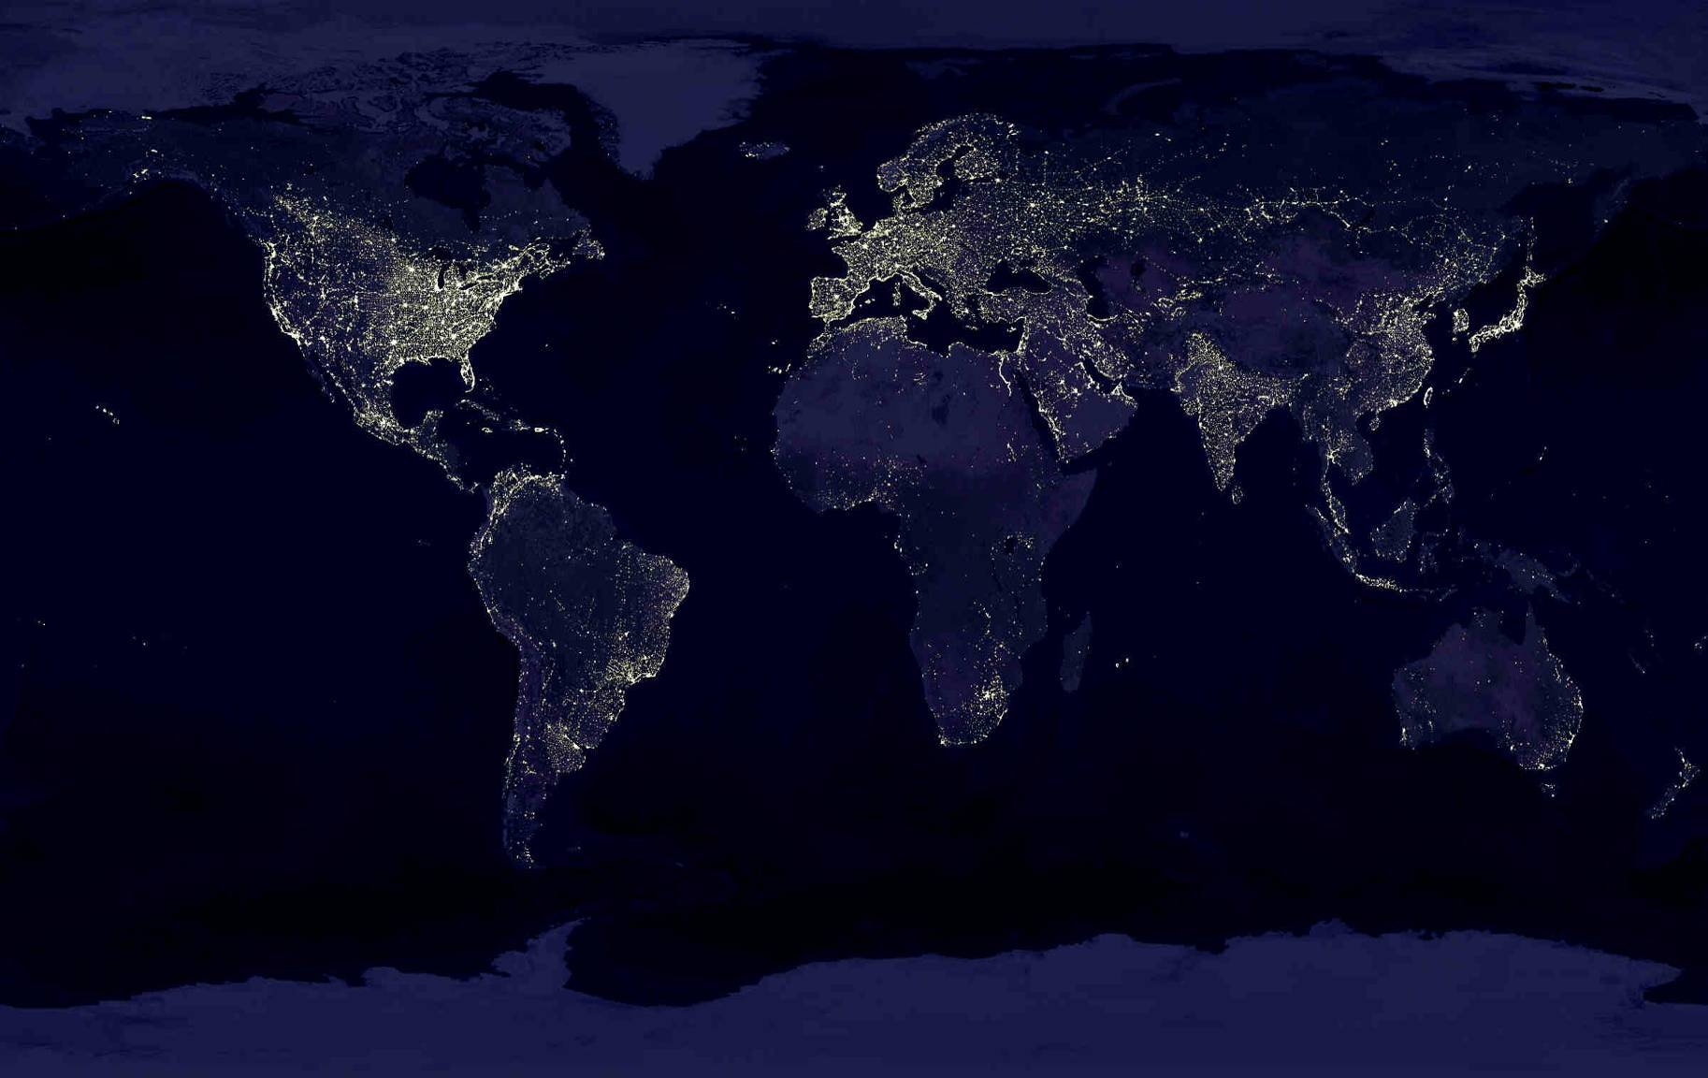
Proposed Reactor Experiments
Krasnoyarsk, Russia
Braidwood, USA
KASKA, Japan
RENO, Korea
Double Chooz, France
Diablo Canyon, USA
Daya Bay, China
Angra, Brazil
8 proposals, most in 2003
Θ₁₃: Fundamental parameter
Gateway to CP and Mass Hierarchy measurements
Less expensive

Slide 11
Precision Measurement at Reactors
Major sources of uncertainties:
Reactor related ~2%
Detector related ~2%
Background 1~3%
Lessons from past experience:
Chooz: Good Gd-LS
Palo Verde: Better shielding
KamLAND: No fiducial cut
Near-far relative measurement
Mikaelyan and Sinev, hep-ex/9908047
Parameter | Error | Error w/ Near-far
Reaction cross section | 1.9 % | 0
Energy released per fission | 0.6 % | 0
Reactor power | 0.7 % | ~0.1%
Number of protons | 0.8 % | < 0.3%
Detection efficiency | 1.5 % | 0.2~0.6%
Chooz Combined | 2.7 % | < 0.6%

Slide 12
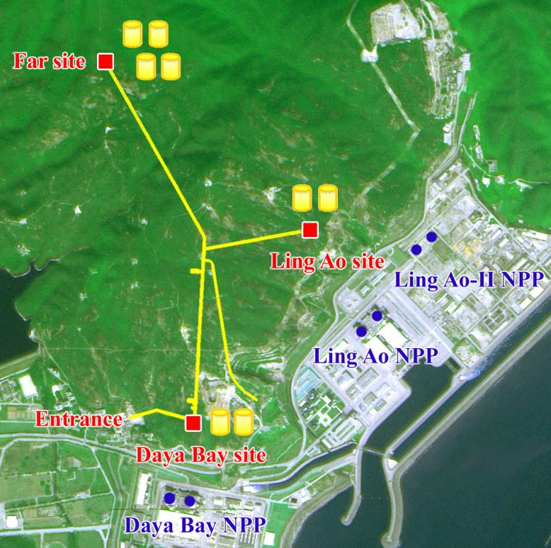
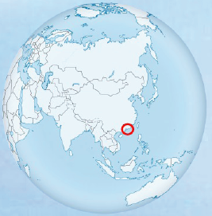
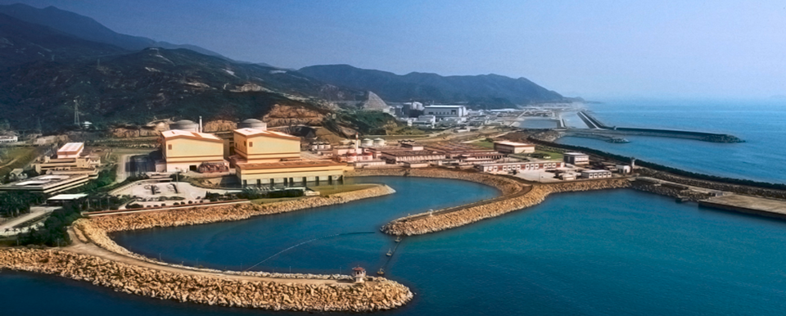
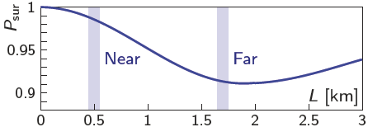
The Daya Bay Experiment
6 reactor cores, 17.4 GW_{th}
Relative measurement
  2 near sites, 1 far site
Multiple detector modules
Good cosmic shielding
  250 m.w.e @ near sites
  860 m.w.e @ far site
  Redundancy

Slide 13
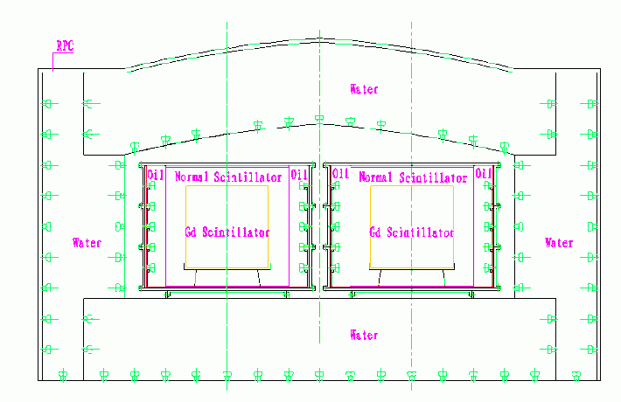
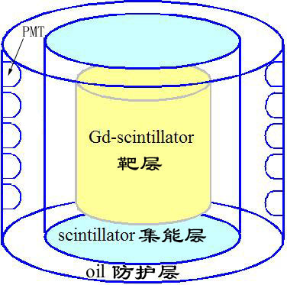
Neutrino Detector in Jan. 2004
Yifang proposed “multiple detector modules, w/ reflection + Water house ”
Wrote a Geant3 MC based on Yifang’s Palo Verde MC.
Explored many options w/ MC
2-m thick water house
RPC outside
Φ4.5m × H 4m AD, total weight 50 ton. Drain the detector during transportation. Vessels ~ 5 ton
Near site: 2 modules
Far site: 4-8 modules

Slide 14
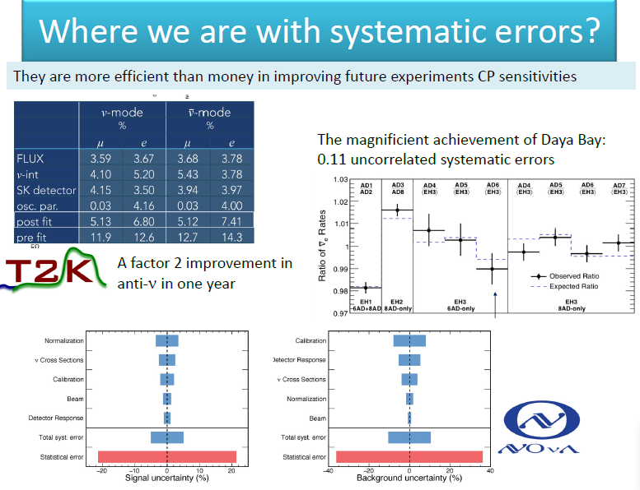
Summary Talk at Neutrino2016

Slide 15
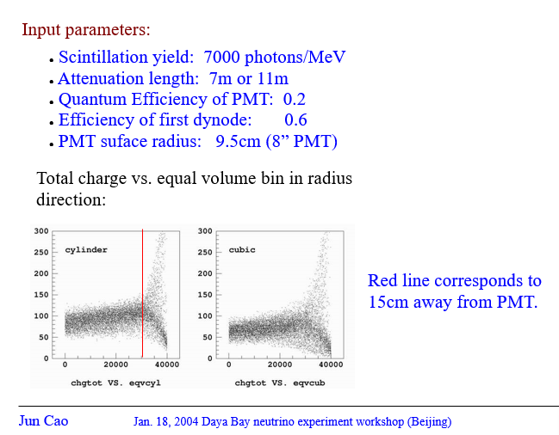
With Geant3 MC

Slide 16
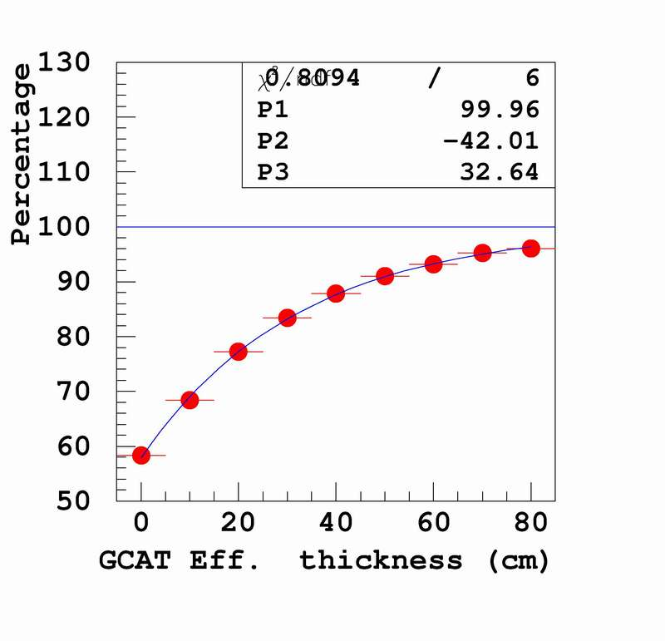
Simulation
For 8m³ target + 50cm buffer, 100 PMTs
Energy Resolution
Detection eff. for gamma-catcher
40cm: 87.80%
50cm: 91.04%
70cm: 95.23%
Background from PMT: Gammas that can penetrate 2m water and 50cm oil buffer and deposit
U: 11 per 3*10⁸ gammas
Th: 34 per 3*10⁸ gammas
K: 5 per 3*10⁸ gammas
Background from rock

Slide 17
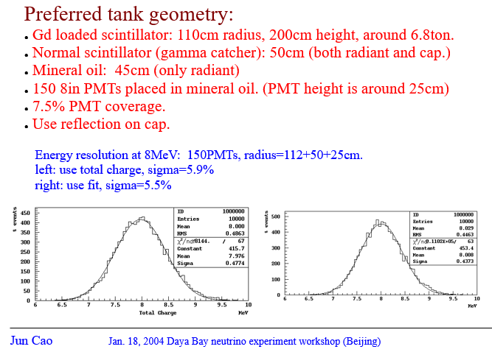

Slide 18
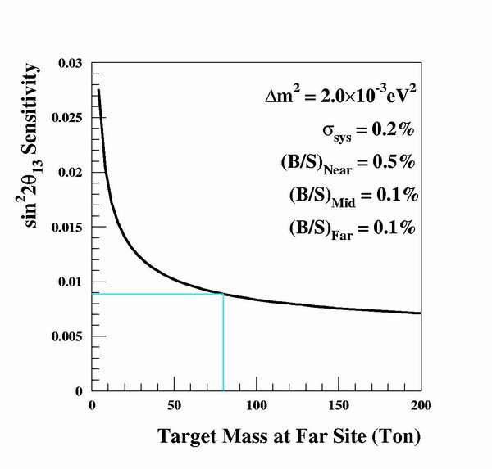
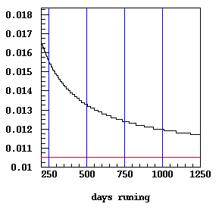
Target Mass
6.8-ton to 20-ton
“We recommend, as a high priority, …, An expeditiously deployed multi-detector reactor experiment with sensitivity to ‾ν_{e} disappearance down to sin²2θ₁₃=0.01”
---- APS Neutrino Study, 2004

Slide 19
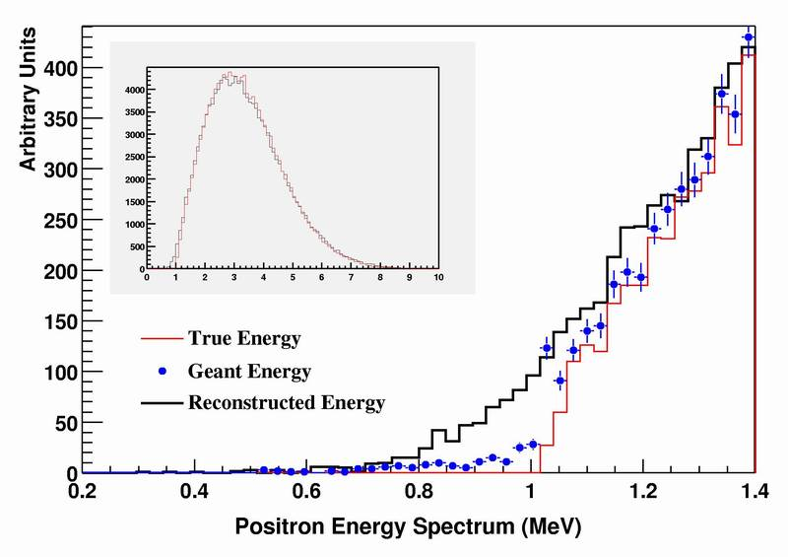
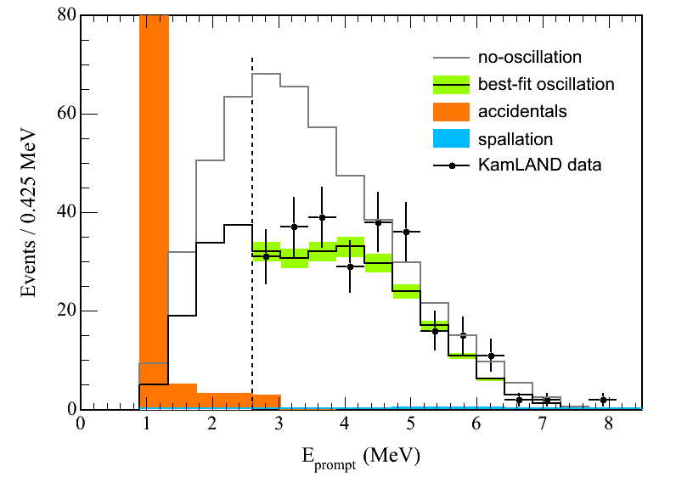
Positron Efficiency
Positron Efficiency 99.6%
Error ~0.05% (Assuming 2% energy scale error)
Chooz 1.3MeV, error 0.8%（bad LS)
KamLAND 2.6MeV, error 0.26%
Daya Bay
Chooz

Slide 20
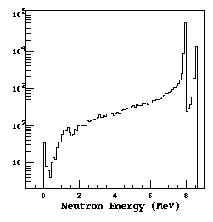
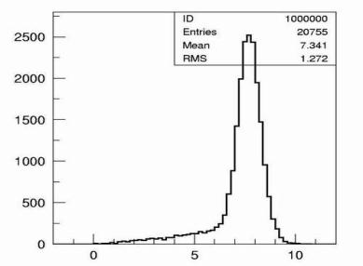
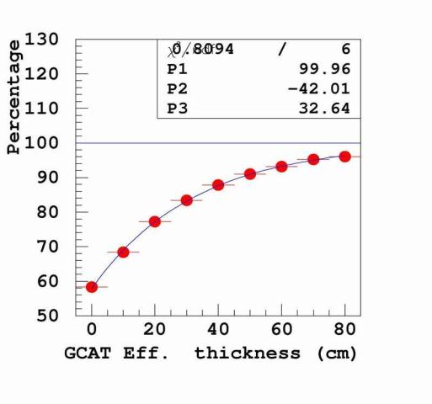
Gamma Catcher
6 MeV
45cm gamma catcher
GEANT energy
Recon.
Neutron Energy (MeV)
Neutron energy cut eff. 92%
Error ~0.2% (Suppose 1% energy scale error）
Energy Resolution | 10%/sqrt(E) | 7%/sqrt(E) | Geant E
6MeV | 92.03% | 92.05% | 92.08%
5.94MeV | 92.23% | 92.23% | 92.25%
6.06MeV | 91.79% | 91.85% | 91.89%
δEff. | -0.24% | -0.20% | -0.19%
 | +0.20% | +0.18% | +0.17%

Slide 21
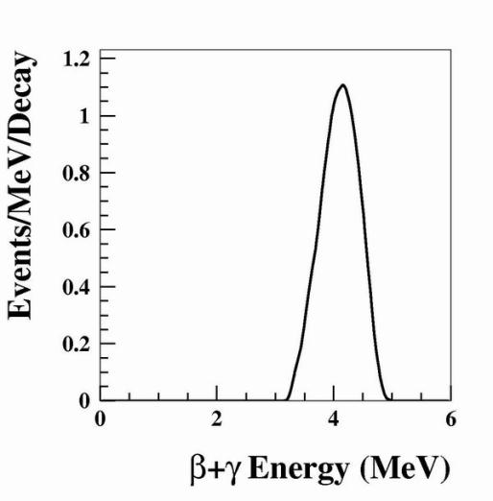
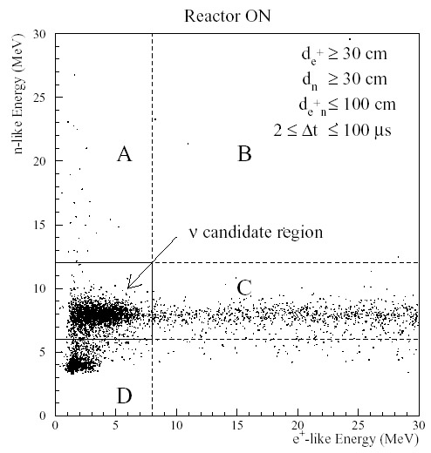
Why 6 MeV and <5% resolution
²⁰⁸Tl
External radiation has only gamma <3MeV
Beta (and alpha) in LS and acrylic tank can contribute, besides gamma
²³²Th in Gd is not easy to get rid of.
Chooz Event Sample

Slide 22
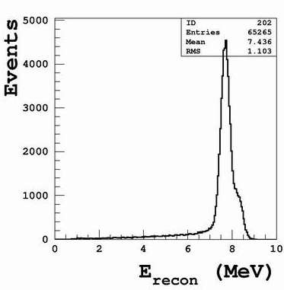
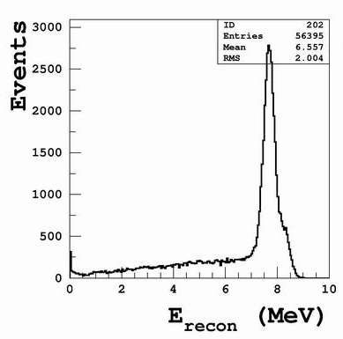
Two-layer vs Three-layer
Braidwood proposed 2-layer detector
Eff. ~ 92%
Error ~ 0.2%
Eff. ~ 73%
Error ~ 0.4%
The most important error!
Fill gamma catcher with Gd-LS, it becomes a two-layer detector (60% more events but larger error)
Spectrum distortion (may not critical)

Slide 23
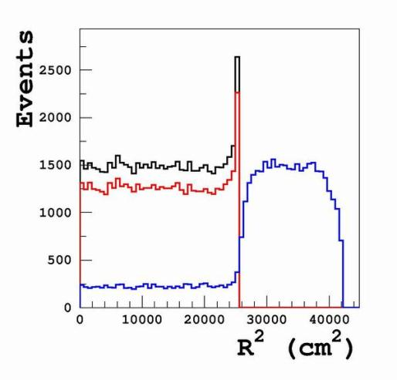
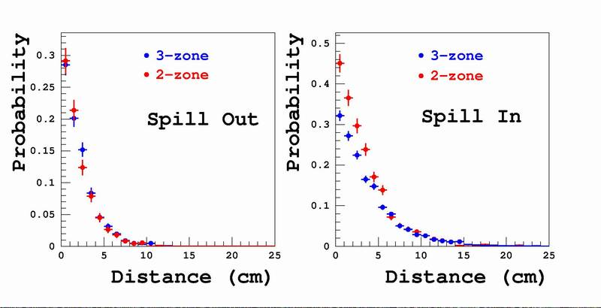
Spill In/Out
Distance means the shortest distance from the generated vertex to the edge.
A dot on the plot reads “an event with vertex XXX cm to the edge has XXX probability to spill in/out.”
Need Identical detectors (One of the reasons)

Slide 24
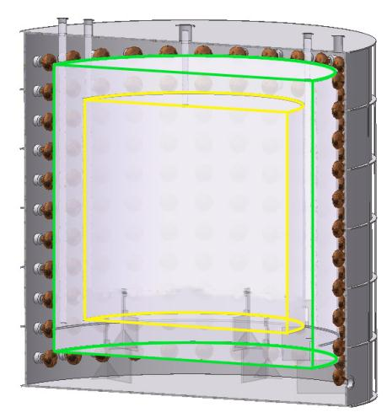
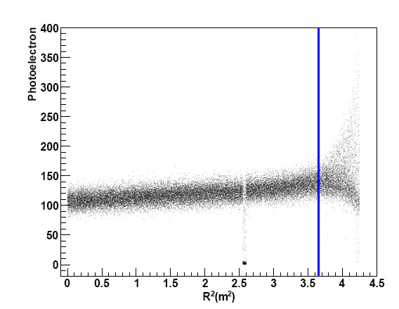
Buffer
Mineral Oil ~50cm
  Keep PMTs away from LS
  Shield radioactivity of PMT and tank
  30 cm PMT height + 20 cm shielding
III
Maximize the target region w/ a relative large bkg → uncertainty well determined

Slide 25
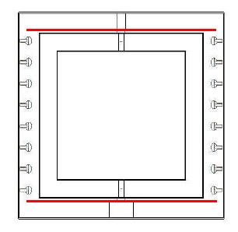
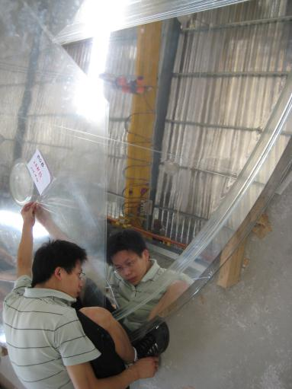
Reflector
Top and bottom
  Reduce PMT#
  Simple mechanic structure
ESR film ~99% reflectivity
Difficulties is how to make a well understood reflector
Sandwich structure, sealed w/ vacuum pressure, perfect surface without any dead area

Slide 26
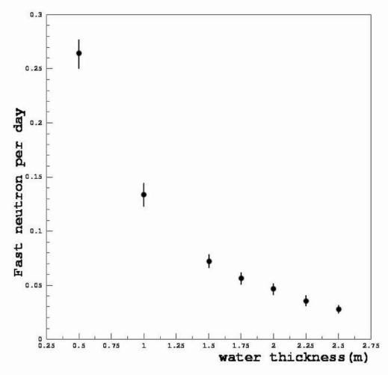
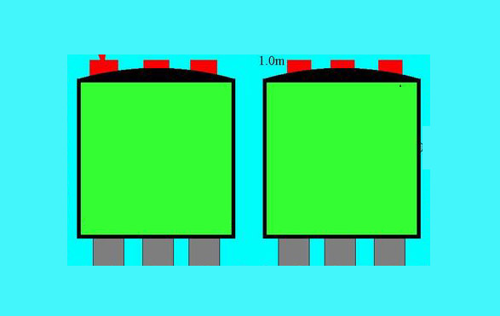
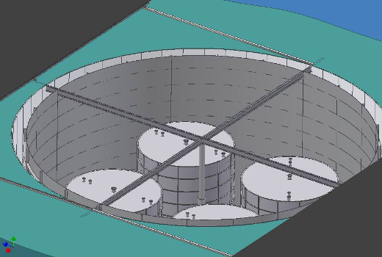
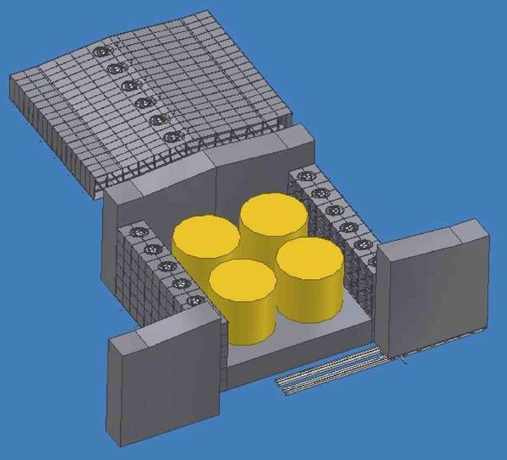
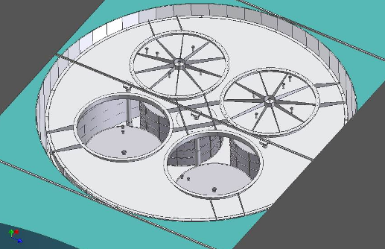
Veto
2m+ water shielding (neutron produced in rock and gammas)
> 99.5% efficiency.
muon
Water Cherenkov
muon

Slide 27

Full χ² analysis
pulls
background spec.
Measured spec.
Expected spec.
Reactor
Detector
Backgrounds
Neutrino Spectrum
χ² with pull terms to take into account the correlation of systematic errors.

Slide 28




Muon simulation for site optimization
Muon simulation is done in the area of possible detector locations in 50 m step
Far
Simulate the cosmogenic backgrounds:
  fast neutron
  He8/Li9
Mid
LingAo II
Daya Bay
LingAo

Slide 29

Site optimization in 2005
Muon simulated in 50m step in interested area.
Fix two sites and optimize the 3rd site. Iterate until converge.
The plot shows the variation of one site while the other two are at optimal sites.
Rate versus shape analysis

Slide 30

Sensitivity
90% confidence level
Near/Far configuration
Three-year run (0.2% statistical error)
Two near sites, 40 ton each
80 ton at Far site
Detector residual error 0.2%
Far site background error 0.2%
Near site background error 0.5%
Daya Bay result on Δm²

Slide 31


Daya Bay CDR
Daya Bay ~0.2%
Double Chooz ~0.6%
RENO ~0.5%

Slide 32

Daya Bay CDR
Actual:
0.05%
0.03%
0.2%
0.3% (Am-C)

Slide 33
Lessons
The largest miss: double neutron
  To accelerate the design optimization, I didn’t use full MC (full generator). Fast neutron are simulated one by one. Actually one cosmic muon can produce multiple neutrons, and form correlated bkgs → huge
  Solved by required longer muon veto time.
Site optimization: MC and analysis is not enough → risk/award (enough contingency and margin of safety)

