Slide 1
Swift J0243.6+6124
ZHANG Yue
HXMT Collaboration
2018-4-12

Slide 2
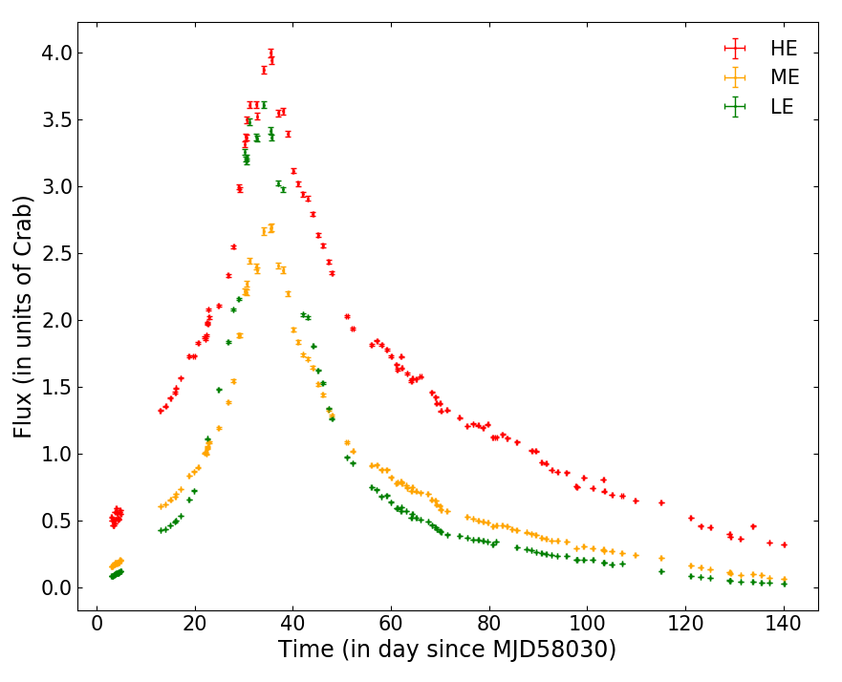
Insight-HXMT observations
Swift J0243.6+6124
Be/X-ray binary
2017-10-07 MJD58033 0ks
2018-02-21 MJD58170 1200ks
Outline
spin evolution
orbital elements
pulse profile

Slide 3
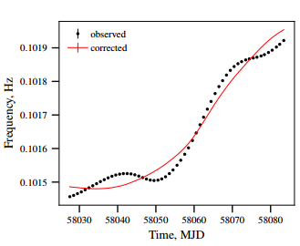
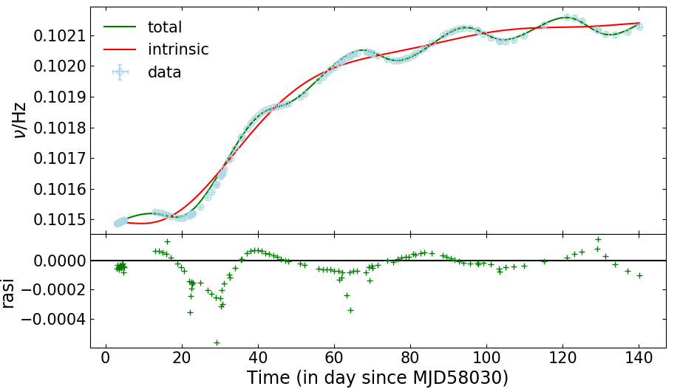
Pulsar spin evolution
HXMT-HE
Doroshenko et al.(2017)

Slide 4
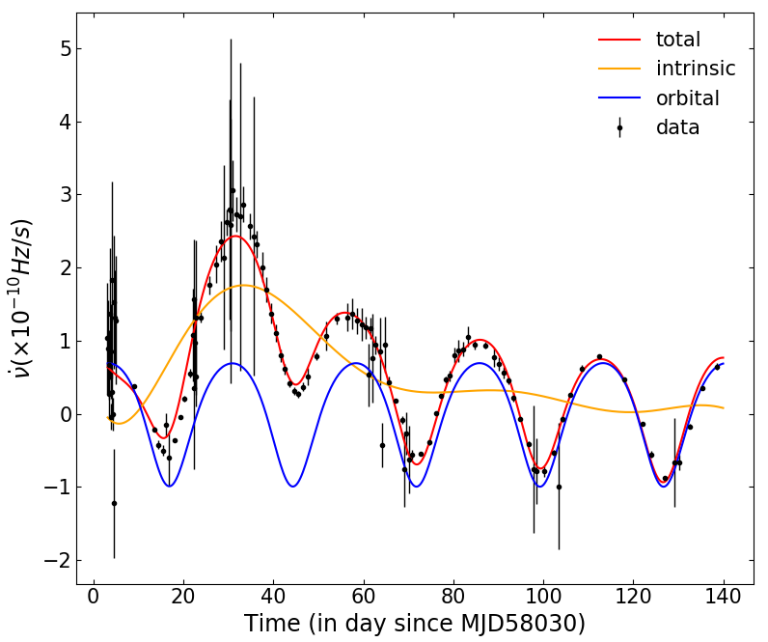
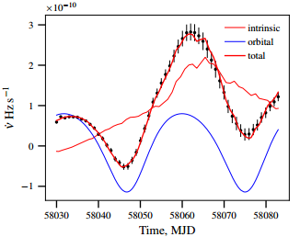
Orbit elements
T0=MJD58019.17
Porb=27.45 d,
e=0.09,
asini = 115 ls
w=85 deg
T0=MJD58019.2
Porb=27.36 d,
e=0.092,
asini = 140 ls
w=-76 deg
Doroshenko et al.(2017)

Slide 5
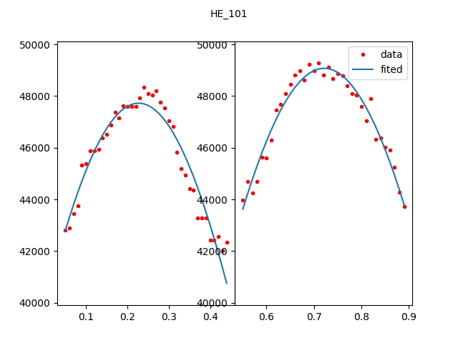
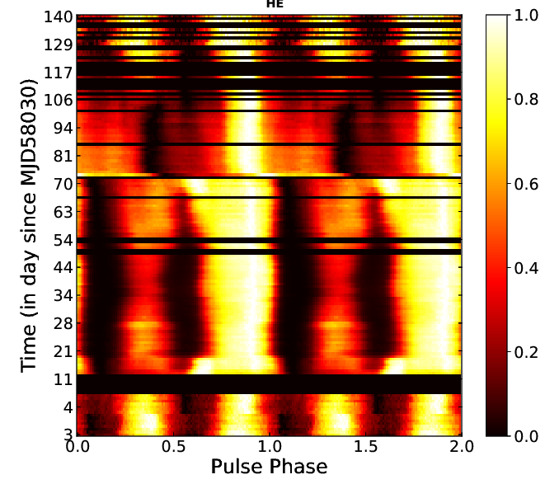
Pulse profile
Fitting the double peaks
Amplitude
Phase center
FWHM

Slide 6
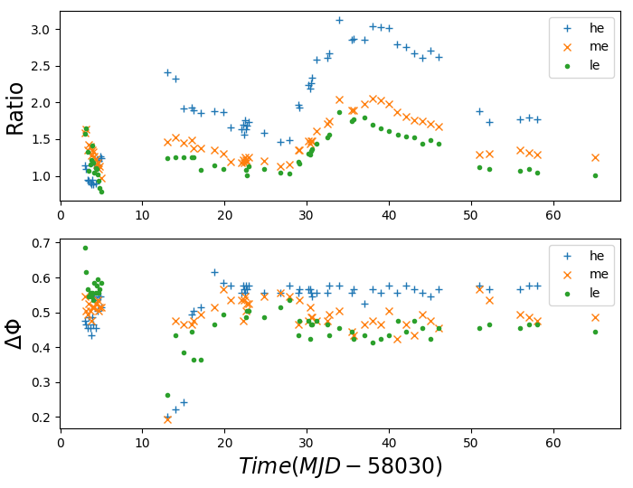
Pulse profile
Pulse profile varies quickly

Slide 7
Summery
Spin evolution
Orbital elements
Pulse profile
fdot vs flux

