Slide 1
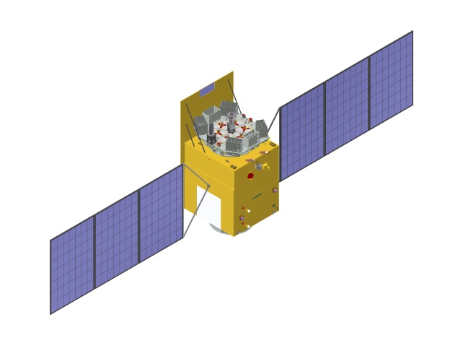
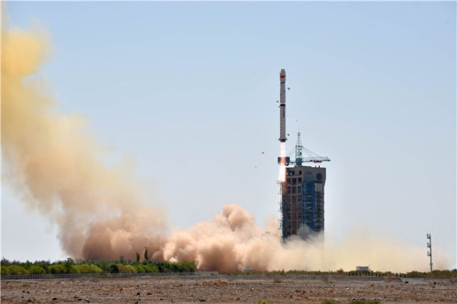
MAXI J1535-571: Timing Analysis
HUANG Yue
on behalf of the Insight-HXMT team
2018-04-12
The second Joint workshop on Insight-HXMT calibration and science, 2018-04, Beijing

Slide 2
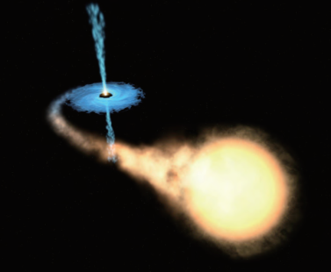
OUTLINE
Introduction
Insight-HXMT data reduction
Preliminary results
Summary

Slide 3
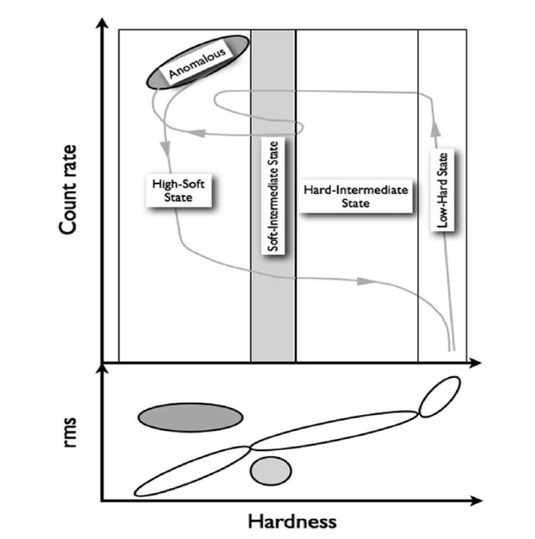
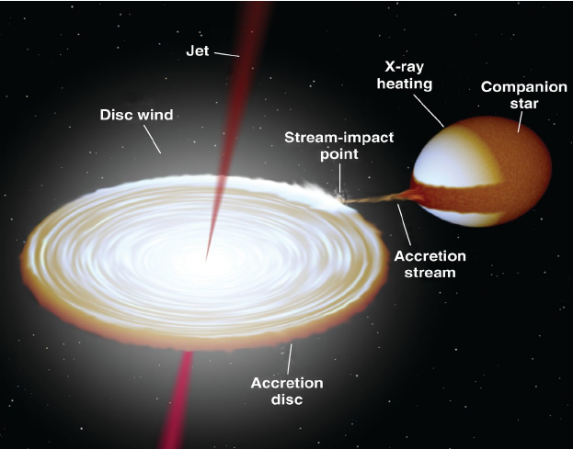
Transient Black Hole Binaries
The fundamental diagrams
Belloni 2010

Slide 4
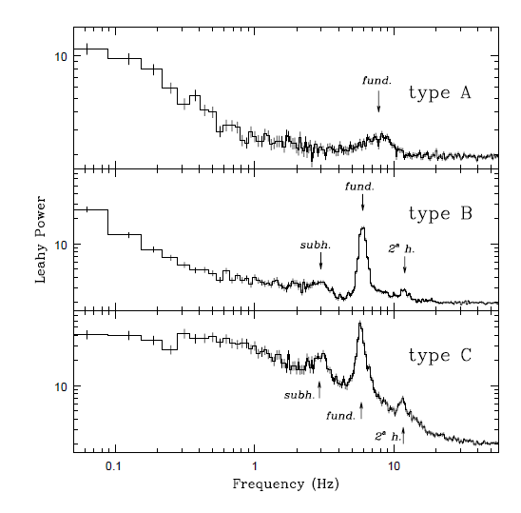
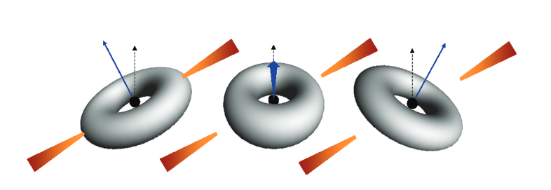
Fast time variability
Low Frequency QPOs
Models For LFQPOs
Casella et al. 2004
Lense-Thirring Precession
Instabilities
Geometrical effects
Ingram et al. 2009

Slide 5
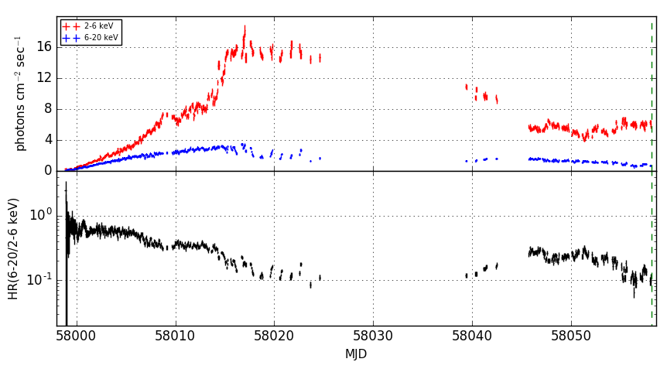
BHC: MAXI J1535-571
Detected by MAXI and Swift on 2017 September 02 (ATel #10699 & 10700)
(R.A., Dec) = (233.83, -57.23)
BHB Candidate
MAXI: >L_{Edd} of NS (ATel #10708)
ATCA: radio (ATel #10711)
~5 Crab
http://134.160.243.88/nakahira/1535monitor/

Slide 6
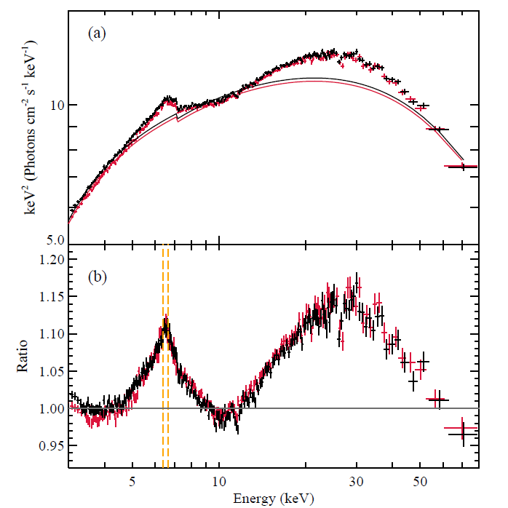
BHC: MAXI J1535-571
Swift/XRT: LFQPO 1.87 Hz & 3.87 Hz (ATel #10734)
NICER: (ATel #10768)
a=${0.88}_{−0.2}^{+0.1}$, $i={27}_{−5}^{+1}°$
LFQPO: 1.9-2.8 Hz
NuSTAR:(Xu et al. 2018)
Fe line, Compton hump
$a>0.84，i=57°/75°$
NuSTAR
Xu et al. 2018

Slide 7
Insight-HXMT observations
 | Start Time | Exposure (ks)
1 | 2017/09/06 07:37:21 | 100
2 | 2017/09/14 04:56:05 | 8
3 | 2017/09/15 04:48:01 | 8
4 | 2017/09/16 06:15:31 | 8
5 | 2017/09/17 06:07:39 | 8
6 | 2017/09/18 02:48:56 | 8
7 | 2017/09/19 23:22:47 | 8
8 | 2017/09/21 02:26:27 | 150
9 | 2018/2/2 15:26:44 | 10
10 | 2018/2/6 05:22:00 | 10
11 | 2018/2/8 19:25:56 | 10
12 | 2018/2/11 17:27:38 | 10
13 | 2018/2/12 17:20:01 | 10
14 | 2018/2/14 21:51:02 | 10
15 | 2018/2/16 15:13:23 | 10

Slide 8
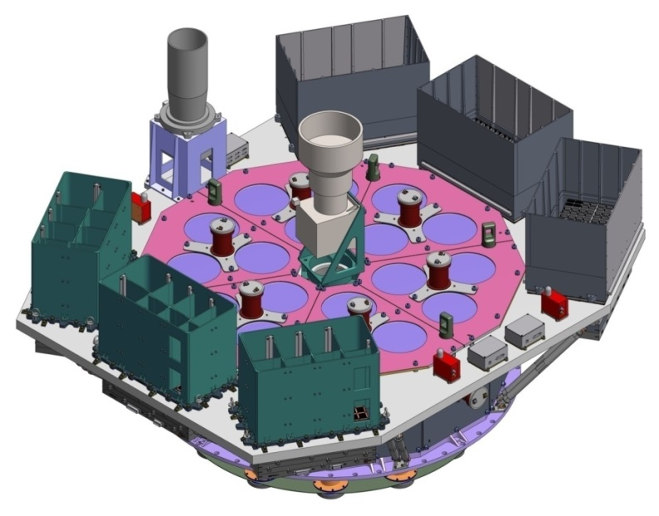
Insight-HXMT
Instrument | HE | ME | LE
Detector type | NaI/CsI | Si-PIN | SCD
Energy range (keV) | 20-250 | 5-30 | 1-15
Detection area (cm²) | 5000 | 952 | 384
Broad energy band
microsecond time resolution
Large effective Area → high energy
No pileup → low energy

Slide 9
Some Preliminary results

Slide 10
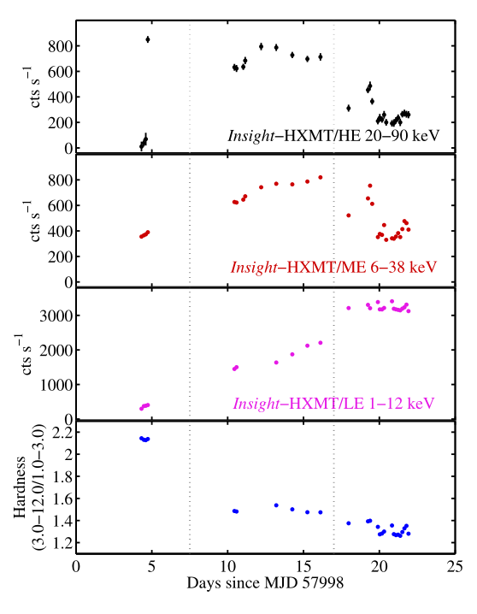
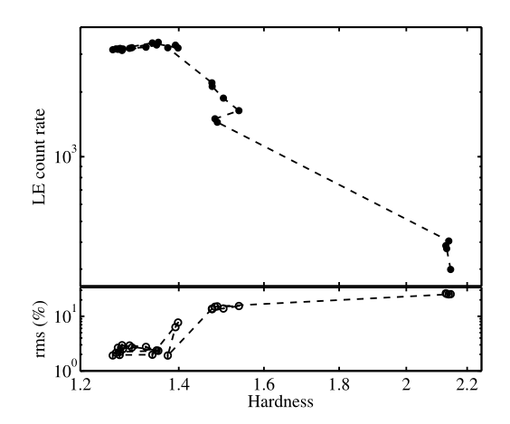
The Outburst Evolution
HID
HRD
Light curve & Hardness

Slide 11
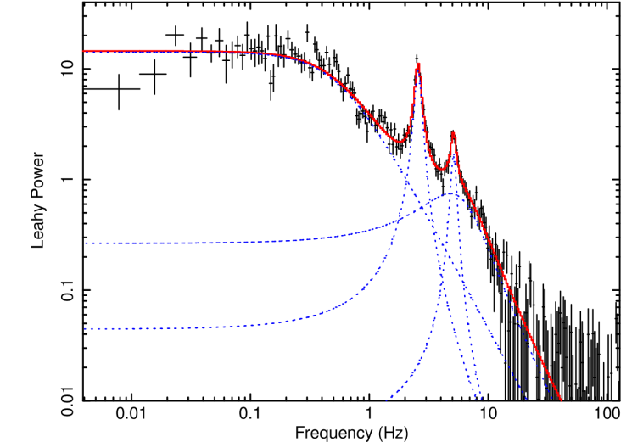
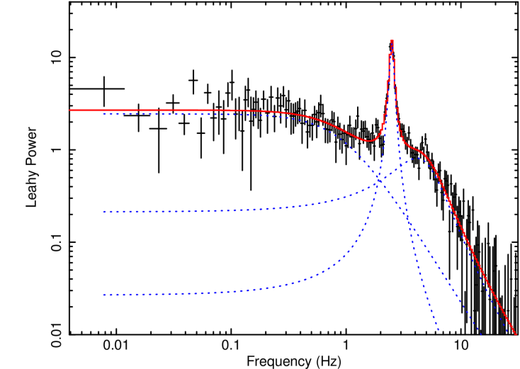
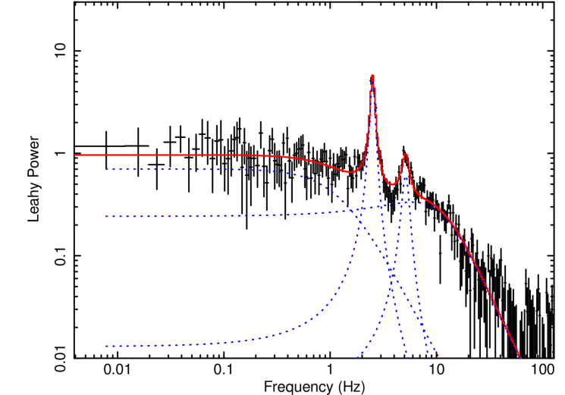
Power Density Spectra
~3000s
LE:1-7keV
ME:12-26keV
HE:36-80keV
The event mode data allows the computation of power spectra in different energy bands
Above 30 keV, the QPO and its first harmonic is detected

Slide 12
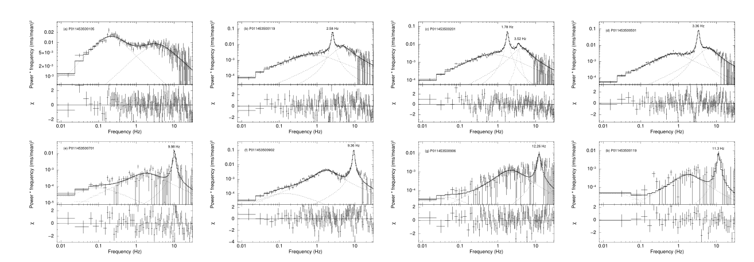
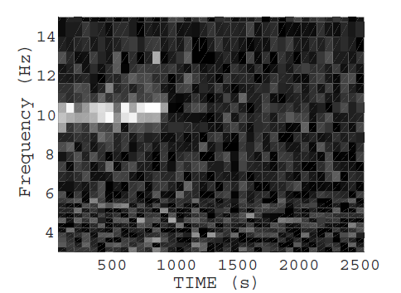
PDS Evolution with Time
Insight-HXMT/ME 8 representative exposures
Type-C
Type-C
Type-C
Type-B
Type-C
Type-A
Type-A
2500s segment dynamical PDS
state transition ?
SIMS→HSS

Slide 13
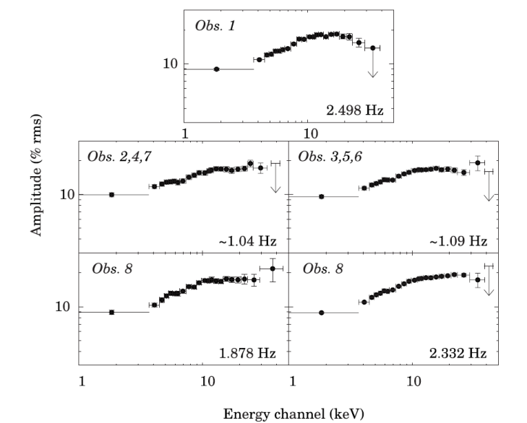
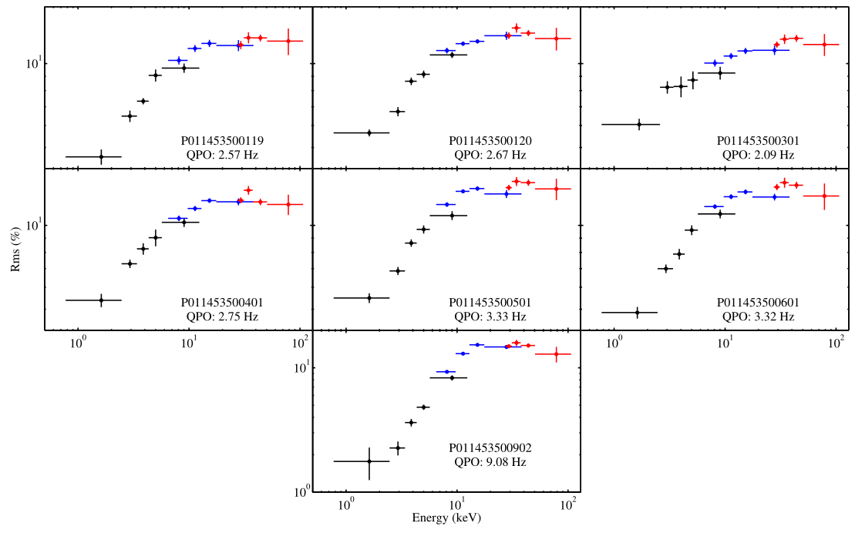
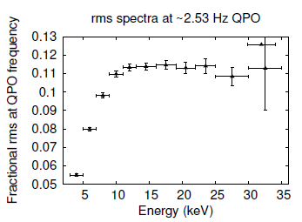
LFQPO RMS spectra
GRS 1915+105
MAXI J1535-571
Insight-HXMT/LE ME HE
RXTE/PCA
Rodriguez et al. 2004
ASTROSAT/LAXPC
blind detectors as background
10% uncertainty added to the background
UP TO 100 keV
YADAV et al. 2016

Slide 14
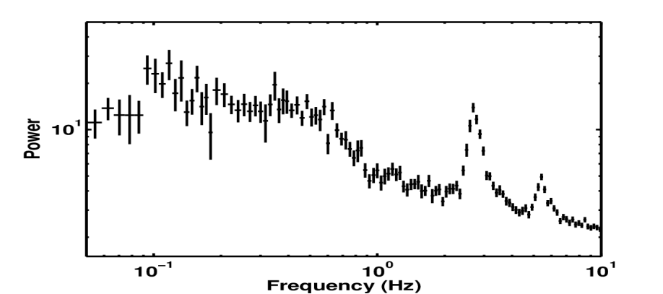
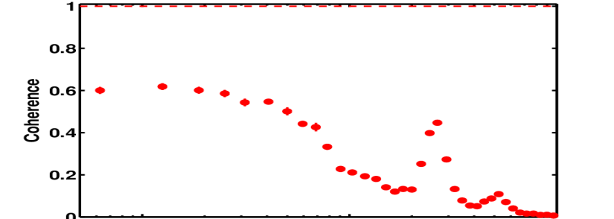
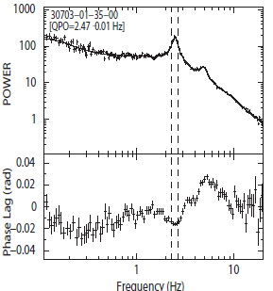
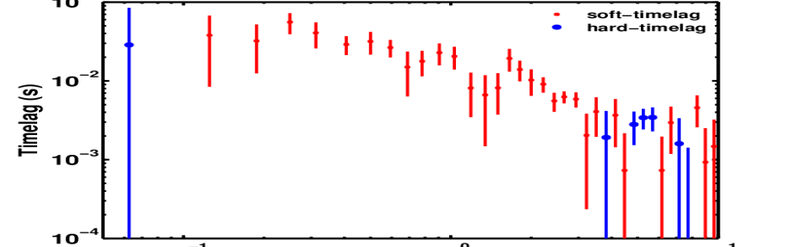
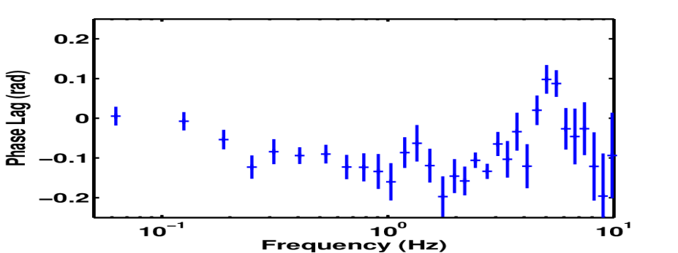
TIME LAG
Insight-HXMT/LE
Fundamental QPO: soft lag
Harmonic: hard lag
RXTE/PCA GRS 1915+105
PDS: 1-7 keV
Coherence, Time Lag, Phase Lag
1-3 keV ~ 3-7 keV
Zhang. et al. 2017

Slide 15
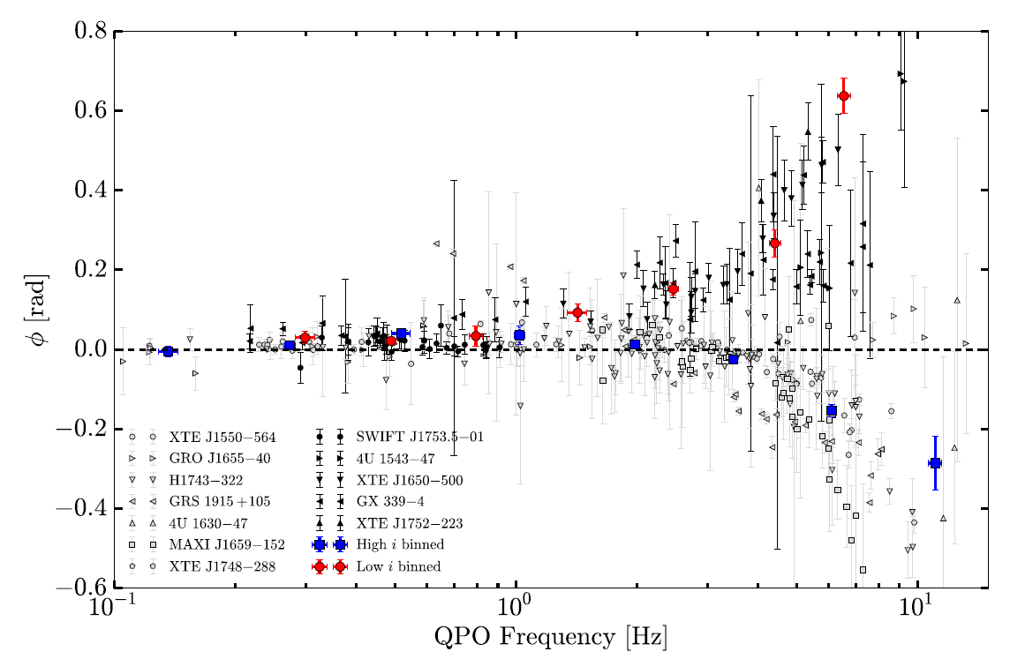
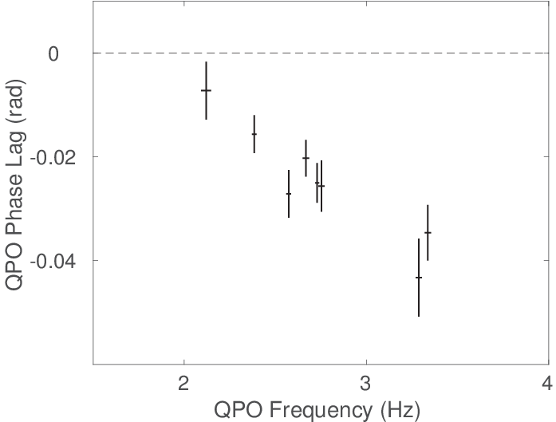
Time lag & Inclination
Geometrical origin: Phase lag depends on inclination
MAXI J1535-571:
high inclination
Type-C QPO
Eijnden et al. 2017

Slide 16
THANK YOU!
Summary
The source exhibits state transition: LHS →HIMS → SIMS → HSS
While the energy dependence rms for energy below ~20 keV is similar to other black hole binaries observed by RXTE, Insight-HXMT reveals their behavior for high energy (up to 100 keV)
From the Type-C QPO phase lags, MAXI J1535-571 is consistent with being high inclination source

