Slide 1
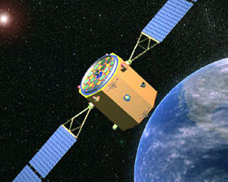
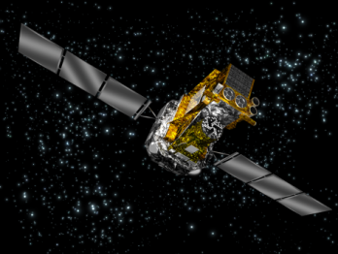
AGN at high energies
A.Malizia, L. Bassani , M. Molina

Slide 2
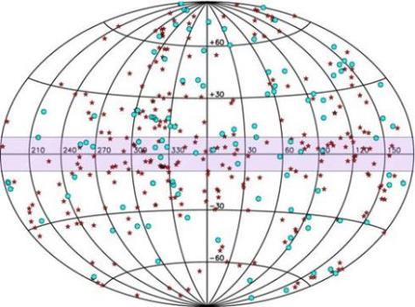
INTEGRAL AGN
380 AGN, but catalogue is constantly updated
All fully characterized in terms of optical (class, z, BH mass, axial ratio, bars etc) and soft X-ray properties (absorption, flux and gamma). For all INTEGRAL AGN light curves (1500 orbits) and spectral info available within the team.
Malizia+ 12,16

Slide 3
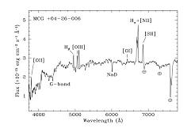
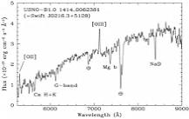
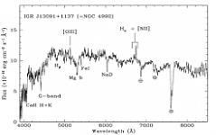
AGN population SEEN by INTEGRAL
INTEGRAL AGN cat (380 sources): Seyferts & Blazars
Few Liners,
all with N_{H} ≥22,
none CT
Also a few type 2 QSO
22.2≤ N_{H} ≤ 23.4
4 XBONG,
0.01≤ z ≤0.1,
N_{H} ≥23

Slide 4
The INTEGRAL complete sample of AGN
The sample has been extracted in the 20-40 keV band by means of the V/V_{max} test from the 3rd INTEGRAL-IBIS survey: the brightest AGN
87 objects with significance greater than 5.2σ:
46 type 1 (Seyfert 1 - 1.5 included 5 NLS1), 33 type 2 (Seyfert 1.8-2),
8 Blazars (QSO-BL Lac)
Hard X-ray studies: INTEGRAL-IBIS and Swift-BAT
(Molina et al. 2013)
Broad Band studies: XMM-pn and INTEGRAL-IBIS/Swift-BAT
(Molina et al. 2009, Malizia et al. 2014)

Slide 5
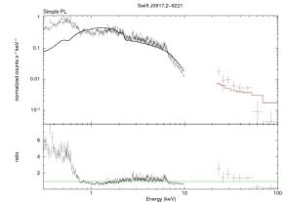
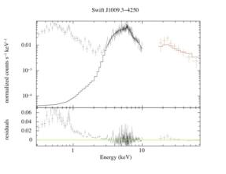
Broad band spectra of the complete sample
Great variety: extreme complexity with many components:
1. SOFT EXCESS
always present in Sy2, but in 6 objects is more complex than a scattered power law
Sy1
Sy2
present in a good fraction of Sy1 (24%) , but dominates only in a few sources

Slide 6
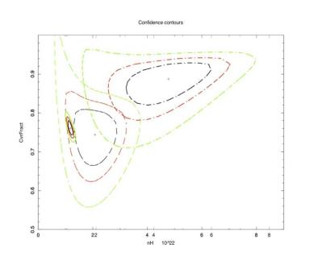
Broad band spectra of the complete sample
Complexity: 2. simple and/or complex absorption
Absorption in type 2 AGN of the complete sample plus complex absorption in 15% of type 1 AGN:
one or more layers of material partially covering the source
OFTEN THIS COMPLEX
ABSORPTION IS VARIABLE
In agreement with results from the entire
AGN sample (Malizia et al. 2012)
 | Opt. type 1 | Opt. type 2 | Total
Unabsorbed | 132 | 10 | 142 (52%)
Absorbed | 22 | 108 | 130 (48%)
Total | 154 (57%) | 118(43%) | 272
IGR J21247+5058

Slide 7
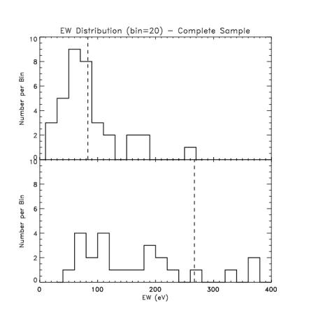
Broad band spectra of the complete sample
Complexity: 3. iron line/s
Kα line almost always present and generally narrow (σ<10 eV)
type 1
A few broad Kα line observed in around 10% of both Sy1 and Sy2
15% of Sy1 require also a Kβ line
type 2
Sy1 : EW=81 eV (σ=50 eV)
Sy2 : EW=490 eV (σ=670 eV)
Sy2(No CT) : EW=306eV (σ=565 eV)
no CT

Slide 8
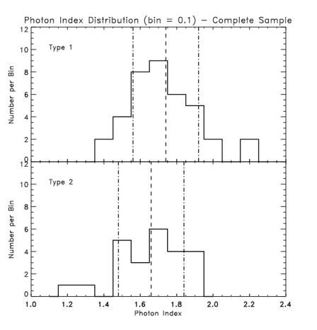
Broad band spectra of the complete sample
PRIMARY PHOTON INDEX now measured
type 1: <Γ>=1.73
(σ=0.17)
type 1 & type 2 consistent
Type 2: <Γ>=1.66
(σ=0.18)

Slide 9
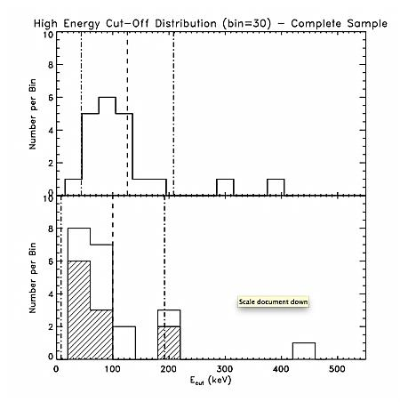
Broad band spectra of the complete sample
CUT-OFF: located
type 1: <E_{c}>=128 keV
(σ=46)
type 2: <E_{c}>=100 keV
(σ=92)
Good agreement with Nustar & BAT

Slide 10
HXMT contributions
Simultaneous broad band coverage: very few AGN have simultaneous broad band spectra (IBIS/BAT versus XMM = average versus snap shots, NUSTAR/XMM very few generally XRT at low energies). Even at present some bright AGN do not have broad band spectral coverage
High energy extension: measured cut-off cluster around 100 keV, bulk of lower limits below 300 keV so high energy extensions very important (Nustar stops at around 70 keV,Integral around 100 keV)
Spectral variability poorly studied: it may pay to concentrate on few bright objects and observe them repeatedly to study spectral changes

Slide 11
Brightest agn in integral catalogue
source name | RA | Dec | z | class | Flux (20-100) | Flux (2-10)
 |  |  |  |  | 10-11 | 10-11
Cen A | 13 25 27.61 | -43 01 08.8 | 0.0018 | Sy2 | 62.1 | 21.2
Mrk 421 | 11 04 27.31 | +38 12 31.8 | 0.03 | BL Lac | 37.65 | 47.9
NGC 4151 | 12 10 32.66 | +39 24 20.7 | 0.0033 | Sy1.5 | 30.5 | 25
NGC 4945 | 13 05 27.28 | -49 28 04.4 | 0.0019 | Sy2 | 25.6 | 0.54
NGC 4388 | 12 25 46.93 | +12 39 43.3 | 0.0084 | Sy2 | 24.6 | 2.3
IC 4329A | 13 49 19.29 | -30 18 34.4 | 0.016 | Sy1.2 | 20.9 | 10.4
Circinus Galaxy | 14 13 08.90 | -65 20 27.0 | 0.0014 | Sy2 | 20.2 | 1
3C 273 | 12 29 06.70 | +02 03 08.6 | 0.1583 | Sy1/QSO | 19.46 | 9.62
3C 454.3 | 22 53 57.75 | +16 08 53.6 | 0.859 | QSO/Blazar | 19.17 | 6.1
NGC 2110 | 05 52 11.38 | -07 27 22.4 | 0.0078 | Sy2 | 17.9 | 2.5
NGC 4507 | 12 35 36.55 | -39 54 33.3 | 0.0118 | Sy2 | 16.3 | 1.28
NGC 5506 | 14 13 14.87 | -03 12 27.0 | 0.0062 | Sy2 | 14.9 | 8.38
MCG-05-23-016 | 09 47 40.17 | -30 56 55.9 | 0.0085 | Sy2 | 14.5 | 8.76
NGC 3783 | 11 39 01.78 | -37 44 18.7 | 0.0097 | Sy1.5 | 13.3 | 6.03
IGR J21247+5058 | 21 24 39.33 | +50 58 26.0 | 0.02 | Sy1 | 12.6 | 4.88
NGC 3227 | 10 23 30.61 | +19 51 53.8 | 0.0038 | Sy1.5 | 11.3 | 0.81
MKN 348 | 00 48 47.10 | +31 57 25.0 | 0.015 | Sy2 | 10.6 | 0.44
3C 111 | 04 18 21.28 | +38 01 35.8 | 0.0485 | Sy1 | 10.4 | 3.51
Mrk 3 | 06 15 36.31 | +71 02 14.9 | 0.0135 | Sy2 | 9.53 | 0.65

