Slide 1
Magnetars with Insight-HXMT
Can GÜNGÖR
Institute of High Energy Physics, Chinese Academy of Science
Notes:
Welcome and Thanks.

Slide 2
Magnetars
Magnetars are neutron stars with long spin periods and large spin period derivatives.
Persistent soft X-ray emission .. higher than their rotational energy output.
Occasional bursts observed in X-ray and gamma-ray bands.
The inferred magnetic fields of most members (26 out of 29) of this class are higher than the quantum critical limit (4.4 x 10¹³ G).
Their soft (2 – 10 keV) X-ray emission .. due to the decay of their high magnetic fields.
From some magnetars persistent and pulsed hard X-ray (> 10 keV) emissions up to ≈200 keV are observed.
2

Slide 3
Magnetars
Hard X-ray band pulse profiles -> energy dependent.
Spectrum -> phase dependent.
Mechanism of the hard X-ray component -> still no clear consensus.
Temporal and spectral capabilities of ‘Hard X-ray Modulation Telescope (Insight-HXMT)’ will allow us to investigate the evolution of pulse profiles, pulsed fractions and spectral parameters –thermal and non-thermal– over time and energy domain.
3
Notes:
In this point Insight-HXMT will play a key role with its spectral and timing capability in harder energy bands.

Slide 4
Magnetars Target List
Targets:
4U 0142+61, 1E 1841-045, 1E 1048-5937, 1E 2259+586
Aim:
To obtain timing solutions for each target and search for timing irregularities. Spin period, spin derivatives, possible glitch/anti glitch events etc.
Investigating persistent and pulsed hard X-ray emission properties of magnetars in a wide energy range using capabilities of Insight-HXMT.
Investigating long-term spin evolution of magnetars.
Searching for possible burst active time intervals in Insight-HXMT data
Although these sources are observed with other missions such as RXTE, INTEGRAL and NuSTAR, Insight-HXMT’s sensitivity especially above 80 keV will provide more stringent results on the hard X-ray properties of the sources.
4
Notes:
4U 0142+61 and 1E 1841-045 which are already detected in the hard X-ray band up to ~150 keV with RXTE and INTEGRAL will be a good starting point.

Slide 5
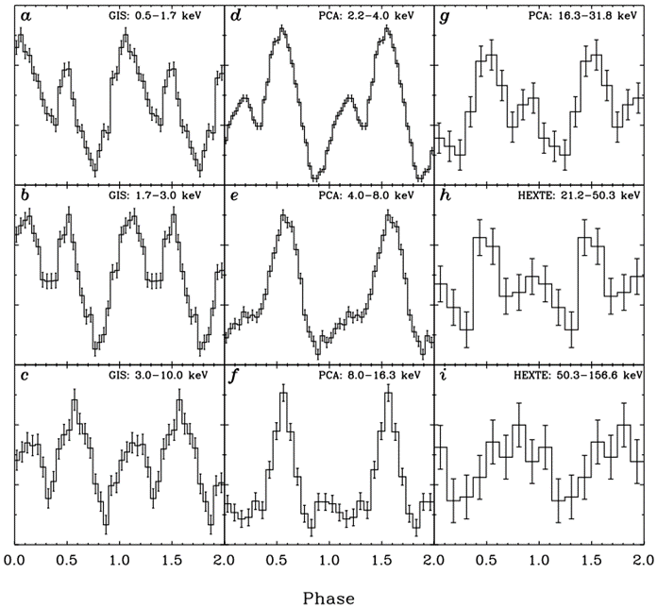
Magnetars Target List
4U 0142+61;
One of the brightest magnetars below 10 keV. It has a spin period of ≈8.6 s. 2 – 10 keV luminosity of the source is ≈1.05 x 10³⁵ erg/s and 2 – 10 keV unabsorbed flux is 6.79 x 10⁻¹¹ erg/cm²/s. The Pulse profile morphology is highly changing with energy and pulsed fraction increases from 10% at 20 keV to 100% between 80 and 100 keV.
Kuiper, L. et al. 2006, ApJ, 645, 556
5
Notes:
In order to achieve these objectives we propose to observe four magnetars

Slide 6
Magnetars Target List
1E 1841-045;
Another bright magnetar with a spin period of ≈11.8 s. 2 – 10 keV luminosity of the source is ≈1.8 x10³⁵ erg/s and 2 – 10 keV unabsorbed flux is ≈2.1 x10⁻¹¹ erg/cm²/s. As seen in the 4U 0142+61 pulse morphology of 1E 1841-045 changes and pulsed fraction increases with energy
An, H. et al. 2013, ApJ, 779, 163
6
Notes:
4U 0142+61 and 1E 1841-045 which are already detected in the hard X-ray band up to ~150 keV with RXTE and INTEGRAL will be a good starting point.

Slide 7
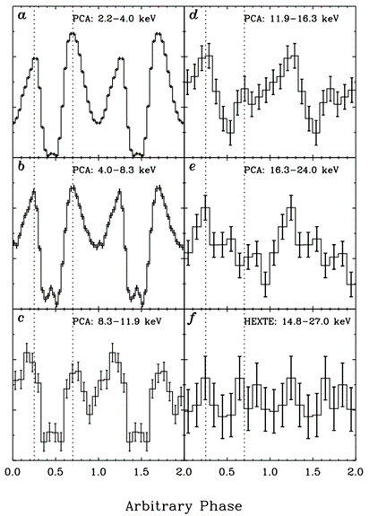
Magnetars Target List
1E 1048-5937;
Very interesting source with its bursting activity, glitches and the first anti-glitch detection in conjunction with a burst. The luminosity of the source in 2 – 10 keV range is ≈1.7 x 10³⁴ erg/s and the 2 – 10 keV unabsorbed flux is 1.4 x10⁻¹¹ erg/cm²/s. Very weak Hard X-ray emission (Kuiper et al. 2006). Pulsations above 20.0 keV using NuSTAR observations. One of the peaks in the pulse profile shifts along energy range. As seen in the other sources pulse profile morphology and pulsed fraction of 1E 2259+586 change in energy.
Kuiper, L. et al. 2006, ApJ, 645, 556
7

Slide 8
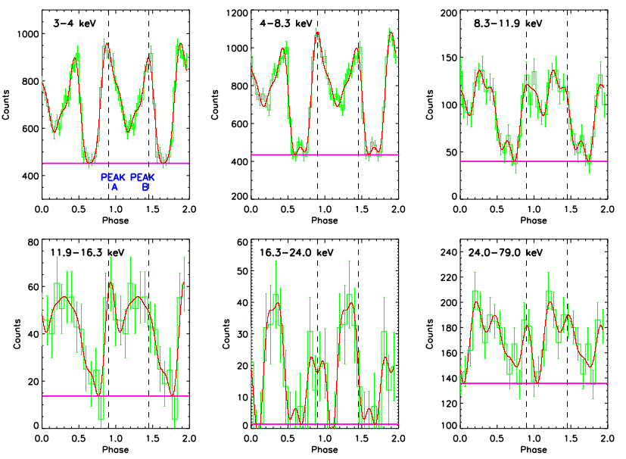
Magnetars Target List
1E 1048-5937;
Very interesting source with its bursting activity, glitches and the first anti-glitch detection in conjunction with a burst. The luminosity of the source in 2 – 10 keV range is ≈1.7 x 10³⁴ erg/s and the 2 – 10 keV unabsorbed flux is 1.4 x10⁻¹¹ erg/cm²/s. Very weak Hard X-ray emission (Kuiper et al. 2006). Pulsations above 20.0 keV using NuSTAR observations. One of the peaks in the pulse profile shifts along energy range. As seen in the other sources pulse profile morphology and pulsed fraction of 1E 2259+586 change in energy.
Vogel, J. et al. 2014, ApJ, 789, 75
8

Slide 9
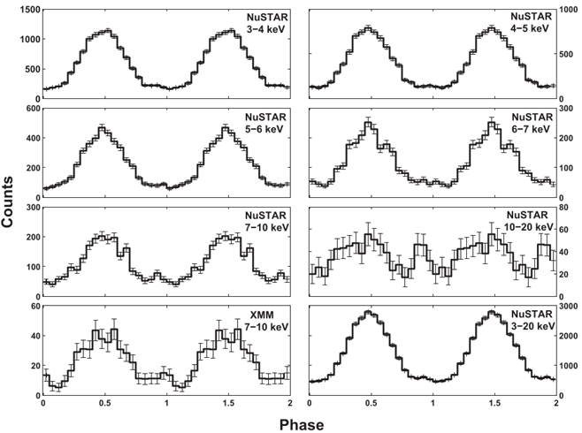
Magnetars Target List
1E 2259+586;
Another bright magnetar. The luminosity of the source in 2 – 10 keV energy range is ≈4.9 x 10³⁴ erg/s and its unabsorbed flux in the same energy range is ≈ 5 x 10⁻¹² erg/cm²/s. Search for hard X-ray emission with RXTE from this source resulted in no detection. NuSTAR detected this magnetar up to 20 keV. However, their analysis showed that long exposure observations are needed for modelling this source’s emission since it is weak in the hard X-ray band.
Yang, C. et al. 2016, ApJ, 831, 80
9

Slide 10
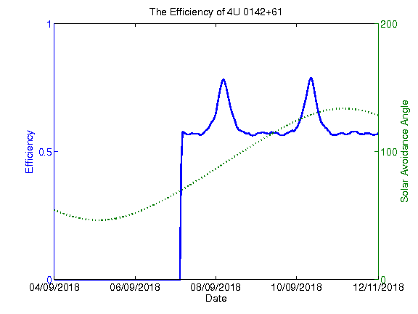
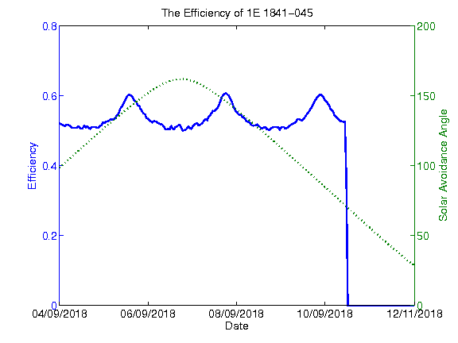
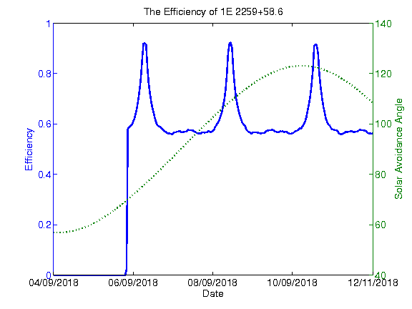
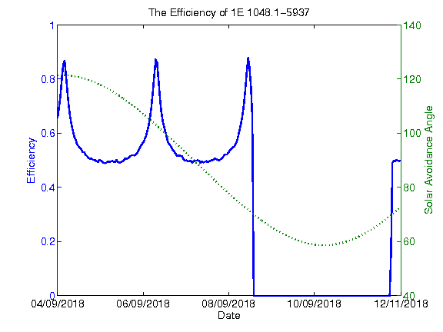
Observablity and FuturePlan
After July
Until November
After june
After September
10

Slide 11
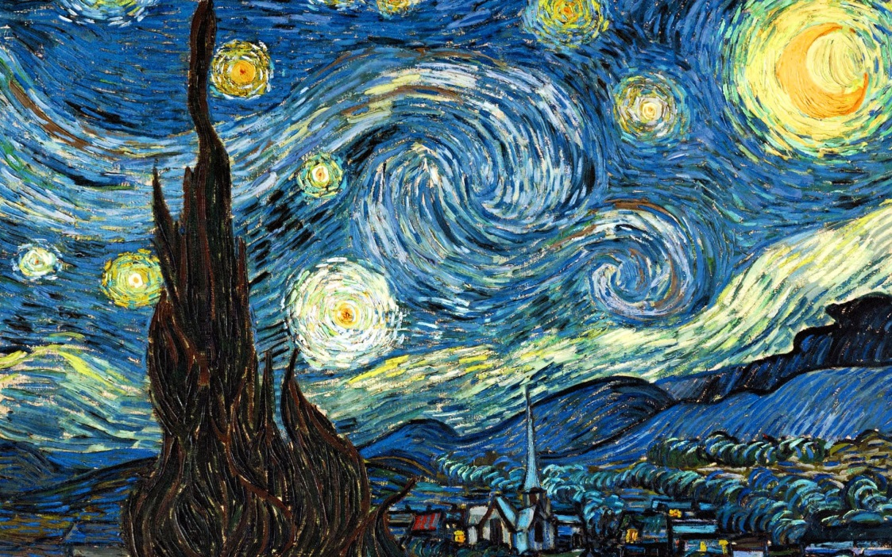
Thanks for listening
Can GÜNGÖR
Dr.
Institute of High Energy Physics,
Chinese Academy of Sciences

