Slide 1
HXMT observations of Her X-1
Long Ji
2018.1@IHEP

Slide 2
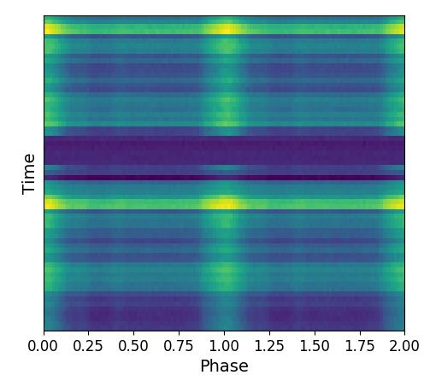
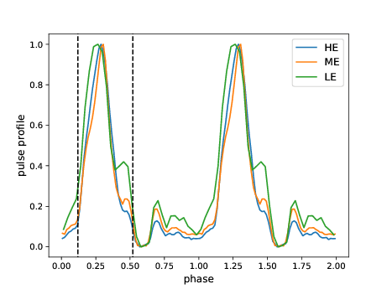
Data analysis
Phase-on-off
1, Using all available data
2, Using the pulse-off phase as the background

Slide 3
Summary of CRSFs
Short time variability?
Discrepancy between NuSATR/HXMT

Slide 4
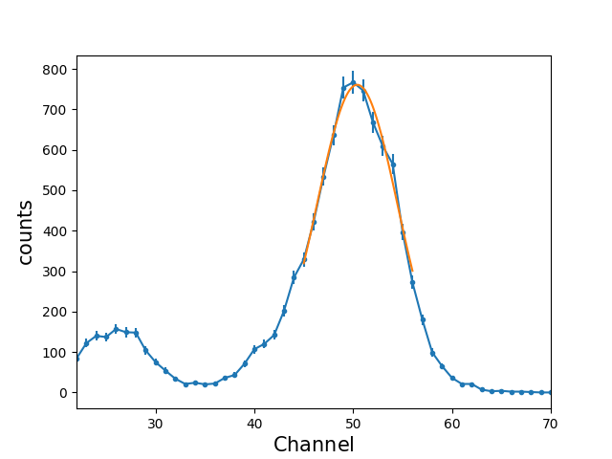
Try to understand the HE response files
Questions:
Is the energy-channel stable in the short time? Yes
Any long-term changes? Yes
A spectrum of the radiative source (Am)

Slide 5
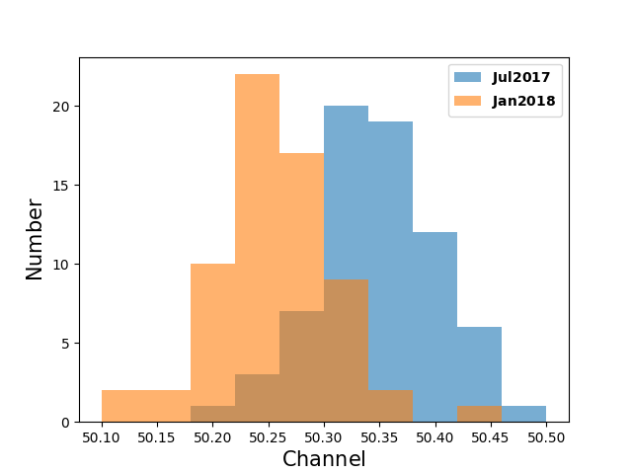
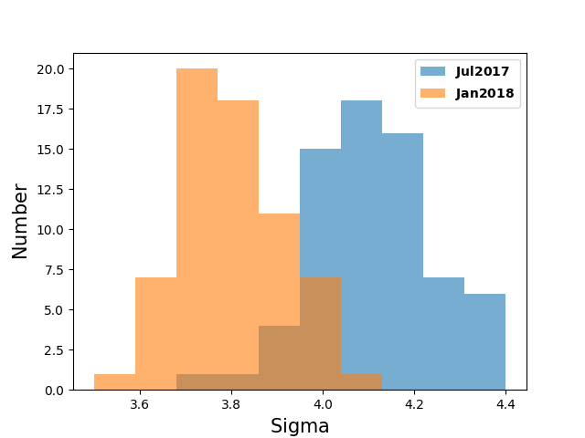
Try to understand the HE response files
Questions:
Is the energy-channel stable in the short time? Yes
Any long-term changes? Yes

Slide 6
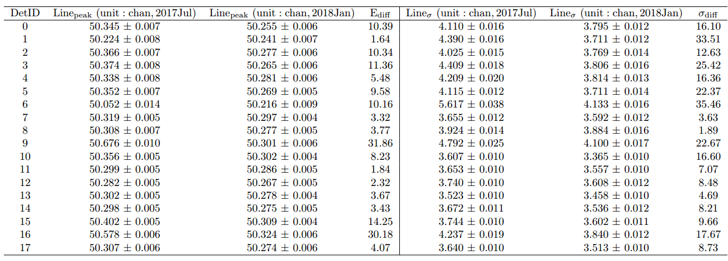
Try to understand the HE response files
Questions:
Can this have a significant influence on the detection of the CRSF? No
We need more monitoring to verify the short time changes of the CRSF

Slide 7
Try to understand the HE response files
the discrepancy between NuSTAR and HXMT
The results of HXMT are systematically ~1keV larger than NuSTAR
Does not due to the difference between averaged and ‘POP’ spectra

Slide 8
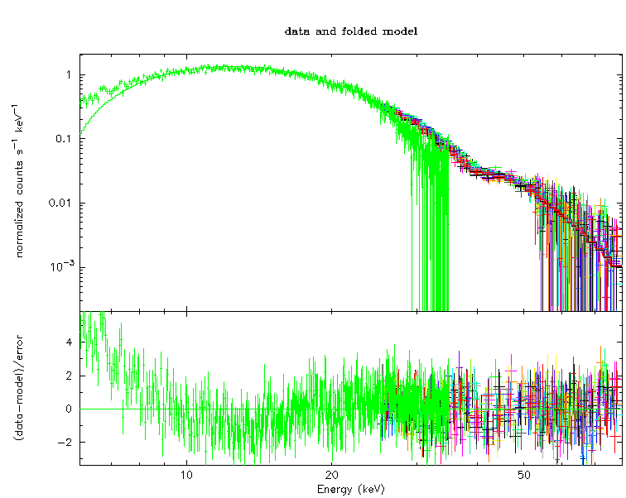
Strong residuals at low energies, the LE/ME response files should be further improved

