Slide 1
Spectral decomposition analysis
Long Ji
2018.1@IHEP

Slide 2
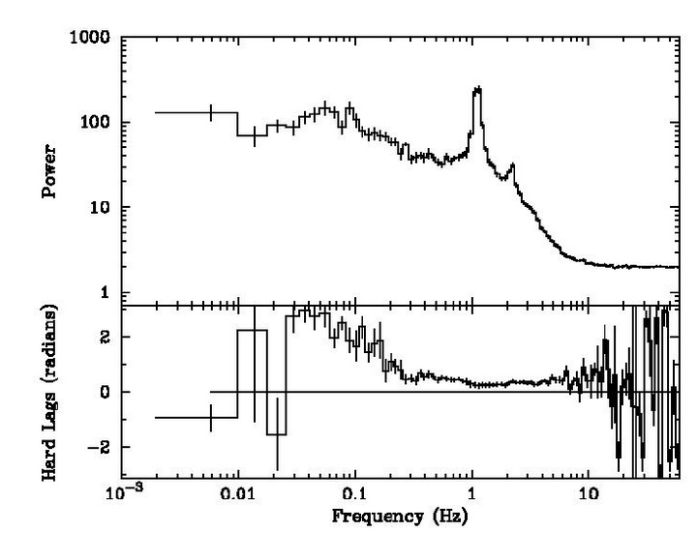
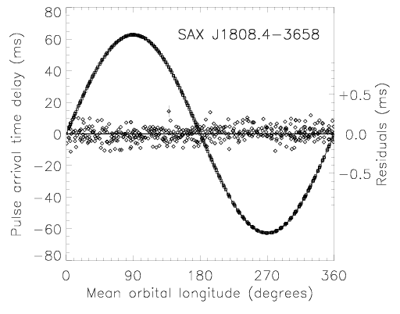
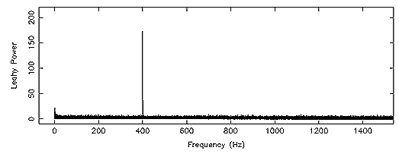
Background
traditional methods of data analysis
Light curve
Spectral
Timing (power/cross/lag spectrum)
Can we combine them?
Spectral-timing analysis
Spectral decomposition analysis

Slide 3
Outlines
principal component analysis (PCA)
non-negative matrix factorization (NMF)
$\left(\begin{matrix}F_{00} & \text{⋯} & F_{0C} \\ \text{⋮} & \text{⋱} & \text{⋮} \\ F_{T0} & \text{⋯} & F_{TC}\end{matrix}\right)$
The spectrum for T=0
$$F_{T∗C}≅\sum_{k=0}^{n}{A_{T∗k}B_{k∗C}}$$
Decomposing it into several components
But how?
The lightcurve for each channel

Slide 4
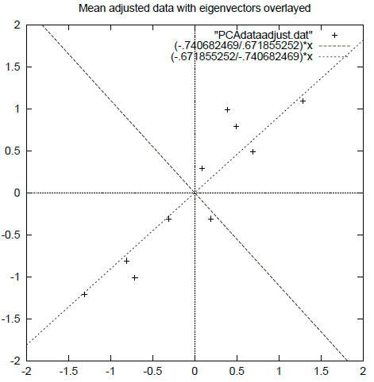
Principal component analysis (PCA)
A$\hat{x}$+B$\hat{y}$
Find the direction having max variance

Slide 5
Principal component analysis (PCA)
chan1
chan2
A$\hat{x}$+B$\hat{y}$
time
So A/B is meaningful
Find the direction having max variance

Slide 6
Principal component analysis (PCA)
chan1
chan2
…chanN
time
……
Find the direction having max variance

Slide 7
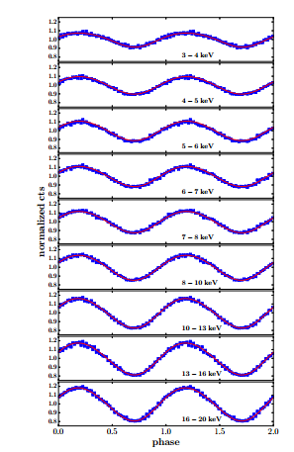
Principal component analysis (PCA)
For example: GRO J1744-28
$\text{What} \text{will} \text{contribute} \text{to} \text{the} \text{variance} \text{in} \text{our} \text{data}\text{?}$
$\text{Periodic} \text{variability}\text{ −−− }\text{close} \text{to} \text{the} \text{polar} \text{cap}$
$\text{Non}\text{−}\text{periodic} \text{variability}\text{ −−− }\text{accretion} \text{disk}\text{, }\text{background}\text{, }\text{etc}\text{.}$

Slide 8
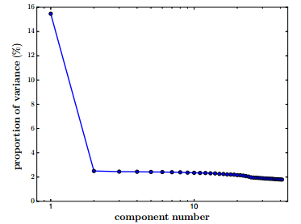
Principal component analysis (PCA)
How to choose “k” parameter?
Scree graphs, k=2
$$F_{T∗C}≅\sum_{k=0}^{n}{A_{T∗k}B_{k∗C}}$$

Slide 9
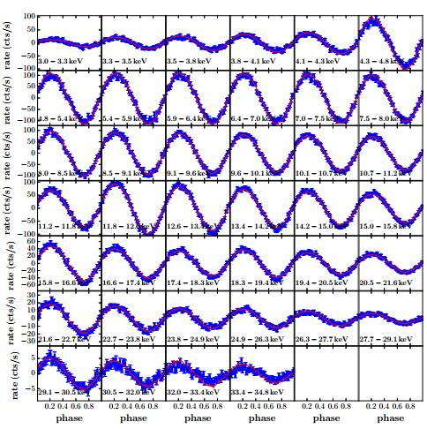
Principal component analysis (PCA)
Does the principal component correspond to the pulsation?
Check the folded lightcurve of the principal component and compare with the raw data

Slide 10
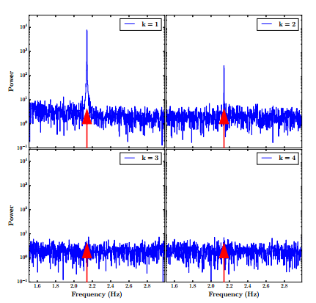
Principal component analysis (PCA)
Does the principal component correspond to the pulsation?
Check the PSD of each component
k=1 component contributes rarely all the power

Slide 11
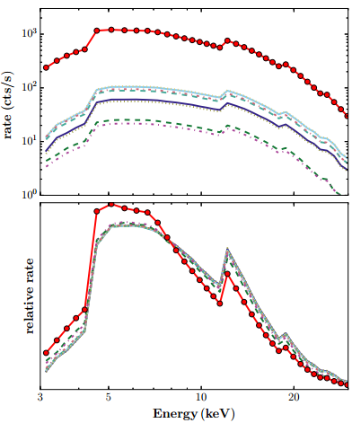
Principal component analysis (PCA)
Produce a modified database
$$F_{new_T∗C}≅\sum_{k=0}^{n=2}{A_{T∗k}B_{k∗C}}$$

Slide 12
non-negative matrix factorization (NMF)
Further constraint:
$F_{T∗C}≅\sum_{k=0}^{n}{A_{T∗k}B_{k∗C}}, A and B should be>0$
Different from PCA:
NMF basis vectors are not orthogonal, can be overlap among them
NMF is not unique
Convergence only to local minimum
Differerent NMF algorithms find different factorizations and same NMF algorithm with different parameters may lead to different factorization

Slide 13
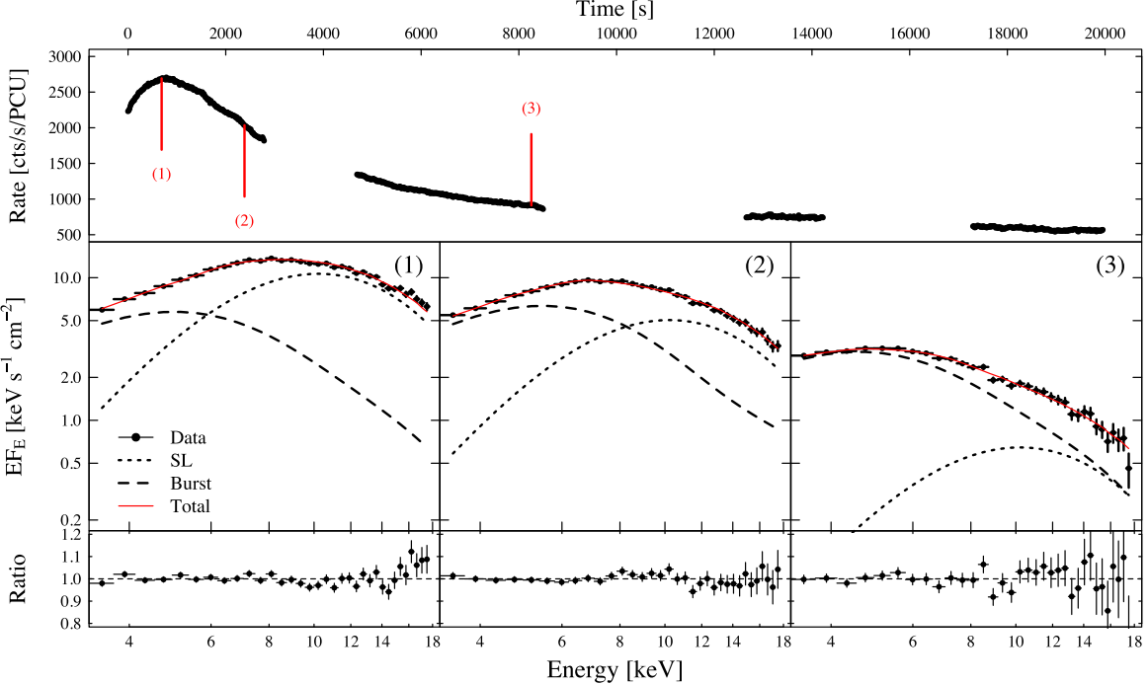
non-negative matrix factorization (NMF)
Example:
4U 1636-536
superburst
Koljonen et al 2016

Slide 14
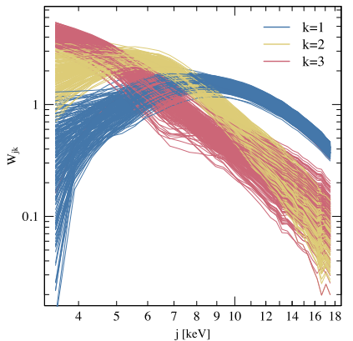
non-negative matrix factorization (NMF)
Decompose to 2 components:
1: k=1 spreading layer
2: k=2,3 burst

Slide 15
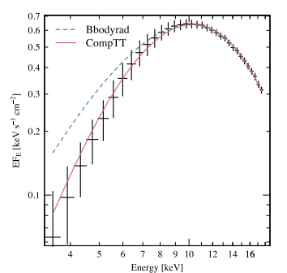
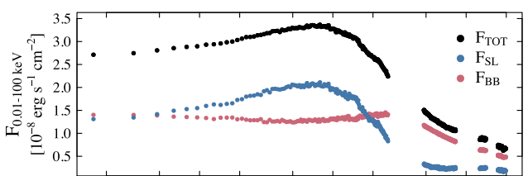
non-negative matrix factorization (NMF)
Extract the spectra of SL (CompTT)
Independently get the flux of$A_{T∗1}B_{1∗C},\sum_{k=2,3}{A_{T∗k}B_{k∗C}}$

Slide 16
Summary
Pros
can deal with large datasets
reflect our intuitions about the data
no special assumptions
Cons
Non-linear structure is hard to model
Black box, i.e., the meaning of the original variables may be difficult to assess
Caution: Computer does not always give a correct decomposition into parts!!
Thanks!

Slide 17
Principal component analysis (PCA)
Detailed process:
1, whitening
2, calculating covariance matrix
3, computing the eigenvalues and eigenvectors of ,
4, Principal component is , where
Different spectral shape
c
Variability of each eigenvector

