Slide 1

Partial Accretion in the Propeller Stage of Aql X-1
Can GÜNGÖR
Institute of High Energy Physics, Chinese Academy of Science
Notes:
Welcome and Thanks.

Slide 2
Outline:
Introduction
  Low Mass X-ray Binaries
  Accreting Millisecond X-ray Pulsars
  Classification and Spectral Evolution of Outbursts of Aql X-1
  Disk Structure of LMXBs – Basic definitions
Disk – Magnetosphere interaction stages;
  Accretion, Propeller, Radio pulsar
The Decay Stages of Outbursts, A new Technique
Applications; Aql X-1
Spectral modelling of RXTE/PCA data of Aql X-1
Results, Summary and Discussion
(Very) Pre-Liminary Results of Insight-HXMT and Future Plan
2

Slide 3
Low Mass X-ray Binaries
LMXBs are the binary systems containing a compact object (a black hole, a neutron star) and a low mass companion (M*<M_{ʘ}), also called ‘donor star’.
Accretion mechanism is Roche lobe overflow.
Old systems. Total life time is ≈10⁷⁻⁹ yr
Observed in the galactic disc, bulge and the globular clusters in the Milky Way
Relatively low magnetic filed ≈10⁸⁻⁹ G.
Recyling Scenario; LMXBs are possible incubator of millisecond pulsars. Accretion onto NS can be the reason of conversion of slow rotator NS with high magnetic field to fast spinning and low magnetic field NS.
3
Notes:
The systems containing white dwarf radiate the most of their energy in UV band (Cataclysmic V.).
Mostly main sequence stars but some can be red giants, but both fills their Roche Lobe.
In the High mass X-ray binary case, accretion mechanism is wind accretion and/or accretion disk

Slide 4
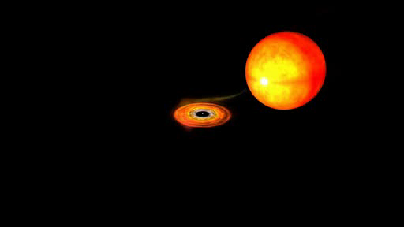
NASA Animation

Slide 5
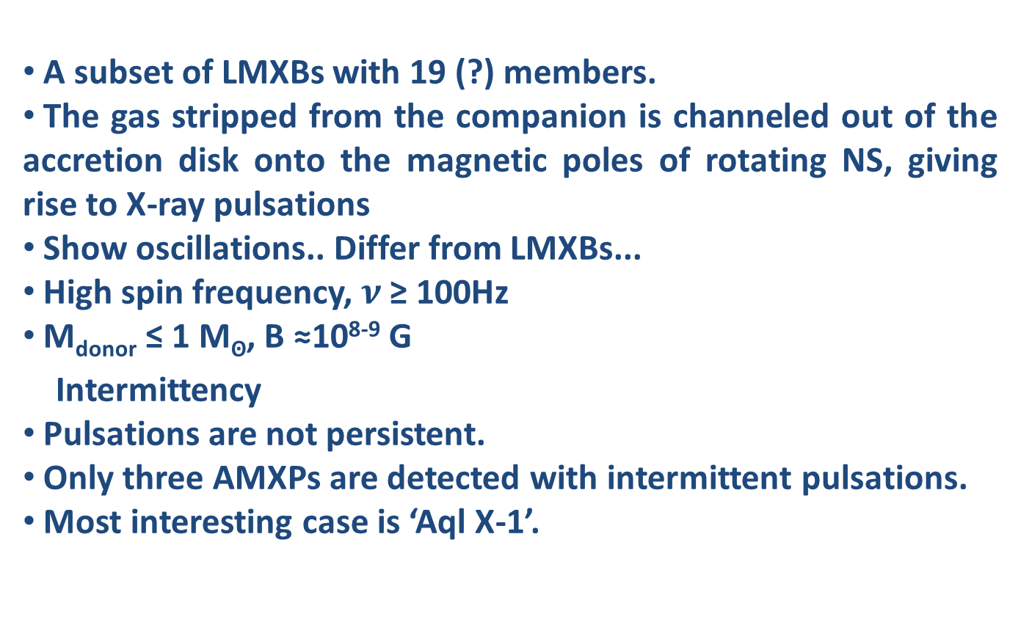
Accreting Millisecond X-ray Pulsars
A subset of LMXBs with 19 (?) members.
The gas stripped from the companion is channeled out of the accretion disk onto the magnetic poles of rotating NS, giving rise to X-ray pulsations
Show oscillations.. Differ from LMXBs...
High spin frequency, $ν$ ≥ 100Hz
M_{donor} ≤ 1 M_{ʘ}, B ≈10⁸⁻⁹ G
Intermittency
Pulsations are not persistent.
Only three AMXPs are detected with intermittent pulsations.
Most interesting case is ‘Aql X-1’.
5

Slide 6
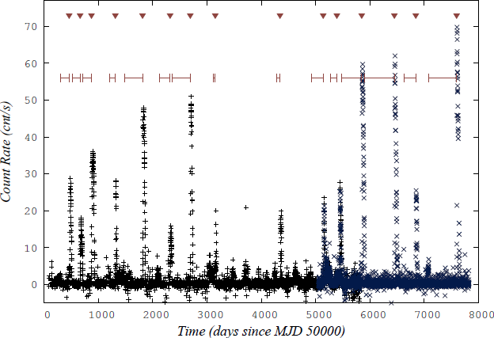
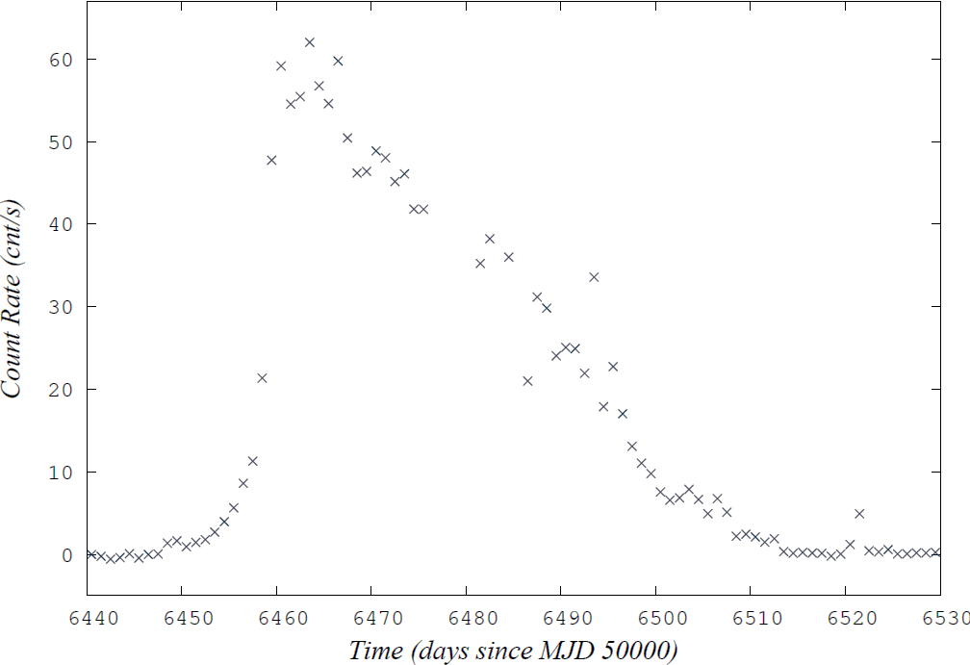
Aql X-1
V1333 Aql -- Low Mass X-ray Binary
Quiescent L_{X} ≈ 10³³ erg s⁻¹, Outburst L_{X} ≈ 10³⁵ erg s⁻¹
Quiescent B ≈ 17 mag, Outburst B ≈ 14 mag
P_{orb}= 18.95 hr, Spin Frequency= 550.27 Hz
Spectral Type of companion: K6-M0
22 years light curve of Aql X-1 obtained by “Maxi” and “ASM”
6

Slide 7
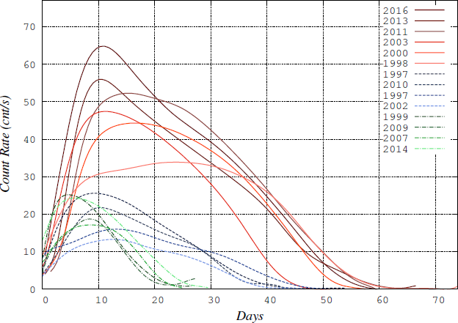
Aql X-1
Long – High Outbursts:
50-60 days, 37-61 cnt/s
Medium – Low Outbursts: 40-50 days, 13-25 cnt/s
Short – Low Outbursts:
20 days, 17-25 cnt/s
Gungor et al. 2014MNRAS.439.2717G,
Gungor et al. 2017NewA...56....1G
7

Slide 8
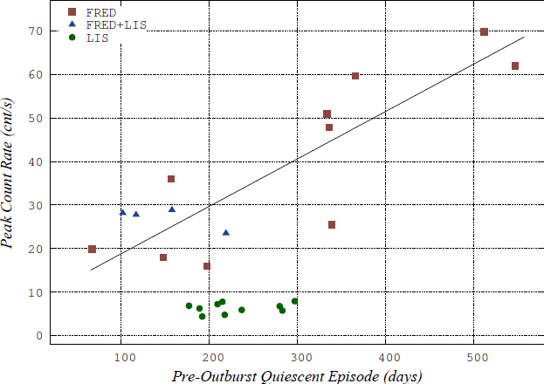
Aql X-1
Long – High Outbursts:
50-60 days, 37-61 cnt/s
Medium – Low Outbursts: 40-50 days, 13-25 cnt/s
Short – Low Outbursts:
20 days, 17-25 cnt/s
Gungor et al. 2014MNRAS.439.2717G,
Gungor et al. 2017NewA...56....1G
8

Slide 9
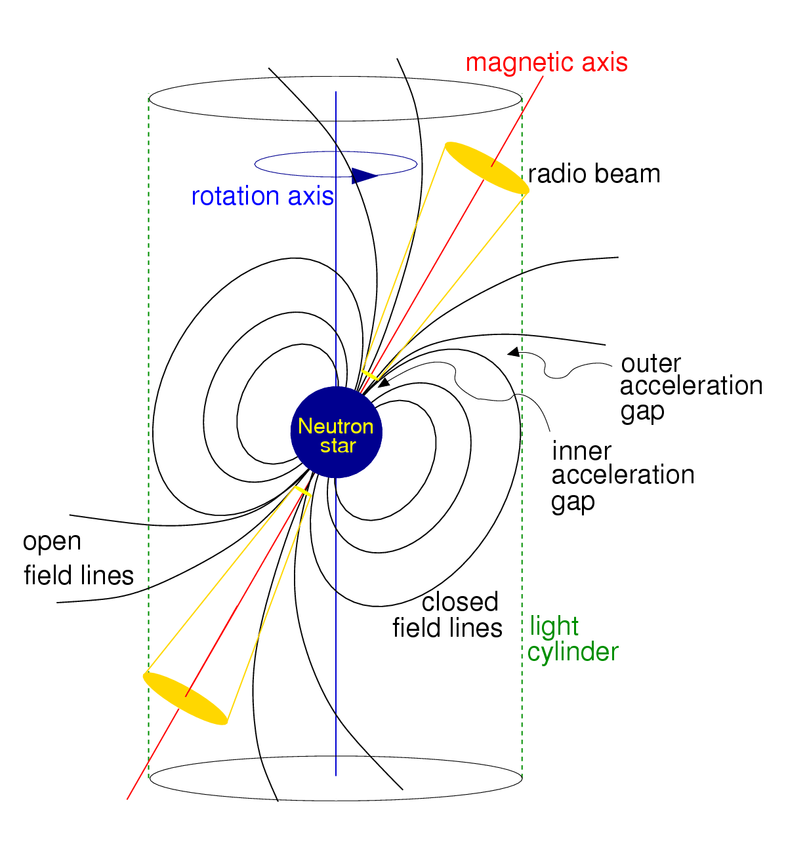
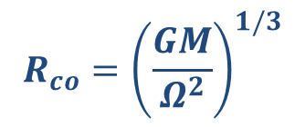

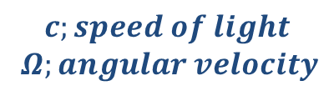
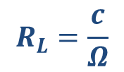
Two Critical Radii of Disk Structure
Light cylinder; The cylinder centered on the pulsar and aligned with the rotation axis at whose radius the co-rotating speed equals the speed of light
$$R_{L}=\frac{c}{Ω}$$
$$c;speed of light$$
$Ω;angular velocity$
Corotation Radius: The radius that the angular velocity of the star is equal to Keplerian angular velocity.
$$R_{co}={\left(\frac{GM}{Ω^{2}}\right)}^{1/3}$$
$ΩK = (GM/r3)$^{1/2}
9

Slide 10
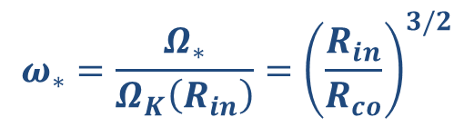

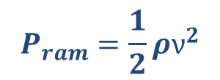
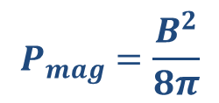
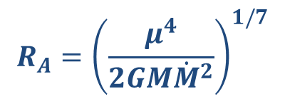
Basic Definitions of Disk Structure
Fastness Parameter; A ratio of the angular velocity of the star to Keplerian angular velocity at the inner disk radius.
$$ω_{∗}=\frac{Ω_{∗}}{Ω_{K}\left(R_{in}\right)}={\left(\frac{R_{in}}{R_{co}}\right)}^{3/2}$$
Alfvén Radius; The radius where the magnetic stresses and the material stresses (ram pressure) are balanced.
$$R_{A}={\left(\frac{μ^{4}}{2GM{\dot{M}}^{2}}\right)}^{1/7}$$
$$P_{mag}=\frac{B^{2}}{8π}$$
$$P_{ram}=\frac{1}{2}ρν^{2}$$
$$R_{in}=ζ{ R}_{A}$$
$ζ≅0.5$ for disk accretion (Gosh & Lamb)
10

Slide 11


Disk – Magnetosphere interaction Stages
Radio Pulsar Stage: If the inner radius of the disk is located out of the light cyclinder, the system acts as an isolated neutron star.
$R_{in} >R_{light cyc}$
No Accretion
No Evidence of the dics existence in the X-ray light curve
Propeller Stage: The inner radius of the disk is around the corotation radius, then not all of the material transferred from outer layers to inner layers can fall onto the pole.
${R_{light cyc}>R}_{in} ≈R_{co}$
Partial Accretion
The possible evidence is the knee between the slow decay phase to fast decay phase of an outburst.
11

Slide 12
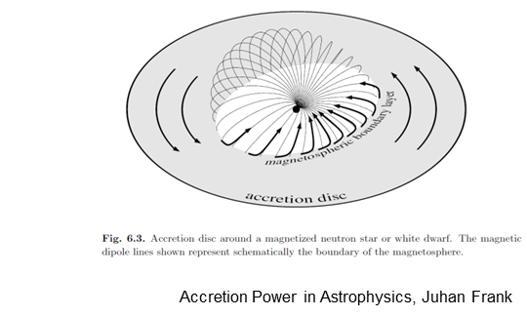

Disk – Magnetosphere interaction Stages
Accretion Stage: The inner radius of the disk penetrates to corotation radius. All of the material transfering inner layers falls onto the neutron star poles.
$R_{in} <R_{co}$
12

Slide 13
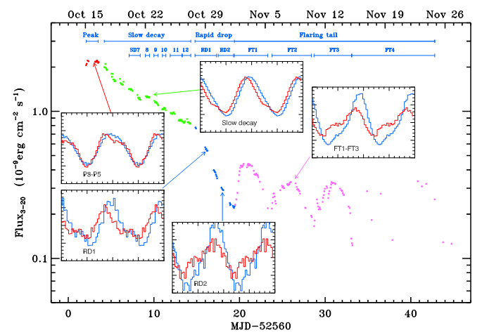
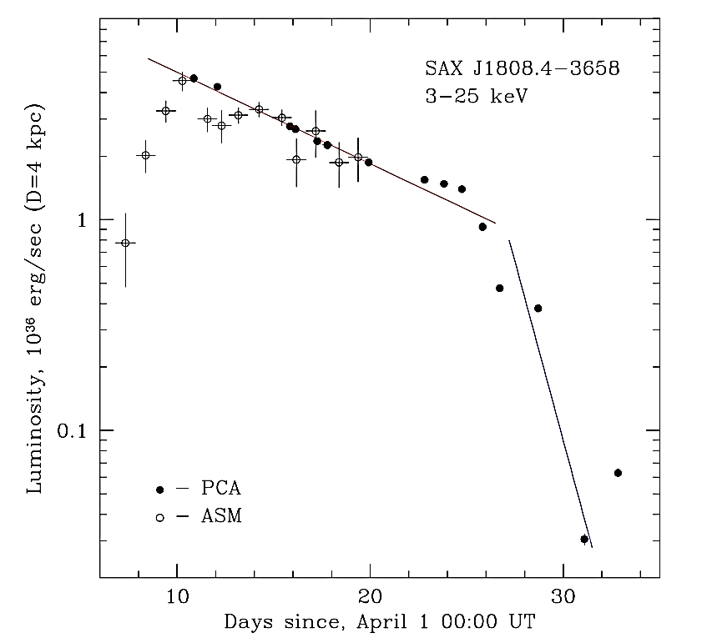
The Decay Stages of Outbursts
2002 outburst of SAX 1808.4 – 3658, Ibragimov & Pountanen 2009
1998 outburst of SAX 1808.4 – 3658, Gifanov et al. 1998
13
Notes:
They discuss the cut of in the decay of outburst may refer to transition from accretion stage to propeller stage. The oscilations in the light curve after outburst has not been understood yet.

Slide 14
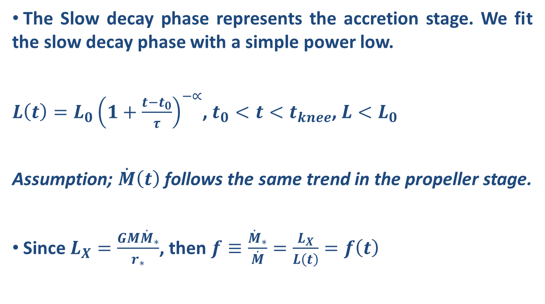
The Decay Stages of Outbursts
The Slow decay phase represents the accretion stage. We fit the slow decay phase with a simple power low.
$L\left(t\right)=L_{0}{\left(1+\frac{t−t_{0}}{τ}\right)}^{−∝}$, $t_{0}<t<t_{knee}$, $L<L_{0}$
Assumption; $\dot{M}\left(t\right)$ follows the same trend in the propeller stage.
Since $L_{X}=\frac{GM{\dot{M}}_{∗}}{r_{∗}}$, then $f≡\frac{{\dot{M}}_{∗}}{\dot{M}}=\frac{L_{X}}{L\left(t\right)}=f\left(t\right)$
14
Notes:
Mdot(t) is the mass transfer rate from outer layers to inner layer. It follows same trend in propeller stage as it shows in accretion stage.

Slide 15
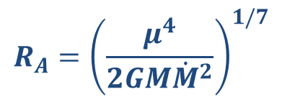
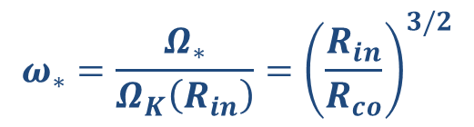
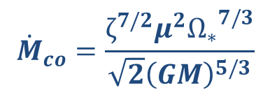
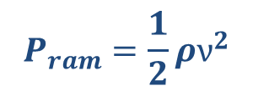

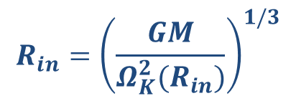
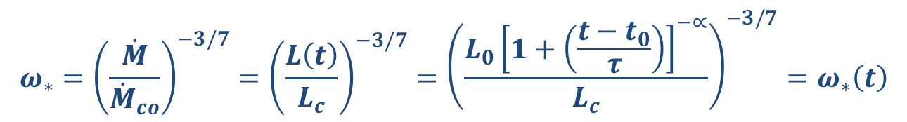
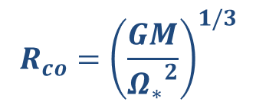

The Decay Stages of Outbursts
Fastness Parameter; A ratio of the angular velocity of the star to Keplerian angular velocity at the inner disk radius.
$$ω_{∗}=\frac{Ω_{∗}}{Ω_{K}\left(R_{in}\right)}={\left(\frac{R_{in}}{R_{co}}\right)}^{3/2}$$
$$R_{co}={\left(\frac{GM}{{Ω_{∗}}^{2}}\right)}^{1/3}$$
$$R_{in}={\left(\frac{GM}{Ω_{K}^{2}(R_{in})}\right)}^{1/3}$$
When $R_{in}=R_{co}$, we can define the critical mass accretion${ (\dot{M}}_{co})$ rate as following;
$${\dot{M}}_{co}=\frac{ζ^{7/2}μ^{2}{Ω_{∗}}^{7/3}}{\sqrt{2}{\left(GM\right)}^{5/3}}$$
$$R_{A}={\left(\frac{μ^{4}}{2GM{\dot{M}}^{2}}\right)}^{1/7}$$
$$R_{in}=ζ{ R}_{A}$$
Alfvén Radius; The radius where the magnetic stresses and the material stresses (ram pressure) are balanced.
$$P_{mag}=\frac{B^{2}}{8π}$$
$$P_{ram}=\frac{1}{2}ρν^{2}$$
$$ω_{∗}={\left(\frac{\dot{M}}{{\dot{M}}_{co}}\right)}^{−3/7}={\left(\frac{L\left(t\right)}{L_{c}}\right)}^{−3/7}={\left(\frac{L_{0}{\left[1+\left(\frac{t−t_{0}}{τ}\right)\right]}^{−∝}}{L_{c}}\right)}^{−3/7}=ω_{∗}\left(t\right)$$
15
Notes:
Omega and Omega(Rin) can be taken from the equations at the right hand side and we can write omega in terms of Rin and Rco

Slide 16
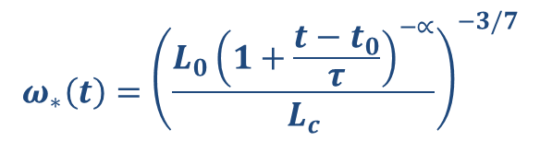
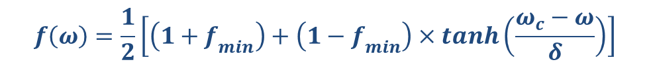

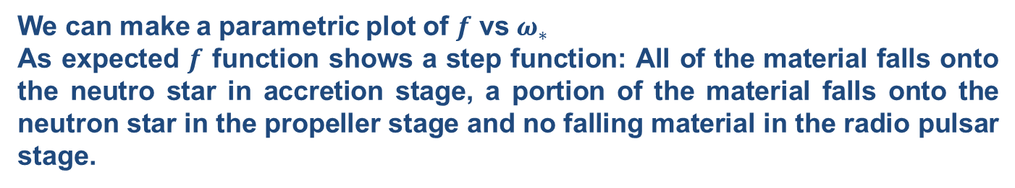
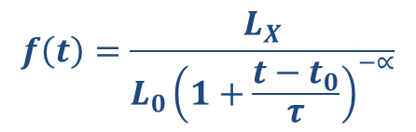
The Decay Stages of Outbursts
As a result, we obtain two parameters, both depends on time
$${ω_{∗}\left(t\right)=\left(\frac{L_{0}{\left(1+\frac{t−t_{0}}{τ}\right)}^{−∝}}{L_{c}}\right)}^{−3/7}$$
$$f\left(t\right)=\frac{L_{X}}{L_{0}{\left(1+\frac{t−t_{0}}{τ}\right)}^{−∝}}$$
We can make a parametric plot of $f$ vs $ω_{∗}$
As expected $f$ function shows a step function: All of the material falls onto the neutro star in accretion stage, a portion of the material falls onto the neutron star in the propeller stage and no falling material in the radio pulsar stage.
$$f\left(ω\right)=\left\{\begin{aligned}1, ω<1 \\ 0, ω≥1\end{aligned}\right.$$
$$f\left(ω\right)=\frac{1}{2}\left[\left(1+f_{min}\right)+\left(1−f_{min}\right)×tanh\left(\frac{ω_{c}−ω}{δ}\right)\right]$$
16

Slide 17
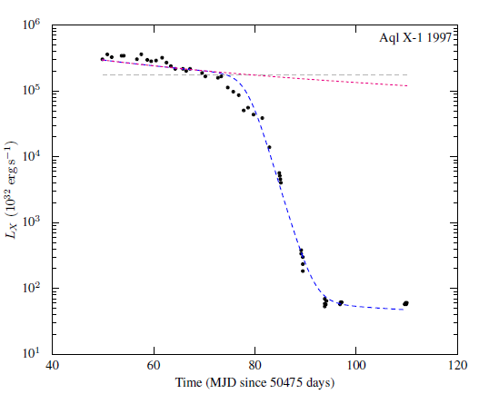
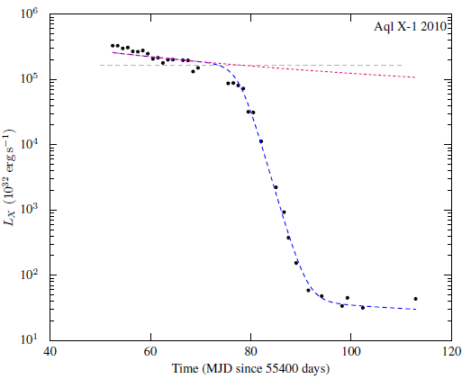
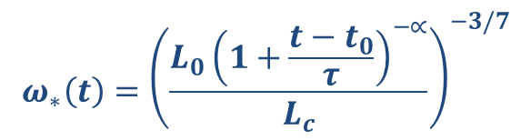


A New Method to Describe Outbursts
$${ω_{∗}\left(t\right)=\left(\frac{L_{0}{\left(1+\frac{t−t_{0}}{τ}\right)}^{−∝}}{L_{c}}\right)}^{−3/7}$$
$f\left(t\right)=\frac{1}{2}\left[\left(1+f_{min}\right)+\left(1−f_{min}\right)×tanh\left(\frac{ω_{c}−ω(t)}{δ}\right)\right]$,
$L\left(t\right)=L_{0}{\left(1+\frac{t−t_{0}}{τ}\right)}^{−∝}$, $t_{0}<t<t_{knee}$,
$$L_{x}\left(t\right)=L_{0}{\left(1+\frac{t−t_{0}}{τ}\right)}^{−∝}×f\left(t\right)$$
17
Campana, S., et al. 2014, MNRAS, 441, 1984

Slide 18
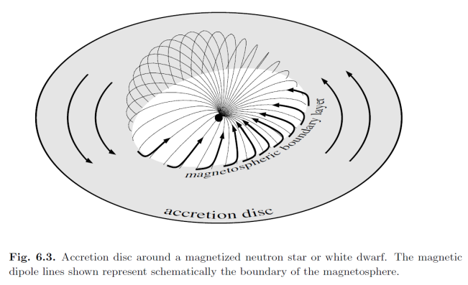
Observation and Data Analysis
However...
The X-ray light does not only come from the pole but also few percentage of total luminosity we take, comes from the disk. To link the light curve to the propeller stage, one should first separate the light comes from the pole caused by an accretion and obtain a light curve only for magnetic pole.
RXTE/PCA observation of 2000 and 2011 outbursts of Aql X-1
Model: blackbody + diskblackbody + gauss
  Blackbody represents NS poles
  Disk blackbody represents inner disk
  Gauss represents iron line
Accretion Power in Astrophysics, Juhan Frank
18
Notes:
Analysis with Eqpair which is a hybrid model representing thermal and non-thermal component.

Slide 19
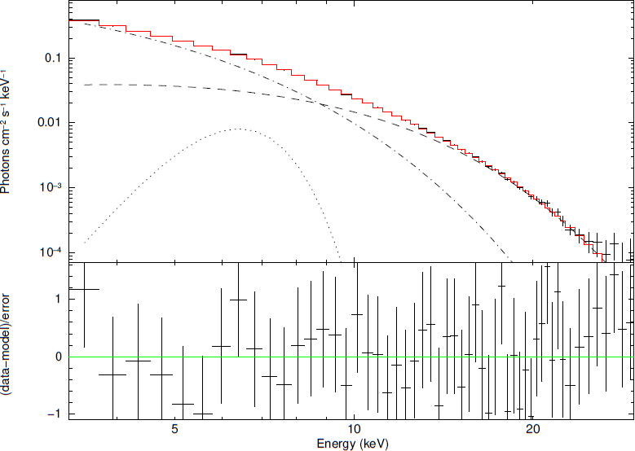
Observation and Data Analysis
An example spectrum obtained by RXTE/PCA, the model is bb+diskbb+ga
19

Slide 20
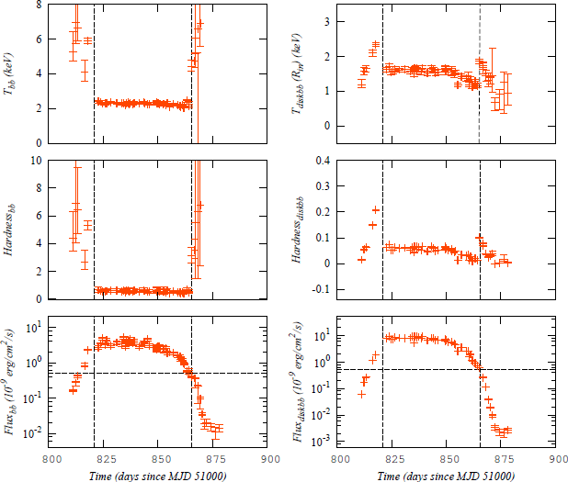
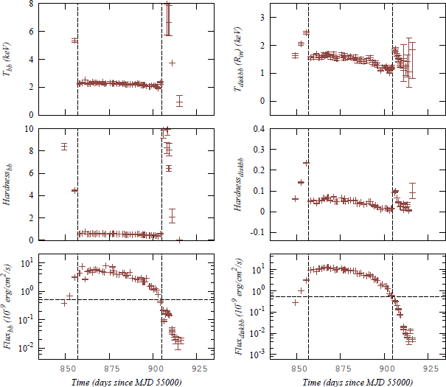
Observation and Data Analysis
Result of sprectral analyses of RXTE observation of 2000 and 2011 outbursts of Aql X-1.
The light curve for the blackbody component (bottom left), the light curve for the disk blackbody component (bottom right), the time evolution of the ratio of the flux in the range of 3-10 keV to to the flux 5-30 keV only for blackbody component (middle left), the time evolution the ratio of the flux in the range of 3-10 keV to to the flux 5-30 keV only for disk blackbody component (middle right), the time evolution of the temperature of the blackbody in keV (top left), the time evolution of the Inner disk temperature of disk blackbody component (top right).

Slide 21
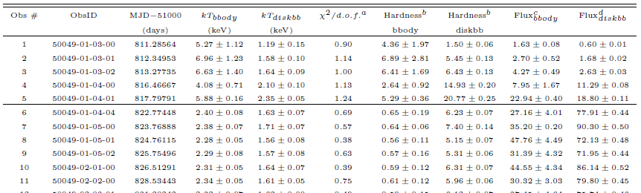
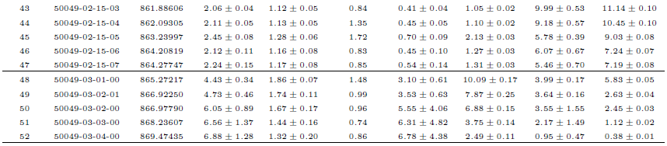
Applicatons: Aql X–1 2000 RXTE/PCA
The 2000 outburst RXTE/PCA – Black body + Disk black body + Gauss

Slide 22
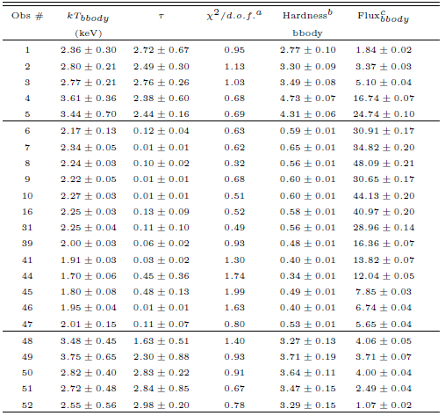
Applicatons: Aql X–1 2000 RXTE/PCA
The 2000 outburst RXTE/PCA – black body + Comptonisation + disk black body + Gauss

Slide 23
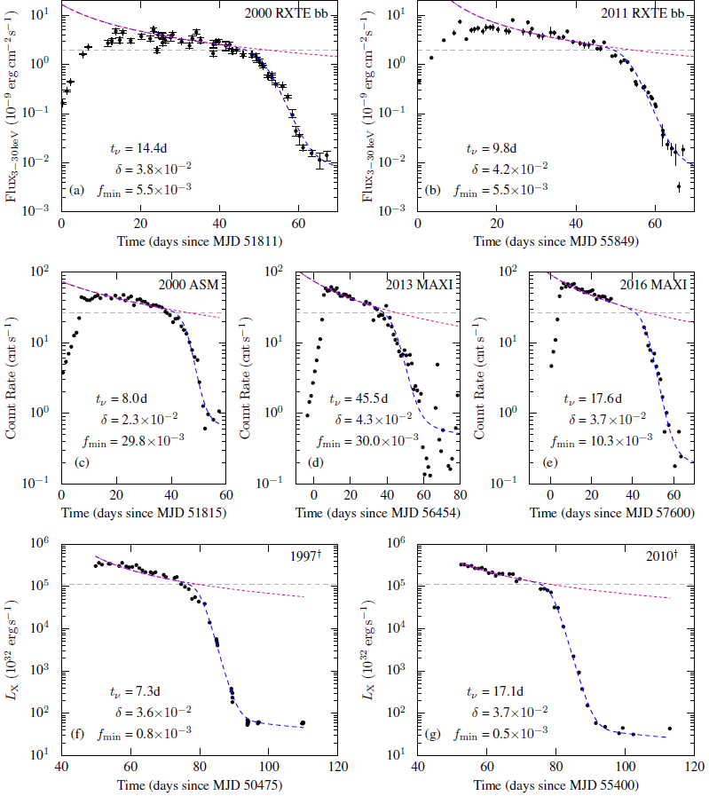
A New Method to Describe Outbursts
23

Slide 24


Result:
24
Notes:
Gnuplot: nonlinear least-squares (NLLS) Marquardt-Levenberg algorithm

Slide 25
Pre-liminary Results from Insight-HXMT
Aql X-1 has been observed by Insight-HXMT three times just after the transition from the soft state to the hard state.
2018/3/19 19:09:24 O011466801001 10ks Exposure
2018/3/20 19:01:00 O011466801002 10ks Exposure
2018/3/22 06:00:39 O011466801003 10ks Exposure
25

Slide 26
Pre-liminary Results from Insight-HXMT
Aql X-1 has been observed by Insight-HXMT three times just after the transition from the soft state to the hard state.
2018/3/19 19:09:24 O011466801001 10ks Exposure
2018/3/20 19:01:00 O011466801002 10ks Exposure
2018/3/22 06:00:39 O011466801003 10ks Exposure
26

Slide 27
Pre-liminary Results from Insight-HXMT
Aql X-1 has been observed by Insight-HXMT three times just after the transition from the soft state to the hard state.
2018/3/19 19:09:24 O011466801001 10ks Exposure
2018/3/20 19:01:00 O011466801002 10ks Exposure
2018/3/22 06:00:39 O011466801003 10ks Exposure
kT_{bbody}=1.56±0.16 keV
kT_{diskbb}=0.9±0.05 keV
27

Slide 28
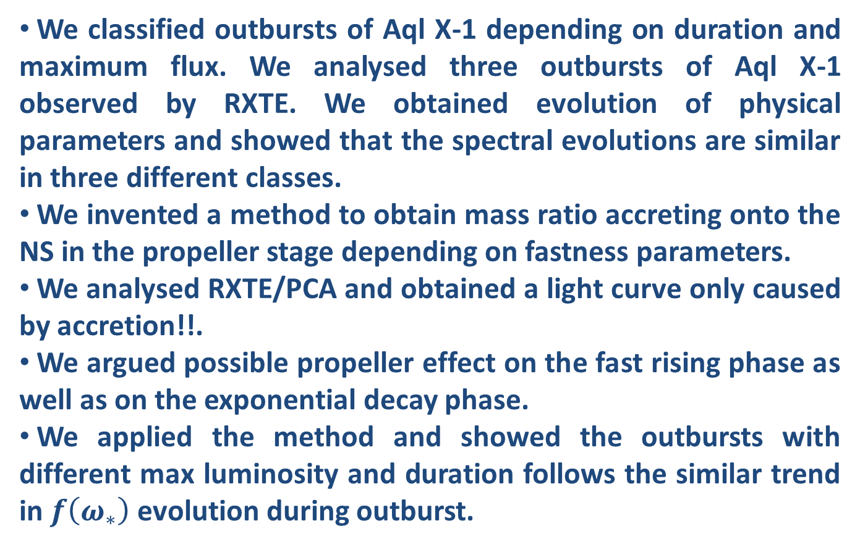
Summary and Discussion:
We classified outbursts of Aql X-1 depending on duration and maximum flux. We analysed three outbursts of Aql X-1 observed by RXTE. We obtained evolution of physical parameters and showed that the spectral evolutions are similar in three different classes.
We invented a method to obtain mass ratio accreting onto the NS in the propeller stage depending on fastness parameters.
We analysed RXTE/PCA and obtained a light curve only caused by accretion!!.
We argued possible propeller effect on the fast rising phase as well as on the exponential decay phase.
We applied the method and showed the outbursts with different max luminosity and duration follows the similar trend in $f\left(ω_{∗}\right)$ evolution during outburst.
28
Notes:
A longer waiting time before an outburst might lead to larger amount of matter accumulation in the disc resulting in long-high-type outbursts.
It might be that only during the long high outbursts the inner radius of the disc penetrates the corotation radius leading to substantial accretion, while the medium low and the short low both proceed by partial accretion during the spin-down regime.
A different portion of the disc is involved in different types of outbursts probably because of different irradiation geometries involved.
Spectral properties of the disc during outburst, can be different for each classes.

Slide 29
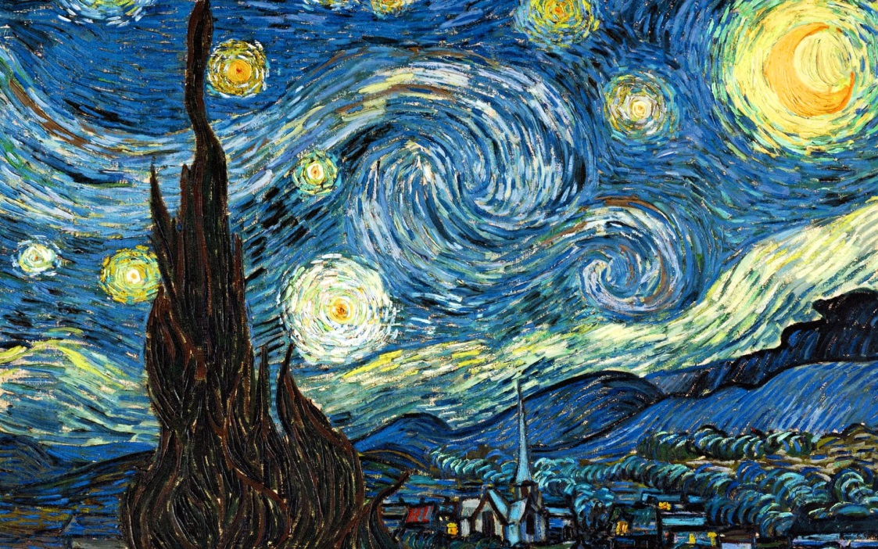
Thanks for listening
Can GÜNGÖR
Dr.
Institute of High Energy Physics,
Chinese Academy of Sciences

