Slide 1
In orbit calibration of Insight-HXMT
LI Xiaobo
2018-04-01

Slide 2
Outline
HE calibration
ME calibration
LE calibration

Slide 3
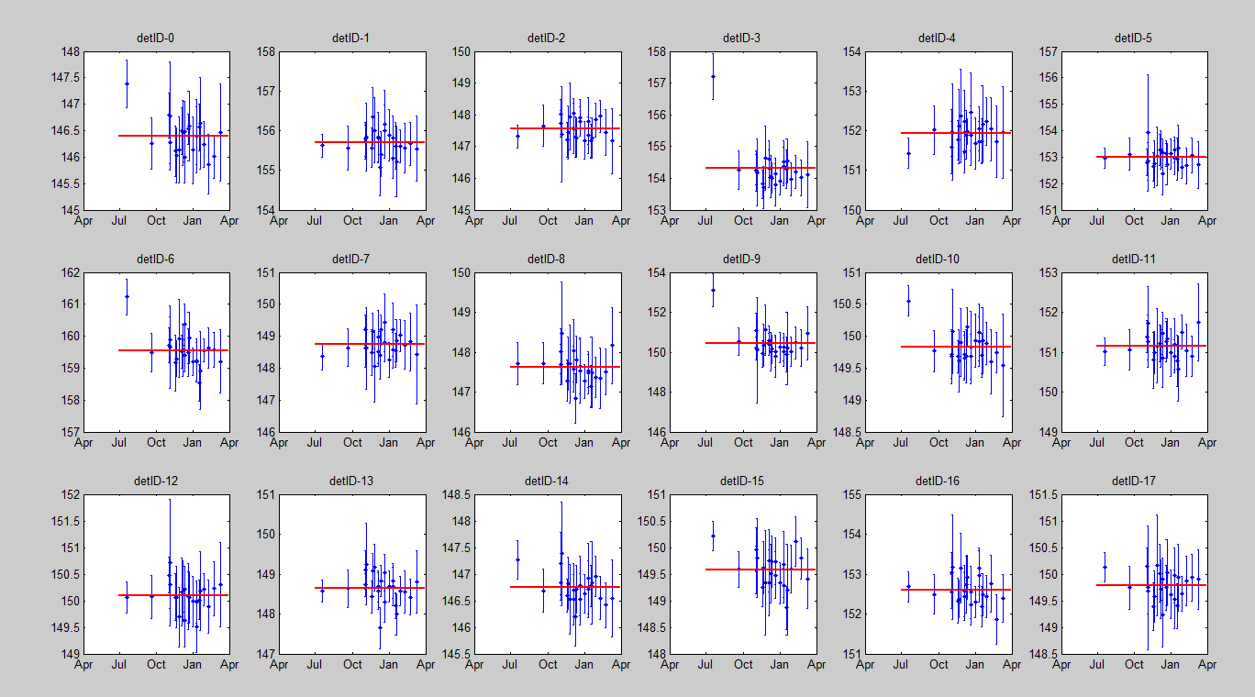
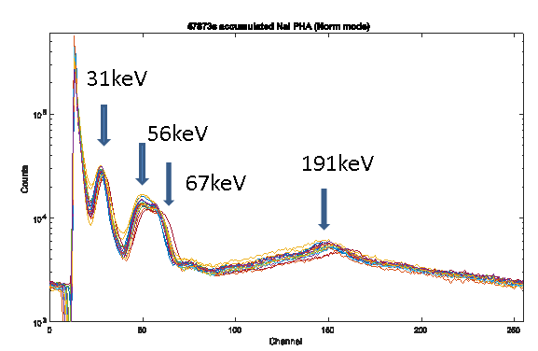
HE/NaI: Energy-Channel Calibration
Four lines can be found in blank sky observation. They will be used as the EC and energy resolution calibration.
191keV line will be used to monitor the long stability of EC relation.
Notes:
multiply

Slide 4
HE/NaI: ARF Calibration
Exposure time(ks)
Crab: the standard X-ray candle with X-ray satellites
We use the crab pulsar to calibrate the ARF in order to avoid the influence of background.

Slide 5
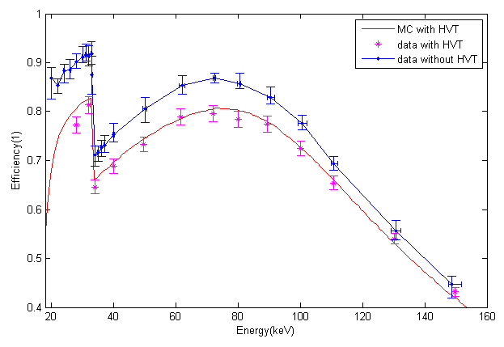
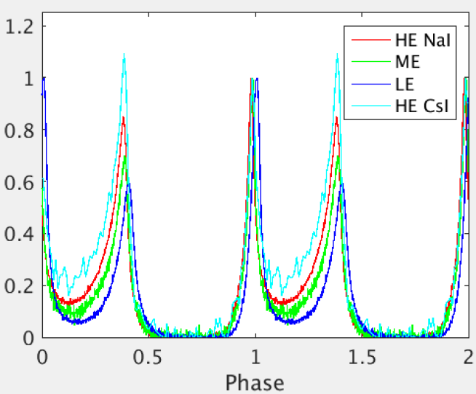
ARF calibration
Pulse off: 0.6-0.8; Pulse On-Pulse off: 1-5*(0.6-0.8)
Pulse profile of Crab
Full Peak Efficiency of NaI detectors with or without ACD on ground
Notes:
germanium
[dʒɝ'menɪəm]
This plot shows the…
And this one shows the efficiency comparaison of MC and experiment result.
In orbit, we have use the Pulsars to calibrate the response in order to decrease the influence of background model.
So our method is the pulse on minus pulse off.

Slide 6
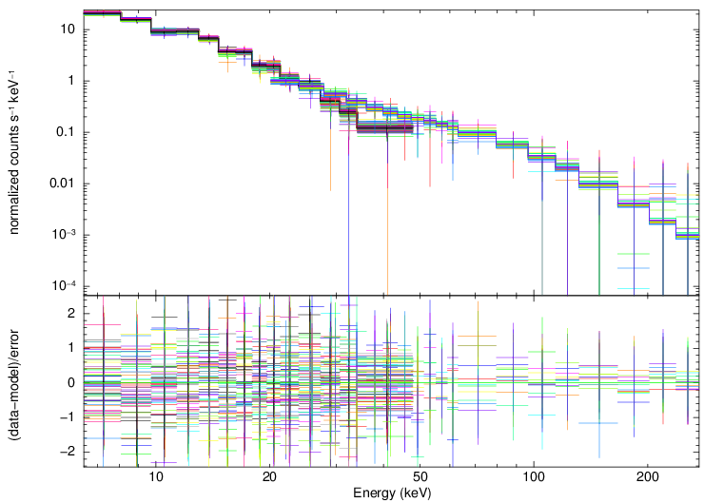
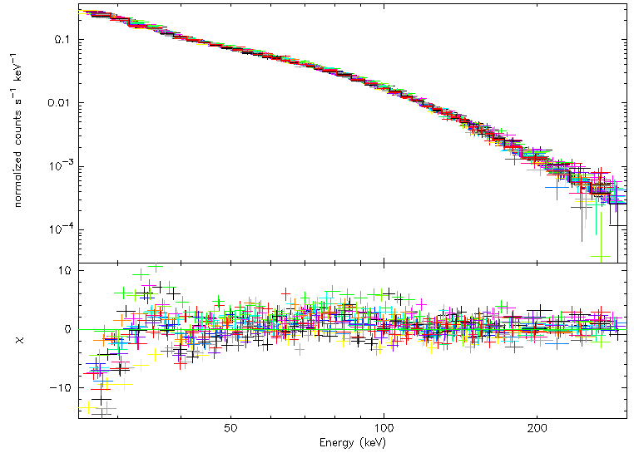
Spectrum fit of Crab pulsar：
RXTE/PCA and HEXTE 2011 obs.
Insight-HXMT/HE 2017 obs.

Slide 7
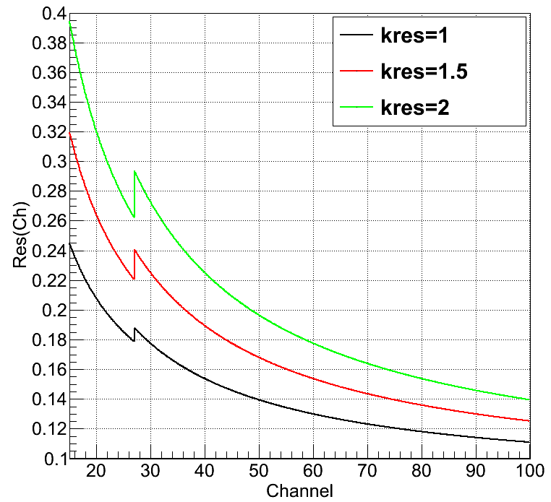
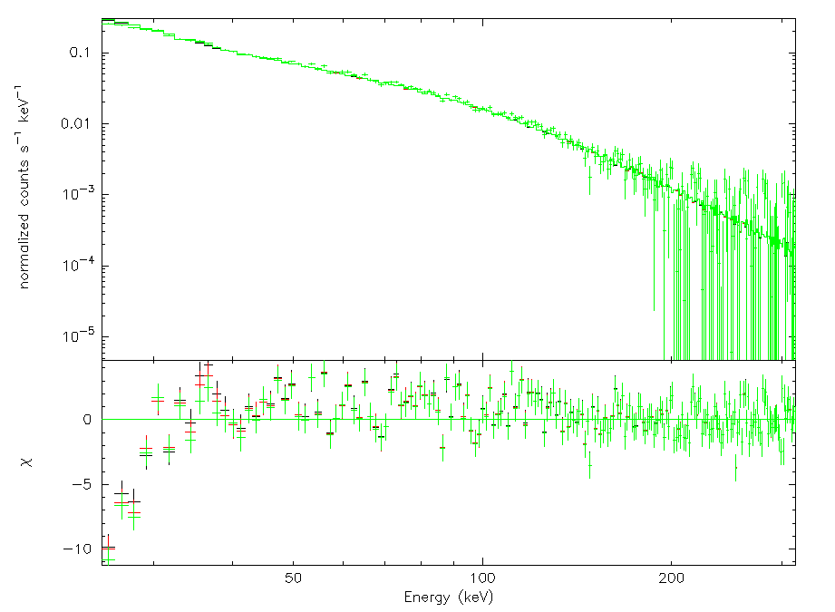
The influence of energy resolution：
Res on ground
Black: kres=1
Red: kres=1.5
Green: kres=2
Fix the parameters of Crab pulsar from RXTE, residual of HE changed little at different Res in RMF.

Slide 8
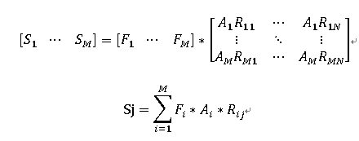
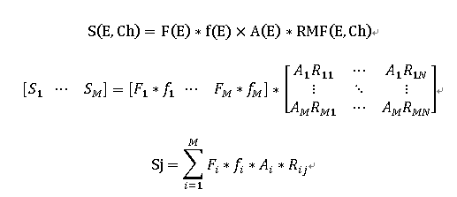
ARF adjustment in orbit
RMF: M*N matrix
A empirical function f(E) has been introduced to modify the ARF.
The new ARF will be: ARF*f(E)

Slide 9
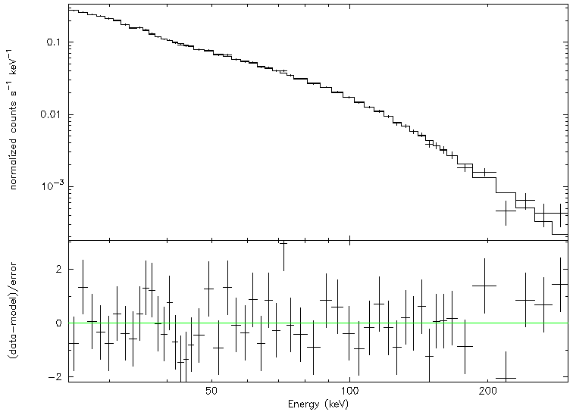
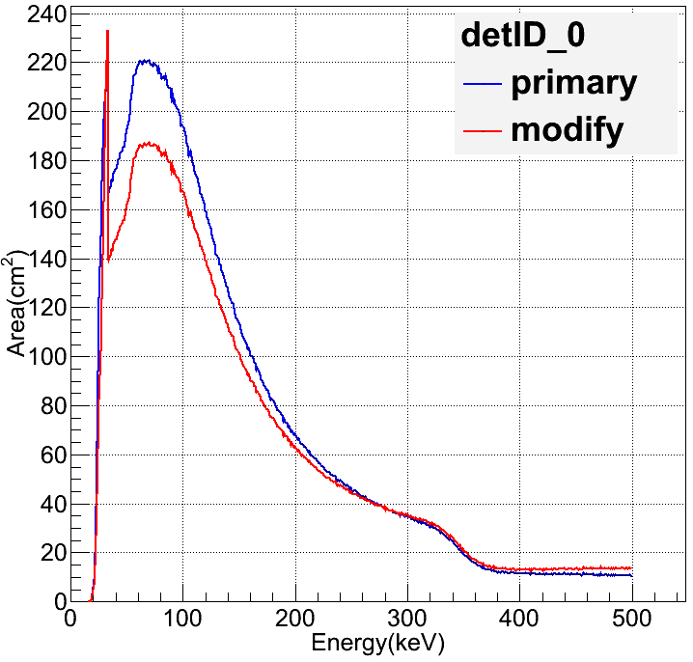
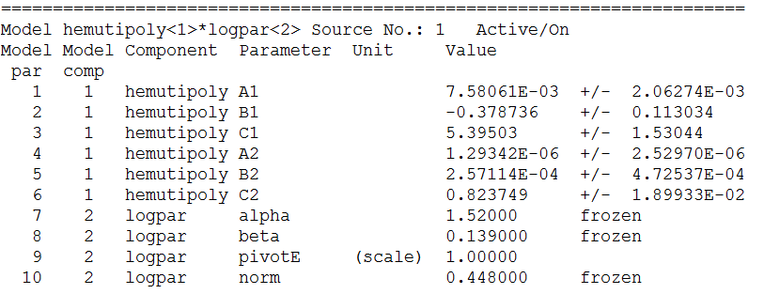
New ARF of HE
f(E) is quadratic function of two segment.
@33.17keV

Slide 10
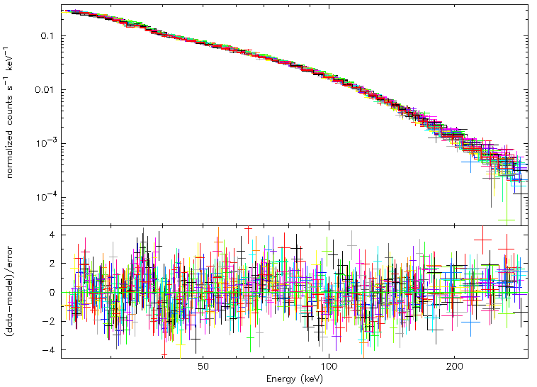
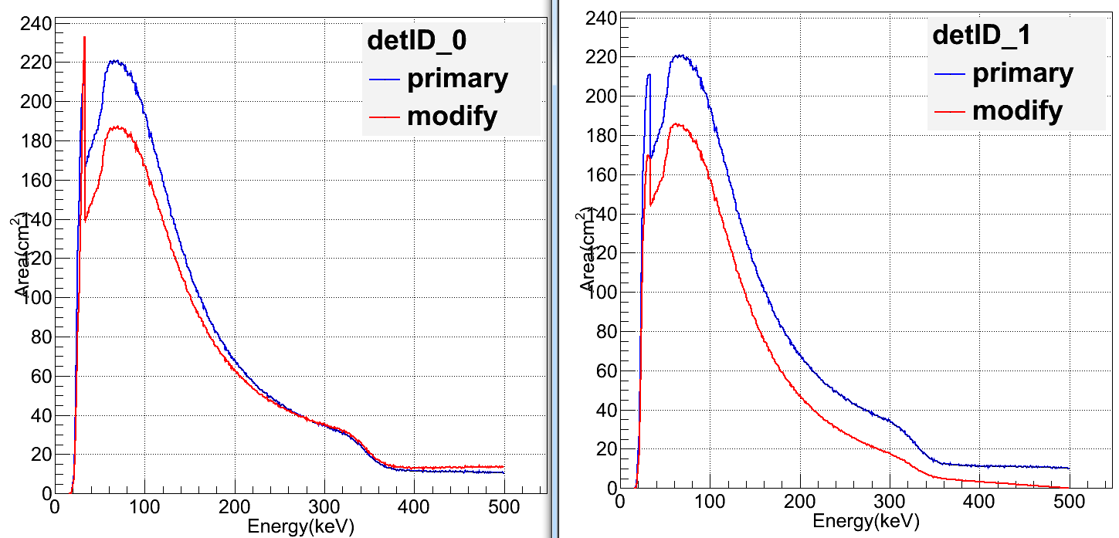
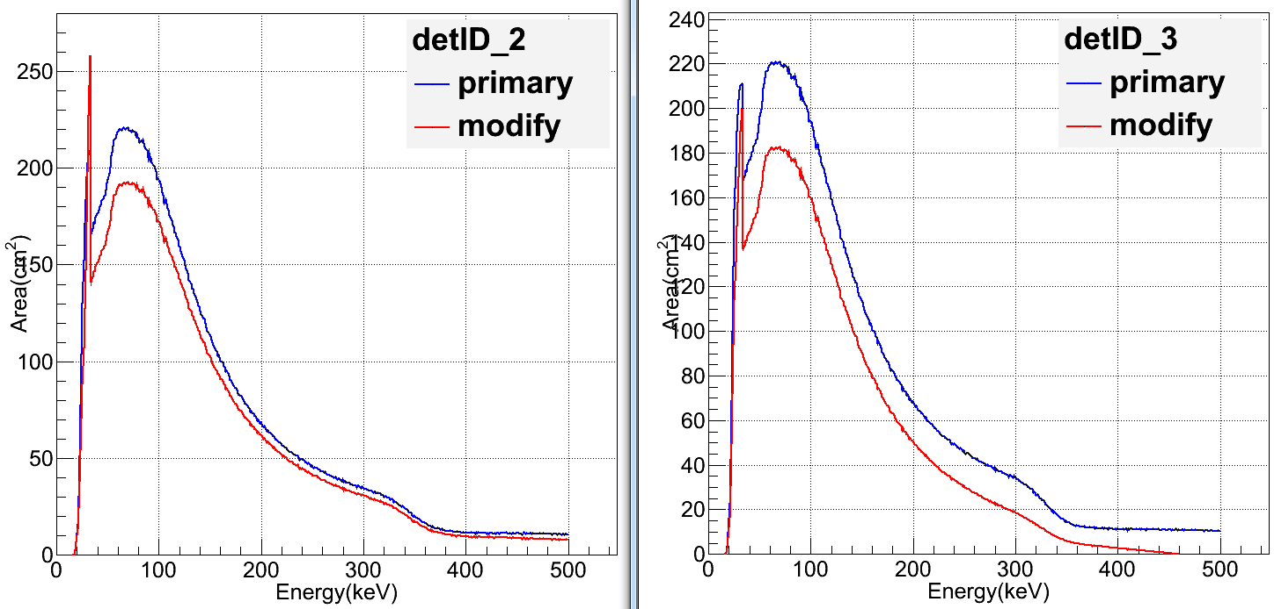
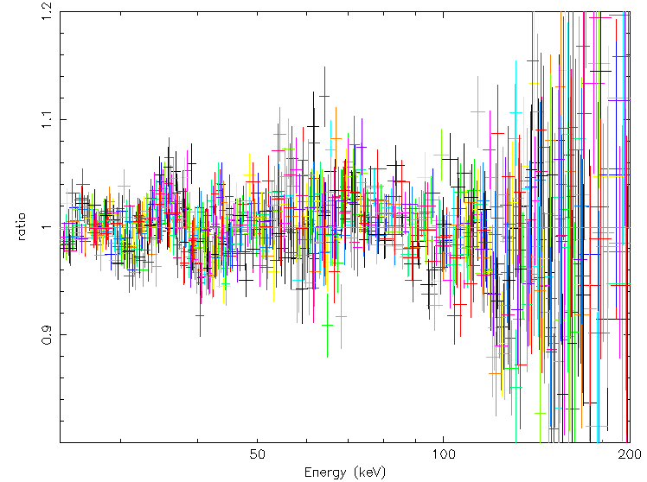
Crab pulsar fit results of 17 NaI
Real ARF revision? Correlated to the input Crab pulse-on spectrum?

Slide 11
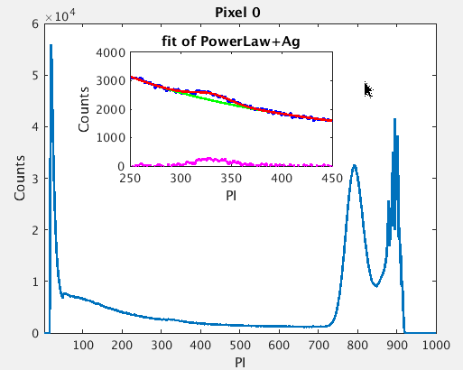
ME: Verification of FWHM and EC in orbit
The pixels carried ²⁴¹Am in orbit can also be used to estimate the change of FWHM in orbit. FWHM is almost same with ground.
The RMF of ME is same as on ground.
The EC is almost same as on ground using the Ag line in orbit.

Slide 12
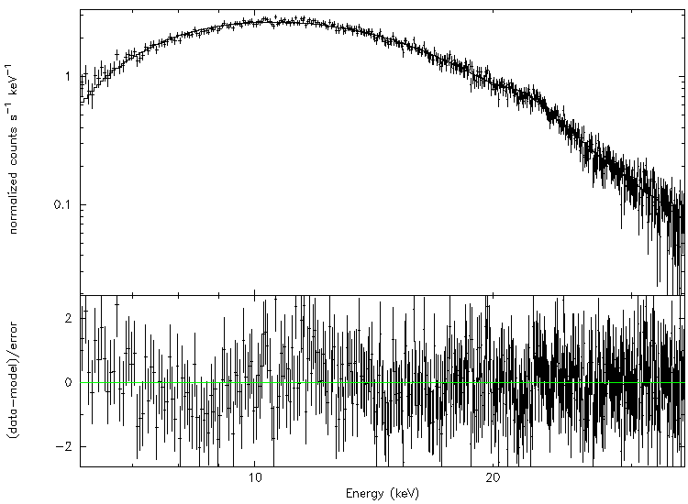
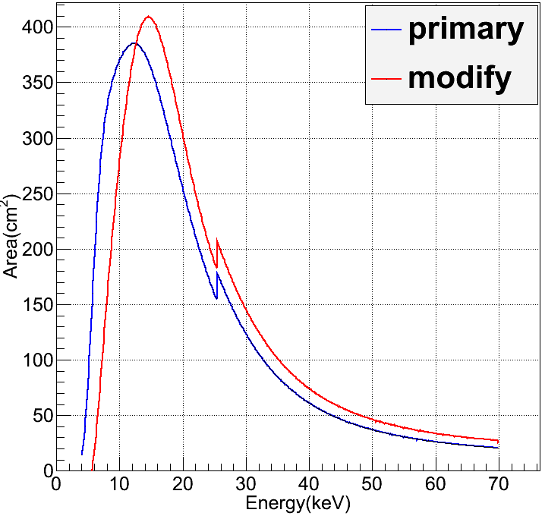
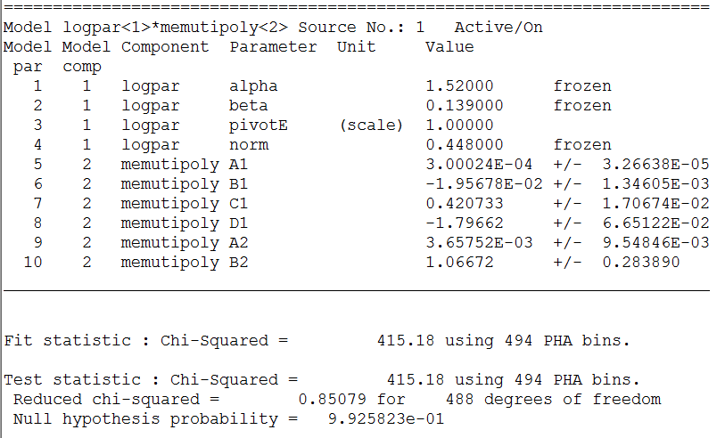
ME: ARF calibration

Slide 13
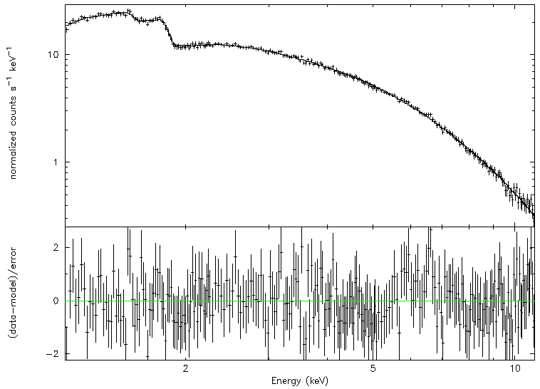
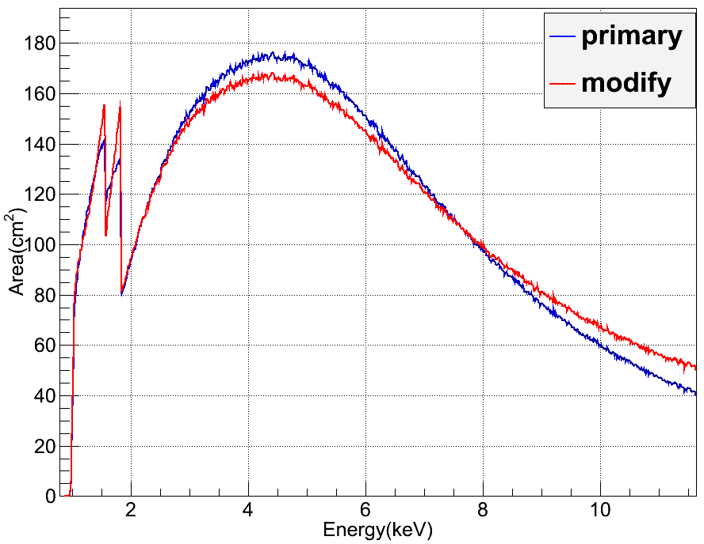
LE: ARF Calibration

Slide 14
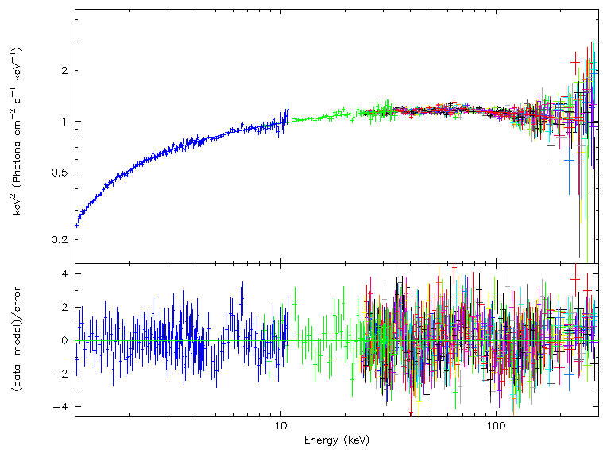
Fit of Crab pulsar using the new ARF
Fix the parameters of Crab pulsar.

Slide 15
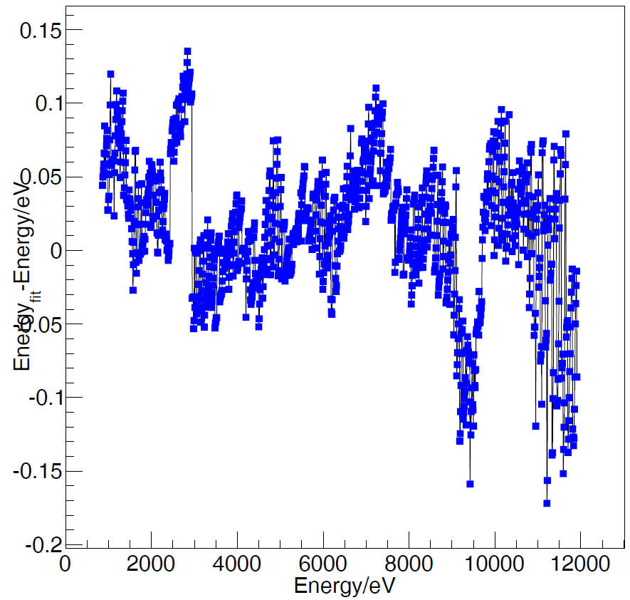
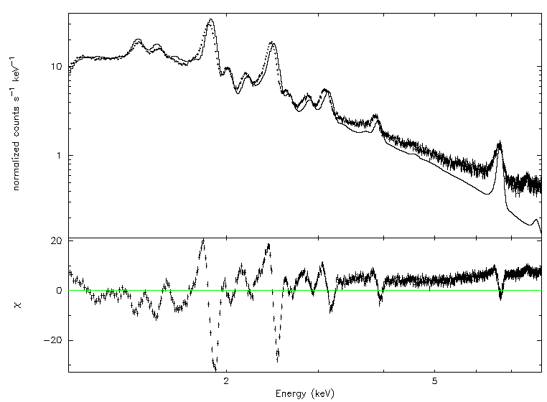
LE: Verification of EC in orbit
Use the EC underground to convert the PHA spectrum of CasA to PI spectrum (black dot). The background has not subtracted from the PI spectrum.
Use CasA model convoluted the RMF and ARF to fit the PI spectrum.
The difference of the full peak energy with the incident energy in RMF will be very small.(<0.2eV).
The EC in orbit has been changed or the input Cas A spectrum?.

Slide 16
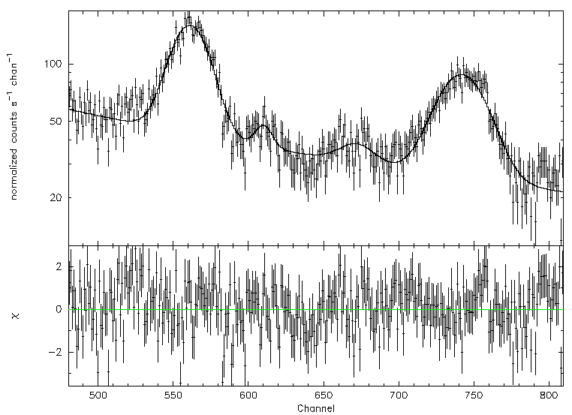
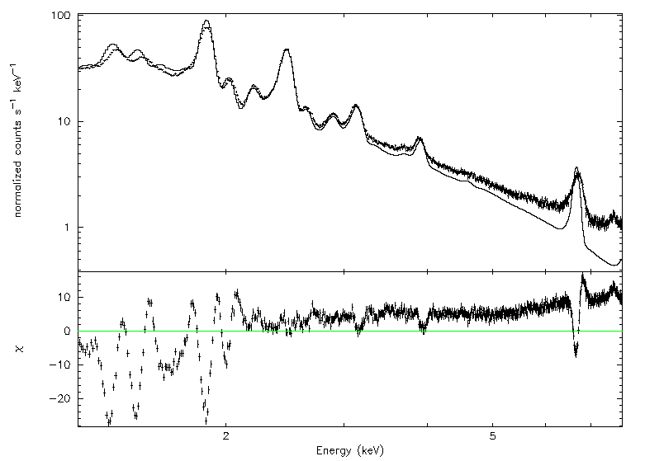
For every CCD, we used the Si (1.87keV) and S(2.46keV) to update the EC relation.

Slide 17
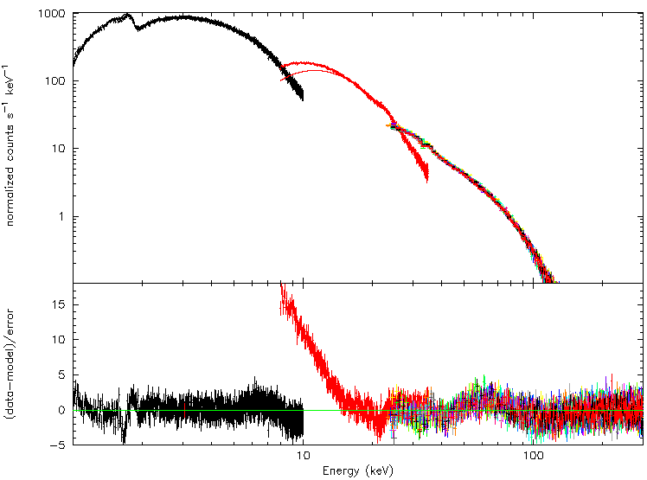
Pulsar of SwfitJ0243

Slide 18
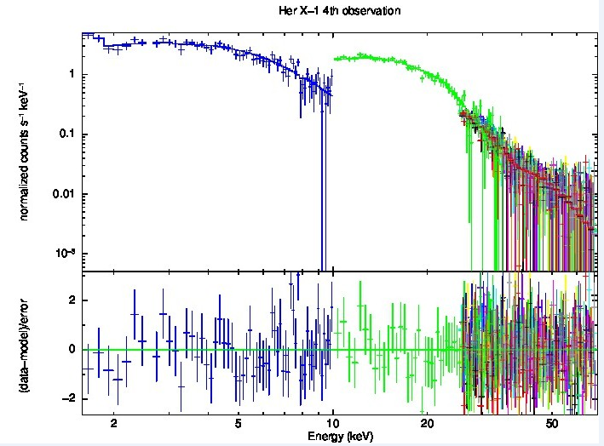
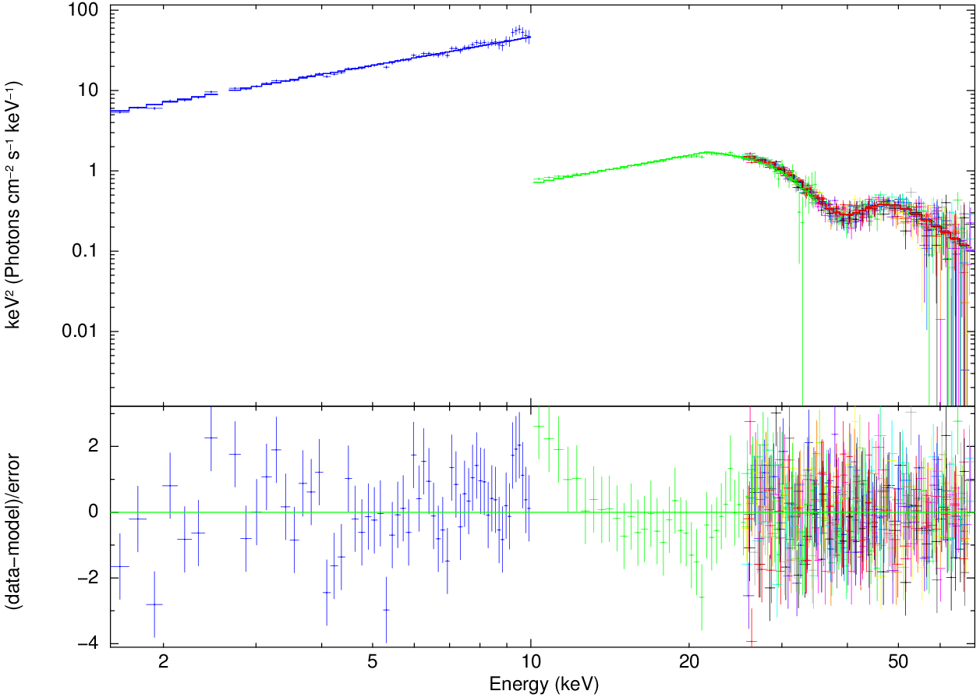
Pulsar of Her X-1
Her X-1 3th observation

Slide 19
Backup slides

Slide 20
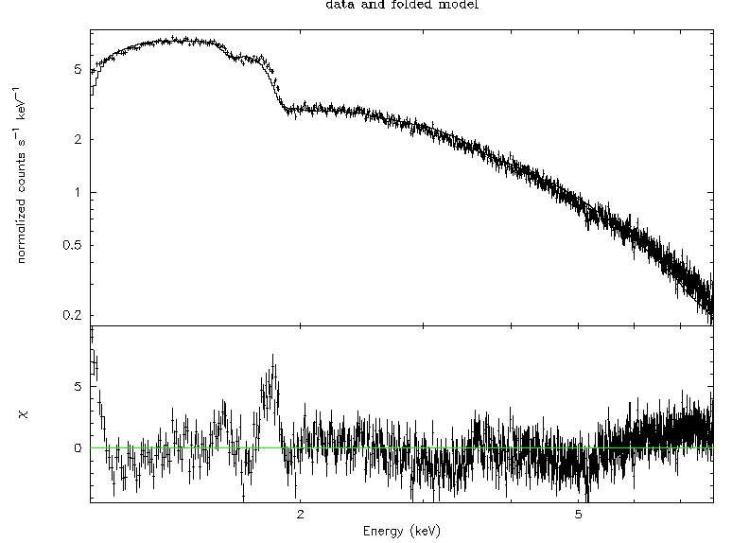
Crab nebular
EC below 1.8keV and more than 6keV has to be verified.
Then the ARF will be adjusted.

