Slide 1
Calibration and Background of GRB-Observation of Insight-HXMT
Speaker: Liao Jin-Yuan
Insight-HXMT GRB group
IHEP, CAS
2018.04.11

Slide 2
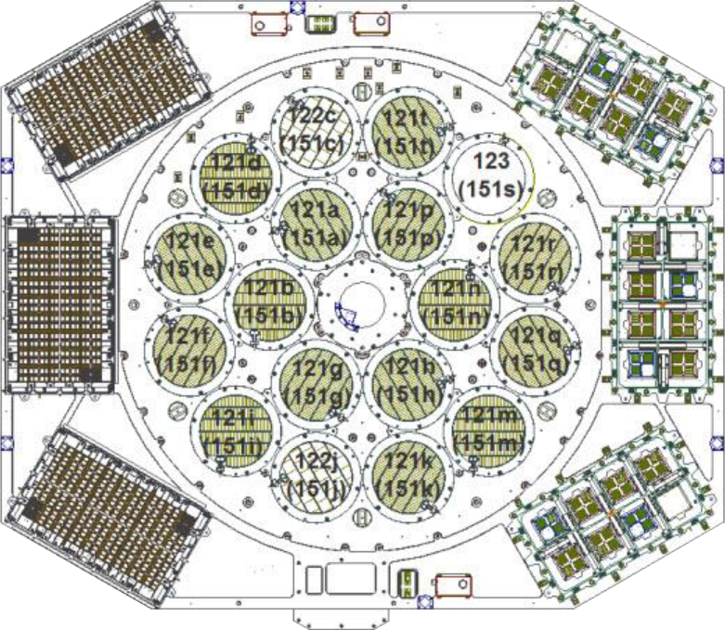
GRB Detectors
High-Energy Telescope, 18 NaI/CsI Phoswich detectors.
CsI detectors are used as the GRB detectors.
80 – 800 keV (high voltage), 200-3000 keV (low voltage)

Slide 3
Background
Normal Short Burst (< 2 s)
Normal Long Burst (> 2 s && < 100 s)
Super Long Burst (> 100 s)

Slide 4
Background: Normal Short/long Burst
We use the spectra pre- & post-GRB as the background during the burst phase.
The red color is the spectrum during the burst phase
The blue color is the calculated background spectrum during the burst phase

Slide 5
Background: Super Long Burst
Make a GRB Background model.
Basic Parameter:
SAA time
ACD counts rate
BKG before and after the burst phase
This is a tentative research in next step！

Slide 6
Calibration
Do the Geant4 simulation with the full quality model of Insight-HXMT to obtain the respond matrix in more than 400 directions cover 4-π solid angle
Use the Crab pulsar spectra to correct the simulated response (the spectral parameters are determined)
e.g., for GW170817, we collected the data in gravitational wave (GW) directions (satellite coordinate), and then we the observational pulsar spectrum and make a comparison with the simulated spectra with the parameter observed by other telescope.
Use the GRB detected by other telescope spectra to correct the simulated response (may suffer from some uncertainty caused by the systematic and statistic errors)

Slide 7
Geant4 Simulation
The effective area is larger for front & back incident, and smaller for edge incident.
G-GRB mode (low voltage), R-Regular mode (high voltage)

Slide 8
Simulation to Spectra fitting and Position
We assume a GRB with medium brightness and medium hardness in different incident angle.
Fluence = 1 x 10⁻⁵ erg cm⁻²，exposure = 10 s
Use the Band function with the simulated respond matrix to fit the spectral parameter and the position simultaneity.

Slide 9
Spectra fitting
For the simulated spectra with Band function, Insight-HXMT is sensitive to hard photons but insensitive to soft photons.
Spectral index in soft energy band (Alpha) can not be well-constrained.
Spectral index in hard energy band (Beta) and the E_{peak} can be well-constrained.

Slide 10
Position
To a GRB with medium brightness and medium hardness, the average position error is different for different incident angle (mean value is ~ 4 degree).
The position accuracy for back incident is better than front incident.
This result is based on the simulated respond matrix, and only considers the statistical error (do not consider the systematic error).
Fluence = 1 x 10⁻⁵ erg cm⁻²，exposure = 10 s

Slide 11
Observation
GRB 170626B, the first GRB detected by Insight-HXMT. We fit the spectrum
with the simulated respond matrix, but the result is somewhat different from
other telescope, such as Fermi-GBM.

Slide 12
Summary
So far, the full quality model has been modified several times, the simulation with the latest version of the full quality model is in progress.
The correction of the respond matrix has not been finished.
When the correction has been well done, all the fitting and instrument parameters will be updated.

