Slide 1



GRB studies with Insight-HXMT
Shaolin Xiong
xiongsl@ihep.a.cn
On behalf of the HXMT GRB&GWGRB team
Key Lab. of Particle Astrophysics (KLPA),
Institute of High Energy Physics (IHEP),
Chinese Academy of Sciences (CAS)
2018-04-11

Slide 2
Outline
Introduction of the Insight-HXMT
How does HXMT detect GRBs (GW EM, etc.)
Progress
  GRB Data and Software
  Calibration (Jinyuan LIAO)
  GRB, GWGRB (first BNS merger GW170817)
  FRB，SFL，others

Slide 3
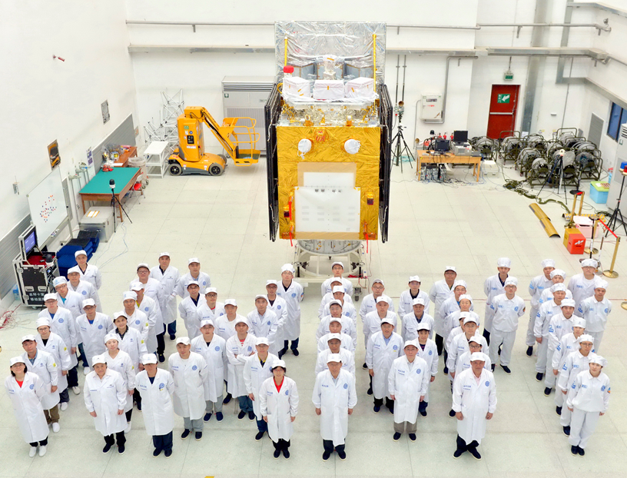
Insight-HXMT
Hard
X-ray Modulation Telescope

Slide 4
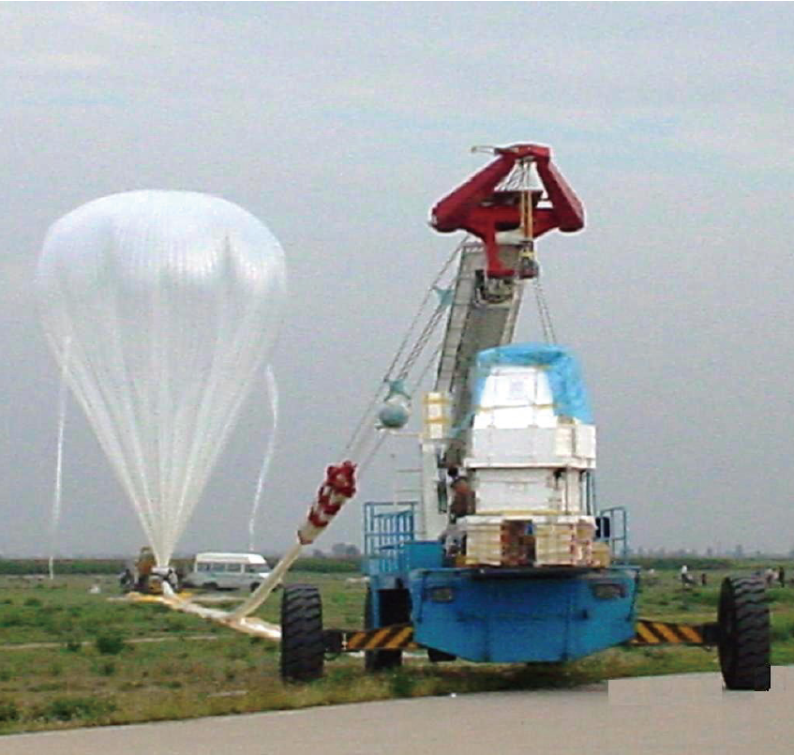
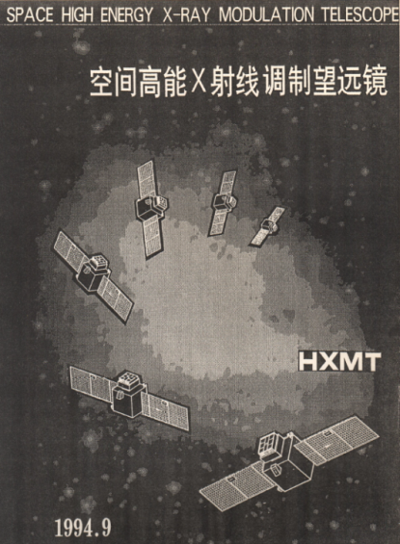
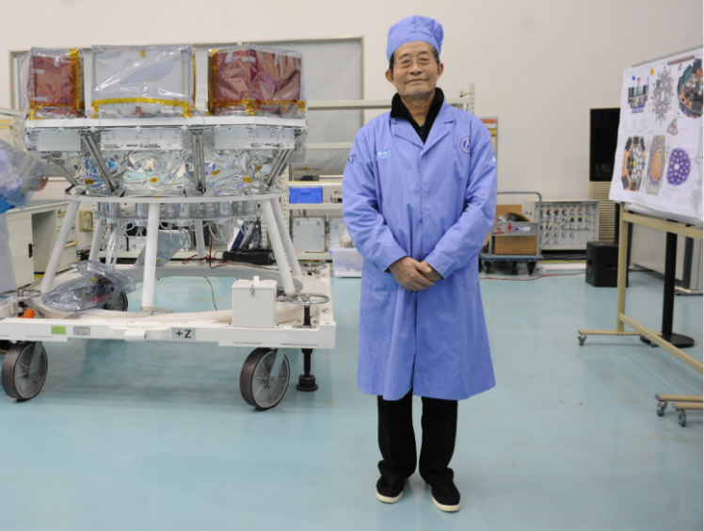

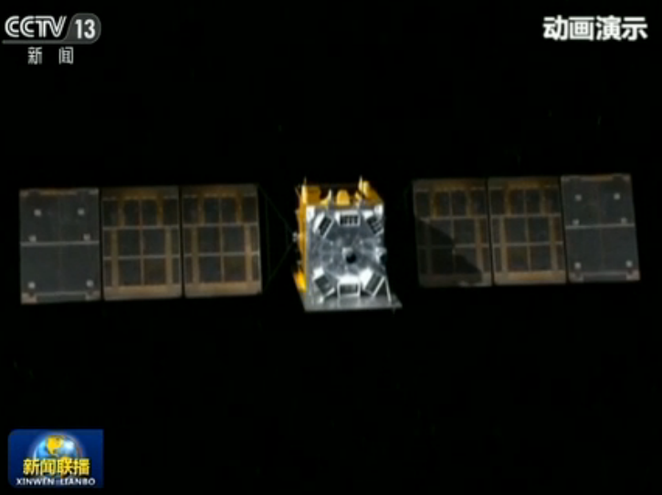
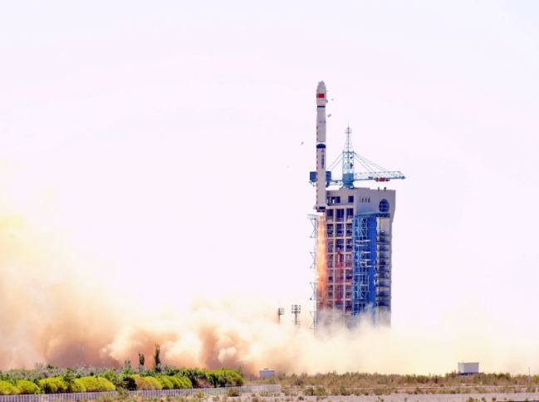
History
1970-80s balloon flight
1994 first proposal, 2011 funded
Prof. Ti-Pei Li
In honor of
何泽慧 Ho Zah-wei (1914-2011)
“慧眼” Insight
2017.6.15 Launched in Jiuquan, China

Slide 5
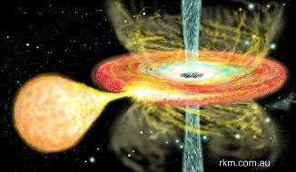
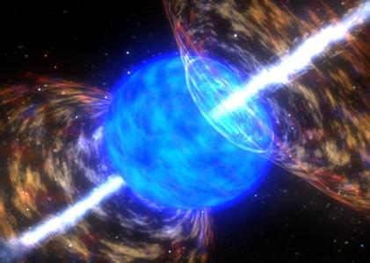
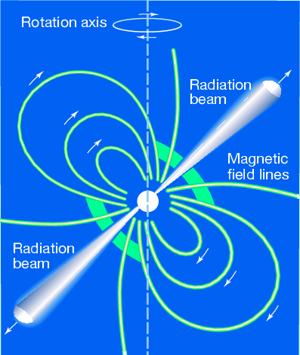
Core sciences
Galactic plane scan and monitor survey for more weak & short transient sources in very wide energy band (1-250 keV)
Pointed observations: High statistics study of bright sources and Long-term high cadence monitoring of XRB outbursts
Multi-wavelength Observations with other telescopes
【Extended】GRBs and GW EM, HEN, FRB, etc.

Slide 6
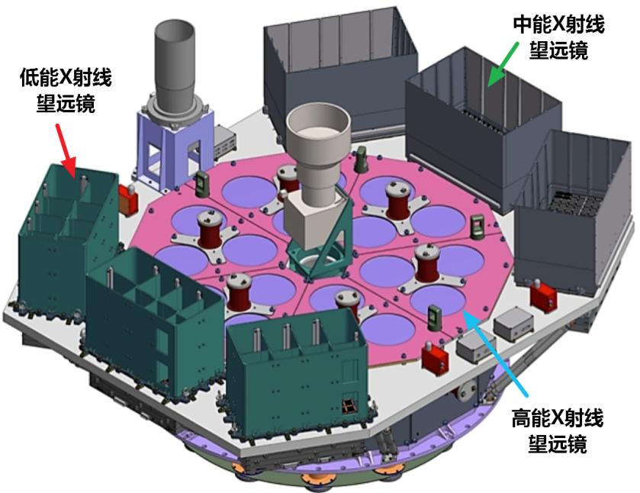
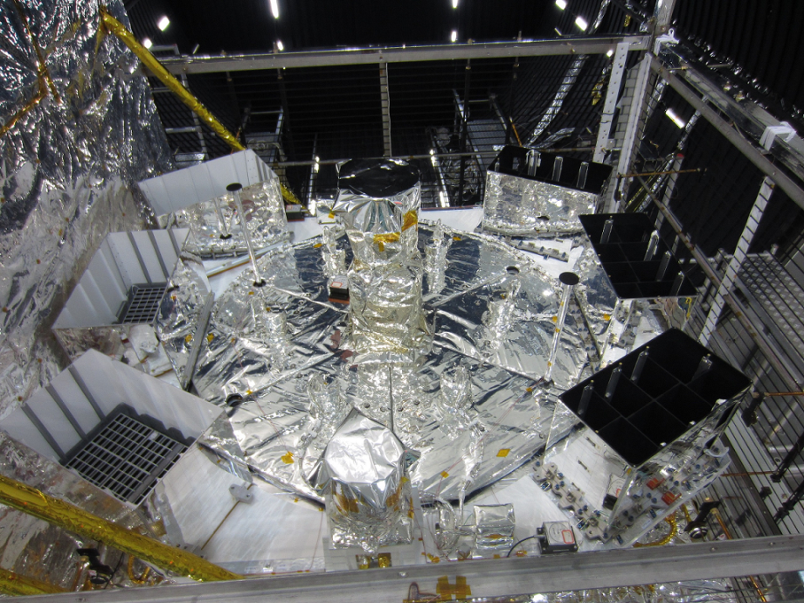
Payload
Medium Energy X-ray Telescope
ME
Low Energy
X-ray Telescope
LE
High Energy
X-ray Telescope
HE
Payloads HE, ME (5-30 keV), LE (1-15 keV)
HE normal 20 – 250 keV (NaI)
Localization collimator (non-focusing)
Obs. modes Pointed, Scanning, Both modes using collimator
GRB obs. HE 200 – 5000 keV (CsI) Without collimator involved

Slide 7
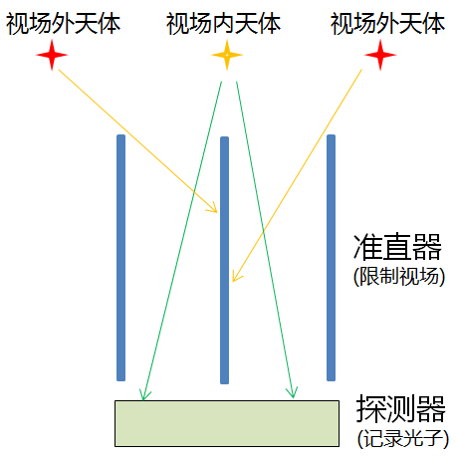
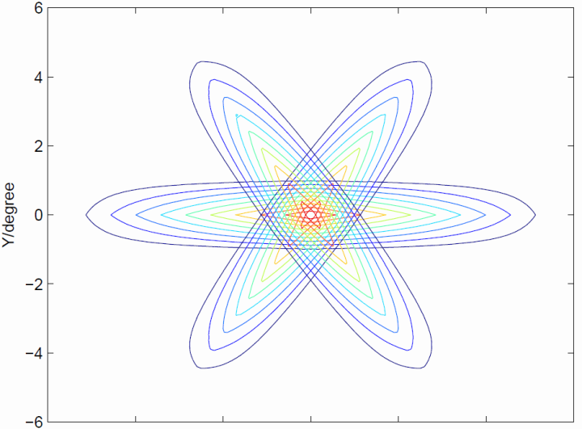
Collimator and Field of View (FOV)
Sources In/Out FOV
Collimator
Limiting FOV
Detector
Point spread function (PSF)
and FOV for 18 HE detectors
which are arranged in 3 groups

Slide 8
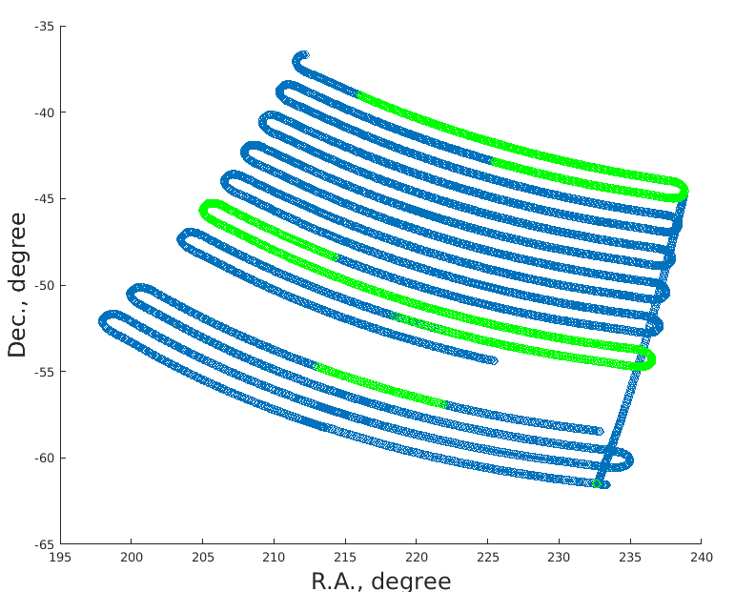
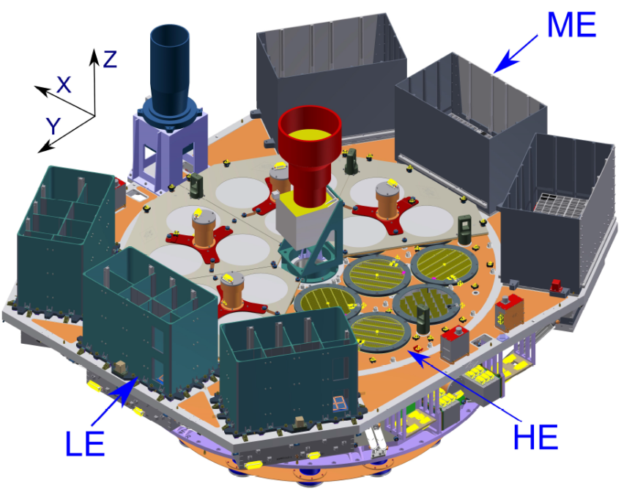
How to observe GRB (GW EM)
Original
  afterglow emission
  LE (0.5-10 keV),
    Scanning, pointed
Scanning for GW170817

Slide 9
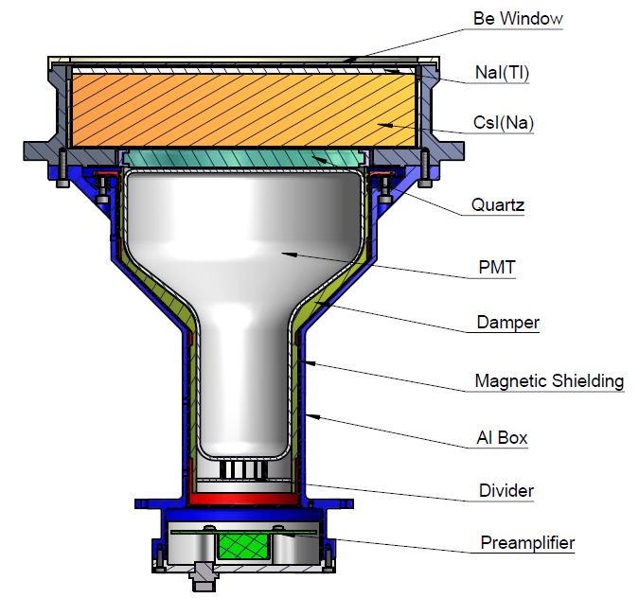
How to observe GRB (GW EM)
Extended capability
  prompt emission
  CsI detector of HE
HE detector
NaI/CsI

Slide 10
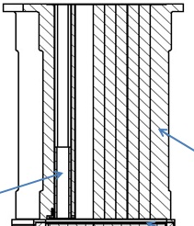
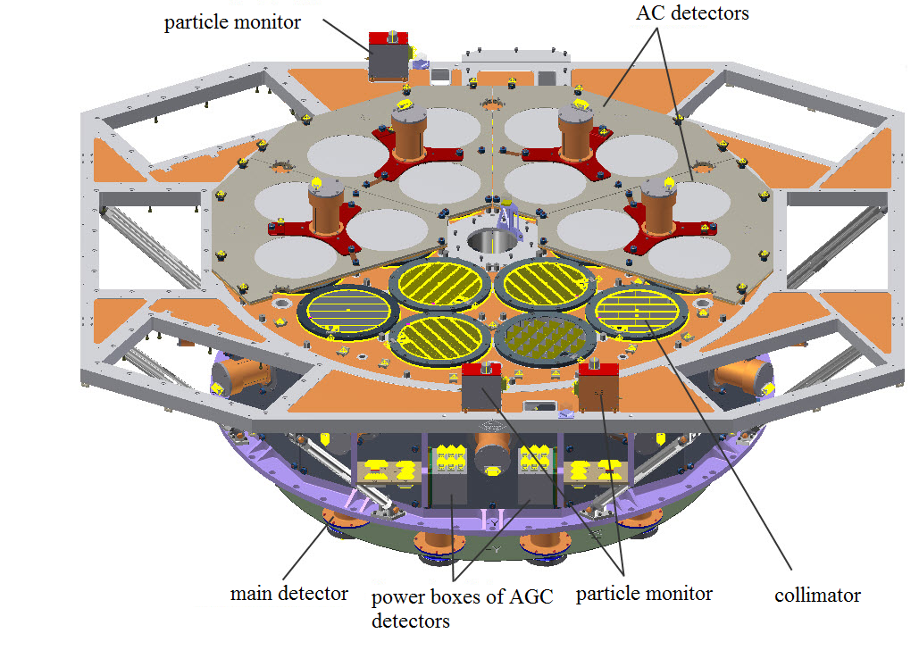
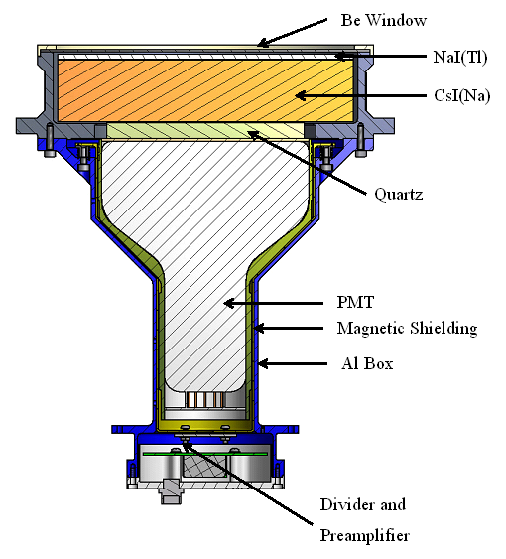
Collimator observation vs. GRB monitoring
photons within collimator FOV
Collimator
NaI
CsI
Gamma-rays
（> ~200 keV）

Slide 11
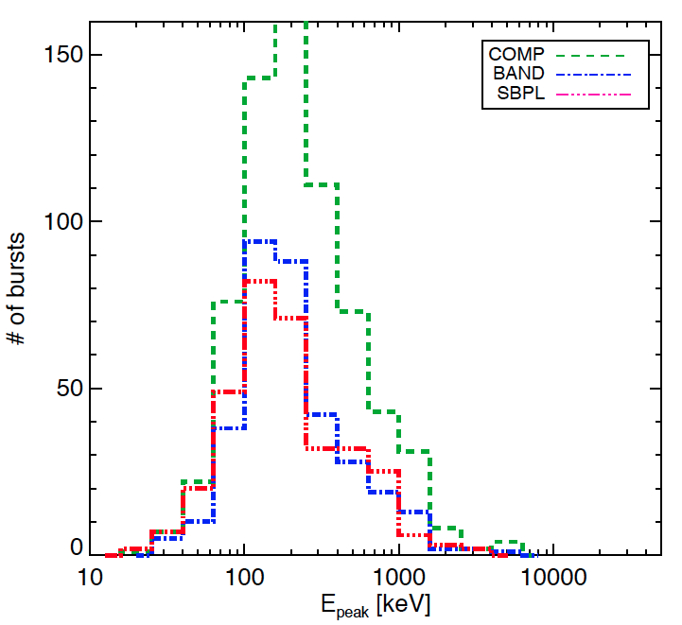
Dedicated working mode for GRB
Working Mode | NaI energy band (keV) | CsI energy band (keV) | Detector Setting
Regular mode | 20-250 | 40-600 | Normal HV
GRB mode | 100-1250 | 200-3000 | Lower the PMT HV, turn off the AGC
GRB mode better energy range:
  According to the simulation, det. efficiency is good for >200 keV
  GRB Epeak distribution
GRB mode: ~30% of obs. time
  When the targeted source is occulted by the Earth in pointed observation
  When HE regular mode is not very useful in an observation
GRB Epeak measured by Fermi/GBM
（Gruber+, ApJS, 2014）

Slide 12
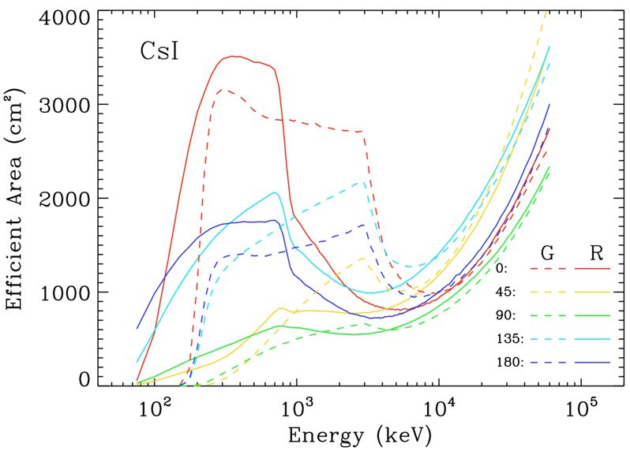
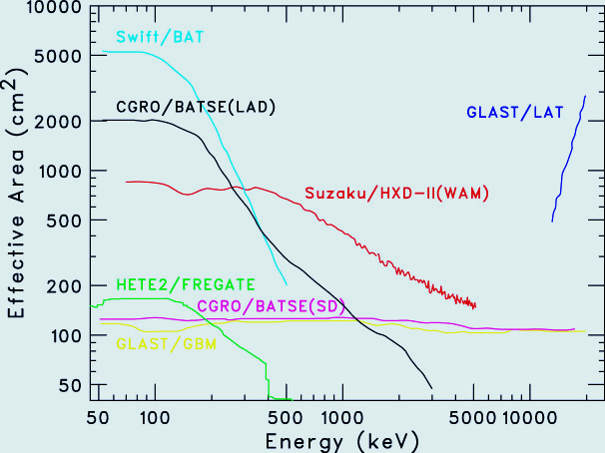
Effective Area for GRBs
HXMT
Can detect GRB in both Regular mode and GRB mode
GRB monitoring FOV: all sky un-occulted by the Earth
Effective area up to ~1000 cm² around MeV range, thus one of the largest GRB monitors ever flown

Slide 13
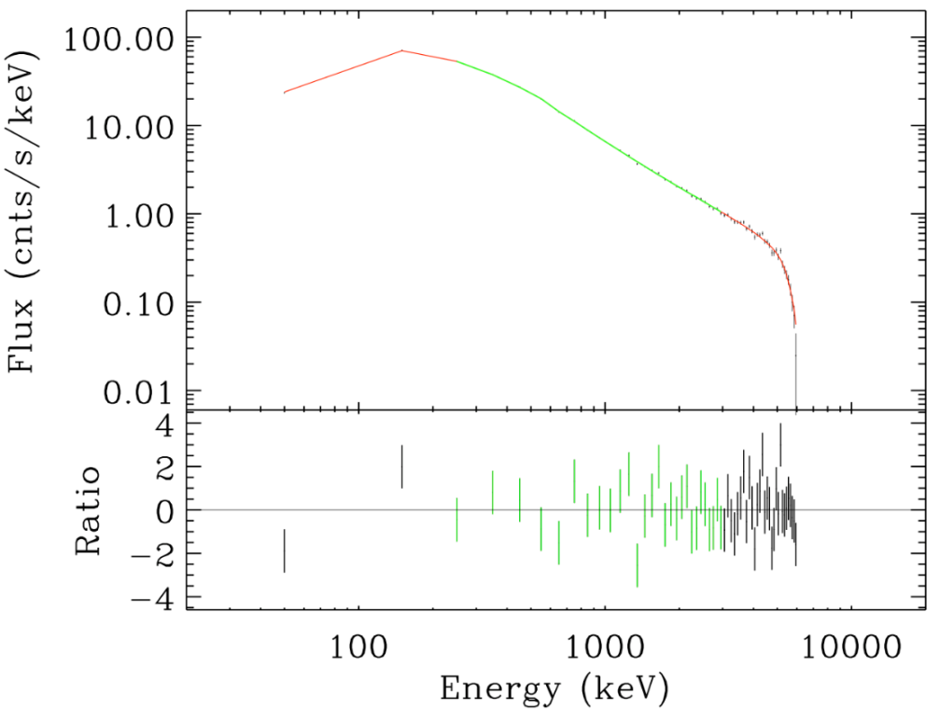
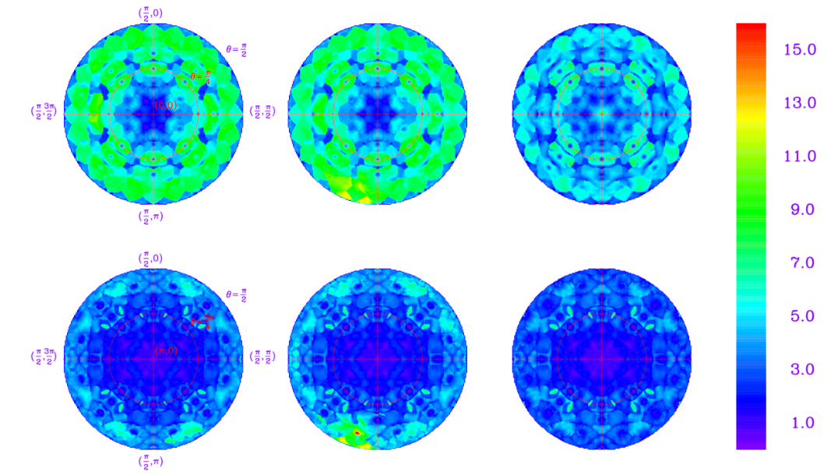
GRB & GW EM: Prompt obs.
wide FOV(~60% all-sky), large eff. area (~1000 cm²), μs events
Temporal analysis with high statistics
Location accuracy: ~4 deg (average)
Spectral analysis (e.g Epeak, beta, HE cutoff?)
Localization accuracy
Fluence: 1E-4 erg/cm2, 10 s
Input：Alpha=0, beta=-1.5, Epeak=1000 keV
Measured：0.02+-0.12, 1.51+-0.01, 1004.6+- 68 keV

Slide 14
GRB Data and Software
GRB observation: new things in the Ground Segment
  science operation, data production, pipeline, specific software, Burst Advocate (BA)…
New data type: continuous data
  1 K, but lots of data gaps, will be filled by June
  Produce data files for individual GRB
Data latency is a problem for GRB quick response
GRB Software: not in the software package
  Light curve, T90, counts rate, significance (done)
  Response Files, Spectrum fitting (optimizing)
  Localization (optimizing)
  Issues
    Developed in multiple-language (ROOT, IDL, MATLAB, Python…)
    Currently installed in the HXMT server. Need a standalone version…

Slide 15
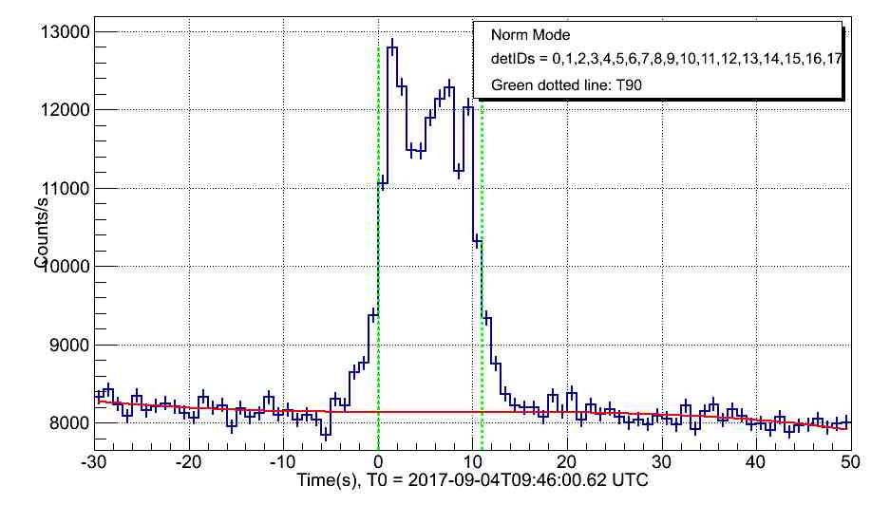
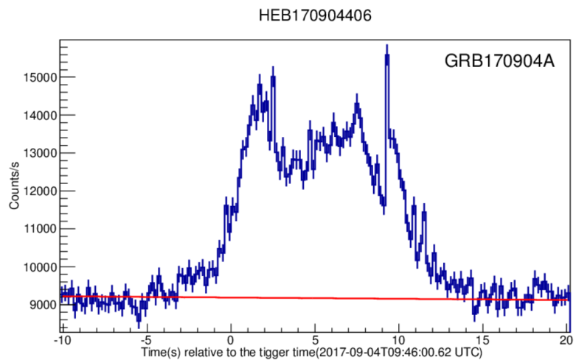
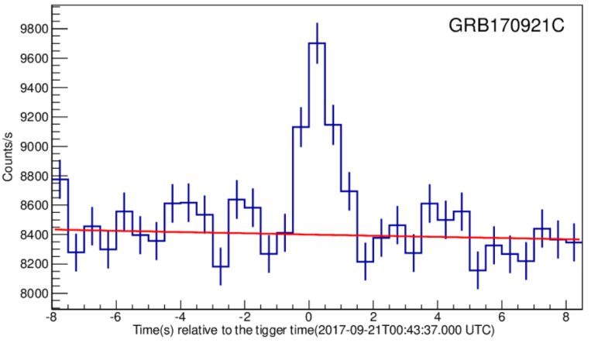
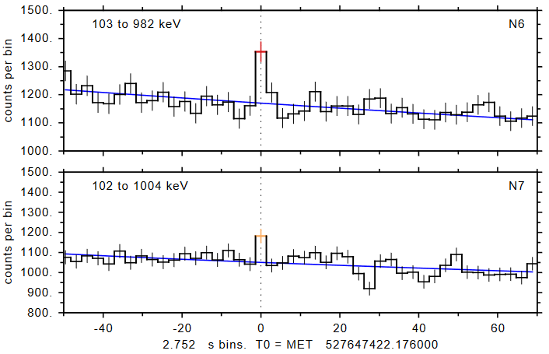
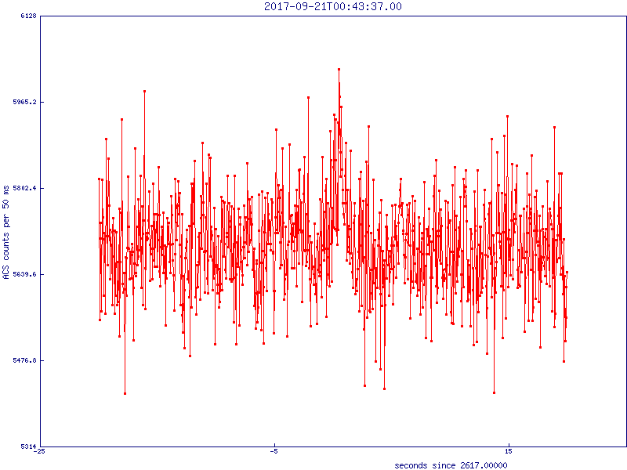
Advantages of Insight-HXMT
Large area: abundant photons → timing
GRB 170904A
Time Bin:
Left: 1 s
Right: 0.1 s
Sensitive in 100s keV to 10s MeV: short/hard GRBs
  Significance: HXMT=12，GBM=8 (subthre)，SPI-ACS=4 (no spectrum)
HXMT
GRB 170921C
GBM
SPI-ACS

Slide 16
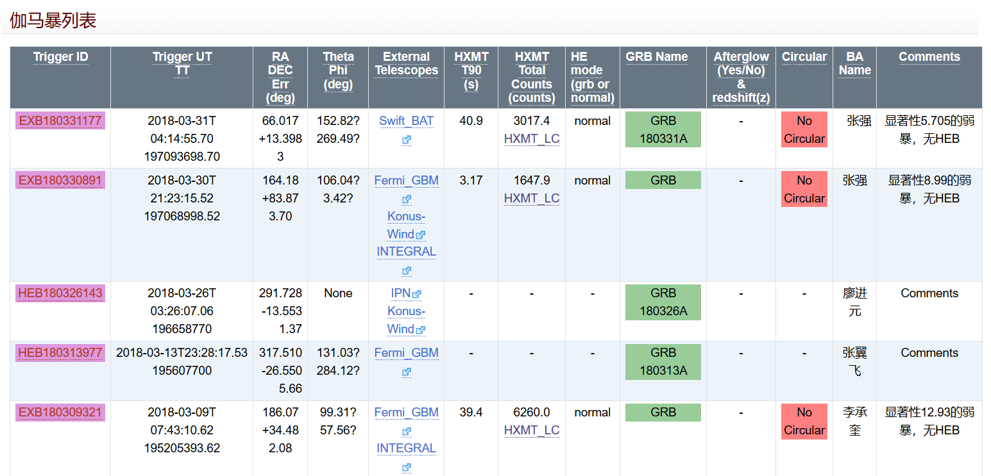
GRBs detected
Total GRBs: 61 (2017/7 – 2018/2)
(more will be found as more data gaps are filled)
Regular mode: 58
GRB mode: 3
Time portion of GRB mode: ~5%
HXMT GRB Twiki system

Slide 17
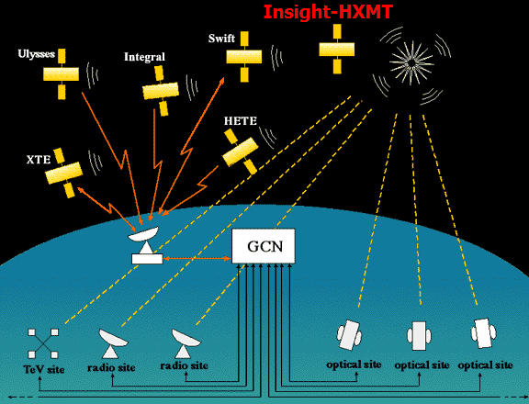
Joined the GCN
Will be more active and beneficial if the data latency becomes less

Slide 18
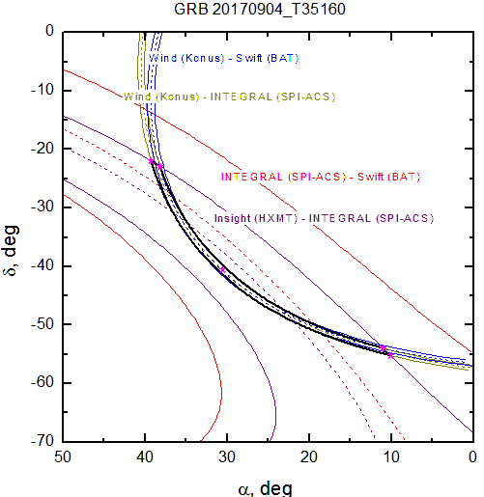
Joined Inter-Planetary Network (IPN）
IPN: All major GRB detectors, near the Earth, L1, Mars orbit, including Fermi, Swift, INTEGRAL, Konus-Wind, etc.
Insight-HXMT joined the IPN, and played an important role.

Slide 19
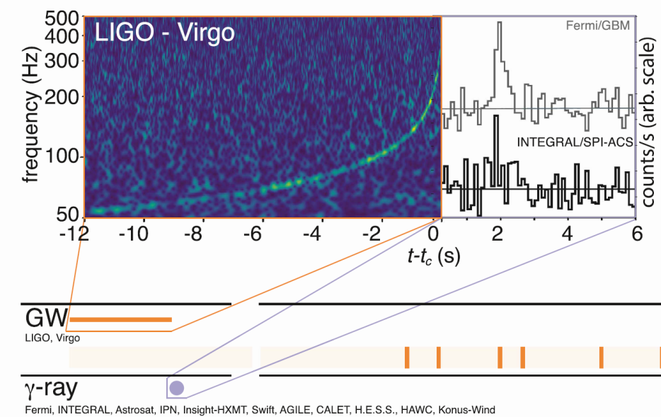

GW EM observations
Monitored 6 GW triggers
  Reported observation results in LVC GCNs
Monitored the first BNS GW event GW170817
  GRB170817A was not detected in MeV range, including HXMT
  Stringent upper limit constraint between 200 keV to 5 MeV
  Joined the MMA paper and published detailed results in Science China

Slide 20
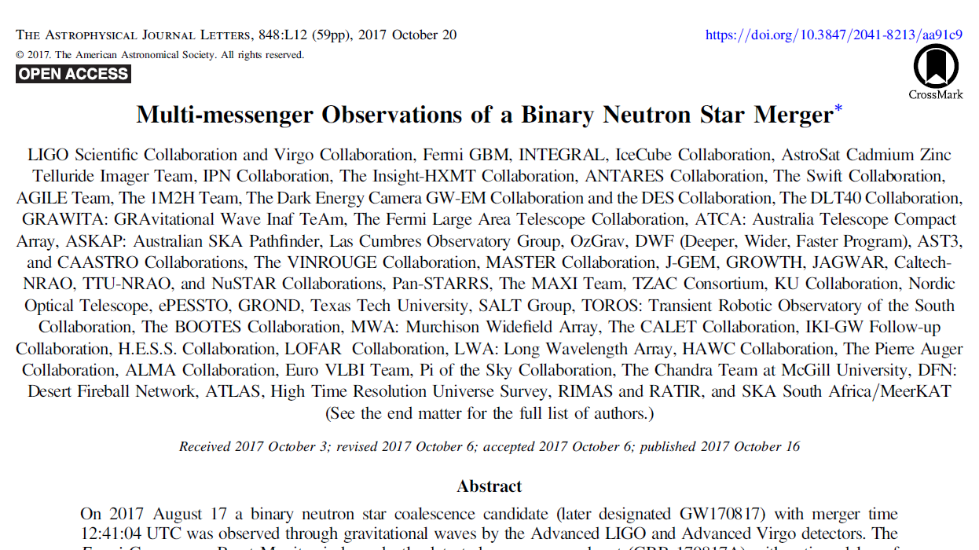
Insight-HXMT joined the MMA paper
Quick response, reported HXMT observation by LVC GCN
One of the 4 X/gamma telescopes monitored the GW source throughout the trigger time
  Fermi/GBM, SPI-ACS, Konus-Wind, Insight-HMXT
  HXMT has the largest eff. Area & time resolution in MeV
Reported observation results in main context and table of MMA

Slide 21
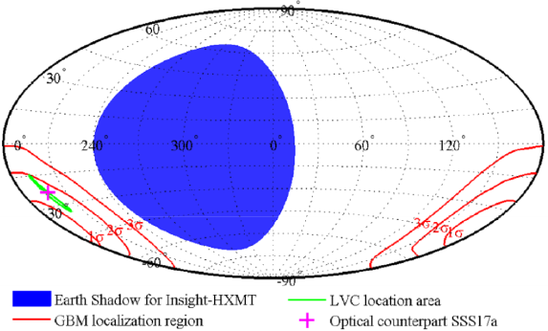
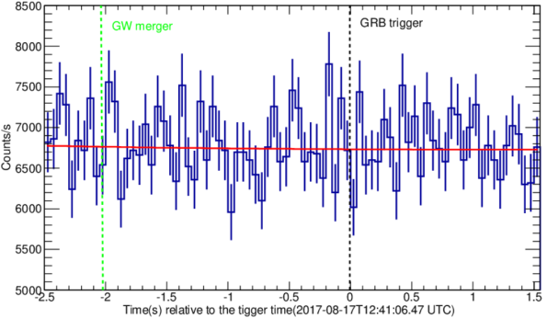
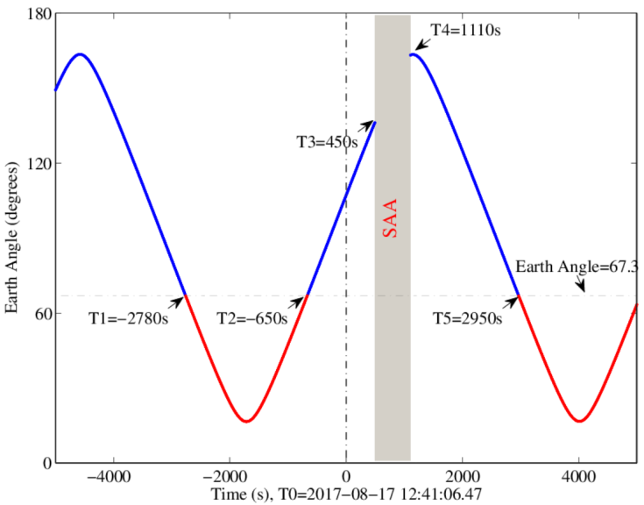
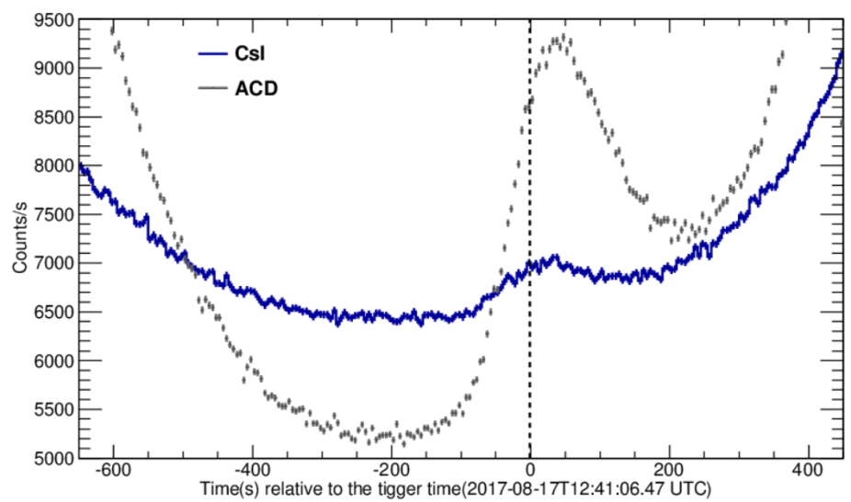
Insight-HXMT observations of GW170817
T. P. Li, et al, Sci. China-Phys. Mech. Astron. 61(3), 031011 (2018)
Monitored the GW around T0 in microsecond with ~1000 cm²
Helped to confirm the weak and soft properties of the GRB170817A
Monitored the entire GW area
Light curve around GW trigger time

Slide 22
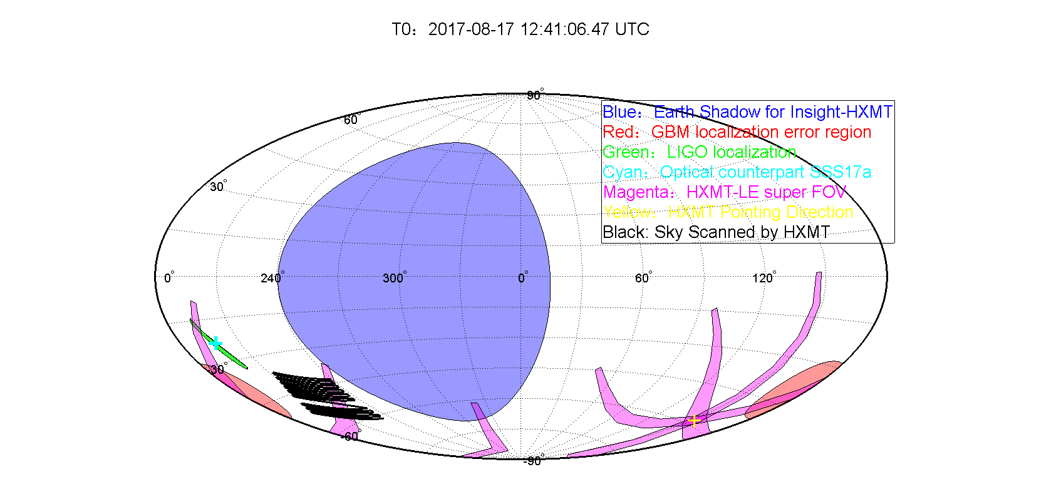
Scanning for the afterglow
Due to the sun angle constraint, the GW source region was not covered.

Slide 23
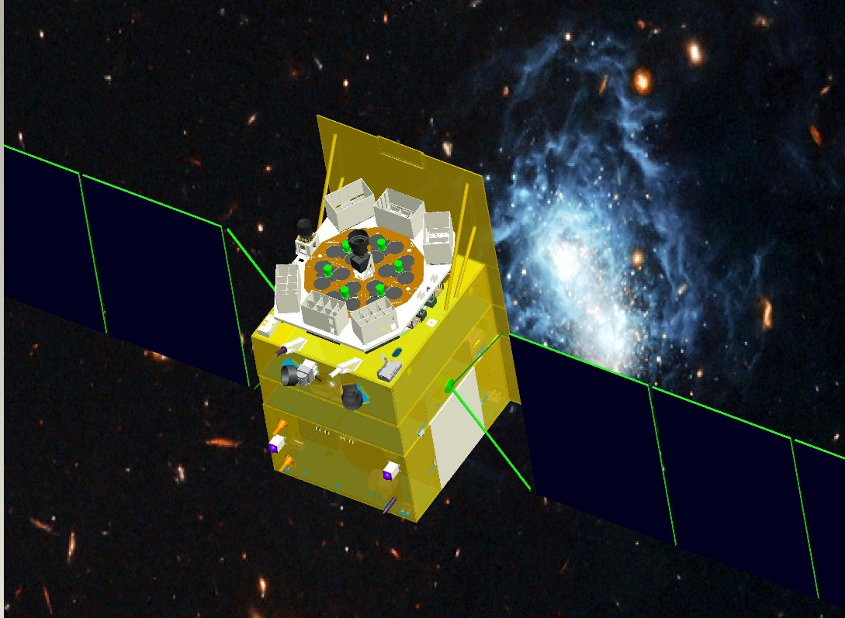
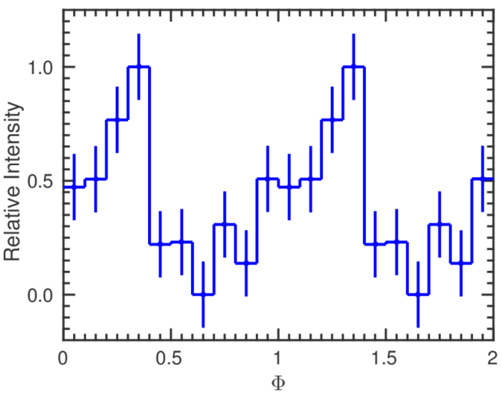
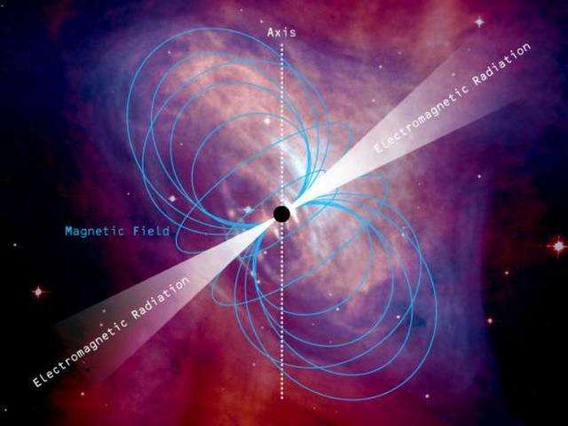
Calibration with Crab pulsar for GW170817
T. P. Li, et al, Sci. China-Phys. Mech. Astron. 61(3), 031011 (2018)
Pulse profile of Crab in GRB monitor (CsI)
Dedicated calibration observation: pulsar set in the same incident direction as GW170817

Slide 24
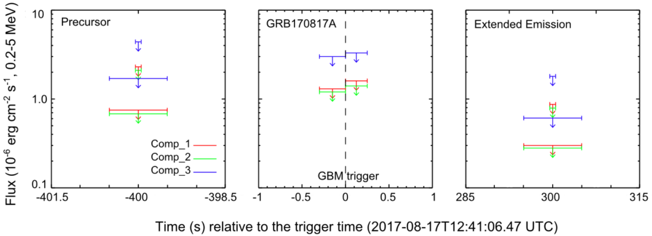
Insight-HXMT observations of GW170817
T. P. Li, et al, Sci. China-Phys. Mech. Astron. 61(3), 031011 (2018)
Upper limits for Band, Compton, PL models
Best constraints for any HE emission from the GW170817
  GRB170817A
  Potential precursor, extended emission
Upper limits (3 sigma) for Comptonized models

Slide 25
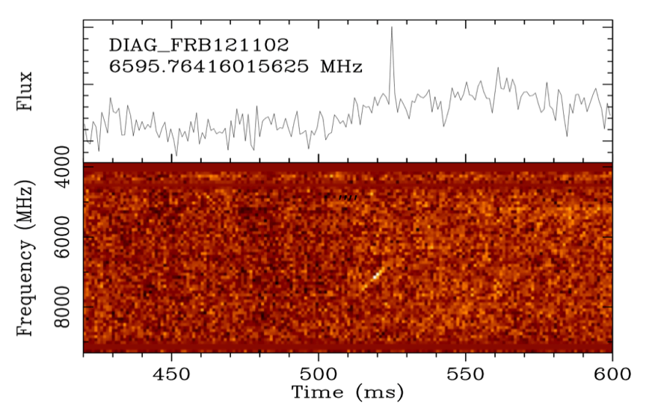
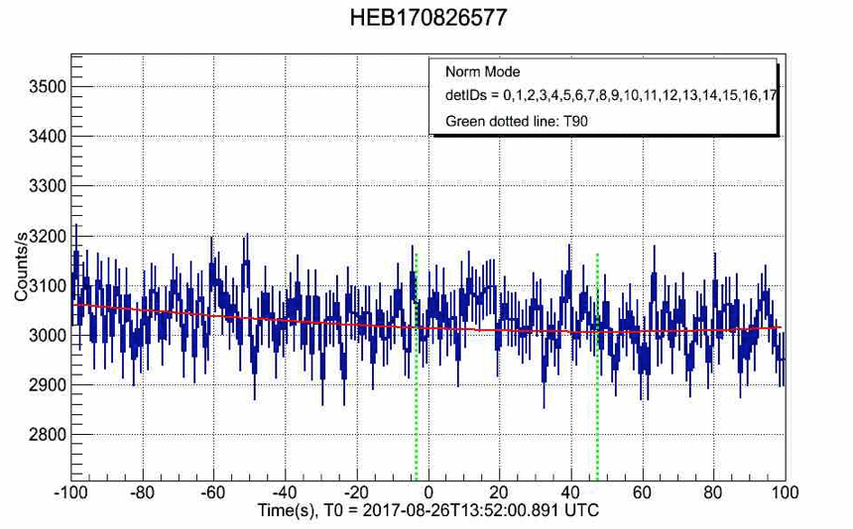
Searching for HE emission of FRB
Preliminary

Slide 26
Summary
Insight-HXMT works great since the launch on June 15, 2017
Extended to monitor GRBs (timing, spectrum, localization)
  Largest effective area (~1000 cm²) around 100s keV to 10s MeV
GRB data products are producing, but with data gaps
GRB software (LC, spectrum, localization) are developing
Calibration for GRB observation (satellite mass model!) is ongoing
>60 GRBs in 8 months (2017/7-2018/2), ~100 GRBs/year
  High statistics, great for timing and spectral
  Joined the GCN, IPN, contributing to the community
Monitored 6 GW events, including the first BNS merger GW170817
Searching for gamma-ray counterpart of FRBs, HENs. Detected Solar Flares. Searching for Terrestrial gamma-ray Flashes
  Thank you!

