Slide 1
Insight-HXMT observation on Swift J1658.2-4242
Ma Xiang, Qu Jinlu, Ge Mingyu
2018-04-12

Slide 2
Outline
Basic information
Observation lists
Preliminary result

Slide 3
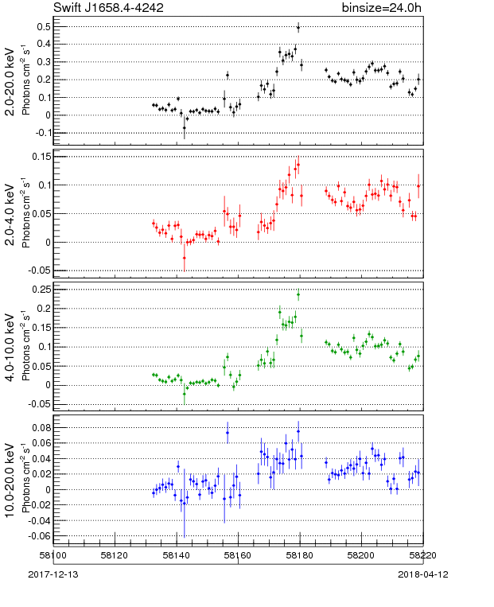
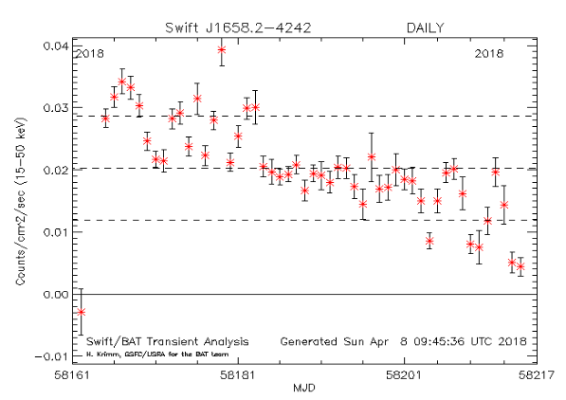
Swift J1658.2-4242
~170mCrab
MAXI
2018-02-16 detected by Swift
Black Hole
RA, Dec = 254.537, -42.712
(GCN #22416, #22417, #22419; ATel #11306, #11307, #11310, #11311, #11318, #11321, #11336,#11375).
~180mCrab
Swift/BAT
Notes:
This source is a little weak for our Insight-HXMT
Between these two lines is our HXMT observation time

Slide 4
Swift J1658.2-4242
NuSTAR(ATel #11321)
2018-02-16T23:26:09 ~ 2018-02-17T20:51:09
Total Exposure : 33.3ks
Flux ： ~65mCrab
Continuum spectra：
Approximately described by an absorbed cutoff power-law
NH = 1.3 x 10^{23} cm^{-2}
Two strong dips are found in the NuSTAR light curve separated by ~30ks, indicating this source could be an eclipsing system
Power spectra：
QPO： increase from 0.138+/-0.002 Hz to 0.166+/-0.003 Hz
The features in the power spectrum are similar to QPOs detected in the hard state of accreting black hole

Slide 5
Swift J1658.2-4242
Swift (ATel #11310)
Spectrum：
Fit by a highly absorbed power-law model
N_{H} = 1.9 +/- 0.5 10²³ cm⁻²
Integral (ATel #11336)
2018.2.20 T14:04 ~ 2018.2.22T15:03, exposure: 125ks
Flux:
20-40keV: 100+/-1 mCrab; 40-80keV:67+/-1 mCrab
3-10keV: 100+/-2 mCrab; 10-20keV: 115+/-3 mCrab

Slide 6
Swift J1658.2-4242
AstroSat LAXPC (ATel #11375)
2018-02-20 18:21:45 UT ~ 2018-02-21 04:25:38 UT
Exposure Time: 20ks
Power Density Spectra (3-80keV)
The centroid frequency of QPO increased with time from ~1.6– 2Hz
The total 0.1-20Hz fractional rms is ~34%
Hard intermediate state
Spectral fitting: (4-60keV):
Absorbed diskbb and cutoff power law
N(H) = 1.6(+/-0.2)x10^{23} cm^{-2}
Flux: 3.6x10^{-9} ergs cm^{-2} s^{-1}
A strong (rms of ~16%) and a sharp QPO in the PDS obtained with the LAXPC data of Swift J1658.2-4242

Slide 7
Insight-HXMT observation
Total Exposure Time: 470ks
2018-02-20~2018-02-21 : 1 Day
2018-02-22--2018-03-12： Monitoring almost every day
2018-03-21: 1Day
Notes:
42次观测

Slide 8
Insight-HXMT Observation List
ObsID | Time (UTC) | Exp (ks)
P0114658001 | 2018-02-20 | 50
P0114658002 | 2018-02-22 | 20
P0114658003 | 2018-02-23 | 20
P0114658004 | 2018-02-24 | 20
P0114658005 | 2018-02-25 | 20
P0114658006 | 2018-02-26 | 15
P0114658007 | 2018-02-27 | 15
P0114658008 | 2018-02-28 | 15
P0114658009 | 2018-03-01 | 15
P0114658010 | 2018-03-02 | 15
P0114658011 | 2018-03-03 | 15
P0114658012 | 2018-03-04 | 10
ObsID | Time (UTC) | Exp (ks)
P0114658013 | 2018-03-05 | 10
P0114658014 | 2018-03-06 | 10
P0114658015 | 2018-03-07 | 10
P0114658016 | 2018-03-08 | 10
P0114658017 | 2018-03-09 | 10
P0114658018 | 2018-03-10 | 10
P0114658019 | 2018-03-11 | 30
P0114658020 | 2018-03-12 | 10
P0114658021 | 2018-03-15 | 30
P0114658022 | 2018-03-18 | 10
P0114658025 | 2018-03-20 | 60

Slide 9
HXMT Preliminary Result

Slide 10
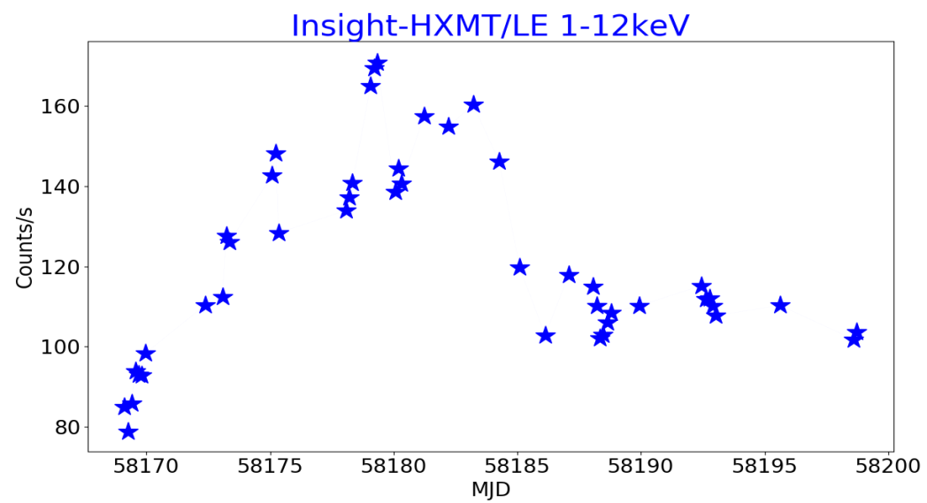
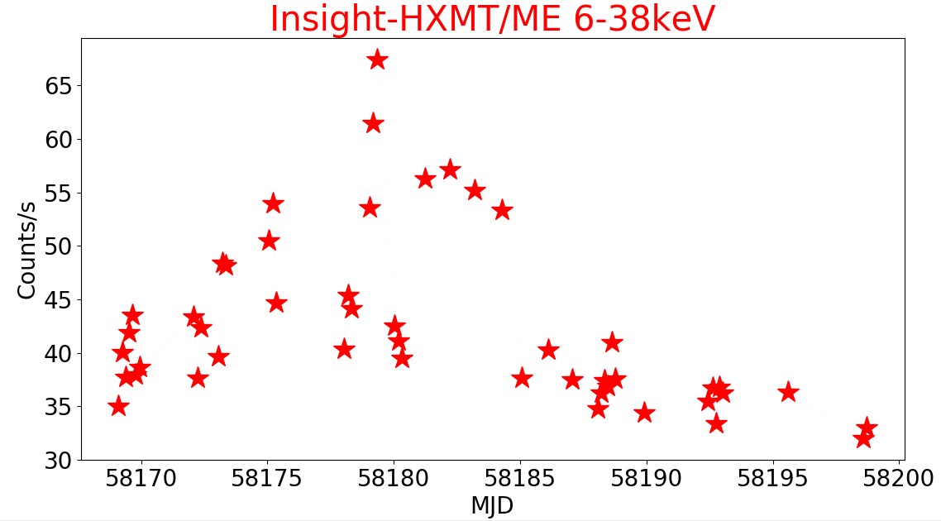
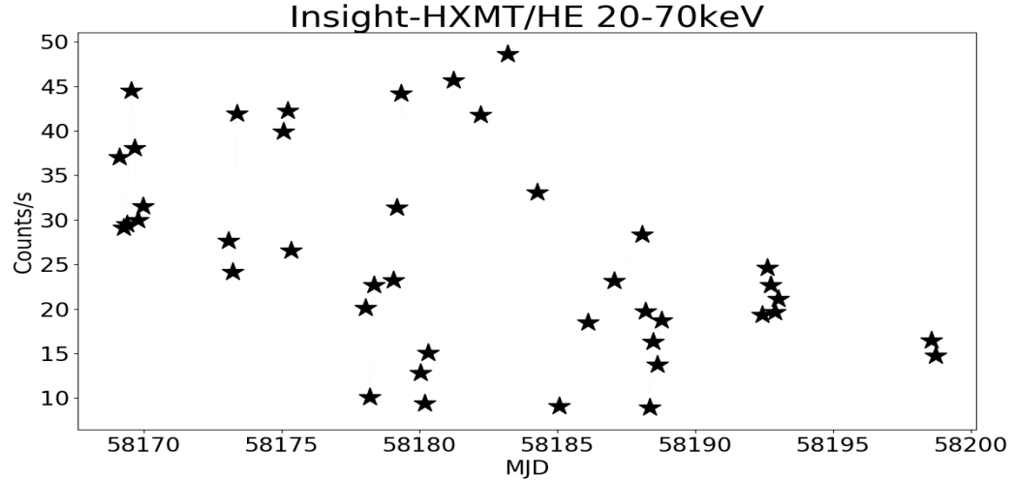
LC: Insight-HXMT vs MAXI
LE(1-12keV)
MAXI
ME(6-38keV)
HE(20-70keV)
Notes:
Consistent with MAXI

Slide 11
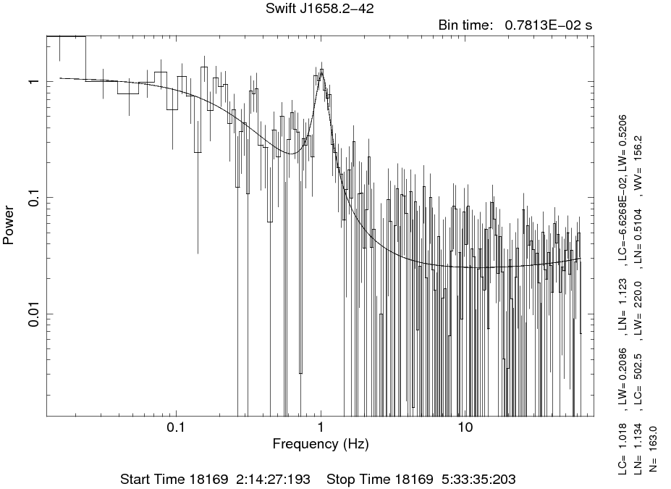
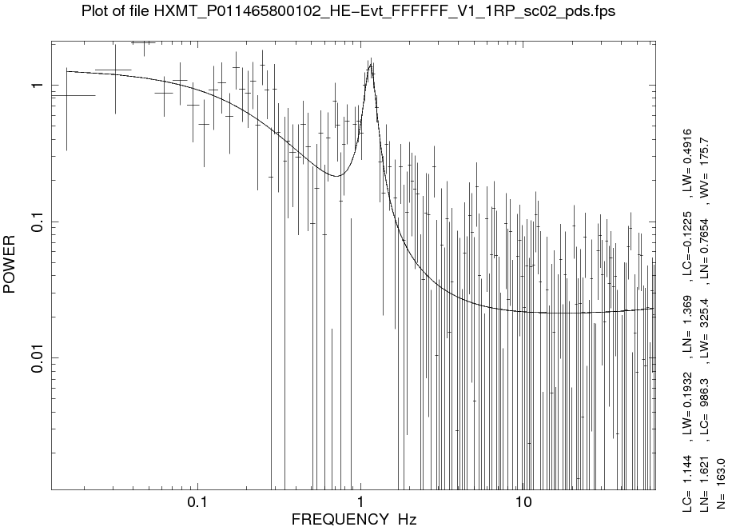
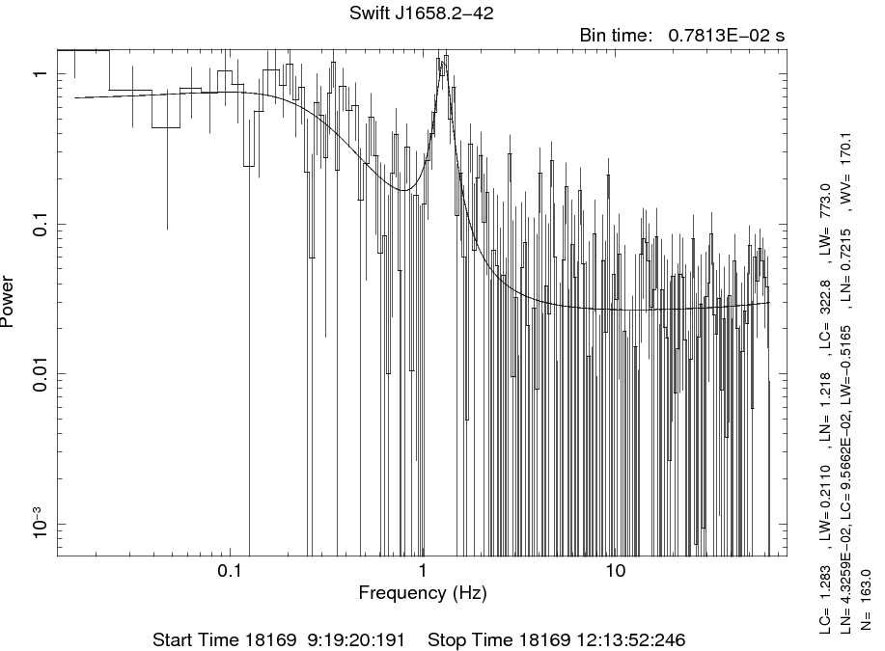
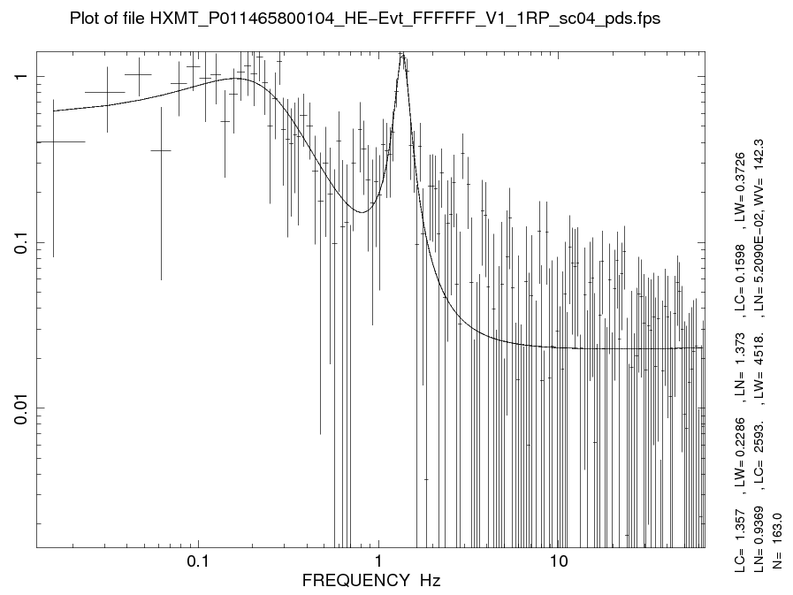
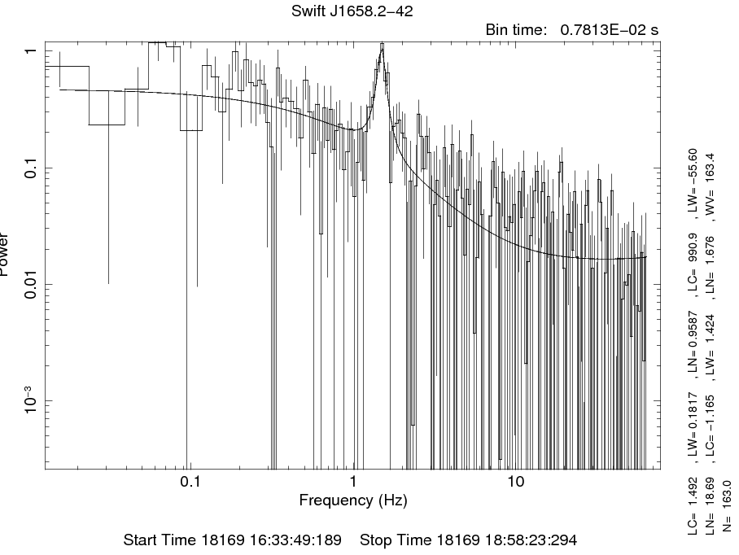
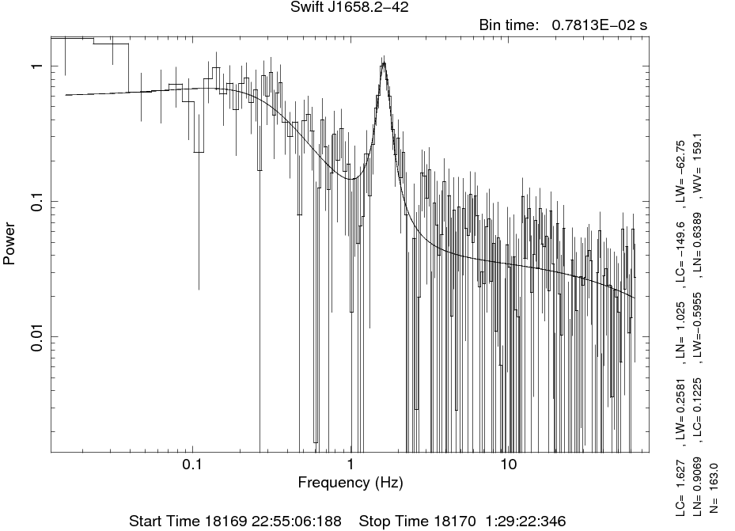
Power Density Spectra
HE: 25keV~100keV

Slide 12
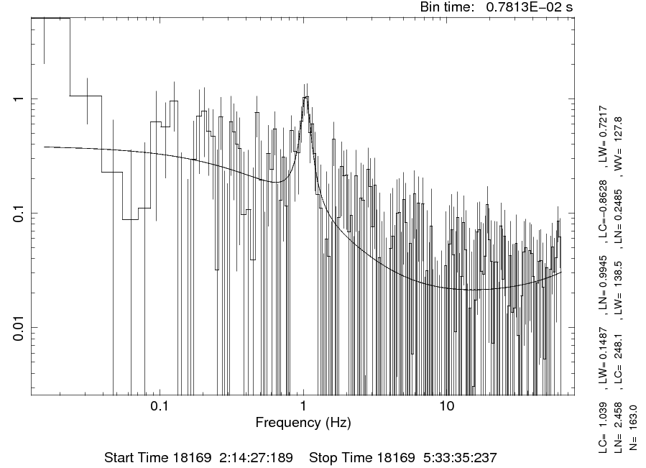
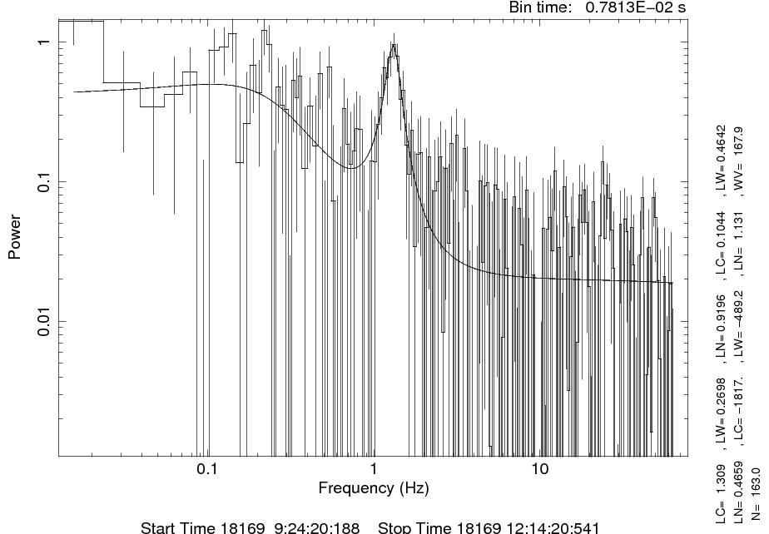
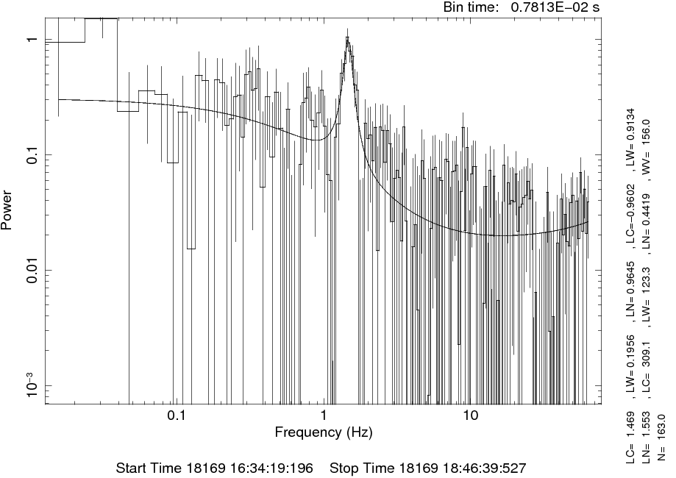
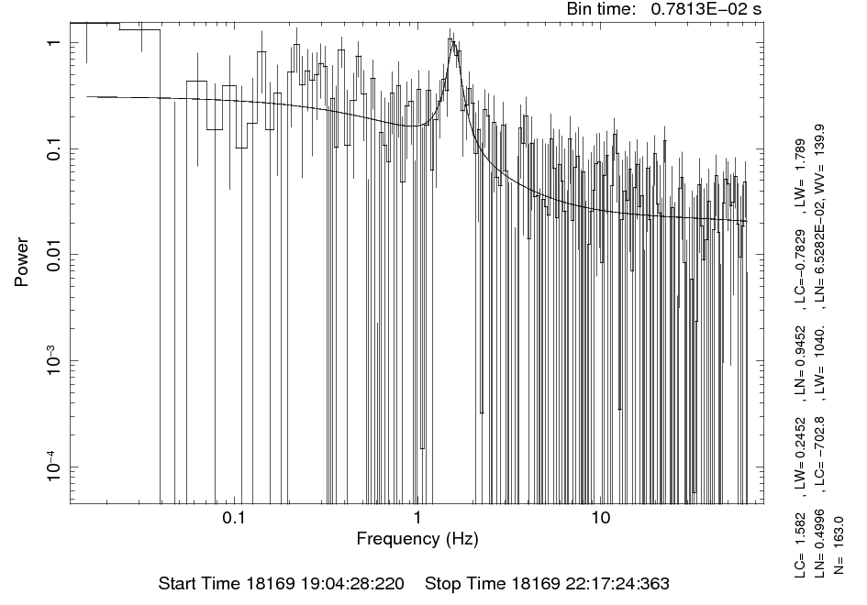
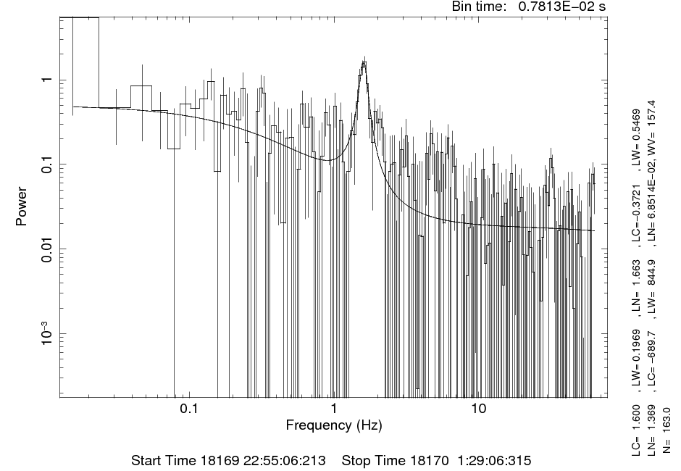
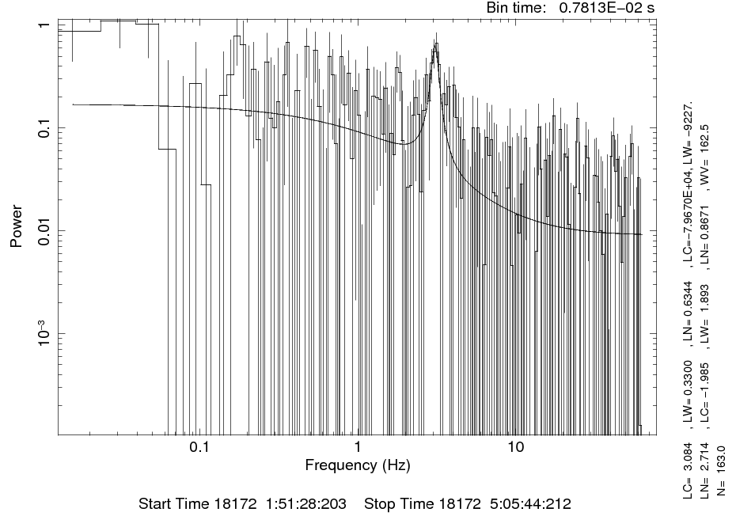
Power Density Spectra
ME:7keV~38keV

Slide 13
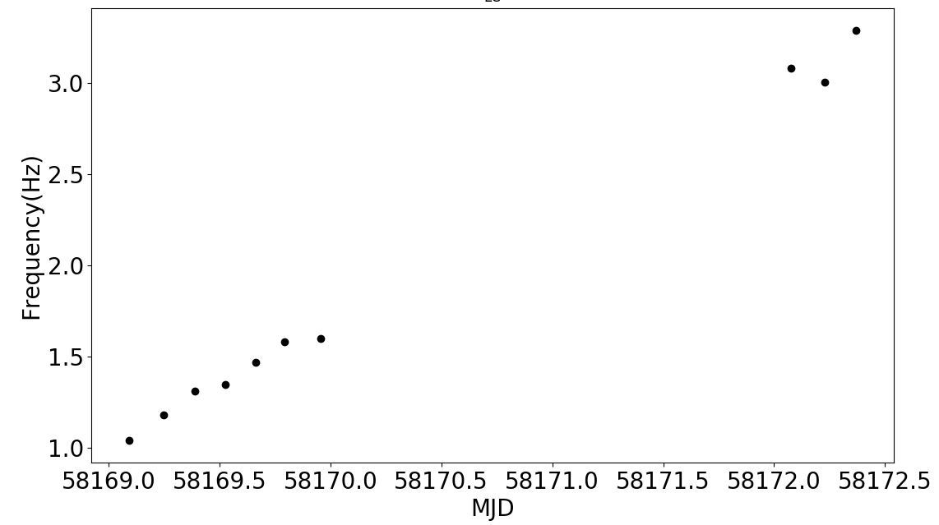
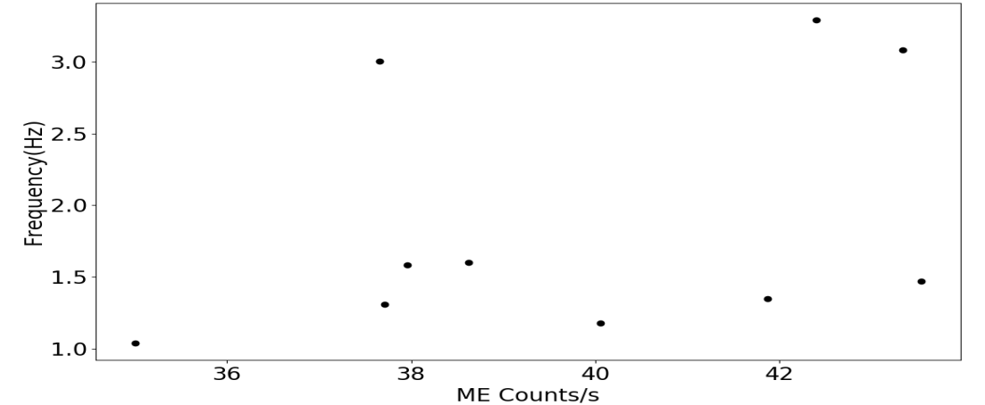
LFQPOs Evolution with Time
QPO： 1.03Hz~3.29Hz
Frequency Vs. Time
Frequency Vs. Flux

Slide 14
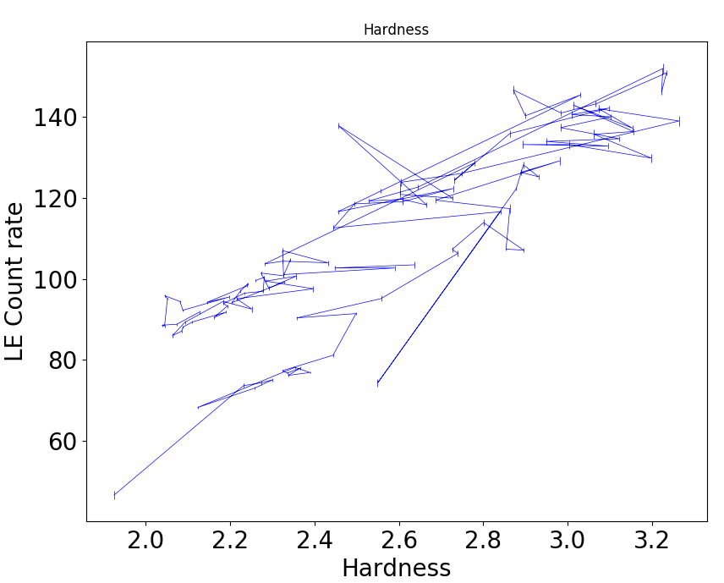
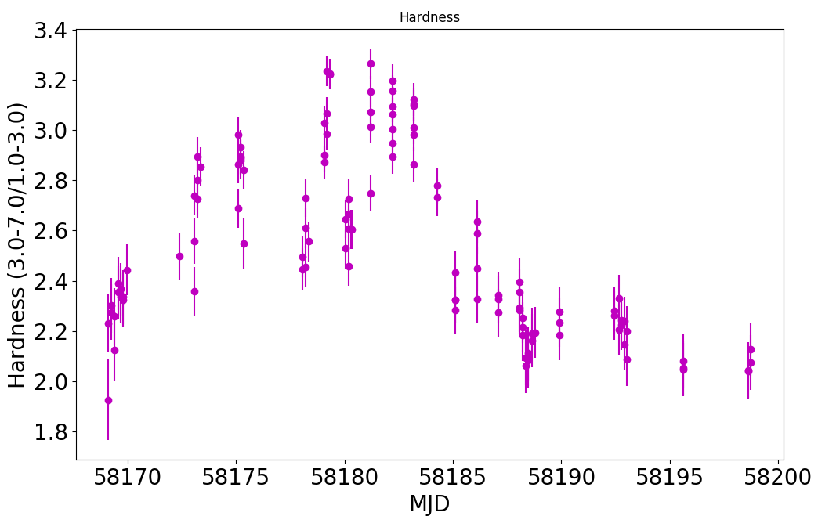
Hardness Evolution
Hardness:
LE
3-7keV/1-3keV
QPO
Flux vs. Time
HID
Hardness vs. Time
Notes:
标出来QPO的位置

Slide 15
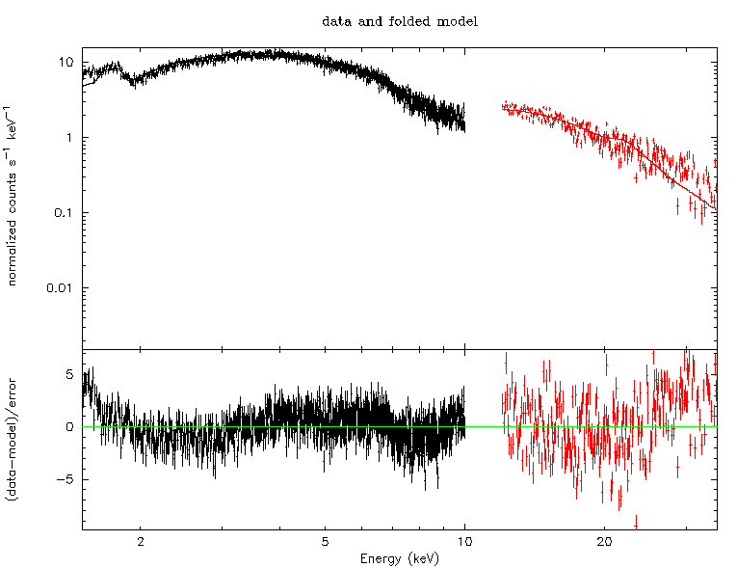
Spectrum
HXMT: ME & LE
Model：Absorbed disk black body and cutoff power law
NH=2.4 (+/-0.1) x 10^{22} cm^{-2}
Astrosat/Nustar/Swift
N(H) = 1.6(+/-0.2) x 10^{23} cm^{-2}
..
？

Slide 16
Summary
Power density spectra show the presence of QPO，the centroid frequency of QPO increased with time from ~1 to 3.3Hz
We propose Swift J1658.2-4242 is a black hole binary.
Analysis of this source is underway. The result is very preliminary, more result need accurate background estimation.

Slide 17
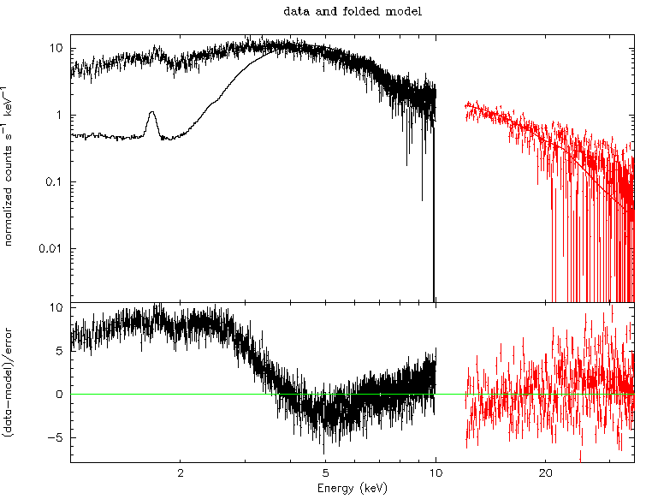
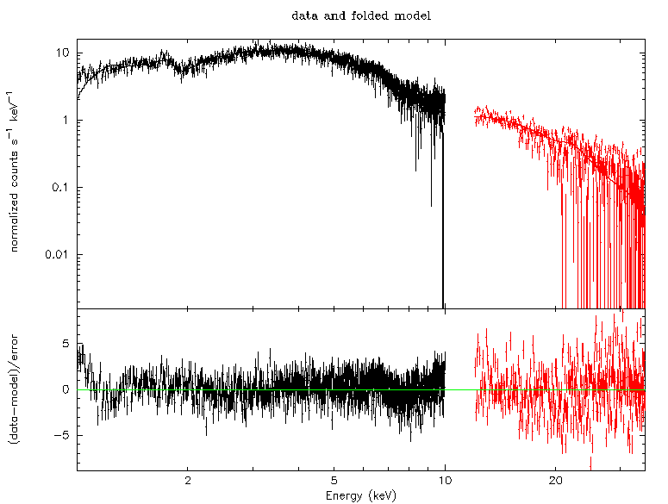
Spectrum

