Slide 1
GRO J1008-57 & MAXI J1820+070
Mingyu Ge
HXMT Collaboration
2018-04-11
Notes:
Name: Mingyu. In this presentation, many sources will be shown, which observed by Insight-HXMT

Slide 2
Outline
GRO J1008-57
Brief introduction
Insight observation
CSRF
Maxi J1820+070
Brief introduction
QPO
Spectrum

Slide 3
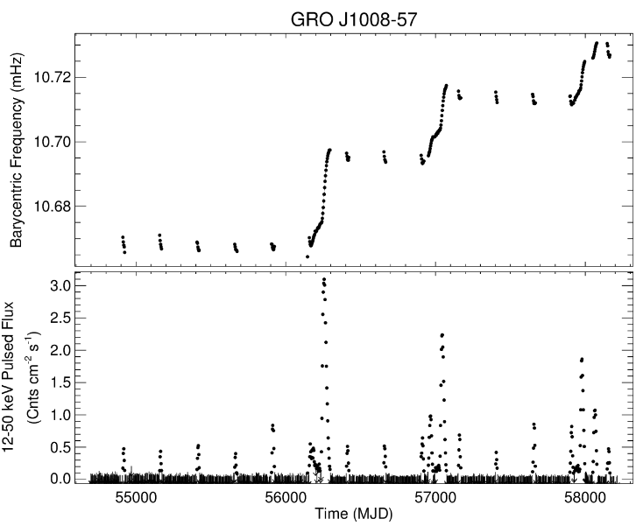
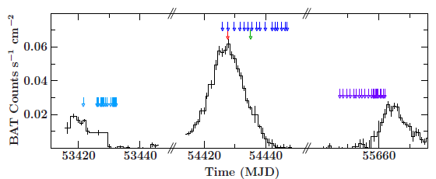
GRO J1008-57
Basic parameters for Companion star
Pulse profile
Kühnel et al. 2013
https://gammaray.nsstc.nasa.gov/gbm/science/pulsars/lightcurves/groj1008.html

Slide 4
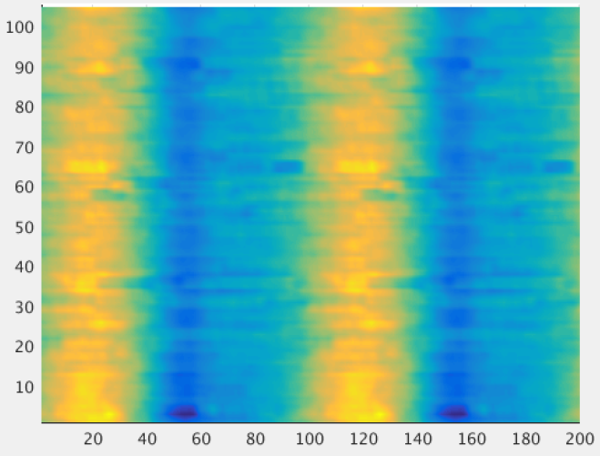
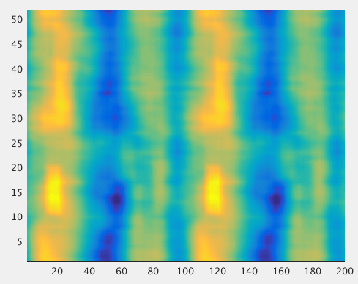
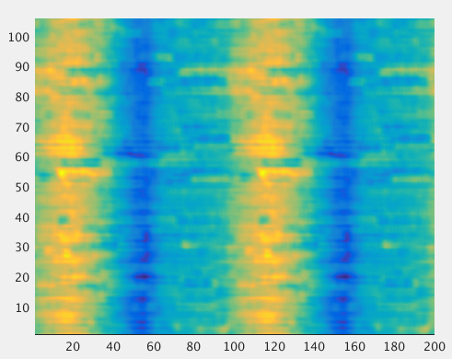
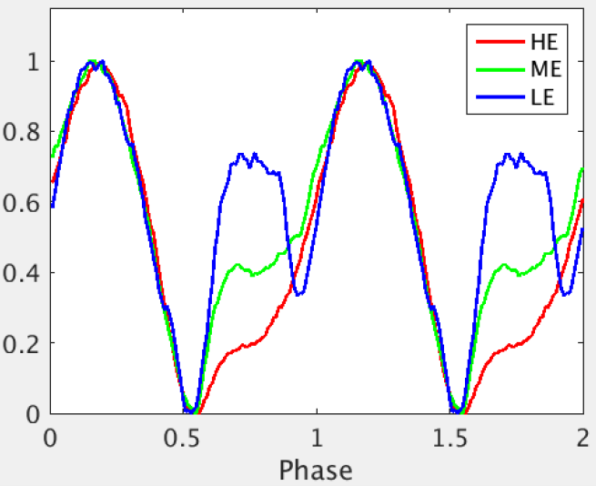
GRO J1008-57
GRO J1008-57
P= 93s，Porb=~247.8d
Kühnel 2013
4 Obs.
Time
（hr）
Phase Num

Slide 5
GRO J1008-57
Kühnel et al. 2013

Slide 6
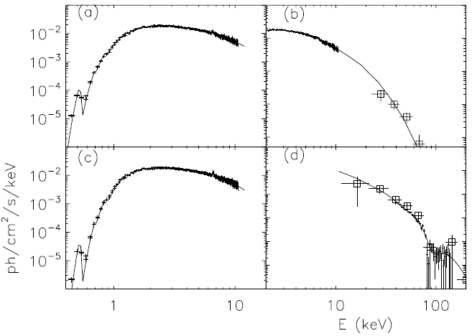
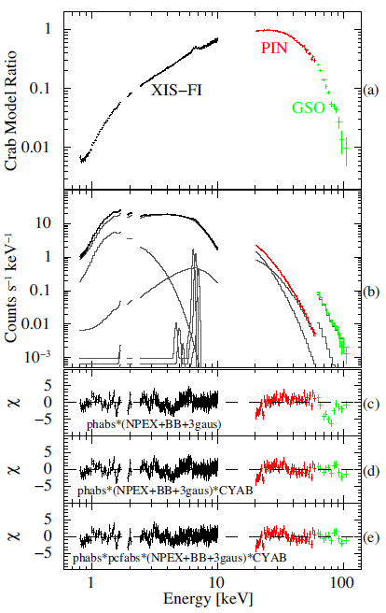
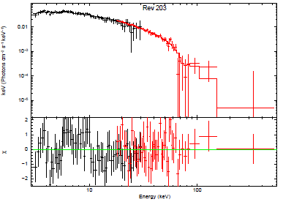
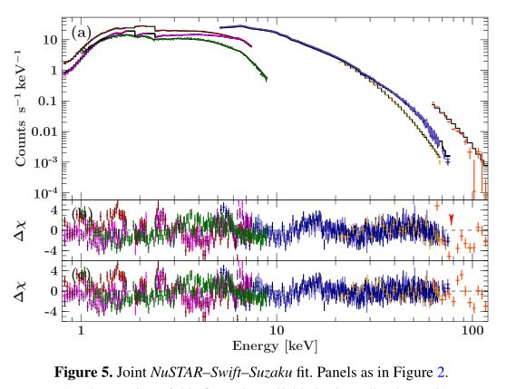
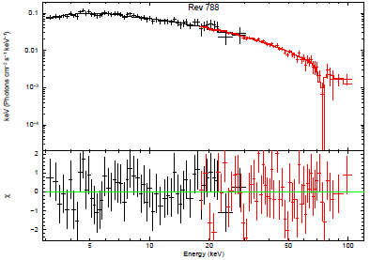
GRO J1008-57
GRO J1008-57
~78-88keV
YAMAMOTO 2014
Wang 2014
Shrader et al. 1999
Bellm et al., 2014

Slide 7
GRO J1008-57
Pulsed spectrum
cyclabs*cutoffpl
Peak phase
Unpulsed phase
2017-08-11---08-18
Background: unpulsed spectrum

Slide 8
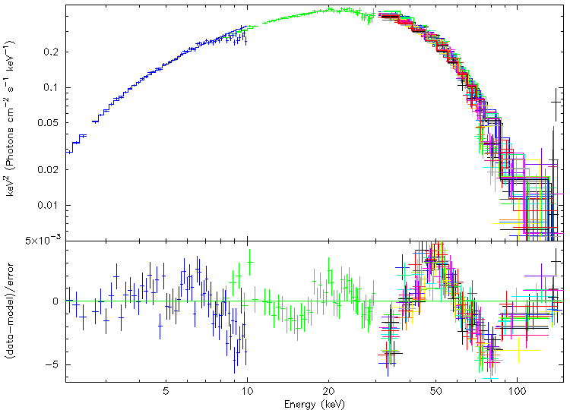
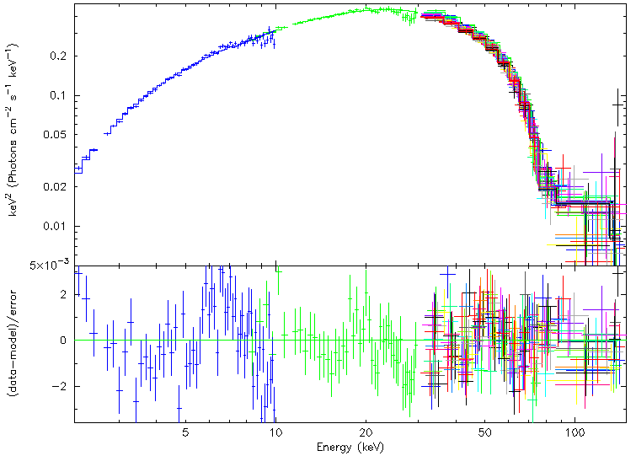
GRO J1008-57
Wabs*cutoffpl
Wabs*cyclabs*cutoffpl
Depth：1.85+-0.1
Ec：82+-1keV
Width：15+-1.5keV
Chi2 = 4.3（328）
Chi2 = 1.4（325）

Slide 9
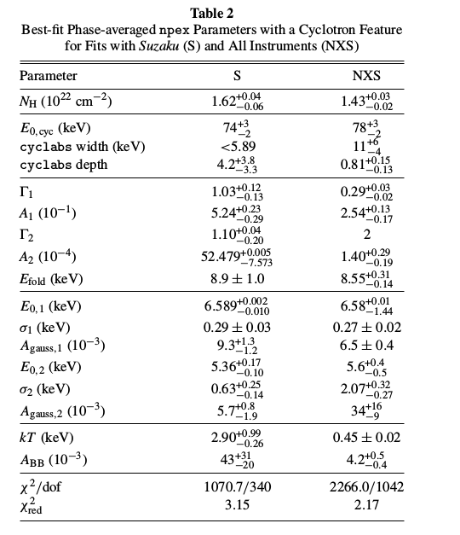
Insight—HE & ME&LE
Phi=2
Ec：82+-1keV
Width：15+-1.5keV
Depth：1.85+-0.1

Slide 10
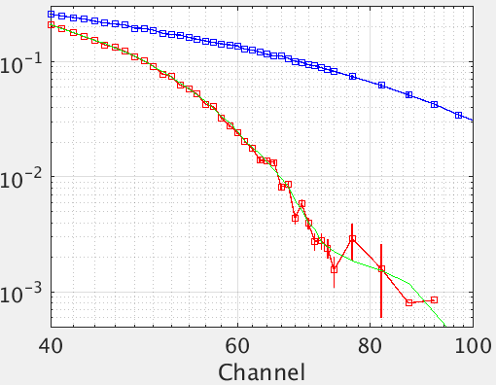
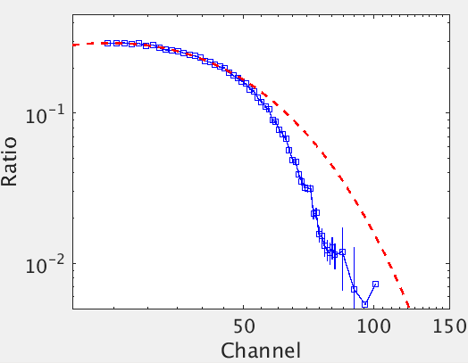
GRO J1008-57
Spectrum ratio
Crab
GRO J1008-57

Slide 11
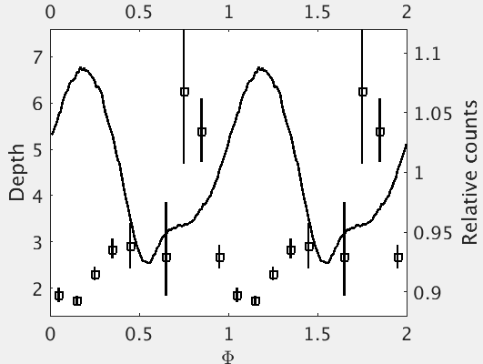
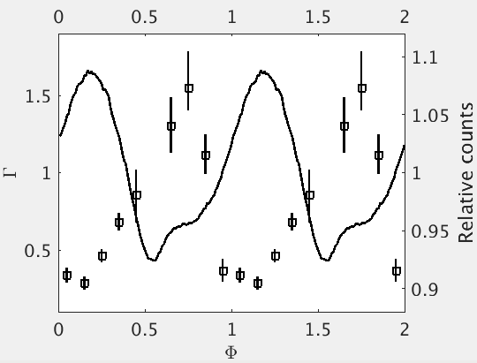
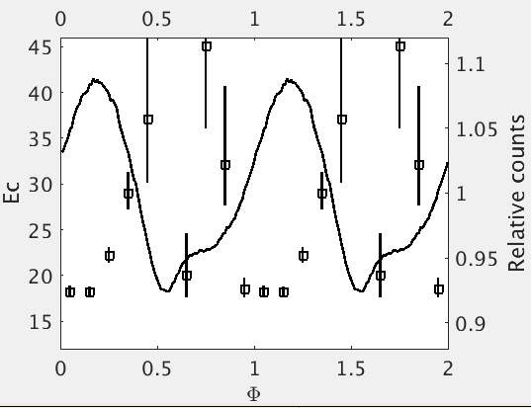
GRO J1008-57

Slide 12
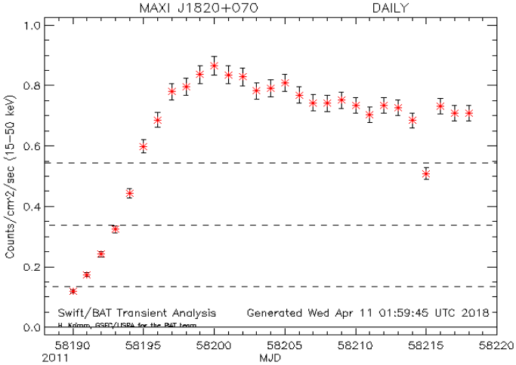
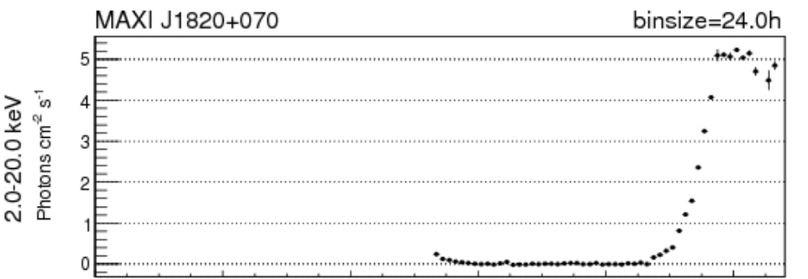
MAXI J1820+070
Discovered by Maxi, low-mass X-ray binary, ~3Crab
(R.A., Dec) =(18 20 26, +07 02 13)
Black hole candidate
optical/IR bands are strongly encouraged
Swift-BAT
Maxi

Slide 13
MAXI J1820+070
Atel# 11421

Slide 14
MAXI J1820+070
Insight-HXMT
Lightcurve
HE
ME
LE

Slide 15
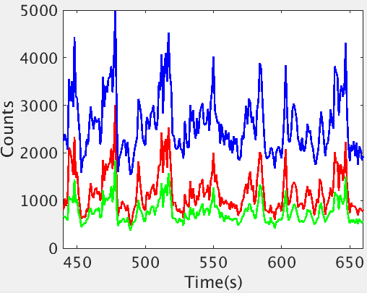
MAXI J1820+070
Insight-HXMT
Lightcurve
HE
ME
LE
X-ray QPO：0.04 Hz
INTEGRAL Atel #11488
Optical：0.05Hz
Lijiang Optical observation Atel #11510
HE--PDS

Slide 16
MAXI J1820+070
Model：wabs(diskbb + po)
kT~0.77keV
Photon index~0.84
Fe line：~6.35keV
Width：0.3keV
Notice：Background was not subtracted
Obs. Date：03-13

Slide 17
Summary
GRO J1008-57：
CSRF~82keV and check it with background model soon
Phase-resolved spectra
MAXI J1820+070
Preliminary results
Timing analysis: QPO…
Spectral evolution, Fe line
Thank you for your attention!

Slide 18
GRO J1008-57

Slide 19
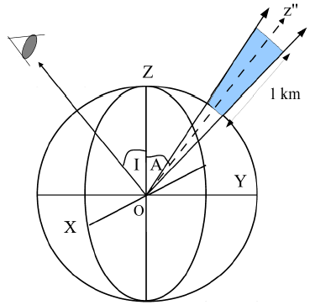
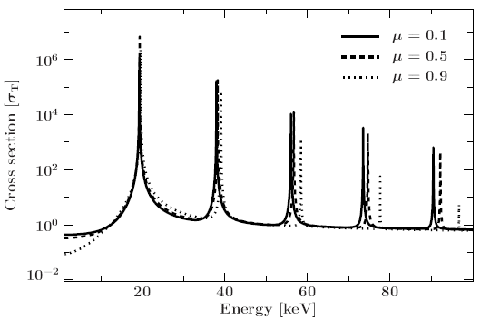
CRSF
Magnetic field
Accretion column
Maitra 2016

Slide 20
