Slide 1
Progress of CEPC Full Simulation Software
Chengdong FU
IHEP
2018-4-16

Slide 2
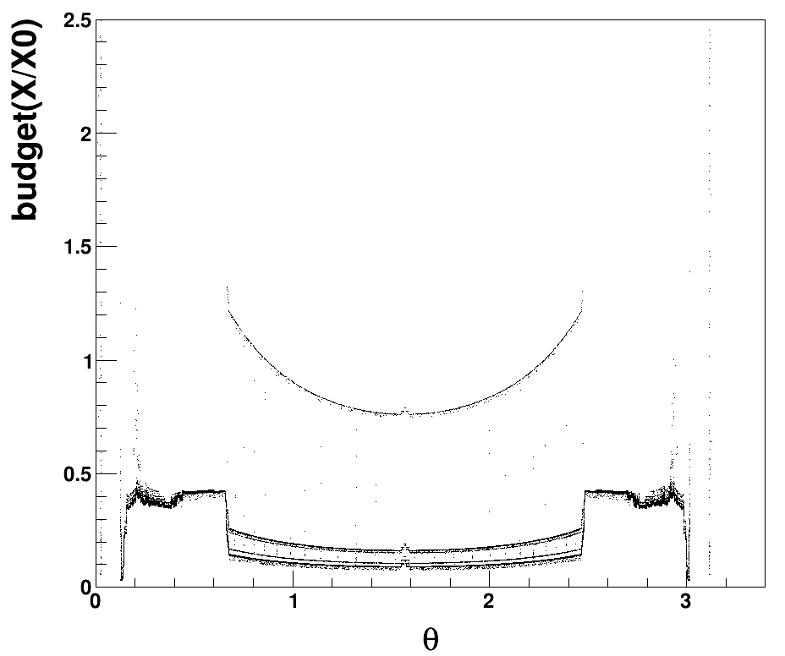
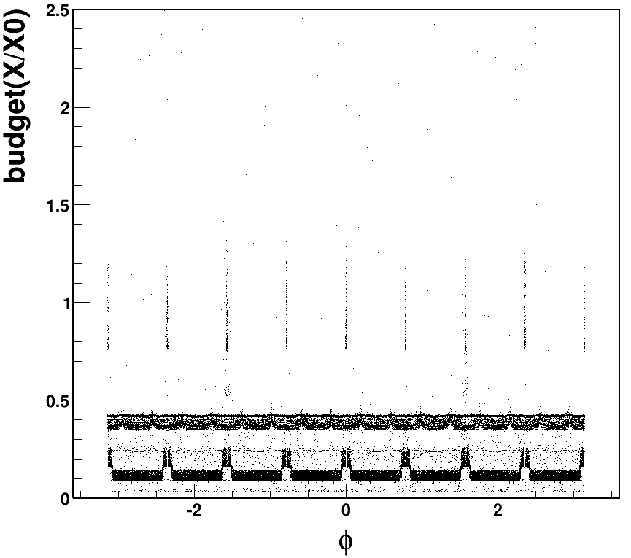
BudgetPlugin
/Mokka/init/registerPlugin BudgetPlugin
/Mokka/init/userInitString OutputFile budget.root
/Mokka/init/userInitDouble zCut 2350
/Mokka/init/userInitDouble rCut 1850
/gun/particle geantino
/run/beamOn 100000

Slide 3
Next to do:
volume naming rule
VXD_Sensitive_*
VXD_Support_*
VXD_Electronic_*
VXD_Cooling_*
etc.
Sub-detector volume
WorldLog→VXDLog→VXD_*_*
→TPCLog→
…

