Slide 1
Selections on data
Dong Ao

Slide 2
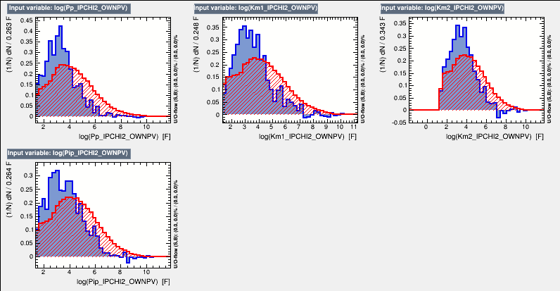
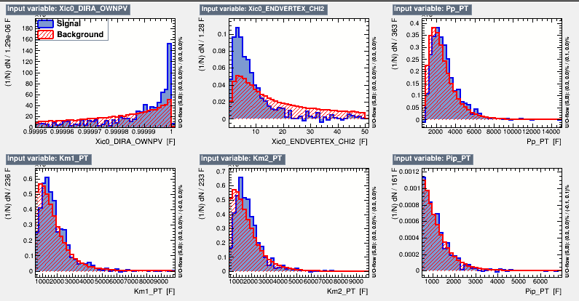
Used BDT method
First one:
Used Xic real data as input signal
input variables:
Xic_ENDVERTEX_CHI2,
Xic_DIRA_OWNPV,
daughter particle’s PT,
daughter particle’s IPCHI2_OWNPV

Slide 3
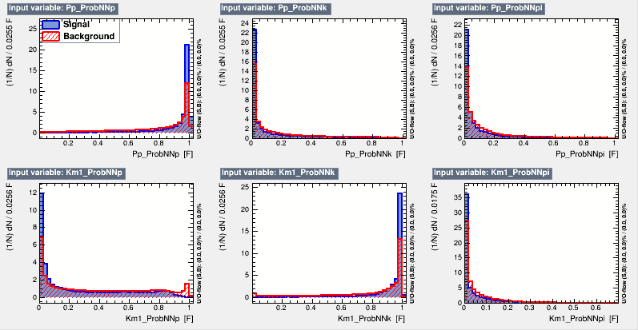
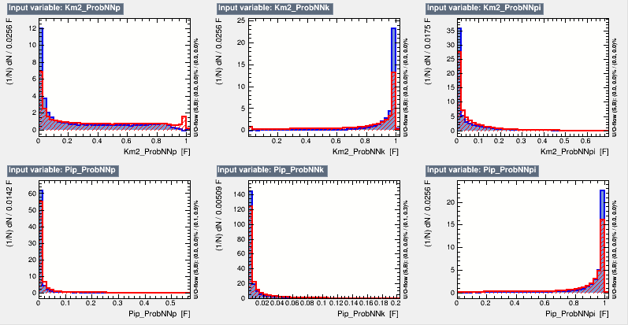
Used BDT method
Second one:
Used Xic real data(after first BDT cuted) as input signal
input variables:
daughter particle’s ProbNN

Slide 4
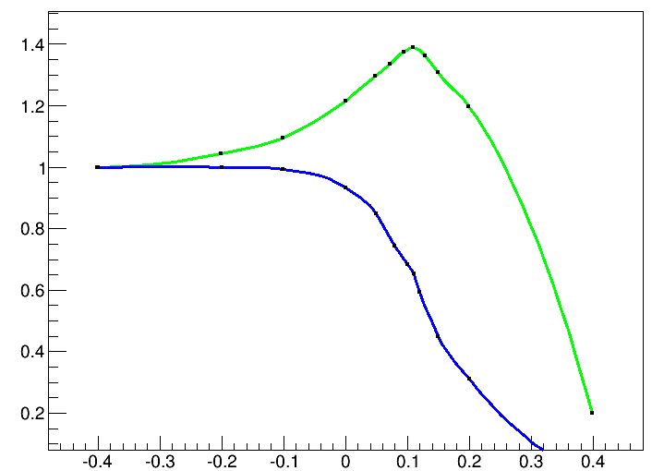
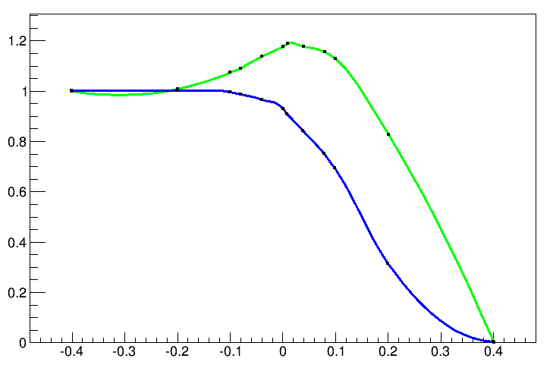
Find the max cut efficiency
To get the max S/sqrt(S+B) of Omegac
—S(number of signal)
—S/sqrt(S+B)
—S(number of signal)
—S/sqrt(S+B)

Slide 5
Orginal data
S | S+B | S/sqrt(S+B)
25273 | 420689 | 38.7
BDT cut
 | S | S+B | S/sqrt(S+B)
BDT>0.110 | 17704 | 105659 | 54.4675
BDT cut && pidBDT cut
 | S | S+B | S/sqrt(S+B)
pidBDT>0.01 | 16079 | 61673 | 64.746

Slide 6
