Slide 1
Observation of an Unknown Structure in Double J/ψ in pp Collisions at sqrt(s) = 8 TeV at CMS
2018 Workshop on Physics Analysis 11-12 June 2018 IHEP
12nd June 2018
Jianguo Bian, Guoming Chen, Hesheng Chen, Chunhua Jiang, Junquan Tao
Institute of High Energy Physics, China
(BPH-10-014, AN -2013/364)
An unknown structure is observed:
mass = 16.5827±0.0931± 0.0239 GeV,
Γ = 0.4740± 0.1735±0.0390 GeV ,
events = 49±14 ±5, significance = 4.9 σ.
The first uncertainties are statistic. The second systematic.
After acceptance and efficiency correction:
mass = 16.7249±0.0934±0.0908 GeV,
Γ = 0.2892±0.1739±0.1264 GeV,
events = 2128±611± 817,
cross section = 29.0±8.3±11.8 pb.
Both J/ψ kinematics is pT(J/ψ)>3.75 GeV and |y(J/ψ)|< 2.3.
Data sample corresponds to an integrated luminosity of 20.65/fb.

Slide 2
Outline
1. History and Motivation ..............................................................3
2. Feynman Diagram ......................................................................4
3. Major Change Since Last Talk .....................................................5
4. Data .............. ..............................................................................6
5. Monte Carlo samples .................................................................7
6. Muon Selection ..........................................................................9
7. Separation of Prompt and Non-prompt Double to J/ψ ............12
8. Suppression of Double Parton Scattering Events .....................18
9. Unbinned Maximum Likelihood Fit to Structure ......................20
10. Look Elsewhere Effect .............................................................23
11. Acceptance and Efficiencies ....................................................24
12. Syetematic Uncertainties ........................................................28
13 Run Number and μ polar angle distributions …………….……….…31
14. Summary .................................................................................33
15. Appendix .................................................................................34
Evidence at 13TeV using 2017 data
Evidence in ΥΥ* at 7&8 TeV

Slide 3
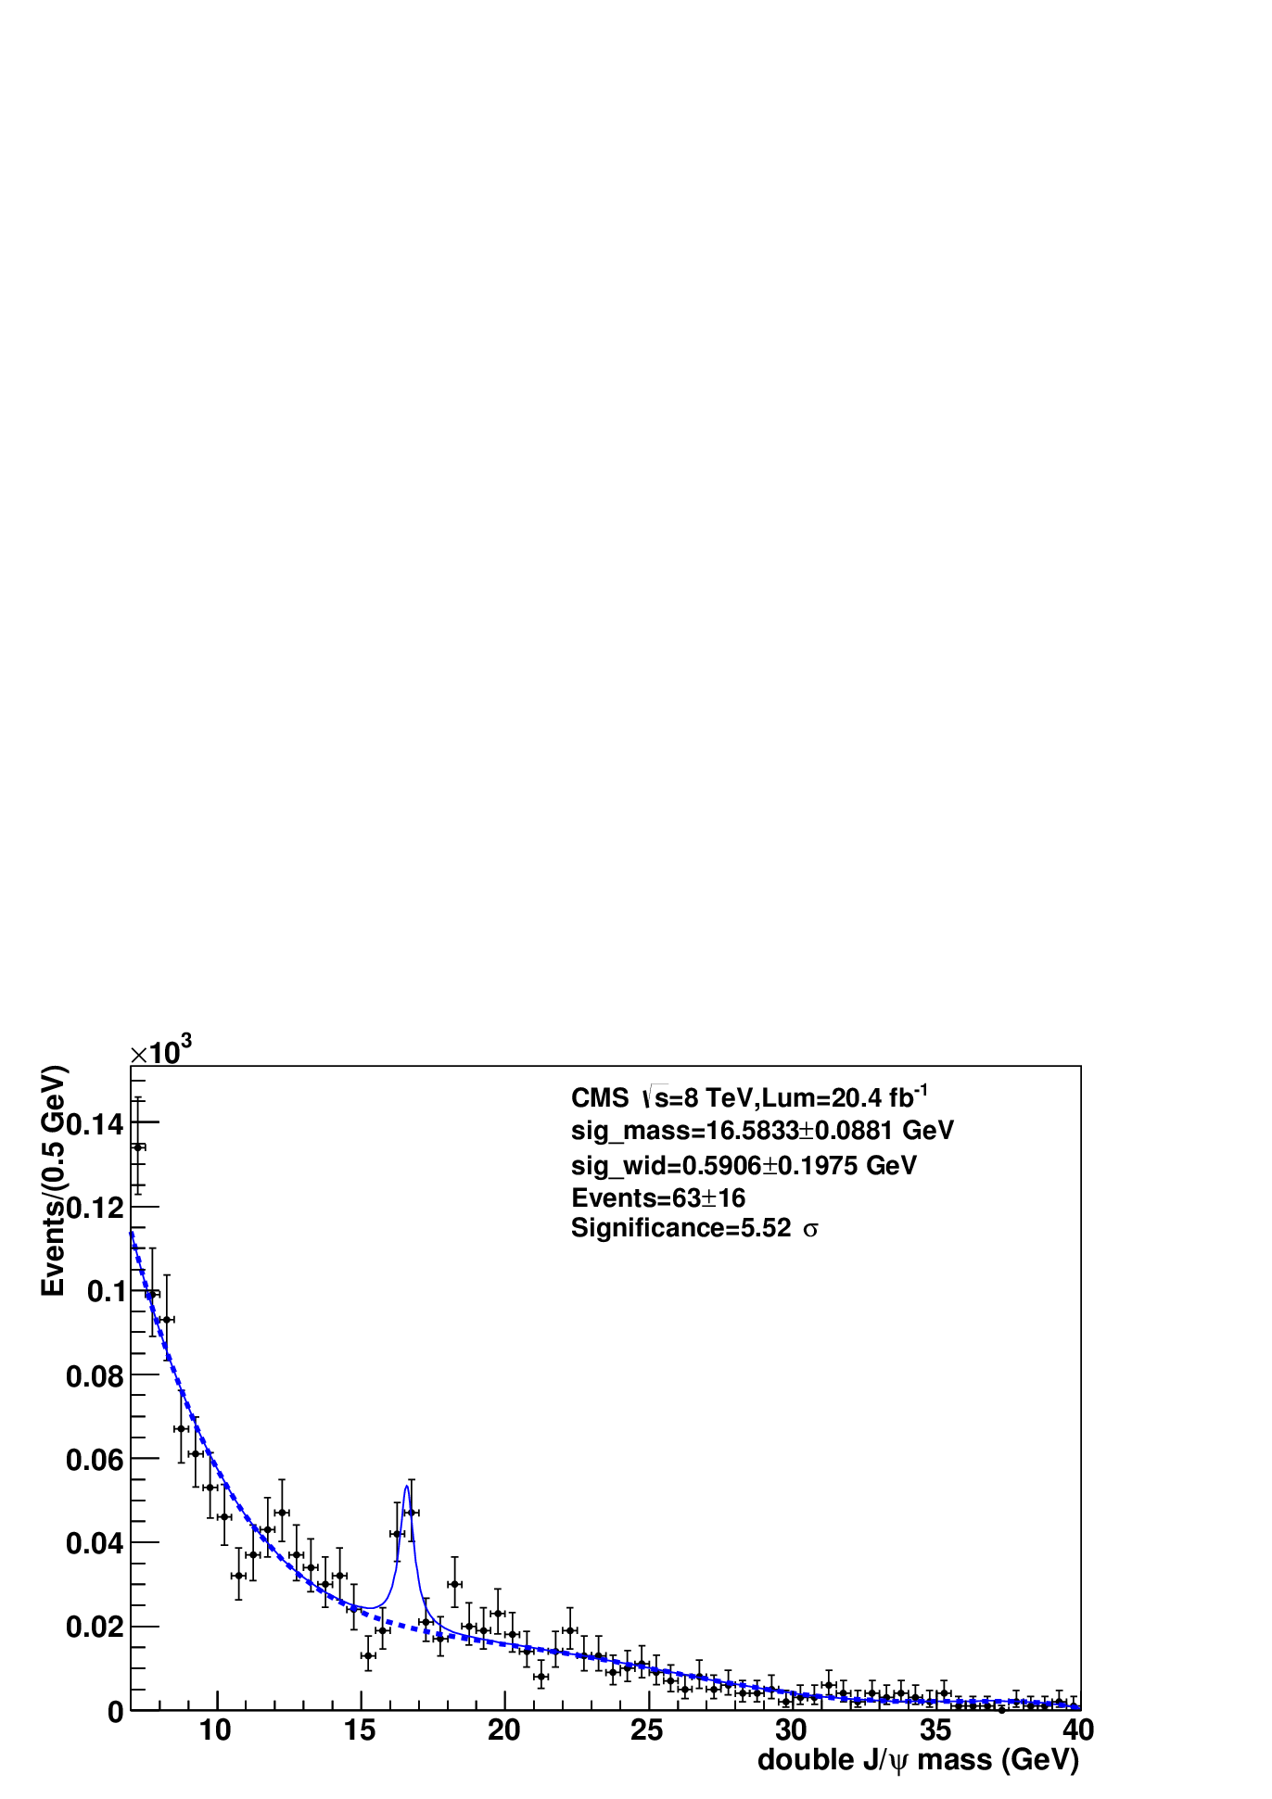
1. History and Motivation
On 2nd Oct 2013, I presented that the hint of an unknown structure was
observed at 16.5 GeV in double J/ψ mass distribution for the first time.
Up to 12th Dec 2017, I presented the structure X(16500) for 10 times to
upgrade and answer the questions from colleagues. The note is AN2013
-364-v12 and the pas is BPH-14-010-pas-v1.
To apply for pre-approval, we will present completely the observation of the
structure at 8 TeV at this meeting, some parts of which are upgraded
(see slide 5).
We will also present the evidence and hint of the structure
We will respond to the question whether X(16500) is the contamination from
X(18500) observed in Ymumu→4mu channel.
signal
first time observation in 2013
@ 8 TeV
last time observation in 2017
@ 8 TeV

Slide 4
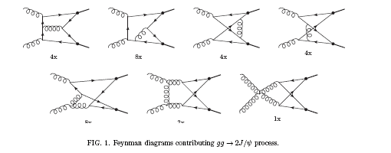
2. Feynman Diagram
Double J/ψ events include two components: prompt double J/ ψ
and non-prompt double J/ ψ.
The prompt double J/ ψ comes from a single parton scattering (SPS)
or a double parton scattering (DPS) , while the non-prompt double
J/ ψ comes from double B meson decays.
At the parton level, the single parton scattering are either produced
in color singlet model or color octet model.
In the production of prompt double J/ ψ, gg→double J/ψ is
dominant.
Feynman diagram for SPS: gg→double J/ψ

Slide 5
3. Major Change Since Last Talk
Fit region: [7, 40] GeV → [6.5, 45] GeV.
Fit function: 4th Chebyshev Polynomial → decay function plus the
2nd Chebyshev Polynomial, as the latter has largest fit probability
prob=prob(χ2, df), where df means degree of freedom.
Significance: 5.5 σ → 4.9 σ.
Acceptance and efficiency correction is upgraded.
The cross section of the structure is upgraded.

Slide 6
4. Data
Table 1: data sample
8 TeV (/MuOnia)
/Run2012A-22Jan2013-v1/AOD
/Run2012B-22Jan2013-v1/AOD
/Run2012C-22Jan2013-v1/AOD
/Run2012D-22Jan2013-v1/AOD
20.65/fb
Json file:
Cert_190456-203742_8TeV_22Jan2013ReReco_Collisions12_JSON_MuonPhys.txt
CMS software:
CMSSW_5_3_33

Slide 7
5. Monte Carlo Samples (1)
Seven Monte Carlo samples are produced as follows and summarized in next slide:
1st sample is used to estimate acceptance event by event in generator level. For each data event, 1000 Monte Carlo events are produced using the method of data substitution.
2nd sample is used to estimate reconstruction, trigger and selection efficiencies event by event. It is produced in recon. level in the way similar to the first sample. The preselection is that pT(mu)>2 GeV,|η(mu)|<2.4.
3rd sample is used to calculate the phase space distribution in recon. level. It is the SPS in color singlet mode produced with DJpsiFDC. pT(J/Ψ)>3 GeV, |y(J/Ψ)|<2.4.
4th sample is used to calculate the phase space distribution in recon. level. It is the SPS in color octet mode produced with DJpsiFDC. pT(J/Ψ)>3 GeV, |y(J/Ψ)|<2.4.
5th sample is used to calculate the phase space distribution in recon. level. It is the DPS produced with PYTHIA8 (430000 evts). pT(J/Ψ)>3 GeV, |y(J/Ψ)|<2.4.
6th sample is used to simulate the detector's mass resolution in recon. level. It is pp→ Higgs→ J/ΨJ/Ψ. Higgs mass is 16.5 GeV, which is produced with PYTHIA6.
7th sample is in recon. level. It is pp→ Higgs→ Ymumu→4mu. Higgs mass is 18.5
GeV, which is produced with PYTHIA6.

Slide 8
5. Monte Carlo Samples (2)
Table 2: Monte Carlo Samples
Set | Process | Ngen | Nrecon | Generator | Preselection | Purpose
1 | data | 1000 for each data evt |  | data substitution |  | acceptance
2 | data | 1000 for each data evt | 1000 for each data evt | data substitution | pT(μ)>2 |η(μ)|<2.4 | efficiencies
3 | SPS_{CS} | 840914 | 840914 | DJpsiFDC | pT(J/Ψ)>3 |y(J/Ψ)|<2.4 | phase space
4 | SPS_{DS} | 335982 | 335982 | DJpsiFDC | pT(J/Ψ)>3 |y(J/Ψ)|<2.4 | phase space
5 | DPS | 429628 | 429628 | PYTHIA8 | pT(J/Ψ)>3 |y(J/Ψ)|<2.4 | phase space
6 | Higgs | 181000 | 181000 | PYTHIA6 | X(16500) | mass resolution
7 | Higgs | 20000 | 20000 | PYTHIA6 | X(18500) | contami-nation

Slide 9
6. Muon Selection (1)
Events are selected with 4 or more identified NEW SOFT muon or Tight muon
candidates (provided by B physics group)
dxy<0.3cm and |dZ|<20 cm. (cut 1)
kinematic requirements imposed on the muon
pT(μ)>2 GeV and |η(μ)|<2.4. (cut 2)
  Events are required to pass the trigger paths, which were used to collect
  the MuOnia set. Among these trigger paths, 3 muon trigger
  HLT-Dimuon0-Jpsi-Muon (cut3 )
  give dominant contribution to this work.
  To select J/Ψ, muons with opposite charge are paired,
  2.8 < m(dimuon) < 3.4 GeV. (cut 4)
If the number of dimuon candidates is larger than two,
the minimal |m(dimuon1) -3.092|2 + |m(dimuon2) -3.092|2 (cut 5)
is used select one combination.
The two muon are refitted with a common vertex constraint with
the fit probability > 0. (Cut 6)
note this cut is correlated with cut 9.
pT(dimuon) > 3.75 GeV and |y(dimuon)|<2.3 (Cut 7)

Slide 10
6. Muon Selection (2)
The kinematic requirement imposed on the double dimuon candidates is
pT(dj)> 3 GeV (cut 8)
to consistent with the theoretical NRQCD calculation of η_{B} decay to double
J/ψ cross section. The number of events at the step is 11722.
The signal of double J/ψ is shown in Fig. 1.
Fig. 1: Double J/ψ signal. The events include
prompt and non-prompt double J/ψ (Cuts 1-8).

Slide 11
6. Muon Selection (3)
Define a double J/ψ signal mass window to be
|m(dimuon1)- 3.092|< 3σ * |m(dimuon2)- 3.092|< 3σ; (cut 9.1)
σ is event by event.
To improve double J/ψ mass resolution, for the events in the double J/ψ
signal mass window, constrain dimuon mass to J/ψ mass 3.097 GeV
with the fit probability > 0. (cut 9.2)
Define the sideband of double J/ψ signal to be
|m(dimuon1)- 3.092|< 3sqrt(2)σ * |m(dimuon2)- 3.092|< 3sqrt(2)σ
- |m(dimuon1)- 3.092|< 3σ * |m(dimuon2)- 3.092|< 3σ. (cut 10)
The area of the sideband is exactly equal
to that of the mass window.
Double J/ψ invariant mass (Cuts 1-9)
is shown in Fig.2; the filled area is
the sideband (Cuts 1-8, 10).
Fig. 2 Double J/ψ invariant mass, which includes the prompt and non-prompt double J/ψ.

Slide 12
7. Separation of Prompt and Non-prompt Double J/ψ (1)
There are five components in the double J/ψ events
 | μμ1 | μμ2 | mass fit function | pdl fit function
1 | prom J/ψ | prom J/ψ | crystalball, crystalball | reso, reso
2 | npro J/ψ | npro J/ψ | crystalball, crystalball | decay, decay
3 | bg | bg | 2nd che poly, 2nd che poly | reso+decay, reso+decay
4 | bg | J/ψ | 2nd che poly, crystalball | reso+decay, reso+decay
5 | J/ψ | bg | crystalball, 2nd che poly | reso+decay, reso+decay
where
reso = fpdl gauss1 gauss1(pdl sigma1) + (1 − fpdl gauss1) gauss2(pdl sigma2),
decay = exp(−pdl/c ), bg means background

Slide 13
7. Separation of Prompt and Non-prompt Double J/ψ (2)
Double J/ψ 4-dimension distribution
Fig. 3: 4d fit to double J/ψ signal. There are five components in the events: both of them are prompt J/ψ(3492±100); both of them are non prompt J/ψ(3265±99); neither of them is a J/ψ(626 ±57); one is not a J/ψ and the other is a prompt or non-prompt J/ψ (2291±78); and vice versa (2228±79).

Slide 14
7. Separation of Prompt and Non-prompt Double J/ψ (3)
To remove non-prompt double J/ψ events, the four muons are refitted with a common vertex constraint with the fit probability > 0.01. (Cut 11)
see Fig. 4
Fig. 4: the fit probability of four muons sharing a common vertex. The solid line is both the prompt and non-prompt the double J/ψ events (Cuts 1-9). The dashed line is the events with one more cut, that is double J/ψ mass mdj < 15 GeV or mdj > 18 GeV, which blinds the unknown structure.

Slide 15
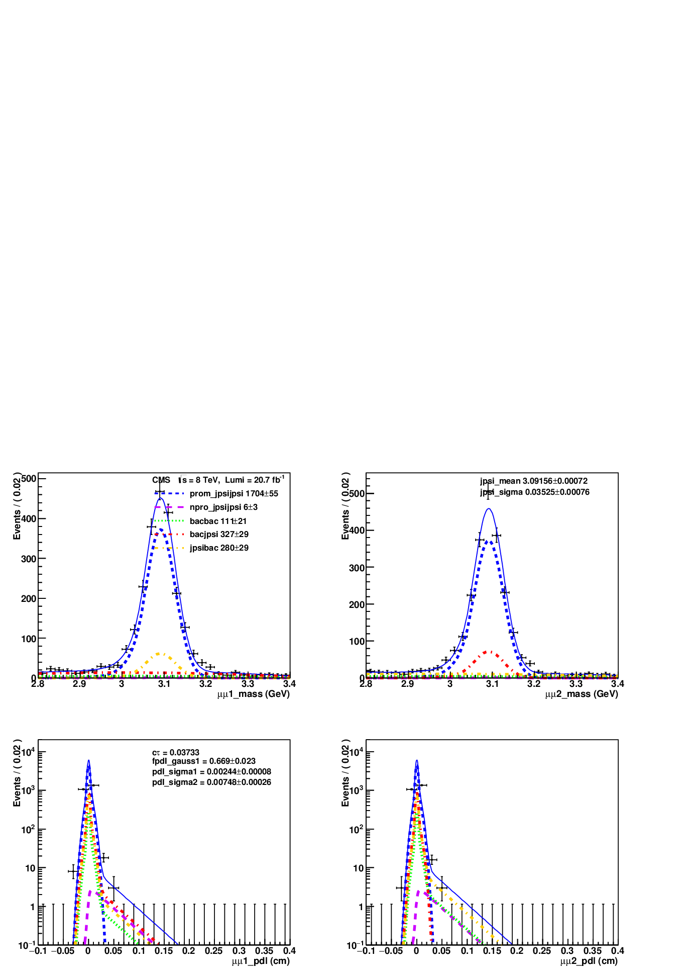
7. Separation of Prompt and Non-prompt Double J/ψ (4)
Pompt double J/ψ 4-dimension distribution
Fig. 5: 4d fit to the double J/ψ events after 4μ are required to share a common vertex with the fit probability larger than 1% (Cuts 1-8, 11). The prompt double J/ψ events are dominant (1704±55) and the non-prompt double J/ψ (6±3) can be ignored safely.

Slide 16
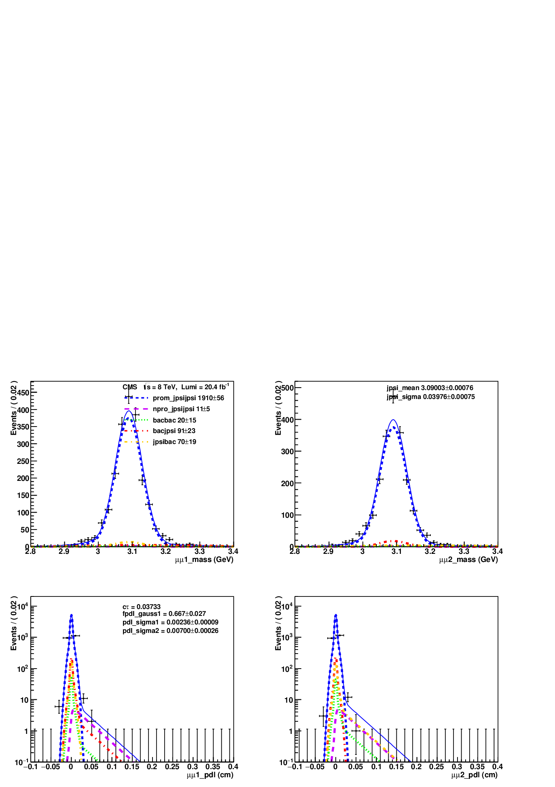
7. Separation of Prompt and Non-prompt Double J/ψ (5)
4-dimension distribution of pompt double J/ψ in the 3σ*3σ mass window
Fig. 6: 4d fit to the double J/ψ events in the signal mass window after four muons are required to share a common vertex with the fit probability >1% (Cuts 1-9, 11). The prompt double J/ψ are dominant (1910±56) and non-prompt double J/ψ (11±5) can be ignored safely.

Slide 17
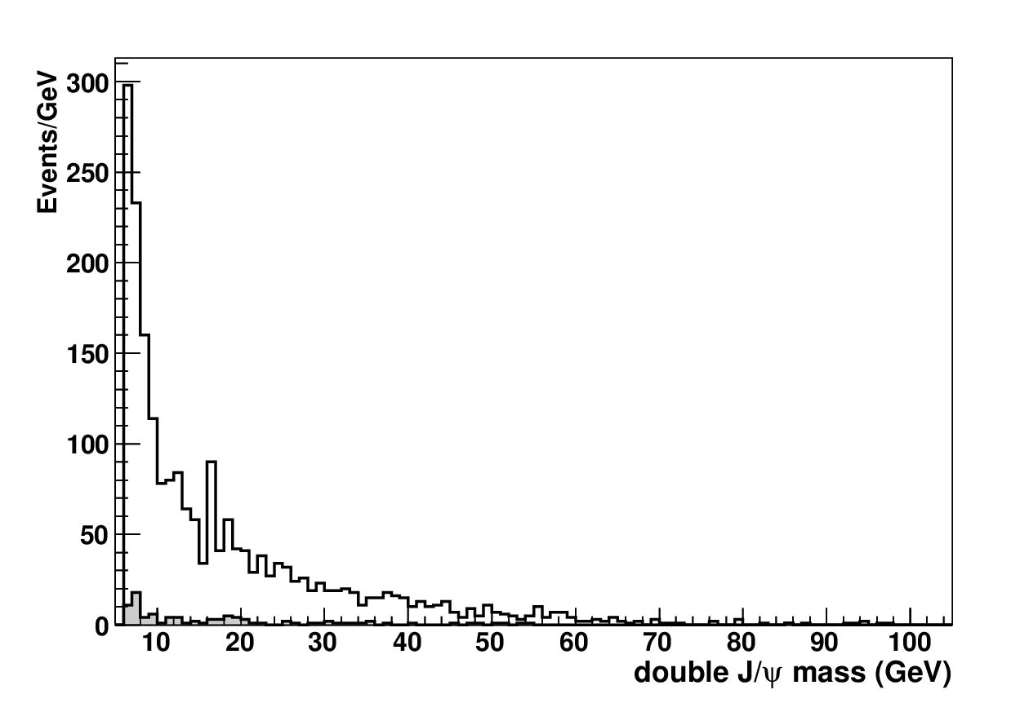
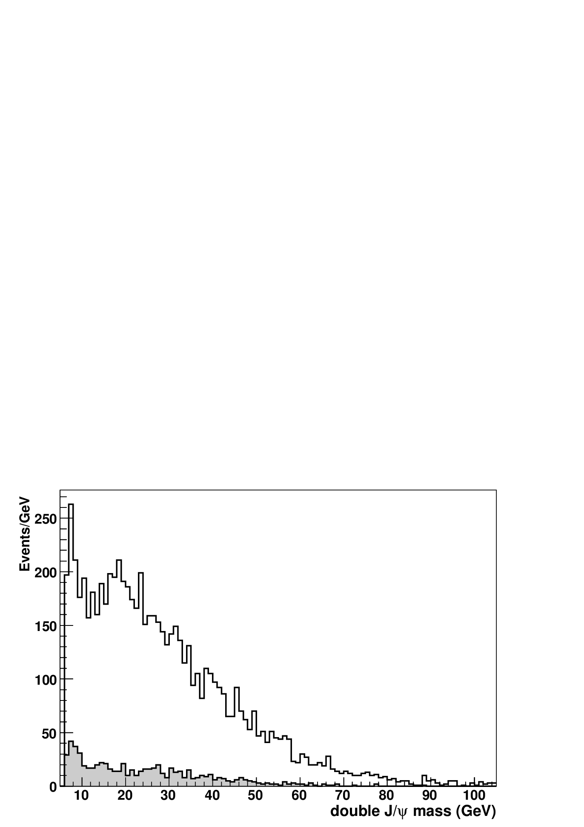
7. Separation of Prompt and Non-prompt Double J/ψ (6)
Pompt double J/ψ invariant mass distribution (Fig. 7)
Non-pompt double J/ψ invariant mass distribution
For comparison, the four muons are refitted with a common vertex constraint
with the fit probability < 0.01 (Fig. 8). (Cut 12)
Fig. 7: The invariant mass for prompt double J/ψ events. The solid line is the double J/ψ events (Cuts 1-9, 11). The filled area is the sideband (Cuts 1-8,10, 11). An unknown structure around 16.5 GeV is observed.
Fig. 8 The invariant mass for non-prompt double J/ψ.The solid line is the non-prompt double J/ψ events (Cuts 1-9, 12). The filled area is the sideband (Cuts 1-8, 10, 12).

Slide 18
8. Suppression of Double Parton Scattering Events (1)
MC SPS
MC DPS
DATA
SIDEBAND
There are two components in the prompt double J/Ψ events: SPS and DPS.
Upper left is MC SPS events. Upper right is MC DPS events. Lower left is data;
Lower right is sideband.
| y(J/Ψ 1) − y(J/Ψ 2) |< 1.5 to suppress DPS events (Cut 13)

Slide 19

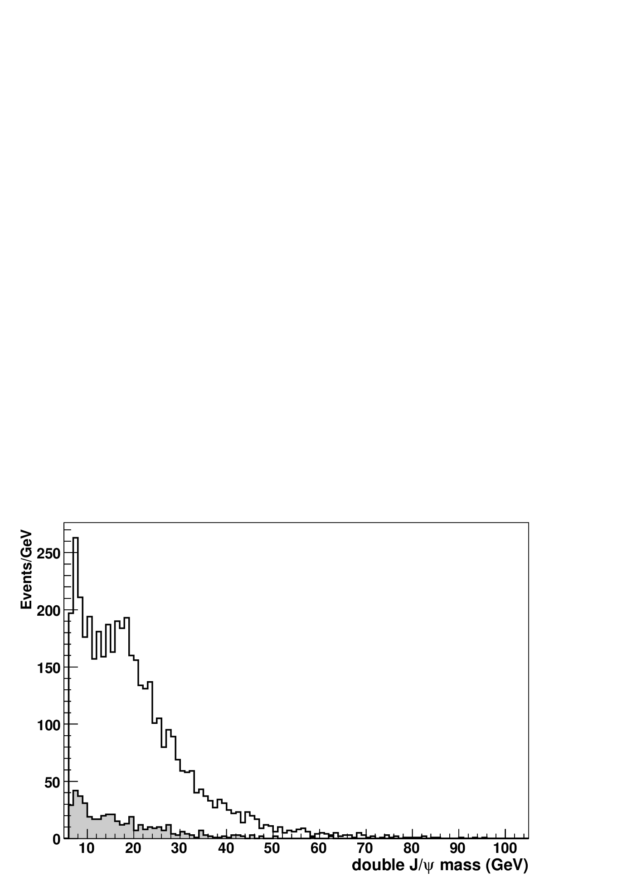
8. Suppression of Double Parton Scattering Events (2)
Pompt double J/ψ invariant mass distribution (Fig. 9)
Non-pompt double J/ψ invariant mass distribution (Fig. 10)
Final
Fig. 9: The invariant mass for prompt double J/ψ events after DPS is supp-ressed. The solid line is the double J/ψ events (Cuts 1-9, 11,13), which is 1659 events. The filled area is the sideband (Cuts 1-8,10, 11,13). An unknown struc-ture around 16.5 GeV is observed.
Fig. 10 The invariant mass for non-prompt double J/ψ after DPS is supp-ressed.The solid line is the non-prompt double J/ψ events (Cuts 1-9, 12-13). The filled area is the sideband (Cuts 1-8, 10, 12-13).

Slide 20
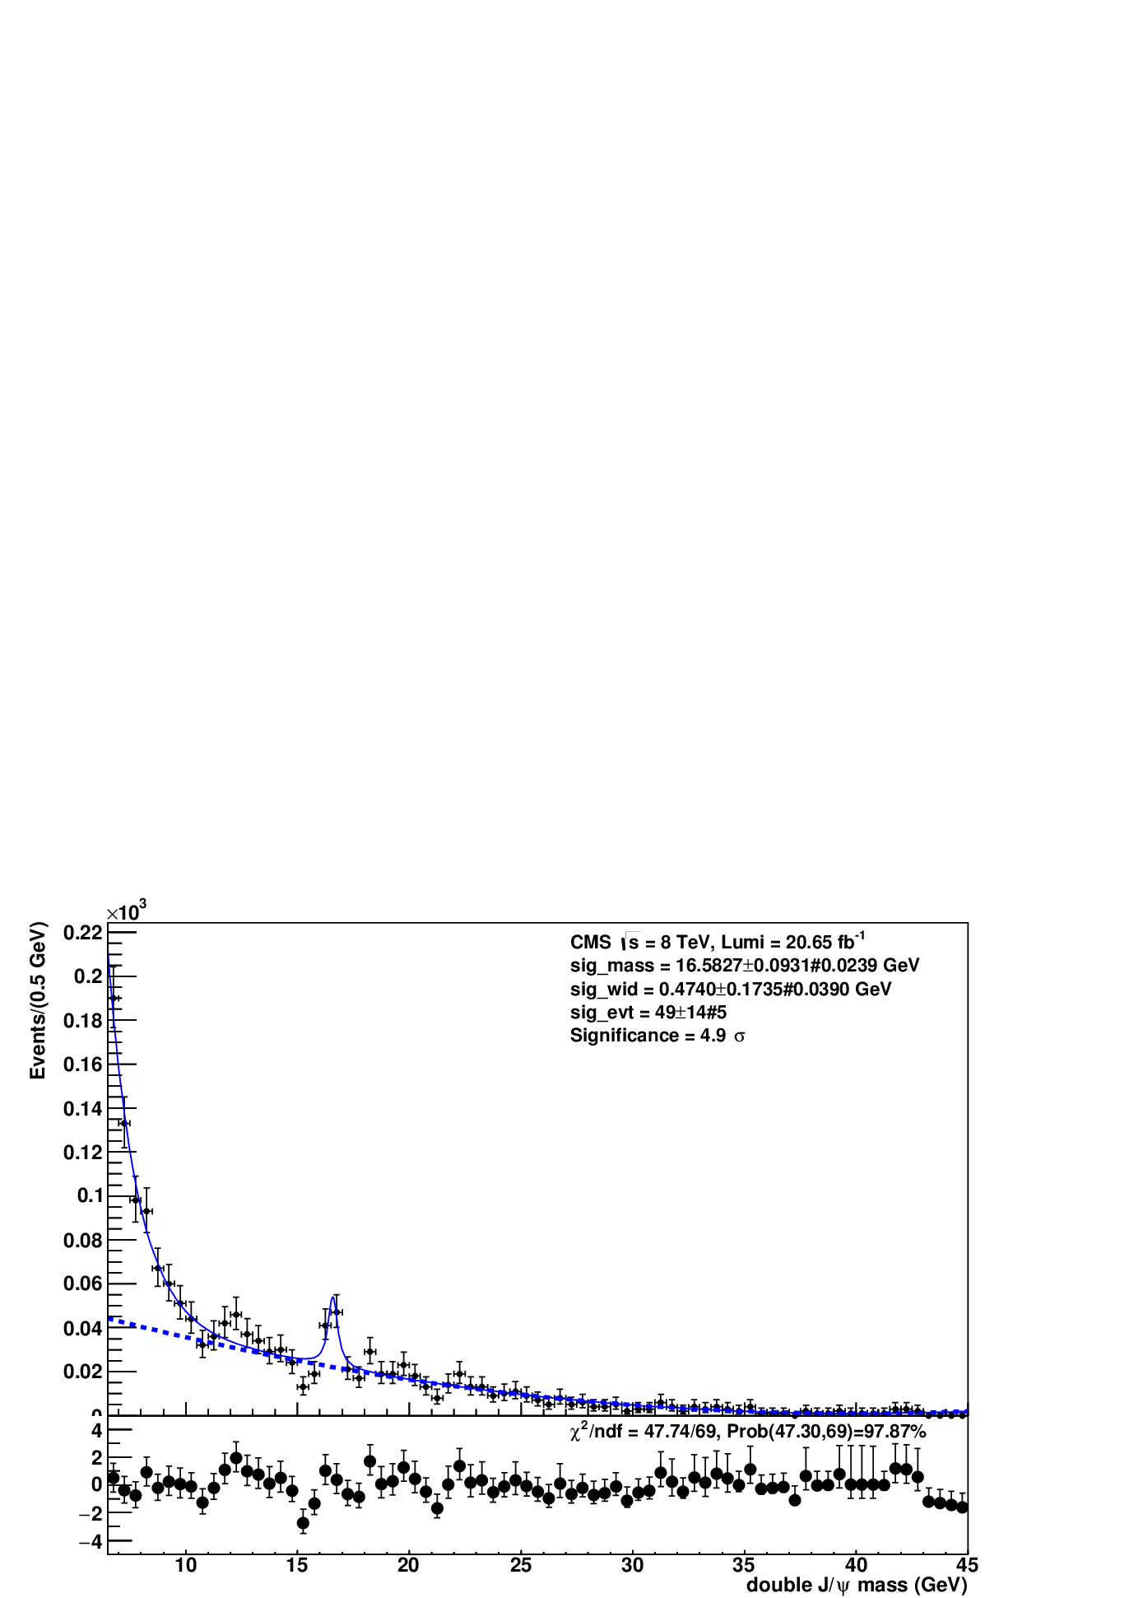
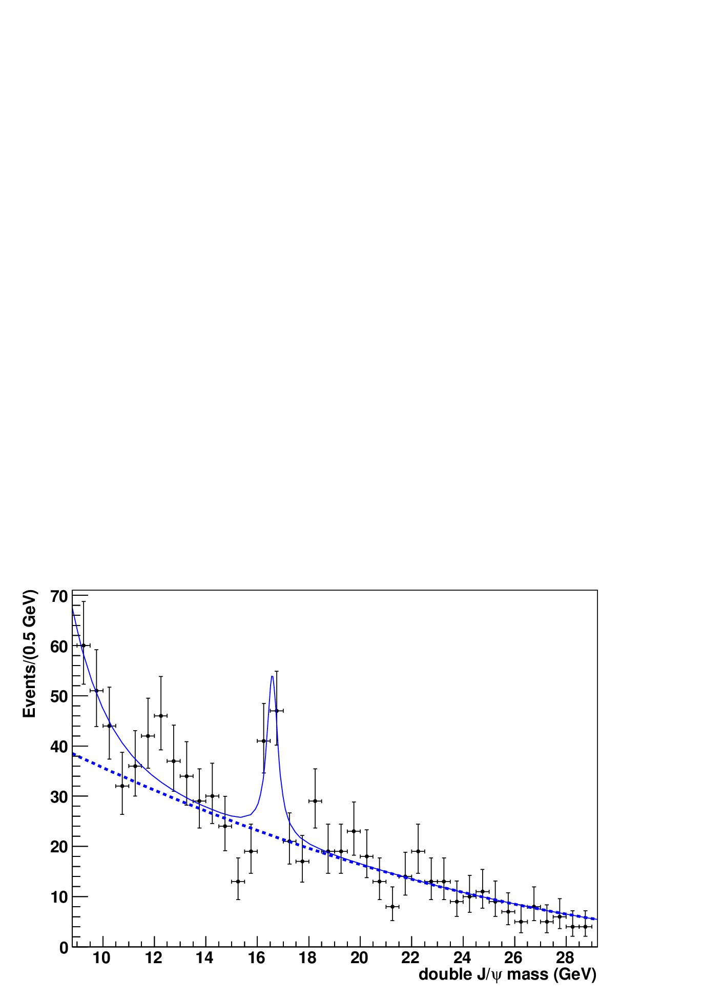
9. Unbinned Maximum Likelihood Fit to Structure (1)
Breit-Wigner function convoluted with a gaussian with σ equal to the peak resolution 55.3 MeV is used to fit the structure. The 2th Chebyshev
Polynomial plus decay function is used to fit the phase space.
Fig 11. Left is a fit to double J/ψ mass distribution in Fig. 9 with 6.5 < m(dj) <45.0 GeV. The events is 1536. The mass, width and events of the unknown structure are obtained to be 16.5827±0.0931±0.0239 GeV, 0.4740±0.1735±0.0390, 49±14 ±5 respectively. The significance is 4.9 σ. χ2/df= 47.74/69, Fit prob(47.74, 69)= 97.87%. The first uncertainties are statistic. The second systematic. Right plot is a
zoom of left plot with 9< m(dj)<29 GeV.

Slide 21
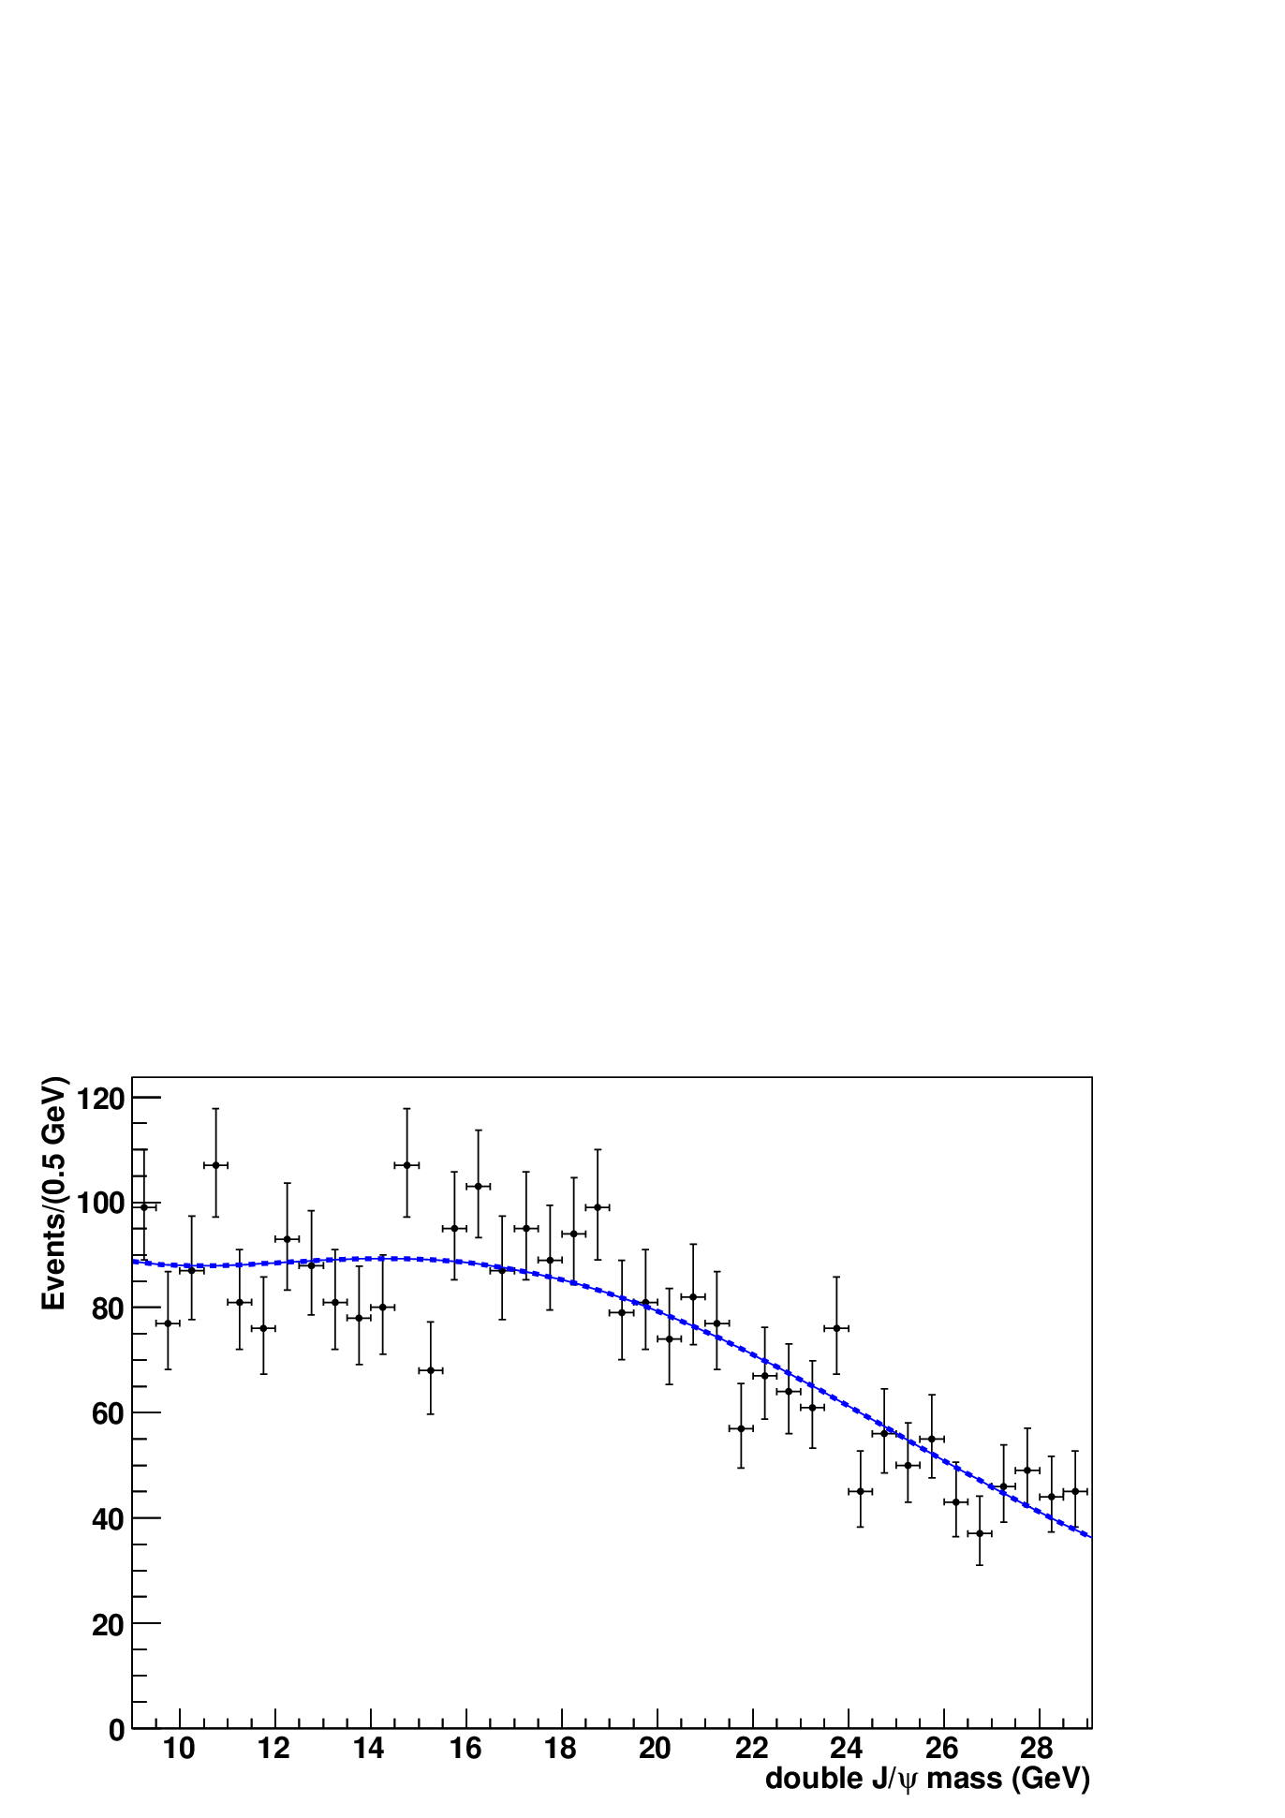
9. Unbinned Maximum Likelihood Fit to Structure (2)
The 4th Chebyshev Polynomial is used to fit non-prompt double J/ψ mass
distribution, see Fig. 12.
Fig 12. The peak at 16.5 GeV can not be seen in the non-prompt double J/ψ mass distribution, which is a zoom of Fig. 8.

Slide 22
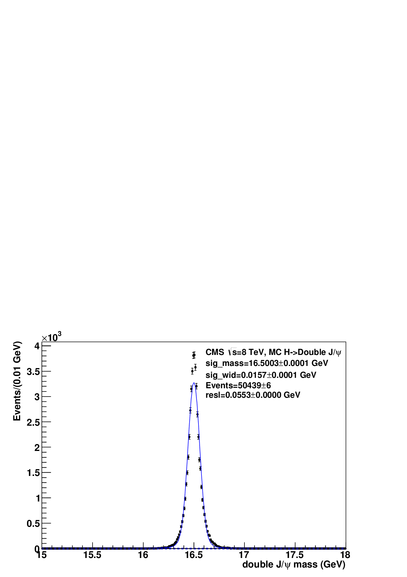
9. Unbinned Maximum Likelihood Fit to Structure (3)
The CMS Detector mass resulotion of double J/ψ
Fig. 13 Detector mass resulotion of double J/ψ from the sixth MC
sample, mass resulotion is 55.3 MeV.

Slide 23
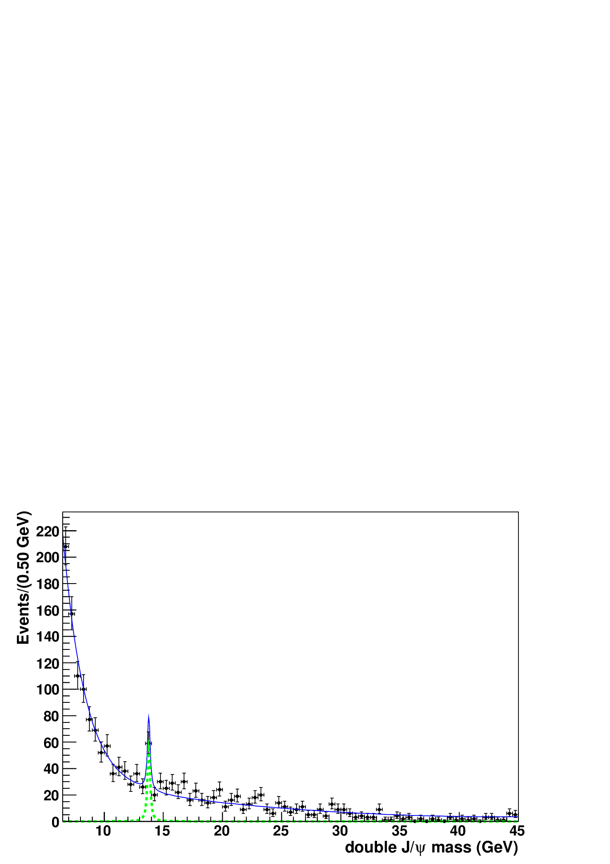
10. Look Elsewhere Effect
fixes a mass window [6.5, 45] GeV for scan;
throws 20000 pseudo experiments according to the 2nd Chebyshev Polynomial and the decay function;
for each experiment, the number of total events is randomized according to the Poisson distribution of nbkg=1659;
a p-value is estimated as the fraction of pseudo experiments for which the test-statistic is equal or above its observed value on the actual data σ_{max}>4.9 σ; it is 1/20000, see Fig. 14
the significance is 4.2 σ according to the p-value.
Fig. 14 A fake peak is from one of 20000 pseudo experiments

Slide 24
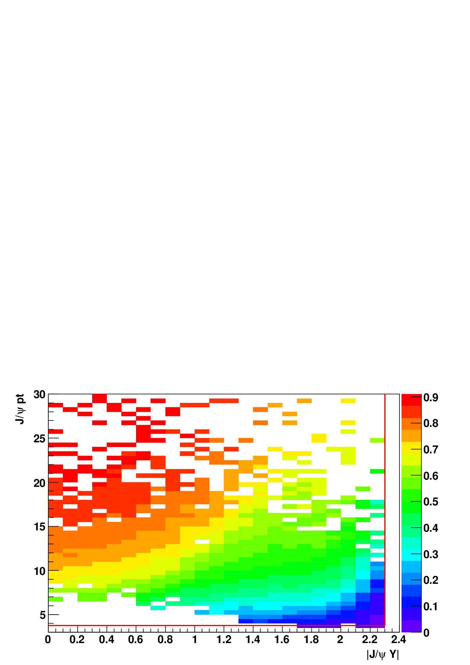
11. Acceptance and Efficiencies (1)
The width of the structure is larger than the detector mass resolution, so we
have to correct the invariant mass of double J/ψ.
Acceptance
The double J/ψ acceptance A(J/ψJ/ψ) for each one of 1659 events in Fig. 9
is factorized to the production of two acceptances of J/ψ, A(J/ψJ/ψ)=
A(J/ψ1)A(J/ψ2).
A(J/ψ) is defined as the fraction of detectable J/ψ→μμ decays,
A(J/ψ)(n)=Ndet(n)/Ngen(n), (n=1, 2, ...,2×1659),
where Ndet(n) is the number of detectable J/ψ events passing pT(μ)>
2 GeV and |η(μ)|<2.4, and Ngen(n)=1000 is the number of J/ψ in generator
level in the 1st MC sample . 2×1659 is due to that one event has two J/ψ.
Fig. 15 Acceptance map as function of pT(J/ψ) and|y(J/ψ)|.
The red line is the acceptance region.

Slide 25
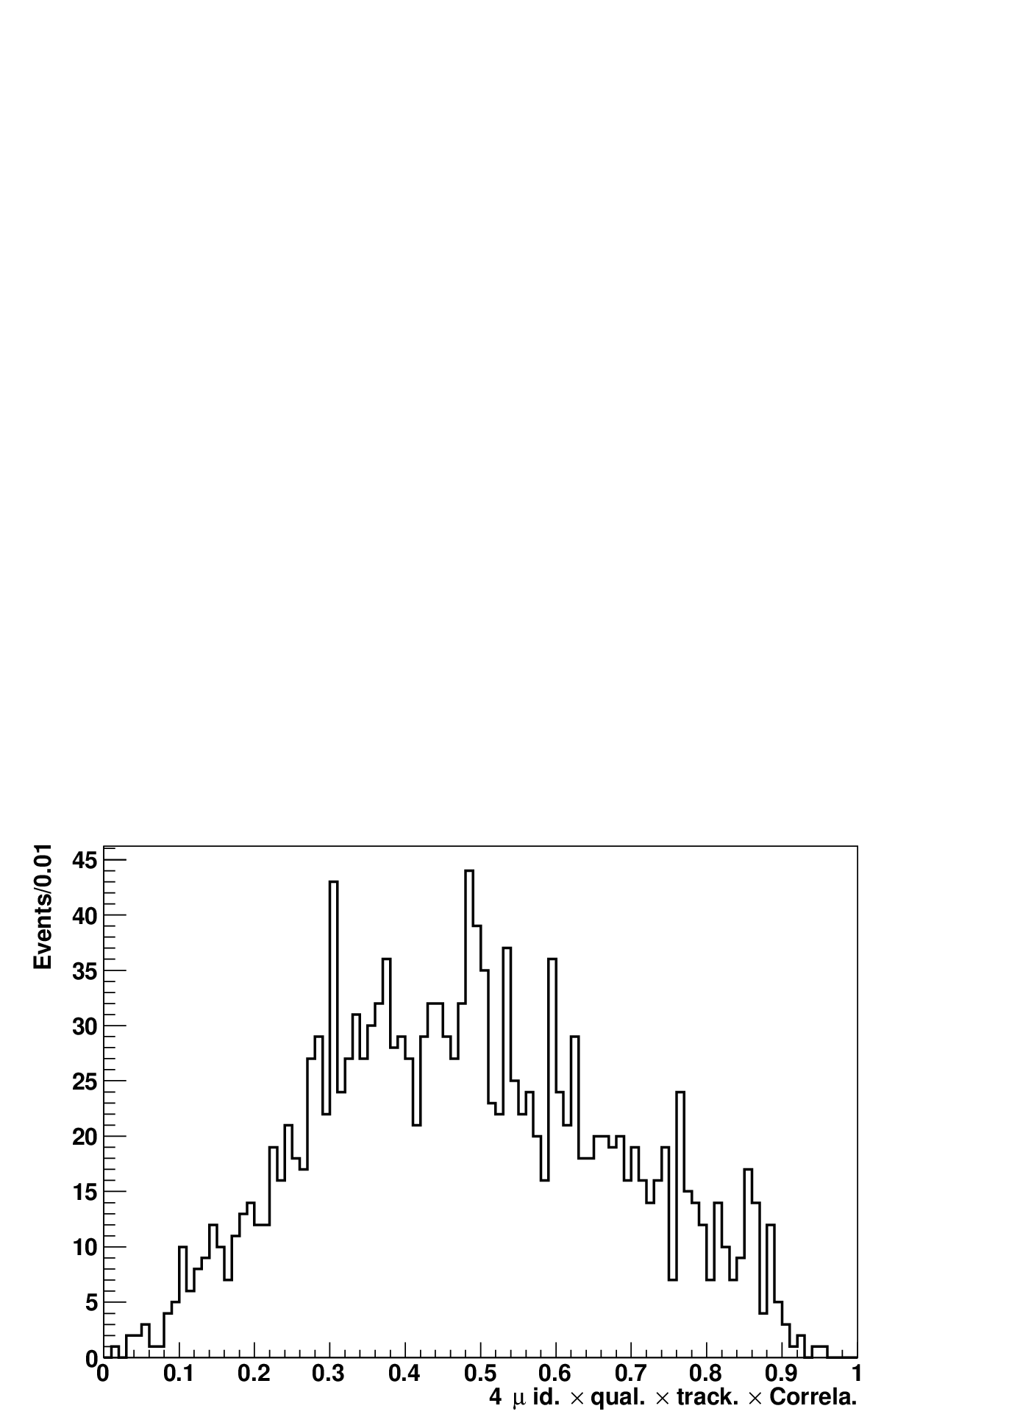
11. Acceptance and Efficiencies (2)
4 μ reconstruction efficiency
The reconstruction efficiency is the product of identification efficiency, specific quality efficiency, offline tracking efficiency and correlation factor of four muons.
Instead of calculating individual ones, we use the 2nd MC sample to calculate the reconstruction efficiency of 4 μ by one step.
ε(4μ)(n)=Nmea(n)/Ndet(n), (n=1, 2, ...,1659).
where Ndet(n) is the number of the events in generator level passing
pT(μ)> 2 GeV and |η(μ)|<2.4, while Nmea(n) is the number of the events
in reconstruction level passing pT(μ)> 2 GeV and |η(μ)|<2.4.
Fig. 16 The 4 μ offline reconstruction efficiency represents the product of identification efficiency, specific quality efficiency, offline tracking efficiency and correlation factor of four muons.

Slide 26
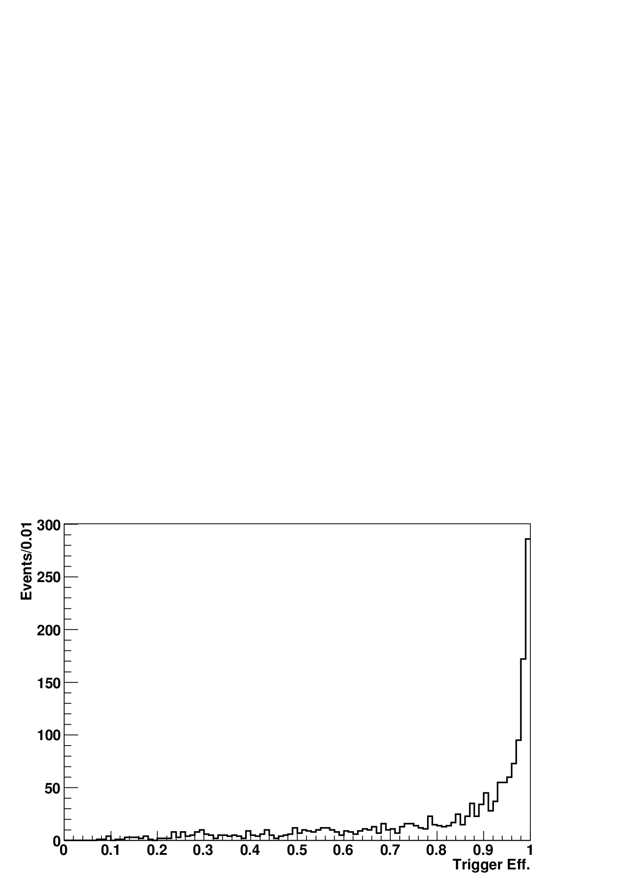
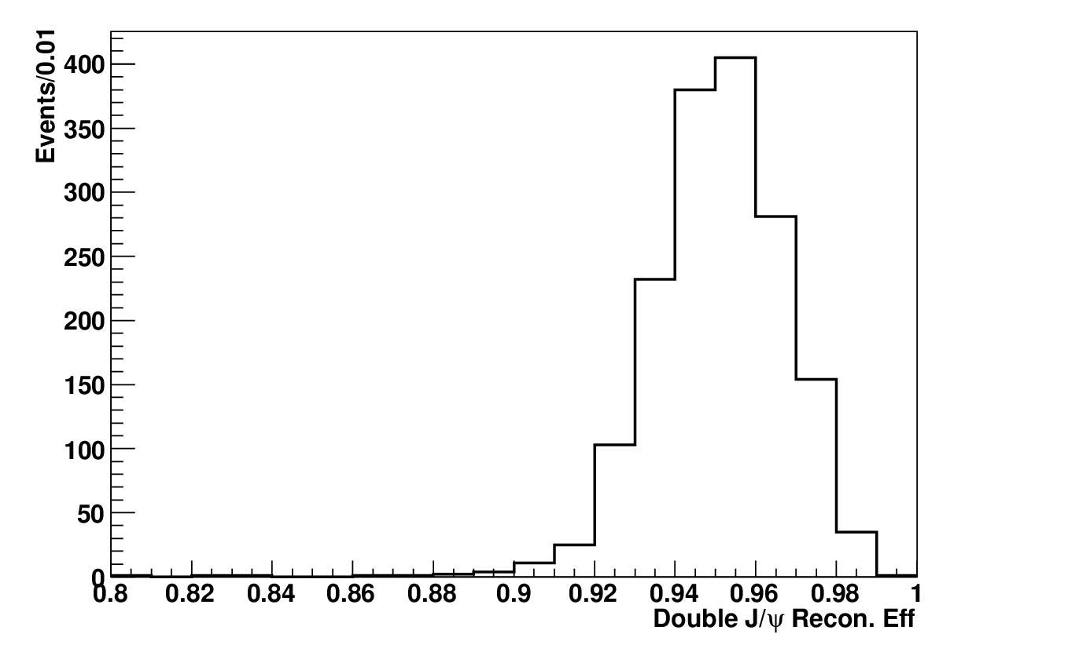
11. Acceptance and Efficiencies (3)
Trigger efficiency
The trigger efficeincy is the fraction of events passing at least one of the trigger paths used to trigger the MuOnia dataset
ε(trig)(n)=Ntrig(n)/Nmea(n), (n=1, 2, ...,1659)
where Nmea(n) is defined as above, Ntrig(n) is the number of the events
passing the trigger using 2nd MC sample.
Double J/ψ reconstruction efficiency
The efficeincy is the fraction of events passing all selection criteria.
ε(djpsi)(n)=Ndjpsi(n)/Ntrig(n), (n=1, 2, ...,1659)
where Ndjpsi(n) is the number of events passing all selection criteria
using 2nd MC sample.
Fig. 17 Trigger efficiency
Fig. 18 J/ψ reconstruction efficiency

Slide 27
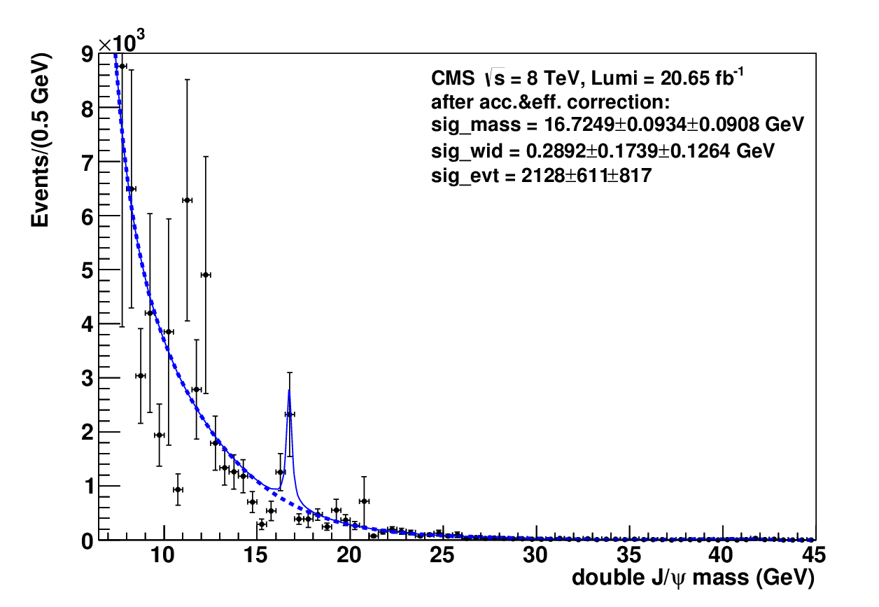
11. Acceptance and Efficiencies (4)
Correction
To consider the correction of the accep&eff, each data event is weighted with:
weight(n)=1/ε(4μ)(n)ε(trig)(n)ε(djpsi)(n) (n=1, 2, ...,1659)
Signal extraction
A BW convoluted with a gaussian (σ = 55.3 MeV) is to fit the structure. The
5th Chebyshevpoly plus a decay function is to fit the phase space distribution.
Structure parameter
mass=16.7249±0.0934±0.0908GeV, Γ=0.2892±0.1739±0.1264 GeV,
evts=2128±611±817.
Fig 19 each event is weighted with the inverse of the product of acceptance and efficiencies. Statistic uncertainties from roofit are Δmass_{we}=0.0079$ GeV, ΔΓ_{we}=0.0116 GeV and ΔEvt_{we}=62.

Slide 28
12. Distributions of Run Number and μ Polar Angle (1)
Run number distribution
Fig 20. The run Number distribution for all left evens in Fig.9. The black line is for Run2012A, the red line Run2012B, the blue line Run2012C, the green line Run2012D. The events/luminosity are 16.5, 28.8, 23.5 and 24.9/fb for runs A, B, C and D respectively,

Slide 29
12. Distributions of Run Number and μ Polar Angle (2)
μ polar angle distribution
Fig 21. The polar angle distribution. The solid line is for all of left muons in Fig. 9, while the dashed line is for the structure with 16<m(dj)<18 GeV.

Slide 30
13. Systematic Uncertainties (1)
Muon momentum resolution on acceptance
In the 1st MC Sample, the 4-mom of J/ψ is used to replace the 4-mom of J/ψ
produced with SPS generator. To estimate the acceptance uncertainty, the 4-
mom of dimuon is used to replace the 4-mom of J/ψ produced with SPS
generator, which corresponds to smearing the muon mom by the detector
mom resolution. The differences are taken as systematic uncertainties.
Kinematic spectra
Reset pT(dimuon)>3.5 GeV and |y(dimuon)|<2.4. The differences
between this cut and default one are taken as systematic uncertainties.
Fit probabilities
Reset the fit probability to be 0.005%, 0.015%, 0.02%, 0.025% for 4μ sha-
ring a common vertex. The standard deviations between these cuts and
default ones are taken as systematic uncertainties.
Fit functions
Reset the fitting function to the phase space to be the 3th Chebyshevpoly
plus a decay function for the observed events and the 6th Chebyshevpoly
plus a decay function for the weighted events. Differences are tanken
as systematic uncertainties.

Slide 31
13. Systematic Uncertainties (2)
Reconstruction efficiency of four muons
The 4μ reconstruction efficiency has a statistic uncertainty which might lead
to systematic uncertainties. The efficiency is smeared by its statistic uncer-
tainty. The differences are taken as systematic uncertainties.
Trigger efficiency
The trigger efficiency has a statistic uncertainty which might lead to syste-
matic uncertainties. The efficiency is smeared by its statistic uncertainty.
The differences are taken as systematic uncertainties.
Reconstruction efficiency of double J/ψ
The reconstruction efficiency of double J/ψ has a statistic uncertainty which
might lead to systematic uncertainties. The efficiency is smeared by its
statistic uncertainty. The differences are taken as systematic uncertainties.

Slide 32
13. Systematic Uncertainties (3)

Slide 33
14. Summary
An unknown structure with
mass = 16.5827±0.0931± 0.0239 GeV,
Γ = 0.4740± 0.1735±0.0390 GeV ,
events = 49±14 ±5, significance = 4.9 σ
The first uncertainties are statistic. the second systematic
is observed in double J/ψ invariant mass in pp Collisions at a mass center energy
sqrt(s)=8 TeV using data of 20.65/fb recorded by the CMS experiment at the LHC.
After acceptance and efficiency correction:
mass = 16.7249±0.0934±0.0908 GeV,
Γ = 0.2892±0.1739±0.1264 GeV,
events = 2128±611± 817.
cross section = evts/(Lumi*Br²(J/ψ→μμ))=29.0±8.3±11.8 pb.
η_{b} signal is not observed.
apply for continuing review towards pre-approval.

Slide 34
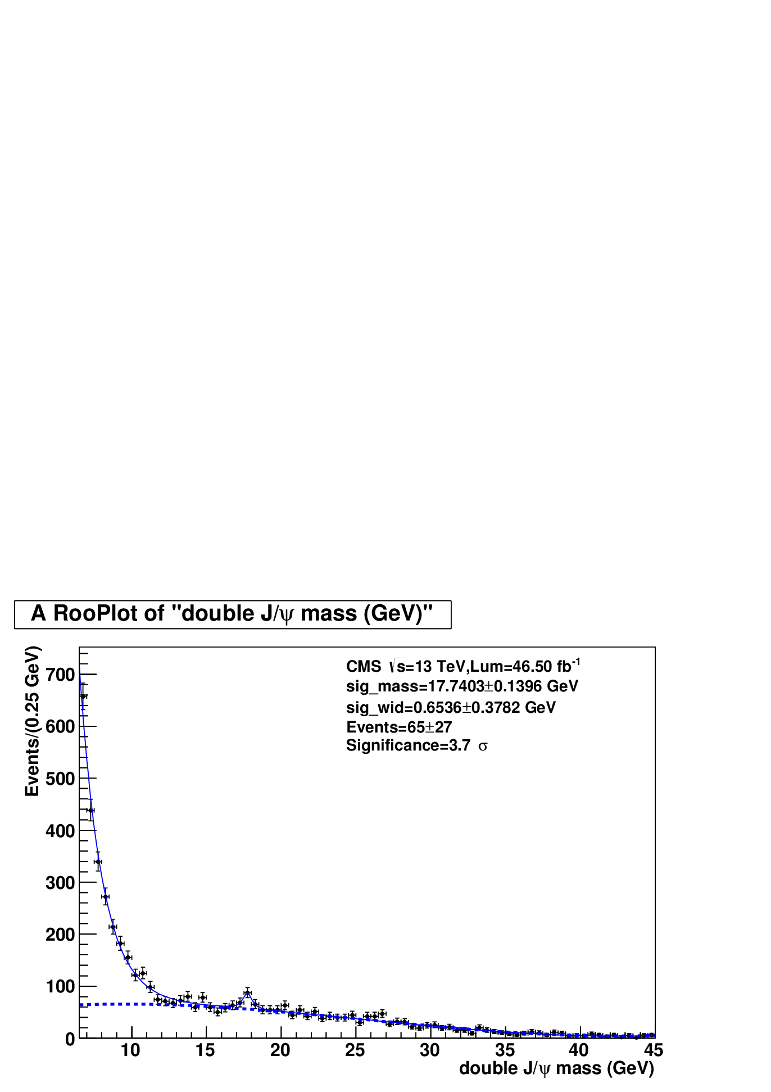
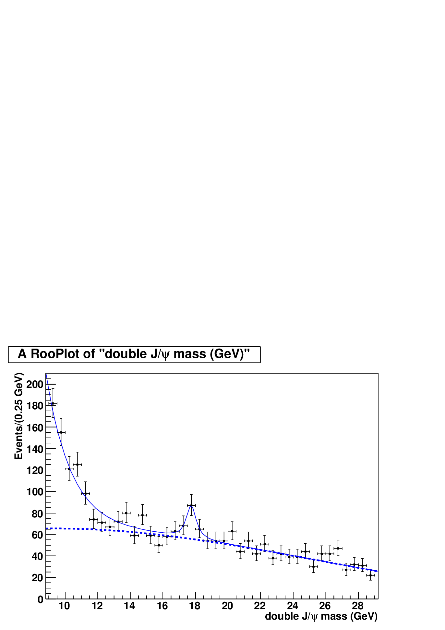
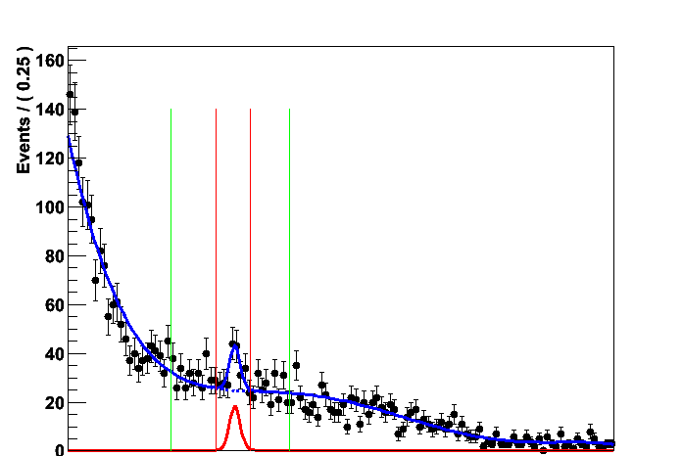
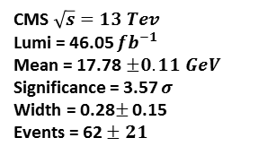
15. Appendix (1)
Evidence at 13 TeV using 2017 data
I presented on 12 Dec 2017 (Fig. 20); T. U. presented on 7 May 2018 (Fig. 21).
data is Run2016H-18Apr-2017, Run2017X-Prompt, X=B,...F; Lumi=46.5/fb;
mass = 17.7403±0.396 GeV, Γ = 0.6536± 0.3782 GeV ,events = 65±27,
significance = 3.7 σ, the uncertainties are statistic, see Fig. 20.
F
CMS $\sqrt{s}=13 Tev$
Lumi = 46.05 $fb^{−1}$
Mean = 17.78$±0.11 GeV$
Significance = 3.57 $σ$
Width = 0.28$±$ 0.15
Events = 62 $± 21$
zoom
Fig. 20 Left: double J/ψ mass distribution at 13 TeV. A BW convoluted with a Gaussian (σ = 120 MeV) is to fit the structure. The 2th Chebyshevpoly plus a decay function is to fit the phase space. Right: zoom of left plot (IHEP).
Fig. 21 double J/ψ mass distribution at
13 TeV picked up from Spectroscopy & Properties WG Meeting on 7th May 2018 (Tennessee University.)
Question is whether the structure is the contamination from X(18500)?
No！Assuming the fiducial cs of X(18500)→Υ(μμ)μμ is 4.5fb@13 TeV
(3fb@8 TeV from Kai Yi email), the 7th MC simulation shows that the contamination
is 0.075 event, mass mean is 18.3681 GeV .

Slide 35
15. Appendix (2)
Evidence in ΥΥ* at 7 TeV and 8 TeV
the plot is picked up from
AN2016_015_v3,
the author is Iowa U.
data: 7 TeV and 8 TeV,
Lumi is 25.4/fb
a structure
mass=16.76±0.076 GeV,
σ=120±52 MeV,
events=41±10,
significance=4.47
in the invariant mass of
ΥΥ*decay to 4μ shown in upper
right plot.

