Slide 1
Y(2175) and its possible partner
Hua-Xing Chen
Beihang University
Collaborators: Cheng-Ping Shen and Shi-Lin Zhu
郑州 2018/10/23

Slide 2
Contents
Internal structure of exotic hadrons
Experimental status of the Y(2175)
Our QCD sum rule studies on the Y(2175)

Slide 3
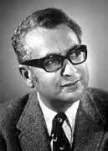
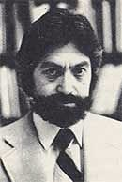

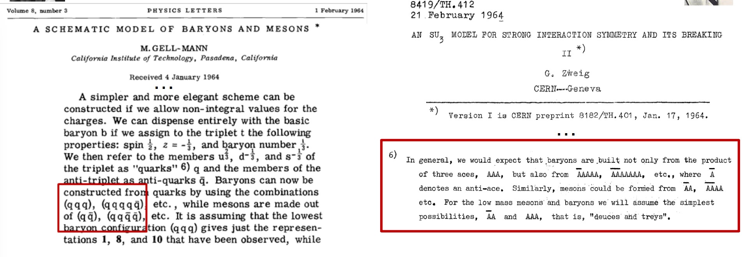
Phys.Lett. 8 (1964) 214-215

Slide 4
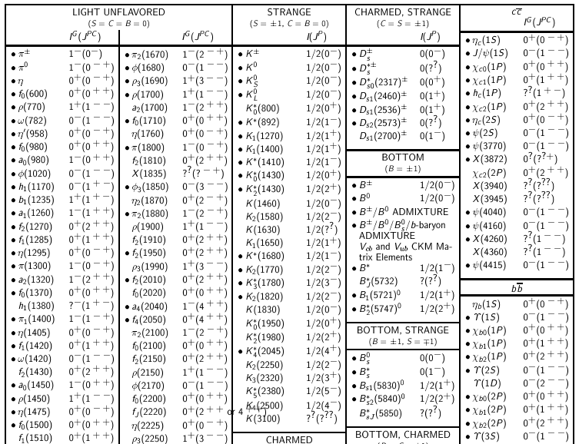
Quark Model

Slide 5
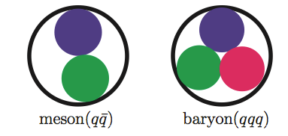
Categorizations
Meson
Conventional Quark Model
Baryon

Slide 6
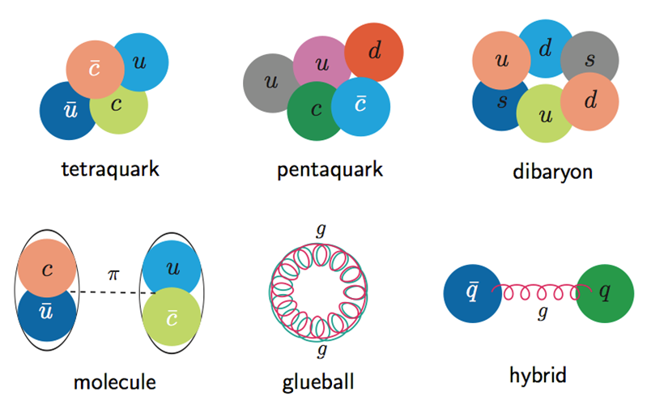
Categorizations
Meson
Conventional Quark Model
Baryon
Multiquark
Exotic hadron
Molecular
Glueball
Hybrid

Slide 7
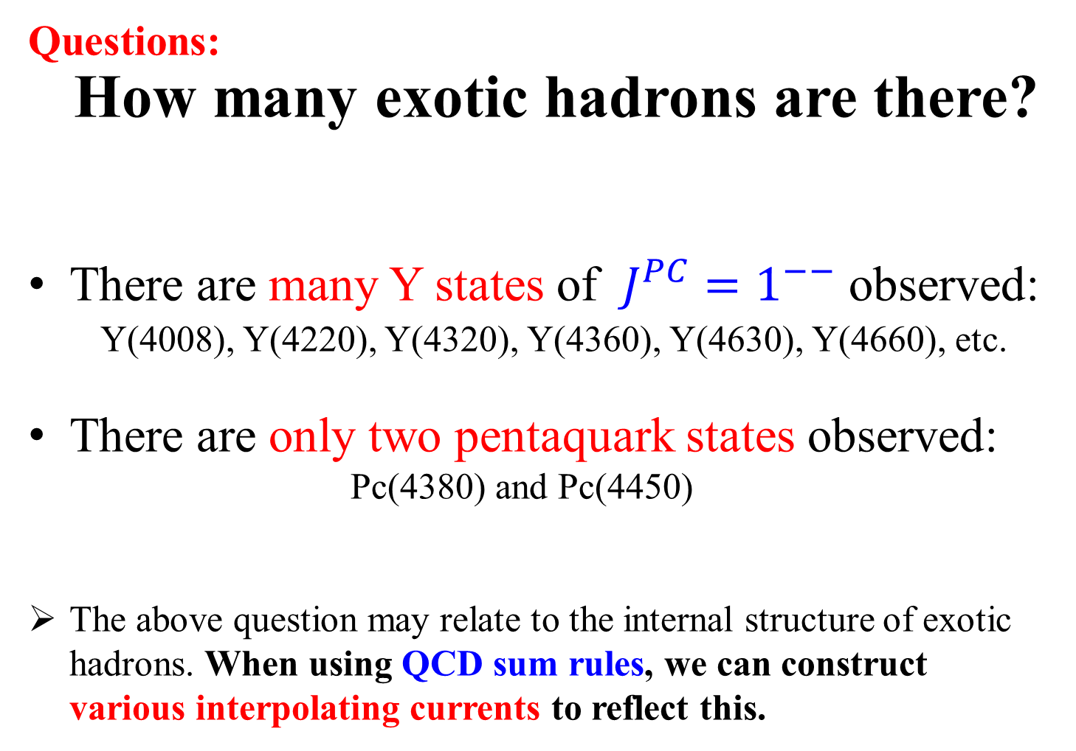
Questions:
How many exotic hadrons are there?
There are many Y states of $J^{PC}=1^{−−}$ observed:
Y(4008), Y(4220), Y(4320), Y(4360), Y(4630), Y(4660), etc.
There are only two pentaquark states observed:
Pc(4380) and Pc(4450)
The above question may relate to the internal structure of exotic hadrons. When using QCD sum rules, we can construct various interpolating currents to reflect this.

Slide 8
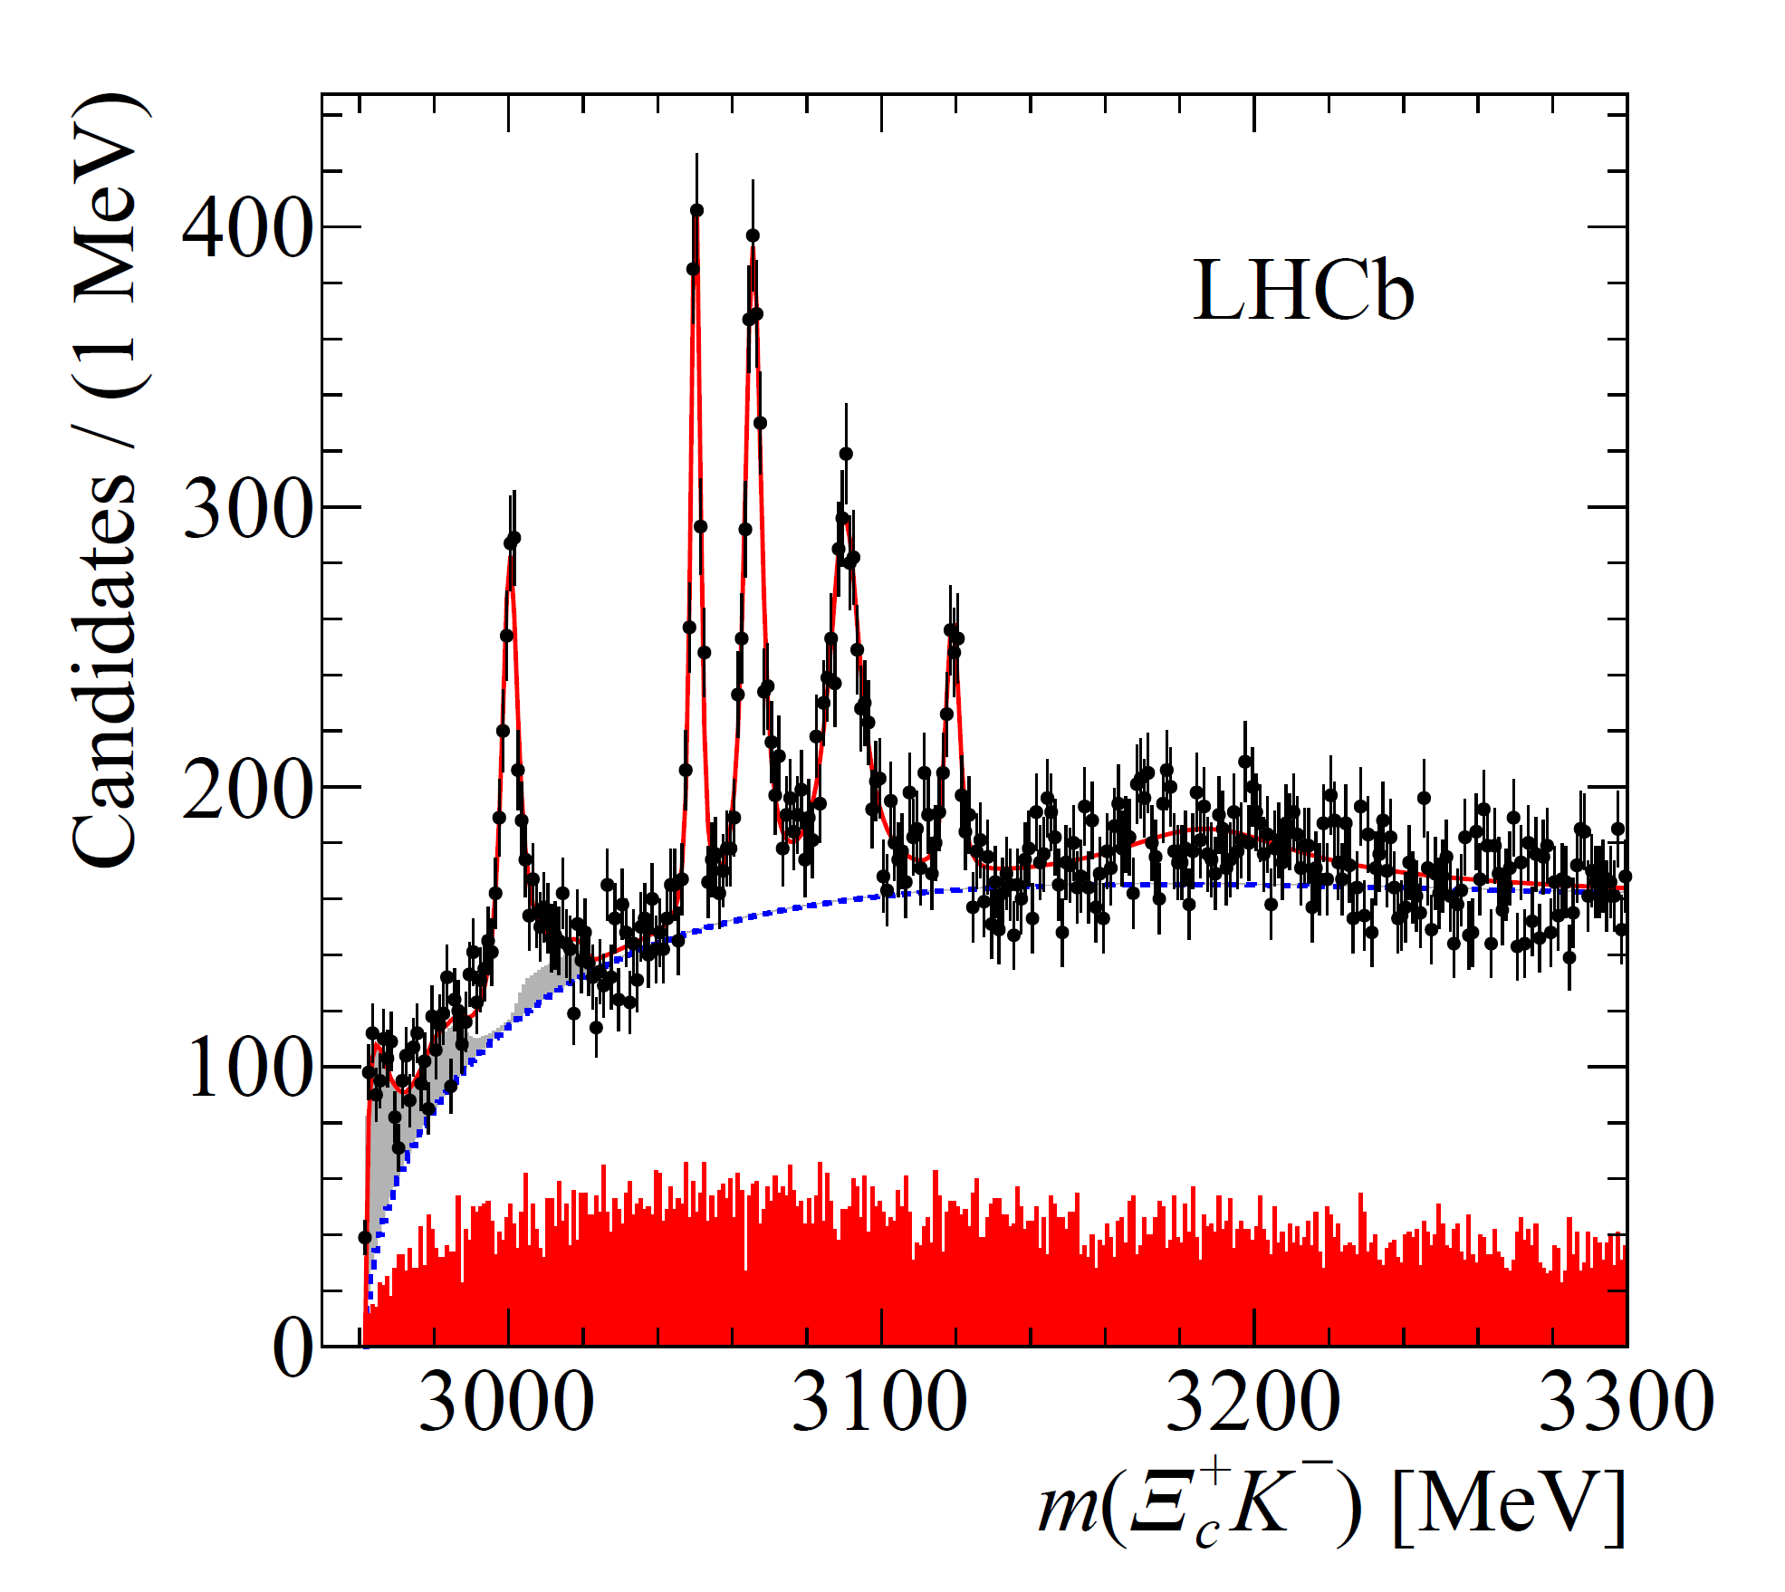
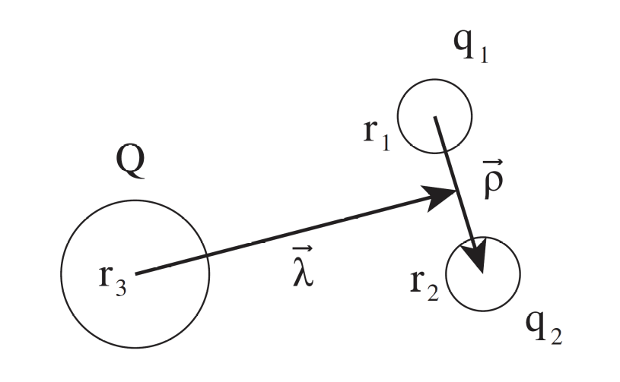
Example 1: P-wave charmed baryons
Theoretically, we find that the P-wave charmed baryons have rich internal structures, and there can be as many as seven P-wave Ωc states
[PRD91, 054034 (2015)]:
The LHCb Experiment [arXiv:1703.04639]

Slide 9
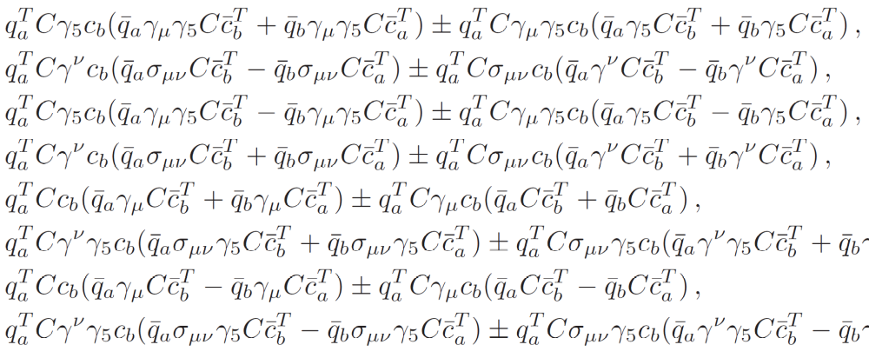
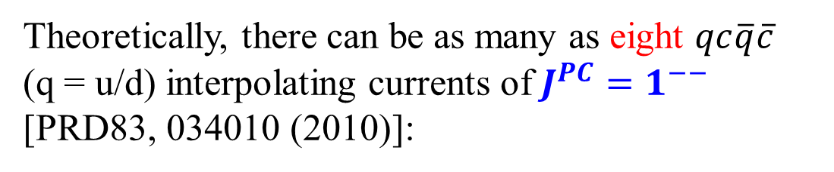
Example 2: charmonium-like Y states of $J^{PC}=1^{−−}$
Theoretically, there can be as many as eight $qc\overline{q}\overline{c}$ (q = u/d) interpolating currents of $J^{PC}=1^{−−}$
[PRD83, 034010 (2010)]:
Y(4008)
Y(4220)
Y(4320)
Y(4360)
Y(4630)
Y(4660)
。。。

Slide 10
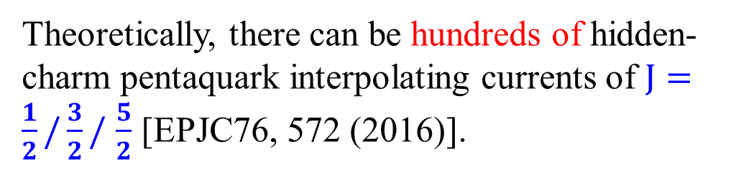
Example 3: hidden-charm pentaquark states
Pc(4380)
Pc(4450)
Theoretically, there can be hundreds of hidden-charm pentaquark interpolating currents of $J=\frac{1}{2}/\frac{3}{2}/$ $\frac{5}{2}$ [EPJC76, 572 (2016)].

Slide 11
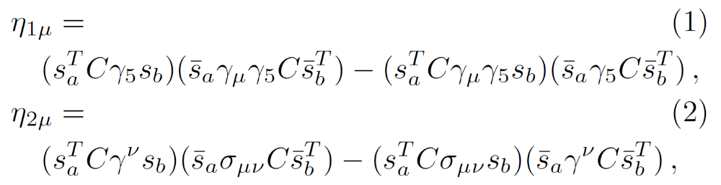
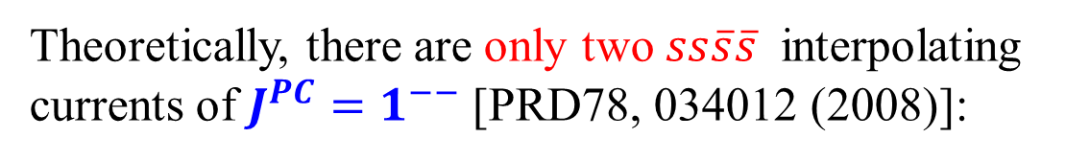
Example 4: light Y states of $J^{PC}=1^{−−}$
Theoretically, there are only two $ss\overline{s}\overline{s}$ interpolating currents of $J^{PC}=1^{−−}$ [PRD78, 034012 (2008)]:
Y(2175)

Slide 12
Example 4: light Y states of $J^{PC}=1^{−−}$
Theoretically, there are only two $ss\overline{s}\overline{s}$ interpolating currents of $J^{PC}=1^{−−}$ [PRD78, 034012 (2008)]:
Y(2175)
Y(24??)

Slide 13
Contents
Internal structure of exotic hadrons
Experimental status of the Y(2175)
Our QCD sum rule studies on the Y(2175)

Slide 14
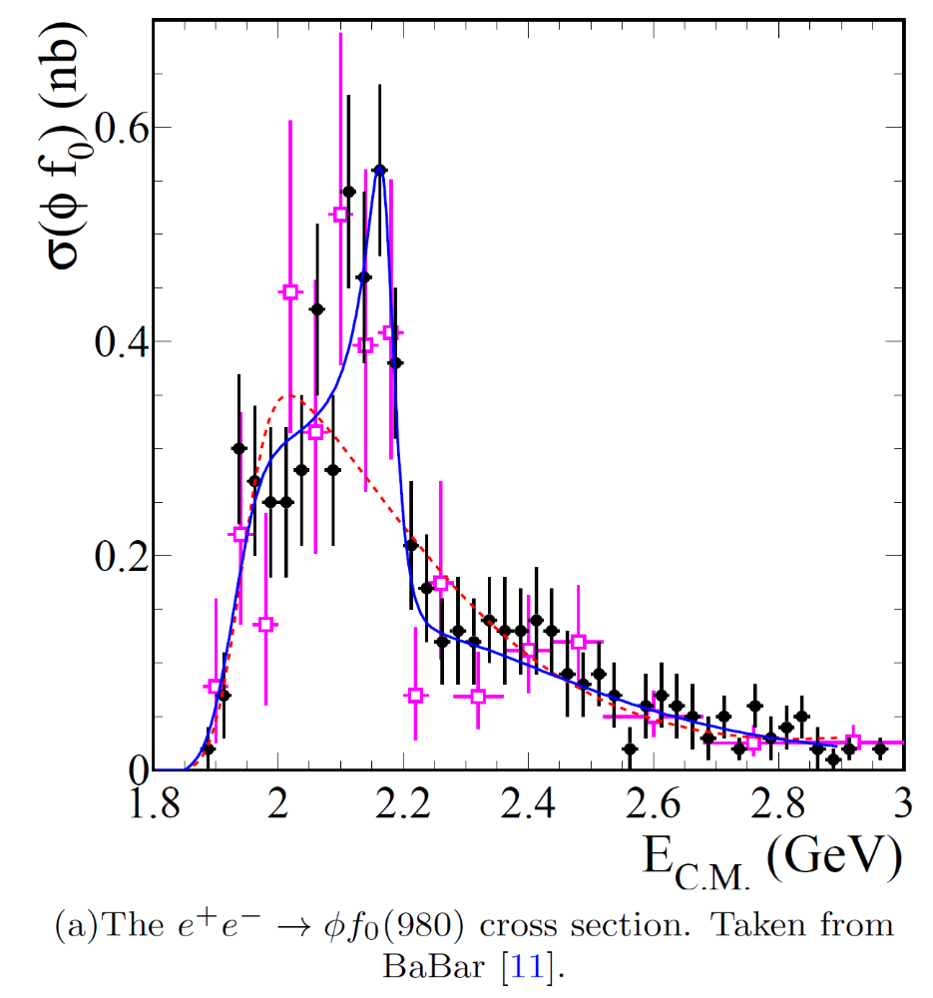
BaBar, PRD74, 091103 (2006)
2175 MeV

Slide 15
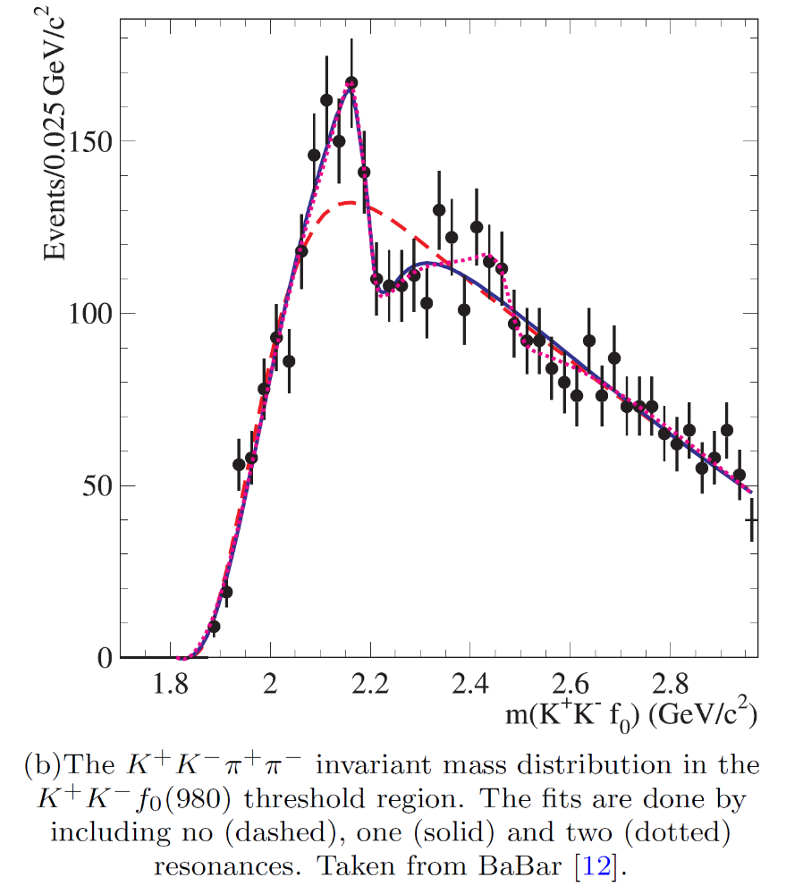
BaBar, PRD76, 012008 (2007)
2187 MeV
2470 MeV
Diff: 283 MeV

Slide 16
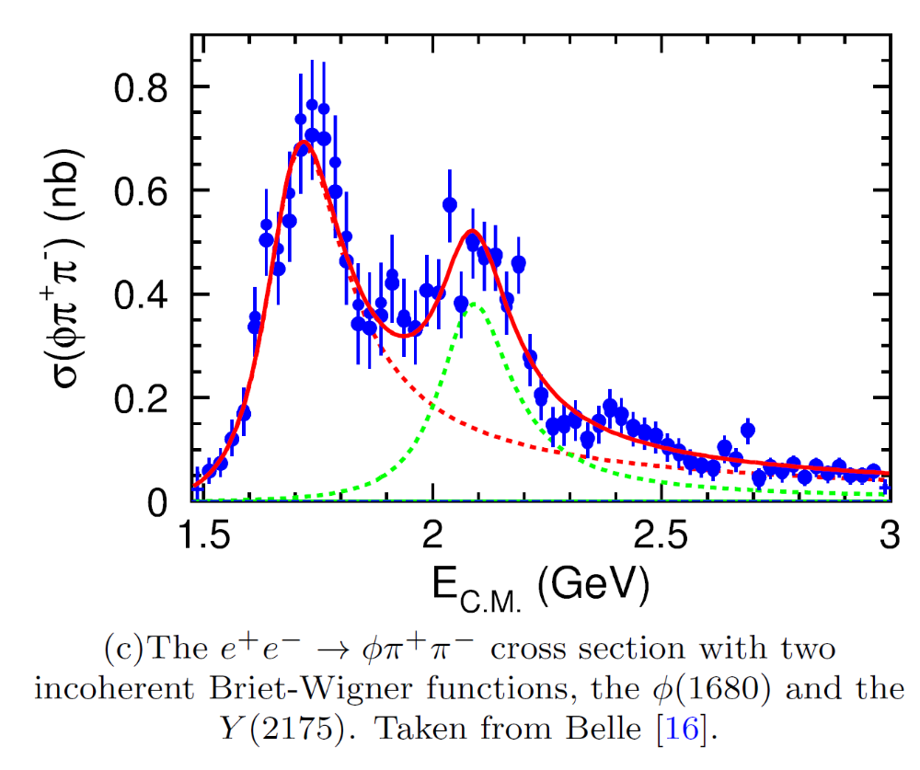
Belle, PRD80, 031101 (2009)
2079 MeV
~2400 MeV
Diff: ~320 MeV

Slide 17
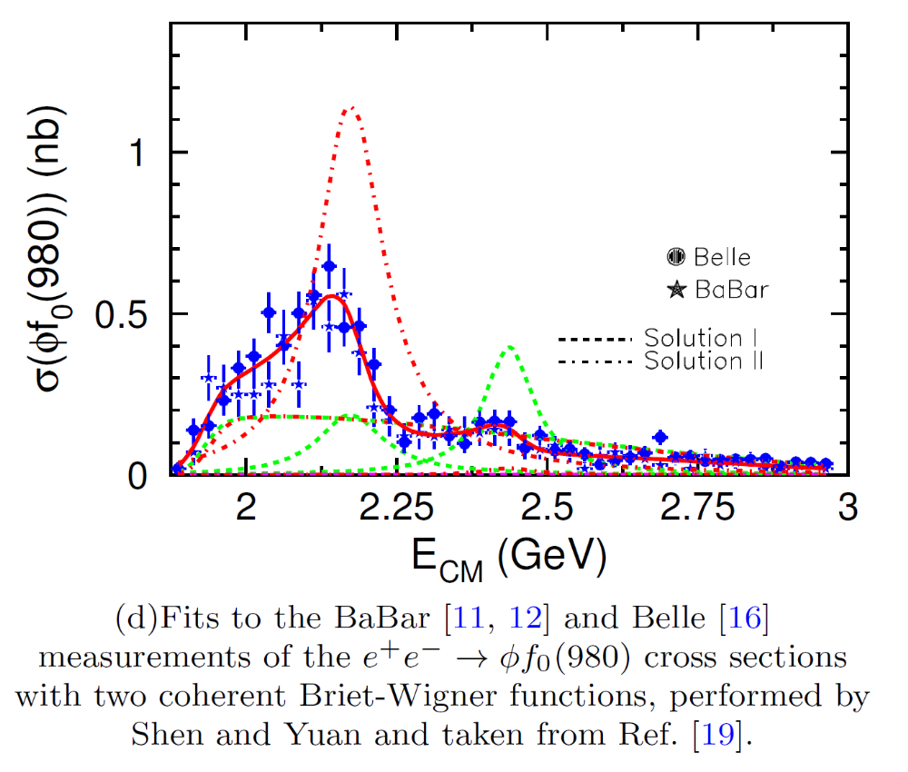
C. P. Shen and C. Z. Yuan, CPC34, 1045 (2010)
2171 MeV
2436 MeV
Diff: 265 MeV

Slide 18
C. P. Shen and C. Z. Yuan, CPC34, 1045 (2010)
2171 MeV
2436 MeV
Diff: 265 MeV
<3.0σ

Slide 19
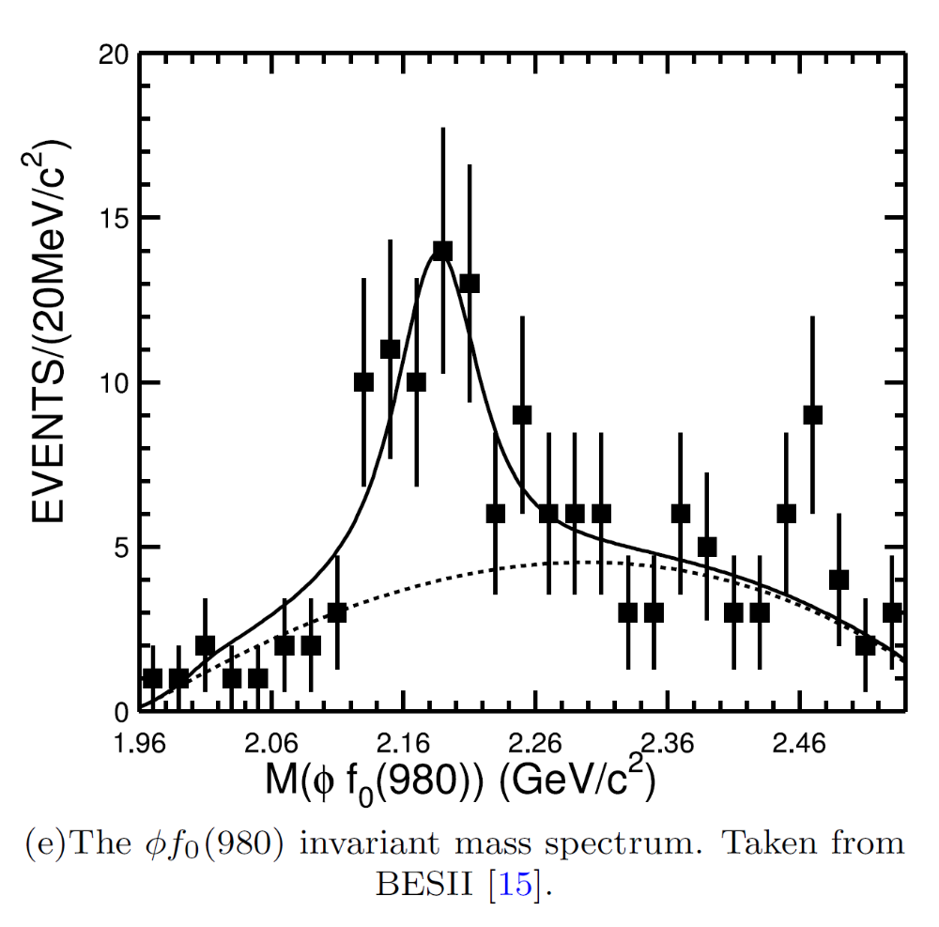
BES, PRL100, 102003 (2008)
2186 MeV
~2460 MeV
Diff: ~270 MeV

Slide 20
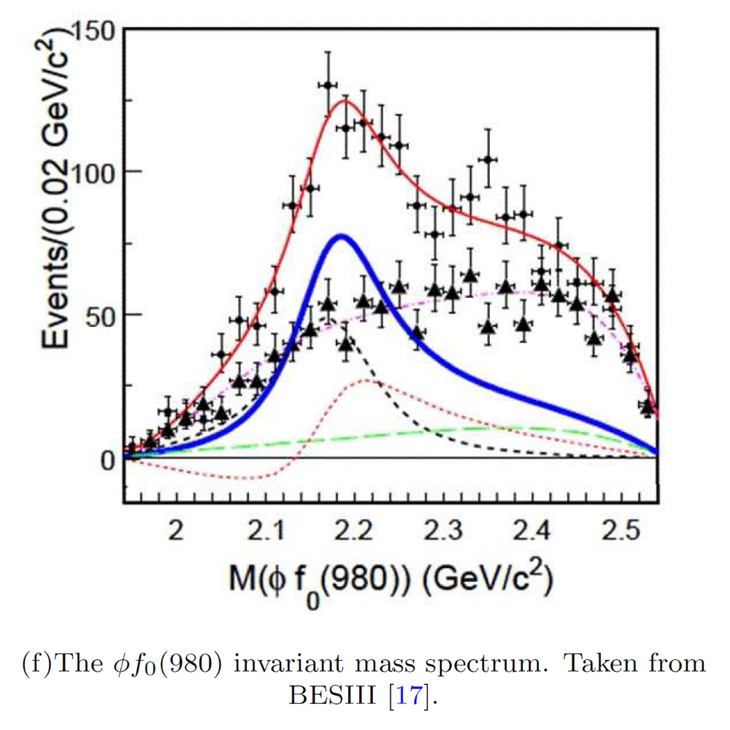
BESIII, PRD91, 052017 (2015)
2200 MeV
~2350 MeV
Diff: ~150 MeV

Slide 21
Contents
Internal structure of exotic hadrons
Experimental status of the Y(2175)
Our QCD sum rule studies on the Y(2175)

Slide 22
Example 4: light Y states of $J^{PC}=1^{−−}$
Theoretically, there are only two $ss\overline{s}\overline{s}$ interpolating currents of $J^{PC}=1^{−−}$ [PRD78, 034012 (2008)]:
Y(2175)
Y(24??)

Slide 23

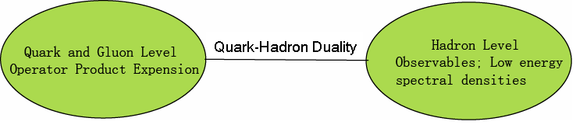
QCD Sum Rule
In sum rule analyses, we consider two-point correlation functions:
where η is the current which can couple to hadronic states.
In QCD sum rule, we can calculate these matrix elements from QCD (OPE) and relate them to observables by using dispersion relation.

Slide 24


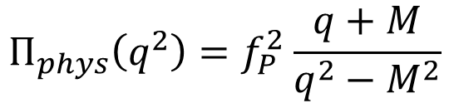
SVZ sum rule (Shifman 1979)
Quark and Gluon Level
(Convergence of OPE)
dispersion relation
s = -q²
Quark-Hadron Duality
Hadron Level
$$Π_{phys}\left(q^{2}\right)=f_{P}^{2}\frac{q+M}{q^{2}−M^{2}}$$
(Positivity)
(for baryon case)
ρ
(Sufficient amount of Pole contribution)
0
M
s₀
s

Slide 25


Relation between interpolating currents and physical states:
Case 1: Y(2175) only
$$<0\left| η_{1μ} \right|Y> =f_{η1} ε_{μ} ≠0$$
$$<0\left| η_{2μ} \right|Y> =f_{η2} ε_{μ} ≠0$$

Slide 26




Relation between interpolating currents and physical states:
Case 1: Y(2175) only
$$<0\left| η_{1μ} \right|Y> =f_{η1} ε_{μ} ≠0$$
$$<0\left|T[η_{1μ}{η_{1ν}}^{+}] \right|0> ≠0$$
$$M\sim 2.3 GeV$$
$$<0\left| η_{2μ} \right|Y> =f_{η2} ε_{μ} ≠0$$
$$<0\left|T[η_{2μ}{η_{2ν}}^{+}] \right|0> ≠0$$
$$M\sim 2.3 GeV$$

Slide 27

Relation between interpolating currents and physical states:
Case 1: Y(2175) only
$$<0\left| η_{1μ} \right|Y> =f_{η1} ε_{μ} ≠0$$
$$<0\left|T[η_{1μ}{η_{1ν}}^{+}] \right|0> ≠0$$
$$<0\left| η_{2μ} \right|Y> =f_{η2} ε_{μ} ≠0$$
$$<0\left|T[η_{2μ}{η_{2ν}}^{+}] \right|0> ≠0$$
$$<0\left|T[η_{1μ}{η_{2ν}}^{+}] \right|0> ≠0$$
[PRD78, 034012 (2008)]

Slide 28
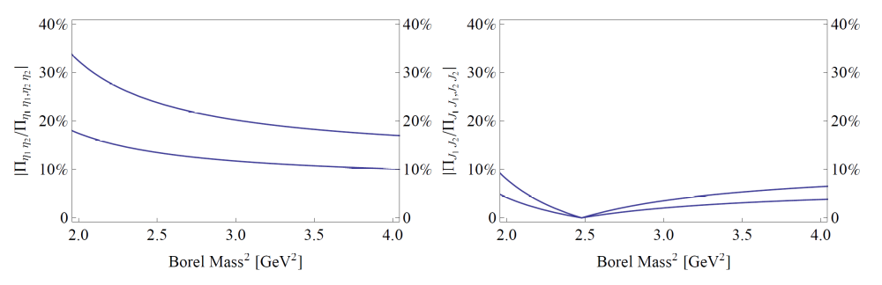
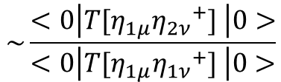
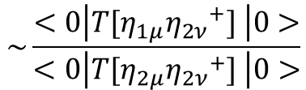
$$\sim \frac{<0\left|T[η_{1μ}{η_{2ν}}^{+}] \right|0>}{<0\left|T[η_{1μ}{η_{1ν}}^{+}] \right|0>}$$
$$\sim \frac{<0\left|T[η_{1μ}{η_{2ν}}^{+}] \right|0>}{<0\left|T[η_{2μ}{η_{2ν}}^{+}] \right|0>}$$

Slide 29
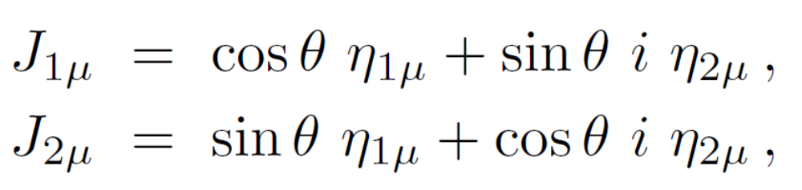

Relation between interpolating currents and physical states:
Case 2:
$$<0\left|T[J_{1μ}{J_{2ν}}^{+}] \right|0>≈0$$

Slide 30
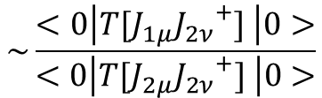
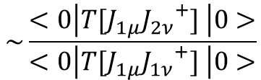
$$\sim \frac{<0\left|T[η_{1μ}{η_{2ν}}^{+}] \right|0>}{<0\left|T[η_{1μ}{η_{1ν}}^{+}] \right|0>}$$
$$\sim \frac{<0\left|T[J_{1μ}{J_{2ν}}^{+}] \right|0>}{<0\left|T[J_{1μ}{J_{1ν}}^{+}] \right|0>}$$
$$\sim \frac{<0\left|T[η_{1μ}{η_{2ν}}^{+}] \right|0>}{<0\left|T[η_{2μ}{η_{2ν}}^{+}] \right|0>}$$
$$\sim \frac{<0\left|T[J_{1μ}{J_{2ν}}^{+}] \right|0>}{<0\left|T[J_{2μ}{J_{2ν}}^{+}] \right|0>}$$

Slide 31


Relation between interpolating currents and physical states:
Case 2:
$$<0\left|T[J_{1μ}{J_{2ν}}^{+}] \right|0>≈0$$
$$<0\left| J_{1μ} \right|Y> =f_{J1} ε_{μ} ≠0$$
Y(2175) only
$$<0\left| J_{2μ} \right|Y> =f_{J2} ε_{μ} ≠0$$

Slide 32
Relation between interpolating currents and physical states:
Case 2:
$$<0\left|T[J_{1μ}{J_{2ν}}^{+}] \right|0>≈0$$
$$<0\left| J_{1μ} \right|Y> =f_{J1} ε_{μ} ≠0$$
Y(2175) only
$$<0\left| J_{2μ} \right|Y> =f_{J2} ε_{μ} ≠0$$

Slide 33




Relation between interpolating currents and physical states:
Case 2: Y(2175) & Y(24??)
$$<0\left|T[J_{1μ}{J_{2ν}}^{+}] \right|0>≈0$$
$$<0\left| J_{1μ} \right|Y_{1}> =f_{J1} ε_{μ} ≠0$$
$$<0\left|T[J_{1μ}{J_{1ν}}^{+}] \right|0> ≠0$$
$$<0\left| J_{2μ} \right|Y_{2}> =f_{J2} ε_{μ} ≠0$$
$$<0\left|T[J_{2μ}{J_{2ν}}^{+}] \right|0> ≠0$$

Slide 34


Relation between interpolating currents and physical states:
Case 2: Y(2175) & Y(24??)
$$<0\left|T[J_{1μ}{J_{2ν}}^{+}] \right|0>≈0$$
$$<0\left| J_{1μ} \right|Y_{1}> =f_{J1} ε_{μ} ≠0$$
$$M_{Y1}=2.41±0.25 GeV$$
$$<0\left| J_{2μ} \right|Y_{2}> =f_{J2} ε_{μ} ≠0$$
$$M_{Y2}=2.34±0.17 GeV$$

Slide 35

QCD Sum Rule
Borel transformation to suppress the higher order terms:
Two parameters
M_{B} , s₀
We need to choose certain region of (M_{B}, s₀).
Criteria
1. Stability
2. Convergence of OPE
3. Positivity of spectral density
4. Sufficient amount of pole contribution

Slide 36
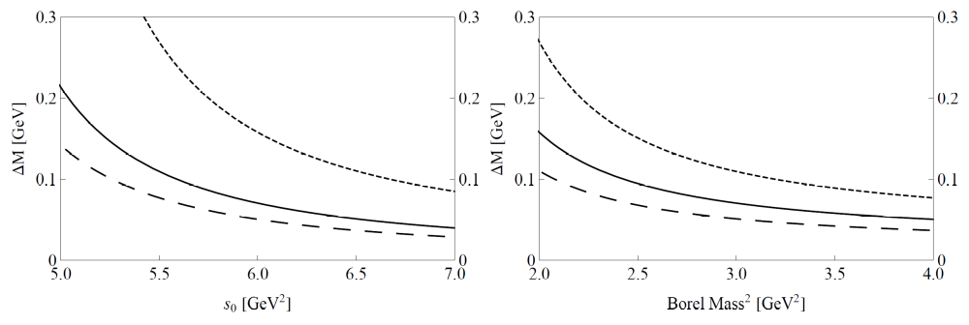

$$∆M={71}_{−48}^{+172} MeV$$

Slide 37
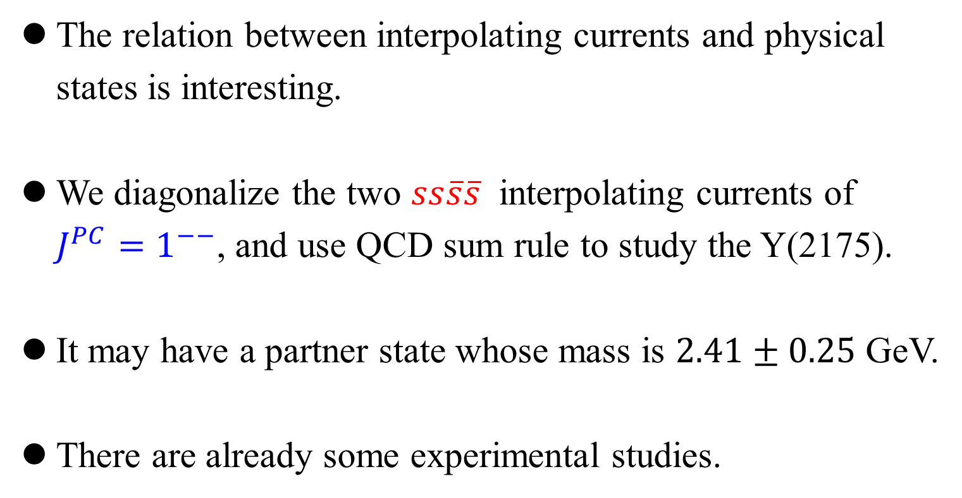
Summary
The relation between interpolating currents and physical states is interesting.
We diagonalize the two $ss\overline{s}\overline{s}$ interpolating currents of $J^{PC}=1^{−−}$, and use QCD sum rule to study the Y(2175).
It may have a partner state whose mass is $2.41±0.25$ GeV.
There are already some experimental studies.

Slide 38
Thank you very much!
谢谢

