Slide 1

High Intensity Electron Positron Accelerator (HIEPA) Super Tau Charm Facility（STCF）in China
彭海平
penghp@ustc.edu.cn
核探测与核电子学国家重点实验室
中国科学技术大学
(代表STCF指导委员会)

Slide 2
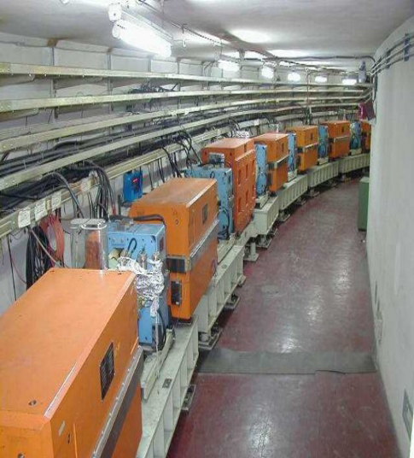
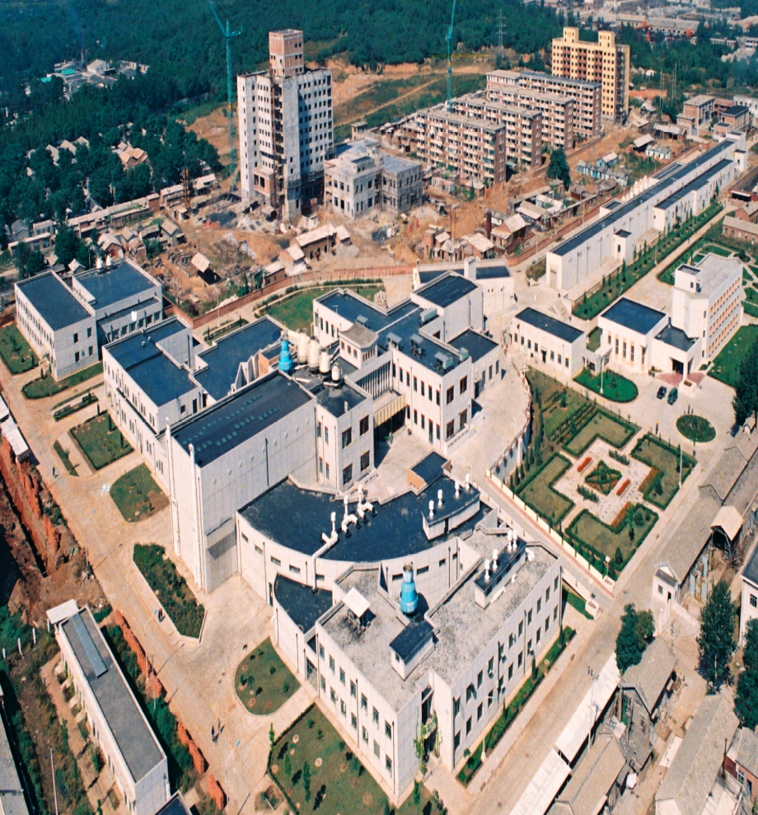
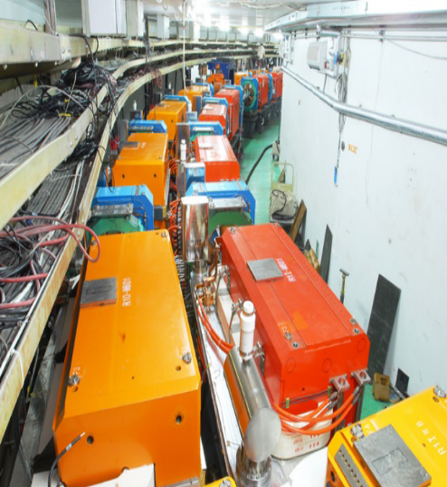
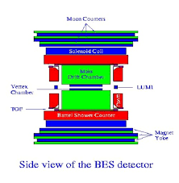
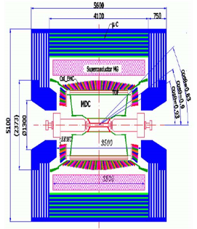
30 Years of τ-c facility in China
BEPCI (1988−2005)
Single Ring
10³¹cm⁻²s⁻¹ ⇒ 10³³cm⁻²s⁻¹
BEPCII (2006−now)
Double Ring
BESI/II
BESIII
Notes:
经历

Slide 3
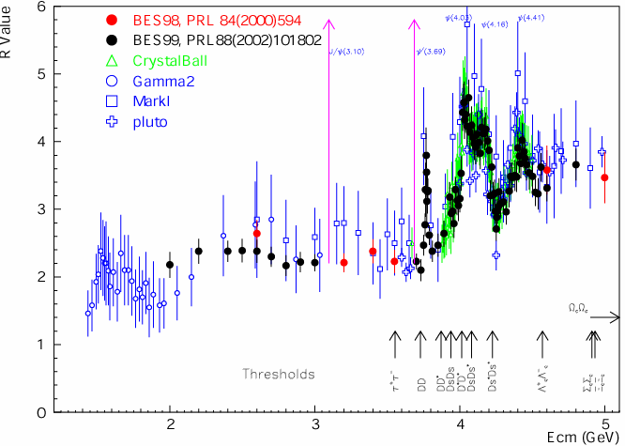
Broad Physics at τ-c Energy Region
Unique features ：Rich of resonance, Threshold characteristics, …..
Abundant physics
R=s(e⁺e⁻→hadron)/
s(e⁺e⁻→m⁺m⁻)
Hadron form factors
Y(2175) resonance
Mutltiquark states with s quark, Zs
MLLA/LPHD and QCD sum rule predictions
Light hadron spectroscopy
Gluonic and exotic states
Process of LFV and CPV
Rare and forbidden decays
Physics with τ lepton
XYZ particles
Physics with D mesons
f_{D} and f_{Ds}
D₀-D₀ mixing
Charm baryons
与其他高精度平台（如B、φ工厂）是互补，不可替代的
Notes:
Abundant physics topic are expected in the tau-charm energy region.
For example, in 2-3GeV, it is ideal region to study the hadron form factors,
Study the properties of Y(2175) and search for the mulitquaks states with s quark,
It also can be used to test QC sum rule predictions.
In the charmonium energy region, which can collect very very last data samples, and
It can be used to study the light hadron spectroscopy And gluonic and exotis states.
It also can be used to search for the LFV process, CPV process and rare and forbidden decays preocss.
Of course tau physics can be one of landmark in this region.
Above the 4GeV region, It is ideal place to study XYZ particle, Physics with D meason
And D-D0 mixing charm bayrons.
Of course, the R scane in the whole energy region will definenalyy improve the presision
Of delta Alpha QDQ, charm quark mass extraction. Estpcaiilly in the range from 5-7 GeV,
There are very rare experiment data to day.
The data can also be use for the hadron from factor study.

Slide 4
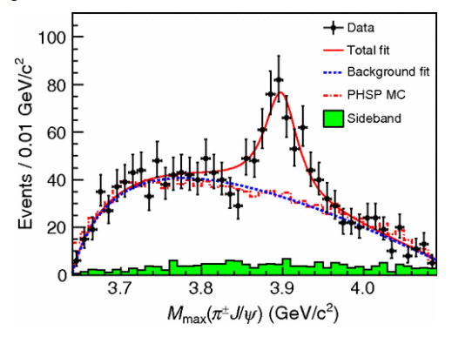
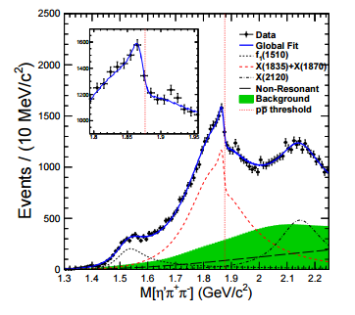
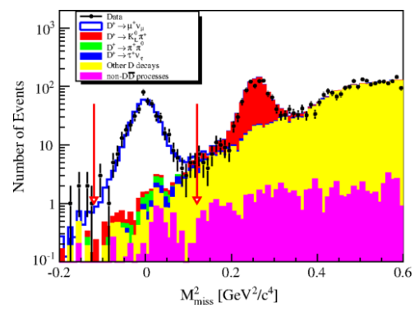
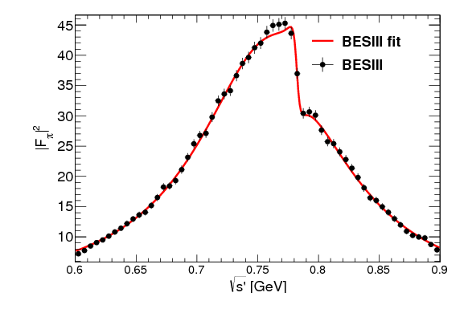
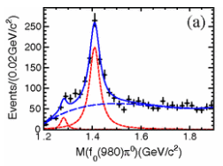
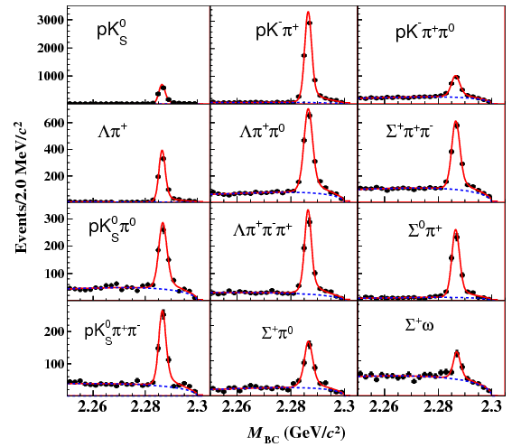
Fruitful BESIII Results
Z_{c}(3900)
Abrupt structure
Most precise measurement for D leptonic decay
X(1835)
Large Isospin Violation
η(1405)→f₀(980)π⁰
First Λc at BESIII
Precise measurement
Precise Measurement on Cross section
e ⁺e⁻→π⁺π⁻

Slide 5
Publication of BESIII
≈200 publications, 1/5 PRL
Excellent in both number and quality
http://bes3.ihep.ac.cn/pub/physics.htm

Slide 6
τ-c facility in China
BEPCII/BESIII have run 9 years, successful and excellent production
Physics study limited by the luminosity, CME ……
Charmonium-like physics
Charmed baryon physics
Charmed meson and tau physics
Limited by length of storage ring, no space and potential for the upgrade
Challenged by Belle II
BEPCII/BESIII will end her mission in 5-10 years
A STCF far beyond BEPCII, is nature extension and a viable option for a post-BEPCII HEP project in China
Notes:
BEPCII/BESIII will end her mission around 2020,
Led by the high energy Physics association of China, we are exploring possible
Future collider proejct post BEPCII and BESIII
High intensity Electron Positron accelerator (HIEPA) is one of the options.
HIEPA facility can be serviced as a collider machine,
Which provide peak lumin…..
The energy range from 2-7Gev, polarization available on one beam
And the symmertic machine with low currents and crabbed saist solution for the interation….
It also can

Slide 7
STCF in China
Super Tau-Charm Facility (STCF)
Peak luminosity 0.5-1×10³⁵ cm⁻²s⁻¹ at 4 GeV
Energy range E_{cm} = 2−7GeV
Polarization available on beam (Phase II)
Basic Features of machine :
Symmetric machine with dual-ring, 600-1000meter
Large Piwinski angle collision + crabbed waist solution for the IR
Siberia snake for polarization
Notes:
BEPCII/BESIII will end her mission around 2020,
Led by the high energy Physics association of China, we are exploring possible
Future collider proejct post BEPCII and BESIII
High intensity Electron Positron accelerator (HIEPA) is one of the options.
HIEPA facility can be serviced as a collider machine,
Which provide peak lumin…..
The energy range from 2-7Gev, polarization available on one beam
And the symmertic machine with low currents and crabbed saist solution for the interation….
It also can

Slide 8
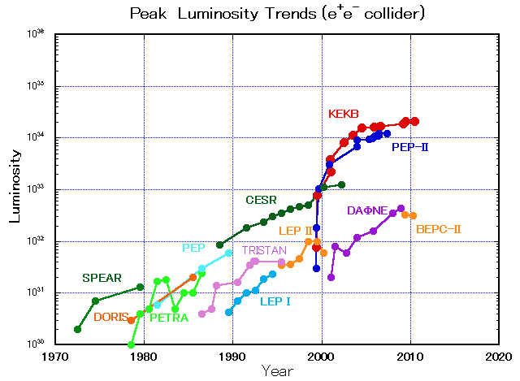
STCF in Perspective
SKEKB
STCF
BEPC-II
BEPC
2028
A luminosity 1×10³⁵ cm⁻²s⁻¹ at 4 GeV at 2028 is reasonable !!

Slide 9
加速器设计与关键核心技术
对撞亮度高于1×10³⁵@2GeV。
束流流强大于2A：BEPCII 2倍以上
极化电子束/正电子束
质心能量调节范围2-7GeV，覆盖更宽能区
=>加速器物理与技术的新挑战

Slide 10
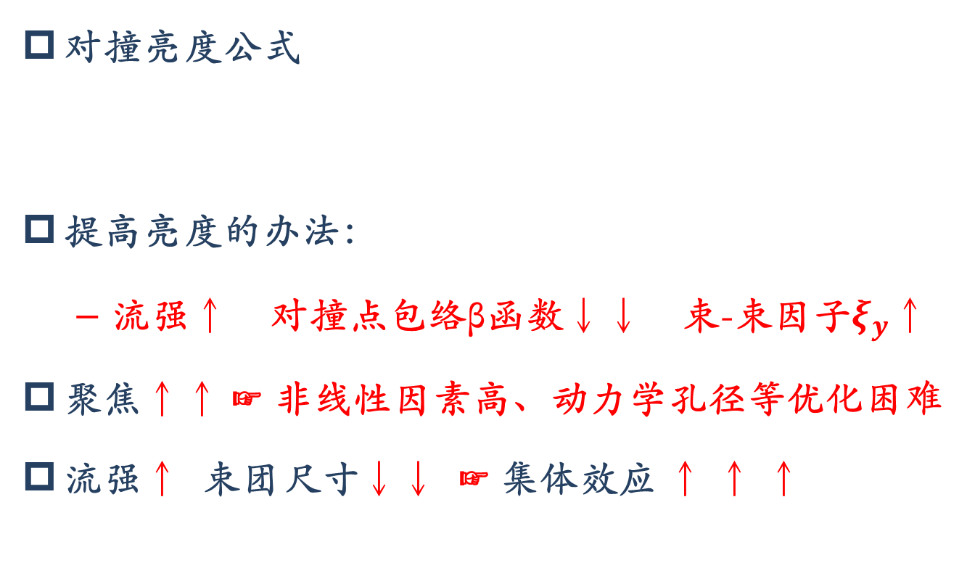
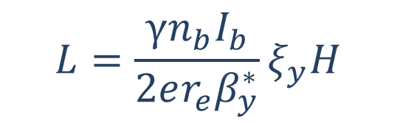
加速器物理：关键难点
对撞亮度公式
提高亮度的办法：
  流强↑ 对撞点包络β函数↓↓ 束-束因子$ξ_{y}$↑
聚焦↑↑ ☞ 非线性因素高、动力学孔径等优化困难
流强↑ 束团尺寸↓↓ ☞ 集体效应 ↑ ↑ ↑
$$L=\frac{γn_{b}I_{b}}{2er_{e}β_{y}^{∗}}ξ_{y}H$$
Notes:
γ为相对能量，n_{b}为束团数，I_{b}为单束团流强，ξ_{y}为垂直方向束-束效应参数，H为因包络函数β沿束团变化导致的亮度限制参数即Hourlass因数。从式(1)中可以看出，对于在给定能量上优化的对撞机，对撞亮度与流强、垂直方向束-束效应参数、Hourglass效应参数成正比，与垂直方向包络函数数值成反比
集体效应：
流强较强、束团尺寸较小而数量较多、能量较低，是HIEPA束流的三大特征，由此导致束流集体效应十分严重；束流不稳定性主要由尾场导致。严重的束流集体效应将引发粒子振荡频率改变、束流发射度增长、束流寿命下降、束流品质降低以及束流不稳定等现象。

Slide 11

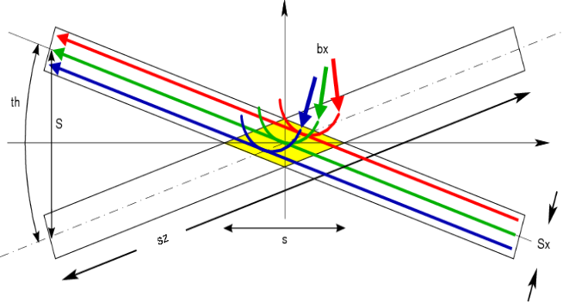
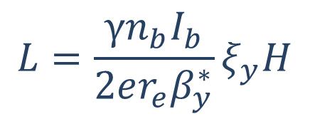
亮度提高的原理
大Piwinski角对撞，Crabbed Waist Scheme
  为提高亮度，必须压缩β_{y}
  克服Hourglass效应，需要束团长度小于β_{y}
  束团长度很难缩短；而且，缩短束团长度会增强束流集体效应→长期存在的传统矛盾
  Large Piwinski Angle避免了此矛盾
  会引入新的束-束共振，限制tune shift，因此需要Crabbed Waist解决
$$L=\frac{γn_{b}I_{b}}{2er_{e}β_{y}^{∗}}ξ_{y}H$$
  E=2GeV，当β_{y}=0.35mm，扁平束， ξ_{y} =0.04 ， 则L=10³⁵/(cm²·s)

Slide 12
加速器物理：研究内容
对撞机制：
  Large Piwinski Angle + Crab Waist
束-束效应参数的优化
总体布局
单粒子动力学
集体效应
Notes:
1 对撞机制：
Large Piwinski Angle，克服束团长度对β函数大小的限制，β函数可以压缩到很小；
Crab Waist，抑制引入的束-束共振效应
2 束-束效应参数的优化：
束-束效应决定了对撞亮度的上限，束-束作用参数可以看做对撞的“效率”。 CEPC预估其垂直方向束-束效应参数约为0.1，BEPC II进行理论设计时假定垂直方向束-束效应参数为0.04。HIEPA采用大Piwinski角和Crab Waist Scheme的对撞机制，与现有的BEPC II、在研的CEPC都完全不同，因此需要对束-束效应参数的优化进行理论推导和计算机数值模拟，更深入地探索其优化方法。
3 总体布局：
对撞机为双环完全对称结构，电子、正电子束流能量相等，全环只有一个对撞点(Interaction Point, IP)。设置两个长直线节，分别作为对撞区和注入区使用，另外设置多个直线节用于安装Damping Wiggler等。为了能同时加速正负电子并且避免对磁铁和电源极性的变换引起的操作复杂度，电子和正电子的注入器各自独立，且只有正电子经过阻尼环。
4 聚焦结构(Lattice)设计与单粒子动力学优化
HIEPA加速器采用模块化设计，设计对撞区时先假设twiss参数为周期解，分别优化对撞区和弧区（Arc）后，再进行全局优化。
对撞区的设计主要是通过超强聚焦磁铁如四极铁、六极铁和螺旋管的排布实现对束团的压缩。超强聚焦将引入较严重的非线性，对撞区同时应进行对聚焦的非线性补偿与优化，从而提供足够的动力学孔径与动量孔径并补偿束流扰动等。除此之外，聚焦系统与探测器位于同一位置，因此还应考虑与探测器的接口，例如部件尺寸、束流引入的背景噪声因素等。需要对整个聚焦系统进行精细的设计计算，给出各磁铁的物理参数（磁场强度、磁场梯度、多极场分量等），并综合考虑探测器部分所提出的要求和限制，以确保聚焦后的束流能够满足对撞实验的要求。
除了对撞区本地补偿外，为了压缩包络函数，还需要对整个Lattice进行动力学优化。超强聚焦需要引入强的非线性补偿，而且对撞区的β函数变化剧烈，磁铁的边缘场效应很强，这些都使得优化难度显著提升。
5 集体效应
束流不稳定性主要由尾场导致。严重的束流集体效应将引发粒子振荡频率改变、束流发射度增长、寿命下降以至束流不稳定等现象。下一代对撞机中，B工厂能量高于韬-粲工厂，Higgs工厂束流能量则接近韬-粲工厂的100倍；CEPC的流强约16.6mA量级，HIEPA则为2A。流强较强、束团尺寸较小而数量较多、能量较低，是HIEPA束流的三大特征，由此导致束流集体效应十分严重，例如由于真空室孔径很小（为了得到强聚焦），电阻性壁尾场更强等。
HIEPA的束流流强较强、束团间距较短，因此以多束团不稳定性为主，如横向阻抗壁不稳定性、耦合束团不稳定性、电子云不稳定性、离子俘获不稳定性等，而束团伸长效应等单束团不稳定性退居次要因素。除此之外，束流集体效应还包括束内散射(IBS)、托歇克散射和残余气体散射等，这些效应将导致束流品质下降与束流寿命降低。

Slide 13
Layout of Machine
Interaction Region : Large Piwinski Angle Collision
+ Crabbed Waist
Detector
Snakes
Crab Sextupole
Injector
Wigglers
Linac
0.5-3.5
GeV
Injector:
No booster, 0.5GeV→1~3.5GeV
e+, a convertor, a linac and a damping ring, 0.5GeV
e-, a polarized e- source, accelerated to 0.5GeV
Key Technology ：
Luminosity ：Large Piwinski Angle Collision + Crabbed Waist
Polarization：Siberlan Snake
e+0.5GeV
e- 0.5GeV

Slide 14
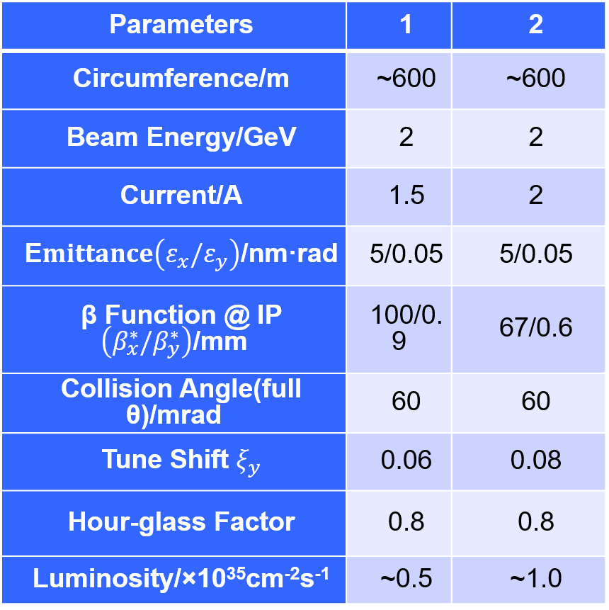
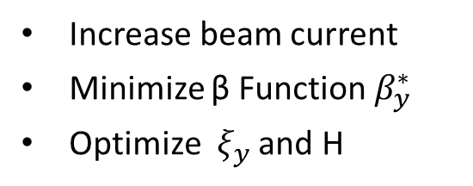
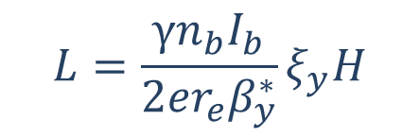
Parameters and Plan of the Machine
Luminosity :
$$L=\frac{γn_{b}I_{b}}{2er_{e}β_{y}^{∗}}ξ_{y}H$$
Increase beam current
Minimize β Function $β_{y}^{∗}$
Optimize $ξ_{y}$ and H
Strategy :
(Phase 0) Pilot: 0.5×10³⁵
(Phase I) Nominal: 1.0×10³⁵
(Phase II) Polarized beam
…..
Final:
90% Polarization e- and e+ injection, 80% Polarization @IP

Slide 15
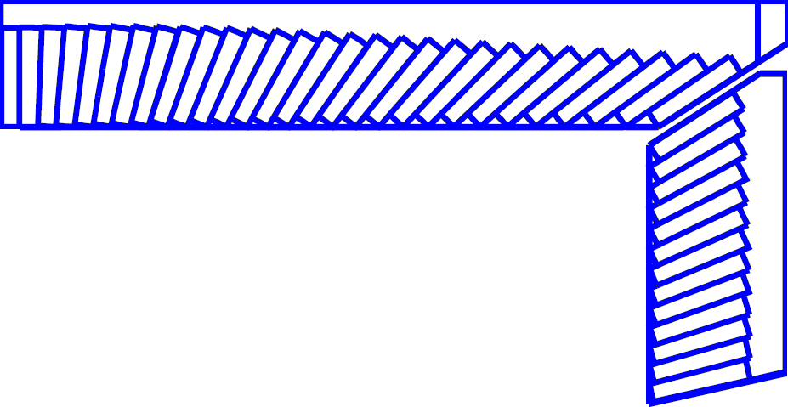
Detector Layout
245 cm
MUD
μ/π suppression power >10/30
York/Muon
185 cm
EMC
Energy range: 0.02-2.5 GeV
At 1 GeV σ_{E} (%)
Barrel(Cs(I): 2
Endcap (Cs): 4
Superconducting magnet
(0.7-1 T)
York/Muon
135 cm
EMC
105 cm
PID
π/K (and K/p) 3-4σ separation up to 2GeV/c
PID-barrel
85 cm
20°
PID-endcap
MDC (Low mass )
σ_{xy}=130 mm
dE/dx<7%, σ_{p}/p =0.5% at 1 GeV
MDC
15 cm
PXD/SSD
PXD
Material budget ~0.15%X₀/layer
σ_{xy}=50 mm
10 cm
3~6 cm
IP
120 cm
140 cm
190 cm
240 cm
300 cm
Notes:
We also have very preliminary conception design for the Detector, a very BESIII like symetry
Detectors is proposed.

Slide 16
General Consideration of Detector
Much larger radiation tolerance, especially at IP and forward regions
Efficient event triggering, exclusive state reconstruction and tagging
The Systematic uncertainty control
Reasonable cost
STCF Detector team has been formed.
Lots of progress on Tracking, PID, EMC and Muon system R&D.
  Tracking: Several Micro-Pattern Detector (DEPFET, MAPS, GEM/MicroMegas/ uRWELL) Technologies for inner tracking are testing.
  PID: RICH/DIRC for Barrel and DIRC-like TOF for EndCap
  EMC: CsI(Tl), CsI, BSO, PbWO4, LYSO
  Muon Counter with precise timing (σ_{T}<80 ps, Space reolution~0.6 mm)

Slide 17
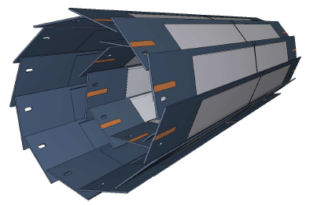
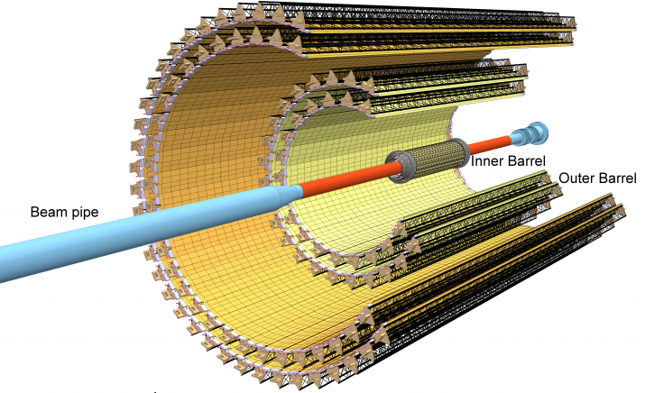
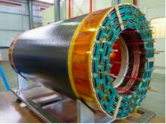
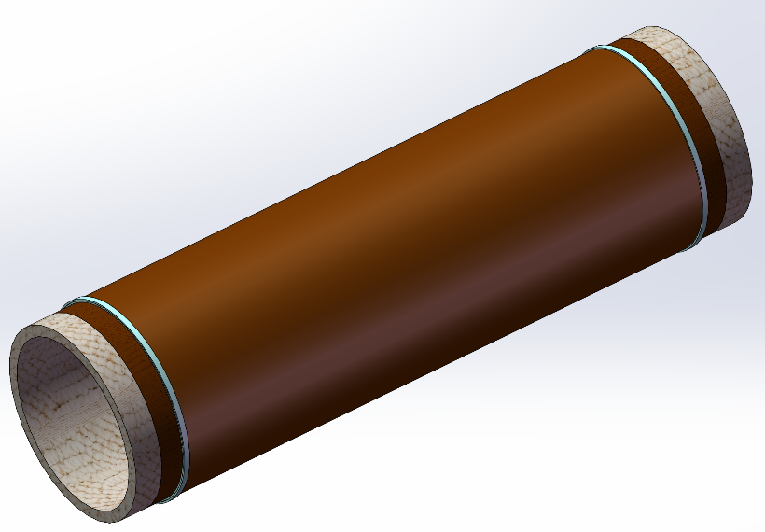
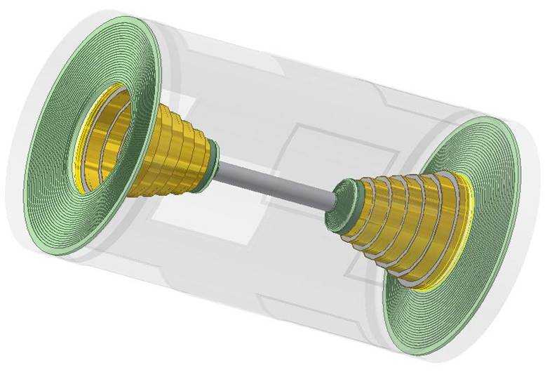
Detector requirements & Baseline
Vertexing :
Not very critical
But to combine with a central tracker to improve the tracking efficiency for low momentum track and resolution
Special design to cope with the large radiation close to IP
Technologies options :
A Low mass silicon detectors : DEPFET, MAPS …
MPGD : Cylindrical GEM/MicroMegas/Urwell
Central tracking :
large acceptance, low mass, high efficiency and high resolution
A low mass drift chamber with smaller cell size and lighter working gas

Slide 18
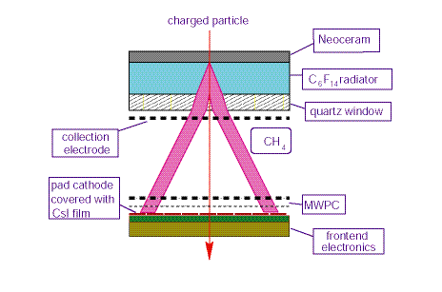
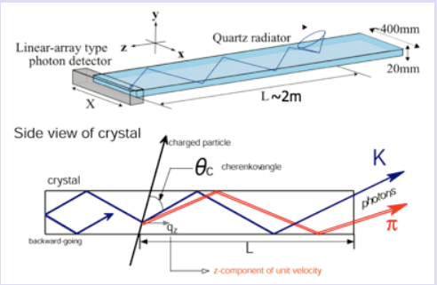
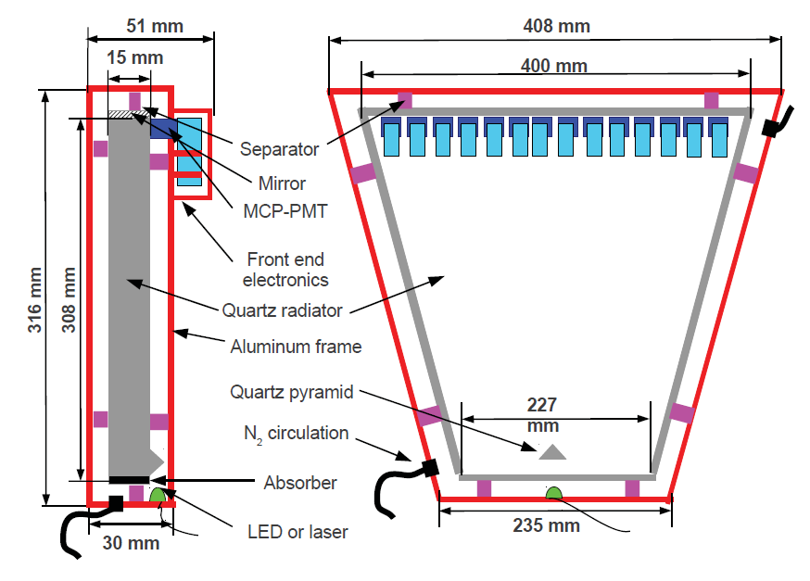
Detector requirements & Baseline
  PID system :
  π/K separation up to 2GeV, compact (<20cm) and low mass (<0.5X₀)
  Cherenkov-based technology is favorable for high momentum, and dE/dx for the low momentum tracks
  Technology options : RICH, DIRC-Like
  Baseline Design : Proximity RICH, similar to ALICE HMPID, but with CsI-coated MPGD readout
  Alternative Design : Aerogel + Position Sensitive Photon Detector, similar to BELLE-II ARICH
ALICE HMPID
iTOP for BELLE2
FTOF for superB

Slide 19
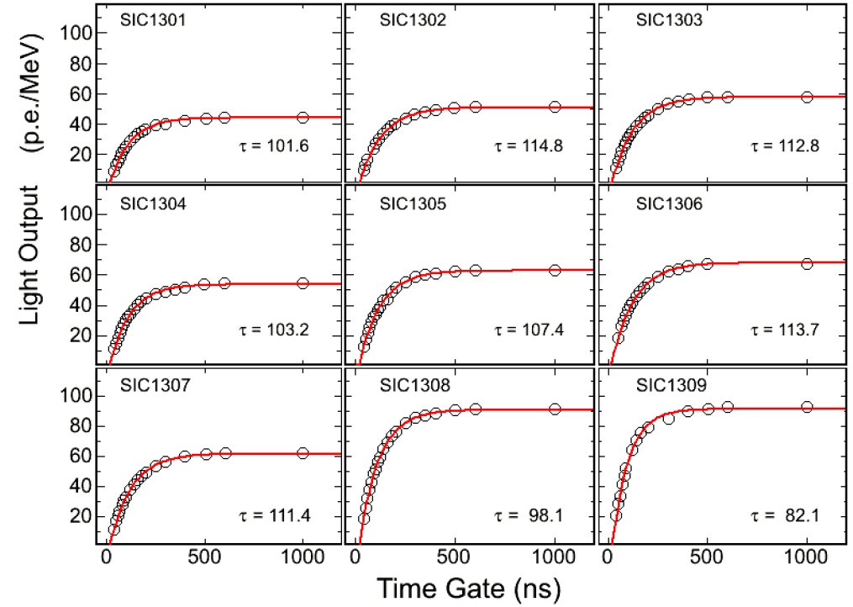
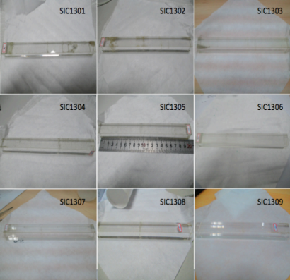
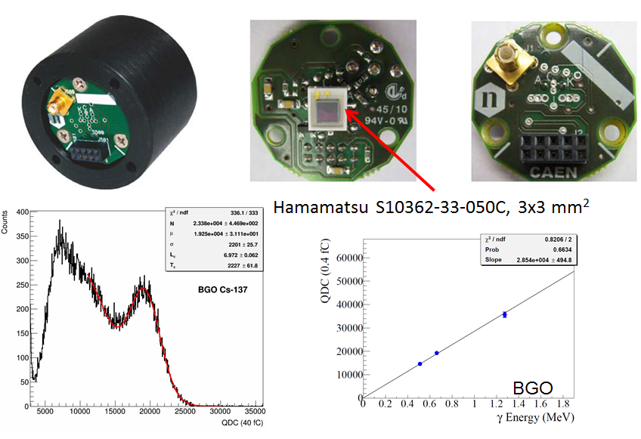
Detector requirements & Baseline
e/γ measurement :
  High efficiency for low energy γ
  Good energy, position and time resolution
  Fast response and Radiation hardened
  Technology option : Crystal + novel photon detector (e.g. SiPM)
  Crystal : pure CsI for barrel, LYSO for Endcap
  Readout : Larger Area PD, APD and SiPM

Slide 20
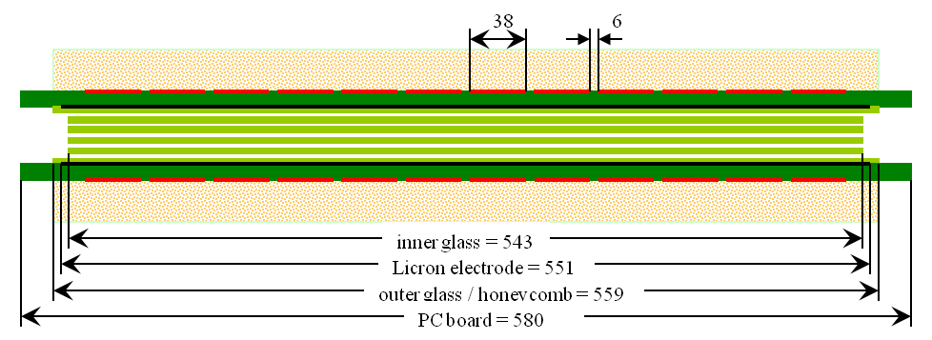
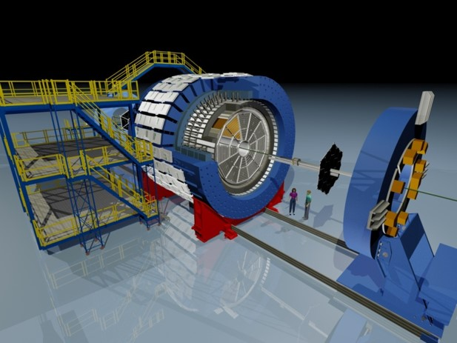
Detector requirements & Baseline
μ detection
  Low momentum threshold (p~0.4GeV)
  high μ efficiency and μ/π suppression power>10 (30）
  Technology option ：
  2-3 inner layers with MRPC for precise timing
  ~8 outer layers with RPC (Barrel : streamer, Endcap : avalanche)
Magnet
  Desirable to be adjustable from 0.5-1.0 T
Long-Strip MRPC Module at STAR
Active area: 87 x 52 cm²
Read out strip: 87 cm x 3.8 cm
Gas gaps: 0.25 mm x 5
MTD at STAR
Performance:
Efficiency: > 98%
Time resolution: < 80 ps
Spatial resolution: 0.6 cm

Slide 21
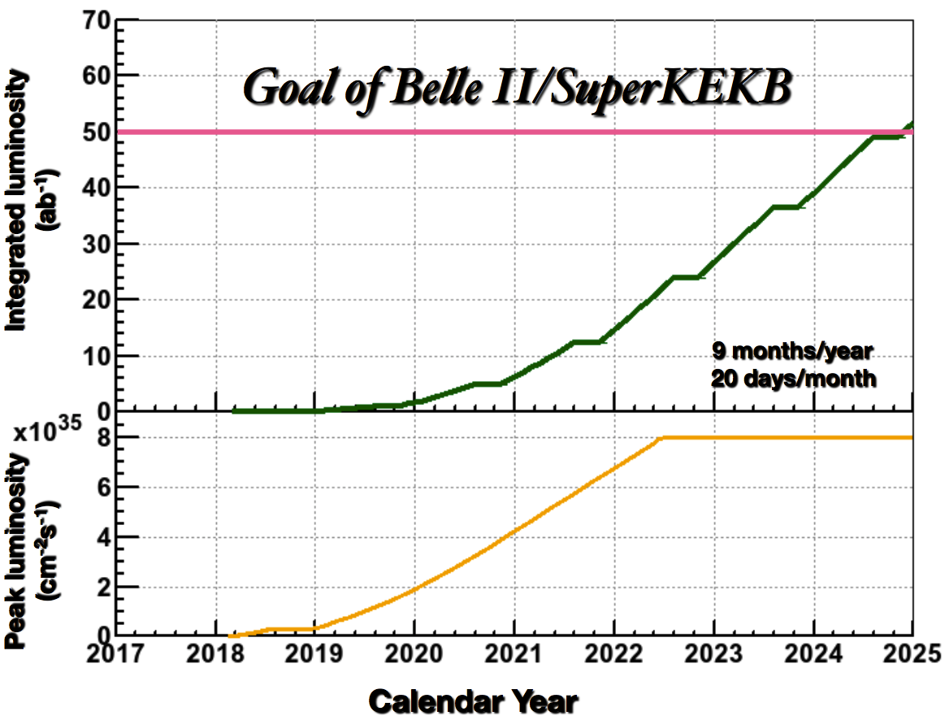
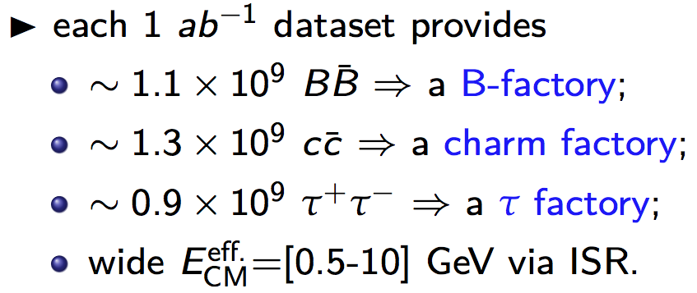
Integral Luminosity of STCF
No Synchrotron radiation mode, assume running time 9 months/year
Assume data taking efficiency 90%
10³⁵cm⁻²s⁻¹ × 86400s × 270days × 90% ∼ 2.0ab⁻¹ /year
10 years data taking, total 20 ab⁻¹ conservatively
Excellent opportunities for the τ-charm physics
BELLEII
Native question : Compete between STCF and BELLE II ?
Notes:
With assumed 10^35 luminrocity, it is estimated to get the 1.4ab-1 data per year
Taking into account really running days and data taking efficiency.
It is expected to collected 10^9 D meson pair and Tau lepton pairs.
These data is about 1/3 of BELLE-II data/per year which is expected to run with luminosity at 10^36

Slide 22
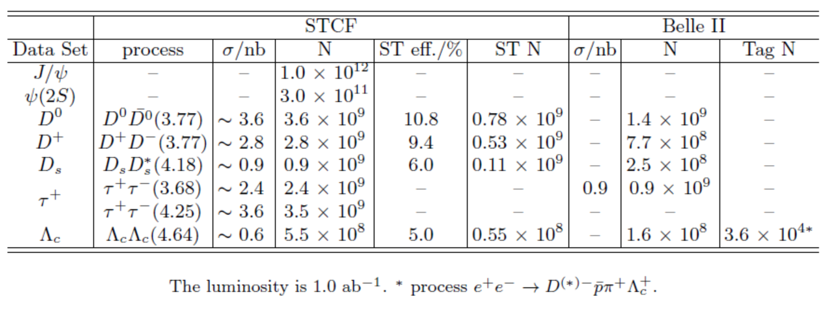
Data samples
Data samples with 1 ab⁻¹ integral luminosity
STCF have more larger x-sec
STCF is expected to have higher detection efficiency, low background
Belle II can have larger integral luminosity
Detail simulations are ongoing to study the potential for the physics research

Slide 23
Highlight Physics @ STCF
Rich of physics program, unique for physics with c quark and τ leptons,
important playground for study of QCD, exotic hadrons and search for new physics.
Charmonium-like (luminosity and CME)
Charmed meson (Luminosity)
Charmed baryon (CME)
Tau CP (polarized beam)
New physics (luminosity)
……..

Slide 24
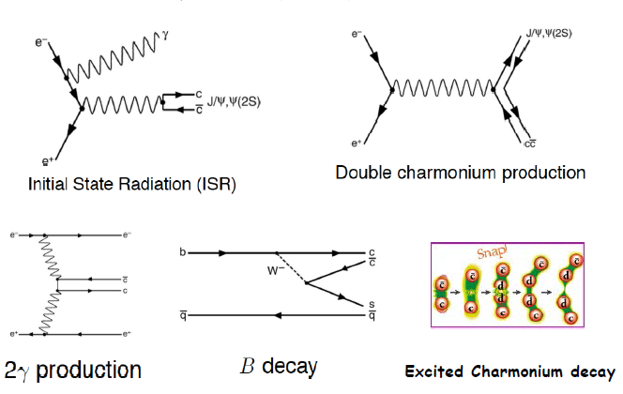
Charmonium-(like) Production @ B Factory
Fruitful results in past decade, a new territory to study exotic hadrons

Slide 25
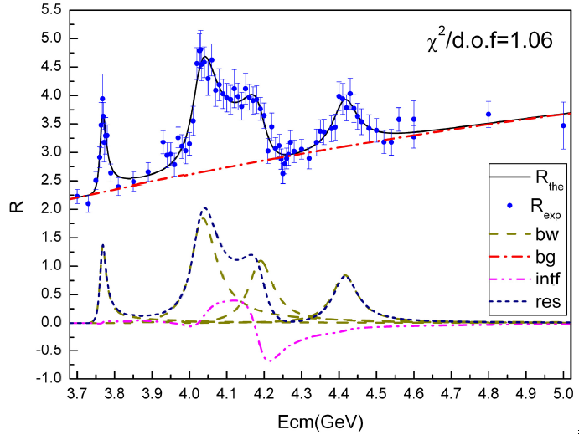
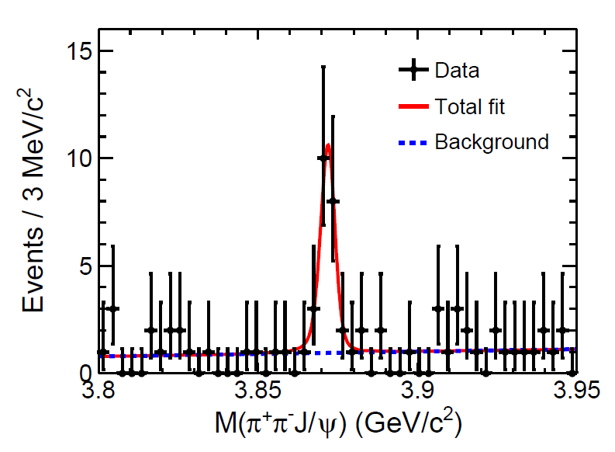
Charmonium (like) Production @ τ-c Factory
ψ/Y/Hybrid(ccg) (1⁻⁻) produced directly in the e⁺e⁻ collision
To determine the resonance parameters for the excited ψ or Y state
Precisely measure the x-sec of inclusive/exclusive final states at different Ecms
Charge parity c=+1 states produced via radiative transition from vector ψ/Y
The decay rate ψ(nS/nD)→γX(3872), X(3940)…
χ_{cJ}(2P)、χ_{cJ}(3P)、η_{c}(3S)、 η_{c}(4S)、 …
  B(ψ(3S)→γχ’_{cJ}) = (7, 3, 1) x 10⁻⁴ for J=2,1,0
Search for new states from hadronic transition
To search for Zc, Zcs, hc(2P) ….
PLB 660, 315 (2008)
PRL 112, 092001 (2014)
σ(Y(4260) →γX(3872))∼6pb
Complementary to B factory

Slide 26
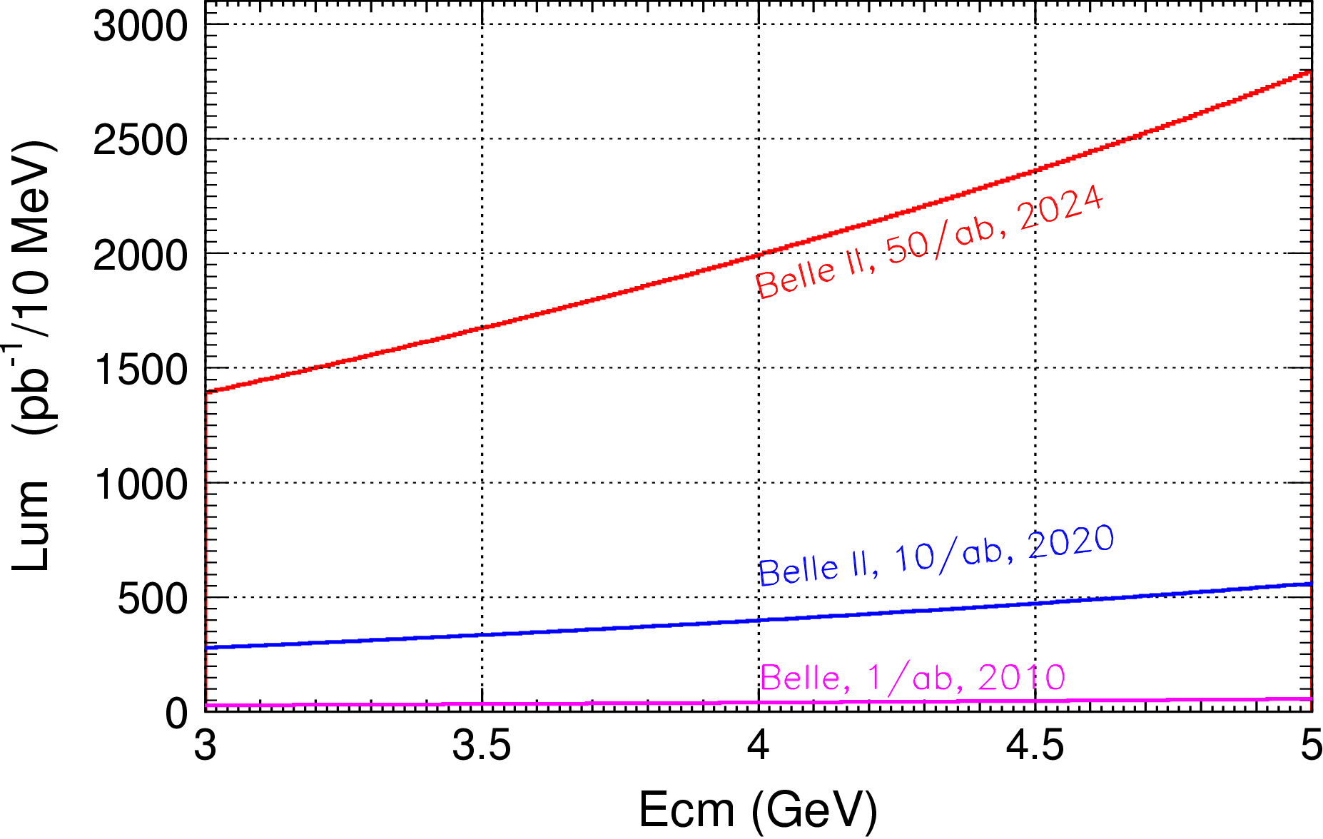

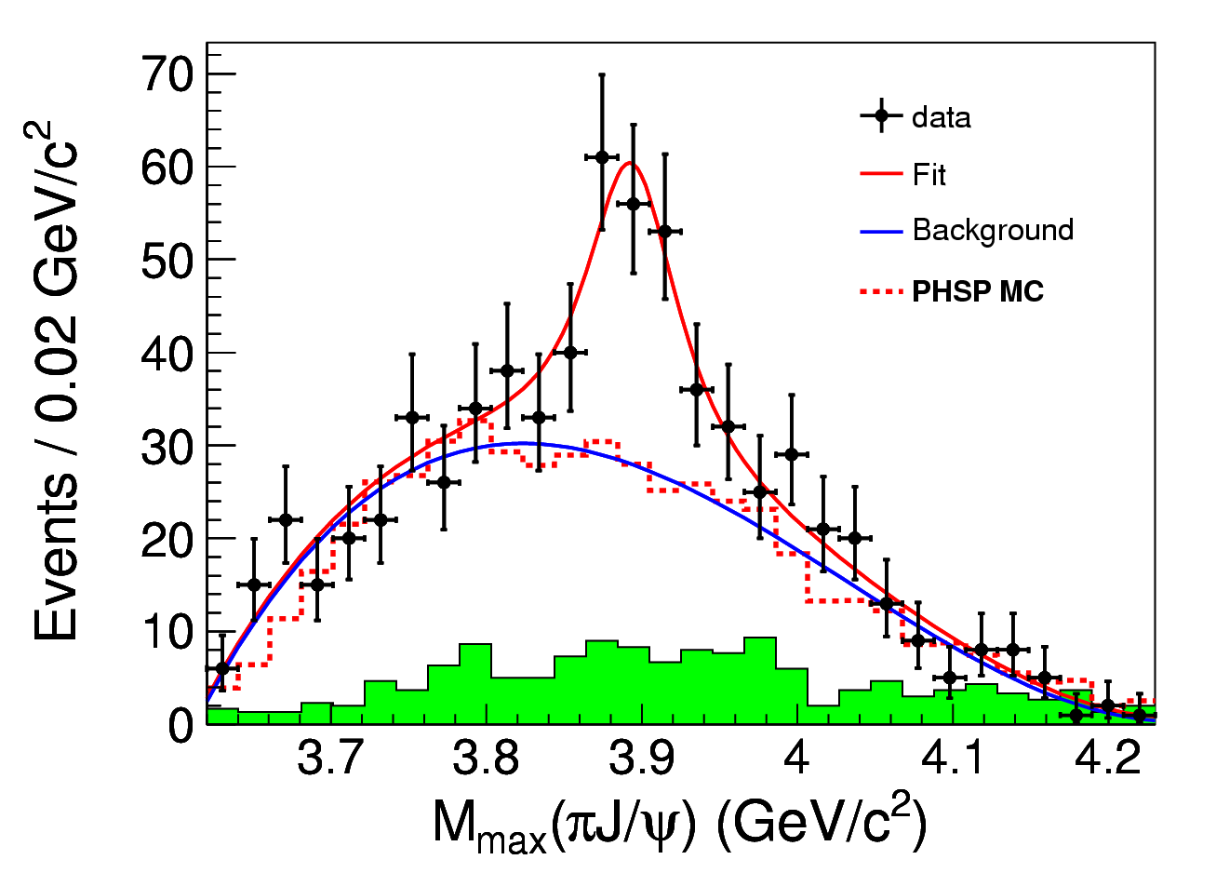
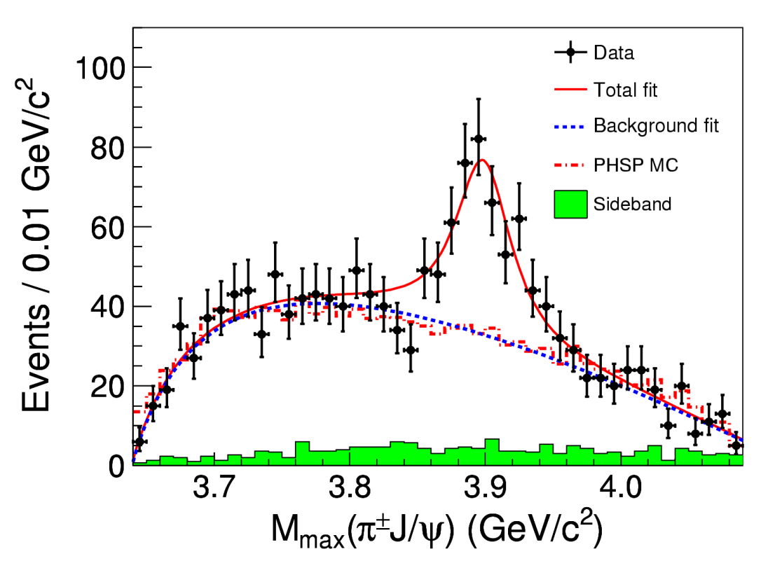

Charmonium-(Like) Physics
Belle with ISR: PRL110, 252002
967 fb⁻¹ in 10 years running time
@ 4.26 GeV for π⁺π⁻J/ψ
ε_{BESIII} = 46%, ε_{Belle} = 10%
>5.2σ
BESIII at 4.260 GeV: PRL110, 252001
0.525 fb⁻¹ in one month running time
B factory : Total integrate effective luminosity between 4-5 GeV is 0.23ab⁻¹ for 50 ab⁻¹ data
τ-C factory : scan in region 4-5 GeV, 10 MeV/step, every point have 20 fb⁻¹/year, 10 time of Belle II for 50 ab⁻¹ data
τ-C factory have much higher efficiency than B Factory
>8σ

Slide 27
Search for 1⁻⁻ Hybrid H_{ccg}→γη_{c} & γχ_{c0}
1^{–-} Hybrid may produce directly in e⁺e⁻ collision, and radiative decay to spin-zero charmonium states [in Hybrid, cc in spin-singlet, LQCD by Dudek′09]
Assume σ(e⁺e⁻→H_{ccg}) ∼ O(10−100) pb [???]
B(H_{ccg}→γη_{c})∼2×B(η_{c2}→γχ_{c0}) ∼ 4×10⁻⁴
Scan between 4-5 GeV for 1 year (2ab⁻¹), search for exotic structure in process e⁺e⁻→γη_{c} and γχ_{c0}
Assume εB ∼ 10% for γη_{c} and γχ_{c0} decay to γ+hadrons
With 100 energy points between 4-5 GeV
N^{obs}(γη_{c})=O(8-80) events/point/year at peak
N^{obs}(γχ_{c0})=O(4-40) events/point/year at peak
Notes:
A selected interesting topic is to search 1-- Hybrid state, since the spin is 1—
And it is expected to produced directly from the ee collistion and detecter
By its e1 trnasition to etc and chi_c0.
So we can try to scan the data for this exotic structure.
If

Slide 28
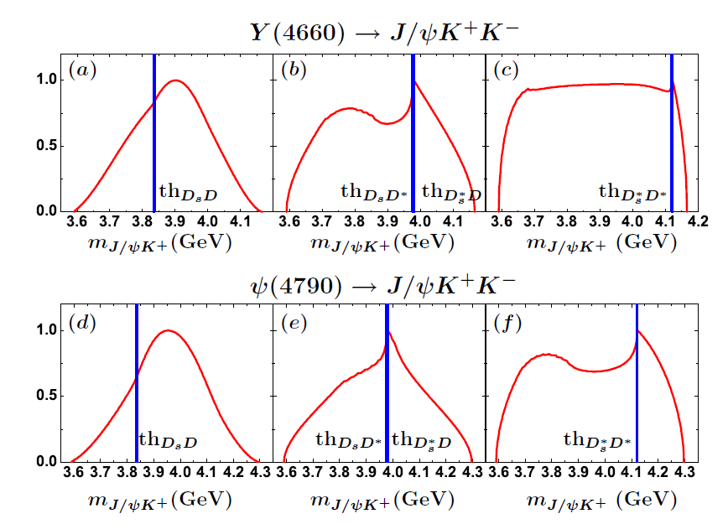
Search for Zcs
search for Excited Z_{c} and Z_{cs} particle@ Ecms>4.5 GeV

Slide 29
Search for η_{c2}(1¹D₂)
B(h_{c}(2P) →γη_{c2}) ∼ 3×10⁻⁴ [E1 trans., Barnes′ 05]
B(η_{c2}→γh_{c}) ∼ (44−54)% [E1 trans., Fan′ 09]
B(h_{c}→γη_{c}) ∼ 54% [E1 trans., BESIII′10]
σ(e⁺e⁻→π⁺π⁻h_{c}(2P)) ∼ 20 pb @ Ecm = ?? GeV
εB(η_{c}→hadrons) ∼ 1.5% at BESIII
N^{obs}=2×10⁻⁵×L (L is int. lumi. in pb⁻¹)
L _{peak} = 10³⁵cm⁻¹s⁻¹, 1 year running = 10⁶pb⁻¹ = 1ab⁻¹
N^{obs}=20 events /year,
Background is expected to be low for narrow h_{c} and η_{c}

Slide 30
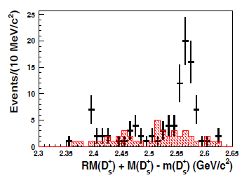
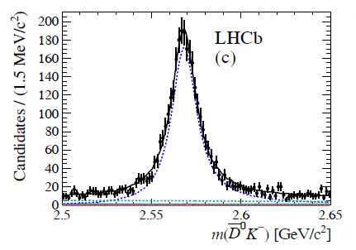
Charm Physics
4×10⁹ pairs of D^{±,0} and 10⁷∼10⁸D_{s} pairs per year
10¹⁰ charm from Belle II/year
Competition to Belle II
The multiplicity of final state is lower by a factor of 2
Threshold effect, clean, double tagging
QM coherent state, J^{PC}=1⁻⁻ for DD,J^{PC}=0⁺⁺ for γDD
Highlighted Physics programs
Precise measurement of leptonic, semi-leptonic decay (f_{D}, f_{Ds}, CKM matrix…)
D⁰-D⁰ bar mixing, CPV
Rear Decay (FCNC, LFV, LNV….)
Excite Charm meson D_{J}, D_{sJ} (mass, width, J^{PC}, decay modes)
Charmed Baryons (J^{PC}, Decay modes, Br)
Some sensitivities @ 1 ab⁻¹ data at threshold
Direct CPV in D→hh sensitivity : 10⁻³∼10⁻⁴
Probe y : Δ(y_{CP})∼0.1%
RM=(x²+y²)/2∼10⁻⁵ in Kπ and Keν channels
Δ(cosδ_{Kπ})∼0.007; Δ(δ_{Kπ}) ∼ 1°
0.5fb⁻¹ ∼ 80Events
1.0ab⁻¹∼ 160000 Events
D_{J2}
3.0 fb⁻¹∼ 4000Events
60.0fb⁻¹∼ 80000 Events

Slide 31
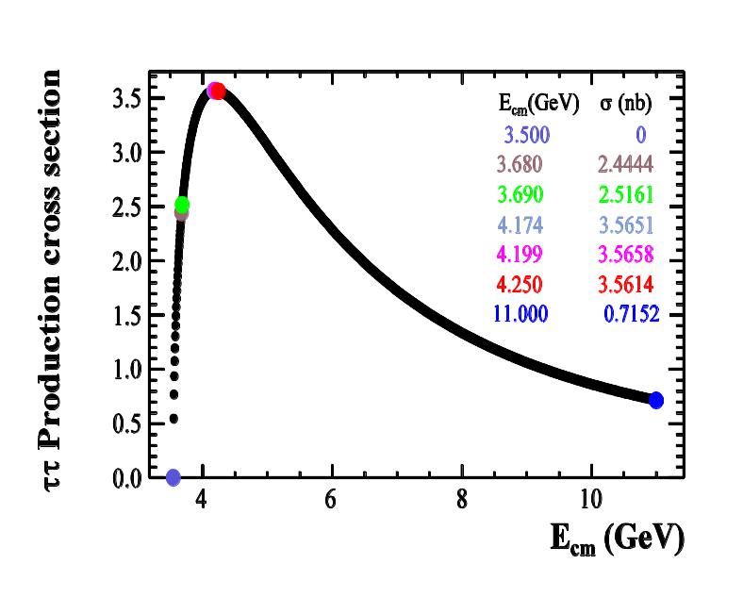
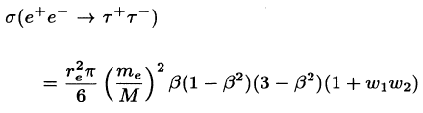
τ Lepton Physics
X sec grows from 0.1nb near threshold to 3.5nb at 4.25GeV
10⁸ tau pairs per year at threshold (x-sec = 0.1nb)
3.5×10⁹ tau pairs/year at 4.25GeV (x-sec = 3.5nb)
10¹⁰ tau pairs per year for Belle II (x-sec = 1nb)
Physics Highlighted Physics program
Precision measurements of α_{s}, m_{s}, V_{us}
Lepton universality : m_{τ}, τ→π⁺ν_{τ} and τ→K⁺ν_{τ}
Lorentz structure of the amplitude for τ→ℓν_{ℓ}ν_{τ}
Search for LFV processes : τ→ℓγ, ℓℓℓ, ℓh
Search for CPV
V-A Structure of the weak current in leptonic decays
Rare hadronic decays
Competition to Belle II
Threshold effect is important for controlling and understanding background
Longitudinal polarization of the initial beams will significantly increase sensitivity in searches for CPV in lepton decays.

Slide 32
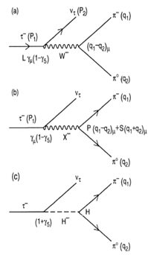


CP Violation in τ Decay
CP violation is observed in B, D and K sectors to date，but not observed in lepton sector yet.
The discovery of CPV in the tau sector would be a clean signature of NP
One of the most promising CPV channels is τ⁻→K_{S}π⁻ν
SM CP asymmetry from K_{S}-K_{L} mixing is expected to be : [Bigi & Sanda, PLB 625, 2005, Grossman &Nir JHEP 1204 (2012) 002]
BaBar measurement [PRD 85, 031102]
Belle measurement [PRL 107, 131801]
Charge Higgs, new Scalar,
W_{L}-W_{R} Mixings, LeptonQuarks?
A_{cp} = (1.8±2.1± 1.4) ×10^{-3 @} W ∼ [0.89-1.11] GeV
Notes:
Now, we move to the CPV in tau decay.
To day, CP violation is observed in B,D and Ksystem
But no ovserved in the lepton sector,
The discovery of CPV in tau decay is a clean signture of NP.
The most promising CPV channels is tau-Ks pi v,
The SM predicted the CVP at 10-3 level duo to the Ks-Kl mixing,
But Belle and Babar did not observed any evindence for it CPV

Slide 33

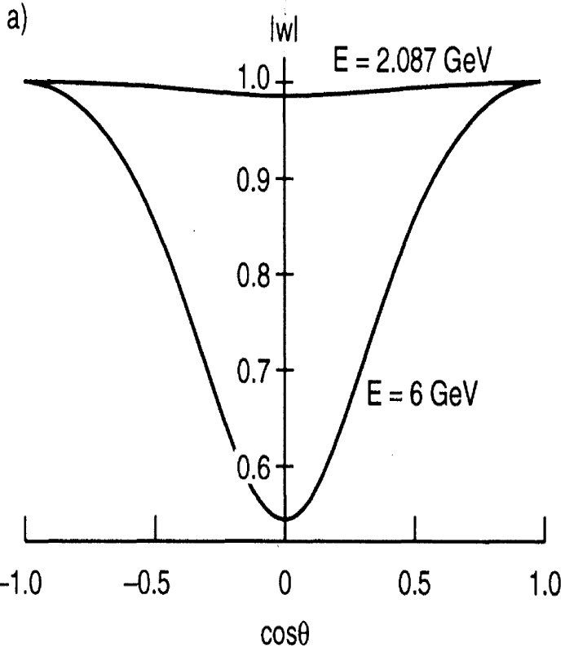

τ CPV in Angle Distribution
Measurement on the angular CPV asymmetry is desirable
Use T-odd rotationally invariant products in >=2 hadrons, such as τ⁻→π⁻π⁰ν_{τ} /k⁻π⁰ν_{τ} , τ⁻→π⁻π⁺π⁻ν_{τ} /K⁻π⁺π⁻ν_{τ} :
Polarized of τ and beam are necessary
Figure of Merits
tau-charm
Y. S. TSAI, PRD 51 (1995) 3172
B factory
BESIII @ 4.25 (10³³cm⁻²s⁻¹) FOM=1
STCF @ 4.25 (10³⁵cm⁻²s⁻¹) FOM=100
SuperKEKB @ (8x10³⁵cm⁻²s⁻¹ ) FOM=52
Notes:
So we need a new measurement on the angular CPV asymmerty.
Like use T-od ratationally invariant products.
The kind of analysis can be performed in the tau decay into final state with more than 2 hadron.
But the polarized beam is necessary.
As we know, the polarization of electron beam can be transver to the produce
Tau,
In tau-charm region, all the produce tau is expected to the 100% poralaztion
While in the super factor, the proporazation is expected to be about 50% with
Tau cos\thet is 0.
A important variable “Figure Of Merits” proposed by the Y.S TSAI which take
into accouting luminorcist, polarization and total cross section,
to quantitative evaluate the feature of different experiment on CPV study
And HIEPA is found to be with the best quilaty.
Evaluate the characters of

Slide 34
R and QCD Physics
Detailed study of exclusive processes e⁺ e⁻→(2-10)h, h=π,K,η, p…. , Scan between 2-7GeV and ISR √s<2GeV
Meson Spectroscopy
Intermediate dynamics
Search for exotic states (tetraquarks, hybrids, glueballs)
Form factors
High precision determination of R=σ(e⁺ e⁻→hadrons)/σ(e⁺ e⁻→μ⁺μ⁻) at low energies and fundamental quantities
(g_{μ}-2)/2, 92% from < 2GeV, 7% from 2-5GeV
α(M_{z}), 19.0% from < 2GeV, 18.1% from 2-5GeV
QCD parameters (charm quark masses)
Inclusive cross section e⁺ e⁻→h + X
QCD parameters (α_{s}, quark and gluon condensates)
Fragmentation functions
Spin alignment of vector
MLLA/LPHP prediction

Slide 35






Nucleon Electromagnetic Form Factors (NEFFs)
Spatial distributions of electric charge and current inside the nucleon
, Λ Λ
Space-like:
FF real
Time-like:
FF complex
Complete picture of nucleon structure requires space-like and time-like FF
JLab
Space-Like FF
1% Precision
JLab
Notes:
Now we move to the Nuclearon Electromagnetic Form factor topic.
The nucleon (proton and neutron) electromagnetic form factors describe the spatial distributions of electric charge and current inside the nucleon and thus are intimately related to its internal structure; these form factors are among the most basic observables of the nucleon.
There two kind of FF measurement, Space-like FF, which can be measured in the scatter process, while the Time like FF, can be measure in the annihilate in the ee and ppbar process.
An complete picture of the nucleon structrure requires both space-like and time-like FF measurement.

Slide 36



Proton FF (√s=2.23GeV) @ τ-c Factory
1 day
2 days
HIEPA reach 1
HIEPA reach 2
Notes:
So, for the Ratio of GE and Gm, the uncertainty of BESIII test run is about 24%,
While is expected 10% in BESIII final results,
while in HIEPA, the uncertiant is expected to be 1.5% or 1% with 1 or 2 days date
taking respectively.

Slide 37
Strategy and Activities
CDR → TDR → project application → construction → commissioning
Strategy: focus on CDR (2 years) and TDR (5-7 years) depend on the available resources.
Webpage: http://wcm.ustc.edu.cn/pub/CICPI2011/futureplans/
Domestic Workshops (2011, 12, 13, 14, 16)
International Workshops (2015, 18)

Slide 38


Science & Technology Review
Two international workshop : Hefei (2015), Beijing(2018)
More than 100 participants, more than 50% of them are from oversea
Presented project status, overview the physics potential and discuss the design and key technology of accelerator and detection

Slide 39




Science & Technology Review
Fragrance Hill science Conference, June, 2015, ∼40 scientists and officials joint

Slide 40




Science & Technology Review
Several Domestic Workshops (2011, 12, 13, 14)
Notes:
build a small working group,
Have domestic workshops every year,
Have a international workshop at Jan. 2015.

Slide 41
Institutions shown Interest
University of Science and Technology of China
Institute of High Energy Physics, CAS
Institute of Theoretical Physics, CAS
Tsinghua University
University of Chinese Academy of Sciences
Shangdong University
Shanghai Jiaotong University
Peking University
Zhejiang University
Nanjing University
Nankai University
Wuhan University
Central China Normal University Lanzhou University
Nanhua University
Beijing University of Aeronautics and Astronautics
…….
Institute for Basic Science, Daejeon, Korea
Dubna, Russia
Budker Institute and Novosibirsk University, Russia
T. Shevchenko National University of Kyiv, Kyiv, Ukraine
University Ljubljana and Jozef Stefan Institute Ljubljana, Slovenia
Jozef Stefan Institute Ljubljana, Slovenia
Stanford University, USA
Wayne State University, USA
Carnegie Mellon University, USA
GSI Darmstadt and Goethe University Frankfurt,
Germany
Goethe University Frankfurt, Germany
GSI Darmstadt, Germany
Johannes Gutenberg University Mainz, Germany
Helmholtz Institute Mainz, Germany
LAL (IN2P3/CNRS and Paris-Sud University),
Orsay, France
Sezione di Ferrara, Italy
L'Istituto di Fisica Nucleare di Torino, Italy
L'Istituto di Fisica Nucleare di Firenze, Italy
Scuola Normale Superiore, Pisa, Italy
University of Silesia, Katowice, Poland
Laboratori Nazionali di Frascati, Italy
INFN, Padova, Italy
University of Pavia, Pavia, Italy
University of Parma, Italy

Slide 42

International Collaboration
SCT at Novosibirsk, RUSSIA
Budker Institute of Nuclear Physics
Long history…..
Pre-Agreement of Joint effort on R&D, details are under negotiation
Joint workshop between China, Russia, and Europe
2018 UCAS (March), Novosibirsk (May), Orsay (December)
2019 …..

Slide 43

Joint workshop on future τ-c factory
Welcome to join the workshop!

Slide 44

Candidate site : Hefei, Anhui province
One of three integrated national science centers, which will play important role in ‘Megascience’ of China in near future
University of Science and Technology of China (USTC)
National Synchrotron Radiation Lab and Hefei Light Source, operated by USTC
The only National Lab operated by University in China. (Totally Four officially approved National Labs in China)
Pay a lot of attention on accelerator facilities
Hefei Advanced light source is under design
STCF is listed in future plan

Slide 45





Slide 46

USTC and LOCAL Goverment
Report to CAS Condition and Finance Bureau
Report to USTC scientific committee and USTC presidents
Report to Hefei High-tech Development Zone
Report to Anhui Development Planning Commission
Jan. 2018, Report to USTC new president -- Prof. Bao
USTC president agreed
Scientific committee endorsed supporting R&D

Slide 47
Support from different aspects
学校：
科大“双一流”重点支持项目，1000万启动经费支持
由学校发展改革部牵头组织与科学院、安徽省等相关部门联系
院系、重点实验室…:
物理学院 : 物理研究与人才培养，恢复加速器专业
核探测器与核电子学国际重点实验室：探测器与电子学研发、建造
合肥同步辐射国家实验室：对撞机的设计与建设
兄弟单位：
科学院合肥分院的研究所：机械设计与加工
兄弟大学：物理、探测器、加速器
兰州近物所、北京高能所等：物理、探测器、加速器
基本粒子与相互作用协同创新中心是一个优秀平台

Slide 48




Activities
计划申请科学院的先导B项目

Slide 49

Candidate site ： Canton Province
Institute of Modern Physics, CAS, proposed building HIAF-EicC in Huizhou, Canton
SUN YAT-SEN UNIVERSITY proposed building Southern Synchrotron Radiation light source in Canton
STCF Share the
design effort of the
electron accelerator
of EicC?

Slide 50

Tentative Plan & Estimated Budget
 | 2018 | 2019 | 2020 | 2021 | 2022 | 2023 | 2024 | 2025 | 2026 | 2027 | 2028 | 2029 | 2030- 2040 | 2041- 2042
Form International Collaboration
Conception Design Report (CDR)
Technical Design Report (TDR)
Construction
Commissioning
Upgrade
A unique precision frontier in the world for 30 years!
R&D budget 200M RMB
Total budget 4B RMB

Slide 51
Organization for STCF
Institutional Board
Steering Committee（Zhenguo Zhao）
International Advisory Committee (IAC)
Project coordinator
(Haiping Peng, Yangheng Zheng)
Theory & MC Simulation
(Jiangping Ma)
Accelerator
(Qing Luo)
Det./Soft.
(Jianbei Liu/Xingtao Huang)
Light Hadron
Charmonium
XYZ
Charm decay
Charm Spectroscopy
Tau
R&QCQ
New Physics
…
Design
RF
IP
Linac
Vacuum
Beam diagnose
…
Tracking
PID
ECAL
Muon
SC
Trigger
DAQ
Software
Computing & Network
…

Slide 52


Pre-Conceptual Design Report

Slide 53



Pre-Conceptual Design Report

Slide 54



Pre-Conceptual Design Report

Slide 55

CDR Input
Physics motivation
Fast simulation is ready, process simulation
Accelerator and Detector R&D
Please contact:
Jianping Ma, Qing Luo, Jiangbei Liu, Xingtao Huang and Haiping

Slide 56
Summary
Super τ-c Facility (STCF): nature extension and a viable option for a post-BEPCII HEP project
Symmetric, double ring with circumference around 600∼1000 m
e⁺e⁻ collision with E_{cm} = 2 – 7 GeV, L = 1×10³⁵ cm⁻²s⁻¹ , polarization beam
STCF is one of the crucial precision frontier
rich of physics program
unique for physics with c quark and τ leptons.
A critical project for China HEP, realistically, practically, reasonably.
A lot of activities recently :
Endorsed by USTC for R&D, initialized funding for R&D
More communication to CAS and Local government
Physics, accelerator, and detector working groups are formed, progress are ongoing
An international collaboration is under preparing
Strategy and Plan
Complete CDR in 2 years, TDR in 5-7 years
Construction site: Currently open

Slide 57
Summary
Status of STCF project in China
Detector & Electronics: Significant progress in R&D at USTC
Accelerator: Design group is formed and working hard, progress are ongoing. More experts are needed.
Funding: 10M RMB for initial R&D from USTC; More communication to CAS and Local governments
An international collaboration is under preparing

Slide 58

Welcome to join the effort

Slide 59

Local Government Support
Beijing
BEPCII
HEPS
Lanzhou
HIRFL
Hefei
HLS2, HALS
HIEPA
Shanghai
SLS
Tibet
Cosmic observatory
Sichuan
CJPL
LHASSO
Guangdong
Daya Bay Reactor ν JUNO
CNSS
HIAF→EiC
59

Slide 60
科学意义与作用
重大的国际影响力：使我国继续在陶粲物理和强相互作用的研究中引领世界。
重要的战略意义：提升我国粒子物理学科和基础科学研究实力、发展和储备核心高新技术、培养高科技综合性人才。
成为世界高能物理的研究中心之一，吸引优秀国际人才。
国内高校粒子物理实验研究的重要平台？

Slide 61


61

Slide 62


Slide 63

CEPC and STCF in China
Consensus in HEP community (about on accelerator
based particle physics project)
http://www.ihep.cas.cn/xh/gnwlxh/zxdt/201609/t20160912_4661283.html
Chinese Physics Society, Division of High Energy Physics
There are viable options for China’s next big project in High Energy Physics :CEPC (includes a Higgs factory and a Z factory) and HIEPA.
the CEPC project is the top choice for future development in High-energy Accelerator Physics in China.
63

Slide 64
CEPC and STCF in China
Physics：very different CMS energy (240 GeV vs 2 -7 GeV)
Budget: different order of magnitude (35 B RMB vs 4 B RMB)
Civil Construction：50 – 100 Km vs 0.6 -1 Km in circumference
Detector/Electronics：Many common detector/electronics R&D efforts can be shared.
Accelerator: Need a lot more experts; Share R&D efforts on high luminosity e+e- collision technologies

Slide 65
Pre-Conceptual Design Report

Slide 66
Pre-Conceptual Design Report

Slide 67



Candidate Site : Huairou Beijing
Planned Scientific City : 100.9 km² (One of three integrated national science centers)
UCAS
Synchrotron radiation light source
Huairou Scientific City
希望路
驸张路
So far, no dedicated facility for particle physics yet!
67

