Slide 1

Productions and decays of $Z_{b}^{(′)}$
Dian-Yong Chen
Southeast University
Collaborate with F.K. Guo,C. J. Xiao and Q. Wu

Slide 2
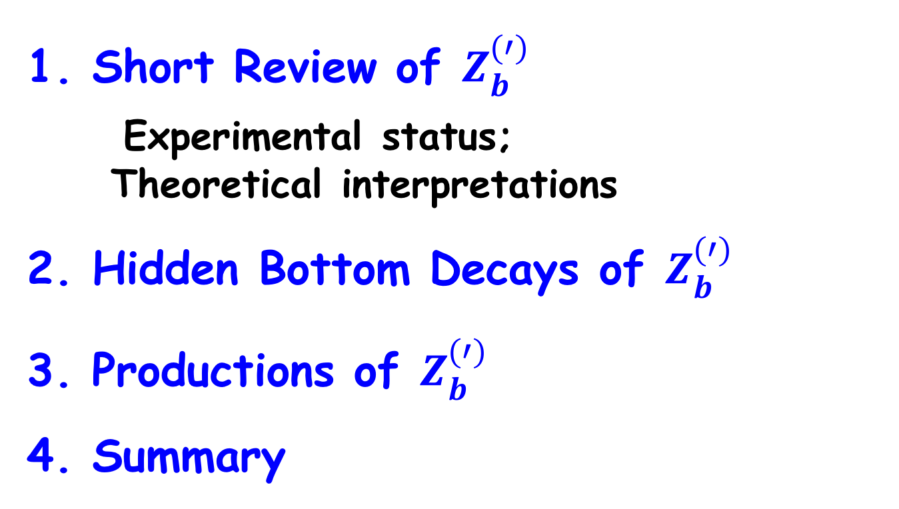
Outline
1. Short Review of $Z_{b}^{(′)}$
Experimental status;
Theoretical interpretations
2. Hidden Bottom Decays of $Z_{b}^{(′)}$
3. Productions of $Z_{b}^{(′)}$
4. Summary

Slide 3
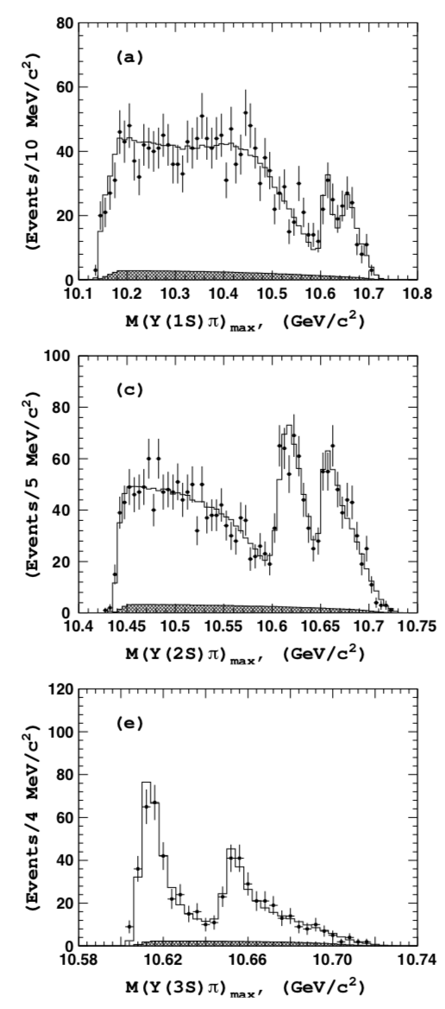
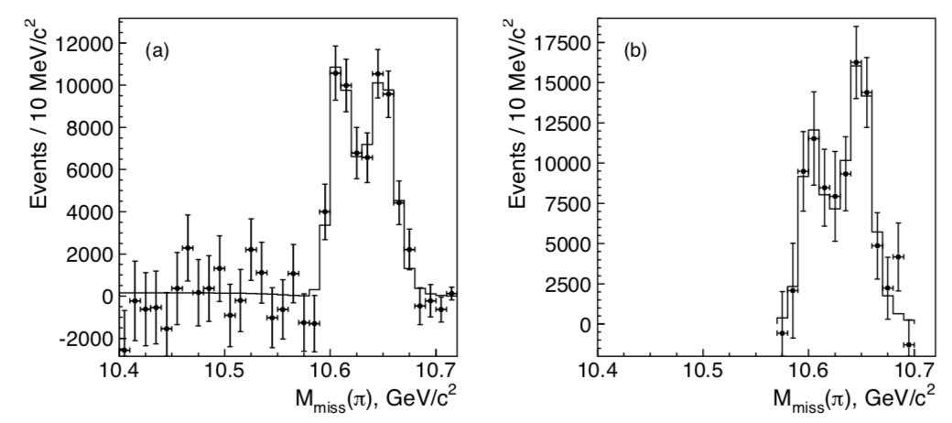


Experiment status of $Z_{b}^{(′)}$： hidden bottom (1)
$$Υ\left(5S\right)→Υ\left(nS\right)π^{+}π^{−}, \{n=1,2,3\}$$
$$Υ\left(5S\right)→h_{b}\left(mP\right)π^{+}π^{−}, \{m=1,2\}$$
Belle Collaboration
Phys.Rev.Lett.108.122001 (2011)

Slide 4
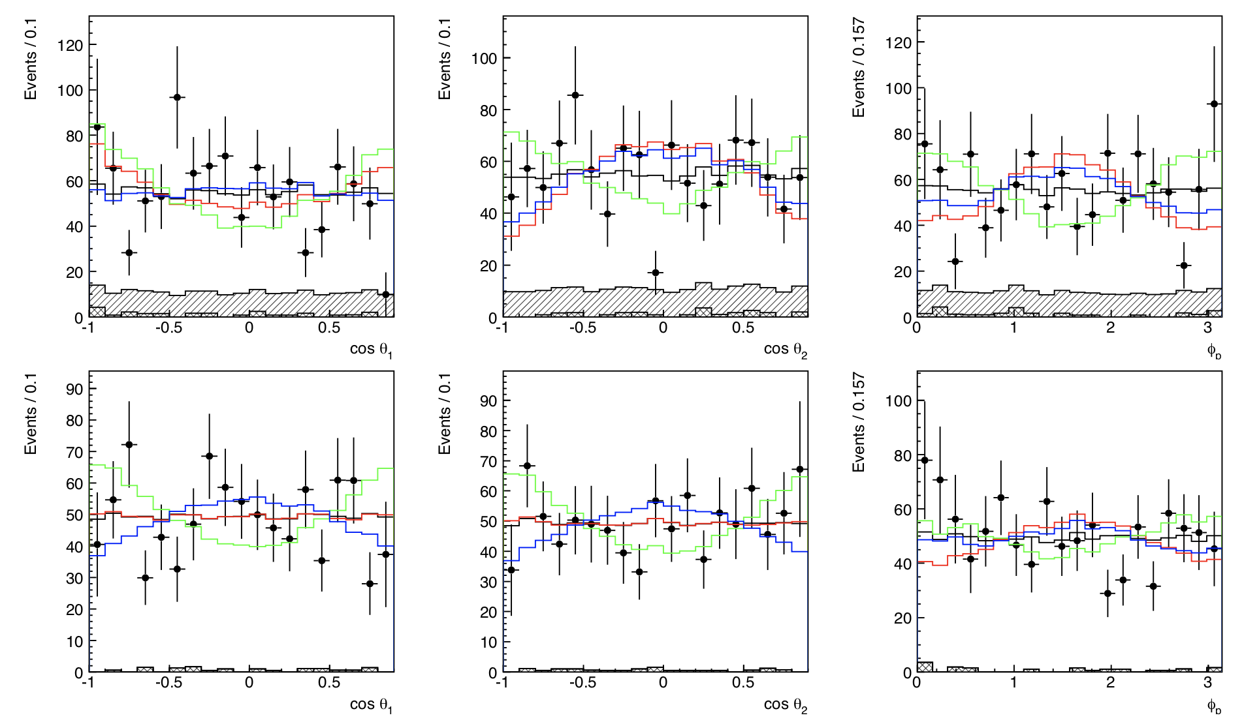
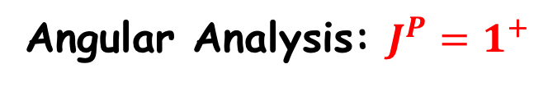
Experiment status of $Z_{b}^{(′)}$： hidden bottom (2)
arXiv:1105.4583
Angular Analysis: $J^{P}=1^{+}$

Slide 5
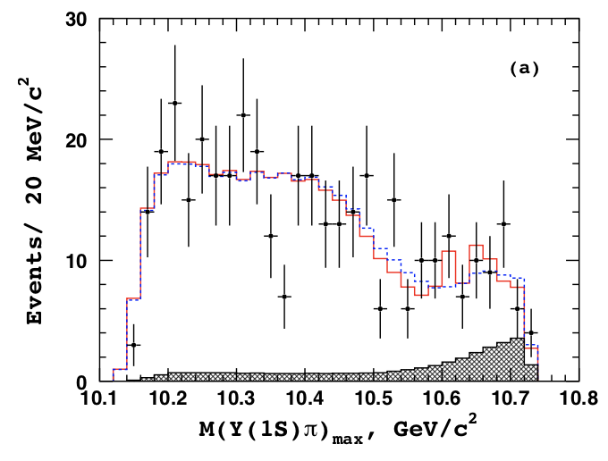
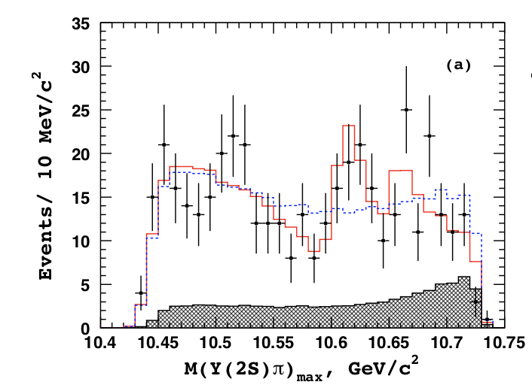
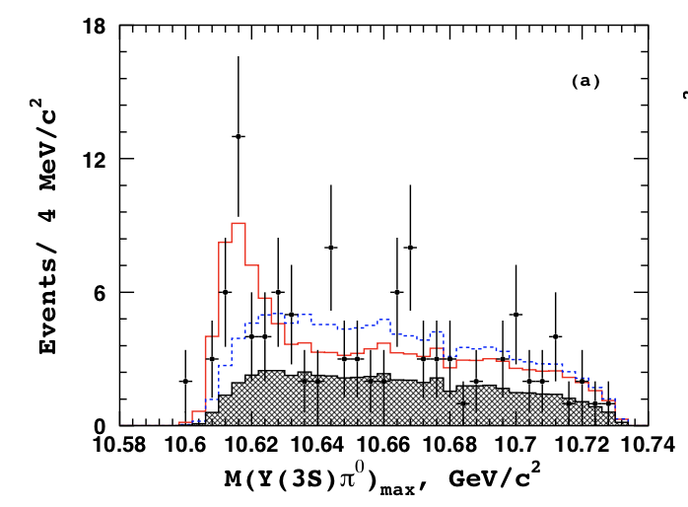

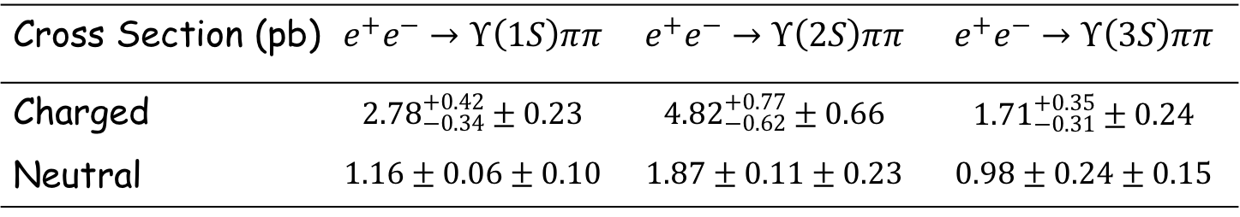

Experiment status of $Z_{b}^{(′)}$： hidden bottom (3)
$$Υ\left(5S\right)→Υ\left(nS\right)π^{0}π^{0}, \{n=1,2,3\}$$
Cross Section (pb) | $$e^{+}e^{−}→Υ\left(1S\right)ππ$$ | $$e^{+}e^{−}→Υ\left(2S\right)ππ$$ | $$e^{+}e^{−}→Υ\left(3S\right)ππ$$
Charged | $${2.78}_{−0.34}^{+0.42}±0.23$$ | $${4.82}_{−0.62}^{+0.77}±0.66$$ | $${1.71}_{−0.31}^{+0.35}±0.24$$
Neutral | $$1.16±0.06±0.10$$ | $$1.87±0.11±0.23$$ | $$0.98±0.24±0.15$$
Consistent with the expectation from isospin conservation.
For $Z_{b}^{(′)}$: I=1

Slide 6
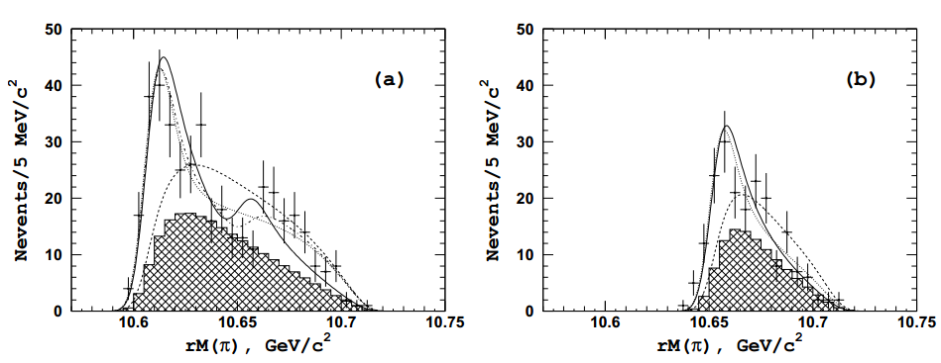
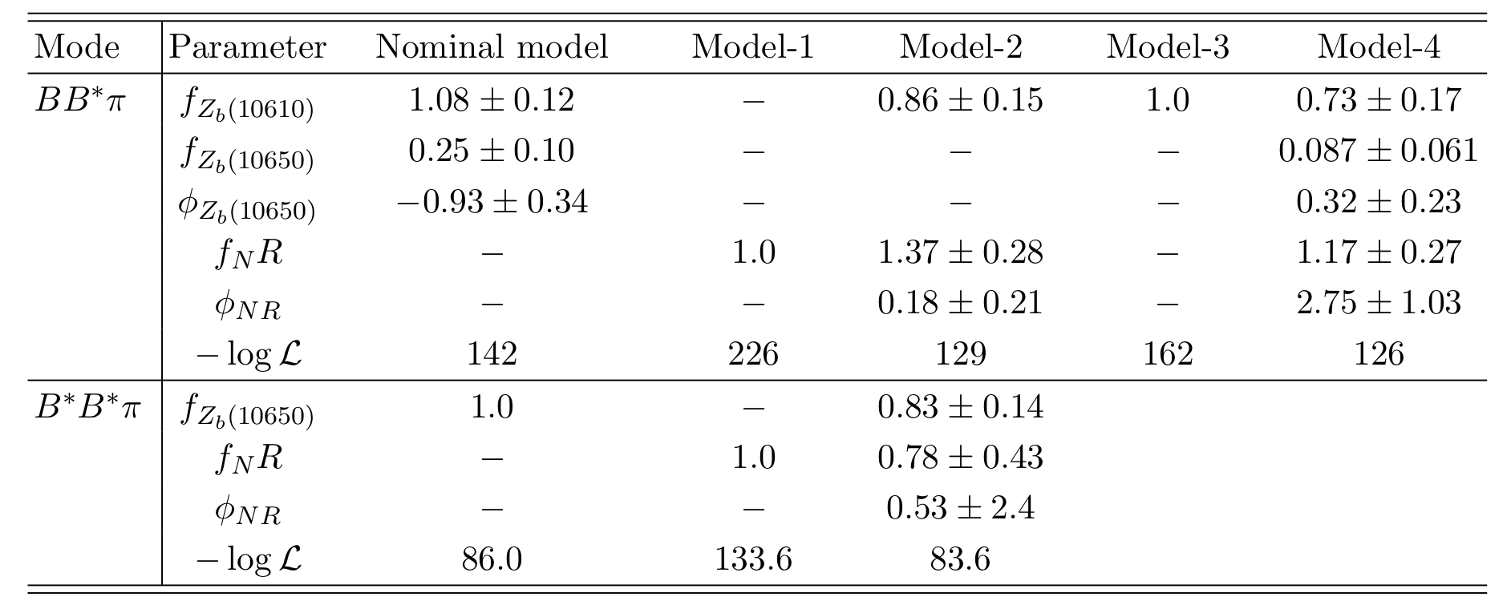
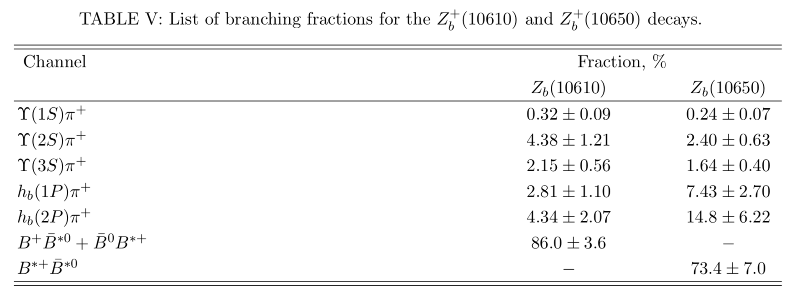
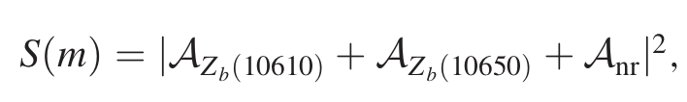
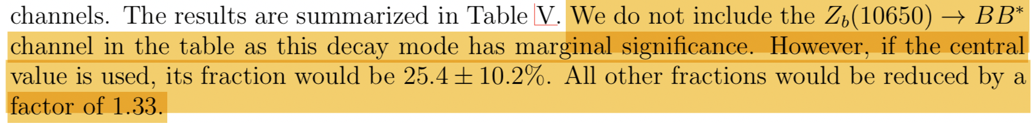

Experiment status $Z_{b}^{(′)}$: open bottom (1)
$Z_{b}^{′}$ signals？
arXiv:1209.6450

Slide 7
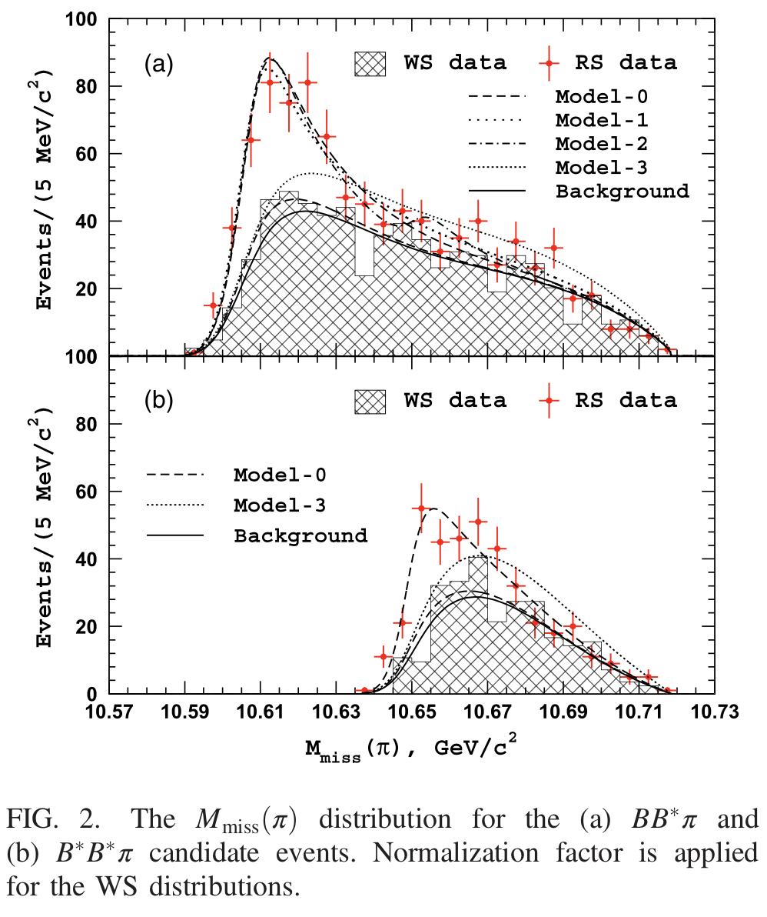
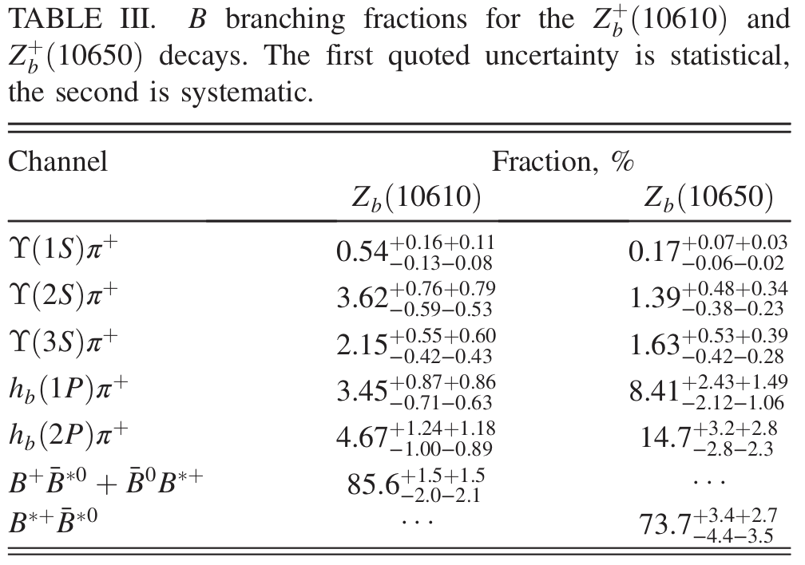
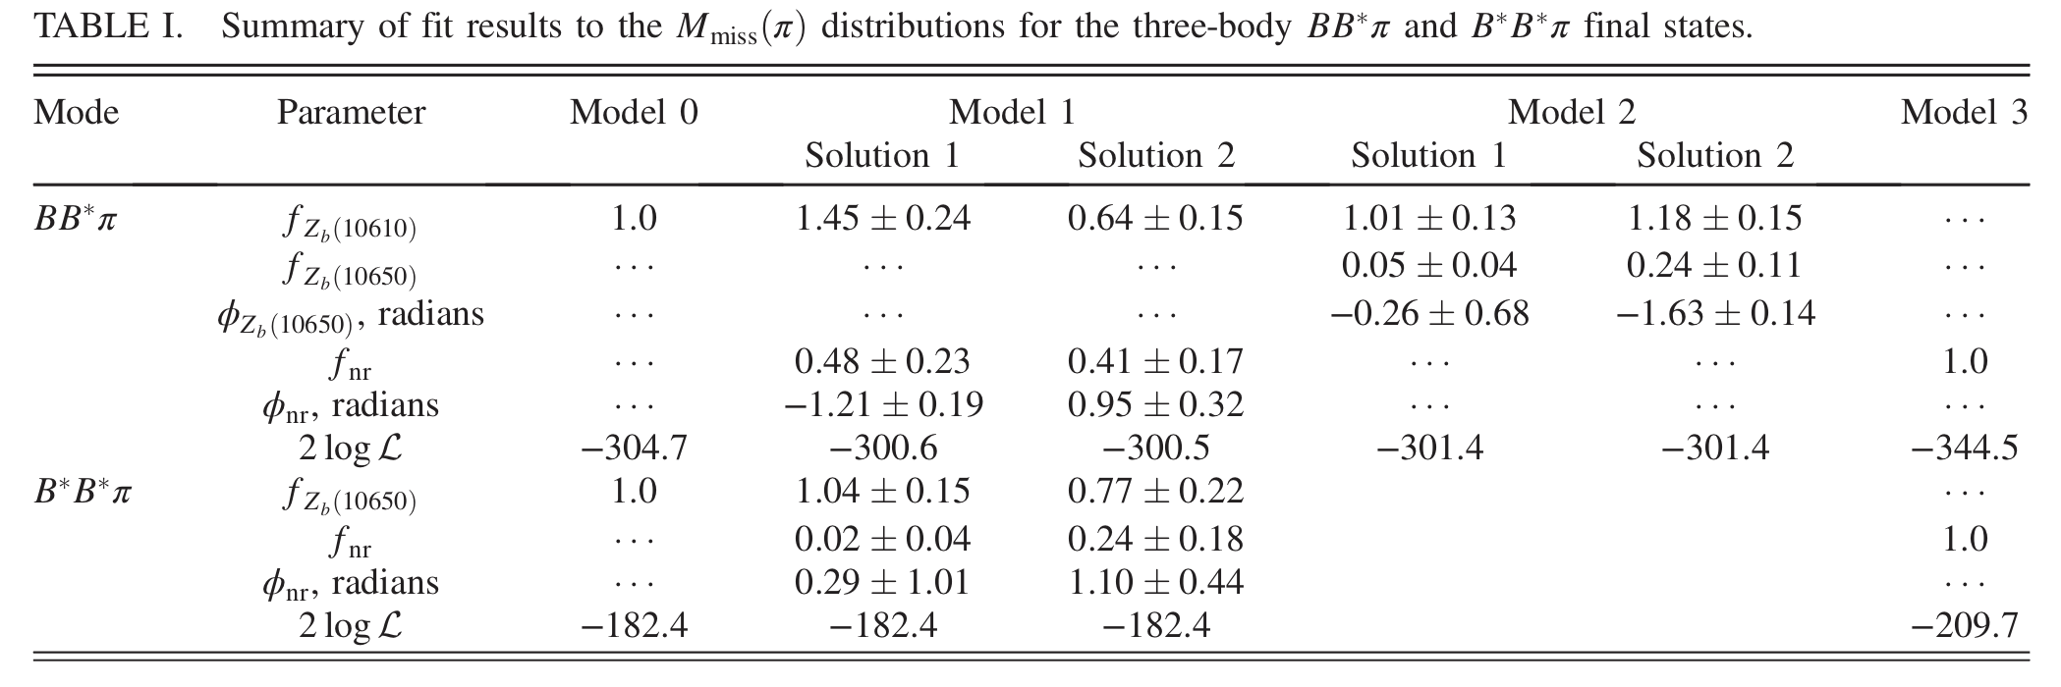


Experiment status of $Z_{b}^{(′)}$:open bottom (1)
Phys.Rev.Lett.116,212001 (2016)
$Υ\left(5S\right)→(B B^{∗}) π$
$Υ\left(5S\right)→(B^{∗} B^{∗}) π$

Slide 8
Theoretical interpretation I- Exotic states
S-wave molecular states:
Before observations: Predicted by potential model
Y.R.Liu, et. al, EPJC56, 63 (2008)
X.Liu, et. al, EPJC61, 411 (2009)
After observations: Estimated by various methods
Potential model:
Z.F. Sun, et. al, PRD84,054002 (2011);
M.T. Li, et. al, JPG40,015003 (2013) ;
Y.Yang, et. al, JPG39, 105001 (2012) ;
QCD Sum Rule:
J. R. Zhang, et. al, PLB704,312 (2011);
Z.G. Wang, EPJC74,2963 (2014)
Decay Behaviors:
Y.B.Dong , et. al, JPG40, 015002 (2013);
G. Li, et. al, PRD87,03400 (2013);
M. Cleen , et. al, PRD87, 074006 (2013);
T. Mehen , et. al, PRD84, 114013 (2011);

Slide 9
Theoretical interpretation I- Exotic states
Tetraquark state:
Potential model:
Y.C.Yang, et. al, JPG39 105001 (2012)
Chromomagnetic interaction Hamiltonian approach:
T. Guo, et. al, arXiv:1106.2284
QCD Sum rule:
C. Y. Cui, et. al, PRD85, 074014 (2012)
Z. G. Wang, et. al, NPA930,63 (2014)
Fit the data:
A. Ali, et. al, PRD90, 054006 (2014)

Slide 10
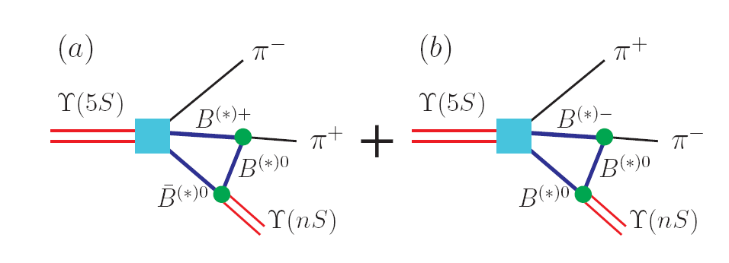
Theoretical interpretation II- threshold effects
Cusp effect:
D. V. Bugg, EPL96, 11002 (2011)
Yu. A. Simonov, arXiv: 1106.1522
Initial single pion emission (ISPE) mechanism
Chen, Liu, PRD84, 094003 (2011)

Slide 11
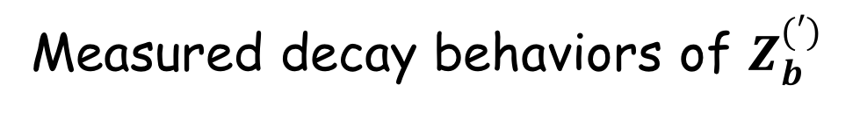
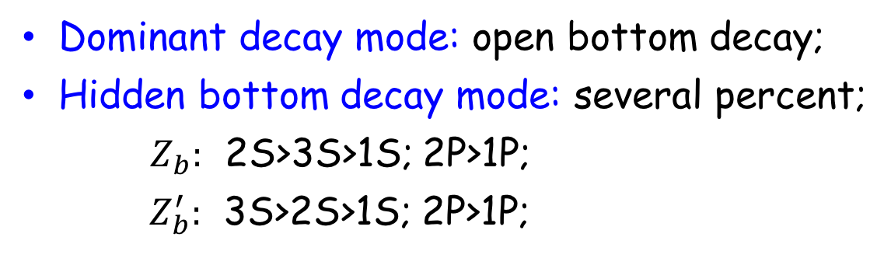
Measured decay behaviors of $Z_{b}^{(′)}$
Phys.Rev.Lett.116,212001 (2016)
Dominant decay mode: open bottom decay;
Hidden bottom decay mode: several percent;
    $Z_{b}:$ 2S>3S>1S; 2P>1P;
    $Z_{b}^{′}:$ 3S>2S>1S; 2P>1P;

Slide 12
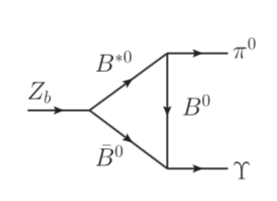

hidden bottom decays of $Z_{b}^{(′)}$: FSI
Final State interactions
Strong coupling
FSI (Meson loop) have been widely used to investigate the decay behaviors of heavy quarkonium;
D. Y.Chen, et.al, PRD87,054006 (2013)
C. Meng, et.al, PRD77,074003 (2008)
X. Liu, et.al, PLB675,441 (2009)
IS that still valid for heavy quarkonium-like states?

Slide 13
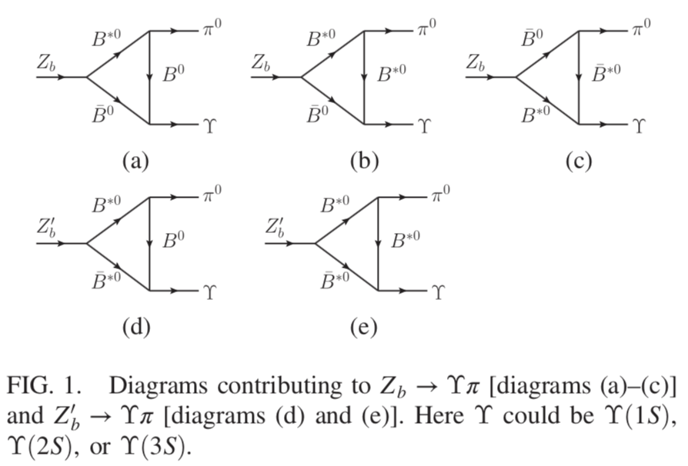
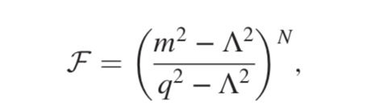
hidden bottom decays of $Z_{b}^{(′)}$: FSI
To Remove the ultraviolet divergence in the amplitudes, we introduce a form factor
Is the form of form factor influence the results?

Slide 14
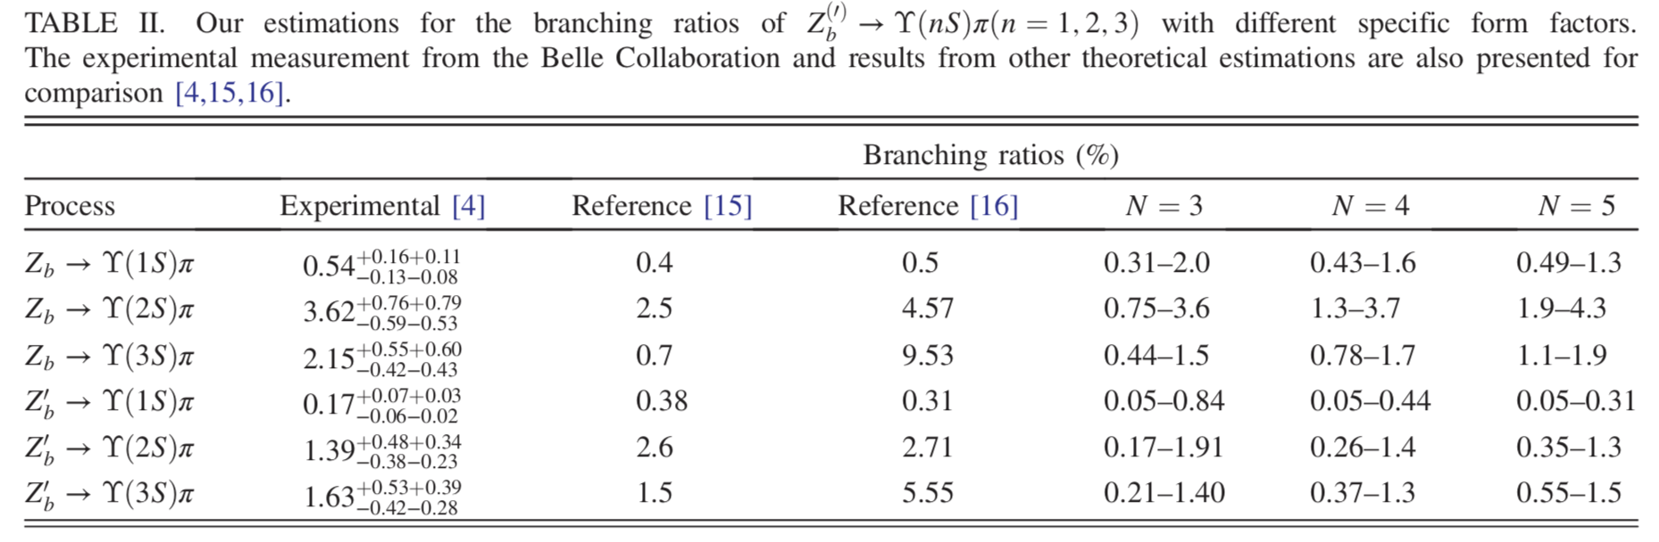
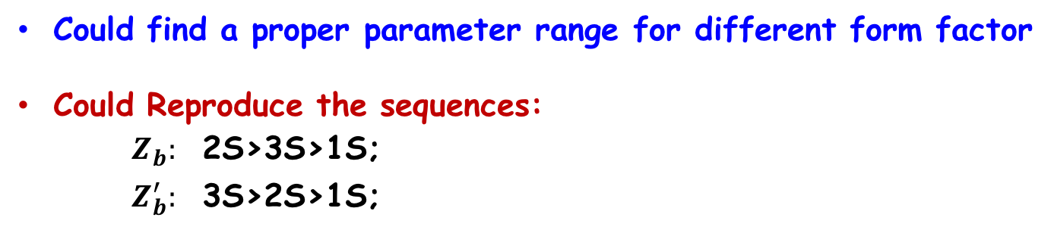
Could find a proper parameter range for different form factor
Could Reproduce the sequences:
    $Z_{b}:$ 2S>3S>1S;
    $Z_{b}^{′}:$ 3S>2S>1S;

Slide 15
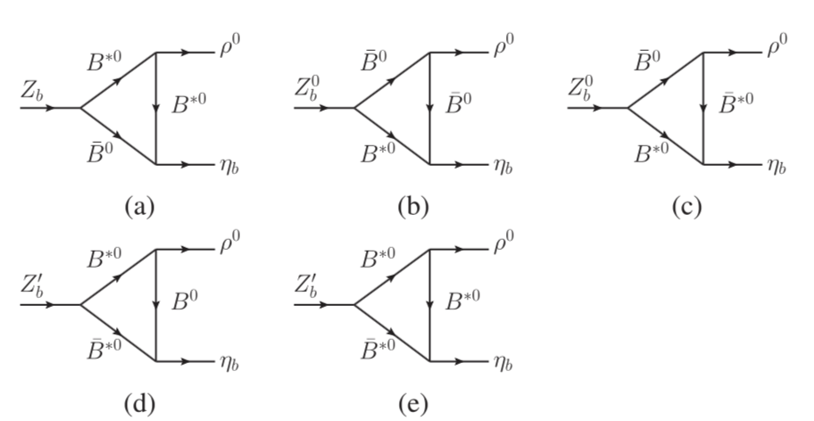
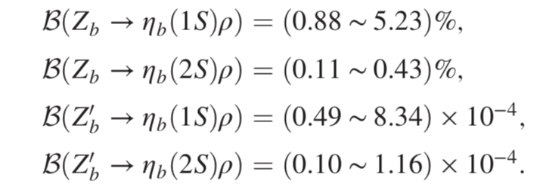
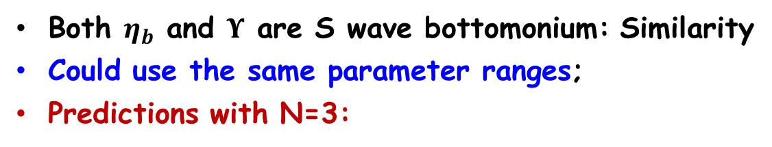
Predictions by FSI (1)
C.J.Xiao and D.Y.Chen, PhysRevD.96.014035
Both $η_{b}$ and $Υ$ are S wave bottomonium: Similarity
Could use the same parameter ranges;
Predictions with N=3:

Slide 16
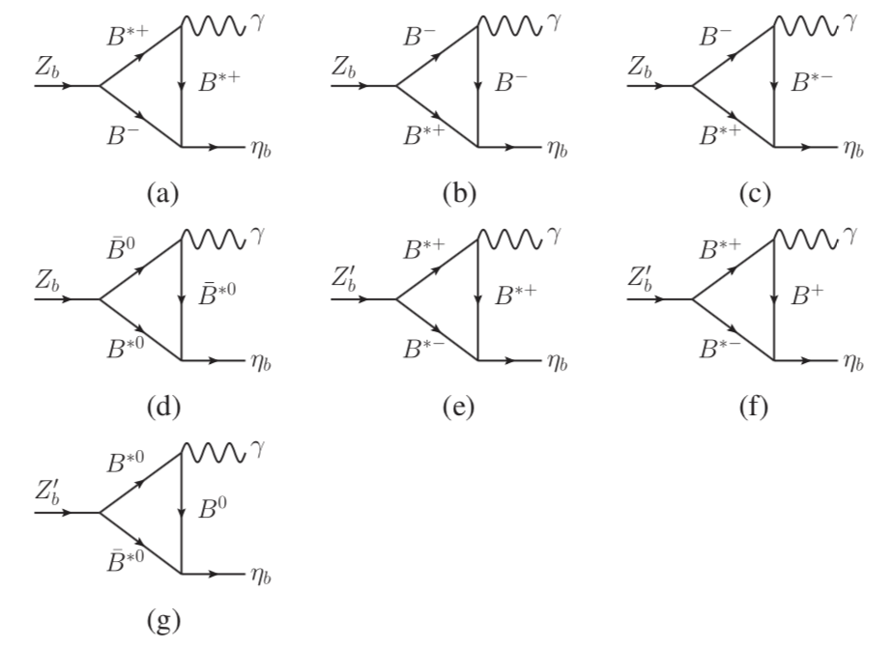
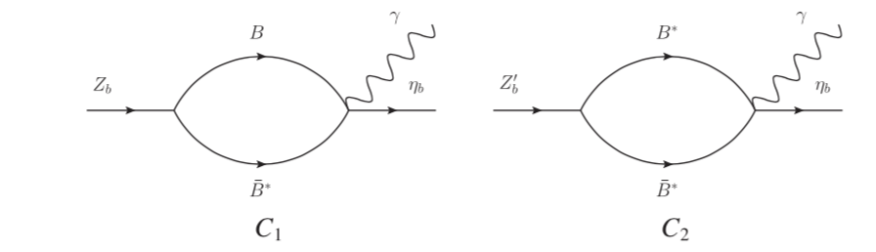
Predictions by FSI (2): radiative decay
Contact diagram: ensure the gauge invariance of the EMF

Slide 17
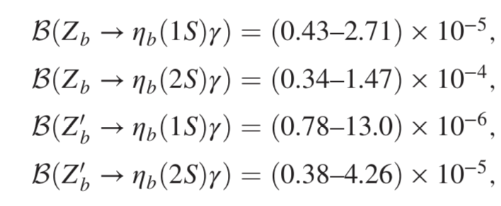
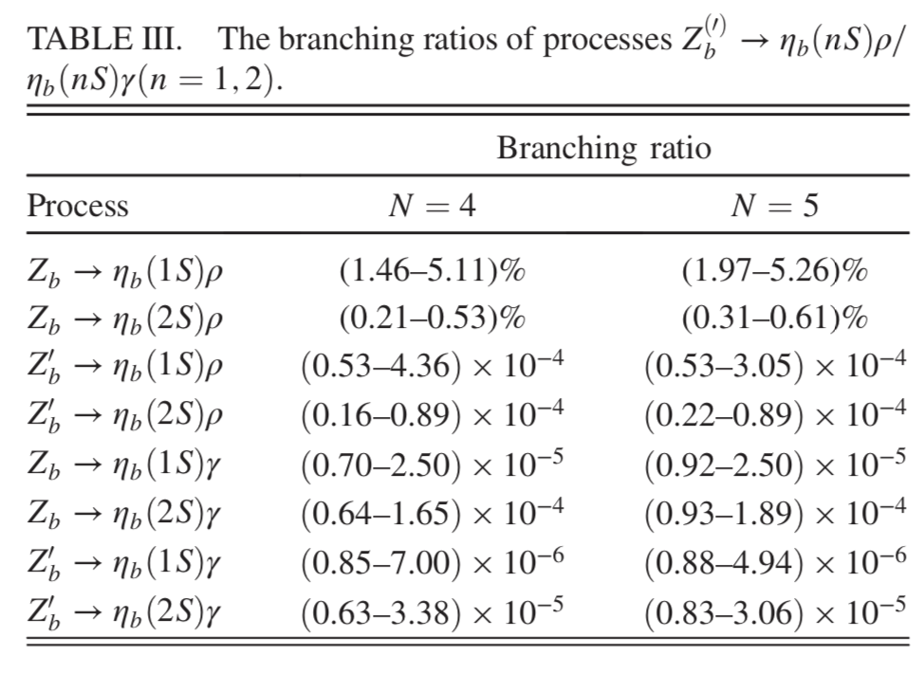
Radiative decay width with N=3
N=4 and N=5

Slide 18
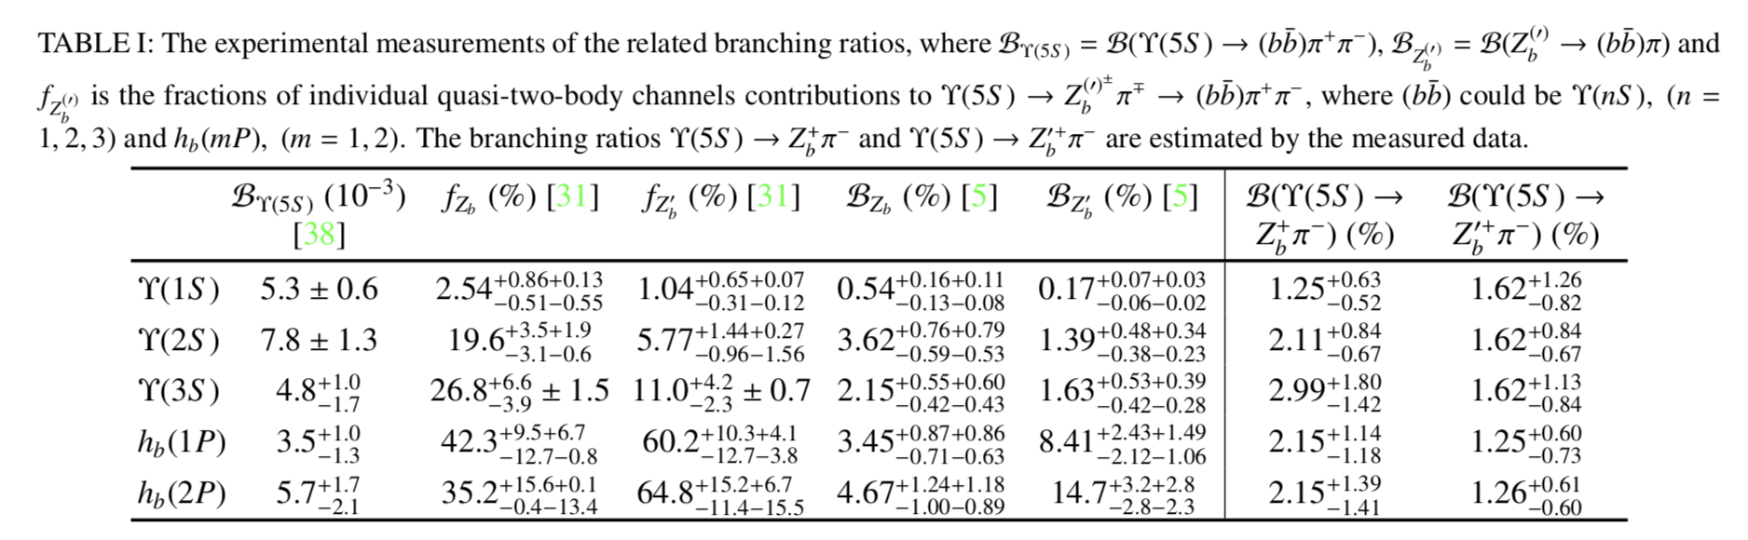
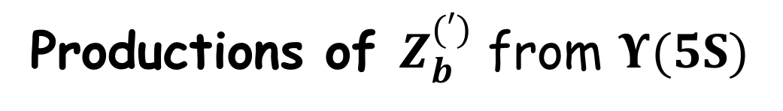
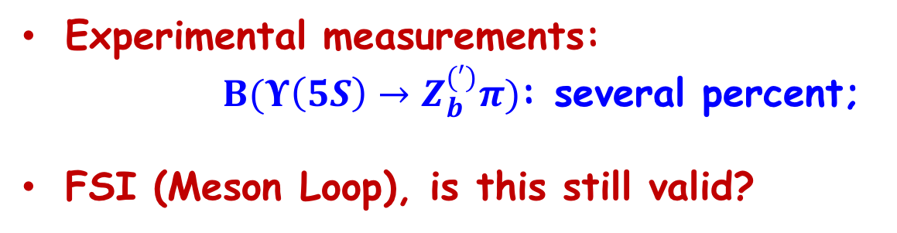
Productions of $Z_{b}^{(′)}$ from $Υ(5S)$
Experimental measurements:
$B(Υ\left(5S\right)→Z_{b}^{\left(′\right)}π)$: several percent;
FSI (Meson Loop), is this still valid?

Slide 19
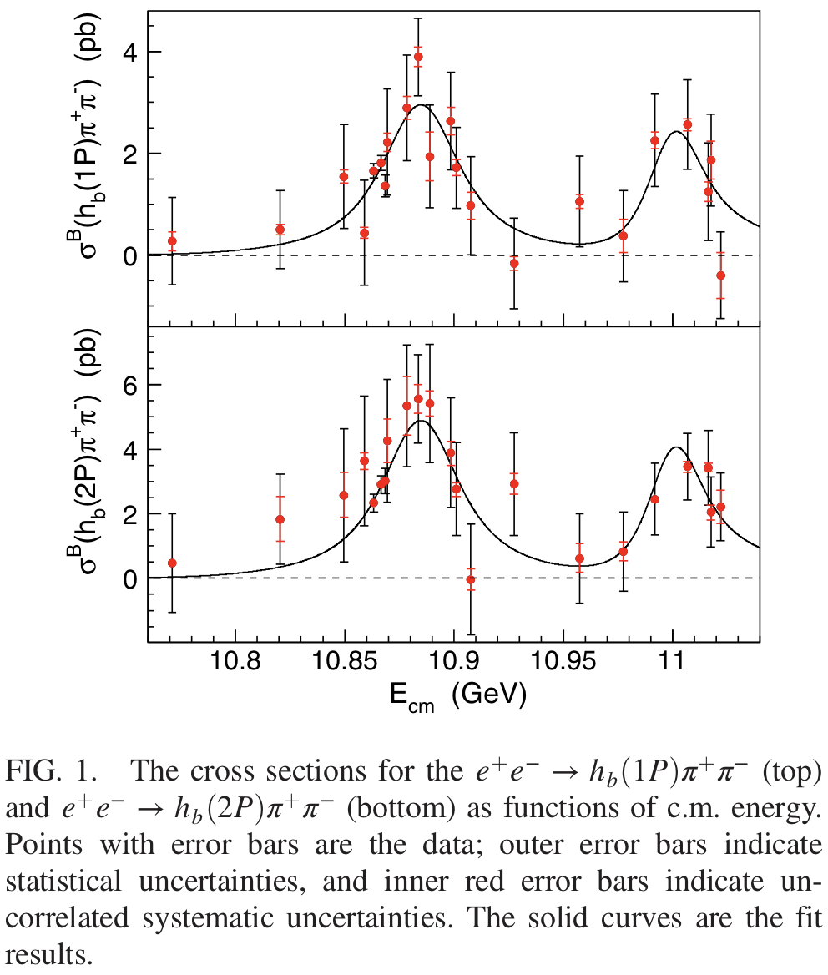
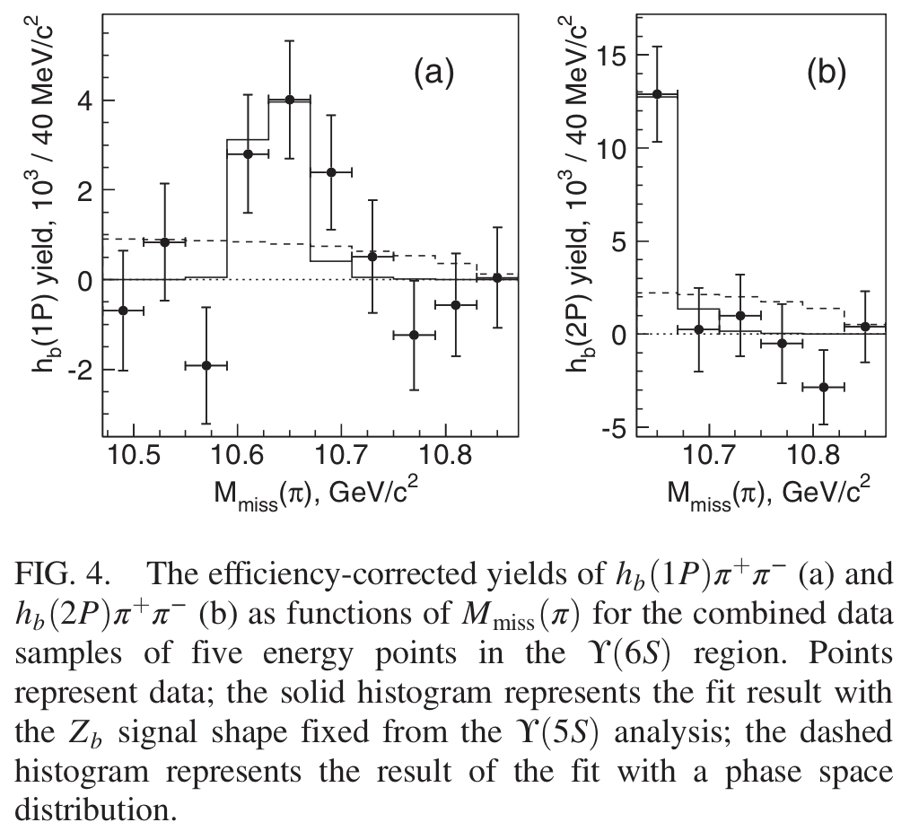
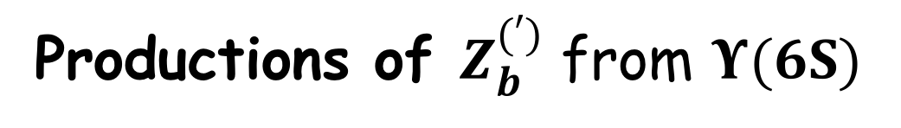


Productions of $Z_{b}^{(′)}$ from $Υ(6S)$
Phys. Rev. Lett. 117, 142001 (2016)
due to current data limit, the relative fraction of Zb and Zb′ could not be constrained.
$$Υ(5S)$$
$$Υ(6S)$$

Slide 20
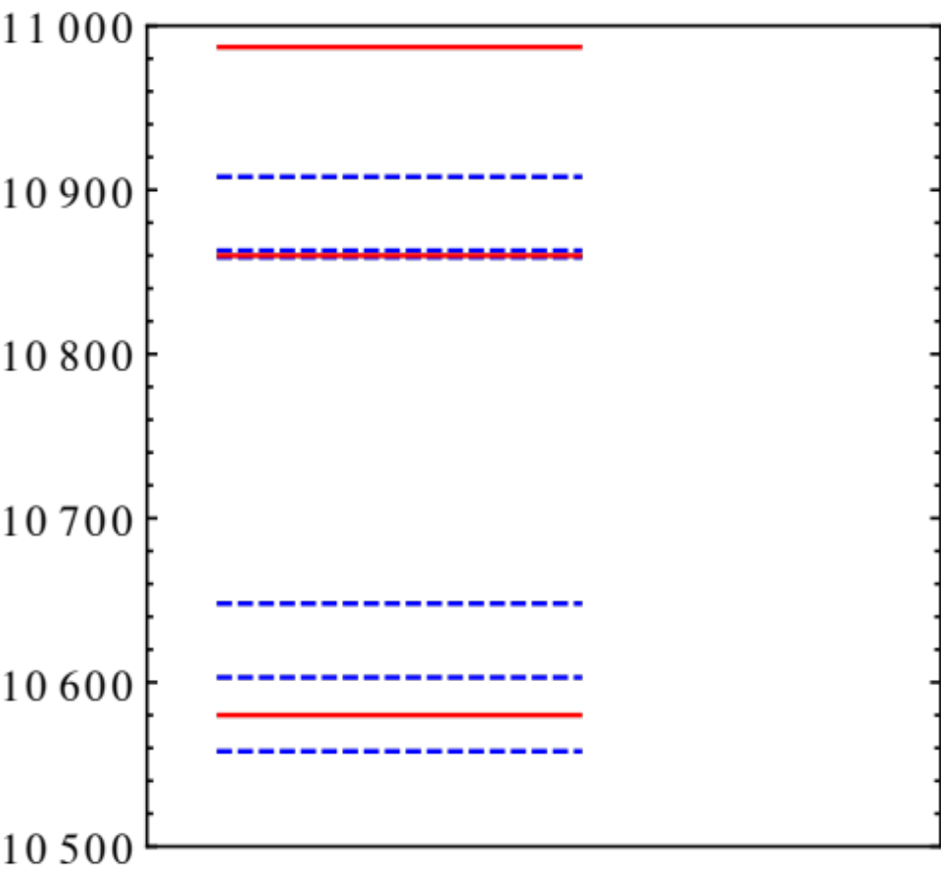
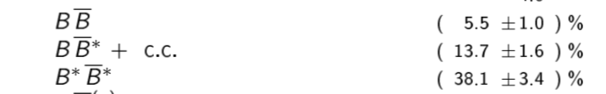
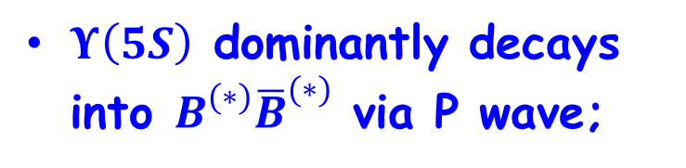
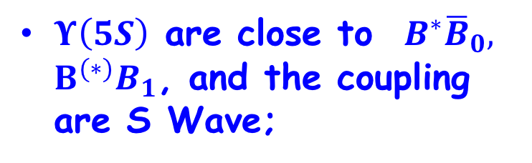









Mass Spectrum and thresholds
$$Υ(11020)$$
$Υ\left(5S\right)$ dominantly decays into $B^{(∗)}{\overline{B}}^{(∗)}$ via P wave;
$$B^{∗}B_{1}$$
$$BB_{1}$$
$$B^{∗}{\overline{B}}_{0}$$
$$Υ(10860)$$
$$B^{∗}\overline{B^{∗}}$$
$Υ\left(5S\right)$ are close to $B^{∗}{\overline{B}}_{0},$ $B^{(∗)}B_{1}$, and the coupling are S Wave;
$$B^{∗}\overline{B}$$
$$B\overline{B}$$
$$Υ(10580)$$
P-wave coupling .VS. S-wave coupling?

Slide 21
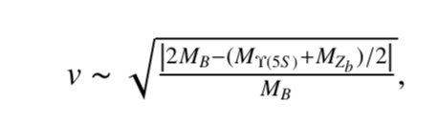
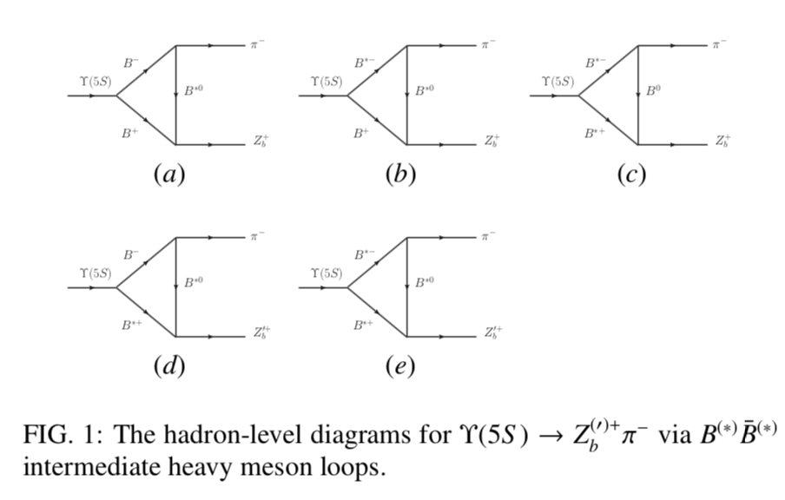
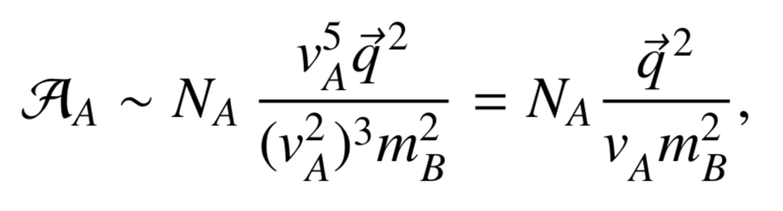
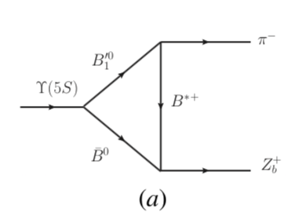
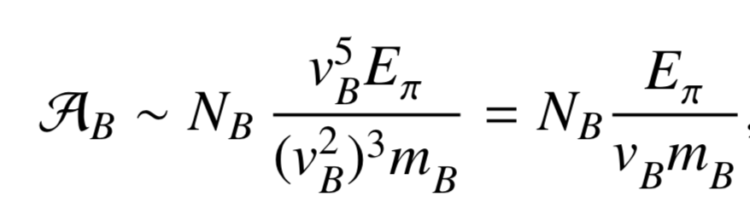
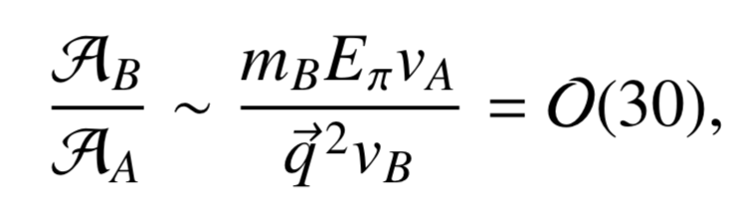


Power counting in NREFT
Q. Wu, D. Y. Chen, and F. K Guo, arXiv: 1810. XXXXX
$$v_{A}=0.12∼0.14$$
$$v_{B}=0.07∼0.09$$

Slide 22



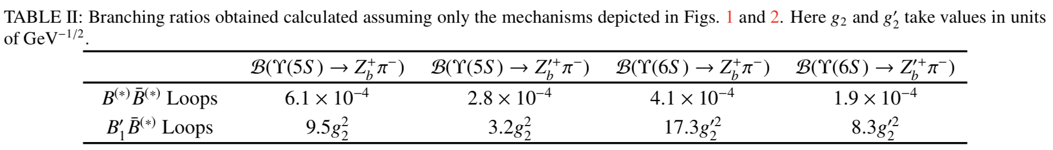
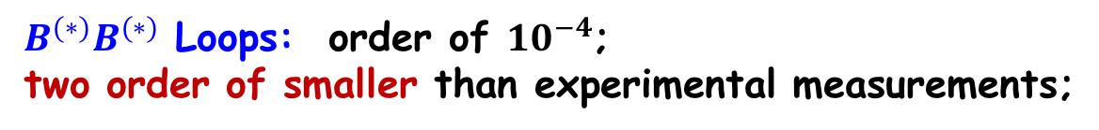

Estimation in NREFT Frame :$B^{(∗)}B^{(∗)}$ Loops
All the coupling constants could be well determined
$B^{(∗)}B^{(∗)}$ Loops: order of ${10}^{−4}$;
two order of smaller than experimental measurements;

Slide 23





Estimation in NREFT Frame: $B^{∗}{\overline{B}}_{0}/B^{(∗)}B_{1}$ Loop
Determined by width of $B_{1}^{′}$
Not well determined
$B^{(∗)}B^{(∗)}$ Loops: order of ${10}^{−4}$
$B^{∗}{\overline{B}}_{0}/B^{(∗)}B_{1}$ Loop:
${10}^{−2}∼10^{−1}$
Consistent with experimental data!

Slide 24




Estimation in NREFT Frame: $B^{∗}{\overline{B}}_{0}/B^{(∗)}B_{1}$ Loop
Include $B_{0}/B_{1}^{′}$ width
Without $B_{0}^{′}$ width

Slide 25

Estimation in NREFT Frame: $B^{∗}{\overline{B}}_{0}/B^{(∗)}B_{1}$ Loop
Present calculation: ~3
Experimental: dependent on channels
Need further professional analysis !!
$\frac{B\left(Υ\left(5S\right)→Z_{b}π\right)}{B(Υ\left(5S\right)→Z_{b}^{′}π)}$,

Slide 26



Estimation in NREFT Frame: $B^{∗}{\overline{B}}_{0}/B^{(∗)}B_{1}$ Loop
Predictions for 6S:
$\frac{B\left(Υ\left(6S\right)→Z_{b}π\right)}{B(Υ\left(6S\right)→Z_{b}^{′}π)}∼2$,
 | $$f_{Z_{b}}$$ | $$f_{Z_{b}^{′} }$$
$$Υ\left(6S\right)→h_{b}\left(1P\right)π^{+}π^{−}$$ | 46% | 54%
$$Υ\left(6S\right)→h_{b}\left(2P\right)π^{+}π^{−}$$ | 40% | 60%
Need further check from Belle II

Slide 27




Estimation in NREFT Frame: $B^{∗}{\overline{B}}_{0}/B^{(∗)}B_{1}$ Loop
$B_{1}^{′}$ width dependent:
Fixed h
Fixed h: $r$ decrease with $Γ_{B_{1}^{′}}$increase
Changed h: $r$ increase with $Γ_{B_{1}^{′}}$increase

Slide 28


Summary
Decays of $Z_{b}^{(′)}$
FSI: Explain the data; predicted more channel
productions of $Z_{b}^{(′)}$
dominant from $B_{1}^{′}B^{\left(∗\right)}/B_{0}B^{∗}$ loops;
From $Υ(5S)$; From $Υ(6S)$
Need further efforts from theoretical and experimental physicist together!

Slide 29
Thank You for your attention !

