Slide 1
Photon reconsruction direction correction
Cuihanhua 2018.04.23

Slide 2
With/without Correction
With Correction
ClusterEE
Without Correction
getEnergy

Slide 3
Sample
Single phton
100k generated
Energy: 10GeV
Theta phi

Slide 4
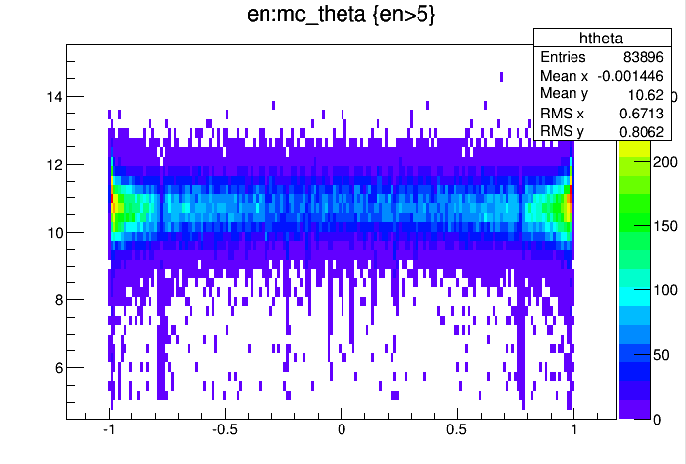
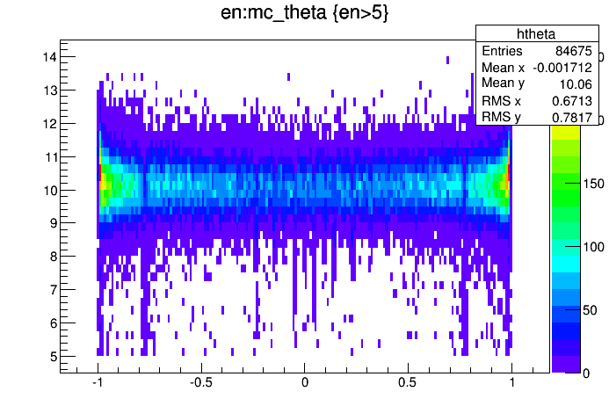
Reconstructed Energy vs cos($θ_{MC}$)
Without Correction
With Correction
calibration constants（main、theta）

Slide 5
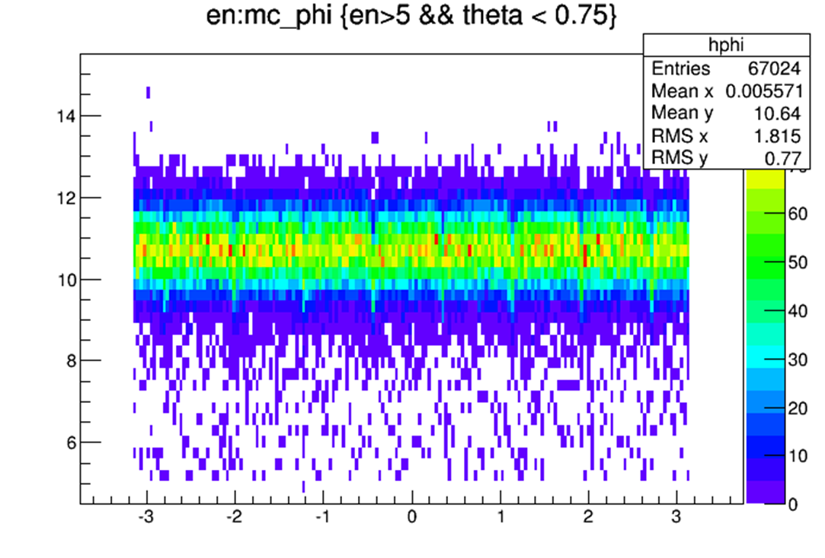
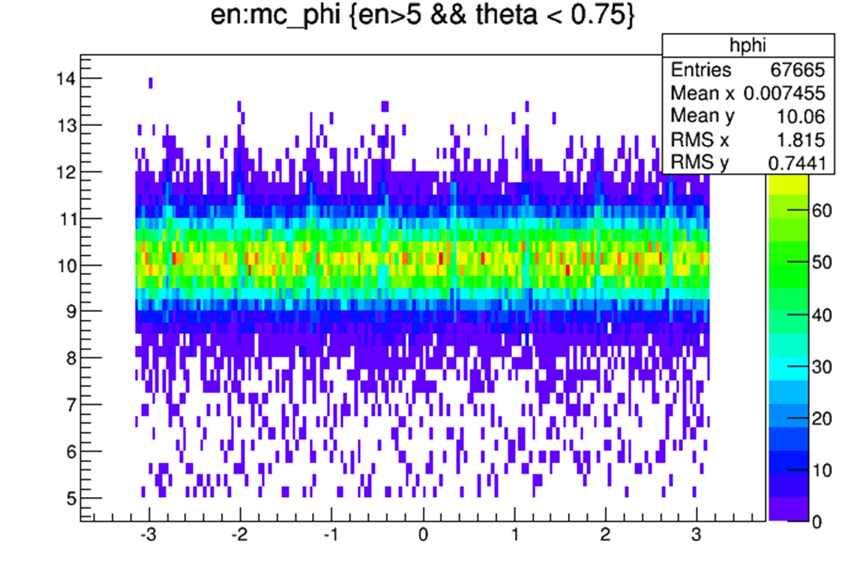
Reconstructed Energy vs $φ_{MC}$
Without Correction
With Correction
overcorrection

Slide 6
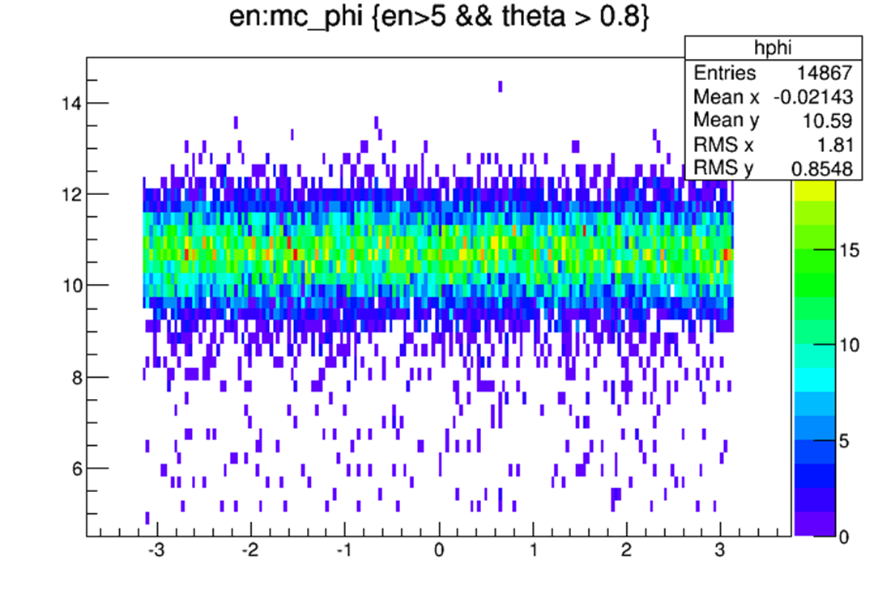
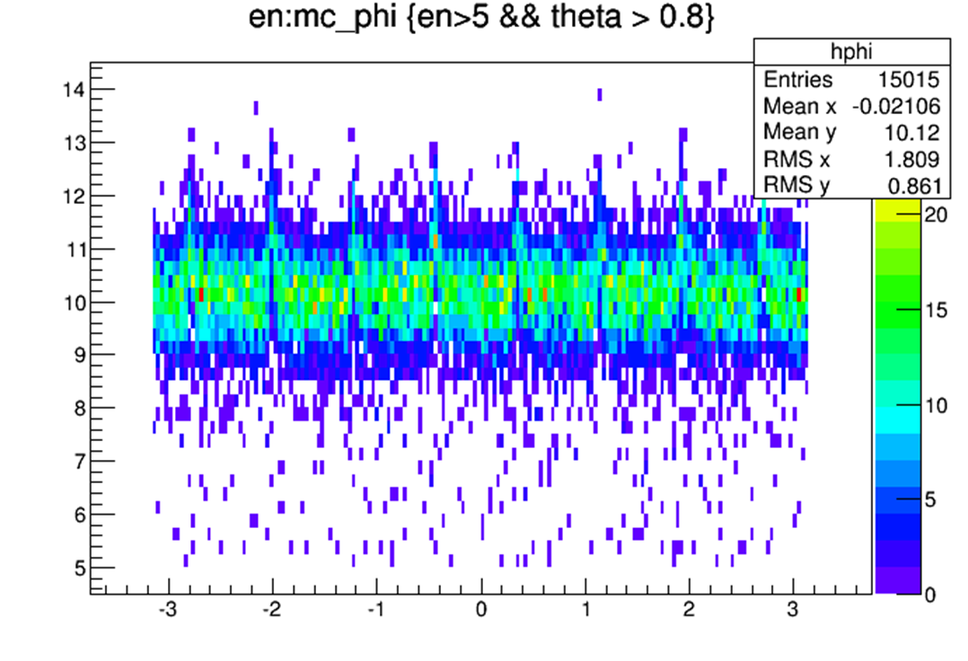
Reconstructed Energy vs $φ_{MC}$
Without Correction
With Correction
No need of correction

Slide 7
thanks

