Slide 1
W/Z physics in CDR
Zhijun Liang
IHEP,CAS

Slide 2
Reminder of CEPC W/Z runs
Some discussion about CEPC Z pole running .
http://indico.ihep.ac.cn/event/7709/
E=91.2GeV, L=1.6 X 10³⁵ cm⁻²s⁻¹, solenoid field = 3T ( new default )
Two year running proposed by accelerator team
WW threshold scan
Proposal from accelerator team
One year running about 160GeV
Total luminosity 3.2 ab⁻¹

Slide 3
CEPC W/Z physics Plan for CDR
Plan to cover the prospects of 6-7 key parameters.
Plan to have First draft of CDR about W/Z physics ready by end of May.
http://cepcgit.ihep.ac.cn/cepcdoc/CDR

Slide 4
R_b measurement
Sensitive to b/c tagging performance
Study the major systematics
Hemisphere correlations
Bo Li (Yantai University)

Slide 5
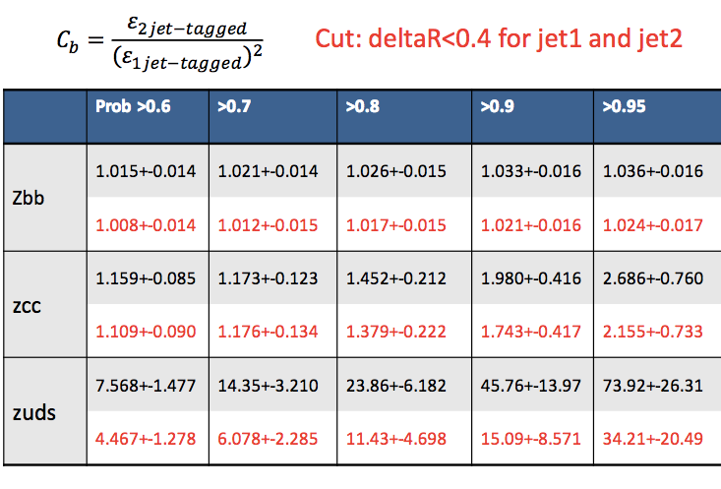
R_b measurement (2)
Hemisphere tagging correlations study in MC samples

Slide 6
R_b measurement (3)
df
Adding this cut reduces the Hemisphere correlations
Notes:
measurement

Slide 7
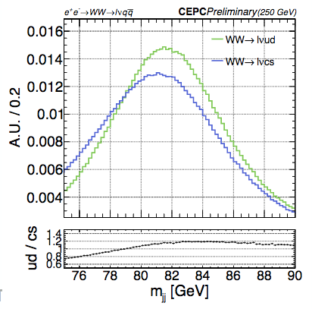
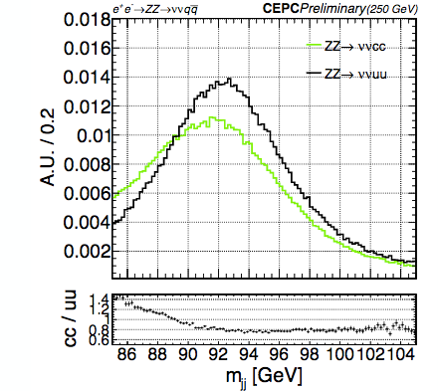
W mass (direct measurement)
Measure W mass directly from ZH runs using lvjj events.
Major activity is from Peizhu Lai (NCU) with the help from Maarten Boonekamp (CEA) and Dr. Hengne Li
In jet energy scale systematics (jet flavor dependence)

Slide 8
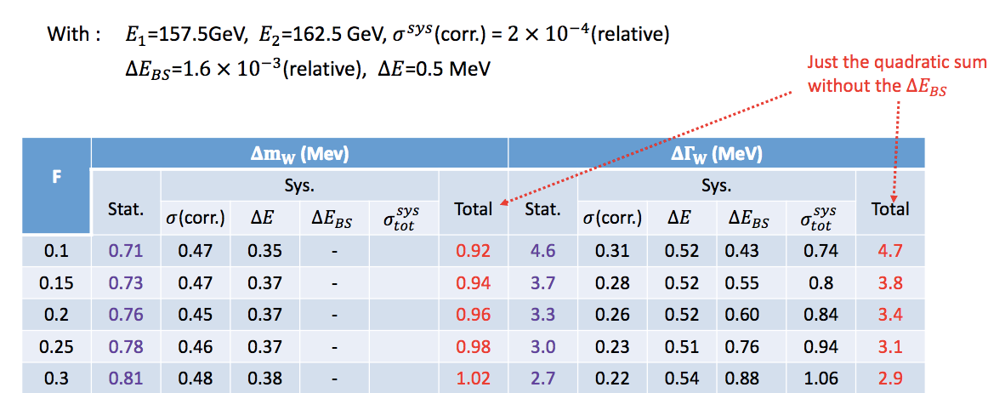
W mass (threshold scan)
Peixun Shen (IHEP) is working on WW threshold scan optimization
With considering the systematics

Slide 9
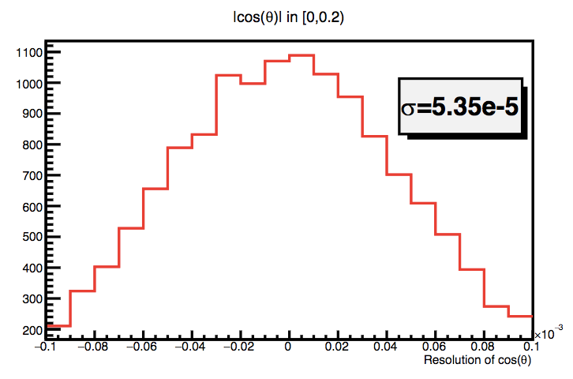
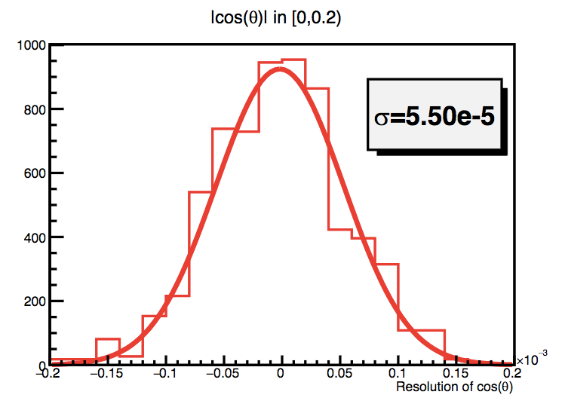
Afb : muon angular resolution
Mengran Li (IHEP) is working on Afb in Z->mumu at Z threshold scan runs.
Simulated 100k full sim Z->mm samples at Z pole
Study one key performance (muon angular resolution)
CEPC v4
B=3.0T
CEPC v1
B=3.5T

Slide 10
MC requests with CEPC v4
W mass direct measurement
240GeV , WW->lvjj, 5M full simulation
240GeV , ZZ->vvjj, 1M full simulation
R_b measurement
91.2GeV, Z->bb , Z->cc, Z->light jets, 3M full simulation

Slide 11
Summary
Plan to converge on W mass study by the end of May.
Analysis which don’t need full simulation
WW Threshold scan is in good shape
Analysis need new MC:
W mass (direct measurement)
First round with CEPC v1 simulation
needs two more weeks after new fullsim sample ready.
R_b (Z->bb) measurements
needs 2~3 weeks to update after full simulation samples ready.
Z->mumu
Fullsim sample ready, next 2~3weeks to go through 1st round.

Slide 12
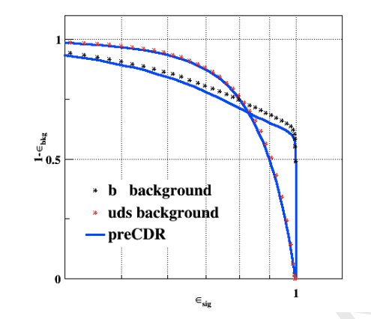
Performance input
Identify some performance input needed to support the W/Z physics prospect study
May need to repeat some study with 3T magnetic field and new detector geometry
Afb(l): lepton angular resolution
R_b: “B jet efficiency” vs “cjet/light rejection “
W mass (direct approach)： jet energy resolution
W mass (threshold scan): ?
N_v : photon energy resolution

