Slide 1
组会报告
敖冬

Slide 2
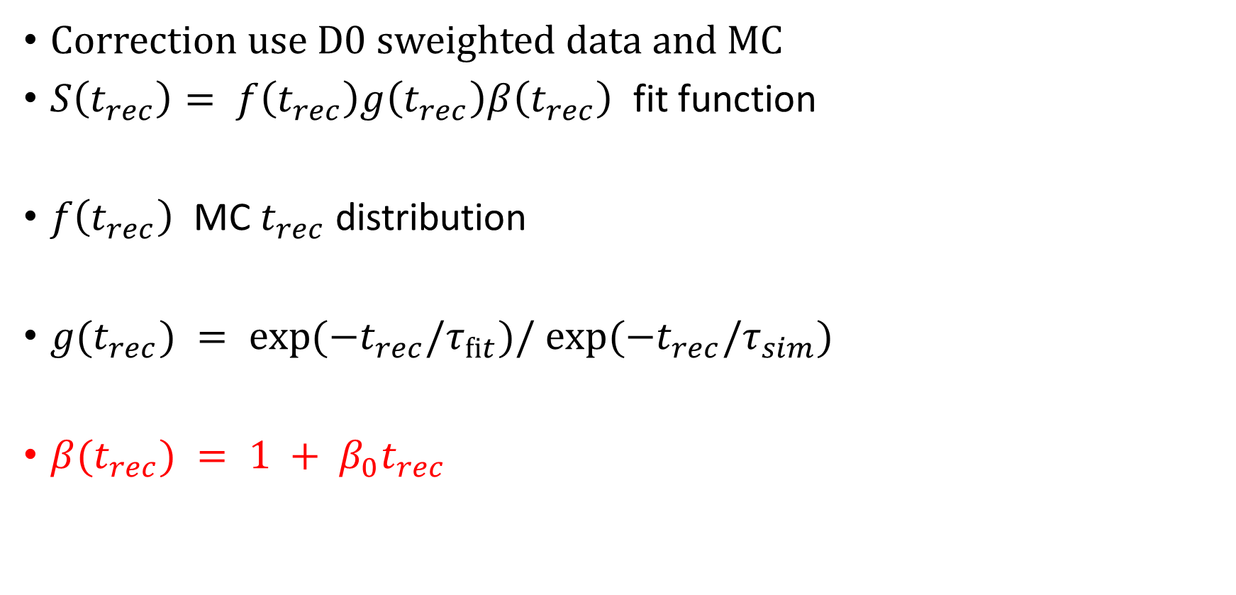
Method of Steve
Correction use D0 sweighted data and MC
$S\left(t_{rec}\right)= f\left(t_{rec}\right)g\left(t_{rec}\right)β\left(t_{rec}\right)$ fit function
$f\left(t_{rec}\right)$ MC $t_{rec}$ distribution
$g(t_{rec}) = exp⁡(−t_{rec}/τ_{ﬁt})/ exp⁡(−t_{rec}/τ_{sim})$
$β(t_{rec}) = 1 + β_{0}t_{rec}$

Slide 3
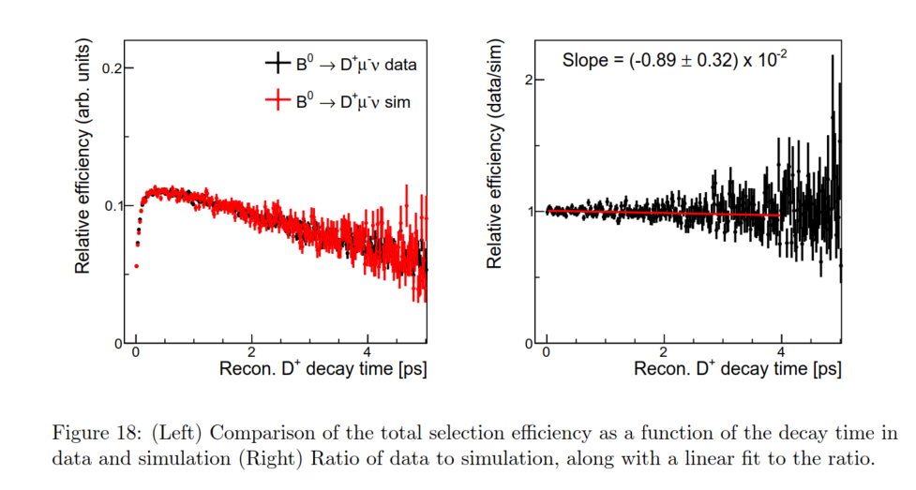
$$β= 1 + β_{0}t_{rec}$$

Slide 4
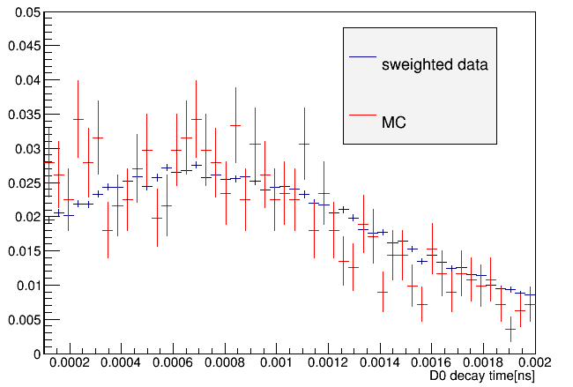
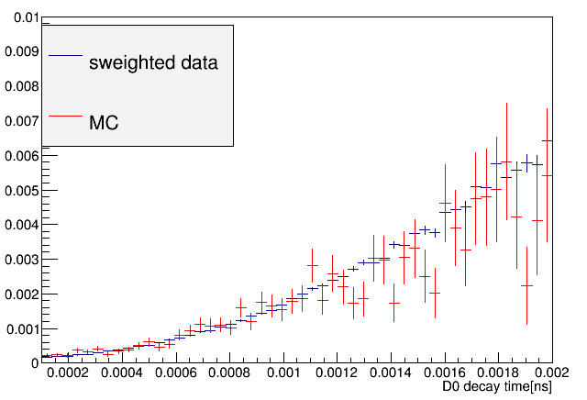
Comparation of D0 data and MC
Tau distribution of D0 data compare with MC
Efficiency of D0 data compare with MC

Slide 5
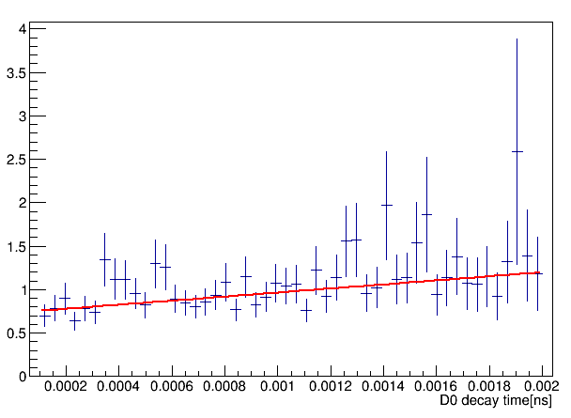
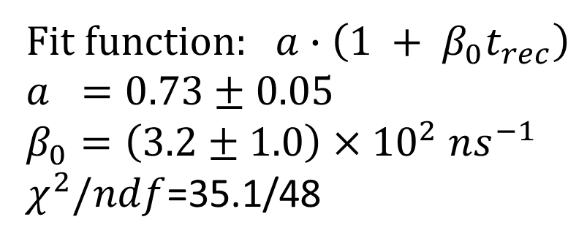

$$\frac{ε_{data}}{ε_{MC}}$$
Fit function: $a∙\left(1 + β_{0}t_{rec}\right)$
$$a =0.73±0.05$$
$$β_{0}=\left(3.2±1.0\right)×{10}^{2} ns^{−1}$$
$χ^{2}/ndf$=35.1/48

Slide 6
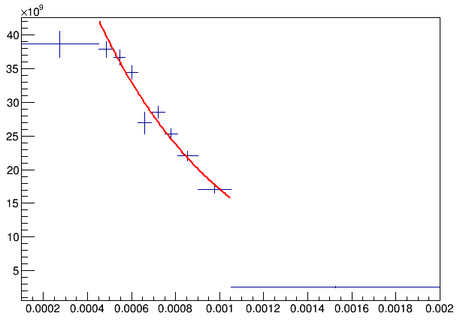
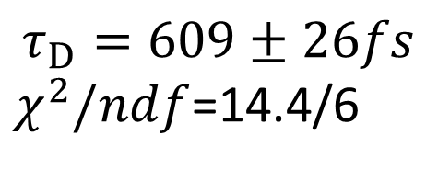
Early result
$$τ_{D}=609±26fs$$
$χ^{2}/ndf$=14.4/6

Slide 7
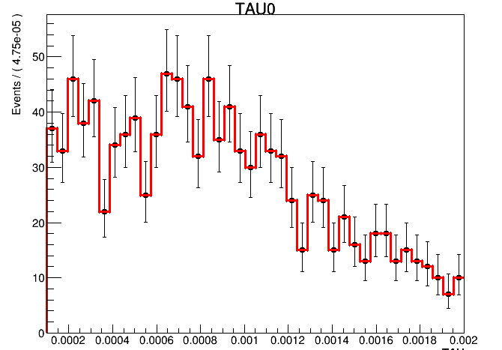
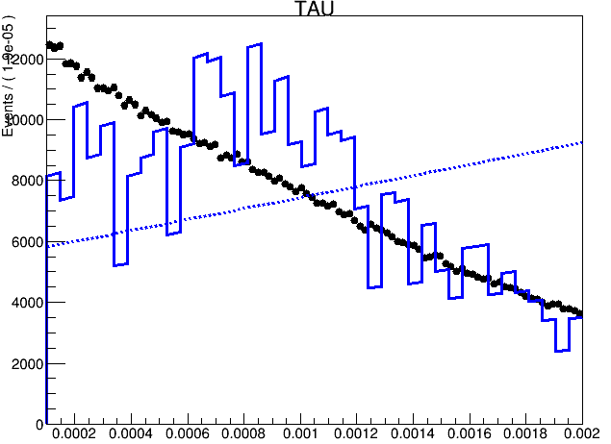

Problem
$f\left(t_{rec}\right)$ MC $t_{rec}$ distribution

Slide 8
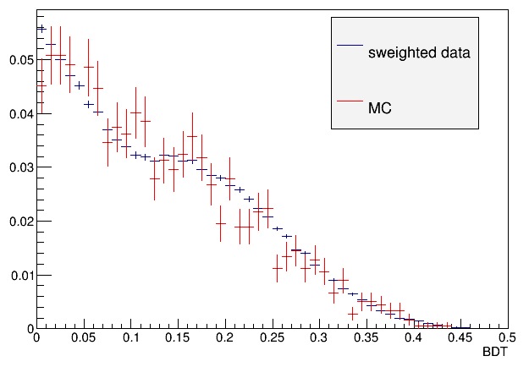
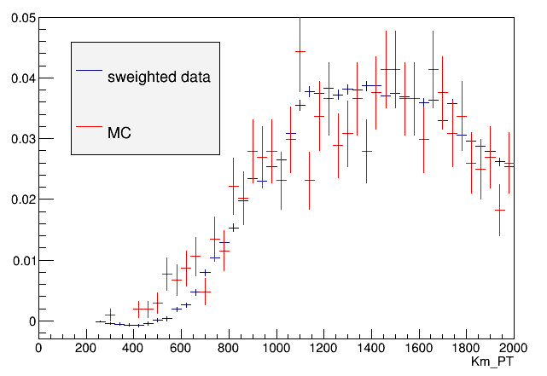

Slide 9
