Slide 1
Recent work of Event Display
Long Peixun
2018.4.26

Slide 2
Content
About the number of MDC wires
CGEM clusters display
Merge Huang Shuhui’s work into mine
Other modifications

Slide 3
About the number of MDC wires
The number of wires of each layer in Besvis:
These data are derived from display.
The number of total MDC wires in BesVis is 6796.
Stereo Layer
Layer | 1 | 2 | 3 | 4 | 5 | 6 | 7 | 8
N wires | 40 | 44 | 48 | 56 | 64 | 72 | 80 | 80
Axial Layer
Layer | 9 | 10 | 11 | 12 | 13 | 14 | 15 | 16 | 17 | 18 | 19 | 20
N wires | 76 | 76 | 88 | 88 | 100 | 100 | 112 | 112 | 128 | 128 | 140 | 140
Stereo Layer
Layer | 21 | 22 | 23 | 24 | 25 | 26 | 27 | 28 | 29 | 30 | 31 | 32 | 33 | 34 | 35 | 36
N wires | 160 | 160 | 160 | 160 | 176 | 176 | 176 | 176 | 208 | 208 | 208 | 208 | 240 | 240 | 240 | 240
Axial Layer
Layer | 37 | 38 | 39 | 40 | 41 | 42 | 43
N wires | 256 | 256 | 256 | 256 | 288 | 288 | 288

Slide 4
About the number of MDC wires
In MDC’s outer 7 layers, two simuLayers represent a trueLayer. But the array m_kReplica[50] contains the replica number of each simuLayer.
I summed all numbers in m_kReplica[50] as the number of wires, so I miscalculated the number of wires in outer 7 layers.

Slide 5
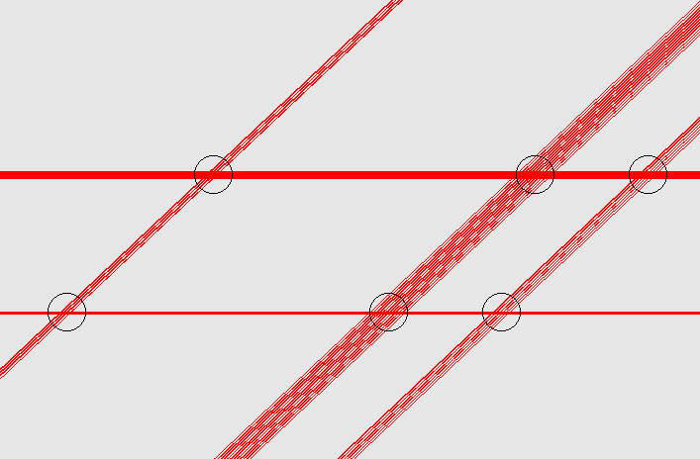
CGEM clusters display
X-clusters, V-clusters and XV-clusters

Slide 6
CGEM clusters display
The information of these 3 kinds of clusters can be got from software package TRecCgemCluster.
Only XV-clusters need to be displayed.
We can get φ and Z coordinates of XV-clusters directly.
However, some information of clusters, such as the relevant hits of each cluster, is not included in TRecCgemCluster.
Some software packages should be updated to adapt to CGEM clusters display.
Some XV-clusters, got from TRecCgemCluster, are out of the sheet, so it is necessary to check the function of clusters filter.

Slide 7
CGEM clusters display

Slide 8
Merge Huang Shuhui’s work into mine
Read and copy Huang Shuhui’s code.
Her code is based on BOSS 7.0.3.
Modify her code to adapt my code and environment.
The name of getting MRPC hits function is different in BOSS 7.0.3 and CgemBOSS 6.6.5.b.
Add 3D display of Tof mrpc.
Test, fix bugs and optimize code.

Slide 9
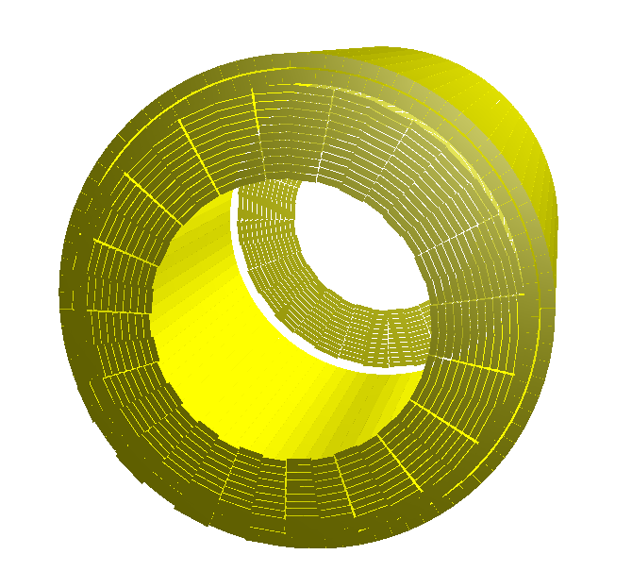
Merge Huang Shuhui’s work into mine
3D display of TOF with MRPC

Slide 10
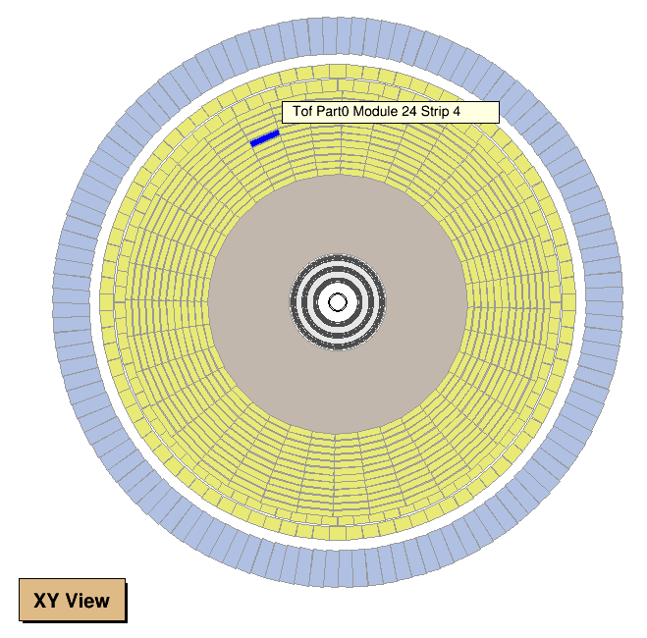
Merge Huang Shuhui’s work into mine
Detector geometry which contains both CGEM and MRPC in XY view.

Slide 11
Other modifications
View zoom is now centered on the center of view, rather than the origin of detector coordinate.
Fix a bug about shortcut key in 3D view, and modify some shortcut keys.
Adjust the text layout of Event Header, in order to avoid text overlapping in some case and make full use of the space of Event Header.
Help text has been moved out of the program.

Slide 12
Text layout of Event Header
old
new

